Slide 1


WIDA
Standards-based instruction and assessment: the WIDa ELP standards
Notes:
The State of Minnesota officially became members of the WIDA Consortium on July 1, 2011. This is to comply with federal law –No Child Left Behind Act of 2001- requiring ELP standards and ELP standards-based assessments.
1

Slide 2

Today’s Agenda
WIDA Standards
Standards-based Assessment
Notes:
2
2
Turn and tell “Why is it important for me to learn about WIDA Standards? “Why is it important for me to learn about standards-based assessment?

Slide 3
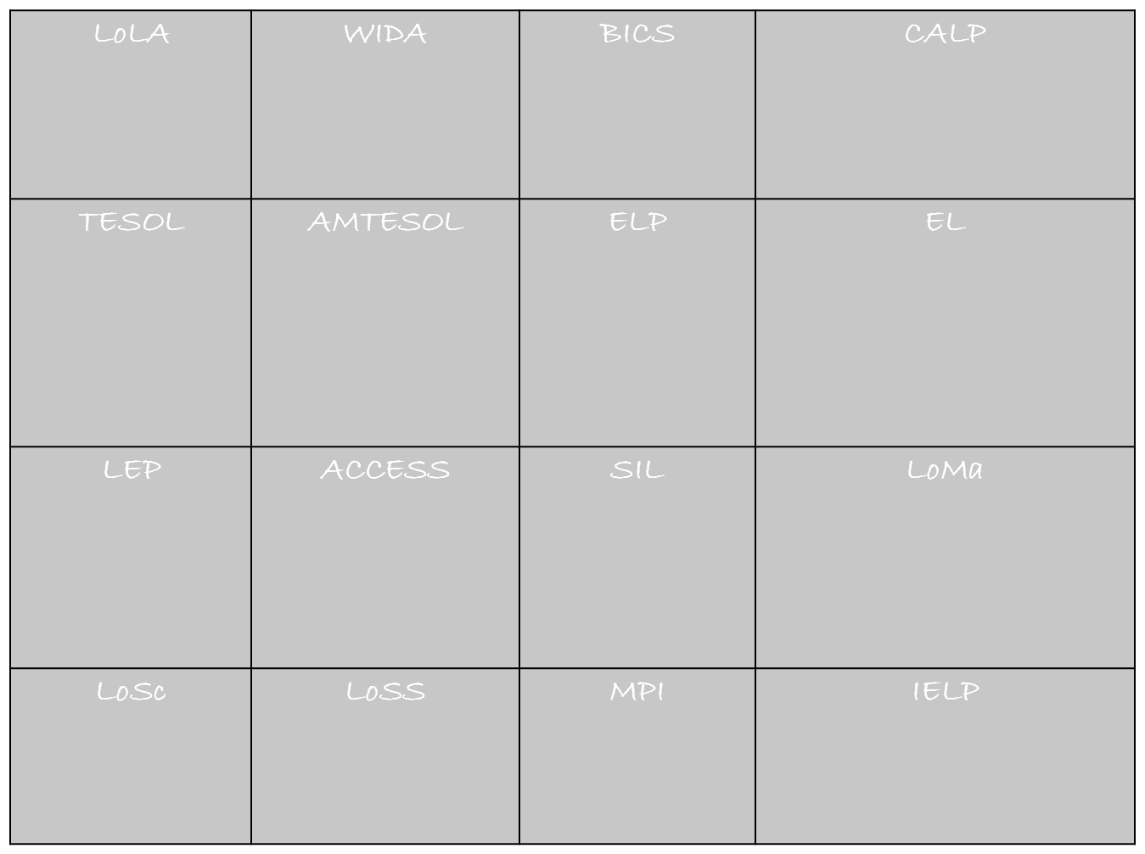
ACRONYM ACTIVITY
World-Class Instructional Design and Assessment
Basic Interpersonal Communicative Skills
Language of Language Arts
Cognitive Academic Language Proficiency
Minnesota Teachers of English to
Speakers of Other Languages
Teachers of English to Speakers of Other Languages
English Language Proficiency
English Learner
Assessing
Comprehension and Communication in English State to State
Social and Instructional Language
Limited English Proficiency
Language of Mathematics
Language of Science
Language of Social Studies
Model Performance Indicators
Individual English Language Plan
Notes:
Pass out handout for activity. Allow a few minutes for the participants to complete activity.
When all are finished click on ppt for animation to reveal each answer.
NOTE:
BICS was changed to reflect Jim Cummin’s exact wording for “Communicative”
3

Slide 4
“NO Child Left Behind”
No Child Left Behind Act, 2001
  Designed to close the achievement gap between disadvantaged students and their peers.
  Established criteria for greater accountability regarding assessments.
  Requires annual assessment of LEP regarding
    English language acquisition (ACCESS)
    Content-area learning ( AIMS WEB,DIBELS, NWEA)
  Access to full educational program.
Notes:
We all have heard or know the challenges and criticisms that the “No child left behind” Act brings with it. But, lets look at some of the good things that have come from it.
4

Slide 5
WIDA and the ELP Standards
Notes:
5

Slide 6

A man walks into the Doctor’s Office and says “Doc I have a pain in my shoulder.”
The Doctor examines him
and says “ Mr. Brown, you
have acute inflammation
of the anterior bursa.”
Notes:
Tell story
6

Slide 7
Mr. Brown is really concerned because the doctor looks very grave.
“What does that mean?”
“You have developed a case of severe bursitis.”
“OH!!!….what does that mean?”
Notes:
7

Slide 8

“You have a pain in your shoulder!”
Notes:
The moral of this story is that sometimes we all need to have content made more comprehensible for us. And while there are simpler ways to phrase ideas, we are also accountable as teachers for ensuring that all students acquire the academic language and vocabulary that will help them achieve scholastically and grow intellectually.
8

Slide 9
How many different ways can you read the following mathematical equation?
3 + 2 = 
Notes:
What words would a student need to know?
Words sum, equation, equals, plus, more than, total, mathematical, and.
On the ACCESS test, students are assessed on the language of mathematics, not the content.
9

Slide 10
An
Academic Task
Please read the following paragraph and answer questions 1, 2 and 3.
Notes:
10

Slide 11
Give this a try. . .
Хората имат два крака. Кучетата и котките имат четири крака,
а насекомите имат шест. Но насекомите имат различни видове
крака. Някои крака са за скачане. Други са за катерене,
хващане, тичане, или плуване.
1. Колко крака имат хората?
2. Колко крака имат насекомите?
3. Как използват краката си насекомите?
Notes:
Allow the participants time to react and then state: This is what English looks like to your newcomer student when we hand them a worksheet or a textbook, especially if they do not know the Roman alphabet.
Are there any parts of this text you are familiar with? (if they answer that punctuation is familiar to them, then say that some students may use similar forms of punctuation but caution that it may not always translate to English punctuation.)
11

Slide 12

Greater success with this?
Tib neeg muaj ob txhais ceg. Aub thiab miv muaj plaub txhais ceg--kab
thaib yoov muaj rau txhais ceg. Tiamsis, kab thaib yoov co ceg tsis zoo
tibyam. Ib co ceg zoo rau txoj kev dhia. Ib co ceg zoo heev rau txoj
kev, nce ntoo, vuag khoom, khiav, los yog ua luam dej.
1. Tib neeg muaj pestsawg txhais ceg?
2. Kab thaib yoov muaj pestsawg txhai ceg?
3. Kab thaib yoov siv lawv co ceg ua dabtsi?
Notes:
After some discussion, point out (unless someone else does) that this is the Roman alphabet—which may help them. Also, the use of an image of a fly will help provide context.
12

Slide 13
Tib neeg muaj ob txhais ceg. Aub thiab miv muaj plaub txhais ceg—kab thaib yoov muaj rau txhais ceg. Tiamsis, kab thaib yoov co ceg tsis zoo tibyam. Ib co ceg zoo rau txoj kev dhia. Ib co ceg zoo heev rau txoj kev, nce ntoo, vuag khoom, khiav, los yog ua luam dej.
1. Tib neeg muaj pestsawg txhais ceg?
2. Kab thaib yoov muaj pestsawg txhai ceg?
3. Kab thaib yoov siv lawv co ceg ua dabtsi?
People have two legs. Dogs and cats have four legs—and insects have six. But not all insect legs are the same. Some legs are good for jumping. Others are perfect for climbing, grabbing, running or swimming.
1. How many legs do people have?
2. How many legs do insects have?
3. How do insects use their legs?
Notes:
13

Slide 14
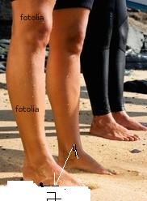
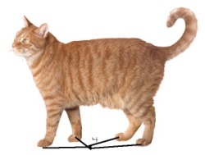
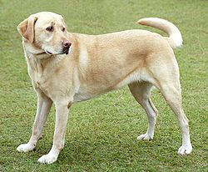

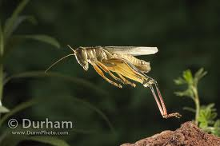

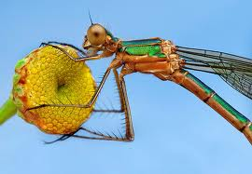

Is this easier? Why?
Tib neeg muaj ob txhais ceg.
Aub thiab miv muaj plaub txhais ceg—
kab thaib yoov muaj rau txhais ceg.
Tiamsis, kab thaib yoov co ceg tsis zoo tibyam.
Ib co ceg zoo rau txoj kev dhia. Ib co ceg zoo
heev rau txoj
kev, nce ntoo, vuag khoom, khiav, los yog ua luam dej.
Notes:
Talk to the person next to you about how the picture clues were helpful. Why/Why not? (Presenter discusses with participants how we make connections from people to insects)
Ask them if they noticed the word “zoo” in this slide—it was also on the previous slide
14

Slide 15

Social Language
Basic Interpersonal Communicative Skills
BICS
Cognitive Academic Language Proficiency CALP
Academic Language
(Cummins, J. 1984)
Notes:
Take a look at this slide. Turn and talk about what this slide means. Using the Iceberg analogy, Cummins (1984) made the distinction between “surface fluency” and the more evolved language skills necessary to achieve academically. “Click” The tip of the iceberg is called Basic Interpersonal Communicative Skills or BICS, and takes from 1-3 years to develop. Under BICS, language learners have immediate access to context-embedded language such as face to face contact, gestures, cues, and clues to support various language domains. This is the language found on the playground, or in the hallways, or at the grocery store. This is why ESL teachers get questions like, “Why does so and so need to be in ESL? He/she speaks English just fine. “Click” The iceberg found underneath the surface is referred to as the Cognitive Academic Language Proficiency or CALP—which can take much longer to develop, anywhere from 5-7 years. CALP occurs in context-reduced situations, typically found in academic settings where higher order thinking skills are required of the learner (evaluating, analyzing, synthesizing, etc.), and very little contextual supports are provided. However, if you have attended trainings on sheltered instruction, you learned some techniques and strategies that provide contextual supports language learners need to attain CALP. The implication of BICS and CALP has given rise to education policy that requires states to set exit requirements from ESL programs so that ELs who have attained BICS are not prematurely exited and can continue to receive services so that they have the opportunity to develop CALP. In the past, ELs were prematurely mainstreamed into regular education classrooms based on their conversational skills that falsely resembled English proficiency—BICS! Once MIS-placed in a regular education classroom, ELs typically performed poorly and were often over-referred to Special Education programs.
Click for next slide
15

Slide 16
BOTTOM LINE . . .
For students to achieve academically and demonstrate learning on a larger scale, such as high stakes assessments, they MUST master Academic Language.
Notes:
16

Slide 17
Integrating English Language Proficiency Standards & Content Standards Builds CALP
http://www.wida.us/standards/DraftRelease/player.html
Notes:
SAY (for transitioning purposes):
In addition to using sound instructional strategies, the WIDA ELP Standards are part of the framework to building ELs’ Cognitive Academic Language Proficiency.
There are 5 WIDA ELP standards with related components. In the next few slides we will take a look at how the WIDA ELP standards are organized.
17

Slide 18
Language vs. Content
Language proficiency involves the language associated with the content areas.
Content knowledge reflects the declarative (what) and procedural knowledge (how) associated with the content.
Notes:
18

Slide 19
Content and Language Objective
Subject: Reading (from English-Language Arts)
Content Objective- Identify topic/ main idea/supporting details/identify unknown words for meaning
WIDA - Level 2 Language Objective- Speaking-Using their first or second language, share the main ideas, details with a bilingual partner.
EXAMPLE
Notes:
An example of a language (Speaking) and content (Reading) objective written for level 2 EL from the speaking domain.
19

Slide 20

Turn to the person next to you and talk about your favorite kind of fruit.

Slide 21
Turn to the person next to you and talk about your favorite kind of fruit.
Now talk about that fruit from the perspective of a poet.

Slide 22
Turn to the person next to you and talk about your favorite kind of fruit.
Now talk about that fruit from the perspective of a poet.
...the perspective of a mathematician.

Slide 23
Turn to the person next to you and talk about your favorite kind of fruit.
Now talk about that fruit from the perspective of a poet.
...the perspective of a mathematician.
...a biologist.

Slide 24
Turn to the person next to you and talk about your favorite kind of fruit.
Now talk about that fruit from the perspective of a poet.
...the perspective of a mathematician.
...a biologist.
...a historian.
Notes:
What did you notice as this activity progressed? Did it get more difficult? In what ways? This is what the WIDA ELP standards boil down to. We can’t expect our ELs to master BICS (Standard 1) and be able to succeed in the other content areas. We need to teach the academic language necessary for those content areas. And the best way to do that is to teach the language side by side with the content--in the regular ed classrooms. It cannot be left up to the ESL teacher alone. The most successful program models are dual-immersion bilingual and collaborative/team-teaching where the content teacher and the ESL teacher work together to get content and language objective into every lesson. That is difficult to do in small districts with low incidence or only one ESL teacher.

Slide 25
Five WIDA ELP Standards
Standard 1- SIL: English language learners communicate for SOCIAL AND INSTRUCTIONAL purposes within the school setting.
Standard 2 – LoLA: English language learners communicate information, ideas, and concepts necessary for academic success in the content area of LANGUAGE ARTS.
Standard 3 – LoMA: English language learners communicate information, ideas, and concepts necessary for academic success in the content area of MATHEMATICS.
Standard 4 – LoSC: English language learners communicate information, ideas, and concepts necessary for academic success in the content area of SCIENCE.
Standard 5 – LoSS: English language learners communicate information, ideas, and concepts necessary for academic success in the content area of SOCIAL STUDIES.
WIDA Consortium / CAL / MetriTech
Notes:
25
There are 5 standards. Each one covers the four domains of language--speaking, listening, reading, and writing. Each one has MPIs (MODEL PERFORMANCE INDICATORS) for 5 levels of language proficiency. And each MPI is meant to be tied directly and taught simultaneously with the content area standard.
Why have ELP Standards?
To provide a curriculum/assessment resource anchored in academic content standards. To facilitate ELL English proficiency attainment, access to content knowledge and their academic success. To establish a common yardstick to measure how ELLs acquire language across the 4 domains of listening, speaking, reading & writing. To comply with NCLB requiring ELP standards and ELP standards-based assessments.

Slide 26


ELP Standard 1
ELs communicate for
SOCIAL AND INSTRUCTIONAL
purposes within the school setting
Notes:
Tell me about today’s weather.
What did you do over the weekend?
Pass your homework forward.
It’s time to line up.
What did you eat for lunch?
Put your books on the table.
The dictionary is on the shelf under the window.
26

Slide 27
Examples of Standard 1
Social and Instructional Language
Classroom language
Routines
Instructions /assignments
School behavior
Recreational objects and activities
Notes:
Gloss over this and the next several slides.
Classroom-table, chair, glue, pencils etc.
Morning lunch choice, copy work off board, pledge, moment of silence
Following directions, language that goes with completing an assignment(copy from board, write a paragraph, complete graphic organizer)
School rules/expectations, raising hands, no speaking out, spatial relations
Playground equipment, gym equipment/supplies.
27

Slide 28


ELP Standard 2
ELs communicate information, ideas, and concepts necessary for academic success in the content area of LANGUAGE ARTS
Notes:
Skip this activity!
For the next 4 standards activities, ask participants to go to the poster that depicts each content area standard, and compose a list of language associated with that content area.
28

Slide 29
Standard 2
The Language of Language Arts
Speaking Task- Level 1/2 Orally paraphrase three key concepts after reading selected text with a partner.
Reading / Speaking task Level 1/2-Ask questions/draw idea and predict key concepts prior to reading. Use language 1 if possible with bilingual partner.
Notes:
What language do ELs need in language arts? Think about how language will be used in the lesson (speaking, in class discussions, in assignments, and in the lesson activities)
At your tables compose a list of language associated with Language Arts . Share
29

Slide 30


ELP Standard 3
ELs communicate information, ideas and concepts necessary for academic success in the content area of MATHEMATICS
Notes:
30

Slide 31
Standard 3
The Language of Mathematics
Reading Task Level 2- Match words or phrases related to estimation. (about twenty cents)
Speaking Task Level 2- Restate or paraphrase basic operations from oral statements referring to pictures of everyday objects. (Ten pencils and ten more are twenty)
Notes:
What do you think the language of mathematics involves? Share
Show examples
31

Slide 32


ELP Standard 4
ELLs communicate information, ideas and concepts for academic success in the content area of SCIENCE.
Notes:
32

Slide 33
Standard 4
The Language of Science
Level 3 Writing Task- Outline steps of scientific inquiry involving elements or compounds with a partner.
Level 3 Listening Task- Identify examples of scientific tools or instruments and their uses from pictures and oral descriptions.
Level 4 Reading Domain- Analyze and identify reasons for genetic alterations based on visually supported text with a partner. (Mutation)
Notes:
What do you think the language of science involves?
Share examples.
33

Slide 34



ELP Standard 5
ELs communicate information, ideas and concepts for academic success in the content area of SOCIAL STUDIES
Notes:
34

Slide 35
Standard 5
The Language of Social Studies
Level 2 Reading Task- Find labeled illustrations or photographs modeled on word walls or displays of seasons.
Level 2 Writing Task- Draw a family portrait from a model or photographs and identify people in the photos.

Slide 36
Organization of the
Wida ELP STandards

Slide 37
Five Grade-Level Clusters
The WIDA ELP Standards are organized by the following Grade-Level clusters:
PreK−K
Grades 1−2
Grades 3−5
Grades 6−8
Grades 9−12
Notes:
37
Gloss over...
The clustering of grade levels reflects the fact that language proficiency increases over a time period that does not necessarily correspond with grade level.
That is, a sixth grade EL who has been in U.S. schools for three years will likely be at a higher level of English language proficiency than a ninth grader who has just recently arrived in the U.S.

Slide 38
Four Language Domains
Listening ─ process, understand, interpret, and evaluate spoken language in a variety of situations
Speaking ─ engage in oral communication in a variety of situations for a variety of purposes and audiences
Reading ─ process, interpret, and evaluate written language, symbols, and text with understanding and fluency
Writing ─ engage in written communication in a variety of forms for a variety of purposes and audiences
Notes:
38
Do not read this slide. Let audience read--you say the following:
Listening/Speaking/Reading/Writing are the four main language skills.
Listening and Reading are comprehension skills that involve receptive language;
Speaking and Writing are communication skills that require productive or expressive language.
In order to give educators a comprehensive picture of EL students’ English language proficiency – and to comply with federal law - all four domains are tested on the ACCESS for ELs test and the W-APT screener.

Slide 39
Levels of English Language
Proficiency
6
6
REACHING
5
4
BRIDGING
3
EXPANDING
DEVELOPING
2
EMERGING
1
ENTERING
WIDA Consortium / CAL / MetriTech
Notes:
39
39
Before the workshop prepare re-usable envelopes of the 6 proficiency levels. Cut apart each level, mix them up out of order, place the 6 ELP stages in envelopes. Make enough envelopes for each table.
Pass out envelopes per table and ask them to place the English Language Proficiency Levels in the order students develop. Ask tables to discuss these levels
The labels used for the six proficiency levels were created by the WIDA development team. EL status is restricted to levels 1 through 5. A student reaching level 6 shows no language characteristics that would distinguish him or her as needing special English language services. Such a student would be capable enough in all language domains: Speaking, Listening, Reading and Writing, to be able to benefit fully from mainstream classroom instruction. Note that a student at a lower level in the policy set by states or school districts may be designated as functionally able to participate in and benefit from regular classroom instruction and may, in fact, be exited from special English language services. There is no exit level set for MN at this time. It’s our first year. Exit criteria will be left up to individual school districts to decide. Once MDE has had time to study results, they will make a recommendation, but it will likely not be a hard and fast rule. That’s how most things are with ESL.

Slide 40
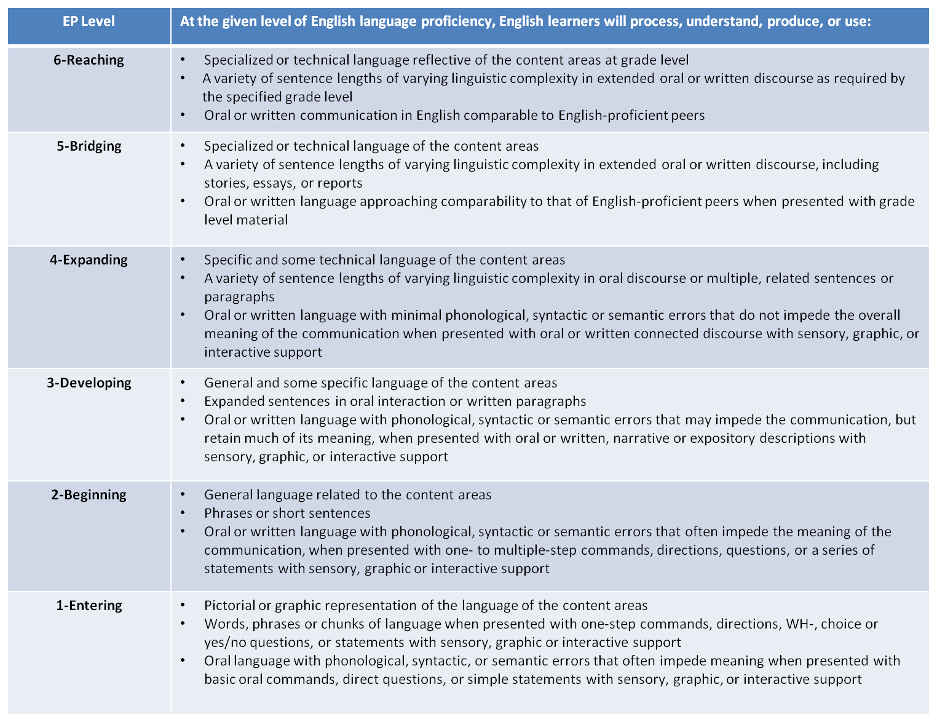
Performance Definitions
Notes:
With this slide, click to highlight each bullet, emphasizing how the complexity of language increases as you go from Level 1-entering to Level 6-Reaching. Cite specific examples (at level 1 students use and respond to pictorial or graphic representation of language then at level 2, they move from graphic representation to “general language….”
Look at your composite grade level adjusted score for your Els to see what level they are overall. W-APT or ACCESS
If you have 30 minutes or more remaining... At tables, have each group discuss the continuum for each second bullet (Level 1 to Level 6) then discuss as a whole group how it changes. Ask for specific examples.
Do the same activity for the third bullet.
40

Slide 41
Criteria for Performance
Definitions
1
2
3
4
5
6
ENTERING
EMERGING
DEVELOPING
EXPANDING
BRIDGING
REACH
I
NG
Linguistic Complexity:
The amount and quality of speech or writing for a given situation
Vocabulary Usage:
The specificity of words or phrases for a given context
Language Control:
The comprehensibility of the communication based on the amount and type of errors
WIDA Consortium
Notes:
These 3 criteria are significant, especially regarding assessment and evaluation of ELs. We will revisit this concept when we discuss assessment.
The 3 criteria for performance definitions are also integral elements to the speaking and writing rubrics WIDA developed for use with the ACCESS for ELLs and the WIDA ACCESS PLACEMENT TEST (W-APT).
41

Slide 42
Performance Level Expectations at
Different Proficiency Levels
Language Proficiency
(Performance Level Descriptions)
PIs
Linguistic Complexity
Vocabulary Usage
Language Control
5 Bridging
L 5
4 Expanding
L4
3 Developing
L 3
2 EMERGING
L 2
1 Entering
L 1
WIDA Consortium
Notes:
Gloss over...
You can see how a student’s command of each three criteria expands and develops as s/he undergoes the process of second language acquisition as it relates to CALP.
42

Slide 43
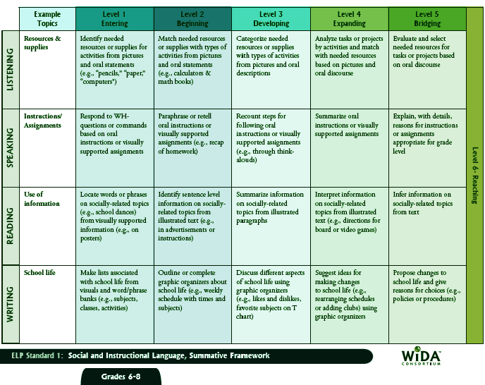
Identifying elements of the frameworks
Performance Definitions
ELP Standard 1: Social and Instructional Language, Formative Framework
Model Performance Indicators
STRAND
Language Domains
WIDA Consortium / CAL / MetriTech
Notes:
43
43
Each framework of the standards is presented in a matrix format.
At the top of the framework is the standard and type of framework
The first row depicts the performance definition (EP Level)
Inside each cell lies the Model Performance Indicator (MPIs)
The first column gives the language domains, and second one shows the sample topic
When we have a developmental horizontal row of MPI’s, across the 5 levels of language proficiency, and within the same domain, it is called a Strand. Notice that the language demand gets more difficult with every level.
Skim through one strand and note the increasing difficulty and decreasing support.

Slide 44
Model performance indicators
An MPI is a language objective that contains 3 parts:
A language function word such as describe,
label, critique.
The content of the lesson
Support or scaffolding to help the EL obtain the content.
Notes:
44

Slide 45
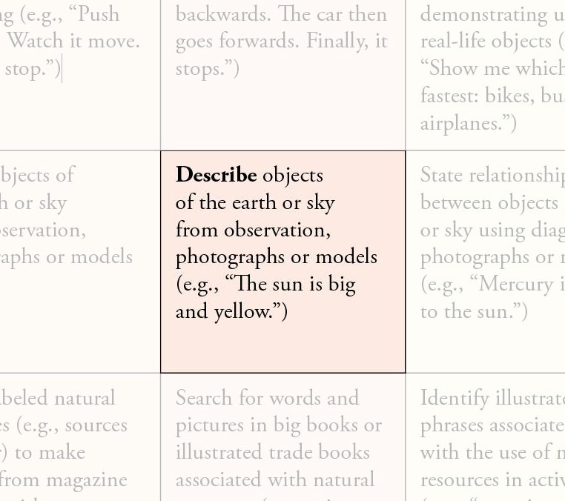
The Model Performance Indicator
Language Function
WIDA Consortium / CAL / MetriTech
Notes:
The language refers to words such as describe, infer, predict, identify and state.
45

Slide 46
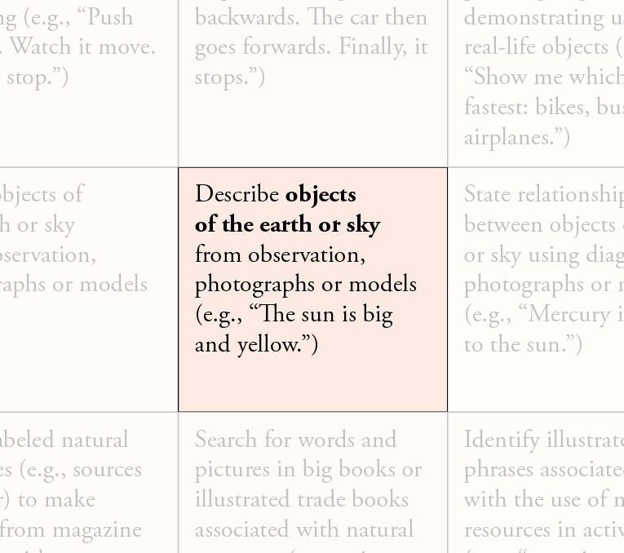
The Model Performance Indicator
Content Stem
Content Stem = “objects of the earth or sky”
WIDA Consortium / CAL / MetriTech
Notes:
The content stem is derived from the ALCOS.
46

Slide 47
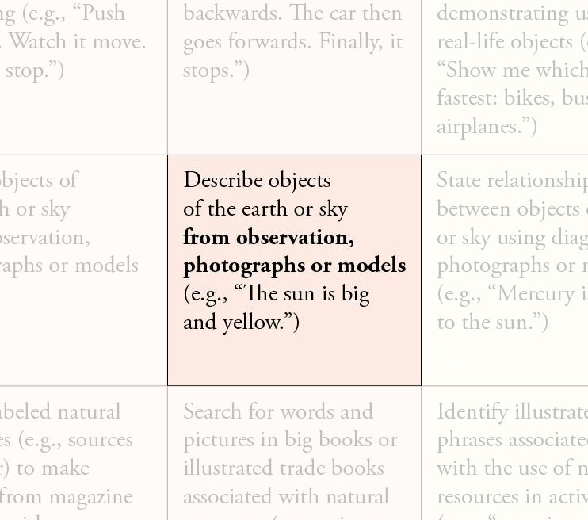
The Model Performance Indicator
Support or Strategy
Support = “from observation, photographs or models”
WIDA Consortium / CAL / MetriTech
Notes:
Support is the scaffolding you will implement to help the EL, making content comprehensible. Such as using graphics, modelling, experiential support, and interaction.
Skip below...
SAY and SHOW (if you have it)
pp. RG 20-24 of the WIDA ELP Standards and Resource Guide classify various types of supports and give explicit examples of each kind (sensory, graphic, and interactive supports (including native language interactive supports for levels 1-2)—they even break them down into specific content areas).
47

Slide 48
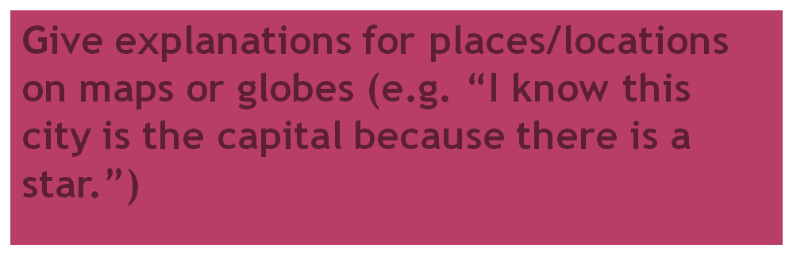
Practice Your Knowledge
1. Identify the 3 elements of an objective (MPI)
Level 5 Bridging/ Social Studies/Speaking
2. Describe how a mainstream teacher implements ELP standards using the language functions handout.
Notes:
Give each participant a handout on WIDA Language functions to answer #2 on slide.
With a partner;
Now you are going to practice identifying the 3 elements of an objective. On this slide you see an objective. Identify the 3 elements, language function, content of lesson and support in each of these.
Answer #2 with a partner
Share results.
48

Slide 49

Transformations
The Key to your Lesson Planning and Curriculum Development
Changing the MPI and Strand to more specifically address state content standards and classroom practice
Notes:
Read
49

Slide 50
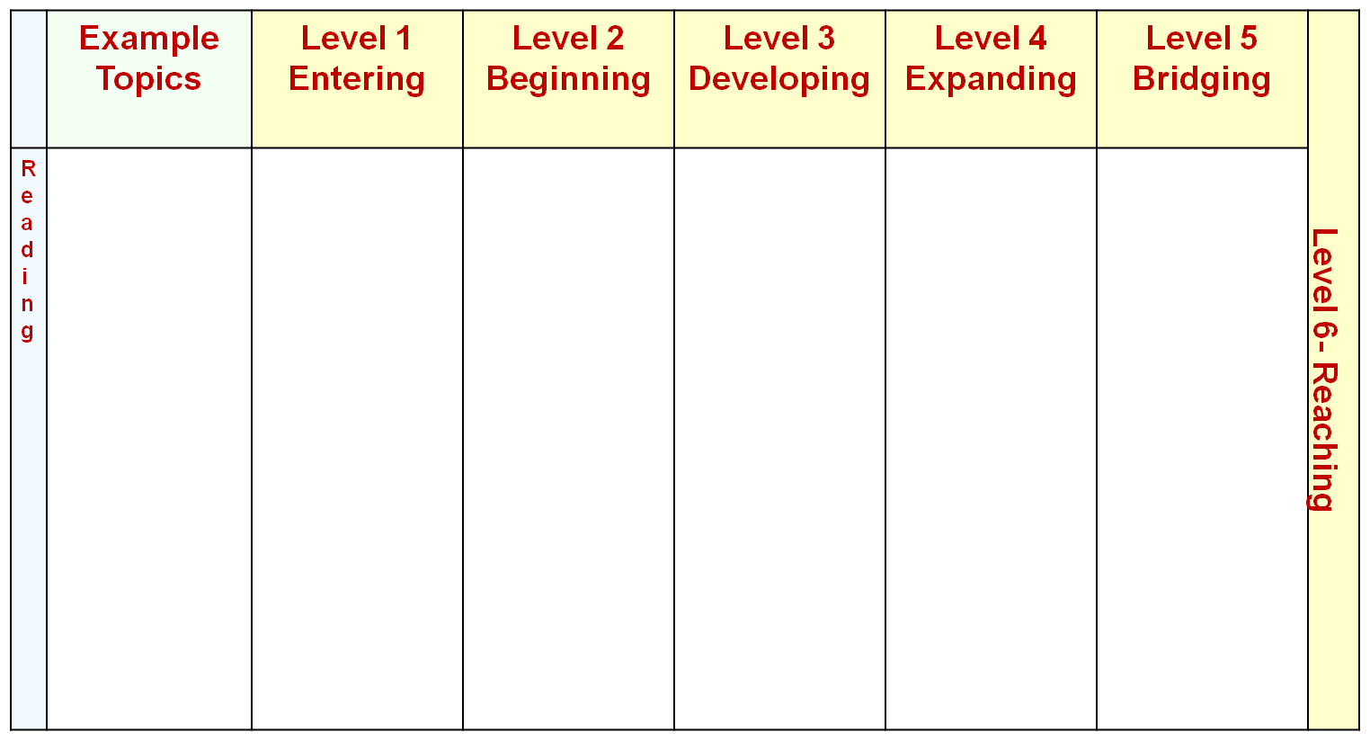
What are the language functions, supports and content stems?
Author’s perspective and point of view
Identify words and phrases related to author’s perspective in illustrated sentences
Identify main ideas related to author’s perspective in illustrated series of related sentences
Identify main ideas and supporting details related to author’s perspective in illustrated paragraphs
Analyze author’s perspective in illustrated text
Interpret author’s perspective in literary text and apply to other contexts
Notes:
Skip unless ample time remains...
At your tables, discuss each level and identify the language, content, and supports of each objective in reading.
2. Have each table share the 3 components of each level.
50

Slide 51
Planning:
Can Do Descriptors
      Use with ELP scores from each language domain.
      More specific than Performance Definitions.
      Describes the language functions an EL
      “CAN DO” with support at a given ELP level.
      Built upon the Performance Definitions.
      Most useful tool for teachers in planning.
Can you identify the “CAN DO” level in each domain for the native English speakers in your classroom?
Notes:
Discuss the “Can Do Descriptors” explaining how easily it tells you what your EL can do at their English Proficiency Level.
The CAN DO Descriptors do not function like MPIs,
51

Slide 52
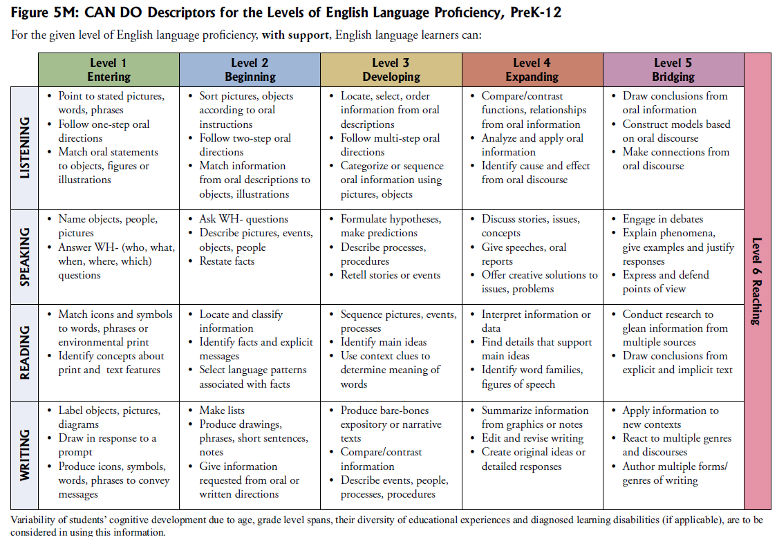
Notes:
Can-do Descriptors do not include the content stem, just the language function and support.
Look at your W-APT or ACCESS scores for each domain to see what your Els CAN DO. Highlight the cells that correspond with your student’s scores.
Even if you’re not ready to fully integrate the WIDA standards with your content standards, keep these CAN DO descriptors in mind when you are planning lessons and differentiating for Els.. BTW--we use CAN Dos so that the focus is on our successes, not limitations.
52

Slide 53
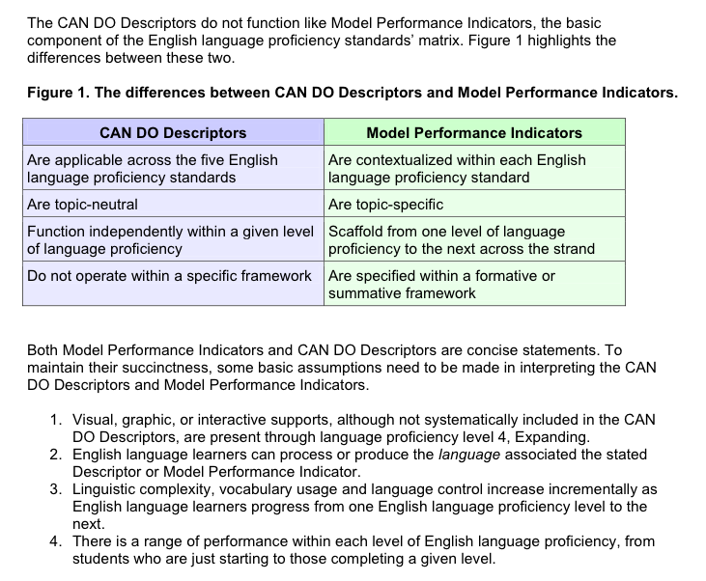
Notes:
WIDA reps really stress that you should not use CAN DO descriptors as MPIs. However, it might be a good place to start if you are overwhelmed by the standards themselves. It would be better to use CAN DO descriptors to write language objectives for yourcontent lessons than to forget about language objectives because the MPIs are overwhelming. Start small and build from there. And remember that language objectives will not only benefit your ELs. They will help all students.

Slide 54
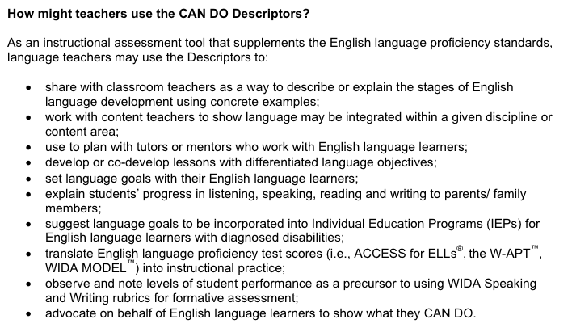
Notes:
This is more about how ESL teachers would use the CAN DO descriptors. I’ll give you a minute to skim.

Slide 55
Activity
With several partners and using the lesson plans on the table:
Write a MPI (Model Performance Indicator) using the three components, content, language, and support.
What English Proficiency Level is the student?
What are the “Can Do Descriptors” for this level?
What are some accommodations you can use at their English Proficiency Level?
Notes:
Do we have time for this?
Pass out lesson plans per table of a variety of grade levels.
Working with small groups, write a Model Performance Indicator, using the lesson plan. State the students proficiency level and Can Do Descriptors for the Proficiency level.
Group Share
55

Slide 56
What do you already do?
Turn-and-tell
  Think of 2-3 ways you explicitly provide language instruction to ALL students in your classroom.
  Tell your across-the-table partner.
  Think of 1-2 things you need to remember about language instruction for ELs in your classroom.
  Share with your group.
  Prepare to share with the entire group.
Notes:
Do we have time for this?
56

Slide 57

Assessment FOR ELs

Slide 58
EL Profile:
Data from the W-APT Report
At Your Tables Discuss the following:
Look at the “W-APT Teacher Report” at your tables.What does it show?
Highlight or underline the combined
Grade Adjusted Composite Proficiency Level score.
Highlight or underline the ELP score for
  Reading, Writing, Listening, and Speaking. Why is each language function score important for you to know?
How will you use this report in your classroom?
What other documents can you review to help guide you with assessment and instruction of your EL?
Notes:
Pass out W-APT Teacher Report copies for tables to review.
Ask tables to answer questions on slide.
Share whole group table discussions.
58

Slide 59
Assessment BRAINSTORMING
At Your Tables
Get one piece of chart paper per small group and discuss:
How do you assess ELs according to their different English proficiency levels?
What accommodations do you employ?
What challenges do you experience?
How have you overcome these challenges?
What do you want or need to know about assessments?
Select one person per group to post charts and present to whole group.
Notes:
Do we have time for this?
After the participants do the activity and present, have a whole group discussion and answer questions that arise from this activity. Be sure to emphasize that:
Just as we differentiate instruction for ELs, we also must differentiate assessment.
Begin with the outcomes and think about how to assess ELs before you think about how to teach the lesson.
Ask what English skills ELs need to know to be able to access the content and master COS.
59

Slide 60
Assessment Activity
Quick Review Quiz
Name the 3 criteria for the performance definitions
Name the 6 English Proficiency Levels
Language Control, Linguistic Complexity, and Vocabulary Usage
1- Entering
2- Emerging
3- Developing
4- Expanding
5- Bridging
Notes:
60

Slide 61
Criteria for Performance
Definitions (Review)
1
2
3
4
5
6
ENTERING
EMERGING
DEVELOPING
EXPANDING
BRIDGING
REACHING
Linguistic Complexity:
The amount and quality of speech or writing for a given situation
Vocabulary Usage:
The specificity of words or phrases for a given context
Language Control:
The comprehensibility of the communication based on the amount and type of errors
WIDA Consortium
Notes:
Remind the participants what each criteria means because the next activity involves using them in the WIDA writing rubric.
61

Slide 62
Assessment Activity
Using the WIDA Rubric to Assess Writing
Read page RG51 – RG53 silently
Discuss in groups how the 3 criteria are used to assess the writing samples
What key points are illustrated in
a. Linguistic Complexity
b. Vocabulary Usage
c. Language Control?
Share with whole group
Notes:
Before the participants read page RG 51-53 silently, explain that this is a sample ACCESS for ELLs writing prompt for grade cluster 6-8 followed by 2 student writing samples. Next to each sample is a review using the 3 criteria, linguistic complexity, vocabulary usage, and language control.
After they read silently,
Click to show next instructions.
62

Slide 63
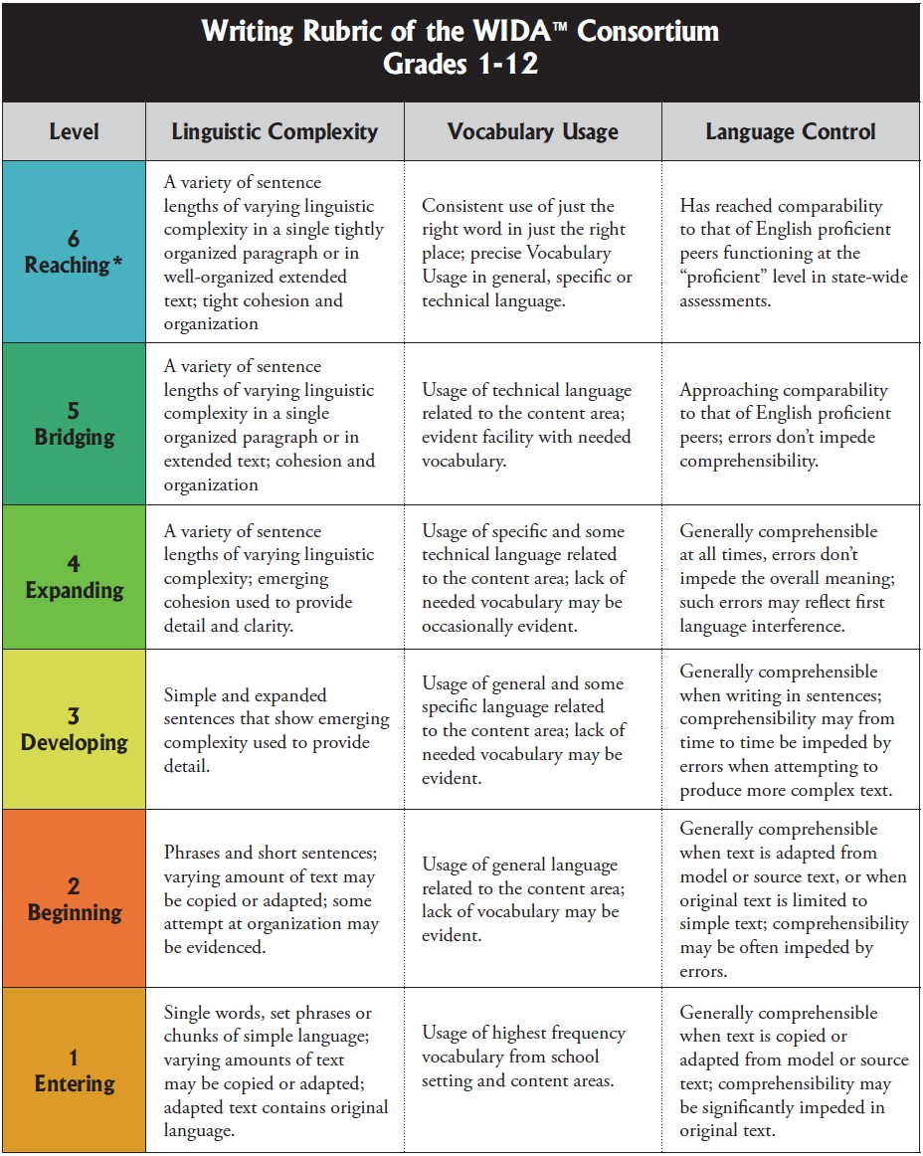
Notes:
Ask participants to compare Tazak’s writing to level 2-Beginning
Then compare Felipe’s to level 5-Bridging
Let them know this is a starting point for them—mastery will take time, and this is where the ESL teacher and classroom teacher collaboration can occur—the ESL teacher can support (and coach) the classroom teacher with using the writing rubric. Say that if they are confident enough they may begin to develop rubrics that are more specific to the language skills they are teaching the ELs.
63

Slide 64
Effective Assessment FOR ELs:
ELs MAY NOT RECEIVE FAILING GRADES or BE RETAINED AS A RESULT OF ANY LANGUAGE BARRIER.
Was appropriate instruction used to increase comprehension and develop CALP according to the student’s EPL?
Were authentic assessment methods used to evaluate EL student learning of content?
Were all content objectives included in student’s instruction?
What level of mastery on content objectives did student demonstrate?
Notes:
Take turns having someone read a bullet.
Discuss Bullets
64

Slide 65
GRADES AND RETENTION
Grades and retention should be determined through support of evidence.
ASK YOURSELF
  Were accommodations provided?
  Was consideration made of student’s level of language proficiency?
  Were progress monitoring and intervention strategies implemented?
Notes:
Discuss bullets
65

Slide 66

Where to Go for WIDA Resources
www.wida.us
Access and download the sample ACCESS for ELLs test items and the W-APT test materials
Take Online ACCESS for ELLs Test Administrator Training Course
Read FAQs about WIDA and ACCESS for ELLs
Access your state’s page with contact information, important dates, state policies, and local training opportunities
Purchase and/or download the WIDA ELP Standards and Resource Guide
Learn more about WIDA staff, products, and services
WIDA Consortium / CAL / MetriTech
Notes:
66
66

Slide 67
WHY IS WHAT YOU DO CRITICAL to the SUCCESS of
ALL ENGLISH Learners?
Notes:
Read and ask for people to respond to question.
Wrap up and thank everyone for coming.
67

Slide 68

Contact Information
Doreen Nelson– ESL Teacher
dnelson@blh.k12.mn.us
Melissa Larson – ESL Teacher
mlarson@isd2190.org
Notes:
68

