Slide 1
Supporting Your
Child's Mental Health
Jonathan Ybarra M. Ed., LPC-S
Maricela Hinojosa M. Ed., LPC-S
Marcela Fernandez M. Ed., LPC
South Texas ISD
November 2022

Slide 2
1. Learn About Mental Health
2. Learn Ways to Support Your Child’s Mental Health
3. Learn to Use Mindful Movement to Support Mental Health
OBJECTIVES:

Slide 3


What is Mental Health?
Two-word check-in
Notes:
“Two words that come to your mind when you hear ‘Mental Health’”
Mental health includes our emotional, psychological, and social well-being. It affects how we think, feel, and act. It also helps determine how we handle stress, relate to others, and make choices. Mental health is important at every stage of life, from childhood and adolescence through adulthood.

Slide 4
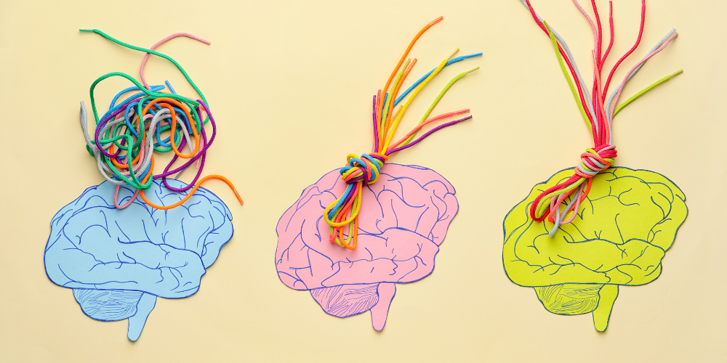
What is Mental Health?
Mental health includes our emotional, psychological, and social well-being.
It affects how we think, feel, and act.
It also helps determine how we handle stress, relate to others, and make choices.
Mental health is important at every stage of life, from childhood and adolescence through adulthood.
Source: https://www.cdc.gov/mentalhealth/learn/index.htm

Slide 5

What is Mental Health?
Positive mental health allows people to:
Realize their full potential
Cope with the stresses of life
Work productively
Make meaningful contributions to their communities
Notes:
Two word checkin

Slide 6
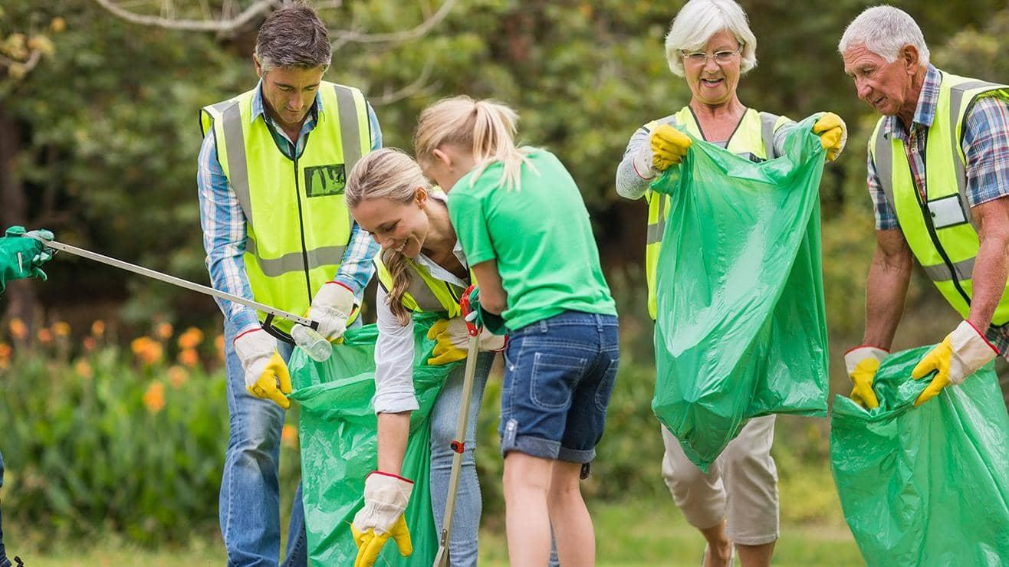
Ways to Support Your Child’s Mental Health:
Understand, What is Mental Health
Provide love, attention and support at their comfort level
Stay connected with family and friends
Give to the community, volunteer or fundraise. Make it a family event
Stay Active: Take walks together, play a game/sport, communicate the importance of physical activity
Notes:
Two word checkin

Slide 7

Ways to Support Your Child’s Mental Health Cont’d:
Create family house rules for electronic use, reduce social media usage
Model proper sleep habits
Eat Healthy foods e.g., fruits and vegetables
Teach importance of relaxation, take a time out
Notes:
Two word checkin

Slide 8
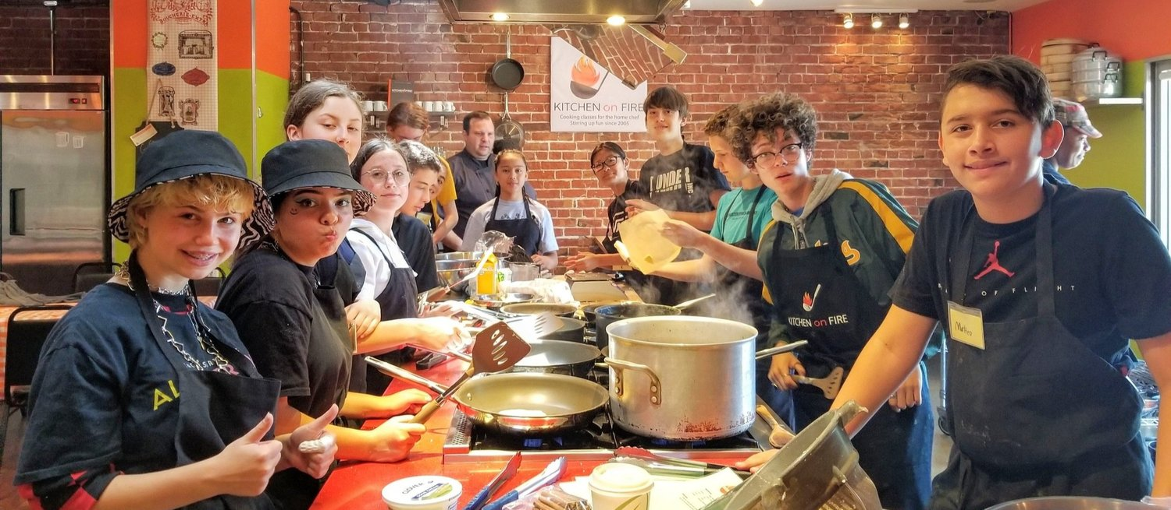
Ways to Support Your Child’s Mental Health Cont’d:
Teach them to plan for the morning the night before e.g., lay out clothes, have backpack ready
Sign them up for classes to learn new things
Model desired behaviors
Notes:
Two word checkin

Slide 9


Mental Health and
Mindful Movement
What is it?
“engaging in different exercises while placing all of your attention (or as much as you can) on the movements of your body as well as your breathing.”
How does it help?
Lower stress and anxiety
Improve mood
Improve focus
Enhance relaxation and sleep
Sources:
https://us.thesportsedit.com/blogs/news/nutrition-what-is-mindful-movement
https://www.health.harvard.edu/staying-healthy/yoga-for-better-mental-health
Notes:
https://us.thesportsedit.com/blogs/news/nutrition-what-is-mindful-movement
https://www.health.harvard.edu/staying-healthy/yoga-for-better-mental-health

Slide 10

Chair Yoga
Deep Belly Breath
Shoulder Stretch
Wrist Stretch
Seated Side Stretch
Seated Twist
Seated Forward Fold/Half Sun Salutation
Let’s Practice!

Slide 11
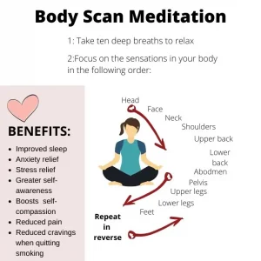
Chair Yoga
How could this mindful movement help your:
emotional,
psychological, and
social well-being?
Body Scan-
How do you feel?
Body Scan Meditation Script From Jon Kabat Zinn (thedailymeditation.com)

Slide 12
Questions?
Thank you for supporting your family’s mental health.

