Slide 1

Some common ideas about science, engineering, and technology:
Science and engineering are the same thing.
Engineering is a branch of science.
Technology is only computers or things that plug into the wall.
Science and engineering are mutually exclusive fields.
Engineers fix cars/drive trains/work on computers/etc.

Slide 2
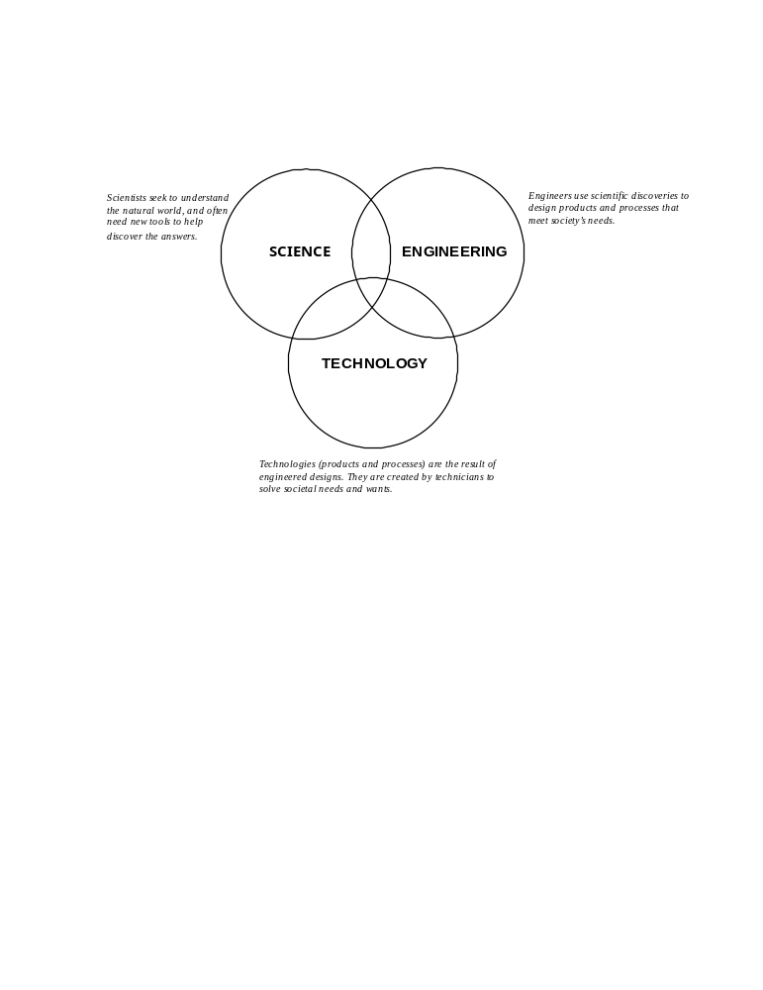
MA Dept. of Ed. Science and Technology/Engineering Curriculum Framework

Slide 3
Engineering is Elementary Definitions
Science: The process of inquiring into the natural or human-
made world in an attempt to make observations, develop
explanations for what is observed, and test these ideas by
making predictions and comparing them to what happens in
new situations.
Engineering: A problem-solving process (called the
Engineering Design Process) that can be described as: Ask,
Imagine, Plan, Create, and Improve.
Engineer: A person who uses his or her creativity and
understanding of materials, tools, mathematics, and science to
design things that solve problems for people.
Technology: Any thing or process that humans create or use
to solve a problem or meet a need.

Slide 4
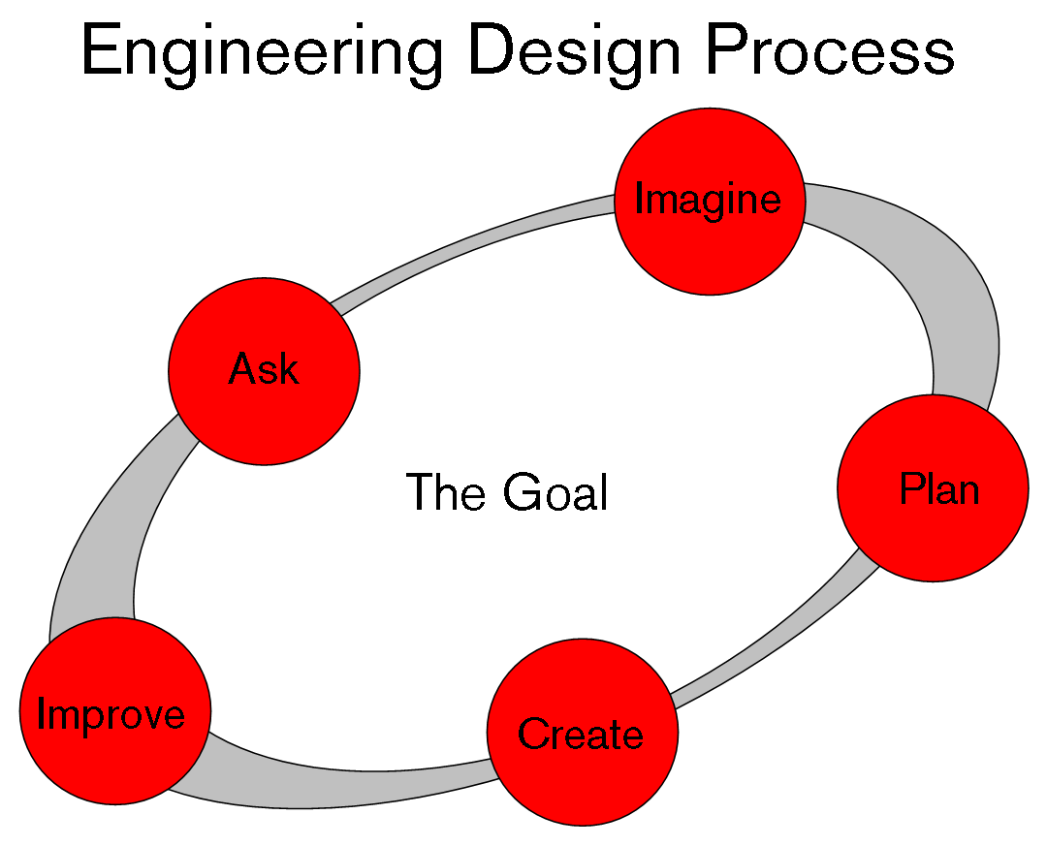
*conduct experiments, examine scientific data, etc.
(To design/improve a
technology)
*and test using controlled scientific experimentation

Slide 5
Science: The process of inquiring into the natural or human-made world in an attempt to make observations, develop explanations for what is observed, and test these ideas by making predictions and comparing them to what happens in new situations.
Engineering: A problem-solving process (called the Engineering Design Process) that can be described as: Ask,
Imagine, Plan, Create, and Improve.
Technology: Any thing or process that humans create or use to solve a problem or meet a need.
What are Science, Engineering, and Technology?
How are they related?
*conduct experiments, look at scientific data, etc.
*and test using controlled scientific experimentation
Notes:
How do these formal representations differ from the ideas in the “typical” responses that we looked at earlier?
How are the three representations similar? How are they different?
How would you explain the relationship between the three to someone else–-a child? parent? peer?

