Slide 1
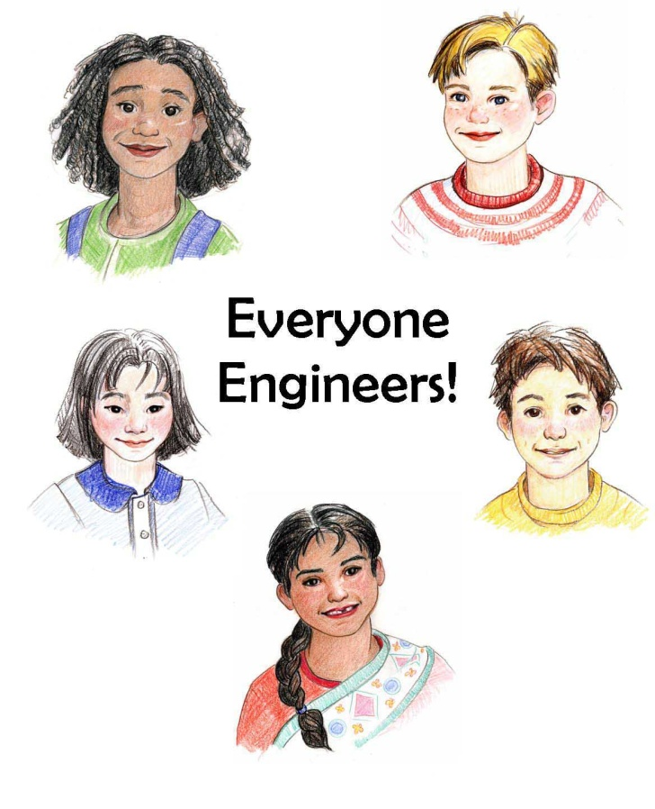
Engineering is Elementary
Museum of Science, Boston

Slide 2

Why Elementary Engineering?
Technological literacy is a basic 21st century literacy
Makes math and science relevant, integrates other disciplines
Builds and reinforces skills
Increases students’ awareness of access to engineering and science careers

Slide 3
Engineering is Elementary (EiE)
Lessons that integrate engineering and technology concepts into elementary science.
Goal 1. Increase children’s level of technological literacy
Goal 2. Increase elementary teachers’ understanding of technology and engineering and their abilities to teach these subjects to their students
Goal 3. Modify the U.S. system of education to include engineering at the elementary level.

Slide 4
EiE Units
Science Topic Eng Field Technology Country
Water Environmental Water Filters India
Insects/Plants Agricultural Pollinators Dominican Republic
Wind & Weather Mechanical Windmills Denmark
Simple Machines Industrial Redesign Potato USA (Af Am)
Chip Factory
Earth Materials Materials Walls China
Balance & Forces Civil Bridges USA (Hisp)
Sound Acoustical Animal Sound Ghana Representation
Organisms Bioengineering Model Membranes El Salvador
Electricity Electrical Alarm Circuits Australia
Solids & Liquids Chemical Playdough Process Canada
Landforms Geotechnical Bridge Siting Nepal
Plants Packaging Plant Package Jordan
Magnetism Transportation Maglev Vehicle Japan
Energy Green Solar Oven Botswana
Solar System Aerospace Parachutes Brazil

Slide 5
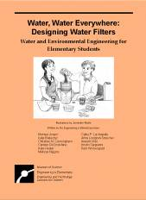
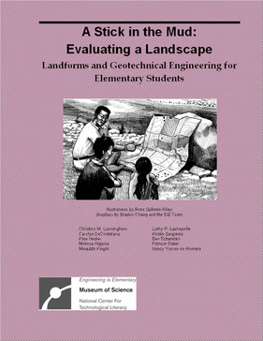
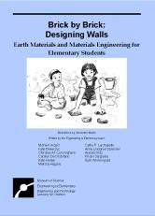
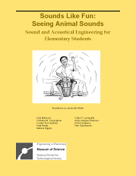
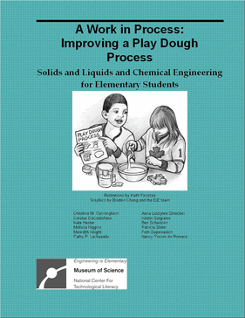
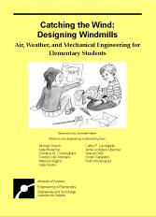

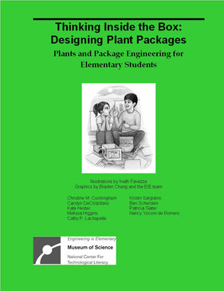
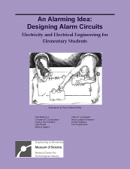
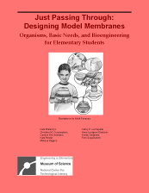
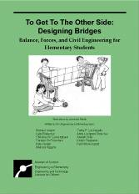
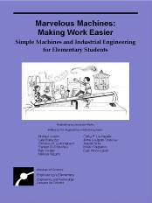
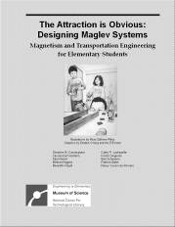
Units

Slide 6














Slide 7
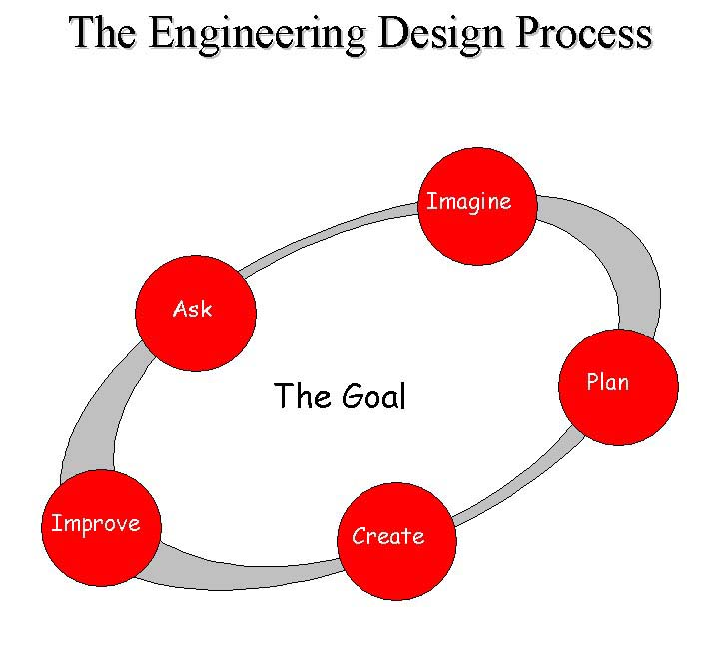
Science and Math
Lesson 1: Engineering Story
Lesson 2: A Broader View of an Engineering Field
Lesson 3: Scientific Data Inform Engineering Design
Lesson 4: Engineering Design
Challenge

Slide 8
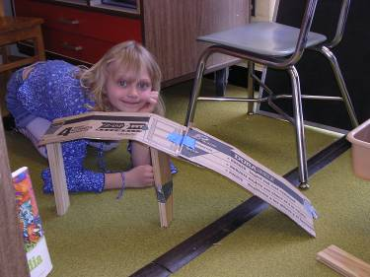
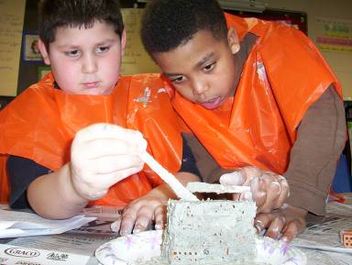
Units Include
Teacher lesson plans
Student duplication masters
  Basic
  Advanced
Assessment materials
Background resources

Slide 9
Skill Building
Problem solving

Slide 10
Skill Building
Problem solving
Analysis and data-driven decisions
Variables and optimization
Teamwork
Creativity
Communication

Slide 11
Curriculum Development Process
Initial Unit Development
Regional Pilot Testing (MA)
Unit Revisions
National Field Testing (MA, MN, CO, FL, CA)
Unit Revisions
Final Unit Released
It takes about 3000 hours to develop a unit that is 8-10 hours of classroom time

Slide 12
EiE Use
EiE National Use (as of Sept 2008)
Teachers | 9,306
Students | 484,081
Schools | 1200
Districts | 400
States | 50 + DC

Slide 13
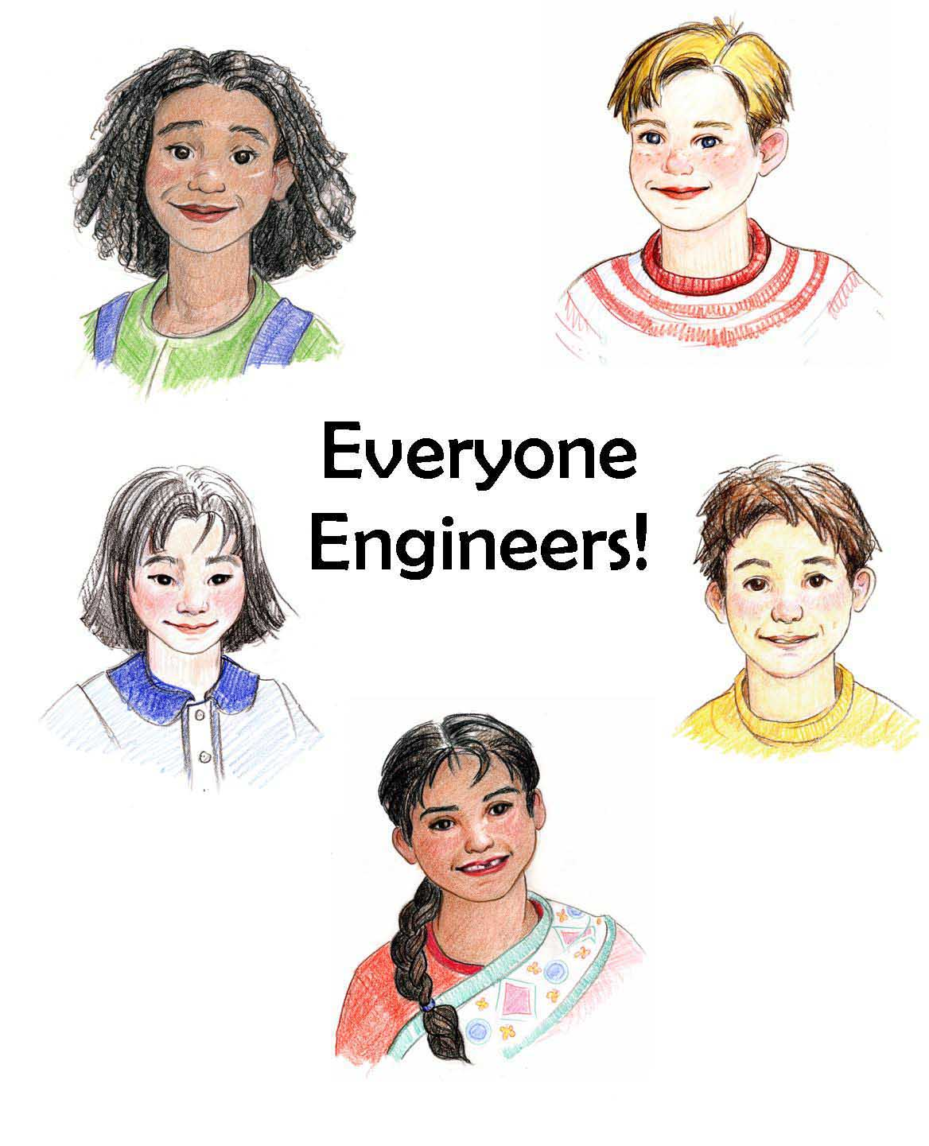
Contact Information
Engineering is Elementary: eie@mos.org
Engineering is Elementary: www.mos.org/eie
National Center for Technological Literacy: www.nctl.org

