Slide 1

A Clubs
The following clubs will meet once a month on Tuesdays.

Slide 2


Art Club
The art club is open to all students who have a passion for creating art.
Our purpose is to promote and encourage students to create original artwork. Art club will give you the opportunity to experiment with new media.
For more information, contact Ms. Tangires

Slide 3

Drama Club
Our purpose is to promote and educate students about drama in the school, local and regional communities.
We offer workshops on various aspects of theater, encourage theater participation, and sponsor a field trip to a Broadway show.
All members are expected to participate in fundraisers and FSK productions (this does not mean you must be on stage!)
Advisors: Ms. Eiwen, Mrs. Garcia and Mrs. Gore

Slide 4


Eagle Book Club
The book club is open to all FSK students interested in reading and discussing fiction and non-fiction books.
Our purpose is to enrich and expand our enjoyment of reading.
For more information contact Mrs. Myers in the Media Center.

Slide 5


Educators Rising
Are you interested in a career in the field of education? If so, consider joining the Educators Rising.
FEA is an organization for students who are interested in a teaching career or other careers in education.
The group's mission is to provide students with opportunities to explore their related interests.
Students from all grades who are interested in all education related fields are invited to join us.
Club dues are $20
See Mrs. Cherneski or Mrs. White for more information!

Slide 6

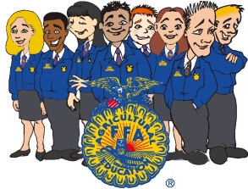
FFA
The FFA organization is dedicated to making a positive difference in the lives of young people by developing their potential for PREMIER LEADERSHIP, PERSONAL GROWTH, and CAREER SUCCESS through agriculture education.
Our chapter participates in various activities that promote the development of leadership and cooperation which include:
  Competitions
  Conferences
  Demonstrations
  Meetings
For more information see an active FFA member, Mrs. Althoff or Mr. White.

Slide 7
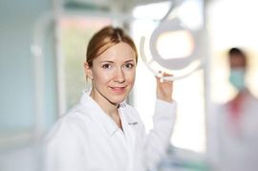




Health Careers Club
Does a career in the health field such as the medical profession, healthcare, EMS, or teaching interest you? The Health Careers Club may be for you!
The goal of the club is to have guest speakers in various health related career fields and possible field trips to related destinations to enhance and enable students to make informed choices in their career path.
Our club will meet in person.
See Mrs. Wagner in Room 320 for more information

Slide 8



Rho Kappa
Rho Kappa is a Social Studies Honor Society. It is the only national organization for high school juniors and seniors that recognizes excellence in the field of Social Studies. Invitation for membership is earned through taking a number of social studies courses, having a GPA of at least 3.00, as well as other qualities.
Members participate in community service and social studies related activities, including field trips.
See Mrs. Bell or Mr. Smith for additional information about Rho Kappa.

Slide 9

B Clubs
The following clubs will meet once a month on Wednesdays.

Slide 10

Academic Challenge Team
We compete several times a year at the practice level at various local high schools. The final championship is at Spotlight on Youth.
We compete on the “It's Academic” TV show once a year. (To be determined for the 2022-2023 school year)
Looking for members who are highly skilled in any of these areas:
  math, science, English (lit and grammar), social studies, current events
We practice during Key time.
Advisor: Mrs. Meininger

Slide 11
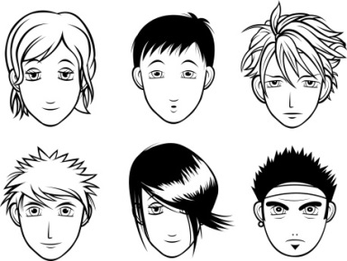
Anime Club
Want to further your knowledge of Japanese culture? Do you enjoy reading manga or drawing Anime characters? Then this is the club for you!!
Come and experience the world of Anime, manga and Japanese culture.
For further information see Mrs. Myers in the Media Center.

Slide 12

Class of 2023
We would like at least one person from each advisory
Help plan class activities and fundraisers to make our years at FSK a blast!
Activities include: Homecoming (hall decorating, spirit activities), Corn Maze, Movie Night, Senior Prom, & more!
The more people involved, the better your senior year will be!
Class Advisors: Ms. Eiwen & Mrs. Hoyos

Slide 13

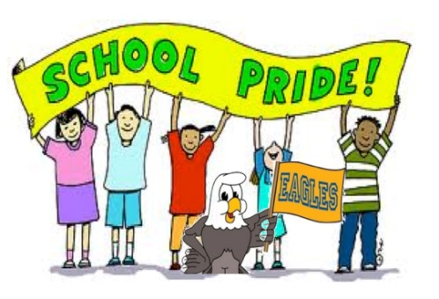
Class of 2024
Help to plan activities and fundraisers for the Class of 2024.
Activities include: Homecoming Hallway decorating, picnics, dances, talent shows, and more.
Make your four years at FSK the best by getting involved!
Advisor - Mrs. Brilhart

Slide 14


Class of 2025
Make your four years at FSK the best by getting involved!
Be part of planning activities and fundraisers for the Class of 2025.
Activities include: Homecoming Hallway decorating and other events decided upon by the class.
Advisor - Mrs. Hafner

Slide 15

Class of 2026
Support the Executive Board and let your voice be heard by joining our class club!
Help brainstorm and run fundraising and activities for your class!
Be part of decision making for homecoming, hall decorating,
Get involved and make it count!!
Advisor – Mrs. Garcia

Slide 16
Esports “Club”
Do you play League of Legends or Rocket League, and want to compete with other people in your school against other schools in the county and around the country? Then sign up for FSK Esports! These are competitive teams, and there will be tryouts. You do not have to have played the games before to try out.
Rocket League tryouts will begin next Wednesday in room 805 at 2:45pm, with games starting in October on Wednesdays at 3:15. We will be forming a Varsity and JV team that consist of 3 members and at least 1 alternate per team.
League of Legends times and tryouts are still being finalized, but we will announce something when we know.
More games may be coming, but we don’t have a lot of info yet. Stay tuned for updates. For any other questions, contact Mr. Hamilton in room 905. Or email at b_hamil@carrollk12.org

Slide 17

Friends for Life
The purpose of the club is to enhance the lives of people with intellectual disabilities by providing one-to-one friendships.
Students form friendships with students in the special education classroom.
This is a fun way to include everyone in making long-lasting friendships.
If you are interested see Mrs. Cassatt

Slide 18

SOAR
(Students Organized for Anti-Racism)
Students in this organization will plan and implement activities that support positive culture, relationship building between all students, and anti-racism in many forms. All students are welcome to join!
Please contact Ms. Miller ajmille@carrollk12.org if you’re interested.

Slide 19

C Clubs
The following clubs will meet once a month on Thursdays.

Slide 20

Allies
Our purpose is to bring together gay, lesbian, bisexual, transgender, questioning, and straight allied students to promote anti-bullying; to increase awareness and education within the group and the FSK community; and to work to foster classroom climates in which all students, regardless of sexual orientation or gender identity, may feel safe, supported, respected, and affirmed.
Activities include educational sessions, sharing circles, community events, and after school meetings.
Advisor: Ms. Eiwen

Slide 21

Fellowship of Christian Athletes (FCA)
F.C.A. or Fellowship of Christian Athletes was a club designed to meet the spiritual needs of student athletes.
Over the years it has grown and expanded to all students of any religious or non religious affiliation. Students do not even need to be athletes.
The club will meet during KEY time and on every Wed morning at 7am in the old gym.
Games, singing, a lesson and snacks make up the typical Wed morning meeting.
No dues or fundraising, just fun with friends and an opportunity to meet new people.
For more info contact Mrs. Brilhart in Room 803.

Slide 22


FSK Model Engineers
The FSK Model Engineers is a model railroad club that focuses on model building, electricity, wiring, scenery, programming, repair, and running trains.
This is a modular layout club where individual members can have their own track modules.
We model different parts of Maryland,
so each unique location can
be recognized.
Advisor – Ms. Smith

Slide 23

Key Club
“Caring - our way of life.”
We are a community service organization that builds leadership skills.
We are part of the Kiwanis International family.
Members earn service learning hours by participating in projects for charities such as UNICEF and March of Dimes.
We also volunteer at local organizations such as SERRV and the Kiwanis of Westminster.
For more information please see Mrs. Myers in the Media Center

Slide 24

Mock Trial
Mock Trial is where teams are given a fictional court case to represent where they will prepare the defense/plaintiff arguments to compete in court against other teams in the county. Winners will move onto regionals and states.
Open to anyone, especially those interested in pursuing careers in law.
We will have practices and competitions after school that will require your own transportation.
See Mrs. Bell or Ms. Wixted for more information

Slide 25

National English Honor Society (NEHS)
NEHS is an organization that recognizes high school students for accomplishments and enthusiasm in the field of English and language arts.
Membership is through invitation, which is earned through taking a number of English courses, having a set GPA, as well as other qualities.
See Mr. Cornell for more information.

Slide 26

Student Government Association (SGA)
SGA members represent the student body by making FSK a more productive learning environment for students and staff.
SGA sponsors several community service projects throughout the year such as volleyball tournaments, lock-ins, dances and blood drives.
Every year SGA is in charge of coordinating the Homecoming festivities; from the pep rally, to spirit week to the dance.
SGA Dues are $5
For more information please contact Ms. Tangires or Ms. Wixted

Slide 27

Tri-M
Tri-M is an honor society dedicated to music and music advocacy that is sponsored internationally by MENC.
Students show they are candidates for this club by participating in music organizations and activities at FSK as well as in the community.
Members of the club must have participated in a certain amount of musical activities, have and maintain a certain grade point average, and continue to pursue activities in music, music advocacy, and community service.
Those interested in the club should speak to Mr. Workman.

Slide 28

D Clubs
The following clubs will meet once a month on Fridays.

Slide 29


Black Student Union
This group will support Students of Color as they navigate life at FSK and after high school.
The advisors are Mrs. Garcia and Mr. Cunningham.

Slide 30

D and D Club
Dungeons and Dragons
Join other students that have the same interests in this unique “roll” playing game. The group meets during Key Time and after school year.
Discuss the game and strategies
Set up gaming opportunities
Develop your own D&D world to share with the rest of the group
Advisor: Mr. White

Slide 31

Join Furious Fiction Friday
We are a club that meets every other Friday, starting September 30, from 2:45-3:45 in Mrs. Gore’s room to CREATIVELY WRITE– no stress, no grade, no judgment—just an opportunity to get lost in our collective “What ifs”. ALL are welcome!

Slide 32

Girls Athletic Association (GAA)
We are an organization devoted to serve and support female athletics at FSK.
All members must be VARSITY female athletes.
We participate in many projects to serve athletics as well as the surrounding community.
See Mrs. Wagner in Room 320 for more details.

Slide 33

National Honor Society (NHS)
NHS is a leadership & service organization to which students must earn membership. The opportunity for membership is by invitation only.
To be considered as a candidate : At least Sophomore standing, minimum weighted GPA of 3.75, & CCPS student for one or more semesters
Applications evaluated for : Character, continued leadership, involvement in &
service to school and community
Advisor: Ms. Miller

Slide 34
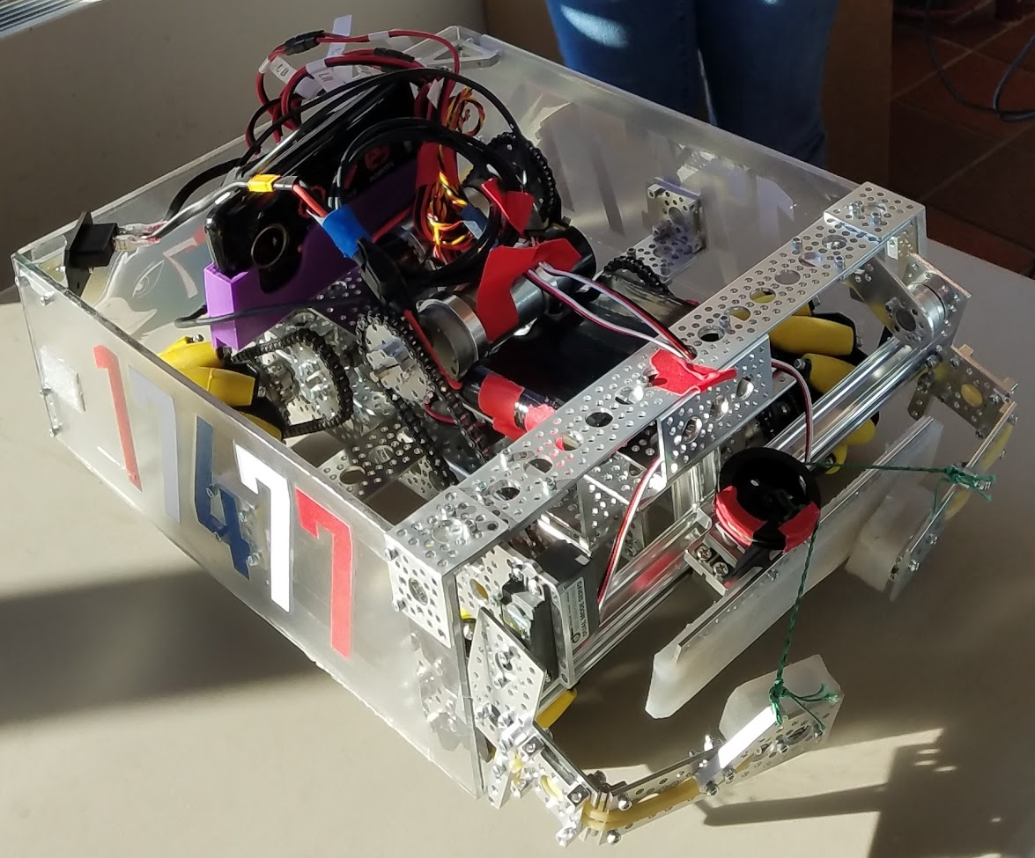
Join FSK FTC Robotics Team: Kettle 2 the Mettle
Team Based Competitions! We build and program robots to compete against other schools across the state/world.
Last year we took 2nd at Regionals - as rookies!
No prior knowledge needed! This is a learning club!
You don’t even have to build or code! We have lots of other opportunities for people to be on the team.
We have need for people with any of the following skills:
Engineering, Coding, Publishing, Fundraising, Video Production, Graphic Design, Purchasing, Technical Writing, Corporate Espionage, Strategic Planning, Fabrication, 3D Printing, Editing, Social Media Management, Logistics, Business Management, Gaming, Costuming, and more!
Advisors:
Mr. White
Mr. Hamilton

Slide 35

Clubs That Are Being Formed
The following clubs are in the process of being formed. Please see the advisor(s) if you would like to be involved.

Slide 36
Event Coverage Team
This team would set up cameras to film events at FSK, to live stream and provide commentary and coverage, as well as record and edit videos to later post on YouTube or other digital media.
If you think it would be fun to be in front of a camera and react to things happening live, this might be a great opportunity for you!
If you think it would be fun to learn AV technologies for live streaming and creating YouTube videos, this might be a great opportunity for you!
We will be using digital cameras, and using OBS, YouTube, Premiere Pro, After Effects, Audacity, and other tools and technologies. You don’t have to know them already - we’ll teach interested people.
Contact Mr. Hamilton in room 905 for more information. Or email at b_hamil@carrollk12.org

Slide 37

Fishing Club
This club is in the process of being formed as the result of student interest. Any students who are interested should see Mr. Harrison in Room 906 to get the club underway.

Slide 38

Leo Club
Leo Clubs are an extension of the Lions service organization which aims to encourage community service and involvement from a young age.
They provide youth volunteer opportunities that allow young adults become involved in community service and begin learning about the impact they can have around the world.

Slide 39
Leo Club
Where there’s a need, there’s a Leo
“Leadership, Experience, Opportunity.” That’s what makes a Leo. Members of Leo clubs embody the best qualities of our incredible organization. They are devoted young people who realize the power of action. Together, Leos and Lions form a powerful partnership — one of mutual respect where Lions learn from the innovative insights of Leos, and where Leos gain access to the proven strategies of those who’ve successfully served the world for decades
Mr. Linthicum will be the advisor to the Leo Club.

Slide 40

Clubs That Meet on Different Schedules
The following clubs will meet outside of the school day, on an alternate club day schedule, or only a few times throughout the school year.
Watch the announcements for club meetings!

Slide 41
Athletic Leadership Council
Leadership club for athletes who are nominated by their coaches.
Club works to develop leaders within the FSK Sports Program.
Create unity throughout all sports.
Meets on the first Friday of the month during KEY Time.

Slide 42

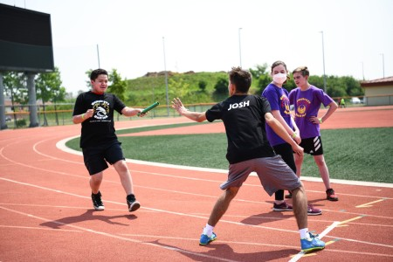

Corollary Sports Teams
FSK’s Corollary sports teams participate in games and matches against the other county high schools. The purpose of the program is to help students learn the skills of the specific sport, develop new friendships, promote physical fitness and teach teamwork.
Fall – Track
Winter – Bowling
Spring – Corn Toss
A sports physical and athletic fee are required in order to participate in Corollary sports.
If you are interested in participating in a Corollary sport, see or contact Mrs. Fine in the School Counseling office or Mr. Kimble in the Main Office.

Slide 43

FSK TV News
Become part of the team that makes the FSK TV News happen!
Work on camera or behind the scenes!
For more information contact Mrs. Brilhart

Slide 44


International Thespian Society
The International Thespian Society is an honor society for performing artists. Students who have earned a certain amount of points for work on theatrical productions are invited to join ITS. ITS participates in the annual Maryland Thespian Festival, held every January, performs a show and does community outreach. Membership to the Thespian Society is by invitation. Contact Mrs. Gore or Ms. Eiwen
for details.

Slide 45
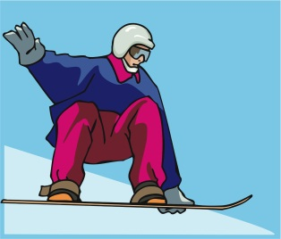

Ski and Snowboard Club
The Eagles Ski and Snowboard Club provides students, families, and friends with an opportunity to remain active during the winter months enjoying skiing and snowboarding.
Through the club, participants may purchase "Night Club Cards" through Liberty Mountain Resort. Cardholders will be able to ski or snowboard for one package price at any of three resorts: Ski Liberty, Ski Whitetail, and Ski Roundtop.
If members show interest, other trips may be planned to other resorts at an additional cost. There are no dues for this club. For more information, contact Mr. Cornell
Final information about Club Cards, etc. will be sent out when it becomes available.

Slide 46


Turtle Soup
Our goal is to learn how to be adept improvisational actors! We aim to learn experientially, which means everyone in the club has lots of opportunities to participate in all kinds of games, exercises, and shows. Turtle Soup members participate in county-wide events, along with school talent shows. Practices are typically after school a few times a month.
Advisor: Mrs. Gore

