Slide 1
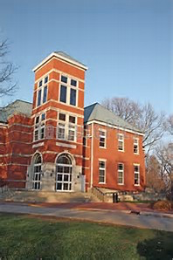
Two-Year Colleges, Transfers and Career Planning
GRCHS Junior Parent Night
October 2022

Slide 2

Topics to Cover
Two-Year College Options
Advantages
Disadvantages
Transferring to a 4-year college
GRCH supports for college search and 2-year college registration process

Slide 3


Two-Year/Community
College Options
  Grand Rapids Community College
  Muskegon Community College
  Baker College
  Davenport University

Slide 4



Advantages to starting with a Two-Year College
Ability to transfer to a four-year school
Improve Academic Record
Associate’s Degree or Certificate
“Try out” college coursework to build confidence

Slide 5

Advantages to starting with a Two-Year College
Lower Tuition ($100/credit hour)
Rolling admissions
Go to college without leaving home
Smaller setting

Slide 6

Advantages to starting with a Two-Year College
Flexible scheduling and credit requirements
Learn a relevant trade (continuation of KCTC to Culinary Arts program or M-Tech)
Direct route to an open job
Support Services

Slide 7
Disadvantages of starting with a Two-Year College
What should I be aware of when attending a Two-year college?
Limited curriculum
Lack of campus life
Less demanding work load
Some courses may not transfer

Slide 8
Transferring to a
Four-year college
College and University Transfer Portals
  College and university websites show which courses they will accept
Michigan Transfer Network
  https://www.michigantransfernetwork.org/
  Website shows transfer course equivalencies between many Michigan colleges and universities
4-year college admission counselors

Slide 9
How GRCH counselors can help in college searches
“Building a College List” presentations
College admissions representative visits
Assistance with ACT/SAT registration
  Test prep in early June for summer ACT/SAT
Advising in all areas of college search

Slide 10
How GRCH Counselors can help your student enroll at GRCC
Application process
Financial aid
Accuplacer/Aleks testing at GRCH
Campus tour
Scheduling classes

Slide 11
Questions…

