Slide 1

EXPLORE YOUR BENEFITS
LAWRENCE COUNTY SCHOOLS COUNCIL OF GOVERNMENT
DISTRICT: SOUTH POINT LOCAL SCHOOL DISTRICT
2021 BENEFITS ENROLLMENT GUIDE

Slide 2
YOUR BENEFITS GUIDE
Benefits Open Enrollment…..…..……….…...3
Contact Information...………………...….…....4
Enrollment Management Services.….…….....5
Health Plan……………………………………..6
Live Health Online….…..………………….…..7
Anthem Preventive Benefits…………………..8
Dental Insurance……….……………………..15
Vision Insurance….………………...……......16
Life Insurance....……………….……………..17
Questions & Answers.……..……..…...……..18
Compliance Notices...…………………...…...19
YOUR ENROLLMENT CHECKLIST
PLAN |  | Review this brochure to understand your 2021 benefit options.
DECIDE |  | Think about you and your family’s benefit needs for the coming year. Decide which options are best for you and your family.
ENROLL |  | Make your benefit elections from April 12– April 26, 2021.
ELIGIBILITY
If you work on a full-time basis, you are eligible for all benefits. As such, you may enroll dependents in the medical, dental and vision plans.
Eligible dependents include:
Spouse
Dependent children who have not attained age 26 for medical; not attained 19 for dental and vision (25 if a full-time student)
Dependent children of any age if they become mentally or physically incapable of self-support before age 19 and remain incapacitated and enrolled in the plan
Are you a recent hire?
New hires are eligible on 1st of month following date of hire.

Slide 3
YOUR BENEFITS
BENEFITS OPEN ENROLLMENT
4/12/2021 – 4/26/2020
As a Lawrence County Schools Council of Government employee, you are vital to our success. That is why we offer a comprehensive array of benefits—spanning medical, dental, vision, and life insurance—all of which are designed to help you achieve well-being. You will have the opportunity to change your benefit decisions during Open Enrollment, which takes place April 12,2021– April 26, 2020. Decisions that you make will take effect May 1, 2021.
Unless you experience a qualifying event during the year, Open Enrollment is the only time you can make changes to your benefit decisions. That is why it is so important to carefully review your options and make sure they meet the needs of you and your family.
IMPORTANT REMINDERS
Open enrollment is your chance to:
Change, elect, or drop medical, dental, and/or vision coverage.
Add or remove a dependent to your benefits.
If you do not make any changes to your current elections, those elections will remain the same for the plan year May 1, 2021 through April 30, 2022.

Slide 4
YOUR BENEFIT CONTACTS
BENEFIT | VENDOR | CONTACT INFORMATION
Medical Plan | Anthem | Member Services: 1-800-552-9159 Nurse Line: 1-888-249-3820 Claim Address: Anthem P. O. Box 105187, Atlanta, GA 30348-5187 Website: www.anthem.com
Prescription Drug Plan | Express Scripts | Member Services: 1-855-216-1512 Website: www.Express-Scripts.com
Dental Plan | Guardian | Member Services: 1-800-541-7846 Claim Address: PO Box 981572 El Paso, TX 79998-1572 Website: www.guardiananytime.com
Vision Plan | Guardian / VSP - Choice | Member Services: 1-877-814-8970 Claim Address: Vision Service Plan P. O. Box 997105, Sacramento, CA 95899-7105 Website: www.vsp.com
Life and AD&D | Guardian | Member Services: 1-800-541-7846
Benefit Consultant / Claims Advocate | Marsh & McLennan Agency | Claims Manager: Leslie Hayes Phone: 513-707-1751 Email: leslie.hayes@marshmma.com Account Management: Michelle Barnes Phone: 859-816-2515 Email: michelle.barnes@marshmma.com Account Assistant: Kara Valle Phone: 513-707-5024 Email: kara.valle@marshmma.com Toll Free Number: 1-800-949-1167 Address: 6279 Tri-Ridge Blvd., Suite 400, Loveland, OH 45140

Slide 5


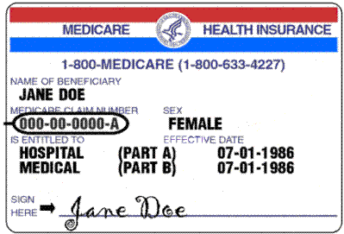
Enrollment Management Services (EMS) is a healthcare consulting firm with the primary goal of helping families understand their healthcare options and supporting the choice they feel best meets their needs.
You might be eligible for low-cost or free healthcare for you or your children. SCHIP, Medicare or government programs. If one of the following situations may apply to you or you have questions, please contact Suzanne Lepore from EMS at Suzanne@enrollmentmanagementservices.com, OR 513-561-0000 Ext #4
State Children’s Health Insurance (SCHIP)
If you are or someone in your home is pregnant and currently earning less than the income guidelines per year
If you have children in your home and currently earning less than the income guidelines per year
If you meet the expanded Medicaid for adults guidelines
Medicare
If anyone in your home is age 65 or older, or under 65 collecting a disability check from Social Security
Opt Out Benefit
For those members who waive medical coverage because of coverage elsewhere (e.g. Spouse’s plan, Medicare, Military, etc.) Lawrence Co. may offer opt out credit towards the costs of the other plan (Not all districts have this offering). Documentation is required to show costs of outside plan before Opt out Credit can begin. Please contact EMS for this benefit.
6934 Miami Avenue Suite 10, P.O. Box 43146, Cincinnati, OH 45243
Main Line 513.561.0000 Fax Line: 513.561.0777

Slide 6
YOUR MEDICAL PLAN OPTIONS
As a South Point employee, you have the choice of the following medical plans through Anthem:
Blue Access PPO $500 Deductible
Blue Access PPO $4,000 Deductible
Services | OPTION 1 | OPTION 2
Preventive Care | Covered in Full | Covered in Full
Physician Office Visit *PCP includes family practice, general physician, internist, pediatricians, OB/GYNs | $20 copayment Primary Care Physician*; $40 copayment Specialist | $20 copayment Primary Care Physician*; $40 copayment Specialist
Calendar Year Deductible | $500 per person to a maximum of $1,500 per family | $4,000 per person to a maximum of $8,000 per family
Inpatient Hospitalization | 80% after Deductible | 80% after Deductible
Outpatient Surgery | 80% after Deductible | 80% after Deductible
Non-Surgical Outpatient Services for diagnostic testing, labs and x-rays (except Advanced Imaging) | Covered in Full | Covered in Full
Advanced Diagnostic Imaging (CT Scan, MRI, Nuclear Medicine, PET Scan, etc.) | 80% after Deductible | 80% after Deductible
Durable Medical Equipment | 80% after Deductible | 80% after Deductible
Outpatient Therapies Calendar Year Visit Limits: Cardiac Rehab: 60 Pulmonary Rehab: 30 Physical Therapy: 30 Occupational Therapy: 30 Manipulation Therapy: 20 Speech Therapy: 30 | If billed as office visit, then Specialty Physician Office Visit applies. If billed as outpatient facility, 80% after Deductible | If billed as office visit, then Specialty Physician Office Visit applies. If billed as outpatient facility, 80% after Deductible
Urgent Care | $35 copayment | $35 copayment
Emergency Room | $250 copayment (waived if admitted) | $250 copayment (waived if admitted)
Out of Pocket Maximum (includes deductible) Per Calendar Year | $3,000 per person to a maximum of $5,000 per family (INCLUDES COPAYS EXCEPT RX) | $5,000 per person to a maximum of $10,000 per family (INCLUDES COPAYS EXCEPT RX)
Prescription Drugs Retail Pharmacy (30-days) Mail Order (90-days) Specialty Rx is Retail Copay | Retail Pharmacy $10 / $25 / $40 Mail Order $20 / $50 / $80 Rx OOP max: $1,000 single / $2,000 family | Retail Pharmacy $10 / $25 / $40 Mail Order $20 / $50 / $80 $1,000 single / $2,000 family

Slide 7



Slide 8
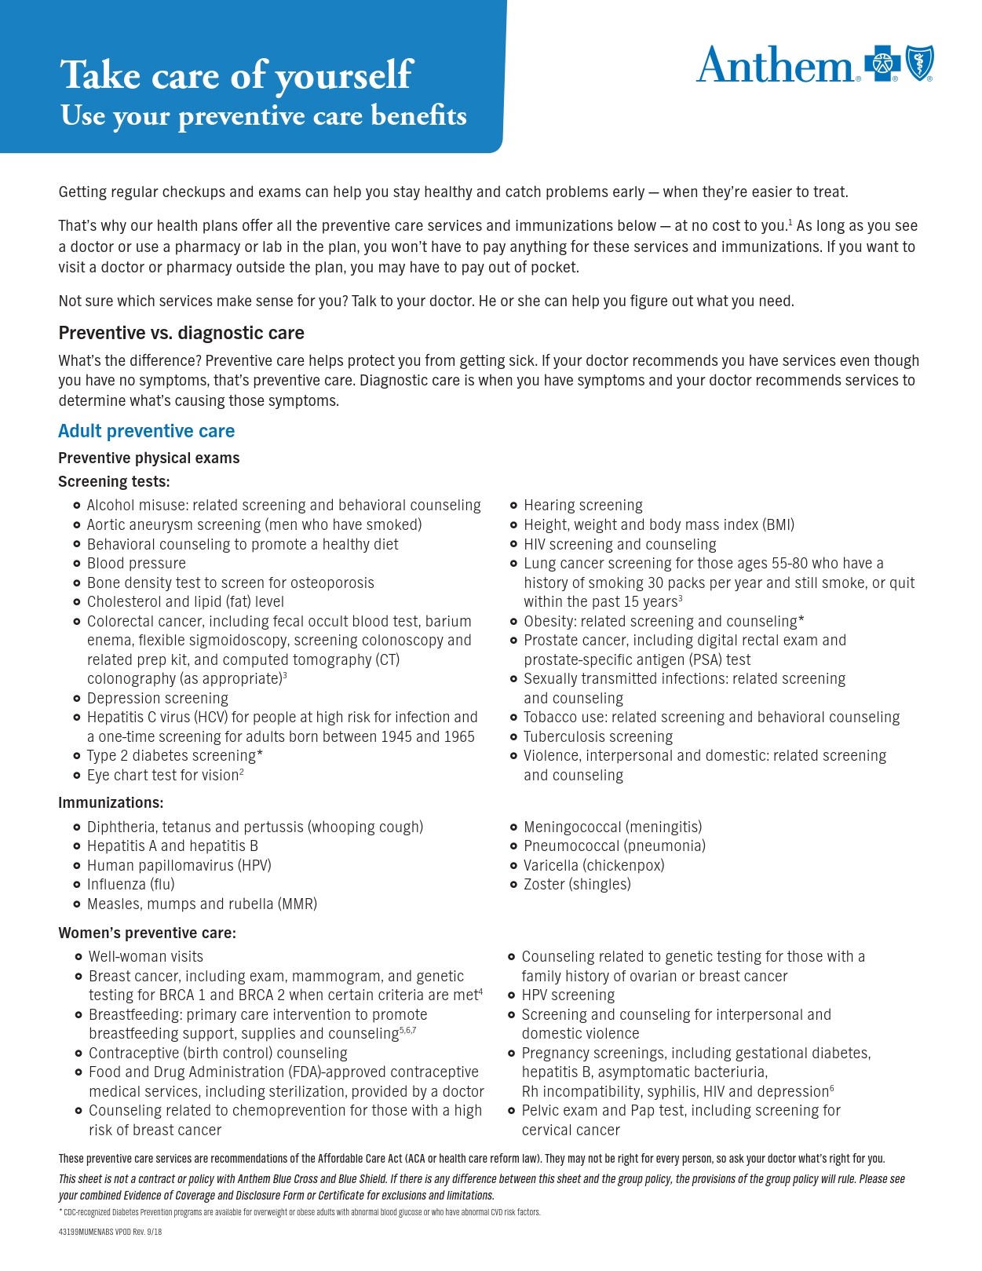

Slide 9
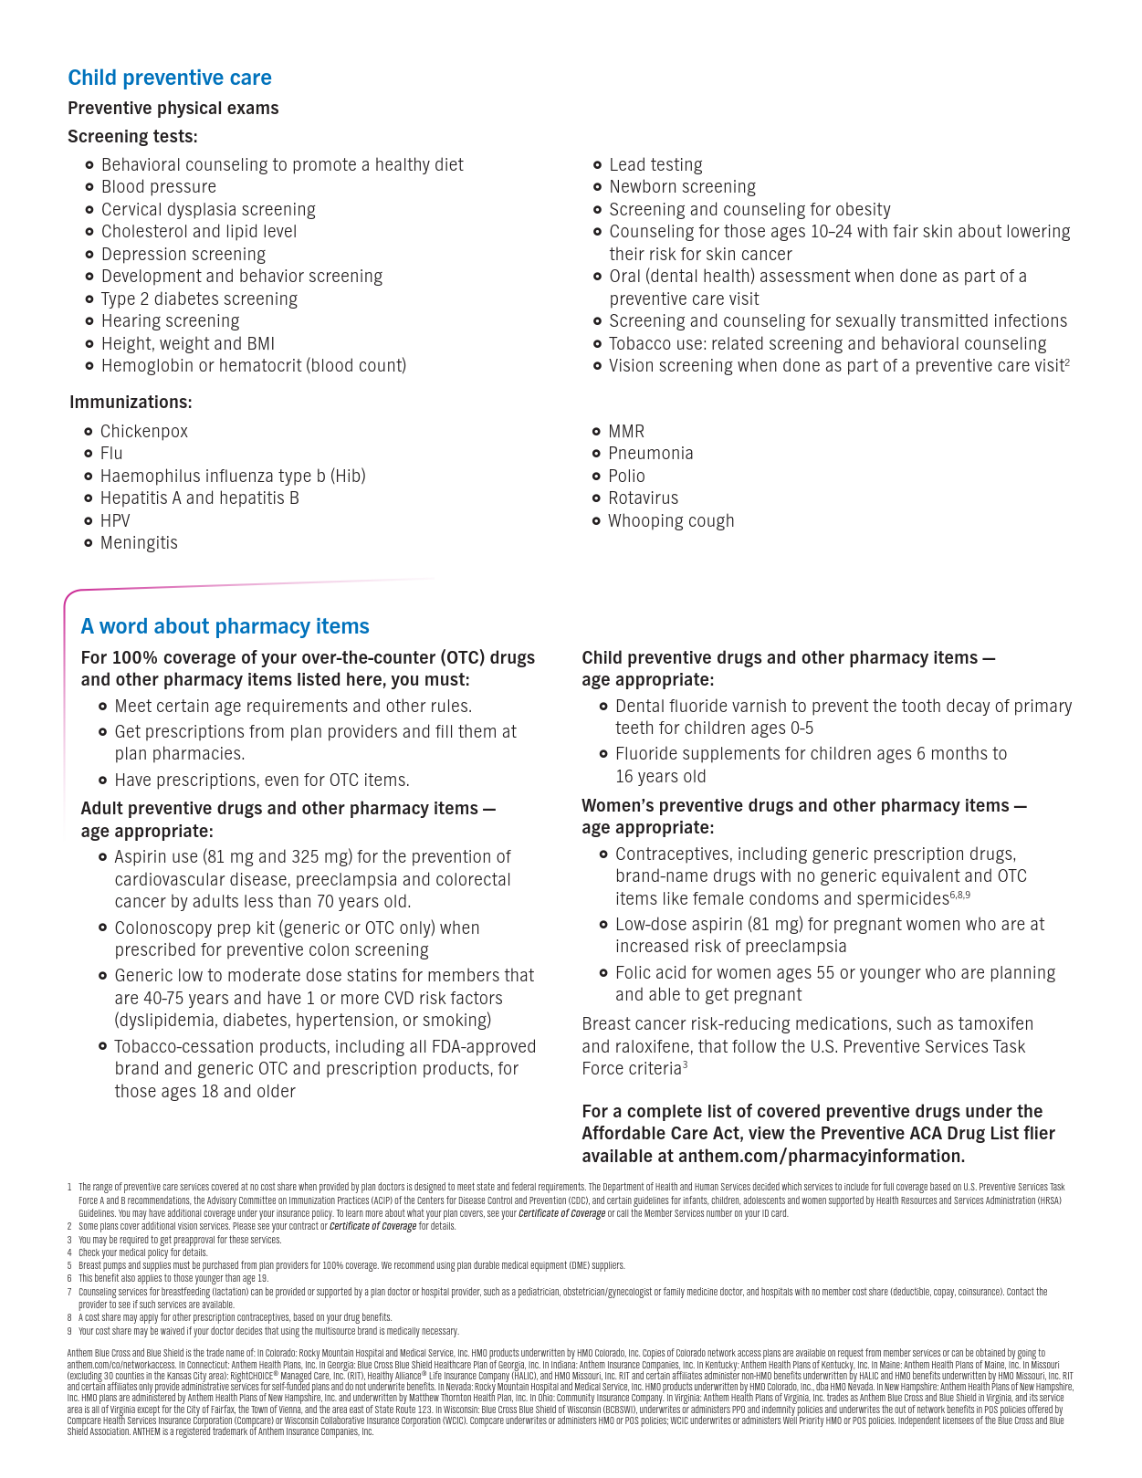

Slide 10


Slide 11
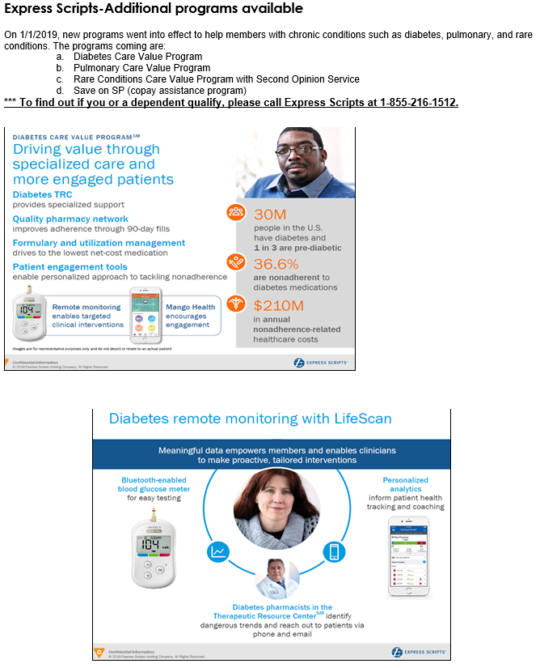

Slide 12


Slide 13
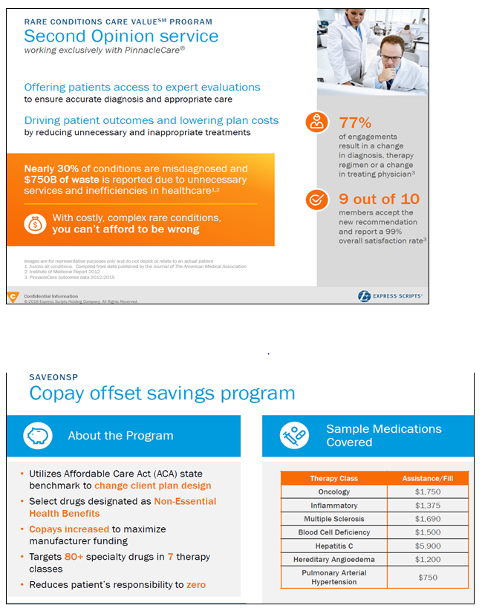

Slide 14
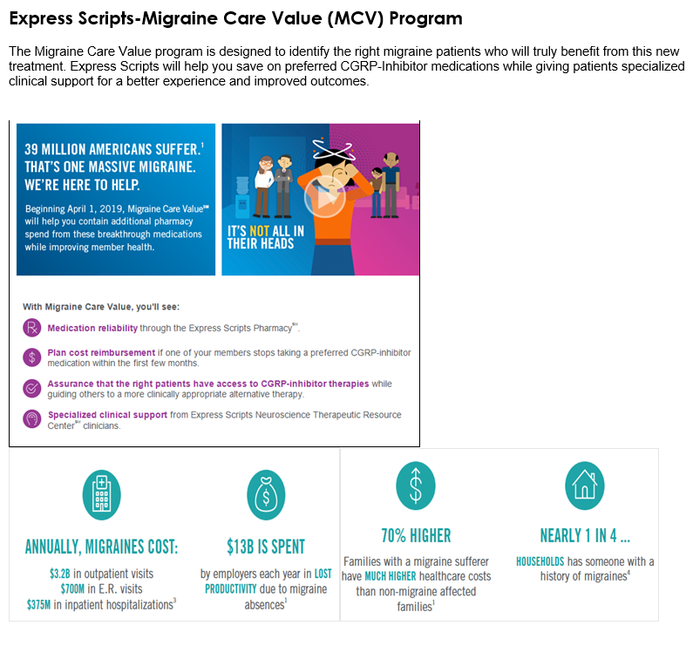

Slide 15
YOUR DENTAL PLAN
DENTAL
You can choose to participate in the Guardian dental plan. There are no plan changes to your dental benefits as of May 1, 2021. The claims address has changed, please find new address on your Contact Page (pg.4). You should have received a new Guardian ID Card with an updated claims address on the back of the card.
 | PPO – Dental Guard Preferred Network (for both plans)
TYPE OF SERVICE | VALUE PLAN | NAP (Network Access) PLAN
Preventive Services | Covered in Full | Covered in Full
Deductible, per Calendar Year | $50 per person, maximum of $150 per family | $50 per person, maximum of $150 per family
Basic Services | 100% after Deductible | 80% after Deductible
Major Services | 60% after Deductible | 50% after Deductible
Orthodontia Services (children up to age 19) | 50% to $1,000 lifetime | 50% to $1,000 lifetime
Annual Maximum, per person, per Calendar Year | $1,000 (*maximum rollover benefit available) | $1,000 (*maximum rollover benefit available)
Dependent Child Age Limit | To age 19 (25 if a full-time student) | To age 19 (25 if a full-time student)
*With maximum rollover, Guardian will roll over a portion of your unused maximum into your personal Maximum Rollover Account (MRA). The MRA can be used in future years, if you reach the plan’s regular annual maximum. To qualify, you must have a claim for covered services for which a benefit payment is used, in excess of any deductible, and you must not exceed the claims threshold during the benefit year. You and your insured dependents maintain separate MRAs based on your own claim activity. You can view your annual MRA statement detailing your account and those of your dependents on www.GuardianAnytime.com.
Your regular annual maximum is $1,000. The MRA threshold is $500, which means that your claims had to be under that amount for the calendar year. If you used out of network dental providers, your MRA credit would be $250 and if you used in network providers, your MRA credit would be $350. Your MRA account can grow to a maximum of $1,000 over several years, which may be used in a later year after you have depleted your regular annual maximum.

Slide 16
YOUR VISION PLAN
VISION
There are no plan changes to your vision benefits as of May 1, 2021. To locate a participating VSP Choice provider, please log onto www.vsp.com, or call Member Services at 1-877-814-8970. The chart below outlines the in-network benefits. By seeking care from an in network provider allows you to maximize your plan benefits. Your policy also contains a reimbursement for services received out of network, but the claim needs to be filed by you (the provider will not file the claim). For out of network services, please obtain an itemized receipt from your vision provider, and contact Marsh and McLennan Agency for an out of network vision claim form.
TYPE OF SERVICE | VSP CHOICE PLAN
Eye Exam (every 12 months) | $20 copayment
Lenses (every 12 months) Single Vision Bifocal Trifocal Ventricular | $20 copayment
Frames (every 24 months) | $130 allowance then 20% off remaining balance
Contact Lenses (every 12 months) Elective Medically Necessary | $130 allowance Covered in Full
Dependent Age Limit | To age 19 (25 if a full-time student)
*If the covered person chooses elective contact lenses, VSP does not cover frames until the beginning of the calendar year following the next calendar year after the elective contacts are purchased.

Slide 17
YOUR LIFE and AD&D BENEFITS
LIFE INSURANCE AND ACCIDENTAL DEATH & DISMEMBERMENT
South Point Local School District pays 100% of the cost for the Basic Life and AD&D benefits. Employees pay 100% of the cost for the Voluntary Life and AD&D benefits.
Basic Life Insurance | Certified employees: $30,000 benefit Classified employees: $30,000 benefit Administrators: $50,000 benefit
Basic Accidental Death and Dismemberment (AD&D) Insurance | Certified employees: $30,000 benefit Classified employees: $30,000 benefit Administrators: $50,000 benefit
Voluntary Life Insurance | Employee: $10,000 increments up to a $200,000 maximum Spouse (up to age 70): $10,000 increments up to $50,000 maximum Children (14 days up to age 23 or up to 25 years if a full time student): up to 10% of your elected amount up to a maximum of $10,000 per child
Voluntary Accidental Death and Dismemberment (AD&D) Insurance | Employee: $10,000 increments up to a $200,000 maximum (benefit begins to reduce when you reach age 65) Spouse (up to age 70): $10,000 increments up to $50,000 maximum Children (14 days up to age 23 or up to 25 years if a full time student): up to 10% of your elected amount up to a maximum of $10,000 per child
If you waived the Voluntary Life Insurance Coverage when it was initially offered in 2010 (or during your new hire election period), and decide later to apply for this coverage, you will be subject to underwriting approval based on the completion of an Evidence of Insurability form (medical history). Guardian has the right to decline you and/or your dependents based on information disclosed.
The voluntary life coverage is portable up to age 70, or it can be converted to a whole life policy, which builds cash value and has a level premium for the life of the policy (no age limit). If you are interested in continuing your coverage after your employment ends, you will need to contact Guardian within 30 days of your termination date. Guardian can be reached at 1-800-541-7846, or contact Michelle Barnes at Marsh & McLennan Agency for further information.

Slide 18
QUESTIONS & ANSWERS
Changes that can be made effective May 1, 2021:
Enroll or terminate individual and/or dependent coverage in the medical/dental/vision plans
Add or make changes to the Voluntary Life plan
(Evidence of Insurability – medical underwriting – may be required)
Forms to be completed if making changes:
Anthem Enrollment Form to change medical plans or individual/dependent coverage levels in the medical plan
Guardian Enrollment Form to change dental or vision plan elections
Guardian Voluntary Life and AD&D Enrollment and/or Medical Underwriting Form
What Forms MUST be completed?
If waiving the health insurance plan, you are required to sign a waiver form each year.
Where do I find these forms?
Contact your district’s board office for all forms.
When are the forms due and where do I return them?
All forms are due by April 26, 2021 and must be returned to your district’s board office.
Other Information:
If you do not make changes to your current elections, those elections will remain the same for the plan year May 1, 2021 through April 30, 2022.
The information in this Enrollment Guide is presented for illustrative purposes and is based on information provided by the employer. The text contained in this Guide was taken from various summary plan descriptions and benefit information. While every effort was taken to accurately report your benefits, discrepancies or errors are always possible. In case of discrepancy between the Guide and the actual plan documents the actual plan documents will prevail. All information is confidential, pursuant to the Health Insurance Portability and Accountability Act of 1996. If you have any questions about your Guide, please contact your district’s board office.

Slide 19
YOUR REQUIRED ANNUAL NOTICES
HIPAA If you do not enroll yourself and your dependents in a group health plan after you become eligible or during annual enrollment, you may be able to enroll under the special enrollment rules under the Health Insurance Portability and Accountability Act of 1996 (“HIPAA”) that apply when an individual declines coverage and later wishes to elect it. Generally, special enrollment is available if (i) you declined coverage because you had other health care coverage that you have now lost through no fault of your own (or employer contributions to your other health care coverage terminate); or (ii) you have acquired a new dependent (through marriage or the birth or adoption of a child) and wish to cover that person. When you have previously declined coverage, you must have given (in writing) the alternative coverage as your reason for waiving coverage under the group health plan when you declined to participate. In either case, as long as you meet the necessary requirements, you can enroll both yourself and all eligible dependents in the group health plan if you provide notice to the Plan Administrator within 30 days after you lose your alternative coverage (or employer contributions to your alternative coverage cease) or the date of your marriage or the birth, adoption, or placement for adoption of your child. See the Plan Administrator for details about special enrollment. CHIP You may also enroll yourself and your dependents in a group health plan if you or one of your eligible dependent’s coverage under Medicaid or the state Children’s Health Insurance Program (“CHIP”) is terminated as a result of loss of eligibility, or if you or one of your eligible dependents become eligible for premium assistance under a Medicaid or CHIP plan. Under these two circumstances, the special enrollment period must be requested within 60 days of the loss of Medicaid/ CHIP coverage or of the determination of eligibility for premium assistance under Medicaid/CHIP. See the Plan Administrator for details about special enrollment. COBRA The Consolidated Omnibus Budget Reconciliation Act (COBRA) requires group health plans to offer continuation coverage to covered employees, former employees, spouses, former spouses, and dependent children when group health coverage would otherwise be lost due to certain specific events. Those events include the death of a covered employee, termination or reduction in the hours of a covered employee’s employment for reasons other than gross misconduct, a covered employee’s becoming entitled to Medicare, divorce or legal separation of a covered employee and spouse, and a child’s loss of dependent status (and therefore | coverage) under the plan. COBRA sets rules for how and when continuation coverage must be offered and provided, how employees and their families may elect continuation coverage, and what circumstances justify terminating continuation coverage. GRANDFATHERED STATUS The Plan believes that none of the group health plans available under the Plan are “grandfathered health plans” under the Patient Protection and Affordable Care Act (the “Affordable Care Act”). SPECIAL RULE FOR MATERNITY AND INFANT COVERAGE Group health plans and health insurance issuers generally may not, under federal law, restrict benefits for any hospital length of stay in connection with childbirth for the mother or newborn child to less than 48 hours following a vaginal delivery, or less than 96 hours following a cesarean section. However, federal law generally does not prohibit the attending provider or physician, after consulting with the mother, from discharging the mother or her newborn earlier than 48 hours (or 96 hours, as applicable). SPECIAL RULE FOR WOMEN’S HEALTH COVERAGE The Women’s Health and Cancer Rights Act of 1998 (“WHCRA”) requires group health plans, insurance issuers, and HMOs who already provide medical and surgical benefits for mastectomy procedures to provide insurance coverage for reconstructive surgery following mastectomies. This expanded coverage includes: reconstruction of the breast on which the mastectomy has been performed; surgery and reconstruction of the other breast to produce a symmetrical appearance; and (iii) prostheses and physical complications at all stages of mastectomy, including lymphedemas.

Slide 20
YOUR REQUIRED ANNUAL NOTICES
NOTICE REGARDING LIFETIME AND ANNUAL DOLLAR LIMITS In accordance with applicable law, none of the lifetime dollar limits and annual dollar limits set forth in the Plan shall apply to “essential health benefits,” as such term is defined under Section 1302(b) of the Affordable Care Act. The law defines “essential health benefits” to include, at minimum, items and services covered within certain categories including emergency services, hospitalization, prescription drugs, rehabilitative and habilitative services and devices, and laboratory services, but currently provides little further information. Accordingly, a determination as to whether a benefit constitutes an “essential health benefit” will be based on a good faith interpretation by the Plan Administrator of the guidance available as of the date on which the determination is made. PATIENT PROTECTION DISCLOSURE You have the right to designate any participating primary care provider who is available to accept you or your family members (for children, you may designate a pediatrician as the primary care provider). For information on how to select a primary care provider and for a list of participating primary care providers, contact the Plan Administrator. You do not need prior authorization from the Plan or from any other person, including your primary care provider, in order to obtain access to obstetrical or gynecological care from a health care professional; however, you may be required to comply with certain procedures, including obtaining prior authorization for certain services, following a pre-approved treatment plan, or procedures for making referrals. For a list of participating health care professionals who specialize in obstetrics or gynecology, contact the Plan Administrator. AFFORDABLE CARE ACT CONSUMER PROTECTIONS (a.) Coverage for Children Up to Age of 26 The Affordable Care Act of 2010 requires that the Plan must make dependent coverage available to adult children until they turn 26 regardless if they are married, a dependent, or a student. (b.) Prohibition of Lifetime Dollar Value of Benefits The Affordable Care Act of 2010 prohibits the Plan from imposing a lifetime limit on the dollar value of benefits. | (c.) Your Health Insurance Cannot Be Rescinded The Affordable Care Act of 2010 prohibits the Plan, or any insurer, from rescinding your health insurance coverage under the Plan for misrepresentation. (d.) Prohibition of Pre-existing Conditions Effective January 1, 2014, the Affordable Care Act of 2010 prohibits the Plan, or any insurer, from denying any health insurance claim for any person because of a pre- existing condition. (e.) Prohibition of Restrictions on Annual Limits on Essential Benefits The Affordable Care Act of 2010 prohibits the Plan, or any insurer, effective January 1, 2014, from placing annual limits on the value of essential health benefits. (f.) Notice of Marketplace/Exchange If this health insurance is unaffordable (your cost of the premium exceeds 9.5% of your income) as defined under the Affordable Care Act , you may have the right to subsidized health insurance purchased through an exchange/ marketplace created pursuant to the Affordable Care Act. THE GENETIC INFORMATION NONDISCRIMINATION ACT (“GINA”) GINA prohibits the Plan from discriminating against individuals on the basis of genetic information in providing any benefits under the Plan. Genetic information includes the results of genetic tests to determine whether someone is at increased risk of acquiring a condition in the future, as well as an individual’s family medical history.

Slide 21
YOUR REQUIRED ANNUAL NOTICES
WELLNESS If your Plan includes a Wellness program that provides rewards or surcharges based on your ability to complete an activity or satisfy an initial health standard, you have the right to request a reasonable alternative should it be determined that it is not medically advisable for you to either complete the activity or satisfy the initial health standard. MENTAL HEALTH PARITY AND ADDICTION EQUITY The Medical Plan provides the same coverage for any mental health service as are provided for medical coverage. This means that stated medical deductibles, copays, coinsurance and out-of-pocket limits will also apply to mental health services. PRESCRIPTION DRUG COVERAGE AND MEDICARE Please read this notice carefully and keep it where you can find it. This notice has information about your current prescription drug coverage with Express Scripts and about your options under Medicare’s prescription drug coverage. This information can help you decide whether or not you want to join a Medicare drug plan. If you are considering joining, you should compare your current coverage, including which drugs are covered at what cost, with the coverage and costs of the plans offering Medicare prescription drug coverage in your area. Information about where you can get help to make decisions about your prescription drug coverage is at the end of this notice. There are two important things you need to know about your current coverage and Medicare’s prescription drug coverage: Medicare prescription drug coverage became available in 2006 to everyone with Medicare. You can get this coverage if you join a Medicare Prescription Drug Plan or join a Medicare Advantage Plan (like an HMO or PPO) that offers prescription drug coverage. All Medicare drug plans provide at least a standard level of coverage set by Medicare. Some plans may also offer more coverage for a higher monthly premium. Lawrence County Schools Council of Government has determined that the prescription drug coverage offered by the Express Scripts plan is, on average for all plan participants, expected to pay out as much as standard Medicare prescription drug coverage pays and is therefore considered Creditable Coverage. Because your existing coverage is Creditable Coverage, you can keep this coverage and not pay a higher premium (a penalty) if you later decide to join a Medicare drug plan. | WHEN CAN YOU JOIN A MEDICARE DRUG PLAN? You can join a Medicare drug plan when you first become eligible for Medicare and each year from October 15 to December 7. However, if you lose your current creditable prescription drug coverage through Lawrence County Schools Council of Government, by no fault of your own, you will also be eligible for a two (2) month Special Enrollment Period (SEP) to join a Medicare drug plan. WHAT HAPPENS TO YOUR CURRENT COVERAGE IF YOU DECIDE TO JOIN A MEDICARE DRUG PLAN? If you decide to join a Medicare drug plan, your current Express Scripts coverage will not be affected. If you do decide to join a Medicare drug plan and drop your current Express Scripts coverage, be aware that you and your dependents will be able to get this coverage back at the next open enrollment period. WHEN WILL YOU PAY A HIGHER PREMIUM (PENALTY) TO JOIN A MEDICARE DRUG PLAN? You should also know that if you drop or lose your current coverage with Express Scripts and don’t join a Medicare drug plan within 63 continuous days after your current coverage ends, you may pay a higher premium (a penalty) to join a Medicare drug plan later. If you go 63 continuous days or longer without creditable prescription drug coverage, your monthly premium may go up by at least 1% of the Medicare base beneficiary premium per month for every month that you did not have that coverage. For example, if you go nineteen months without creditable coverage, your premium may consistently be at least 19% higher than the Medicare base beneficiary premium. You may have to pay this higher premium (a penalty) as long as you have Medicare prescription drug coverage. In addition, you may have to wait until the following October to join. FOR MORE INFORMATION ABOUT THIS NOTICE OR YOUR CURRENT PRESCRIPTION DRUG COVERAGE Contact your district’s board office for further information. NOTE: You’ll get this notice each year. You will also get it before the next period you can join a Medicare drug plan, and if this coverage through Anthem changes. You also may request a copy of this notice at any time.

Slide 22
YOUR REQUIRED ANNUAL NOTICES
FOR MORE INFORMATION ABOUT YOUR OPTIONS UNDER MEDICARE PRESCRIPTION DRUG COVERAGE More detailed information about Medicare plans that offer prescription drug coverage is in the “Medicare & You” handbook. You’ll get a copy of the handbook in the mail every year from Medicare. You may also be contacted directly by Medicare drug plans. For more information about Medicare prescription drug coverage: Visit www.medicare.gov Call your State Health Insurance Assistance Program (see the inside back cover of your copy of the “Medicare & You” handbook for their telephone number) for personalized help Call 1-800-MEDICARE (1-800-633-4227). TTY users should call 1-877-486-2048. If you have limited income and resources, extra help paying for Medicare prescription drug coverage is available. For information about this extra help, visit Social Security on the web at www.socialsecurity.gov, or call them at 1-800-772-1213 (TTY 1-800-325-0778). REMEMBER: Keep this Creditable Coverage notice. If you decide to join one of the Medicare drug plans, you may be required to provide a copy of this notice when you join to show whether or not you have maintained creditable coverage and, therefore, whether or not you are required to pay a higher premium (a penalty).

Slide 23

Marsh & McLennan Agency LLC
6279 Tri-Ridge Blvd., Suite 400
Loveland, OH 45140
859-816-2515 | 1-800-949-1167
www.marshmma.com
Disclaimer: This document is not intended to be taken as advice regarding any individual situation and should not be relied upon as such. Marsh & McLennan Agency LLC shall have no obligation to update this publication and shall have no liability to you or any other party arising out of this publication or any matter contained herein. Any statements concerning actuarial, tax, accounting or legal matters are based solely on our experience as consultants and are not to be relied upon as actuarial, accounting, tax or legal advice, for which you should consult your own professional advisors. Any modeling analytics or projections are subject to inherent uncertainty and the analysis could be materially affective if any underlying assumptions, conditions, information or factors are inaccurate or incomplete or should change.

