Slide 1

*

Slide 2

WELCOME AND PRAYER

Slide 3
KEY CALENDAR DATES,
SENIOR SERVICE,
STUDENT SUPPORT AND EXPECTATIONS
John Buethe
Assistant Headmaster

Slide 4
KEY DATES
FIRST SEMESTER
September 12: Back to School Night 12-16: Homecoming Week 17: Homecoming Dance 20: Grandparent’s Day | October 4: Senior Class Phot- Class A 5: Late Start 12: Senior App day & School Day SAT 20-21: MEA 22: ACT 28: End of Quarter 1 | November 2: Late Start 4: No School 16 & 17: Conferences 18: No School 23: Cadet Colonel | DECEMBER 5-9: Senior Portraits 6: Late Start 19-21: Semester 1 Exams

Slide 5
ACADEMICS
Saint Thomas Academy is a place where boys harness their greatest intellectual, athletic, spiritual and leadership potential... It’s the origin of a life-changing bond of brotherhood your son will carry with him for life.
Senior year is the capstone to the STA experience.

Slide 6
Graduation Requirements
FOUR YEARS English Military Leadership Social Studies * (1 Semester Grade 9) Theology | THREE YEARS Mathematics* Science * (Laboratory - Chemistry & Biology required) World Language Completion of 3 years in Upper School *Most selective colleges expect four years of math, science and world language if available in high school. | OTHER Fine Arts (½ credit) Health (½ credit) Physical Education (½ credit) Senior Speech 100 hours of Community Service Application to a Four-Year College

Slide 7
ACADEMICS
We have worked with you and your boys to ensure that
they meet the curricular requirements for graduation.
Tonight, you’ll hear from Mr. Joe Seidel, Mr. Doug
Hoverson, and Mrs. Norma Gutierrez about the ‘other’
requirements that make a diploma from STA unique.
Namely, (1.) community service, (2.) the senior speech,
and (3.) college applications.

Slide 8
SENIOR SERVICE HOURS
Mr. Seidel reports that 80 seniors have completed their 30 hour requirement.
Another 35 seniors have chosen an agency/church/program and are in the midst of completing their 30 hour requirement.
The remaining 20 seniors will attend the Visitation Service Fair on September 12th, and choose a place to complete their 30 hour requirement.
All seniors will participate in Senior Projects during the last week in May. They will spend an additional 30 hours serving at one of thirty-three sites in groups of 2 or 3 seniors.
Questions? Please contact Mr. Seidel at jseidel@cadets.com

Slide 9
Senior Speech Program
Mr. Doug Hoverson

Slide 10
The Speech
Each senior will give a 4-6 minute speech to the entire school at formation sometime between mid- September and April.
This speech should be on a topic of importance that is suitable and interesting to a wide audience.
The speech is not part of a course grade.
The speech is an opportunity, not an entitlement.

Slide 11
The Program
Each senior and their advisor will meet to plan, draft and practice the senior speech prior to presentation. Mr. Hoverson will also help edit speeches.
All speeches must be submitted to the advisor and Mr. Hoverson 10 days prior to their scheduled speech date. Failure to do so without acceptable reasons will result in the speech being postponed or cancelled. The speeches will be approved or sent back for required and recommended revisions.

Slide 12
Logistics
Speech dates have been set (mostly at random).
Students & families have some limited ability to change the date of the speech, but we want to avoid more than one speech per formation, and some days will not be available due to other events
Speeches will be recorded and digital files will be provided to families

Slide 13
Logistics
Formation begins at 10:00 a.m. (except for late start days)
Family members should plan to arrive ten to fifteen minutes early, park in the main parking lot and go through Flynn Hall to Founders’ Hall. Family and friends will view the speeches from the railing on the upper level of the court near the Senior Lounge.

Slide 14
Logistics
To change the speech date, seniors must send an e-mail to Mr. Hoverson which is copied to his senior advisor and parents. (dhoverson@cadets.com)
Requests for changes will be granted provided the change is requested at least two weeks in advance (except for illness), alternative dates are proposed, and there is an available spot. Students will be asked to try to find someone to switch with if there is time to do so.
Emergency changes will be on a case-by-case basis

Slide 15
Goals for the speeches
Each senior should give a speech which expresses their unique experience and viewpoint
Speeches should be meaningful and interesting to a broad audience, and not simply directed to friends or family
Speeches should have a clear theme and not just be a list of experiences

Slide 16
Topics that are not original
Lists of funny things classmates have done
Lists of funny things you have done
Family speeches without a unique or meaningful theme
“When I first came to STA …”

Slide 17
Be original
What is different about you?
What do you do that is different?
Where have you traveled? What did you learn?
What do you feel strongly about?
What should change? What should stay the same?
Ideally, while the speech may be from the senior’s experience, it won’t be just about him.

Slide 18
Details to avoid
“Chirping” students or adults in the building
Mentioning faculty members or students without express permission
Inside jokes
Sexual or drug references
Random initials that hide references
Clichés (“I would be remiss if …)
Ending with an irrelevant quote
Ending with a list of unconnected thank yous

Slide 19
Unauthorized Speech Changes
Giving a speech that varies from the approved version (except for honest mistakes of omission or order) will result in the speaker being stopped mid-speech. Detention, service work or other consequences will be assessed.
If the offense is at the end, speakers will still be assessed appropriate consequences.

Slide 20
Senior Photos & Yearbook
Mr. Tom Weber

Slide 21
YEARBOOK SENIOR SECTION
IMPORTANT DATES
Class of 2023 Group Photo October 4
Six Year Veterans Photo
Following group photo
Senior Squares Baby Photo Due January 15
Personalized Family Message
Individual Formal Senior Week - December 5-9
Portraits Schedule available Nov. 1
Yearbook Pose Choice Due January 15
Athletics & Activities Due April 1, 2023

Slide 22
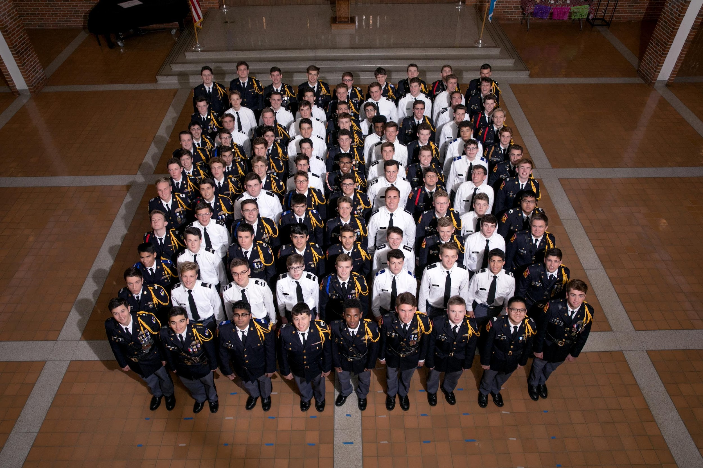
CLASS OF 2023 GROUP PHOTO
SIX-YEAR “VETERAN” PHOTO
Class A with Blouse Coat
In School – BE PRESENT!
During Community Time

Slide 23
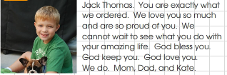
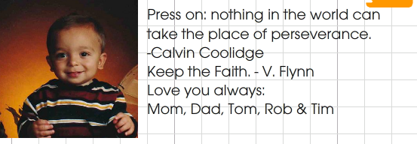
SENIOR SQUARE BABY PHOTO
PERSONALIZED MESSAGE
Both are due on January 15
Use the link on the Senior Information page. (Available Dec. 1)
Photo File Name: JPEG with Son’s Name in File Name
Message: no more than 30 words

Slide 24
FORMAL SENIOR PORTRAITS
DECEMBER
15-minute individual appointment for each senior
Avoid appointments this week
Schedule to be published by November 1
In school during study hall, military or community time
Class A with blouse coat – remember all medals
Haircut – plan ahead
No swapping appointments
Choose yearbook pose by January 15 – or it will be chosen for you
Limited yearbook pose options
Available for purchase (optional)
All information and links will be available on the Senior Information page.
Notes:
This is after cadet promotions so boys should have new ranks. Taken by professional photographer of The Photographers Guild. Some families also take more casual photos with another photographer. A number of poses will be taken and available for optional purpose. The yearbook pose, specifically, will be uniform to all years of cadet senior photos which you see in our hallways, holding the sword. An email will be sent in late October with the exact portrait schedule, photo viewing instructions and pricing information.

Slide 25
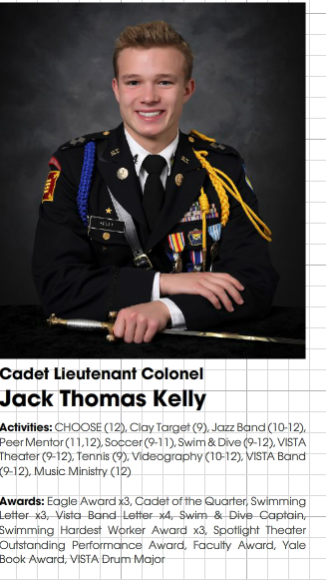
ATHLETICS & ACTIVITIES
Link available February 1, 2023
Due by April 1, 2023
STA only, not external awards or sports
Notes:
The form will be sent to BOTH parents and senior. This is not a college application or job resume. It is for only STA official activities. Disregard the grid lines shown in this example.

Slide 26
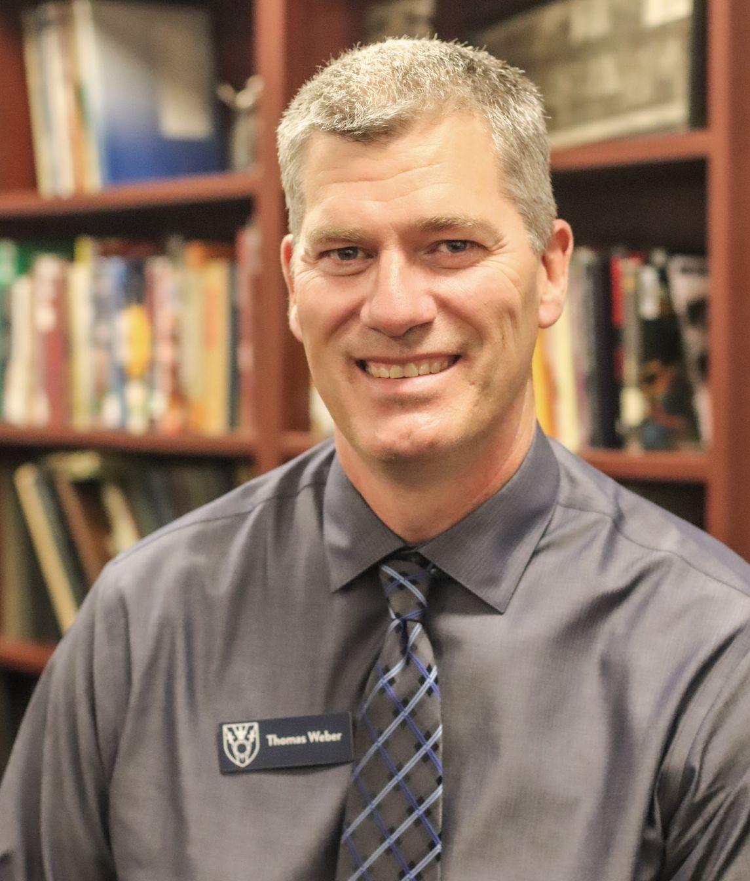
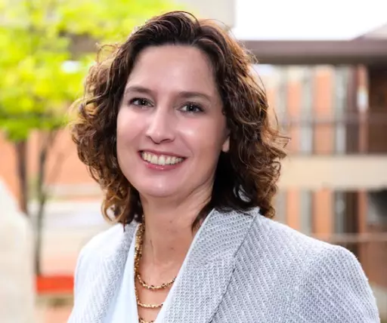
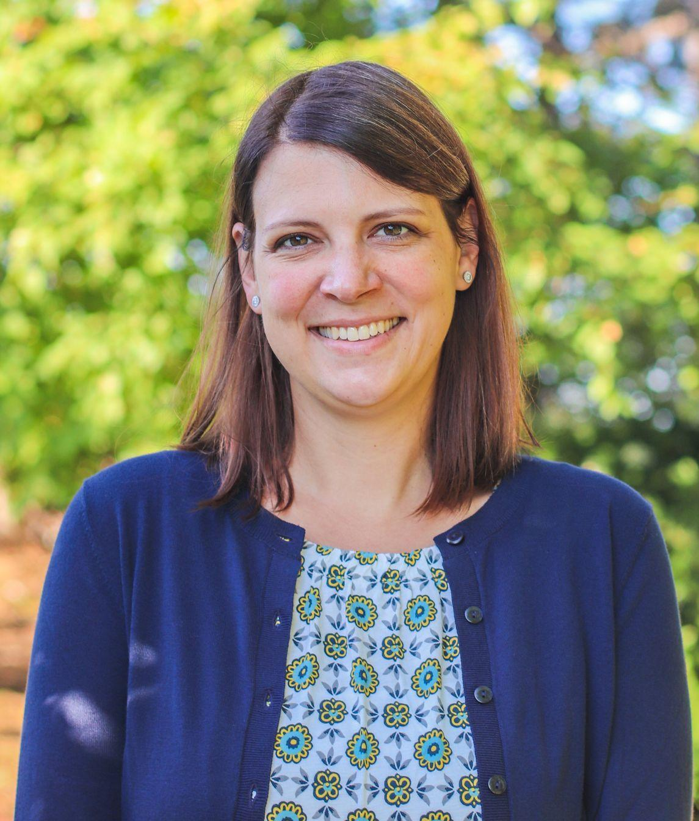
YEARBOOK MODERATORS
Questions?
Tom Weber Lisa Deyak Sara Krivak
tjweber@cadets.com ldeyak@cadets.com skrivak@cadet.com
All information and links will be available on the Senior Information page.

Slide 27
MOTHER’S CLUB

Slide 28
Father’s Club

Slide 29

Nobis
(For Us)
Pro eo
(For Me)
Pro ego
(For Him)

Slide 30
2022-2023 STA FATHERS’CLUB: FOR HIM, FOR ME, FOR US
July
Aug
Sept
Oct
Nov
Dec
Jan
Feb
Mar
Apr
May
FC Leadership
FC General Assembly
Kickoff
Group
Hockey Night
Military Ball
Smoker
School Functions
Middle School
Tailgate
(9/30)
Grandparent’s
Day
Cadet Classic
Basketball Tour.
Parent-Teacher
Conferences
New Parent Info
JROB Wrestling Tour.
FC Mega-Events
Trivia Night
Mother-Son
Dance
Father-Son
Banquet
Military Ball
Valet
Father-Son Masses
Mass
(9/2)
Mass
(10/7)
Mass
(11/4)
Mass
(12/2)
Mass
(2/3)
Mass
(3/3)
Mass
(5/5)
TEAM Spotlights
(Parents of Captains)
Football (Kickoff)
3A Golf
Football (x3)
Cross-Country (9/1)
Football (x3)
Soccer (10/6)
Football (x2)
Wrestling
Basketball
Swimming
Baseball
Lacrosse
Track

Slide 31
College Counseling
Ms. Norma Gutierrez, Director of College Counseling
Mr. Casey Erickson, Associate Director of College Counseling
Mr. James Lund, Scholarship and Career Counselor

Slide 32
The College Application Process
Research! Every college’s process is different:
        Interviews, self reporting grades/test scores, college/major
Which application to use? When to submit?
Connect with the Admissions Rep
Adding your College Counselor as an Advisor to the Common App (two step process)
Sharing essays
We recommend submitting applications at least 72 hours prior to the application deadlines.

Slide 33
The College List and Application Strategy
A well-rounded list of colleges that include "REACH," "LIKELY," and "TARGET" schools.
Decide if you plan to apply Early Decision, Early Action or Regular Decision.
Being thoughtful with the college applications and personal statements.
Strategically fill out the Activities section.

Slide 34
Testing at Saint Thomas Academy
SAT: October 12th Click here to register
ACT: October 22nd register at ACT.org by September 16 to avoid late fees – Saint Thomas Academy site code: 230600

Slide 35
Reminders
Check Naviance to ensure your ‘Colleges I am Applying to” is up-to –date.
Complete the surveys (both student and parent)
Reconnect with teachers regarding letters of recommendations.
Keep track of deadlines!

Slide 36
Send Test Scores or Do Not Send Test Scores…….
Most colleges are test-optional and some are test-blind, even fewer are test-flexible
Test-optional policy, colleges still welcome test scores from students who choose to submit them and consider them a valuable data point and part of the review process if testing is available. At the same time, they are confident in reviewing a file without a test score and still rendering a fair decision—in other words, students without scores are not disadvantaged.
Test Blind, it means they will not consider standardized testing at all. Even if you have a 36 on the ACT, if you send it to them, they will not consider it as a part of your file. Test-blind policies are far rarer than test optional. Notable schools with test-blind policies include University of San Diego, California System, Catholic University, and Loyola University New Orleans.
Test Flexible Allows students to submit a variety of standardized test scores. This can include SAT/ACT scores, but it can also include AP (Advanced Placement) tests, or PSAT. At some colleges, students can submit a writing sample, portfolio, or additional letters of recommendation. University of Michigan and Purdue prefer to see some form of testing results.
FairTest

Slide 37
After the applications are sent, then what?
Request transcript on Naviance
Check email!
Set up your Application Tracker
College Scholarships with separate applications
Honors Programs
Housing Applications
Stay in contact with Admissions Representatives- when appropriate

Slide 38
What we are messaging to your student
Stay in contact with your College Counselor
Social media presence
Stay on track with grades and stay involved in co-curricular activities
Senior year grades do matter!
An updated transcript will be sent to all colleges in January

Slide 39
College Campus Visits
Plan Ahead!
                * Weekend and Special Visit Days fill up fast!
        * Communicate with teachers
        * Complete the purple College Visit Form

Slide 40
Paying for College
FAFSA https://studentaid.ed.gov/sa/fafsa
CSS profile https://cssprofile.collegeboard.org/
Outside scholarships:
  James Lundberg: jlundberg@cadets.com 651.683.1528
  Naviance: Colleges Tab; Scholarships and Money
Financing College Virtual Event: October 26th

Slide 41
Have More Questions?
Monthly coffee chats – October 7th
One-on-one appointments with college counselors

Slide 42
Thank you for coming!

