Slide 1
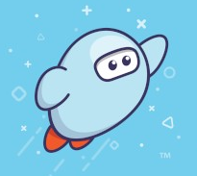
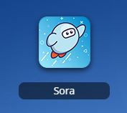

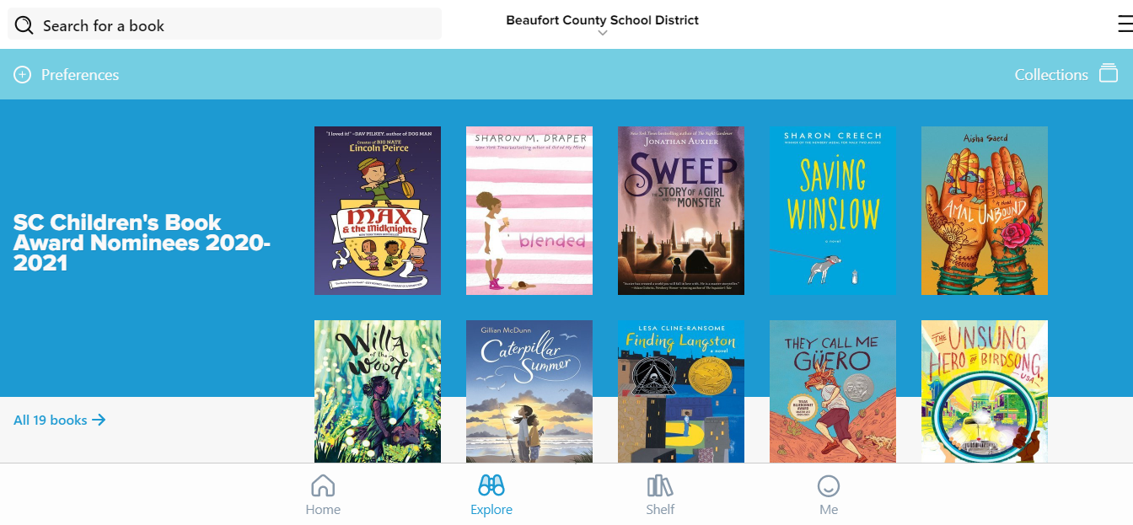

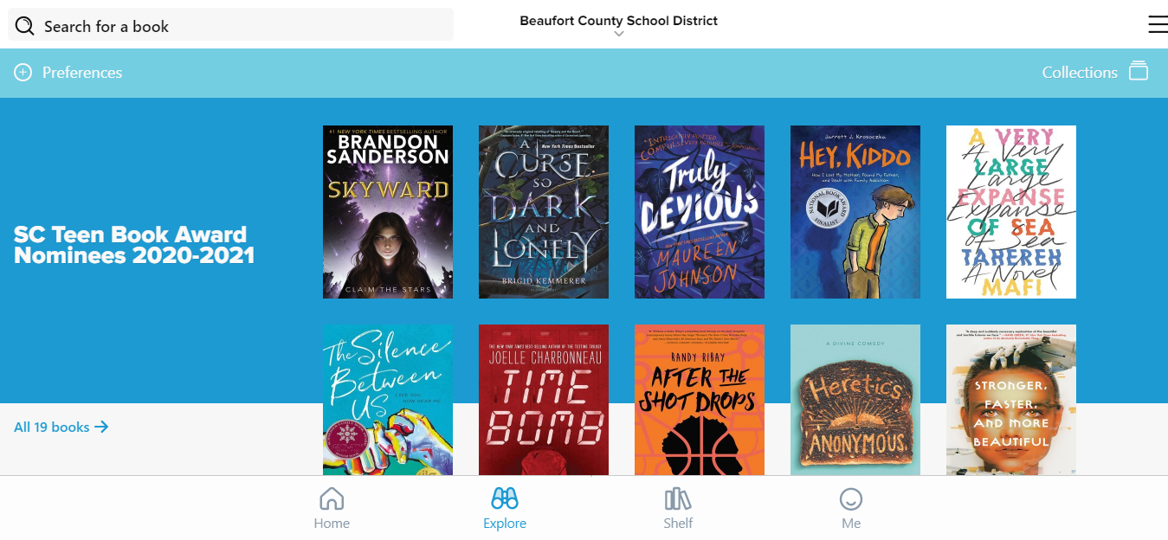
Student Guide to Sora
(formerly known as Overdrive)
Log into Sora (There are 2 different ways!)
On a computer,
log into ClassLink,
then click the Sora icon (not the old Overdrive icon.)
On a smartphone or tablet, install the Sora app, then login with your ClassLink login info.
Can’t remember your ClassLink login info? Ask your teacher!
Student logins look like this: cooperoa0809@beaufortschools.org
If you’re using the app, you may
need this setup code: beaufortsc
Browse or search for an eBook or Audiobook!
Looking for a specific book? Search for it by title or author.
Under Preferences, you can filter by language, format (eBook vs audiobook) & availability.
The Collections tab features curated lists of award nominees, holiday-themed books, and more!
Younger students may especially love our collection of “Read-Along” (narrated) eBooks. You can find that list under the Collections tab!
Click Explore to browse. Just keep scrolling down to discover more books!
Different grade levels have access to different books!
A sample list of books for
elementary students
A sample list of books for
high school students

Slide 2
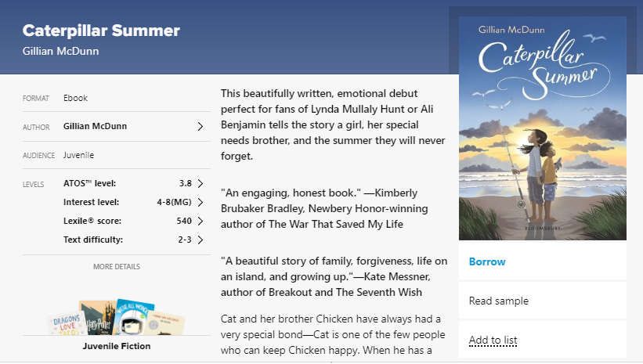
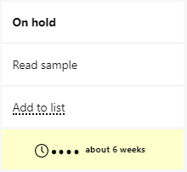
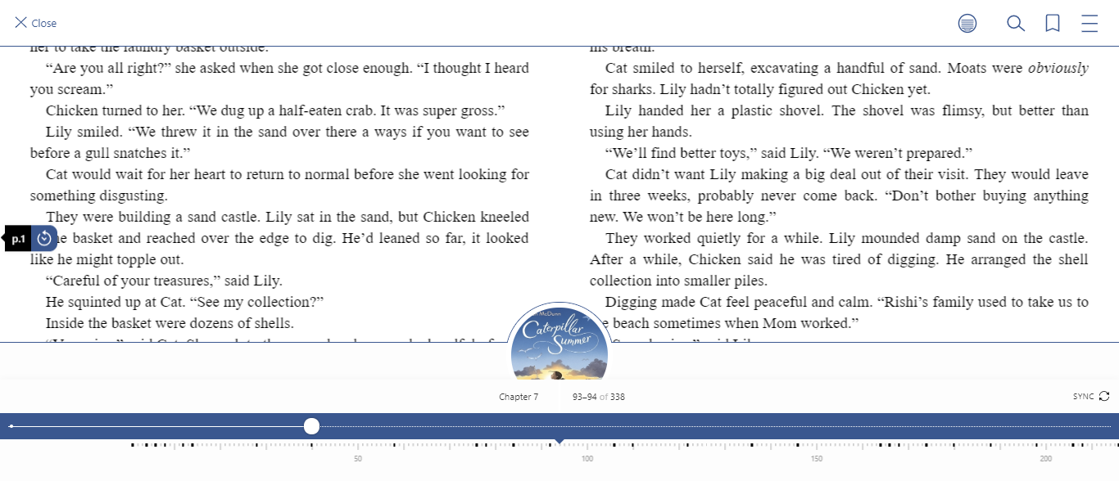
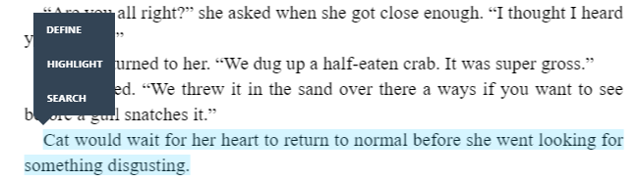
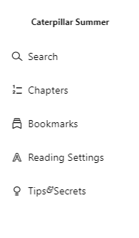

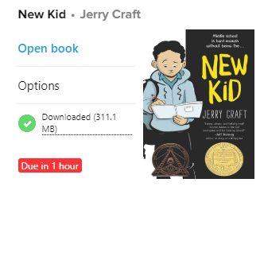

Click on a book to find out more about it.
Ready to read? Just click “borrow” and the book will automatically open.
Not sure about the book yet? Read a sample first!
Sora is a shared,
districtwide library,
and we only have a
certain number of
copies per book.
Sometimes, you may
need to place a hold.
Want to read the book, but later? Add it to your list!
Want a book we don’t have? Ask your School Librarian - we may be able to add it!
Use the available tools to help you read
Click and hold on a word to look it up in the dictionary.
Or, you can highlight a passage and then add your own notes!
Open up the menu to change your font size, add bookmarks, or search for a word/passage.
Click or tap in the center of the page to open up your reading tools
Under “Reading Settings,” you can change your background color & font size.
There’s even a dyslexic-friendly font!
Return it when you’re done!
Don’t worry, there are no late fees with Sora books. Books automatically return themselves 2 weeks after you check them out! However, we encourage you to return books as soon as you’re finished with them so other students can read them too! To return a book, just click Shelf and and then click Options under the book you’re ready to return. Then, click Return!

Slide 3
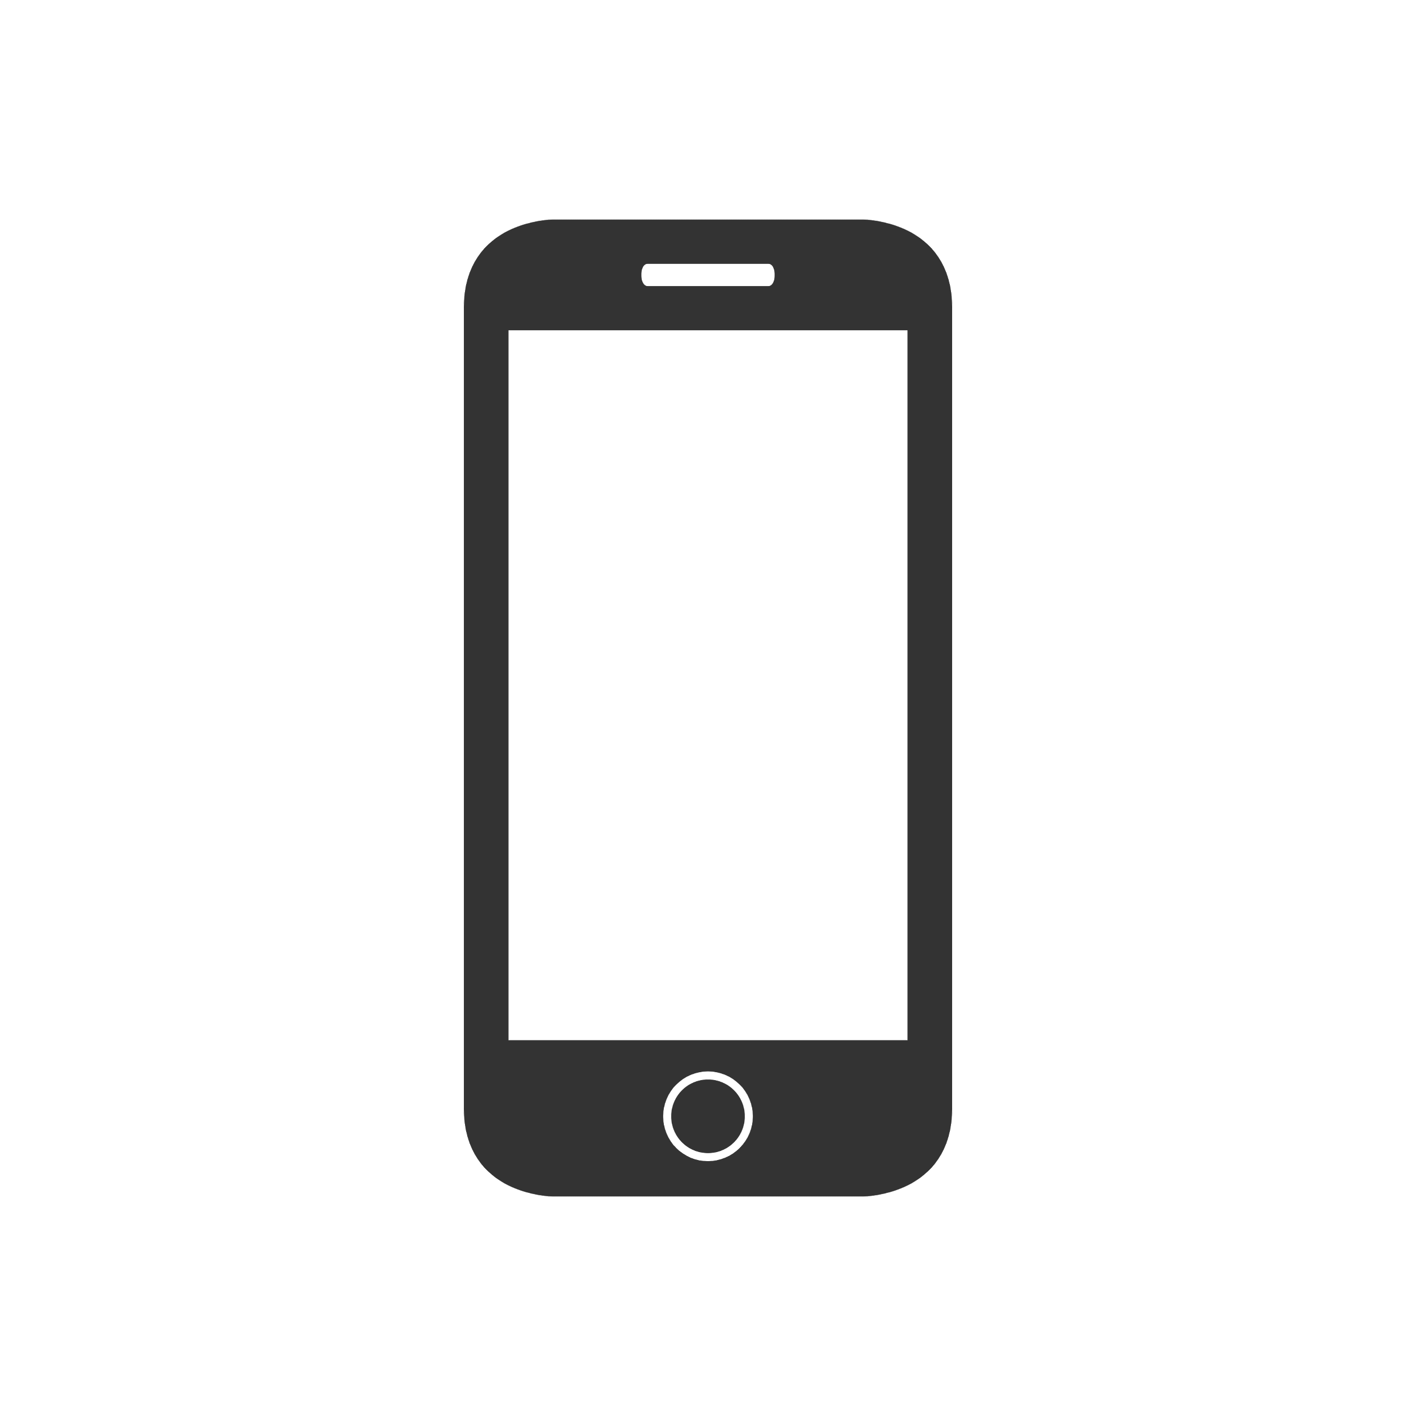
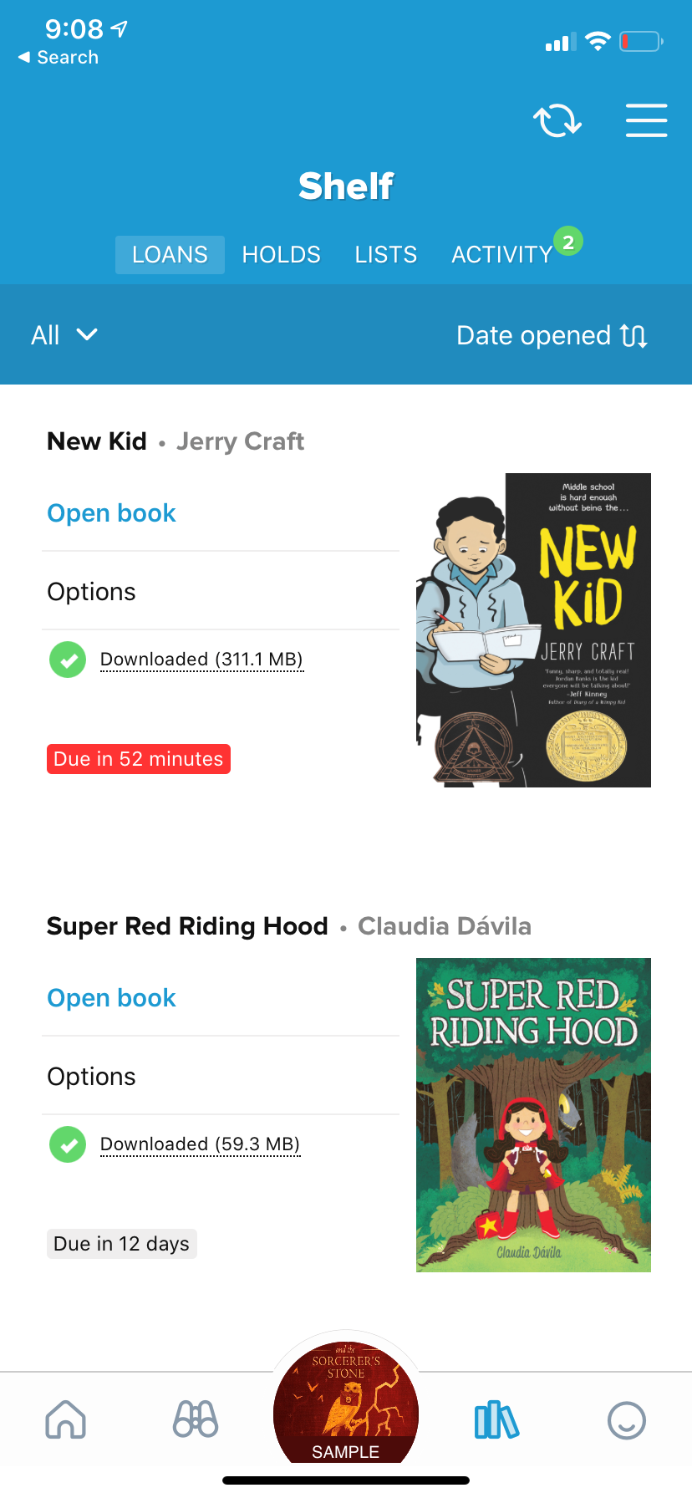

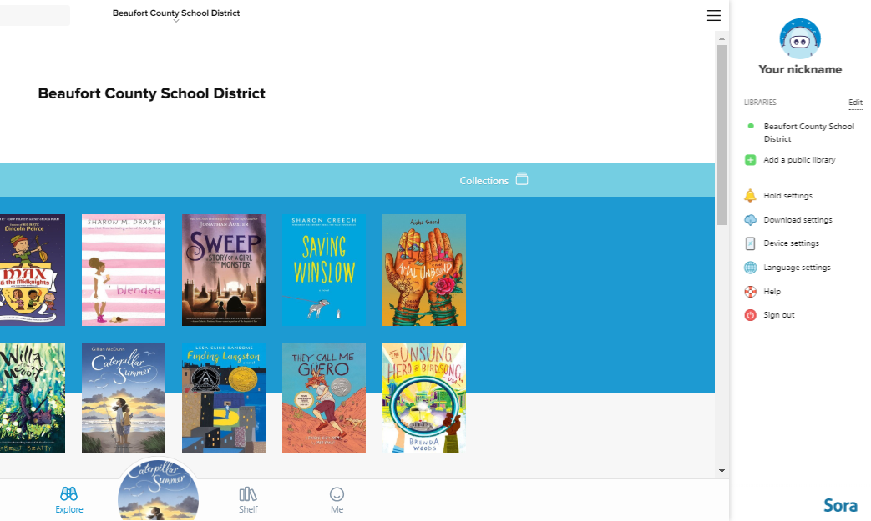
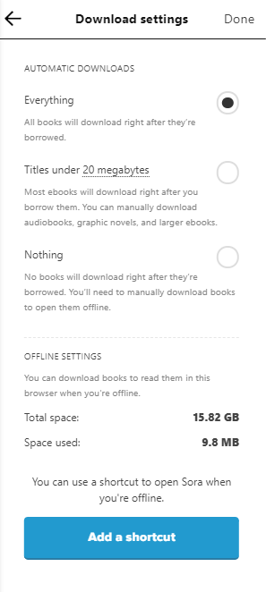

No Internet? No problem!
Accessing Sora eBooks/Audiobooks Offline
If you’re using the SORA app on a smartphone or tablet,
books you checkout will automatically download to
the SORA app anytime you’re connected to WiFi.
This makes it easy to read your books on-the-go on the bus, in the car, or even on the beach!
If you click the
menu button then download settings, you can adjust your own download settings, including the option to download books using your cell phone’s data plan.
If you’re using the Sora app on a computer, books you checkout will also automatically download to your computer while you’re connected to WiFi (like at school.)
But to access the books offline, you’ll first need to add a desktop shortcut for Sora by clicking the menu button, then all settings > downloads > add a shortcut.
After adding the shortcut, just open it from your desktop to access your downloaded books!

