Slide 1
CCB PROPOSAL GUIDE
OPRF CULTURE, CLIMATE AND BEHAVIOR COMMITTEE
NOVEMBER 2017

Slide 2
DEVELOPING A PROPOSAL
Proposals can either build on prior CCB work, or present a new recommendation to consider along the key areas (Student and Families, Faculty and Staff, Community, and Tardies)
A proposal should be S.M.A.R.T.
Specific
Measurable
Actionable
Realistic
Time-bound
In alignment with the OPRF strategic plan, each proposal should also include:
Action steps
Deliverables
Target Completion Date
Owner
2

Slide 3
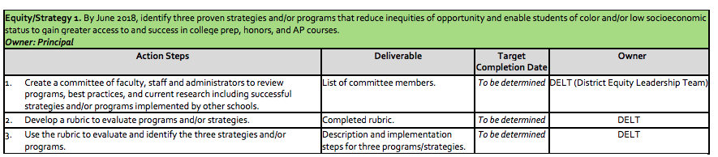
EXAMPLE OF A SMART GOAL:
OPRF STRATEGIC PLAN
A proposal should be SMART
Specific (”strategies…that reduce inequities of opportunity”)
Measurable (“identify three programs….”)
Actionable (3 defined action steps)
Realistic (Deliverables are clear and easy to understand)
Time-bound (”By June 2018…”)
3

Slide 4
DEVELOPING A PROPOSAL:
KEY CONSIDERATIONS
Is there research that supports this idea as being effective or a best practice?
Which current OPRF initiatives (if any) are aligned with this idea?
Who at OPRF would be responsible for implementation?
What training would be necessary for successful implementation?
Which school policies and procedures would need to change?
How would we measure progress and success?
Where does this proposal align with the OPRF Strategic Plan?
4

Slide 5
CCB (2016 – 17):
DRAFT PROPOSALS
Student and Family Voice and Belonging
Create and adhere to schedule of adult volunteers to act as school-day welcoming greeters.
Promote student voice by soliciting regular feedback from students concerning the school’s climate.
Faculty and Staff Voice and Innovation
Potential creation of ombudsperson to provide “whistleblower protection” to those reporting issues affecting culture and climate.
Community Voice and Connections
Engage student and family voice to improve equity across all demographics through town halls, assemblies, family visitation days, and regular mechanisms for providing feedback to the Administration and Board of Education.
Student Tardiness
Assessment of practices, policies, and tools related to tardy management
5

Slide 6
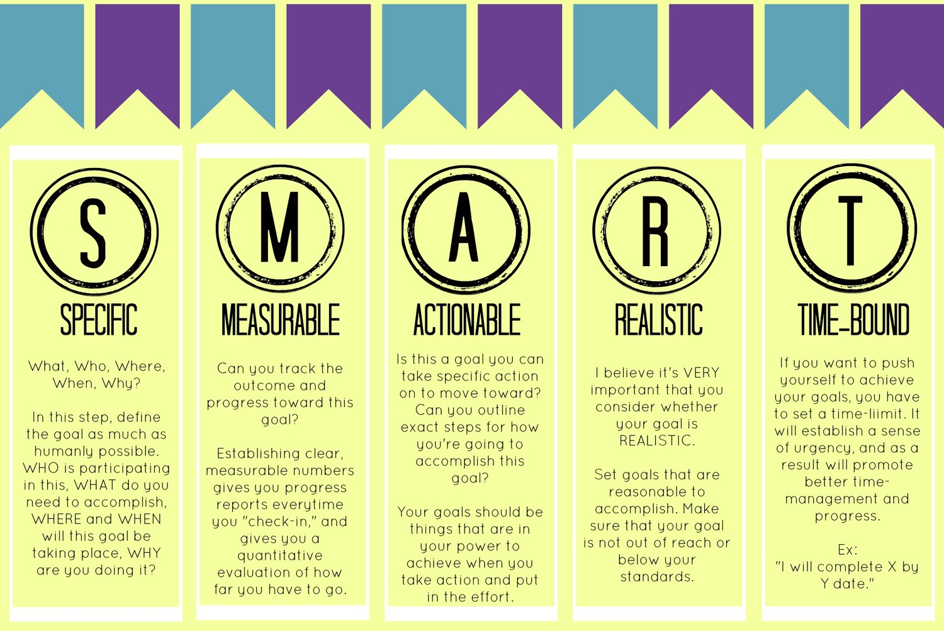
S.M.A.R.T. QUICK REFERENCE OVERVIEW
Source: http://microbesandmuscles.com/blog/2016/2/17/10-ways-to-be-a-better-goal-setter

