Slide 1

ESSER/ARP ESSER Grant Funding
Hampton Township School District Proposed Grant Proposal
Stakeholder Feedback Plan

Slide 2
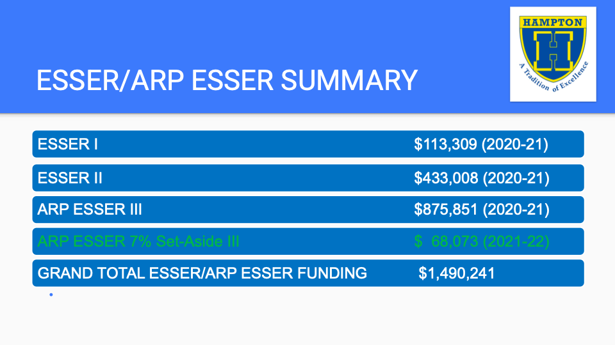

Slide 3
HTSD Proposed Plan
ARP ESSER Allocation
The District plans to use the $875,851 ARP ESSER funding to provide additional in-person high-dosage tutoring in reading and math instruction for elementary and middle school students who have been identified through a universal screening and data analysis. Students' progress will be actively monitored and evaluated through ongoing formative assessments including the STAR 360 assessment and interventions will be intensified or reduced based upon ongoing and systematic data analysis from multiple data points. Because all students will be screened for services, these supports will specifically address the needs of students’ most impacted by the pandemic, regardless of identified grouping. As students are identified, special attention will be brought to students who have missed the most in-person instruction or who did not participate in remote instruction when offered, to ensure that all students, regardless of group or backgrounds, will have access to support based upon academic need.

Slide 4
ARP ESSER 7% Set Aside HTSD Grant Funding
Specific Spending Required Domains
Total Grant Amount | $68,073
Learning Loss Allocation for SEL | $14,587
Learning Loss Allocation for SEL PD | $4,862
Learning Loss Allocation for Reading | $3,890
Remaining Learning Loss Allocation | $25,284
After School Programming Support | $9,725
Summer School Programming Support | $9,725

Slide 5
HTSD Proposed Plan
Learning Loss Allocation
The district is proposing to use $25,284 of the grant funding to purchase a digital instructional resource for teachers to use with our students that would benefit from skill-building in reading, written language and mathematics. We will use $3,890 of the grant funding to also support the purchase of a digital reading instructional resource to support students with skill development delays in reading. We have selected these digital resources as they align with our curriculum and with the standards for evidence-based interventions.

Slide 6
HTSD Proposed Plan
Summer & After-School Programming
HTSD will use $9,725 of the grant funding for instructional resources to support an elementary school summer program during August 2022 focusing on supporting students experiencing academic delays. HTSD will use the additional $9,725 of the grant funding for instructional resources to support after-school programs focused on supporting students with academic delays during the 2022-23 school year.

Slide 7
HTSD Proposed Plan
Social Emotional Learning Allocation
HTSD will use $14,587 of the grant to purchase a universal screening tool.
The universal screening tool will be used by school based data teams to provide supports for students. We are in the process of piloting this tool and if it is determined to be effective it would be implemented in the 2022-23 School Year
HTSD will use $4,862 of the grant funding to coordinate and provide professional development for district staff related on grant mandated mental health related topics .

Slide 8
Stakeholder Feedback on Grant Plan
If you would like to provide feedback to the Hampton Township School District on the district’s grant plan, you may do so by clicking on the link below.
HTSD ESSER 7% Set Aside Grant Funding Feedback

