Slide 1
McCreary County School District
Staff Opening Day 2016-2017

Slide 2
Welcome & Introductions
Dr. Jason Creekmore

Slide 3
Drug & Alcohol Free Workplace
Mrs. Sunshine Canada

Slide 4
Drug-Free/Alcohol-Free Schools
03.13251 Certified Staff
03.23251 Classified Staff
Sunshine Canada

Slide 5
Drug-Free/Alcohol-Free Schools
Drugs, Alcohol and Other Prohibited Substances
District employees shall not manufacture, distribute, dispense, be under the influence of, possess or use, or attempt to purchase or obtain, sell or transfer any of the following in the workplace or in the performance of duties:
Alcoholic beverages;
Controlled substances, prohibited drugs and substances, and drug paraphernalia; and
Substances that "look like" a controlled substance. In instances involving look‑alike substances, there must be evidence of the employee’s intent to pass off the item as a controlled substance.
In addition, employees shall not possess prescription drugs for the purpose of sale or distribution.

Slide 6
Drug-Free/Alcohol-Free Schools
Authorized Drugs: Employees/volunteers who personally use or who are designated to administer to a student a drug authorized by and administered in accordance with a prescription from a health professional shall not be considered in violation of this policy.
Random Screening: The Board has established a random drug testing program for employees/volunteers in a safety sensitive position (All Staff of the McCreary Co. School District). Employee/volunteers will be notified when they are on the random pool for drug testing. Employees/volunteers must test on the day that drug testing takes place. If an employee/volunteer leaves school on the day of testing this could be considered an act of insubordination.

Slide 7
Drug-Free/Alcohol-Free Schools
Confidentiality : Appropriate measures shall be taken to protect confidentiality throughout the testing process and in the handling of test results. Access to drug testing results shall be restricted on a need-to-know basis to those persons in positions designated by the Superintendent.
Providing Documentation of a Prescription: Staff are not required to provide a prescription at the time of random drug testing. If a staff member has a positive drug screen it will confirmed by the Medical Review Officer. Staff will then be contacted to obtain additional information in regards to the prescription.

Slide 8
Drug-Free/Alcohol-Free Schools
2016/2017 Updates:
Random drug testing will take place at every school on a monthly basis for all staff.
Random drug testing will take place on a monthly basis for students at McCrery Central High School and McCreary Academy. A smaller student pool will be selected.
In case of a shy bladder, a saliva test will be preformed in place of a urinalysis screen for all staff and students participating in the random drug testing program.
03.13251 - Drug-Free/Alcohol-Free Schools (Certified)
03.23251 - Drug-Free/Alcohol-Free Schools (Classified)

Slide 9
District Tobacco Policy
Mr. Skip Jones

Slide 10
Use of Tobacco
03.1327
Foster “Skip” Jones

Slide 11
Definition of Tobacco Products and Tobacco Use
For the purposes of this policy, “tobacco product” is defined to include cigarettes, cigars, blunts, bidis, pipes, chewing tobacco, snuff, and any other items containing or reasonably resembling tobacco or tobacco products. “Tobacco use” includes smoking, chewing, dipping, or any other use of tobacco products.

Slide 12
Use of Tobacco
Use of Tobacco Prohibited
Tobacco use, including alternative nicotine products and vapor products, is prohibited twenty-four (24) hours a day, seven (7) days a week, inside Board-owned buildings or vehicles, on school owned property, and during school-related student trips.
Beginning with the 2015-2016 school year, McCreary County Schools shall become a 100% tobacco-free District and adhere to the following:
No staff member is permitted to use any tobacco product at any time, including non-school hours:
In any building, facility, or vehicle owned, leased, rented or chartered by the McCreary County School District;
on any school grounds and property, including athletic fields and parking lots, owned leased, rented or chartered by the McCreary County Board of Education; or
at any school-sponsored or school-related event on-campus or off-campus.
In addition, District employees, school volunteers, contractors or other persons performing services on behalf of the District also are prohibited from using tobacco products at any time while on duty and in the presence of students, either on or off school grounds.
Tobacco products may be included in instructional or research activities in public school buildings if the activity is conducted or supervised by the faculty member overseeing the instruction or research and the activity does not include smoking, chewing, or otherwise ingesting the tobacco product.

Slide 13
Tobacco Policy Cont.
Signage
Signs shall be posted in a manner and location that adequately notify students, staff, and visitors of the 100% tobacco-free schools policy.
Enforcement for Staff
Consequences for employees who violate the tobacco use policy shall be in accordance with personnel policies and may include verbal warning, written reprimand, or termination.
Opportunities for Cessation
The administration shall consult with the county health department and other appropriate health organizations to provide employees with information and access to support systems, programs and services to encourage them to abstain from the use of tobacco products.

Slide 14
Procedures for Implementation
The administration shall develop a plan for communicating the policy that may include information in employee handbooks, announcements at school-sponsored for school-related events, and appropriate signage in buildings and around campus. An enforcement protocol, which identifies consequences for staff who violate the policy, shall be created and communicated to all staff.
References:
OAG 81‑295
OAG 91‑137
KRS 160.290
KRS 160.340
KRS 438.050
P.L. 114-95, (The Every Student Succeeds Act of 2015)
Related Policy:
09.4232

Slide 15
Harassment & Discrimination
Dr. Clint Taylor

Slide 16
Harassment / Discrimination 03.262
Dr. Clint E. Taylor

Slide 17
Harassment / Discrimination –Slide 1
Definition – Harassment / Discrimination is unlawful behavior based on race, color, national origin, age, religion, sex, genetic information or disability of an employee involving intimidation by threats of or actual physical violence; the creation, by whatever means, of a climate of hostility or intimidation, or the use of language, conduct, or symbols in such manner as to be commonly understood to convey hatred or prejudice.
Prohibition – is prohibited at all times on school property and off school grounds during school – sponsored activities. District staff shall provide for a prompt and equitable resolution of complaints concerning harassment / discrimination.

Slide 18
Harassment / Discrimination – Slide 2
Disciplinary Actions – employees who engage in harassment / discrimination of another employee or a student on the basis of any of the areas mentioned above shall be subject to disciplinary actions including but not limited to termination of employment.
Guidelines – Employees who believe they or any other employee, student, or visitor is being or has been subjected to harassment/discrimination shall, as soon as reasonably practicable, report it. In each school building, the Principal is the person responsible for receiving reports of harassment/discrimination at the building level. Otherwise, reports of harassment/discrimination may be made directly to the Superintendent.

Slide 19
Harassment / Discrimination – Slide 3
Guidelines Continued - Additionally, if sexual discrimination or harassment is being alleged, reports may be made directly to the District Title IX Coordinator. Complaints of harassment/discrimination, whether verbal or written, shall lead to a documented investigation and a written report.
In applicable cases, employees must report harassment/discrimination to appropriate law enforcement authorities in accordance with law.¹ KRS 158.156
Superintendent investigation timeline.

Slide 20
Harassment / Discrimination – Slide 4
Prohibited Conduct examples include but are not limited to:
Any nicknames, slurs, stories, jokes, written materials or pictures that are lewd, vulgar, or profane and relate to any of the protected categories listed in the definition of harassment/discrimination contained in this policy;
Unwanted touching, sexual advances, requests for sexual favors, and spreading sexual rumors;
Instances involving sexual violence;
Causing an employee to believe that he or she must submit to unwelcome sexual conduct in order to maintain employment or that a personnel decision will be based on whether or not the employee submits to unwelcome sexual conduct;

Slide 21
Harassment / Discrimination – Slide 5
Prohibited Conduct examples include but are not limited to:
Implied or overt threats of physical violence or acts of aggression or assault based on any of the protected categories;
Seeking to involve individuals with disabilities in antisocial, dangerous or criminal activity where they, because of disability, are unable to comprehend fully or consent to the activity; and
Destroying or damaging an individual's property based on any of the protected categories.
Confidentiality - District employees involved in the investigation of complaints shall respect, as much as possible, the privacy and anonymity of all parties involved.

Slide 22
Harassment / Discrimination – Slide 6
Appeal - Upon the completion of the investigation and correction of the conditions, any party may appeal in writing any part of the findings and corrective actions to the Superintendent. If a supervisory staff member is an alleged party, provision shall be made for addressing the complaint to a higher level of authority. Failure by employees to report, notify, and/or initiate an investigation of alleged harassment/discrimination as required by this policy or to take corrective action shall be cause for disciplinary action.
Retaliation Prohibited - No one shall retaliate against an employee or student because s/he submits a grievance, assists or participates in an investigation, proceeding, or hearing. Upon the resolution of allegations, the Superintendent shall take steps to protect employees and students against retaliation.

Slide 23
Grievance Procedures
Rebecca Blakley

Slide 24
Grievance Procedures –Slide 1
The Superintendent shall develop specific grievance procedures to include, but not be limited to, the opportunity for grievances to be addressed and resolved at each level of the chain of command from the point of origin, time limitations for the filing and the appeal of a grievance, and procedures for the orderly review and appeal of each individual grievance.
Grievances are individual in nature and must be brought by the individual grievant.
The Board shall take action only on those grievances that fall within the authority of the Board.

Slide 25
Grievance Procedures – Slide 2
General Grievances
The Board will hear grievances only after unsuccessful resolution by the employee's supervisors.

Slide 26
Grievance Procedures – Slide 3
Personnel Issues
The Board will not hear any grievance concerning personnel actions taken by the Superintendent/designee, unless the grievance is based on an alleged violation of constitutional, statutory, regulatory, or policy provisions.

Slide 27
Grievance Procedures – Slide 4
The Board shall not hear grievances concerning simple disagreement or dissatisfaction with a personnel action.
Exception
Harassment/Discrimination allegations shall be governed by Policy 03.162.

Slide 28
Contract Fulfillment, Attendance, & Timesheets
Mr. Stuart Shepherd

Slide 29
PERSONNEL 03.121 AP.22
‑ Certified Personnel ‑
Personnel Documents
TEACHING CERTIFICATE: An official copy of the certified staff member's certificate or a cover letter that is valid for the current year from the Department of Education, Division of Certification.
I-9 FORM: Required by federal law to determine eligibility for employment in the United States.
SSA-1945: The Social Security Administration requires that this form be used to inform, prior to employment, new certified employees that will participate in KTRS that the position is not covered by Social Security.
CAFETERIA BENEFIT PLAN APPLICATION, if applicable: Must be completed by every full time employee of the School District. (This is usually done shortly after the opening of school by a person who visits each school to have the forms completed.)

Slide 30
Supervision
PERSONNEL 03.132
‑ Certified Personnel ‑
Supervision
Immediate Supervisor
Supervision shall be provided for all certified employees. Employees shall be informed as to whom their immediate supervisor is and to whom they will be responsible.
Job Description
Each employee shall be provided a job description, which shall delineate all essential functions and the general duties and responsibilities of the position held by the employee. Job descriptions shall not be considered all‑inclusive descriptions of the job but shall indicate the general parameters of the duties and responsibilities of the position. The immediate supervisor may, as needed, assign other reasonable duties to the employee.
Reference:
KRS 160.290(1)
Related Policy:
03.133
Adopted/Amended: 1/14/1993
Order #: 5079

Slide 31
Certified and Classified
PERSONNEL 03.133
‑ Certified Personnel ‑ Classified-3.23
Duties
All employees are expected to use sound judgment in the performance of their duties and to take reasonable measures to protect the health, safety, and well-being of others, as well as District property.
Job Description
Prior to the authorization of any personnel position in the District budget, the Superintendent, collaborating with other District authorities with personnel assignment responsibilities, shall develop, for Board approval, a job description which establishes all essential functions of the position. The description shall encompass supervision responsibilities, completion of records and reports, and achievement of professional goals identified to enhance student achievement and help the school and/or District meet goals established by statute and/or Board policy. Certified personnel shall also be held responsible for cooperation with students, professional associates, parents, staff, and community groups.

Slide 32
Planning Periods/ After School Activities
Content PERSONNEL 03.126
‑ Certified Personnel ‑
Planning Time
Provision of Planning Time
In schools not operating under SBDM, the Principal shall cause class schedules to be developed that will provide planning time for teachers. In other schools, the council shall provide for planning time through its policies for assignment of instructional and non-instructional staff time and determination of the schedule of the school day.
Due to emergencies ‑‑ lack of substitutes or other unusual situations ‑‑ teachers may be required to supervise classes or activities during their planning period.
Use of Planning Periods
The planning period shall be used for appropriate duties, such as: instructional preparation; conferring with parents, students, supervisors and administrators; studying and maintaining records; and other duties as specified by the Principal. It may not be used for personal business or teacher organization activities.
Adopted/Amended: 8/22/2000
Order #: 7139
Principal may request and keep staff after school for meetings and school activities that require coverage to include those of ballgames, musicals, Academic Meets and other items as created and assigned by board of education and site base councils as provided in a Certified staff member in fulfillment of their contract.

Slide 33
Attendance
PERSONNEL 03.123
‑ Certified Personnel ‑
Leaves and Absences
Approval
Authorization of leave and time taken off from one’s job shall be in accordance with specific leave policy. Absence from work that is not based on appropriate leave for which the employee is qualified may lead to disciplinary consequences, up to and including termination of employment.
Leave without pay may be granted by the Board provided the leave is for educational or professional purposes, or for illness, maternity, adoption of a child or children, or other disability. Requests shall be made in writing and shall be submitted to the Superintendent.
Time Off During the Day
Full-time certified employees may be allowed time off during the day. The employee shall give his/her immediate supervisor advance notification for the need of time off. Such time shall be taken in no less than quarter-day increments and shall be charged against the appropriate leave account—i.e., personal, sick, or emergency leave. (See Policies 03.1231, 03.1232, and 03.1236.)
The immediate supervisor shall ensure that the employee’s assigned duties and responsibilities are covered during the employee’s absence.

Slide 34
PERSONNEL 03.1325
‑ Certified Personnel ‑
Disrupting the Educational Process
Any employee who participates in or encourages activities that disrupt the educational process, whether on school property or at school-sponsored events and activities, may be subject to disciplinary action, including termination of contract.
For purposes of this section, behavior which disrupts the educational process shall include, but not be limited to:
Conduct that threatens the health, safety, or welfare of others;
Conduct that may damage public or private property, including the property of students or staff;
Illegal activity;
Conduct that interferes with a student's access to educational opportunities or programs, including ability to attend, participate in, and benefit from instructional and extracurricular activities; or
Conduct that disrupts delivery of instructional services or interferes with the orderly administration of the school and school-related activities or District operations.
Other Claims
When a complaint is received that does not appear to be covered by this policy, administrators shall review other policies that may govern the allegations, including but not limited to, 09.422 and/or 03.162, which addresses harassment/discrimination allegations.
References:
KRS 160.290
KRS 161.790
Related Policies:
03.113, 03.162, 03.17, 09.422, 10.21
Adopted/Amended: 8/27/2001
Order #: 7308

Slide 35
Timesheets
MCCREARY COUNTY BOARD OF EDUCATION
PAYROLL CALENDAR - 24 PAYS
CERTIFIED, CLASSIFIED AND SUBSTITUTE
FISCAL YEAR 2016-2017
*Employees, other than 240 day employees, whose contract salary is divided in 24 equal payments will receive two payroll checks in the month of July 2016 and two payroll checks in the month of August 2016 for the services provided during the 2015-2016 Academic school year.
Coaching payments will be paid by one check upon completion of the regular season with the exception of Head coach positions. The salary for
these positions will be divided equally through the year.

Slide 36
Time Sheets and Absence Cards are due to the School Attendance Clerk on the School Calendar Closing Day for all 185 or less day employees.
General Rule for pay date is: The payroll date will be the 15th and 30th of each month. If the 15th or 30th falls on Saturday or Sunday, pay day will be Friday. If the additional gross pay is greater than or equal to $750 a separate check will be issued. If the additional gross pay is less than $750 the earnings will be included in the regular payroll check.
All stipend, referee, extra duty time sheets/standard invoices, etc. must be turned in with the payroll reports on the due date for each pay period and checks will be issued on the same payroll date. If time sheets/standard invoices are not turned in by the due date, payment will not be made until the next pay date.
Timesheets that are incomplete and/or not approved will be returned to the attendance clerk unprocessed.

Slide 37
Sick Leave Donation
Must follow Policy 03.1232 for certified employees
03.2232 for classified employees
District policy that employees participate in direct deposit – See Crystal in payroll for direct deposit information

Slide 38
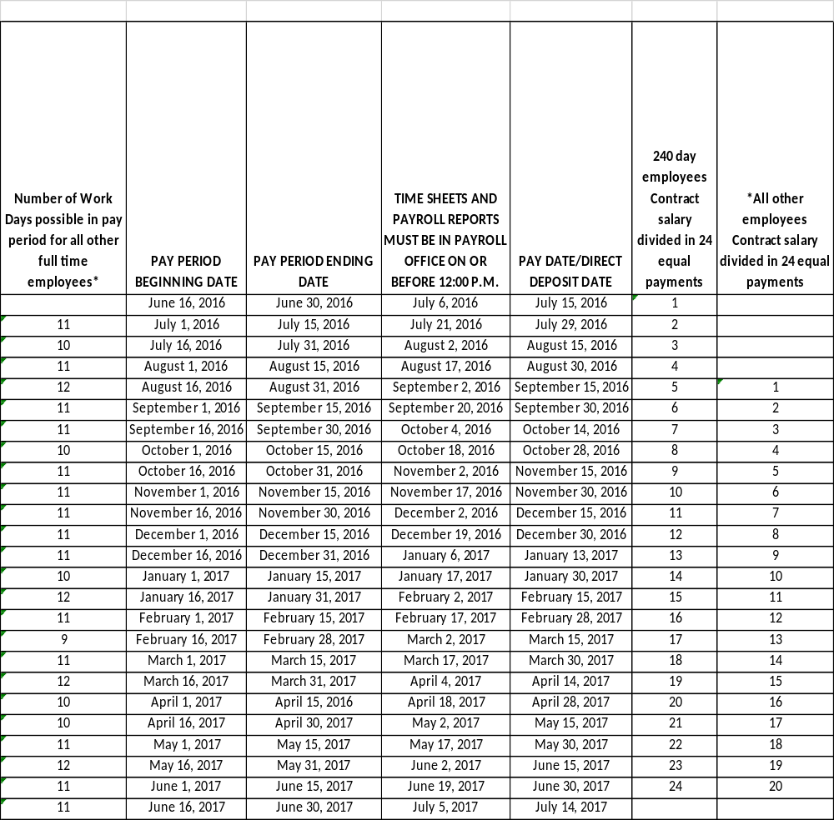
MCCREARY COUNTY BOARD OF EDUCATION
PAYROLL CALENDAR - 24 PAYS
CERTIFIED, CLASSIFIED AND SUBSTITUTE
FISCAL YEAR 2016-2017

Slide 39
Acceptable Use Policy: Technology & Networking
Mr. Jeff Terry

Slide 40
AUP , Wireless Network, Personal Devices, BYOD,
Data Security & Privacy
Notes:
Nothing to add here.

Slide 41
Acceptable Use Policy - AUP
AUP Has not changed other than the Student Publishing permission form—
This was the last page of the AUP document
Now using the same procedure for all Student Publication Consent Form which includes social media
09.14 AP251
NOTE: Teachers and Staff may not post pictures , recordings, videos, or any student information on his/her personal social media site such as Facebook, Twitter, etc.
As per Board Policy, Student information may only be posted on a official , school registered social media site
Notes:
Nothing to add here.

Slide 42
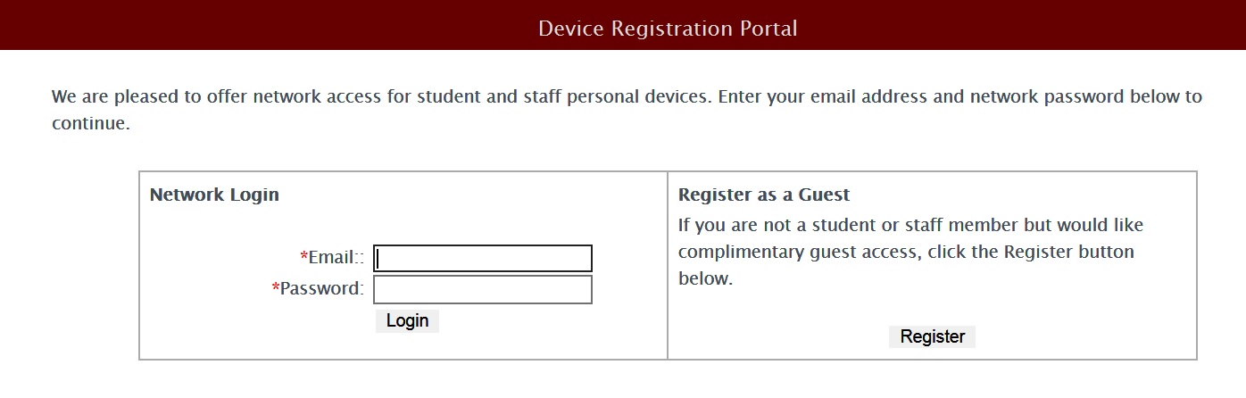
updated Wireless Network district registration Splash Screen

Slide 43
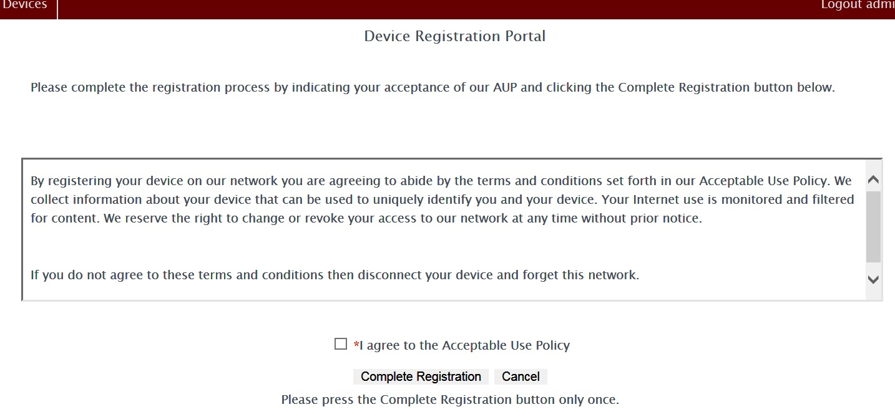
updated Wireless Network district registration Step 2

Slide 44
updated Wireless Network multiple levels of access and speed
The Guest Account -- active for 24 hours with a limited speed - Internet Only access
AdvanceD Guest - active for 24 hours with higher speed; We must upgrade the Guest account in our management tool – Internet Only access

Slide 45
updated Wireless Network multiple levels of access and speed
Personal own Device - A device registered via the district registration Splash Screen using your full email address and password; stays active unless not seen on network for 90 days; full Internet Bandwidth; each user may have 4 personal Owned devices registered at one time - Internet Only access
District own devices- A device owned by district; oNe time registration on the District Registration Splash Screen and we move the device to “District Owned” in our management tool; stays active until removed from the management tool; full Internet and access to network resources such as servers and printers

Slide 46
Personal Owned Devices and Student Confidentiality and publication
Though personal owned devices are allowed on the network– one may not use a personal owned device to record, take pictures, or video students without permission of Superintendent.. Board Policy 03.13214
An exception would be in a Public arena such as sporting event or public performance
As per Board Policy, Student information may only be posted on a official , school registered social media site

Slide 47
Bring Your Own Device --BYOD
Board has adopted a BYOD policy for staff and students
Policy Is flexible so that principals, teachers, and staff MAY allow personal devices in the classroom or “NOT” based on instructional and curriculum needs.
Recommend to start slowly
Recommend ByoD traffic light system- Red – no devices; yellow- as directed; Green- as needed

Slide 48
Data Security and Privacy Relevant Legislation
Federal
  FERPA (1974) – Family Rights and Privacy Act
  COPPA (1998) – Children’s Online Privacy Protection Act
  CIPA (2000) – Children’s Internet Protection Act
  Others – IDEA, PPRA, etc.
State
  Kentucky FERPA (1994 – KRS 160.700 et seq.)
  HB 232 (signed into law April 10, 2014)
  HB 5 (signed into law April 10, 2014; effective January 1, 2015)
  702 KAR 1:170 (filed with LRC August 13, 2015)

Slide 49
Data Security and Privacy Relevant Board Policies & Procedures
01.61 and 01.61 AP.1– Records Management
01.61 AP.11 – Notice of Security Breach
09.14 – Student Records
Notes:
Nothing to add here.

Slide 50
House Bill 232
Called for the creation of KRS 365.734
Prohibits the certain uses of student data by cloud vendors
Defines “student data”
Requires cloud providers to certify in writing that they comply with the KRS
Notes:
Good to remember that “in writing” is open to interpretation. Signed? EULA? Up to each district to define, but KDE requires actual signatures. KDE cannot compel districts to do the same.

Slide 51
House Bill 5
Called for the creation of KRS 61.931, 61.932, and 61.933
Defines “Personal Information” (different from FERPA’s definition of personally identifiable information or PII)
Requires school districts to establish “reasonable security and breach investigation procedures and practices”
Outlines security breach notification procedures and timelines
Notes:
I think you have 5 and 232 mixed up. Also, the KAR is an administrative reg promulgated by the KY BOARD of Ed as authorized by 232 and 5. Neither of those BECAME the KAR. So, there are 3 separate laws – 5 (about breach, etc), 232 (about cloud vendors and student data) and the KAR (about notifying our boards about our data systems that have PII and how they are protected).

Slide 52
702 KAR 1:170
Authorized by House Bills 5 and 232
Requires that the district acknowledge to its local board prior to August 31 of each year that it has reviewed the guidance of the KAR and implemented best practices

Slide 53
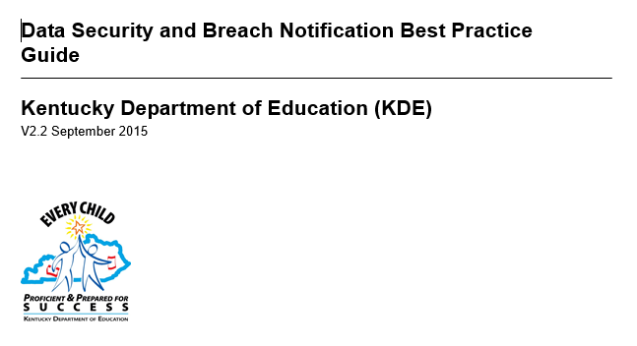
Data Security and Breach Notification Best Practice Guide
Legislation requires KDE to create and update this guide
Email all staff the Guide
Notes:
Nothing to add here.

Slide 54
Main Causes of Data Breaches
Human Error
  Accidental sharing (email, website, paper, etc.)
  Weak or stolen passwords
  Loss or theft of employee device (USB drive, laptop…)
  Phishing, clickbait
Everything Else
  Application vulnerabilities – unpatched software
  Hackers
  Malware
Notes:
Nothing to add here.

Slide 55
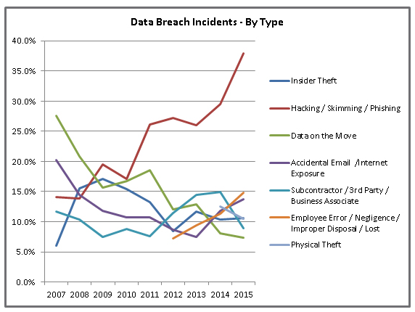
via
Identity Theft Resource Center
http://www.idtheftcenter.org/ITRC-Surveys-Studies/2015databreaches.html
Notes:
This is accurate, but in K12, our main issues are more accidental sharing by staff, at this point. Hackers aren’t a HUGE problem. Yet.

Slide 56
Security Breach Notification
Notify all individuals and agencies as outlined in KRS 61.933 if PII has been disclosed and will result in the likelihood of harm to one or more persons
One of these | AND | One or more of these
First name or first initial and last name Personal mark Unique biometric print/image |  | Account number with PIN that would allow access to the account Social Security Number Taxpayer ID number Driver’s license number or other ID number issued by any agency (student ID number) Passport number or other number issued by the US Individually identifiable health information except for education records covered by FERPA
Notes:
The KAR specifies HOW this happens…

Slide 57
Current Measures to Prevent a Breach
Anti-Virus/Malware/Spam/Spyware Protection
Vulnerability Scanning
System Patch Management
Cloud/Offsite Resources
Active Directory/Group Policy Objects
Private IP implementation
Distributed Denial of Service (DDOS) Mitigation
Web Filtration
Centrally Managed Firewalls
Virtual Private Network Support
Secure File Transfer
Statewide Product Standards
Locked Data Center
Locked File Cabinets/Doors
Limited Access (Need to Know)
Removal of user accounts for staff no longer employed
Staff confidentiality training and planned security training
Notes:
And does McCreary County do anything else? Staff awareness? Training? Handouts? Reviewing accounts and getting rid of the old ones? Nearly anything done for security can also be called a method of protecting data.

Slide 58
Student Data
"Student data" means any information or material, in any medium or format, that concerns a student and is created or provided by the student in the course of the student's use of cloud computing services, or by an agent or employee of the educational institution in connection with the cloud computing services. Student data includes the student's name, email address, email messages, postal address, phone number, and any documents, photos, or unique identifiers relating to the student. (KRS 365.734)

Slide 59
Cloud Providers
KRS 365.734 prohibits cloud providers from processing student data for any purpose other that improving its services. Specifically prohibits use of data for advertising and selling of student data.
Current cloud providers/programs: MUNIS finance program, Infinite Campus, Lunchbox, learning.com, Pearson (CIITS and others), NWEA (MAP), Google, Microsoft, One Call Now, Odysseyware, GradeCam, AIMS Web, Career Cruising, Reading 180, Reading Plus, renaissance Learning, Lexa , Follett Destiny, Study Island, Khan Academy, SchoolPointe, TenMarks, TeachScape, Think Tank
Notes:
Nothing to add here.

Slide 60
District Evaluation Plan
Dr. Jason Creekmore

Slide 61
Certified Evaluation Plan (CEP)
Was completed by Certified Evaluation Committee (50% teachers and 50% administrators) in May of 2014 and revised/approved in May of 2016.
PGES based on The Danielson Framework for Effective Teaching & Learning (The Kentucky Framework)
Includes Standards for Other Professionals (OPGES) & Principals (PPGES)

Slide 62
Required:
All teachers will participate in self-reflection and professional growth planning each year.
All teachers will document self-reflection and professional growth planning in CIITS.
The self-reflection must be completed prior to completion of the Professional Growth Plan.
Both self-reflection and the PGP must be completed by October 15th unless state test scores have not been received. If test scores have not been received by October 15th, self-reflection and PGP must be completed within one week of receiving test scores.

Slide 63
Observation Model:
The McCreary County School District will utilize The Progressive Model (3 & 1 model).
Observers will conduct 3 mini observations (1 peer/2 principal observations) of approximately 20-30 minutes each.
The 4th observation will be conducted by the Principal or Assistant Principal as a formal observation consisting of a full class or lesson observation.

Slide 64
Observations
Immediate supervisor shall be designated as primary evaluator.
Training (meeting) regarding the evaluation plan shall take place no later than the end of the first month of reporting for employment for each school year.
Copy of all evaluation documents will be provided to the evaluatee.
Approved forms and Summative evaluation will become part of the employee’s official personnel file.
Employee’s will have an opportunity to respond in writing to all evaluation documents, which will also become part of the employee’s personnel file.

Slide 65
Observation Conferencing
Observation conferences must be conducted within 5 working days.
A Summative Evaluation Conference shall be held at the end of the summative evaluation cycle and shall include all applicable professional growth and effectiveness data.
Annual evaluations with multiple observations are required for non-tenured certified employees.

Slide 66
Mini Observations:
Pre-conferences may be conducted via electronic means with approval from the principal.
Post-conference shall be conducted face to face with the evaluatee and evaluator.
Both pre and post shall be conducted within 5 working days of the observation.

Slide 67
Full Observations:
Pre and Post-conference shall be conducted face to face with the evaluatee and evaluator.
Both pre and post shall be conducted within 5 working days of the observation.

Slide 68
Timelines for
Observations (Non Tenured):
1st Mini Observation Cycle:
30 days after start of school.
2nd Mini Observation Cycle:
November 1st – December 15th
3rd Mini Observation Cycle:
December 15th- February 21st
4th Full Observation Cycle:
February 21st – April 15th
Note:
All Mini Observations must be completed by March 1st.
All Summative evaluations shall be completed and submitted to Central Office by April 15th.

Slide 69
Timeline for Observations (Tenured):
Year One : Mini Observation
Year Two: Mini Observation
Year Three: Mini & Full Observations
Year Three is considered the tenured certified employee’s summative evaluation year.
All observations for the tenured certified employee may be conducted during the summative year or spread out over the three year cycle.

Slide 70
The Student Growth Percentile will be determined by KDE and will be reported as High, Expected or Low. In cases where there is both a Local Student Growth Goal rating and a State Student Growth Percentile the following table should be utilized to get an overall Student Growth Trend Rating utilizing a 50 % / 50 % calculation.

Slide 71
Determining Overall Performance Category
Supervisors are responsible for determining an Overall Performance Category for each teacher at the conclusion of their summative evaluation year.
The evaluator determines the Overall Performance Category based on professional judgment informed by evidence that demonstrates the educator's performance against the Domains and district-developed rubrics (see local contribution for student growth).

Slide 72
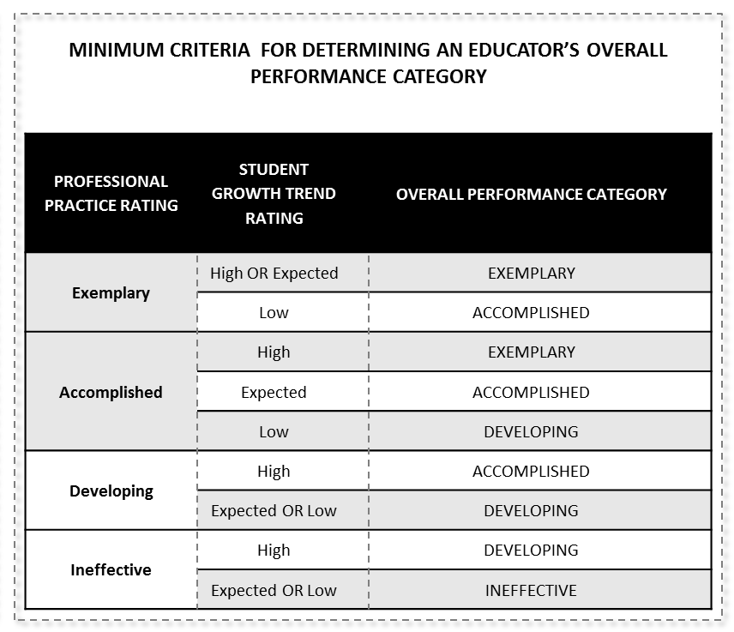
State Overall Decision Rules for Determining Educator’s Overall Performance Category
Required:
Implement the Overall Performance Category process for determining effectiveness.

Slide 73
Student Voice: The Student Voice Survey is a confidential, on-line survey that collects student feedback on specific aspects of the classroom experience and teaching practice.

Slide 74
State approved Student Voice Survey occurs annually during the state Student Voice window.
Employees must read, understand and sign the district’s Student Voice Ethics Statement.
Must occur in the school during the hours of 7 a.m. – 5 p.m.
Class must have 10 or more students
Process for choosing students to participate is a collaborative process by the teacher and principal
IEP accommodations must be met during this process
Support for ELL, IEP, or 504 students will be provided to ensure equal access.

Slide 75
Student Growth: Local Contribution
The local contribution for the student growth measure is a rating based on the degree to which a teacher meets the growth goal for a set of students over an identified interval of instruction (i.e. trimester, semester, year-long).
All teachers, regardless of grade level and content area, will develop a SGG for inclusion in the student growth measure.
All SGG will be determined by the teacher in collaboration with the principal and will be grounded in the fundamentals of assessment quality (Clear Purpose, Clear Targets, Sound Design, Effective Communication, and Student Involvement).

Slide 76
Professional Growth Plan and Summative Cycle
Based on the overall Professional Practice rating and Student Growth rating, supervisors will help tenured teachers determine the type of Professional Growth Plan and the length of the summative cycle.
Teachers with the overall performance rating of Ineffective shall receive a mentor at the building level, selected by the evaluator as part of the Improvement Plan.
Teachers with an overall performance rating of Ineffective at the end of two consecutive years shall receive an Intensive Growth Plan with a district level assistance team appointed by the Superintendent.

Slide 77
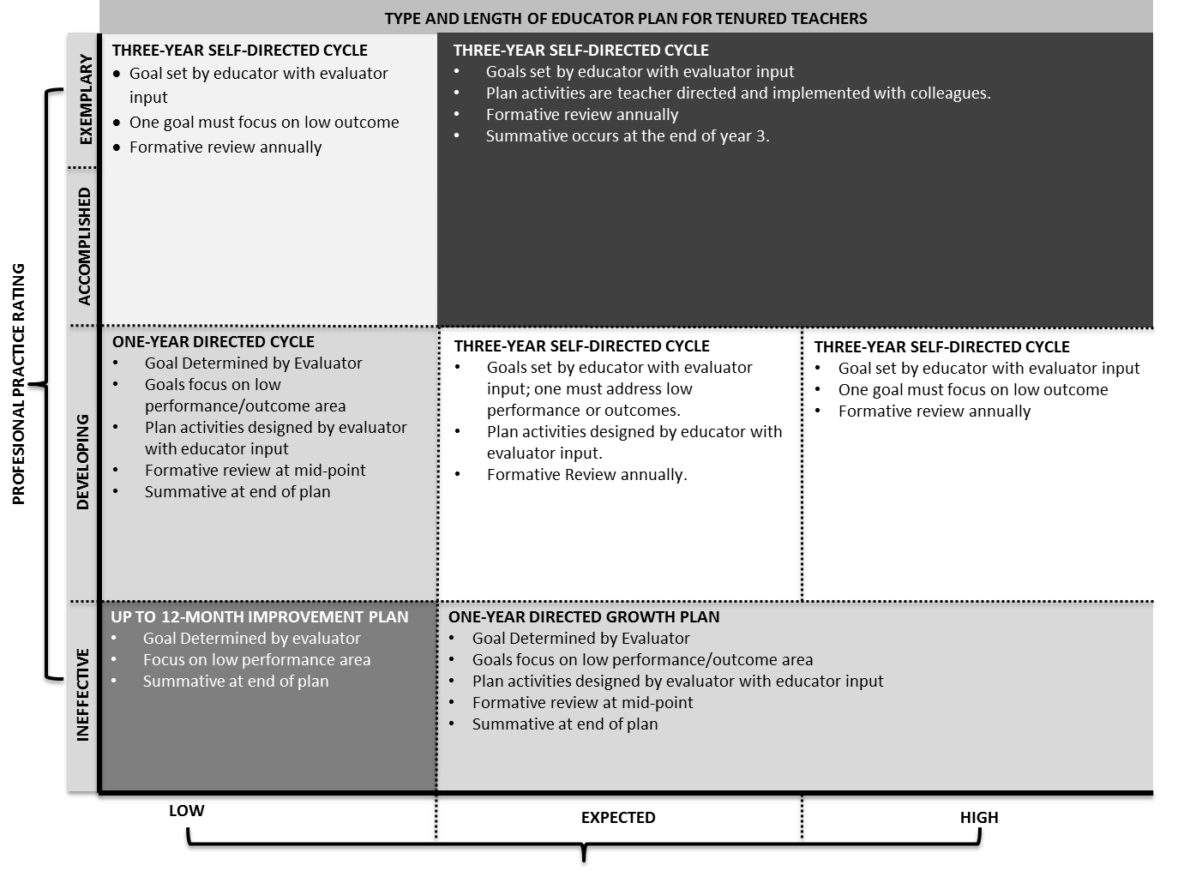

Slide 78
Lunch!

Slide 79
Seclusion & Restraint
Mrs. Sharon Privett

Slide 80
Physical Restraint
is defined as “a personal restriction that immobilizes or reduces the ability of a student to move the student’s torso, arms, legs, or head freely”
but does not mean temporary touching or holding of the hand, wrist, arm, shoulder, or back for the purpose of encouraging a student to move voluntarily to a safe location....does not mean less restrictive physical contact or redirection to promote student safety

Slide 81
Use of Physical Restraint
Must pose imminent danger of self or others
Must summon core team if not trained immediately
Monitored for physical and psychological well being during restraint
Only minimum amount of force necessary to protect from injury

Slide 82
Physical Restraint
KRS 503.050 – protection from unlawful physical force
KRS 503.070 – protection for a third party from unlawful physical force
KRS Chapter 503 – theft, destruction of property, or felony involving force
KRS 503.110 – maintain reasonable discipline

Slide 83
Physical Restraint
Cannot interfere with primary means of communication

Slide 84
Seclusion
is defined as “the involuntary confinement of a student alone in a room or area from which the student is prevented from leaving but does not include classroom timeouts, supervised in-school detentions, or out-of-school suspensions.”

Slide 85
Seclusion
Behavior poses an imminent danger of physical harm to self or others
Less restrictive interventions are ineffective
Monitored visually for the duration
Appropriately trained

Slide 86
Requirements
Annual training
Presence of Core Teams

Slide 87
Procedures
Documentation of the event in IC
Notice to Parents
Processing for conducting a debriefing session, if requested

Slide 88
Notifications
Notify Principal as soon as possible but no later than the end of the day
Notify Parent verbally or through electronic communication as soon as possible within 24 hours of the event (may send mail if not able to contact parent)
Extreme circumstances, Superintendent reports to KDE and law enforcement

Slide 90
Work-Related Injury
Mrs. Sharon Privett

Slide 91
Injury
Follow job descriptions
Use Safety Equipment & Follow Sign Information
Appropriate training for lifting, safety
File incident report ASAP
For students: clear area (relocate remaining students to another teacher’s classroom) call 911 if needed, contact medical/admin staff, file incident report
KEMI Forms available from Principal’s Secretary; Report to Karen Gilreath
People First

Slide 92
Prohibited Political Activities of School Employees
Rebecca Blakley

Slide 93
Prohibited Political Activities –Slide 1
KRS 161.164(5) requires the superintendent of each school district to notify all school employees of prohibited political activities related to school board campaigns.
1. No school employee may take part in the management of any school board campaign.

Slide 94
Prohibited Political Activities – Slide 2
2. No school board candidate shall solicit or accept any assessment, subscription, contribution or service of any school employee.

Slide 95
Prohibited Political Activities – Slide 3
3. No person shall directly use their official authority or influence to effect the appointment or pay of a school employee for the purpose of influencing the vote or political activity of any school employee.

Slide 96
Prohibited Political Activities – Slide 4
4. No school employee shall be promoted or demoted because of political affiliations.

Slide 97

Mandatory Reporting of Child Abuse
Robert E. Stephens, Jr.
Assistant Commonwealth’s Attorney
P.O. Box 430
Williamsburg, KY 40769
606 539 0800
August 11, 2016

Slide 98
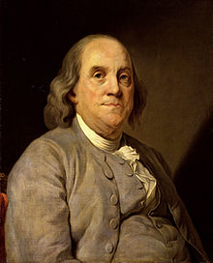
Why Am I Here?
A brief refresher on mandatory reporting laws.
It’s the law!
KRS 620.030.
Because you care.
“An ounce of
prevention….”

Slide 99



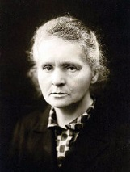


Who Must Report?
Doctors?
Neighbors?
Family?
Lawyers?
Teachers?
School Staff?
Everyone!

Slide 100
Who Must Report?
Husband/Wife Privilege Not Effective
KRS 620.030
(4) Neither the husband-wife nor any professional-client/patient privilege, except the attorney-client and clergy-penitent privilege, shall be a ground for refusing to report under this section or for excluding evidence regarding a dependent, neglected, or abused child or the cause thereof, in any judicial proceedings resulting from a report pursuant to this section. This subsection shall also apply in any criminal proceeding in District or Circuit Court regarding a dependent, neglected, or abused child.

Slide 101

Who Must Report?
Cliff’s Notes Version:
Everyone must report to the Cabinet, KSP or other police, or the local prosecutor;
If he or she knows or has reasonable cause to believe a child is abused, neglected, or dependent.
Failure to report is a crime.

Slide 102
Who Must Report?
Start with some Definitions: Abused, Neglected, or Dependent child:
KRS 600.020 Definitions for KRS Chapters 600 to 645.
As used in KRS Chapters 600 to 645, unless the context otherwise requires:
(1) "Abused or neglected child" means a child whose health or welfare is harmed or threatened with harm when:
(a) His or her parent, guardian, person in a position of authority or special trust, as defined in KRS 532.045, or other person exercising custodial control or supervision of the child:

Slide 103
Who Must Report?
1. Inflicts or allows to be inflicted upon the child physical or emotional injury as defined in this section by other than accidental means;
2. Creates or allows to be created a risk of physical or emotional injury as defined in this section to the child by other than accidental means;
3. Engages in a pattern of conduct that renders the parent incapable of caring for the immediate and ongoing needs of the child including, but not limited to, parental incapacity due to alcohol and other drug abuse as defined in KRS 222.005;

Slide 104
Who Must Report?
4. Continuously or repeatedly fails or refuses to provide essential parental care and protection for the child, considering the age of the child;
5. Commits or allows to be committed an act of sexual abuse, sexual exploitation, or prostitution upon the child;
6. Creates or allows to be created a risk that an act of sexual abuse, sexual exploitation, or prostitution will be committed upon the child;
7. Abandons or exploits the child;

Slide 105
Who Must Report?
8. Does not provide the child with adequate care, supervision, food, clothing, shelter, and education or medical care necessary for the child's well-being. A parent or other person exercising custodial control or supervision of the child legitimately practicing the person's religious beliefs shall not be considered a negligent parent solely because of failure to provide specified medical treatment for a child for that reason alone. This exception shall not preclude a court from ordering necessary medical services for a child;

Slide 106

Who Must Report?
9. Fails to make sufficient progress toward identified goals as set forth in the court-approved case plan to allow for the safe return of the child to the parent that results in the child remaining committed to the cabinet and remaining in foster care for fifteen (15) of the most recent twenty-two (22) months; or
(b) A person twenty-one (21) years of age or older commits or allows to be committed an act of sexual abuse, sexual exploitation, or prostitution upon a child less than sixteen (16) years of age;

Slide 107
Who Must Report?
KRS 532.045
(1) As used in this section:
(a) "Position of authority" means but is not limited to the position occupied by a biological parent, adoptive parent, stepparent, foster parent, relative, household member, adult youth leader, recreational staff, or volunteer who is an adult, adult athletic manager, adult coach, teacher, classified school employee, certified school employee, counselor, staff, or volunteer for either a residential treatment facility or a detention facility as defined in KRS 520.010(4), staff or volunteer with a youth services organization, religious leader, health-care provider, or employer;
(b) "Position of special trust" means a position occupied by a person in a position of authority who by reason of that position is able to exercise undue influence over the minor;

Slide 108
Who Must Report?
Dependent Child.
KRS 600.020 (19) "Dependent child" means any child, other than an abused or neglected child, who is under improper care, custody, control, or guardianship that is not due to an intentional act of the parent, guardian, or person exercising custodial control or supervision of the child;

Slide 109
Who Must Report?
Human Trafficking.
KRS 620.030
(3) Any person who knows or has reasonable cause to believe that a child is a victim of human trafficking as defined in KRS 529.010 shall immediately cause an oral or written report to be made to a local law enforcement agency or the Department of Kentucky State Police; or the cabinet or its designated representative; or the Commonwealth's attorney or the county attorney; by telephone or otherwise. This subsection shall apply regardless of whether the person believed to have caused the human trafficking of the child is a parent, guardian, or person exercising custodial control or supervision.
KRS 529.010
(5) "Human trafficking" refers to criminal activity whereby one (1) or more persons are subjected to engaging in:
(a) Forced labor or services; or
(b) Commercial sexual activity through the use of force, fraud, or coercion, except that if the trafficked person is under the age of eighteen (18), the commercial sexual activity need not involve force, fraud, or coercion;

Slide 110
What Must I Report?
I: Mandatory Report
KRS 620.030 Duty to report dependency, neglect, abuse, or human trafficking –
Any person who knows or has reasonable cause to believe that a child is dependent, neglected, or abused shall immediately cause an oral or written report to be made to a local law enforcement agency or the Department of Kentucky State Police; the cabinet or its designated representative; the Commonwealth's attorney or the county attorney; by telephone or otherwise. Any supervisor who receives from an employee a report of suspected dependency, neglect, or abuse shall promptly make a report to the proper authorities for investigation. If the cabinet receives a report of abuse or neglect allegedly committed by a person other than a parent, guardian, or person exercising custodial control or supervision, the cabinet shall refer the matter to the Commonwealth's attorney or the county attorney and the local law enforcement agency or the Department of Kentucky State Police. Nothing in this section shall relieve individuals of their obligations to report.
Note: Personal responsibility to report, extra obligation for supervisors.
Reporting to supervisor does not satisfy duty to report!

Slide 111
What Must I Report?
II: Further Written Report if Requested
KRS 620.030
(2) Any person, including but not limited to a physician, osteopathic physician, nurse, teacher, school personnel, social worker, coroner, medical examiner, child-caring personnel, resident, intern, chiropractor, dentist, optometrist, emergency medical technician, paramedic, health professional, mental health professional, peace officer, or any organization or agency for any of the above, who knows or has reasonable cause to believe that a child is dependent, neglected, or abused, regardless of whether the person believed to have caused the dependency, neglect, or abuse is a parent, guardian, person exercising custodial control or supervision, or another person, or who has attended such child as a part of his or her professional duties shall, if requested, in addition to the report required in subsection (1) or (3) of this section, file with the local law enforcement agency or the Department of Kentucky State Police or the Commonwealth's or county attorney, the cabinet or its designated representative within forty-eight (48) hours of the original report a written report containing….

Slide 112
What Must I Report?
Written report if requested must include:
(a) The names and addresses of the child and his or her parents or other persons exercising custodial control or supervision;
(b) The child's age;
(c) The nature and extent of the child's alleged dependency, neglect, or abuse, including any previous charges of dependency, neglect, or abuse, to this child or his or her siblings;
(d) The name and address of the person allegedly responsible for the abuse or neglect; and
(e) Any other information that the person making the report believes may be helpful in the furtherance of the purpose of this section.

Slide 113
What Must I Report?
Duty to Assist the Cabinet investigating a claim of Abuse, Neglect, or Dependency.
KRS 620.030(5) The cabinet upon request shall receive from any agency of the state or any other agency, institution, or facility providing services to the child or his or her family, such cooperation, assistance, and information as will enable the cabinet to fulfill its responsibilities under KRS 620.030, 620.040, and 620.050.

Slide 114
Where Do I Report?
DCBS Cumberland Regional Intake Office: 606 330 2192
Statewide Reporting Line: 800 752 6200
Online (for non-emergencies only): https://prd.chfs.ky.gov/ReportAbuse/home.aspx
Kentucky State Police: 606 878 6622
McCreary County Sheriff’s Office: 606 376 2322
Commonwealth Attorney Allen C. Trimble: 606 539 0800
Why is the Cabinet the best place to report?
Automatic documentation of your report having been made.

Slide 115
Why Must I Report?
Because it’s the law, and…
KRS 620.030(6)
Any person who intentionally violates the provisions of this section shall be guilty of a:
(a) Class B misdemeanor for the first offense; up to 90 days in Jail
(b) Class A misdemeanor for the second offense; up to 1 year Jail
and
(c) Class D felony for each subsequent offense. up to 5 years in Jail

Slide 116
Why Must I Report?
In addition to duty to cooperate with the Cabinet:
524.040 Intimidating a participant in the legal process.
(1) A person is guilty of intimidating a participant in the legal process when, by use of physical force or a threat directed to a person he believes to be a participant in the legal process, he or she:
(a) Influences, or attempts to influence, the testimony, vote, decision, or opinion of that person;
(b) Induces, or attempts to induce, that person to avoid legal process summoning him or her to testify;
(c) Induces, or attempts to induce, that person to absent himself or herself from an official proceeding to which he has been legally summoned;
(d) Induces, or attempts to induce, that person to withhold a record, document, or other object from an official proceeding;
(e) Induces, or attempts to induce, that person to alter, destroy, mutilate, or conceal an object with intent to impair the object's integrity or availability for use in an official proceeding; or
(f) Hinders, delays, or prevents the communication to a law enforcement officer or judge of information relating to the possible commission of an offense or a violation of conditions of probation, parole or release pending judicial proceedings.
(2) For purposes of this section:
(a) An official proceeding need not be pending or about to be instituted at the time of the offense; and
(b) The testimony, record, document, or other object need not be admissible in evidence or free of a claim of privilege.
(3) Intimidating a participant in the legal process is a Class D felony.

Slide 117
Other reporting requirements:
Superintendent to EPSB:
KRS 161.120(2)(a):
The superintendent of each local school district shall report in writing to the Education Professional Standards Board the name, address, phone number, Social Security number, and position name of any certified school employee in the employee's district whose contract is terminated or not renewed, for cause except failure to meet local standards for quality of teaching performance prior to the employee gaining tenure; who resigns from, or otherwise leaves, a position under threat of contract termination, or nonrenewal, for cause; who is convicted in a criminal prosecution; or who otherwise may have engaged in any actions or conduct while employed in the school district that might reasonably be expected to warrant consideration for action against the certificate under subsection (1) of this section. The duty to report shall exist without regard to any disciplinary action, or lack thereof, by the superintendent, and the required report shall be submitted within thirty (30) days of the event giving rise to the duty to report.
(b) The district superintendent shall inform the Education Professional Standards Board in writing of the full facts and circumstances leading to the contract termination or nonrenewal, resignation, or other absence, conviction, or otherwise reported actions or conduct of the certified employee, that may warrant action against the certificate under subsection (1) of this section, and shall forward copies of all relevant documents and records in his possession.

Slide 118
Other reporting requirements:
Principal to law enforcement regarding certain offenses:
KRS 158.154:
When the principal has a reasonable belief that an act has occurred on school property or at a school-sponsored function involving assault resulting in serious physical injury, a sexual offense, kidnapping, assault involving the use of a weapon, possession of a firearm in violation of the law, possession of a controlled substance in violation of the law, or damage to the property, the principal shall immediately report the act to the appropriate local law enforcement agency. For purposes of this section, "school property" means any public school building, bus, public school campus, grounds, recreational area, or athletic field, in the charge of the principal.

Slide 119
Other reporting requirements:
School Employees’ Duty to Report Certain Crimes:
KRS 158.155:
(4) A person who is an administrator, teacher, or other employee of a public or private school shall promptly make a report to the local police department, sheriff, or the Department of Kentucky State Police, by telephone or otherwise, if:
(a) The person knows or has reasonable cause to believe that conduct has occurred which constitutes:

Slide 120
Other reporting requirements:
1. A misdemeanor or violation offense under the laws of this Commonwealth and relates to:
a. Carrying, possession, or use of a deadly weapon; or
b. Use, possession, or sale of controlled substances; or
2. Any felony offense under the laws of this Commonwealth; and
(b) The conduct occurred on the school premises or within one thousand (1,000) feet of school premises, on a school bus, or at a school-sponsored or sanctioned event.
Penalty for Failing to report Promptly: Class A Misdemeanor (KRS 158.990(2)).

Slide 121
Other reporting requirements:
KRS 158.156:
(1) Any employee of a school or a local board of education who knows or has reasonable cause to believe that a school student has been the victim of a violation of any felony offense specified in KRS Chapter 508 committed by another student while on school premises, on school-sponsored transportation, or at a school-sponsored event shall immediately cause an oral or written report to be made to the principal of the school attended by the victim. The principal shall notify the parents, legal guardians, or other persons exercising custodial control or supervision of the student when the student is involved in an incident reportable under this section. The principal shall file with the local school board and the local law enforcement agency or the Department of Kentucky State Police or the county attorney within forty-eight (48) hours of the original report a written report containing:

Slide 122
Other reporting requirements:
(a) The names and addresses of the student and his or her parents, legal guardians, or other persons exercising custodial control or supervision;
(b) The student's age;
(c) The nature and extent of the violation;
(d) The name and address of the student allegedly responsible for the violation; and
(e) Any other information that the principal making the report believes may be helpful in the furtherance of the purpose of this section.

Slide 123
Other reporting requirements:
(2) An agency receiving a report under subsection (1) of this section shall investigate the matter referred to it. The school board and school personnel shall participate in the investigation at the request of the agency.
(3) Anyone acting upon reasonable cause in the making of a report required under this section in good faith shall have immunity from any liability, civil or criminal, that might otherwise be incurred or imposed. Any such participant shall have the same immunity with respect to participation in any judicial proceeding resulting from such report or action.
(4) Neither the husband-wife nor any professional-client/patient privilege, except the attorney-client and clergy-penitent privilege, shall be a ground for refusing to report under this section or for excluding evidence regarding student harassment in any judicial proceedings resulting from a report pursuant to this section. This subsection shall also apply in any criminal proceeding in District or Circuit Court regarding student harassment.
Felony Offenses under KRS Chapter 508:
Assault 1st Degree, Assault 2nd Degree, Assault 3rd Degree, Wanton Endangerment 1st Degree, Terroristic Threatening 1st Degree, Terr. Threat. 2nd Degree, Criminal Abuse 1st Degree, Criminal Abuse 2nd Degree, Stalking 1st Degree, Disarming a Police Officer.

Slide 124
New this Year!
2016 HB 111: Amended KRS 156.095 to require every public school post the KY child abuse hotline number prominently.
“Every Public School shall prominently display the statewide child abuse hotline number administered by the Cabinet for Health and Family Services.”
Prominently Display!

Slide 125



We All Want the Same Thing!
Protect
Nurture
Educate
Our Children
If any questions after today, feel free to call!

Slide 126
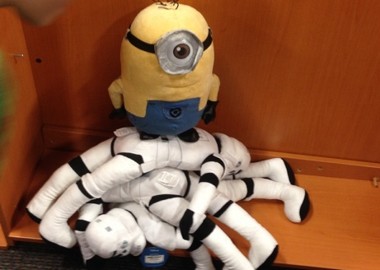
Any questions?
Robert E. Stephens, Jr.
Assistant Commonwealth’s Attorney
606 539 0800
restephens@prosecutors.ky.gov

Slide 127
Blood Borne Pathogens
Mrs. Brandy Rowe, RN

Slide 128


Slide 129
Blood Borne Pathogens for School Personnel
McCreary County School District
Brandy Rowe RN- District Health Coordinator/School nurse

Slide 130
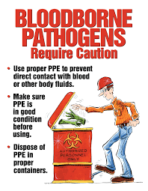
What are Blood Borne Pathogens?
Blood Borne Pathogens are germs found in the bloodstream or body fluids that can cause disease
Most Common Blood Borne Pathogens are Hepatitis B, Hepatitis C and HIV
Means of Transmission: Blood, Body fluids that visibly contain blood and torn or loose skin
*****Sweat, Tears, Saliva, Vomit, Urine and Feces are not considered infectious unless visible blood is present*****

Slide 131


Universal/Standard Precautions
Universal or Standard Precautions are practices that help prevent the transmission of Blood Borne Pathogens
Treat ALL Blood and Body Fluids as if they are infected
Reduce Your Risk of Exposure
Types of Precautions:
*Handwashing
*Personal Protective Equipment
*Gloves
*Mask
*Gown/Apron
*Sharps Container

Slide 132
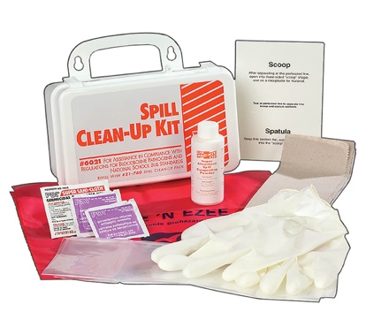
Clean Up and Exposure Procedures
Clean Up Procedure
What if I am Exposed?
Prevent Accidental Exposure to Others
Wear Appropriate Personal Protective Equipment
Absorb Spill (paper towels or spill kit)
Spray Appropriate Cleaning Solution and allow to penetrate for 10 min
Dispose of all Cleaning Materials
Wash area with soap and water
Report to Principal and School Nurse
See Physician for Medical Evaluation

Slide 133
Reminders & Announcements
Dr. Jason Creekmore

