Slide 1
Florida student scholarship grant program Application

Slide 2


www.floridastudentfinancialaidsg.org

Slide 3
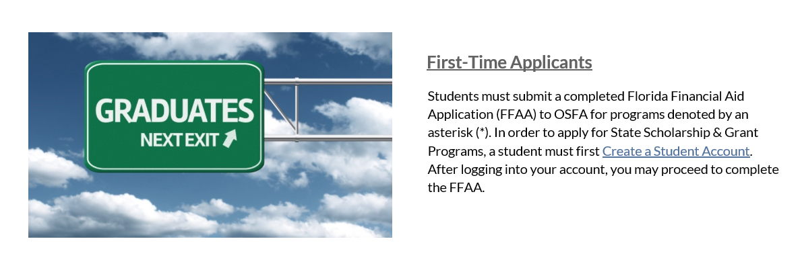
Select create a Student account

Slide 4
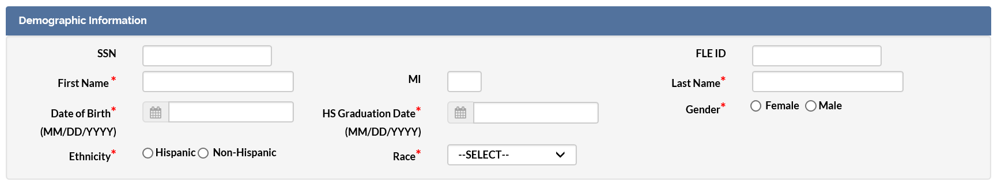
Take out your cheat sheet
Fill out your Demographics, according to your cheat sheet.

Slide 5
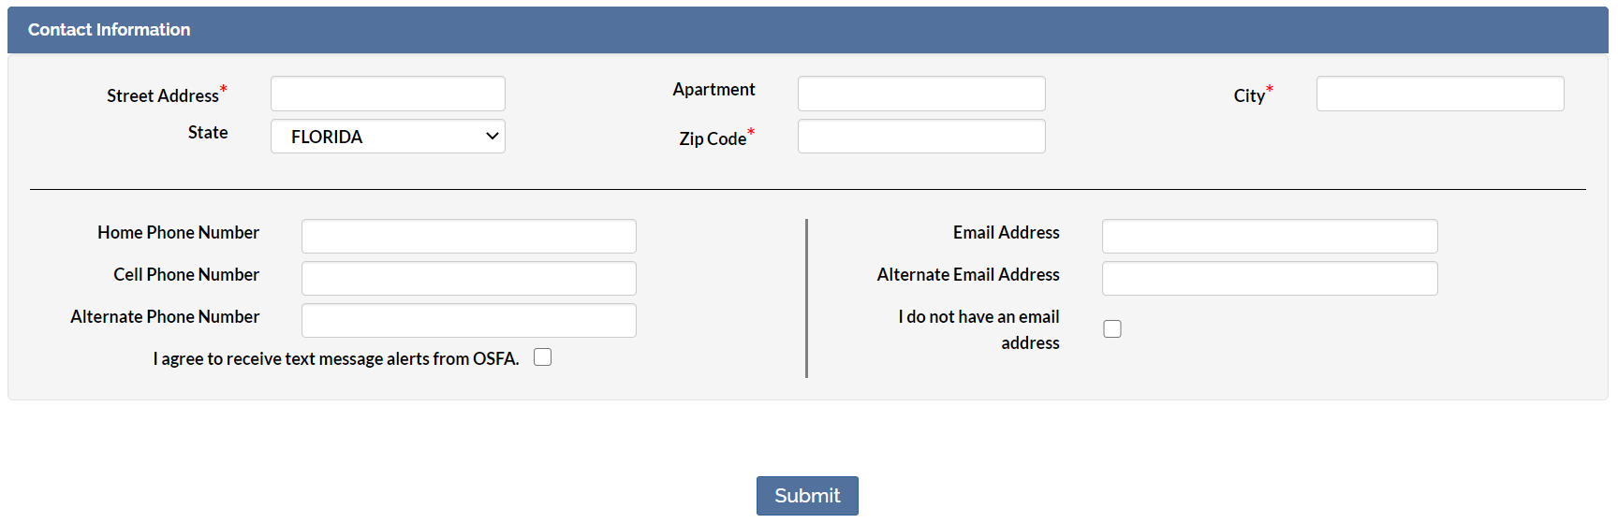
Take out your cheat sheet
Fill out your Contact Information, according to your cheat sheet.
  You will receive an email with your username and password
  Select Submit

Slide 6
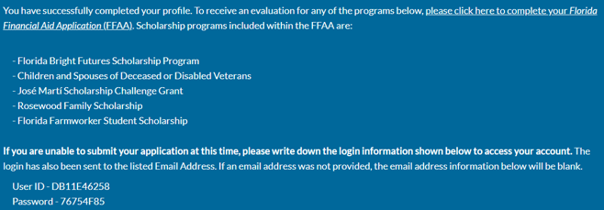
Completed your Profile, now apply
Write down your username and password, it will also be emailed to you.
Click Please click here to complete your Florida Financial Aid Application (FFAA).

Slide 7
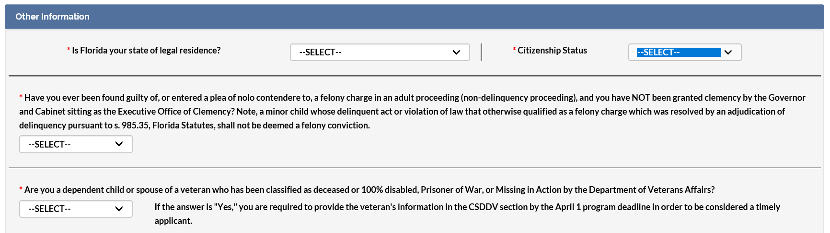
Take out your cheat sheet
Answer the questions under Other Information, using your Cheat Sheet.
Select Next

Slide 8
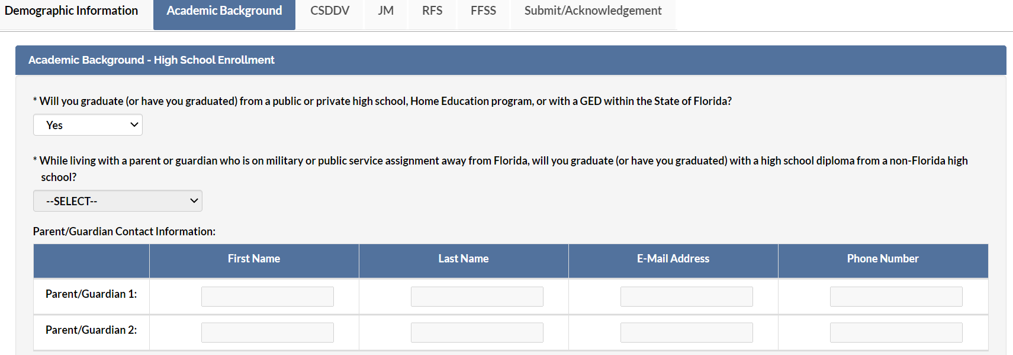
Take out your cheat sheet
Answer the questions under Academic Background- High School Enrollment
  The two highlighted questions below should not be answered.

Slide 9
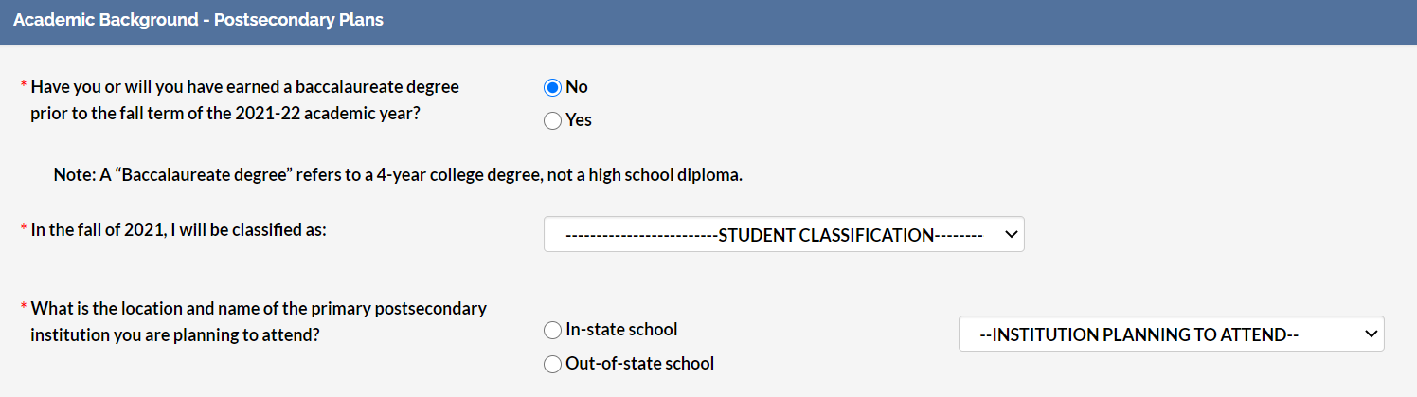
Take out Your Cheat Sheet
Answer the questions under Academic Background- Post-Secondary Plans
  Daytona College is not Daytona State College
Select Next

Slide 10
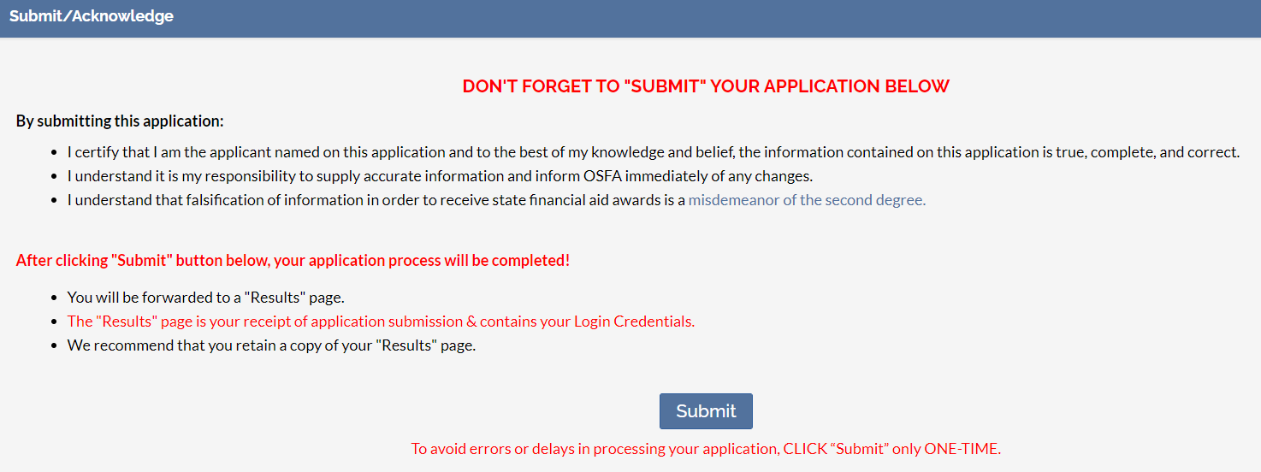
Submit and acknowledge

Slide 11
Write down your login info
Make sure you keep a copy of your Login Credentials for your records.
Check your email that the Office of Student Financial Assistant received your application.
Check on your application throughout the year.
Make sure your SAT or ACT are completed by the June 2o21 Administration.
Make sure your Community Service Hours are completed and turned in by May of 2021.
Turn in your Cheat Sheet for destruction and your receipt.
Graduation is June 2021.
  Be there!

