Slide 1

Updated Esser Funding
Crockett County Public Facing Presentation
ESSER 1.0, 2.0, 3.0….
December 2021

Slide 2
What is ESSER funding?
Elementary and Secondary School Emergency Relief (ESSER) funds are one-time funds from the federal government to be used to assist schools during and post-COVID.

Slide 3
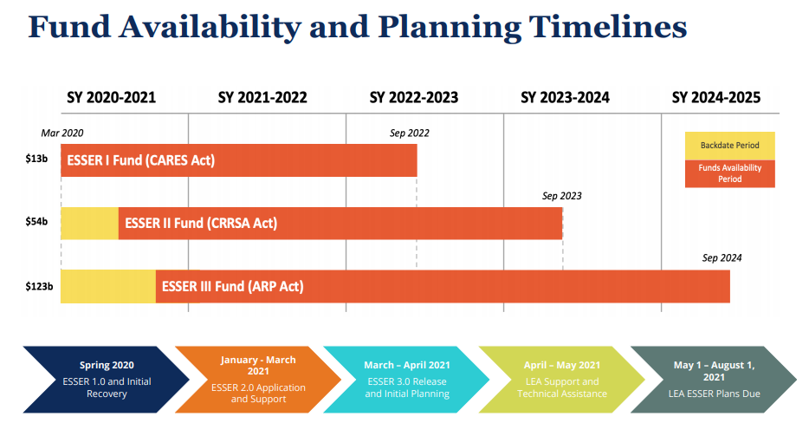

Slide 4
Esser 1.0
March 2020 to February 2021 (complete)
341,655.49

Slide 5
ESSER 1.0 Focus Areas
This is a summary of allowable uses:
Purchasing education technology
Providing summer learning and supplemental afterschool programs
Planning for long-term closures
Addressing the unique needs of special populations
Providing mental health services
Conducting other activities necessary to maintain operation of services and employing staff and coordination of activities

Slide 6
Crockett County’s Spending Plan and Budget
Instructional SEL curriculum 5,723.00
Computer Software (GoGuardian) 20,568.71
Other supplies and materials 8,491.60
Laptops (1,020) 306,872.15

Slide 7
Esser 2.0
May 2021 to June 2023
Total Allocations: 1,439,623.93

Slide 8
ESSER 2.0 Focus Areas
Allowable uses of funds:
Addressing learning loss among students
School facility repairs and improvement to enable operation of schools to reduce risk of virus transmission and exposure to environmental health hazards, and to support health needs.
Addressing learning growth among all students

Slide 9
Investments/Projects to be completed with remaining funds: $791,014.83
Summer School Teachers with benefits
Summer School materials
Summer School snacks
CCHS weather station –STEM
9th grade orientation night
One nurse
COVID supplies: cleaning/disinfecting supplies
Bonus stipends for all employees
Computer carts
Hot spots
School bus
School van
HVACs at MCES and FES
CCMS kitchen/cafeteria
CCMS combi-oven
CCMS cooler and freezer
GES playground and outdoor classroom
LRE outdoor classroom space
CCMS LRE walkway

Slide 10
Esser 3.0
July 2021 to June 2024
Total Allocations: 3,233,190.84

Slide 11
ESSER 3.0 Focus Areas
LEA must reserve at least 20% of funds to accomplish the following:
1. address learning loss through the implementation of evidence-based interventions
2. ensure that those interventions respond to student’s social, emotional, and academic needs
3. address the disproportionate impact of COVID-19 on underrepresented student subgroups
Reopen safely and remain open

Slide 12
ESSER 3.0 Possible Funding Projects
Academics: TN All Corps, Summer Programming, High Quality Instructional Materials, Literacy Support
Student Readiness: ACT, AP Courses, Transition Counseling for 9th grade and 10th grade, CTE Programs and Equipment, Special Education Services
Educators: Bonus, Class Size Reduction
Well-being: Mental health and school nurses
Other: Technology, Infrastructure, Monitoring

Slide 13
Crockett County’s Spending Plan & Budget
Interventionists at MCES and GES to work with students in Grades K-2 in literacy
Kindergarten assistants for MCES, FES, and GES to work with K teachers and students
Additional 3rd grade teacher at FES to reduce classroom size
Summer School teachers salaries with benefits
ACT Mastery Prep consultant and materials for CCHS
Nurses
College Success Coach CCHS
School Psychologist
ESSER bonus stipends
ESSER project manager
6th grade and 9th grade orientation nights
Summer school bus and cafeteria employees
Summer school sancks
Ipads
High Quality Instructional Materials for Math, Literacy, STEM
Paloalto hardware
GES kitchen and cafeteria expansion

Slide 14
We need your feedback.
It is our goal as a district to include your valued input on our spending plan for ESSER 3.0 funding.
If you would like to share feedback, you may:
Complete the following anonymous survey by clicking this link:
https://forms.office.com/Pages/ResponsePage.aspx?id=-vSogAdP5Ei-h_uQaIc4Nl477BDav4RGrWLRkAhtM9RURUVFVjNOMVNEV0MxTkFaUEJRM0RRSURDMC4u
Or you may email us at the following address:
esser3@crockettcavs.net

