Slide 1
DEVELOPING A SINGLE PLAN FOR STUDENT ACHIEVEMENT

Slide 2



Seven Steps for Developing the
Single Plan for Student Achievement
Completed
SPSA
Step 7
Step 6
Step 5
Step 4
Step 3
Step 2
Step 1
‹#›
[Guide pp.5-12]

Slide 3
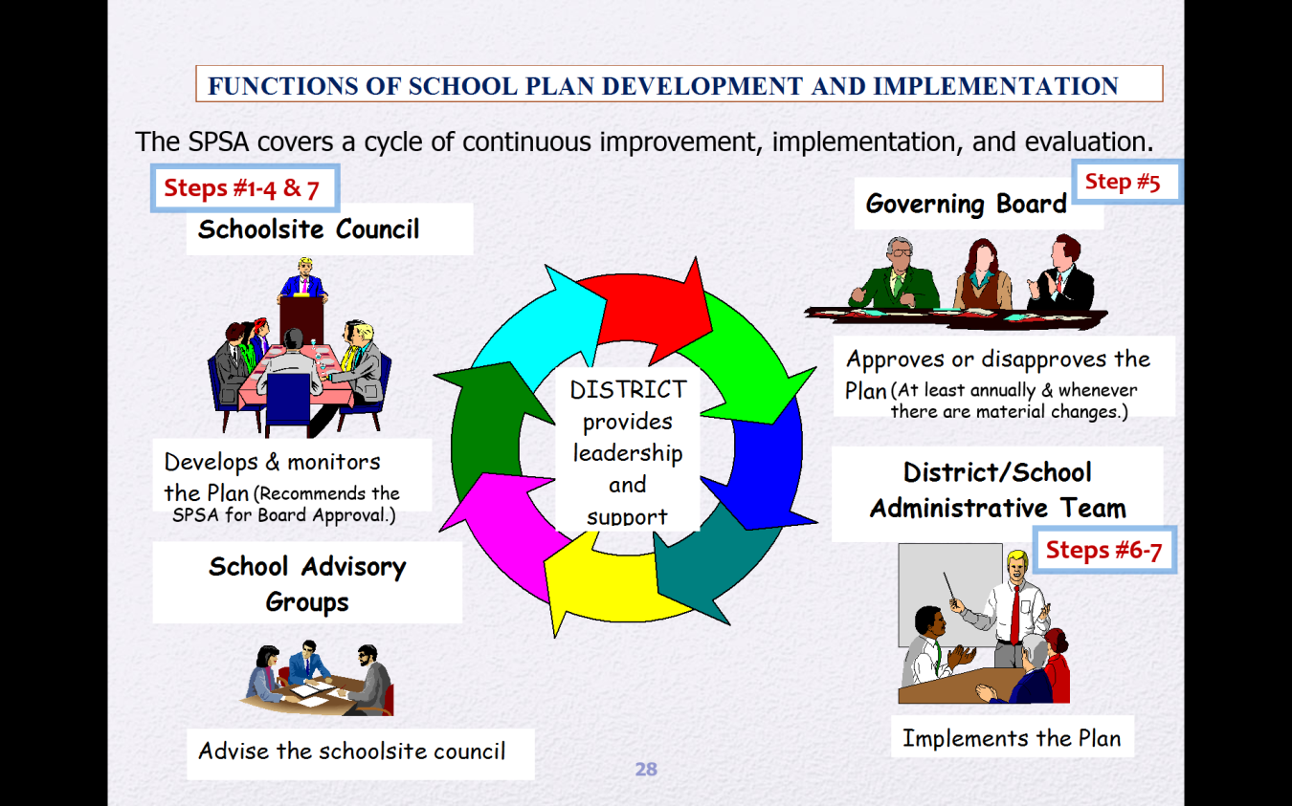
Cycle of Continuous Improvement
‹#›

Slide 4


‹#›

Slide 5


‹#›
    Identify site-specific achievement goals based on a variety of student performance data.
    Describe specific instructional strategies to accelerate student learning.
    Describe the ways in which student progress will be monitored on a regular basis.
    Identify interventions for students not achieving.
    Determine the necessary professional development for staff.
    Delineate strategies for parent communication and engagement.
    Reflect estimated costs and funding sources.
    Involve consultation with other site advisory groups.
Step 1
[Guide pp. 5-6]

Slide 6
1. Analyze Student Achievement Data
‹#›
The SPSA must be based on a review of the school’s current state-level data:
    California Dashboard
    English Language Proficiency Assessments for California CAASPP (California Assessment of Student Performance and Progress)
    Local benchmark assessments
    Curriculum embedded assessments
Step 1
[Guide pp. 5-6]

Slide 7
2. Measure the Effectiveness of Current Improvement Strategies
‹#›
  Conduct a comprehensive needs assessment:
    Use district-, school- or CDE-developed tools to collect information. Processes may include surveys, interviews, observations, and records/documents.
    Consider the relationship between the current instructional program and the conclusions reached from the analysis of student data.
    Seek input from advisory committees
    Determine areas of need that need to be addressed
    to raise student performance of student groups not meeting academic standards.
Step 2
[Guide pp. 6-8]

Slide 8
3. Identify Goals & Key Improvements
‹#›
Ensure that school goals and key improvements are aligned to the LEA Plan
Ensure that school goals are limited in number
Determine key improvement strategies based on research of programs and practices proven to be effective
Ensure improvement strategies are:
    Designed to address the areas of need identified
    Prioritized by student need
    Realistic and attainable
    Measurable by frequent formative assessments
Step 3
[Guide pp. 8-9]

Slide 9
4. Define Timelines, Funding
Expenditures/Sources, and Personnel
‹#›
Expenditures of state & federal categorical program funds are allowable if they:
  Provide an effective means of achieving the purposes of the program funding source
  Are a reasonable use of limited resources
  Are necessary to achieve the goals
  Follow “supplement, not supplant” rules
    Don’t fund services that are required by state law
    Don’t pay for services previously funded with non-supplemental funds
    Don’t provide services to ineligible students
Step 4
[Guide pp. 9-10]

Slide 10
5. Recommend the SPSA to the
Local Governing Board
‹#›
The SSC Chairperson, Principal, and Advisory Committees are asked to sign the SPSA to attest to applicable assurances.
If the local governing board does not approve the SPSA:
    They must communicate the specific reasons
    SSC must revise and resubmit the SPSA for approval
Until the SPSA is revised and approved, the activities
and expenditures are not authorized for implementation.
Step 5
[Guide pp. 10-11]

Slide 11

District Governing Board
‹#›
Adopts policies for the development & implementation of the SPSA consistent with law
Approve or disapprove the Single Plan for Student Achievement and its subsequent revisions
Certify that school plans are consistent with local improvement plans required for federal funding

Slide 12

6. Implement the SPSA
‹#›
The district and school administration are responsible for implementing the SPSA as approved by the local governing board.
    Assigning, directing and supervising project staff
    Purchasing materials and equipment
    Accounting for project funds
Step 6
[Guide p. 11]

Slide 13
7. Monitor Implementation
‹#›
The SSC is responsible for monitoring the effectiveness of planned activities and modifying those activities that prove ineffective.
Step 7
[Guide pp. 11-12]

Slide 14
7. Monitor Implementation (continued)
Mid-year Changes to the SPSA
‹#›
  The following factors may indicate a need to amend the SPSA during the school year:
    A major service or activity proves ineffective, and students are at risk
    Material changes occur that affect the academic programs
    Staff, equipment, or materials essential to the plan cannot be procured
    An activity is found to be non-compliant with state or federal law
    A planned activity is not supported by staff, parents, or students
[Guide pp. 11-12]

Slide 15

What May Cause a School Plan to be Ineffective?
38
Not based on a thorough analysis of student needs based on data
Are not based on an accurate, unbiased assessment of the current instructional program
Are seen as a way to justify spending money rather than a plan for school improvement
Are vague and not actionable (plans to plan)
Do not include measureable outcomes
Don’t involve stakeholders in a meaningful way
‹#›

Slide 16
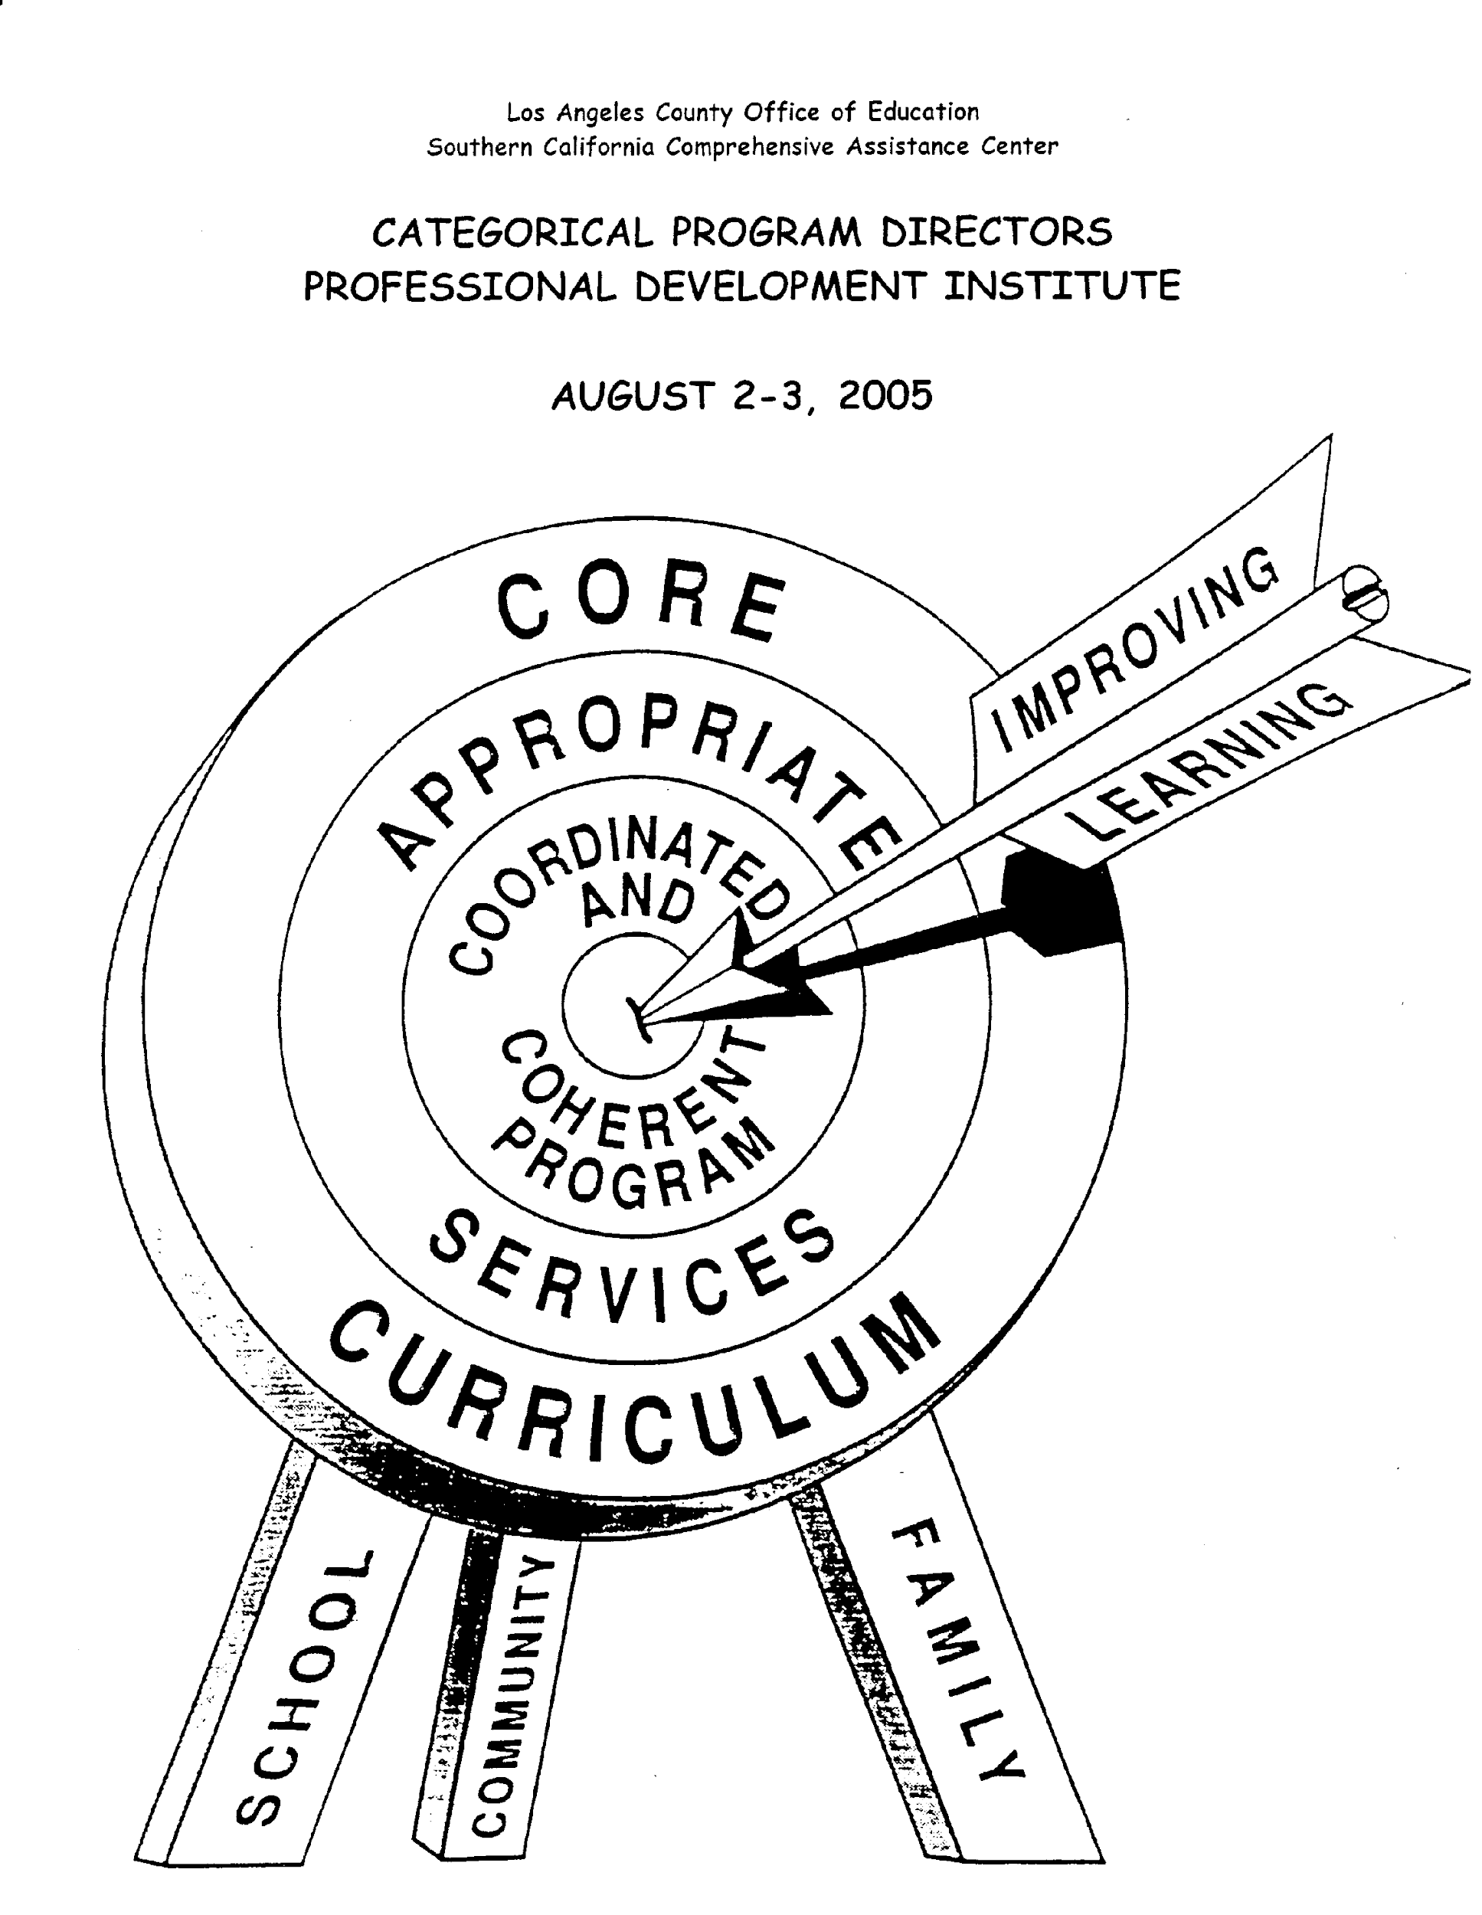
‹#›
Will your SPSA
hit the target?
The SSC must evaluate the effectiveness of planned activities.

