Slide 1
HB 7011 Literacy Policy Update
VPK Expansion
2022-2023
Summer Programs
2022
Notes:
Good afternoon, School Board Members or if individually __________________________. It is my pleasure to share with you Volusia County Schools’ Summer Programs.

Slide 2


Slide 3
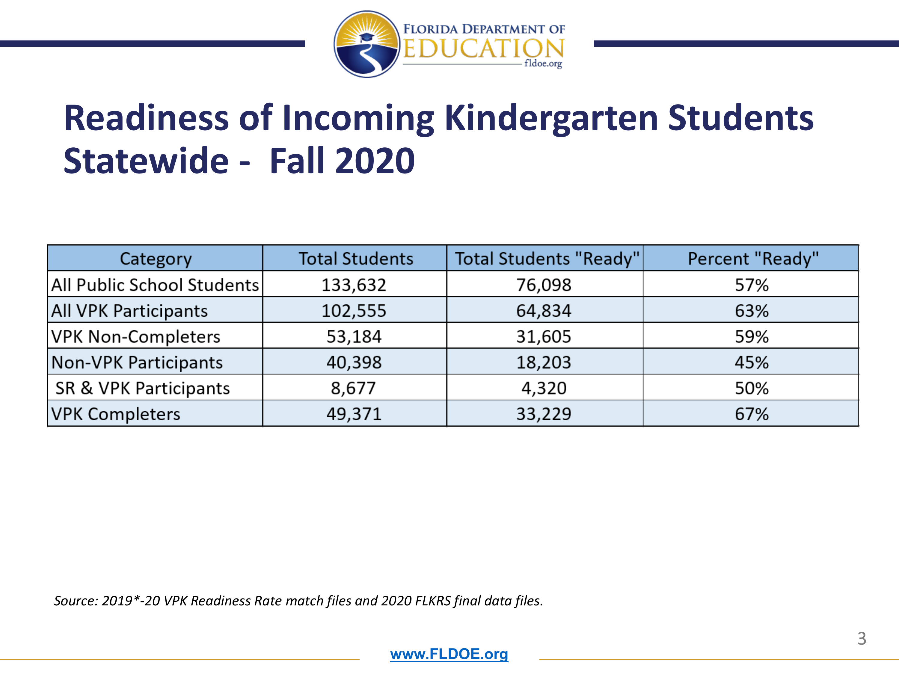

Slide 4
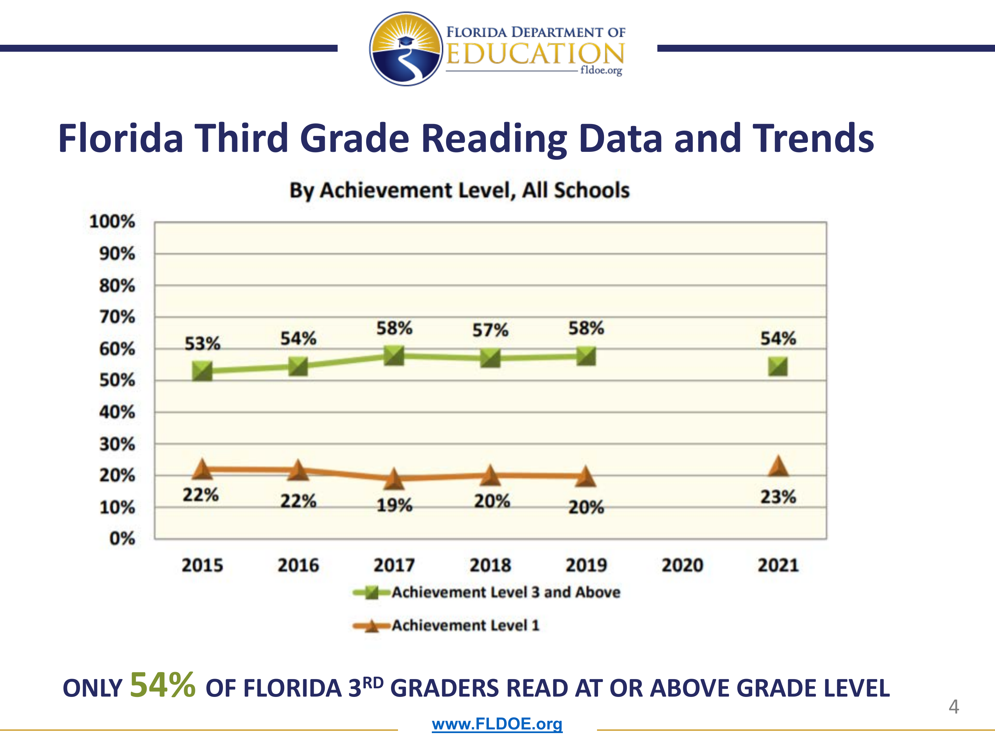

Slide 5
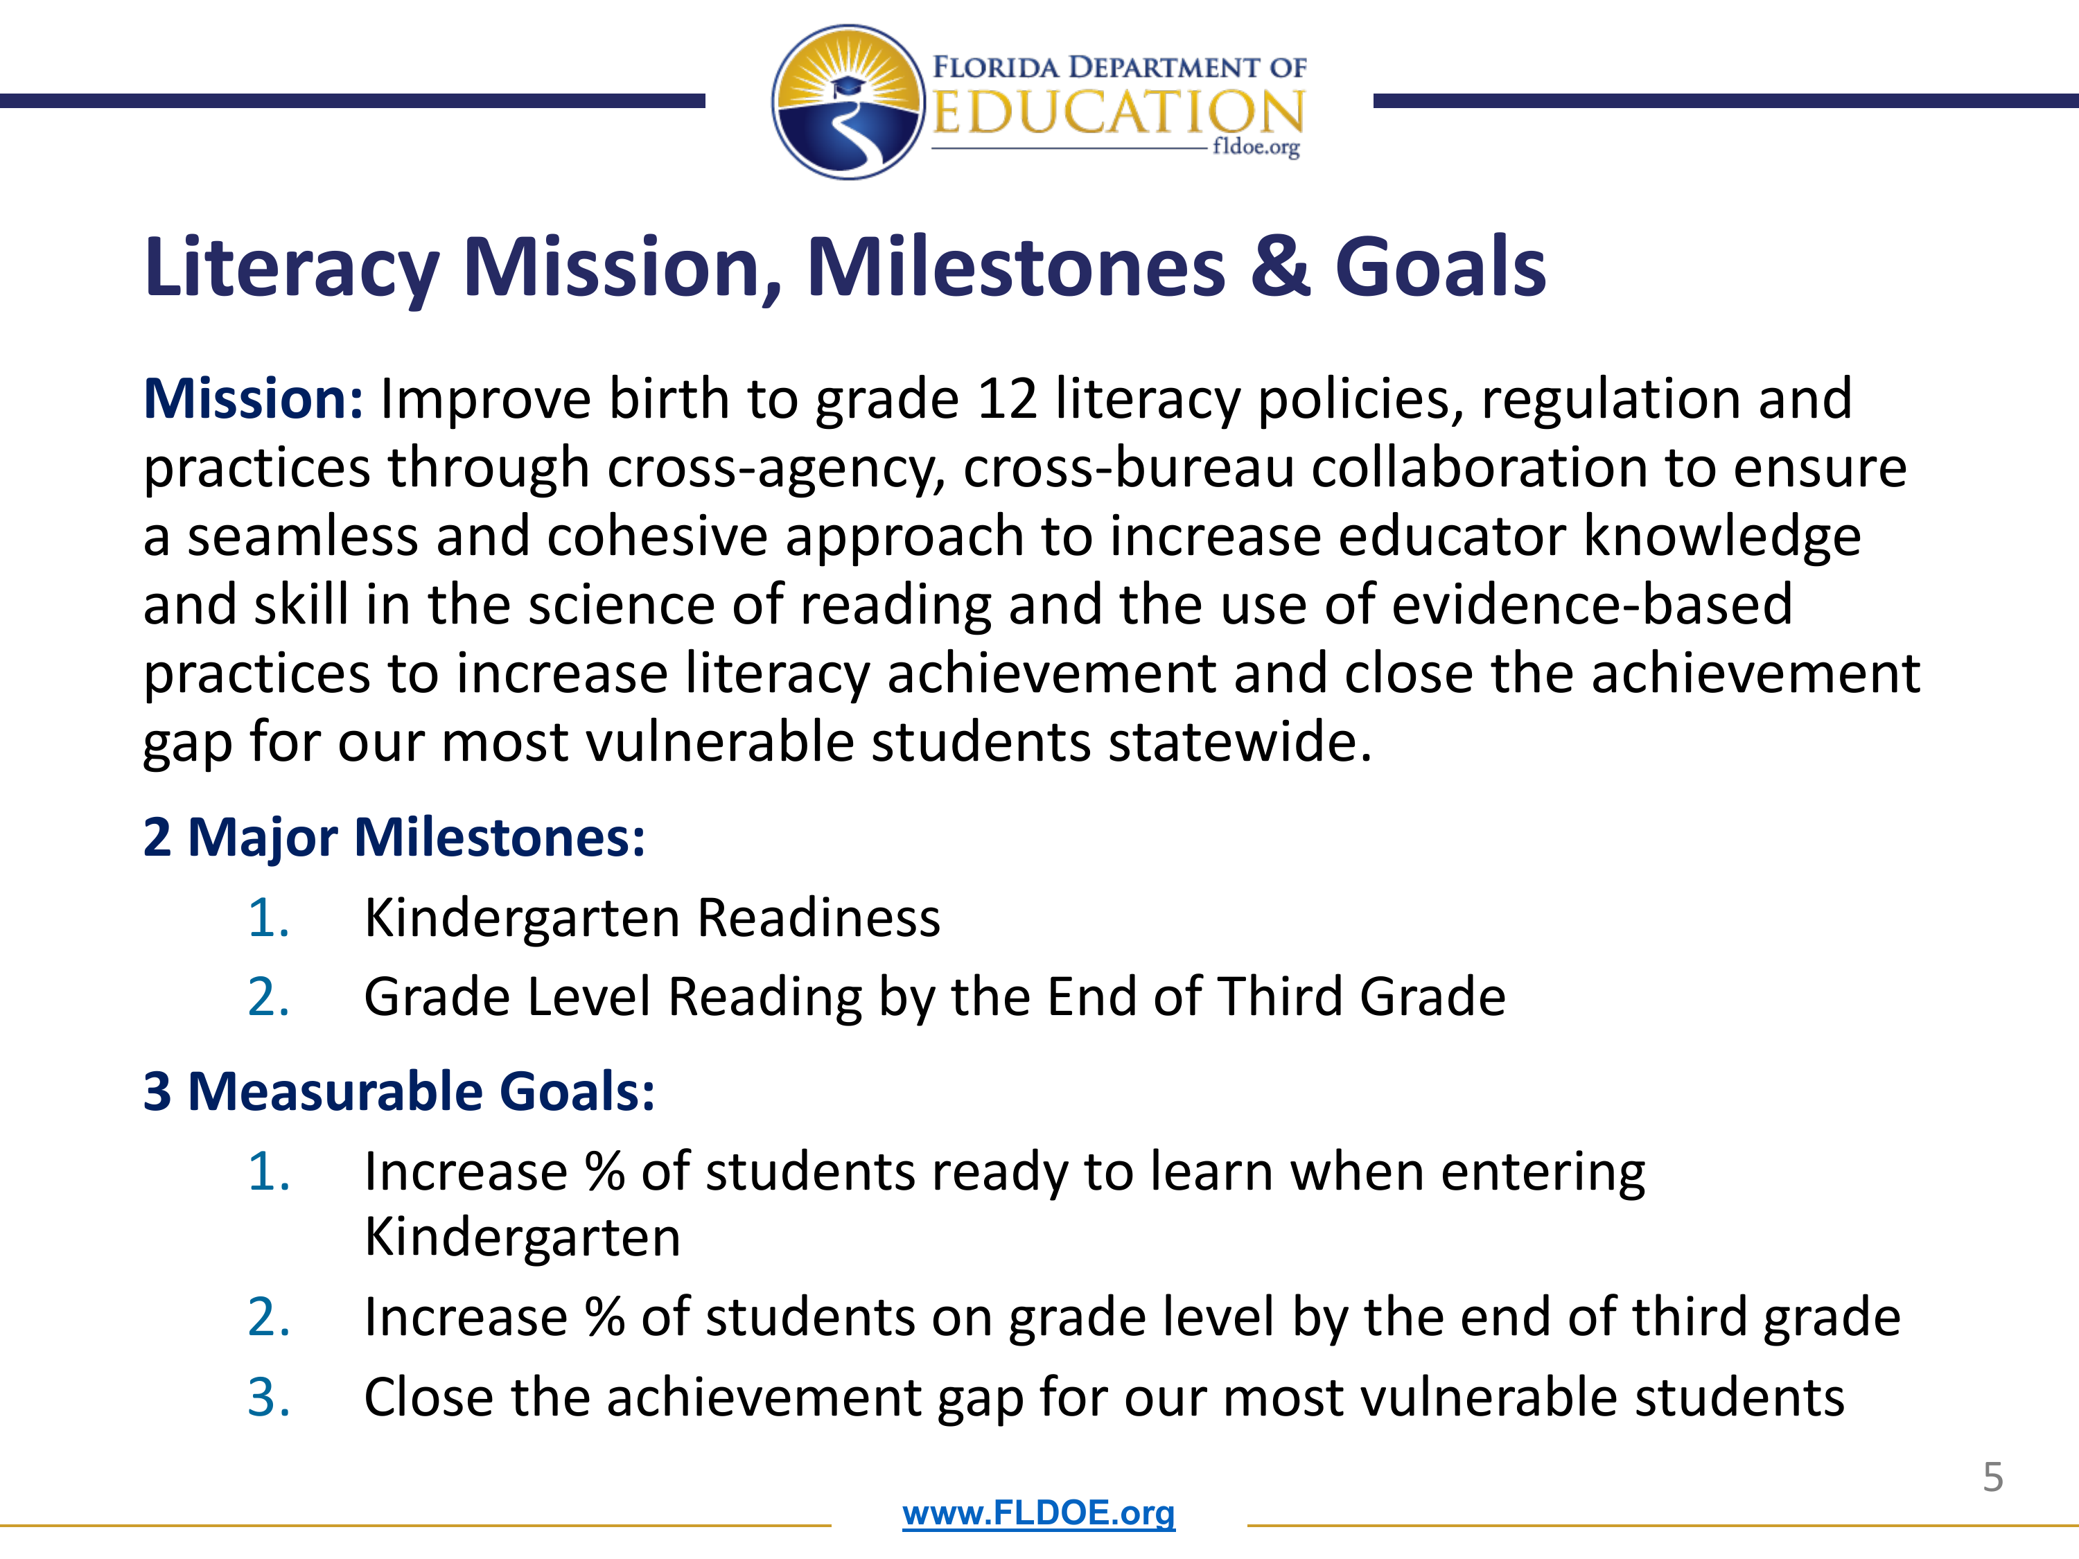

Slide 6
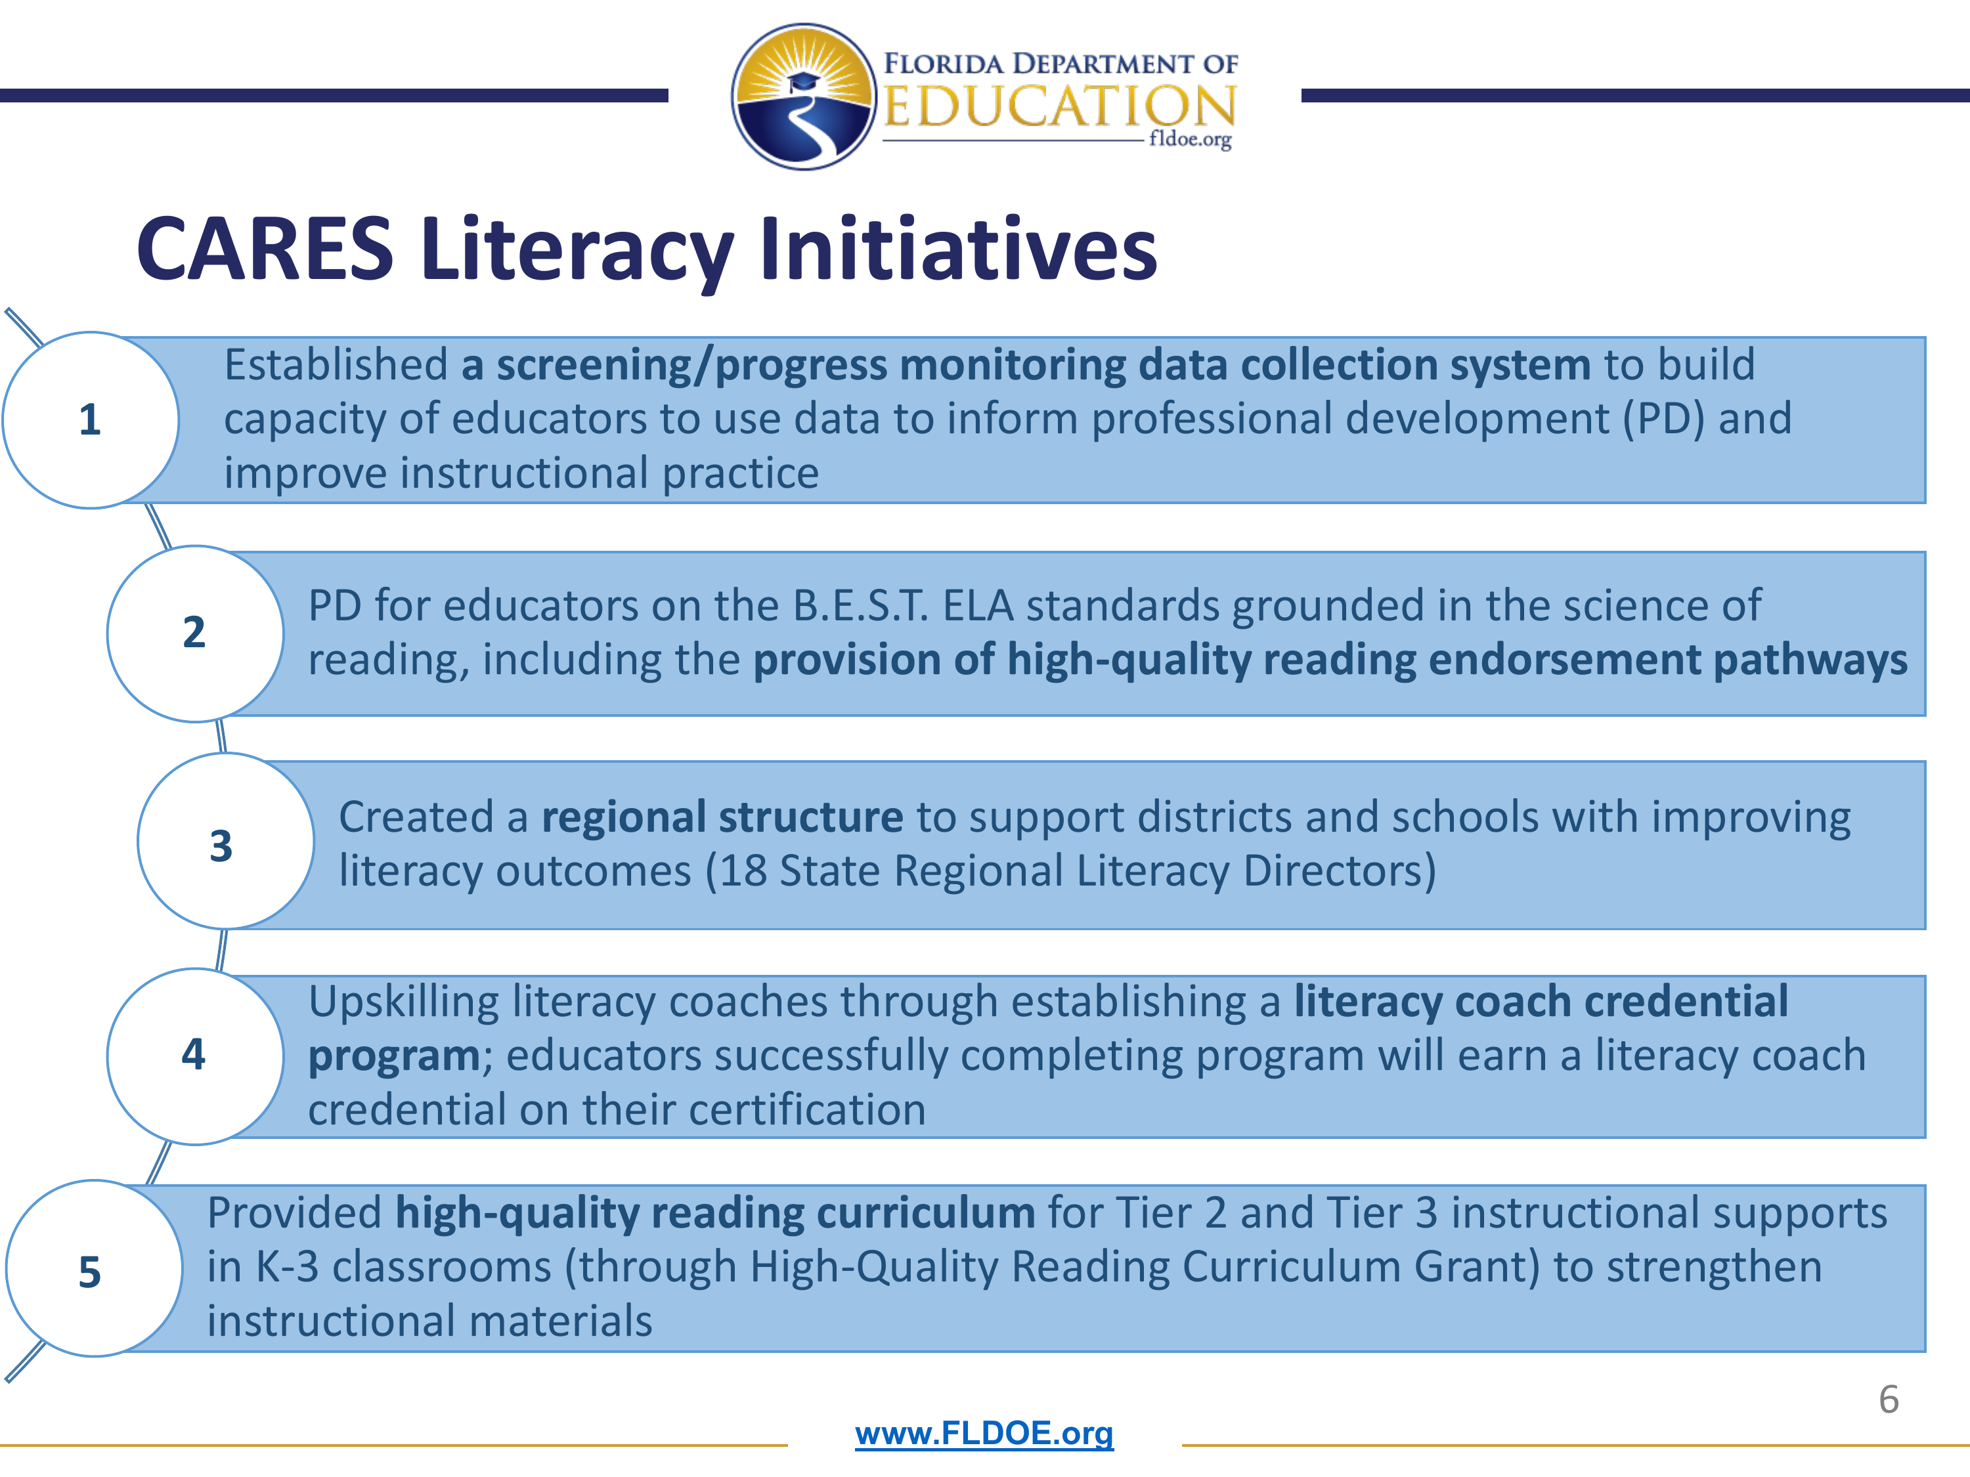

Slide 7
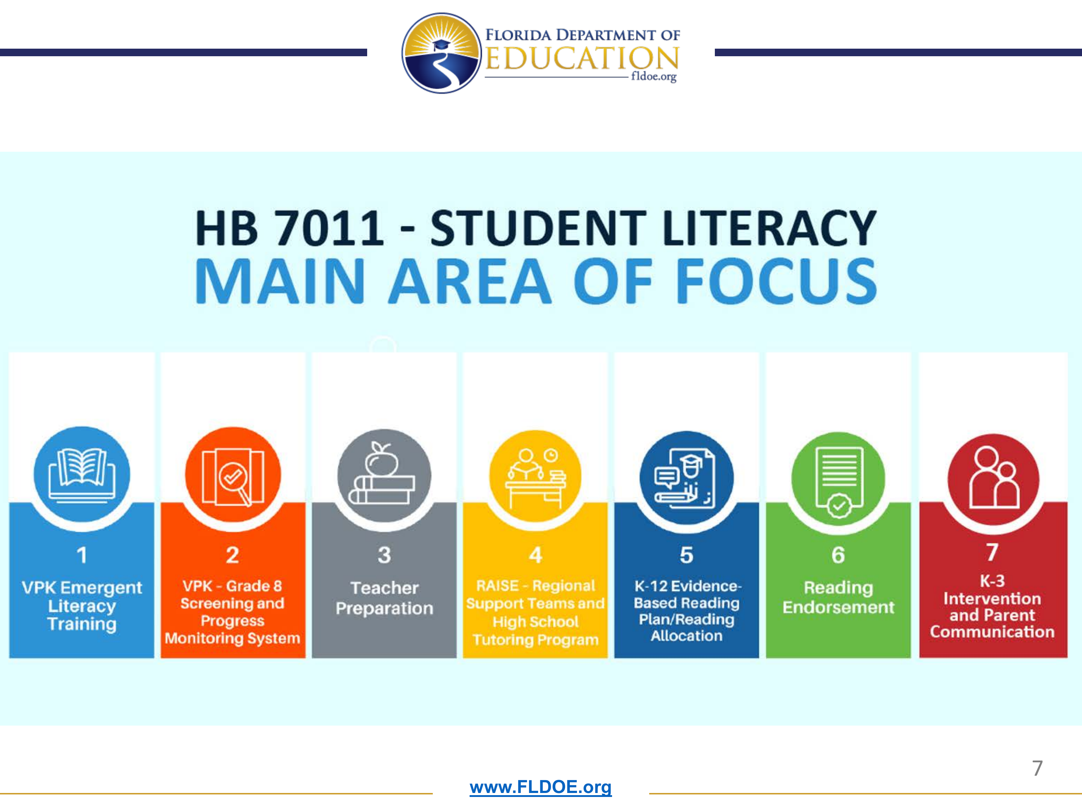

Slide 8
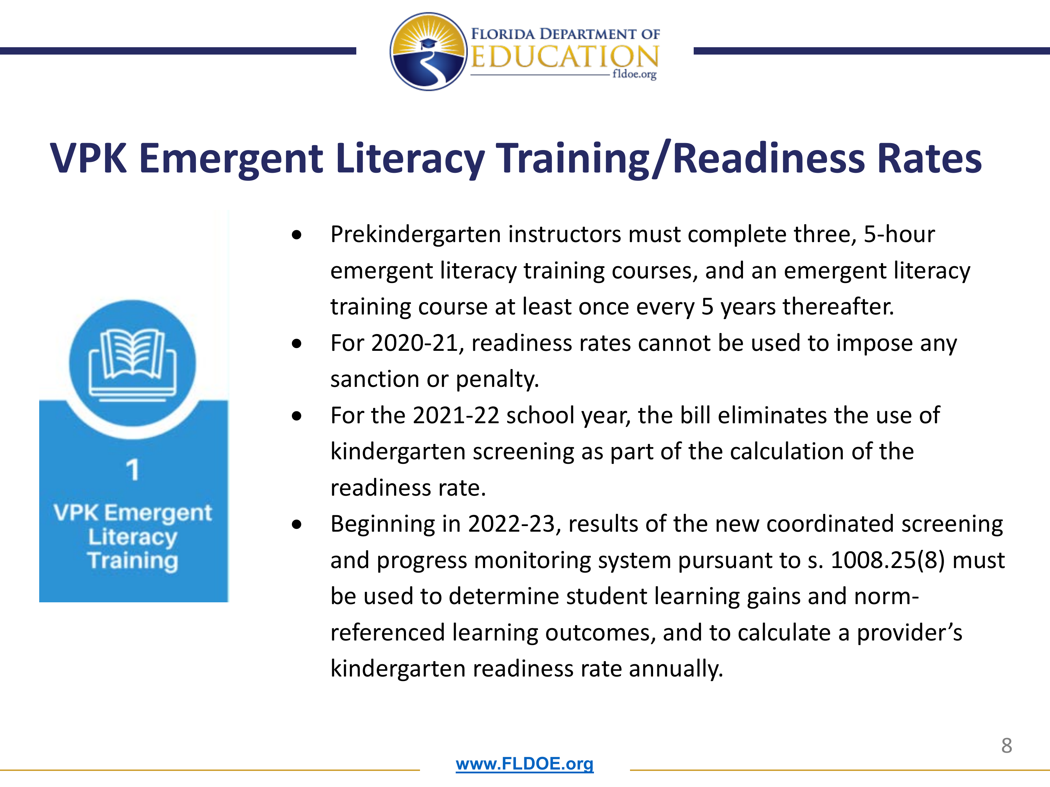

Slide 9
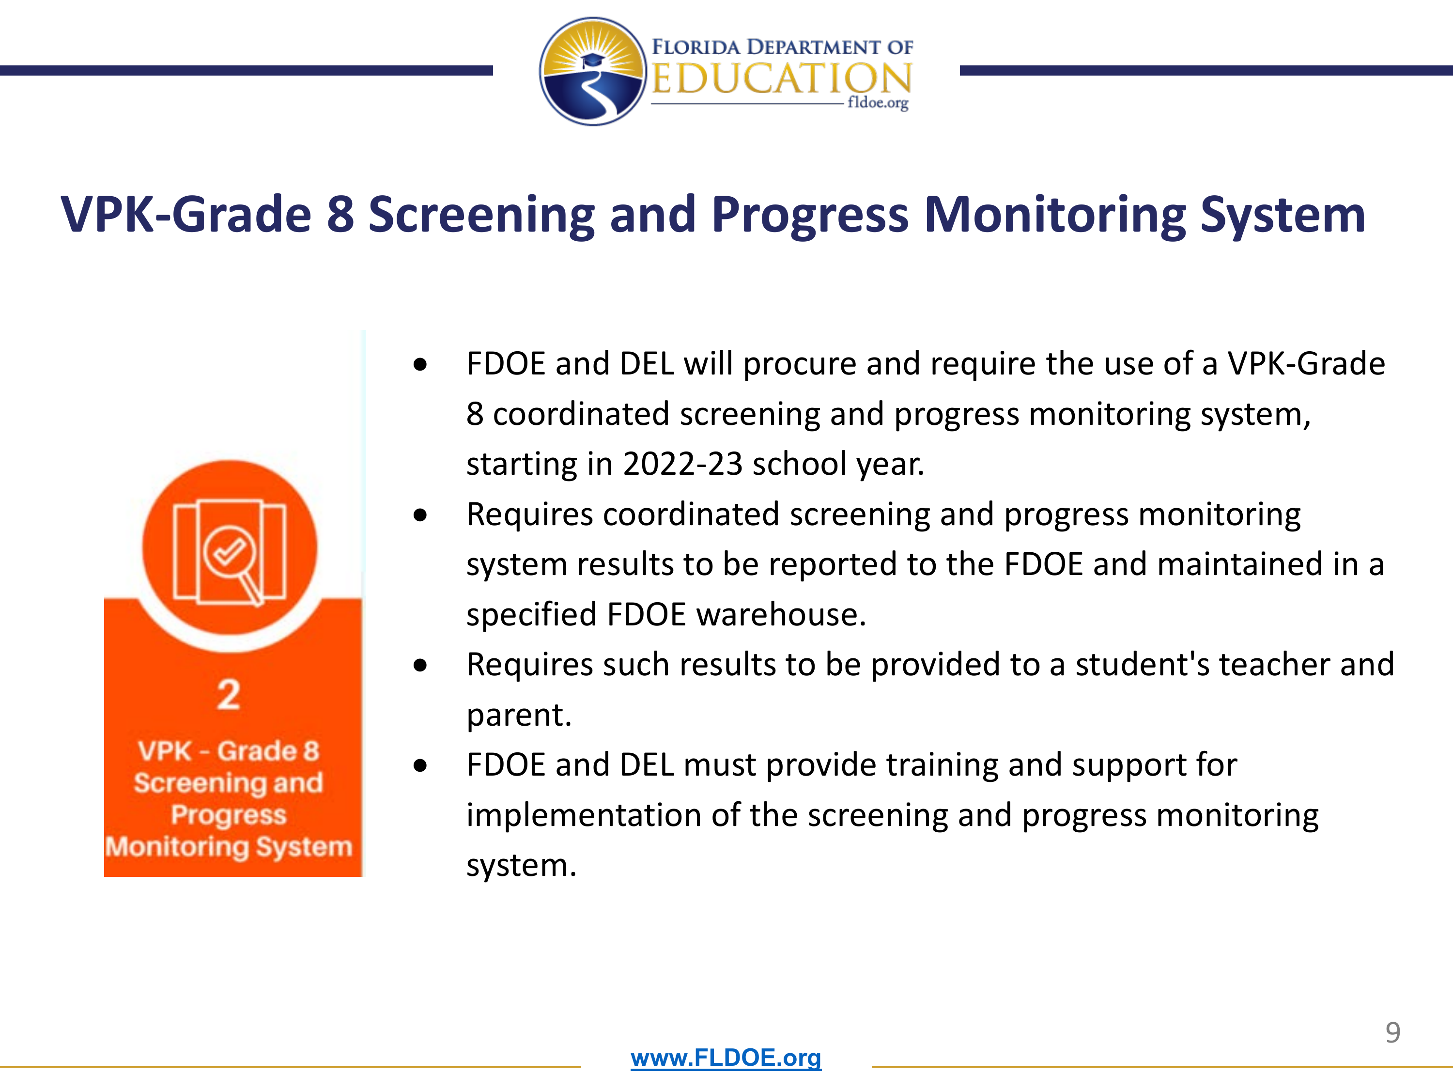

Slide 10
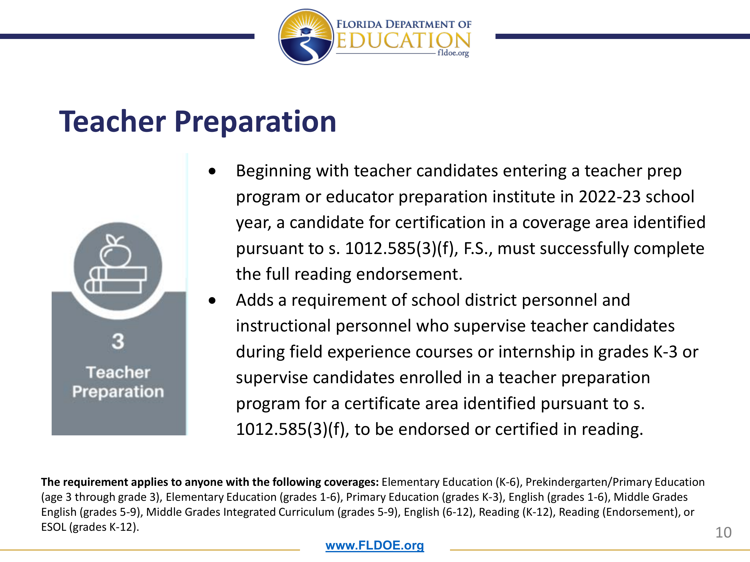

Slide 11


Slide 12
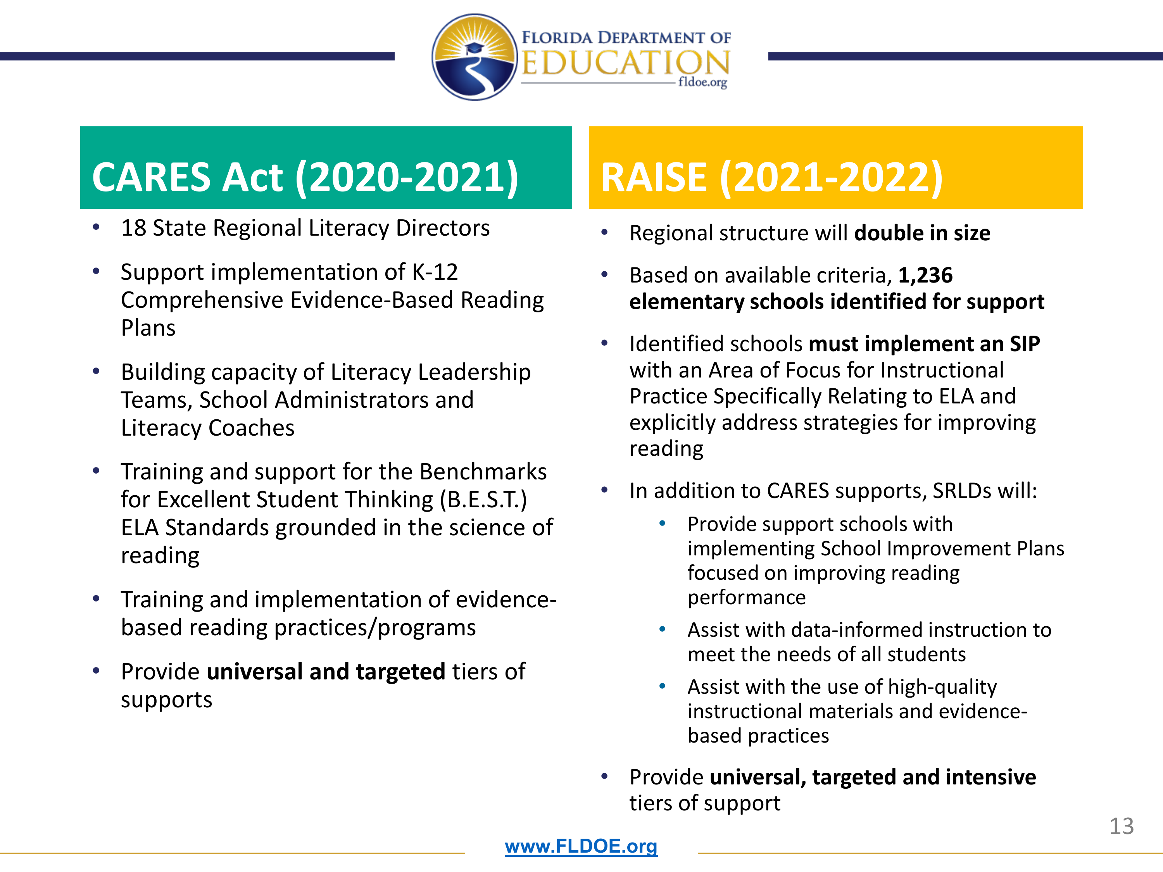
Notes:
Whitney Augustine – SRLD

Slide 13


Slide 14
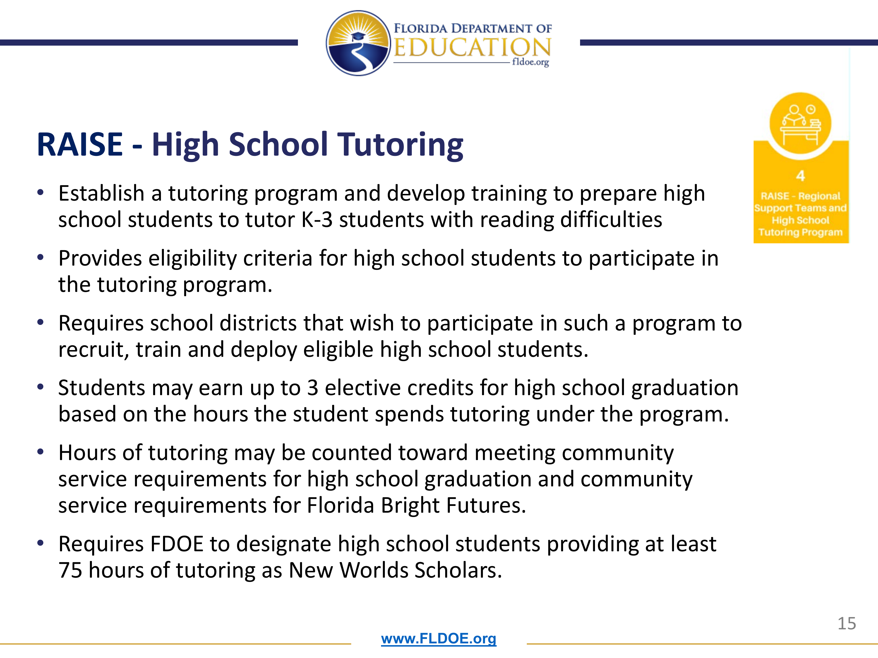

Slide 15
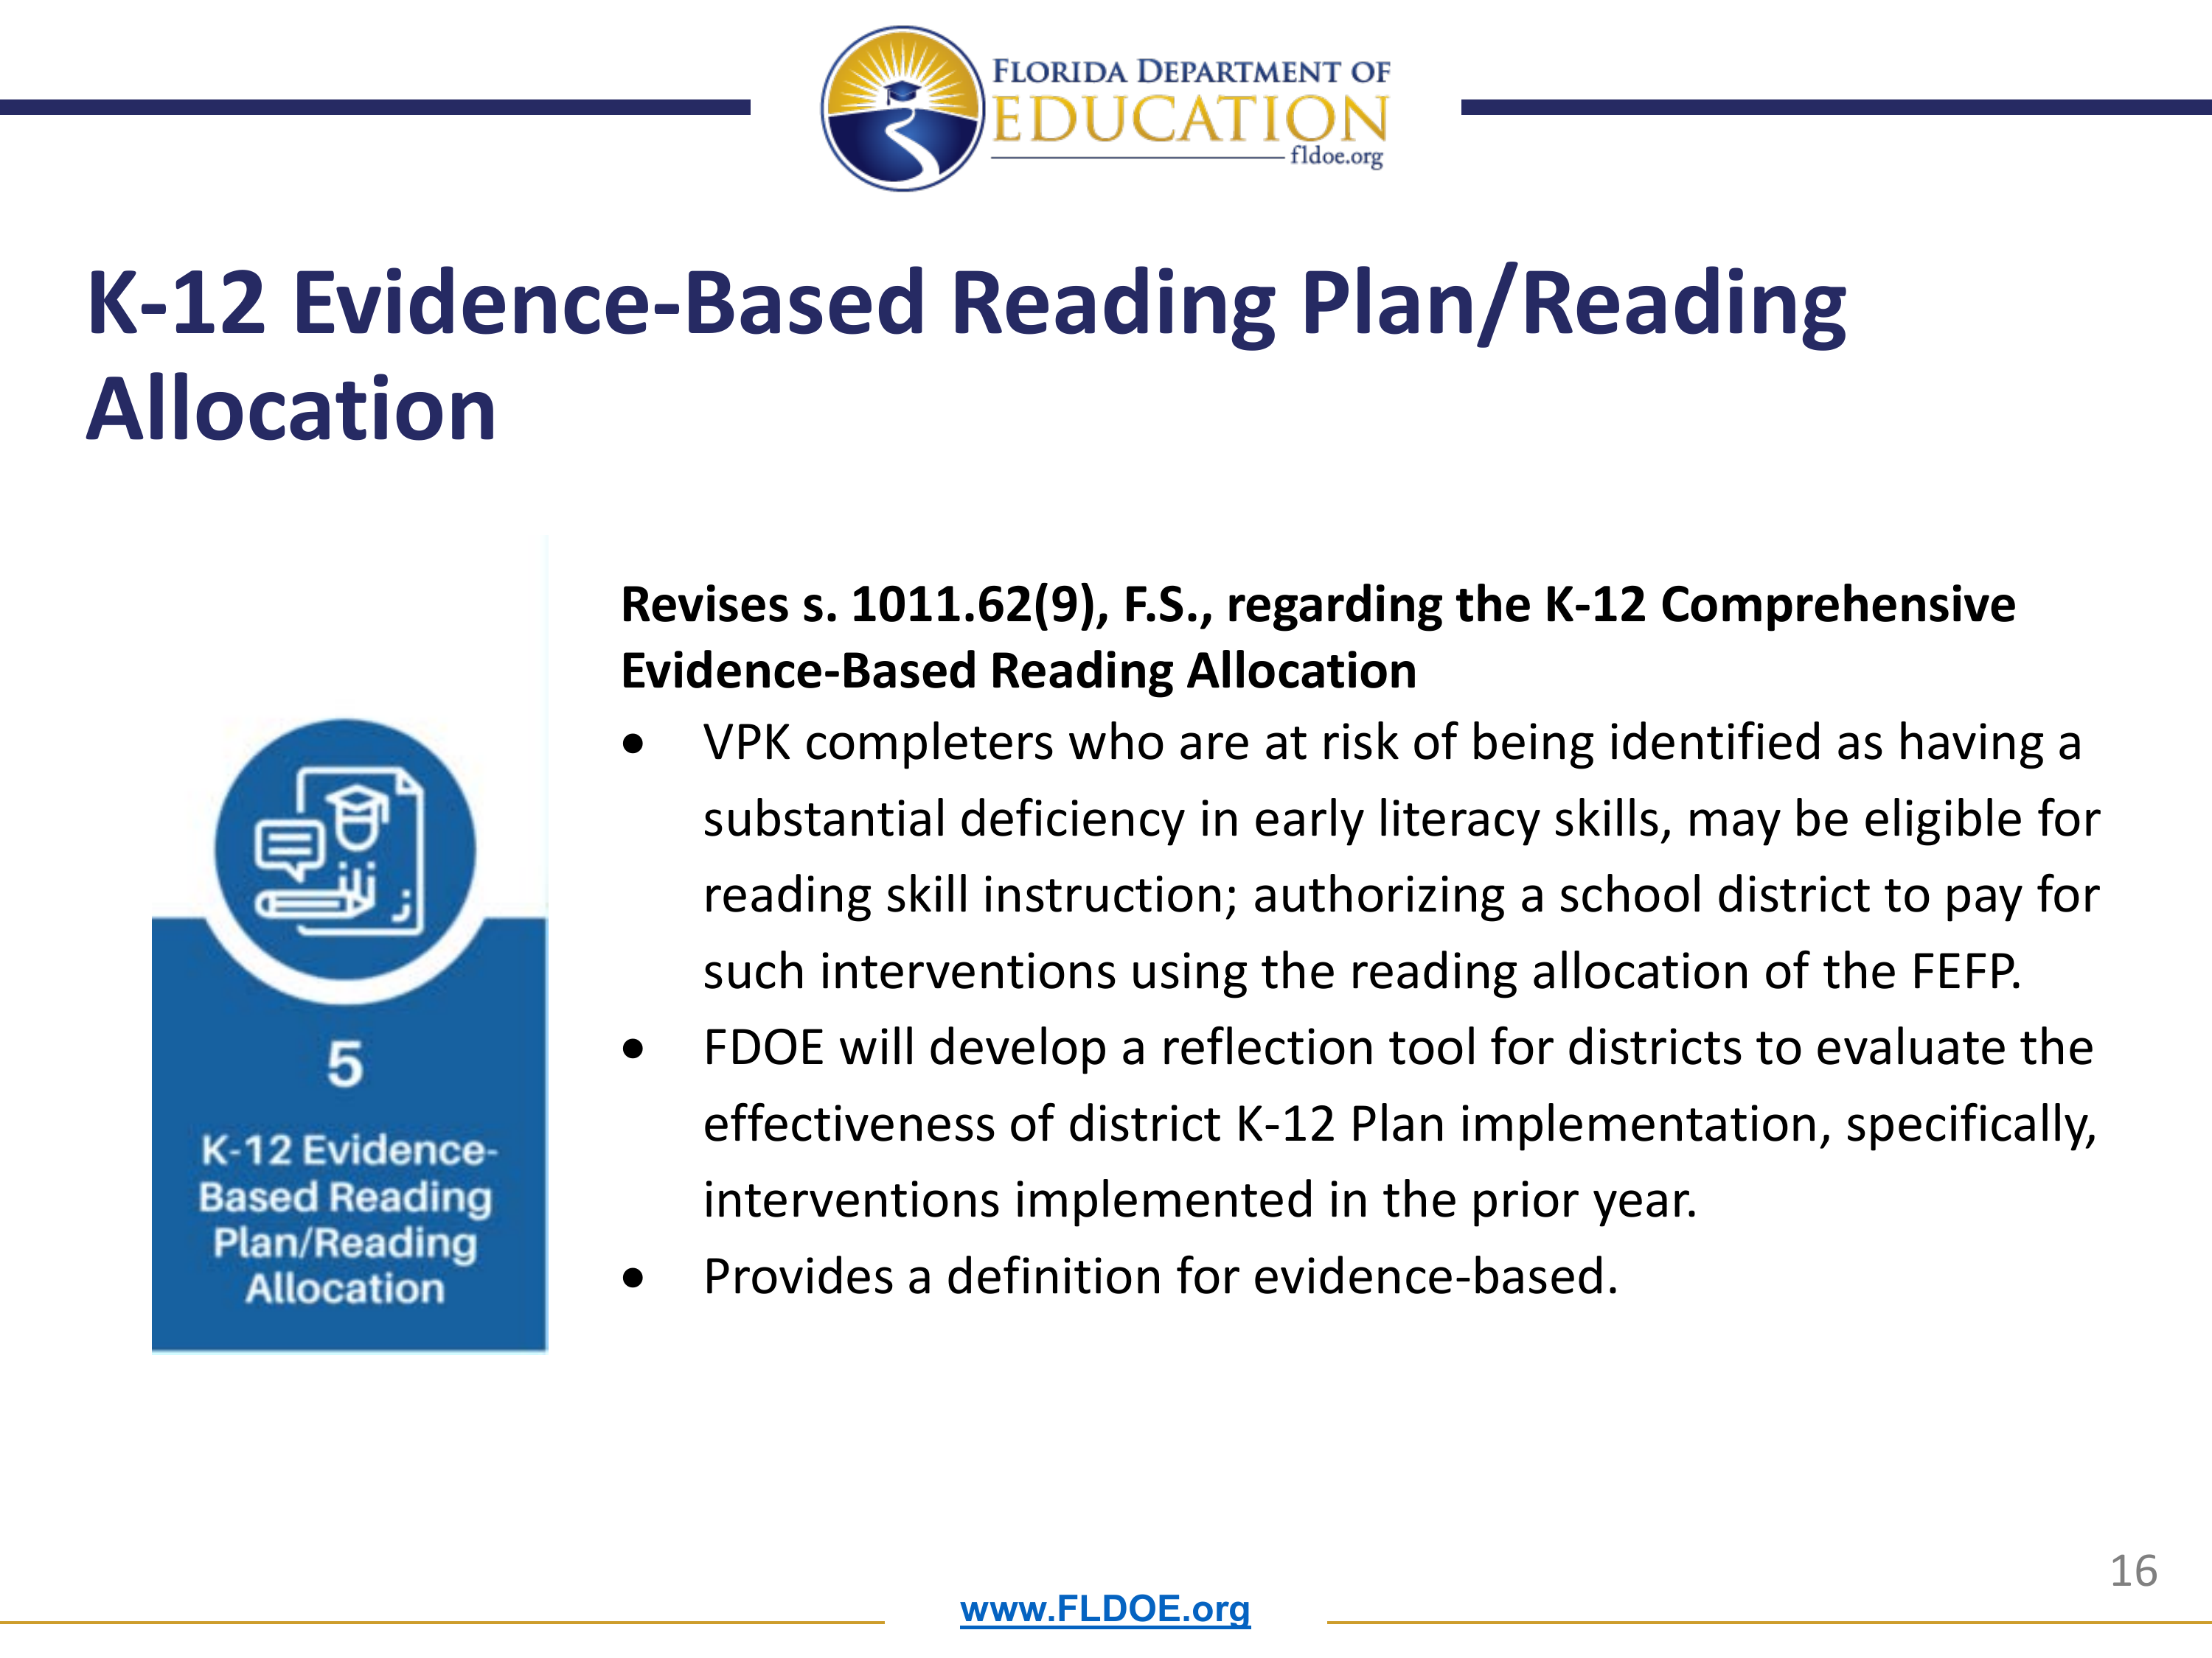

Slide 16


Slide 17


Slide 18
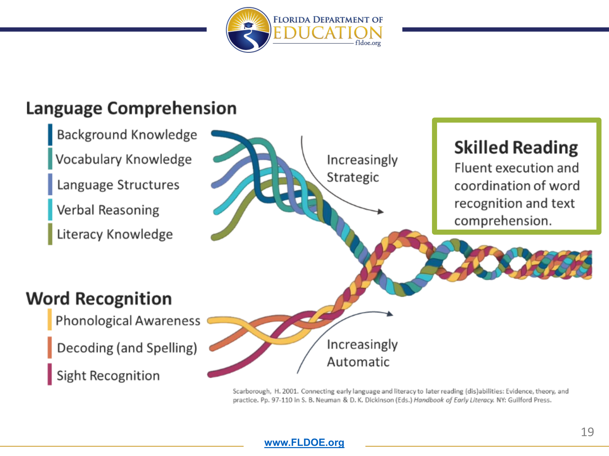

Slide 19
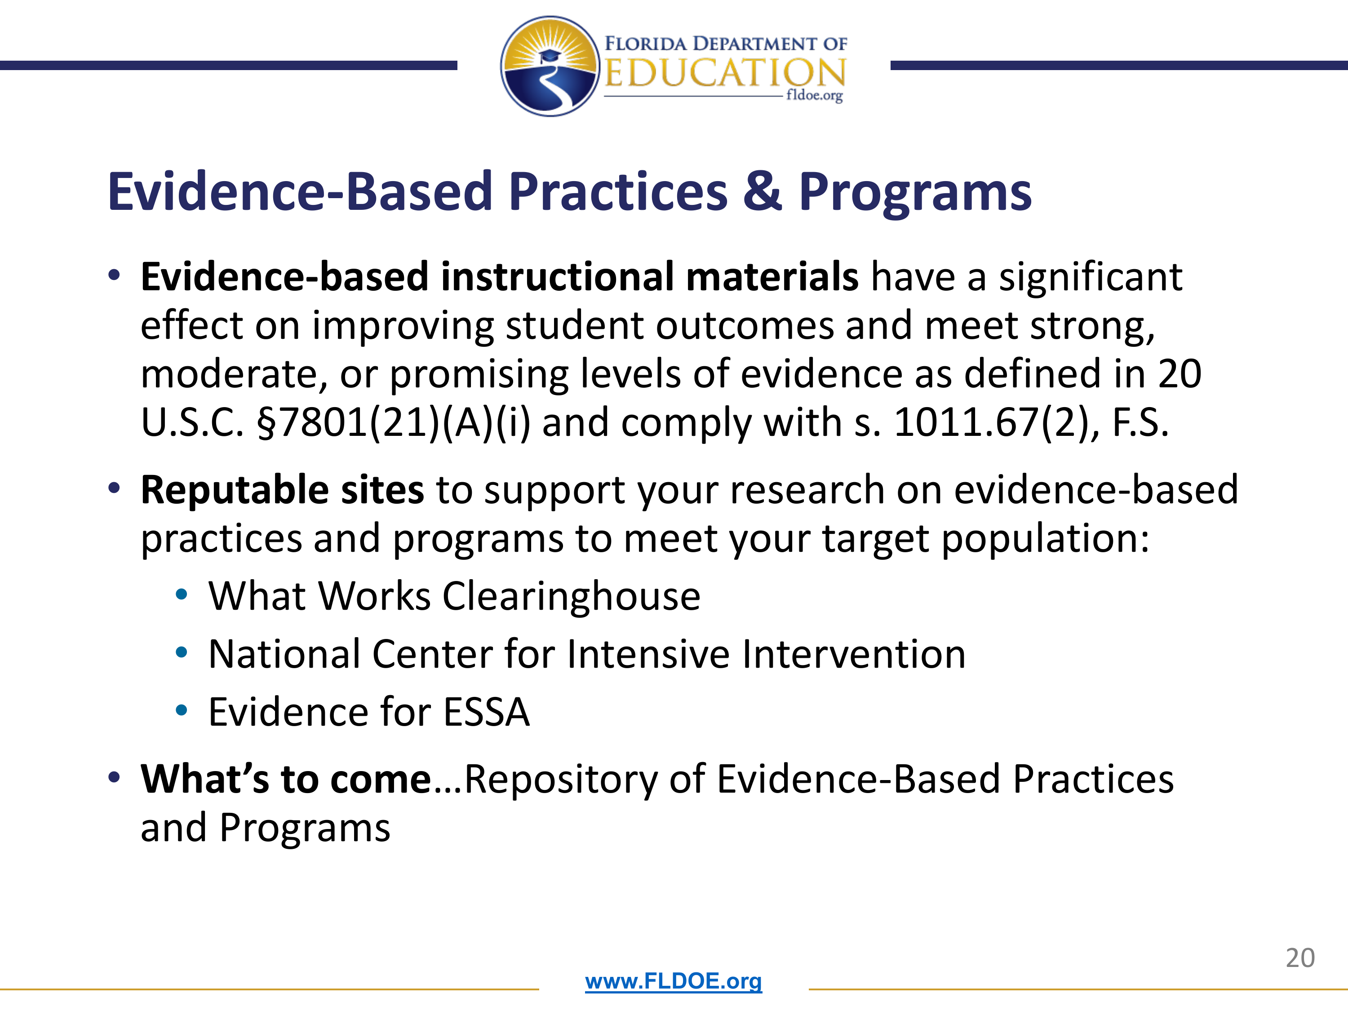

Slide 20
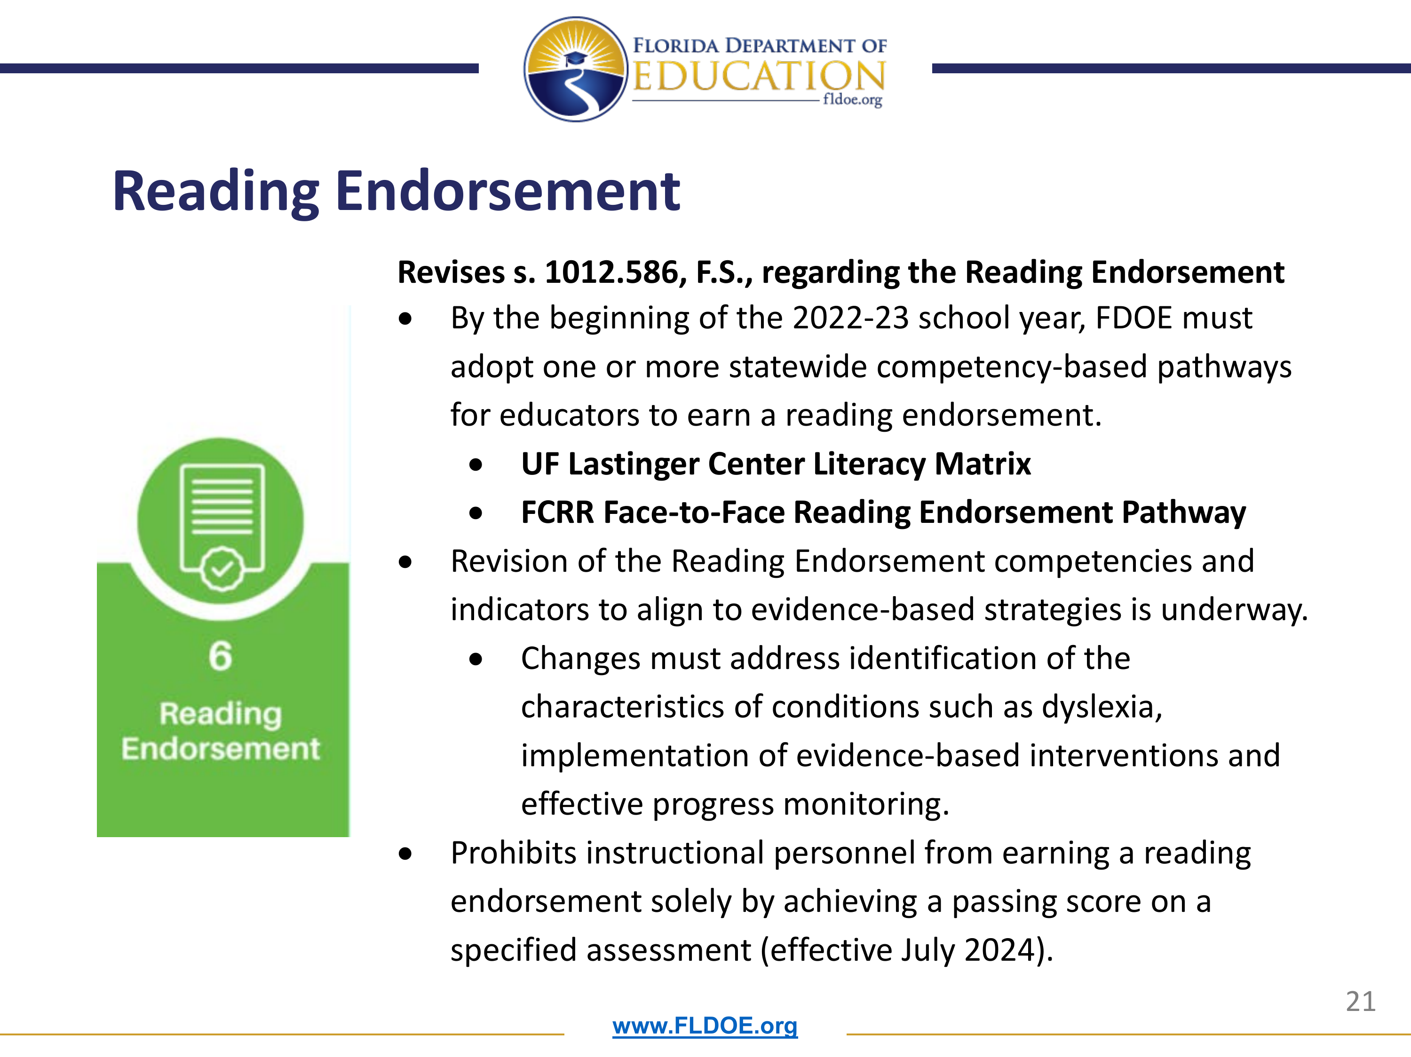

Slide 21
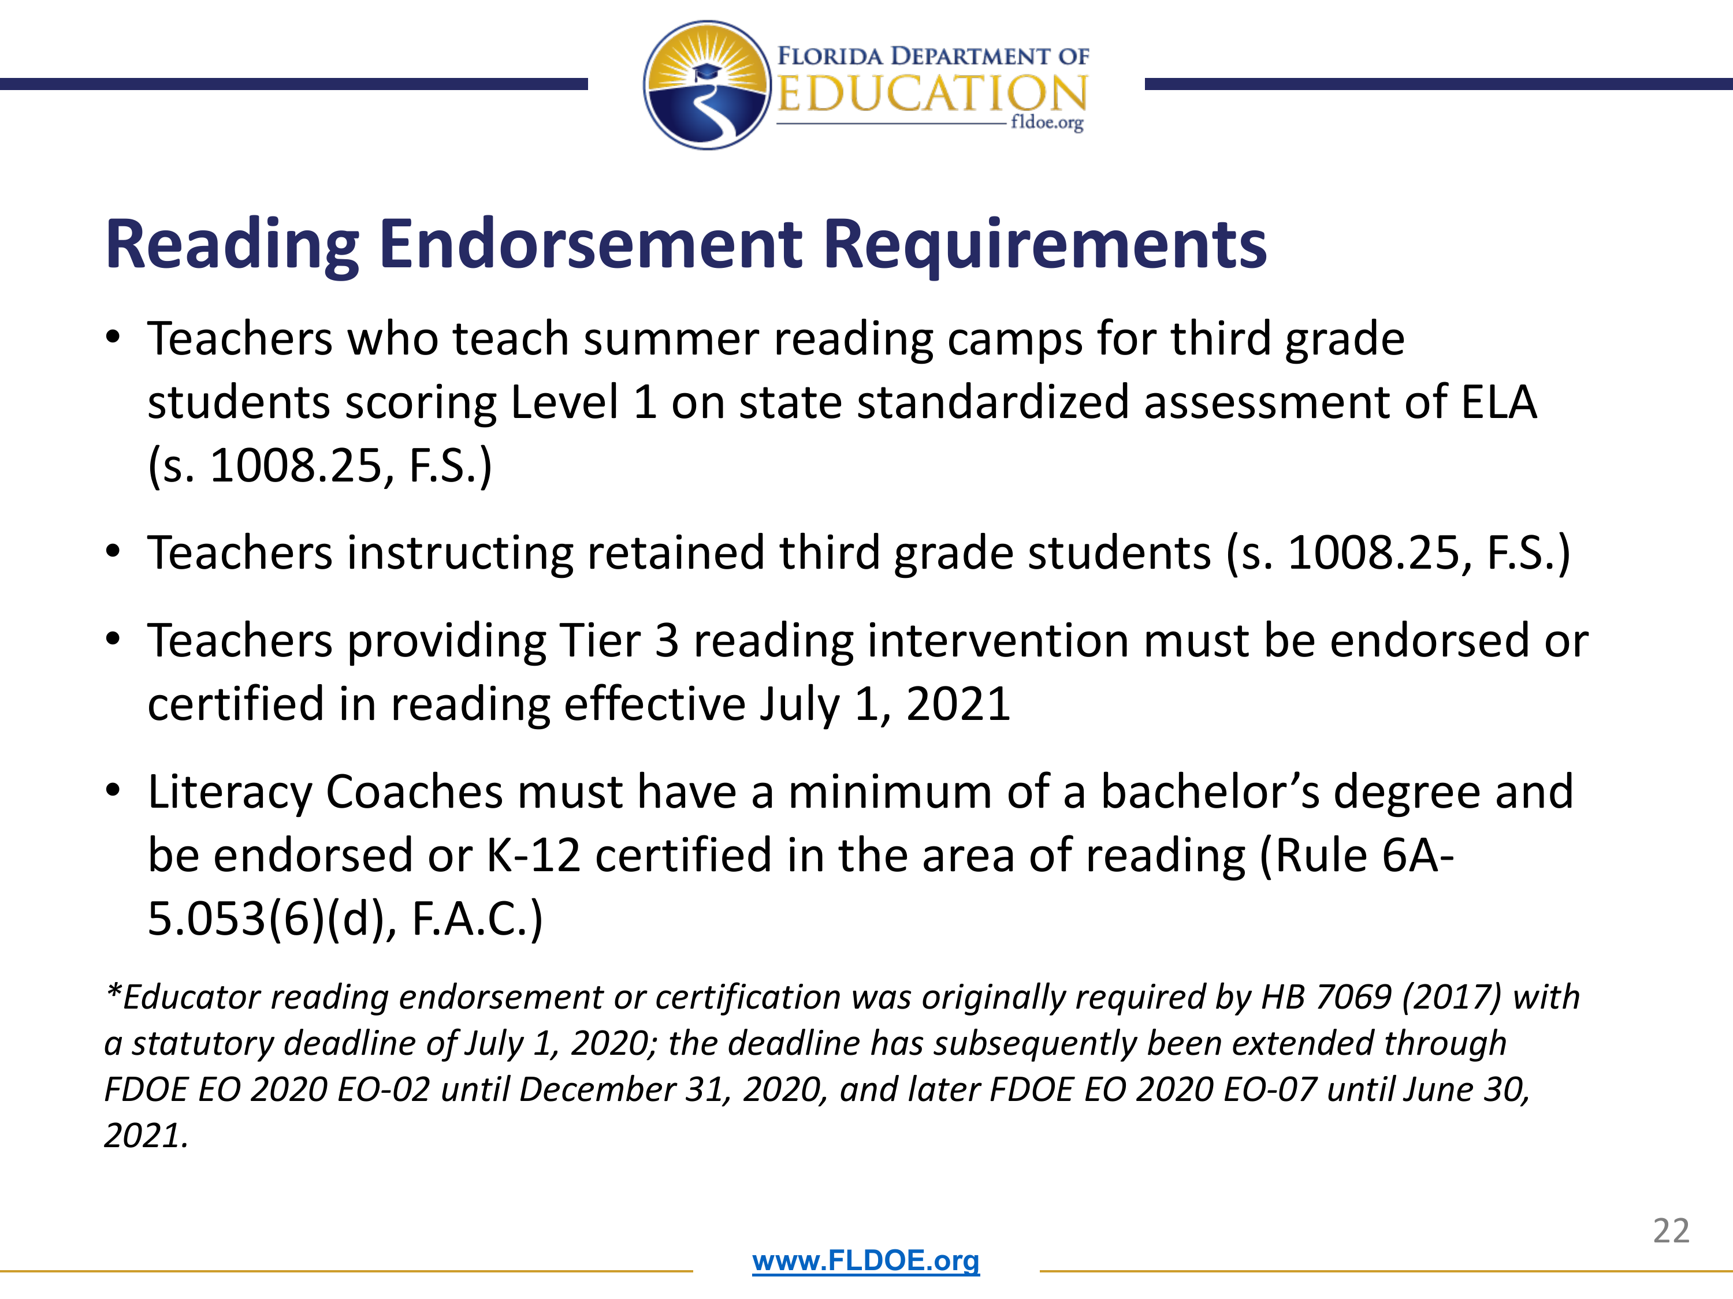

Slide 22
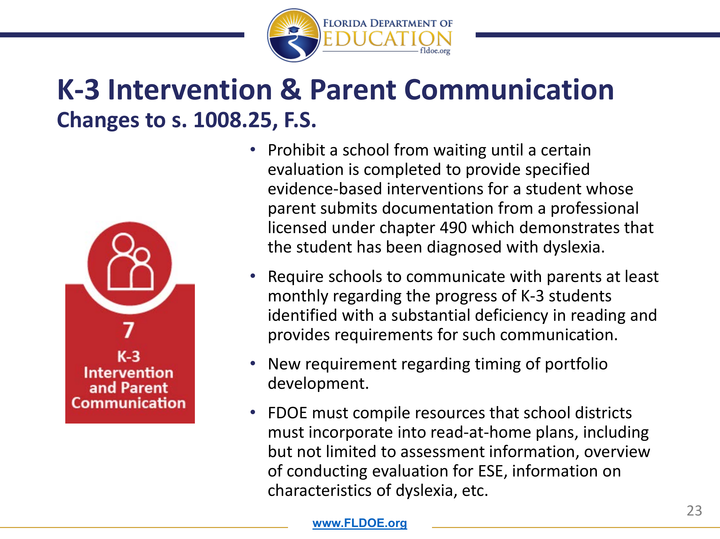

Slide 23


Slide 24


Slide 25


Slide 26


Slide 27


VPK Expansion
2022-2023
Notes:
Good afternoon, School Board Members or if individually __________________________. It is my pleasure to share with you Volusia County Schools’ Summer Programs.

Slide 28

Notes:
Good afternoon, School Board Members or if individually __________________________. It is my pleasure to share with you Volusia County Schools’ Summer Programs.

Slide 29
School Year VPK sites for 2022-23 are:
Five additional schools will host a School Year Voluntary Prekindergarten (VPK) program in the 2022-23 school year, bringing the total to 27.
This program is operated during regular school days and follows the district’s school-year calendar.
West Volusia | East Volusia
Blue Lake | Atlantic High
Discovery | Edgewater
Enterprise | Holly Hill
Forest Lake | Indian River
Friendship | *R. J. Longstreet
*Manatee Cove | Ormond Beach
McInnis | Palm Terrace
Orange City | *Port Orange
Pierson | Read-Pattillo
*Pride | South Daytona
*Spirit | Sugar Mill
Starke | Turie T. Small
Sunrise | Westside
Timbercrest

Slide 30
VPK Registration
VPK Summer – March 1st
  The Summer VPK program is available for students who did not attend a school year VPK program, will be 5 years-old on or before September 1, 2022, and will be attending kindergarten in the fall of the current school year.
VPK 2022-2023 School Year - March 7th
Families are encouraged to contact The Early Learning Coalition of Flagler and Volusia Counties to apply for the VPK Certificate of Eligibility (required for any VPK program). They can be reached at (386) 323-2400, (386) 736-5010 or www.elcfv.org
For more information, call the Volusia County Schools VPK office at
(386) 734-7190, 255-6475, 427-5223 or 860-3322, extension 20505, or visit the school district’s website at https://www.vcsedu.org/VPK.
Contact: Wendy Reaves, Coordinator of Early Learning Programs

Slide 31
VPK Registration
Families are encouraged to contact The Early Learning Coalition of Flagler and Volusia Counties to apply for the VPK Certificate of Eligibility (required for any VPK program). They can be reached at (386) 323-2400, (386) 736-5010 or www.elcfv.org
For more information, call the Volusia County Schools VPK office at
(386) 734-7190, 255-6475, 427-5223 or 860-3322, extension 20505, or visit the school district’s website at https://www.vcsedu.org/VPK.
Contact: Wendy Reaves, Coordinator of Early Learning Programs

Slide 32
Summer Programs
2022
1/27/2022
Notes:
Good afternoon, School Board Members or if individually __________________________. It is my pleasure to share with you Volusia County Schools’ Summer Programs.

Slide 33
Session 1 – June 14th – June 29th
Brick & Mortar Setting
Elementary Stand-Alone Boot Camp
Target - Twelve Elementary Focus Schools
  10-day program; 6 hr. days
  Principals service their students, using their teachers
  District curriculum resources utilized
Notes:
Summer Programs will be offered in two sessions. Session 1 will take place in June. Session 2 will take place in July.
All programs will be offered in a traditional, brick & mortar setting. For June, we will continue to offer newly implemented programs in summer 2021 such as our Stand-Alone Boot Camps for twelve focus schools wishing to participate.

Slide 34
Session 1 – June Offerings
Brick & Mortar Setting
Program | Audience | Dates
Elementary Course Offerings
Extended Summer Tutoring Bootcamp (Brick & Mortar) | Students from 12 Stand Alone/Focus Schools in grades K-5th | June 14 – 29
Title I, SEA Lab | Students in grades K and 1st | June 13 - 23
VPK | Students who have not used their Early Learning Coalition voucher and will be enrolled in kindergarten in the fall | June 13 – August 4
Secondary Course Offerings (Middle and High)
Credit Retrieval Session A | Students (8th & 12th) who earned an ‘F’ in a core course and did not earn credit | June 9 – 29
Volusia Online Learning | Students in middle and high school desiring to earn original course credit | June 9 – 29 and July 5 - 28
Notes:
*Make sure to point out that both VPK and VOL start in June but will continue through July and August
VPK Sites –George Marks, Read-Pattillo, Spirit, Westside
Optional- Also, the SEA Lab enrichment program hosted at an eastside and westside location provides an opportunity for teacher professional development opportunities to grow with classroom management, small group instruction in both ELA and Math through engaging activities.

Slide 35
Session 1– June
Hosting Schools
Elementary | Middle | High
Blue Lake | Campbell MS | Atlantic HS
Champion | Creekside MS | Deland HS
Deltona Lakes | Deland MS | Deltona HS
Discovery | Deltona MS | Mainland HS
Friendship | Galaxy MS | New Smyrna Beach HS
Holly Hill | Heritage MS | Pine Ridge HS
Orange City | Hinson MS | Seabreeze HS
Palm Terrace | Holly Hill | Spruce Creek HS
South Daytona | New Smyrna Beach MS | Taylor MS/HS
Turie T. Small | Ormond Beach MS | University HS
Volusia Pines | River Springs MS
Westside | Silver Sands MS
 | Southwestern MS
Notes:
Elementary hosting sites will be all Transformation Schools.

Slide 36
Session 2– July 5th – July 28th
Traditional Brick and Mortar Setting
Traditional Host Sites w/Feeders
(All Schools Included; providing students opportunity for enriching/engagement programs offered in July)
13 Elementary Sites
14 Middle Schools
10 High Schools
Notes:
All hosting sites have been cleared through facilities/maintenance

Slide 37
Session 2– July Offerings
Traditional Brick & Mortar Setting
Program | Audience | Dates
Elementary Course Offerings
Elementary Reading Camp | Identified students in grades 2-3 | July 5 – 28
Extended School Year (ESY) | Students with disabilities who have been recommended for ESY | July 5 - 28
ESOL | Identified students in grades K-5 | July 5 - 28
Title I, CSI Programs | Students in grades Pre-K-5th (Title I and opportunities for students in Non-Title I) | July 5 - 28
Secondary Course Offerings (Middle and High)
Extended School Year (ESY) | Students with disabilities who have been recommended for ESY | July 5 - 28
Secondary Algebra, Biology, Title I STEM, & Credit Retrieval B | Identified students in grades 6-12 | July 5 - 28
Migrant will continue to support students enrolled in Summer Programs.
Notes:
New this year is second grade Elementary Reading Camp.
Drivers Ed will take place.
Again, VPK and VOL for original credit are carried out through July as well as June.

Slide 38
Session 2– July
Hosting Schools
Elementary | Middle | High
Citrus Grove | Campbell MS | Atlantic HS
George Marks | Creekside MS | Deland HS
Horizon | Deland MS | Deltona HS
Manatee Cove | Deltona MS | Mainland HS
McInnis | Galaxy MS | New Smyrna Beach HS
Osteen | Heritage MS | Pine Ridge HS
Pine Trail | Hinson MS | Seabreeze HS
Read Pattillo | Holly Hill K-8 | Spruce Creek HS
Spirit | New Smyrna Beach MS | Taylor MS/HS
Sugar Mill | Ormond Beach MS | University HS
Westside | River Springs MS
*Discovery | Silver Sands MS
*Friendship | Southwestern MS
Notes:
These are the hosting sites as next up in feeder rotation for 2022 with the exception of Deltona Lakes, which will be under construction so Spirit will host in its place and Deltona Lakes students will be invited to attend at Spirit.
We are adding Discovery and Friendship as stand-alone sites.

Slide 39
Extended Day Enrichment Program (EDEP)
Dates/Locations TBD
Traditional Brick and Mortar Setting
Costs
Registration | $10
Field Trip Fee | N/A
Full Rate | $80/week $75 additional sibling/week
Reduced Lunch | $60/week
Free Lunch | $50/week
*Volusia County Scholarship department along with Parks & Rec at this time no dates on scholarship have been released
Notes:
Please note that the EDEP Program is the only Summer Program that requires a fee for participation.
If families are interested in additional information, they may contact our Extended Day Enrichment Program.
Based on the projected staff and budget from Summer 2021 for Summer 2022 it is approximated that EDEP will run 8-10 Summer Programs.
The sites are based off needs of principal support, staffing, budget, and parent requests from Summer 2021.
I am in the process of coordinating with the Principals and Site Facilitators at each specific site.
See below on projected site locations:
East Side
Pine Trail
R.J. Longstreet
Port Orange
Spruce Creek
Indian River
West Side
George Marks
Osteen
Pride
Spirit
Volusia Pines
After the Summer meeting Friday 1/28/22. I will have more information and can provide a timeline on registration roll out.

Slide 40
Questions?
Notes:
Thank you.
This concludes the formal Summer Programs presentation. Are there any questions?

