Slide 1
Substitute Update
District Advisory Committee
December 1, 2021

Slide 2
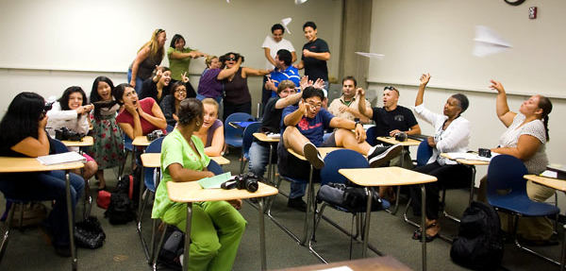

Slide 3
comparison
School Year 2020-2021
School Year 2021-2022
Date | Total Jobs | Fill Rate
November 9-13, 2020 | 1822 | 86.21%
November 16-20, 2020 | 2092 | 89.79%
Date | Total Jobs | Fill Rate
November 8-12, 2021 | 2194 | 86.58%
November 15-19, 2021 | 1476 | 87.05%

Slide 4

Updates
Increased rate of pay - $13.50 per hour
School Based Substitute Allocation
Application Process
  Screening
Onboarding Process
  STAR Training

Slide 5

Recruitment EVENTS
NOVEMBER 15, 2021
DELAND HIGH SCHOOL
DELTONA HIGH SCHOOL
40 Hired
NOVEMBER 16, 2021
ORMOND BEACH MIDDLE SCHOOL
SPRUCE CREEK HIGH SCHOOL
54 Hired
94 HIRED

