Slide 1




A Partnership for the Future…
…of our students.
…of our businesses.
…of our community.

Slide 2
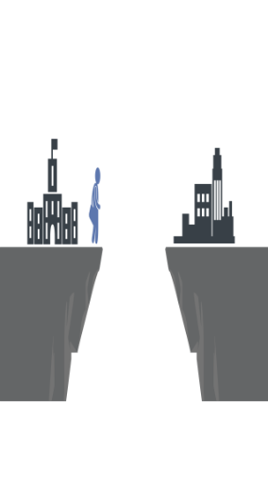

Proof | Aptitudes Align Labor Supply With Demand
Interest-Based Surveys Steer Students Away From The Economy
80%
Interest-Based Recommendations
0%
Interest-Based Recommendations
Social & Artistic Careers:
Arts & Entertainment, Education,
Social Work, Lifesciences
Economic In-Demand Careers:
Architecture & Engineering, IT, Construction, Manufacturing, Transportation & Logistics
20%
Aptitude-Based Recommendations
54%
Aptitude-Based Recommendations
Aptitudes Align Talent With In-Demand Jobs
Analysis of Top 50 Most Frequent Career Recommendations made to 103,050 public school students based on aptitudes and interests

Slide 3
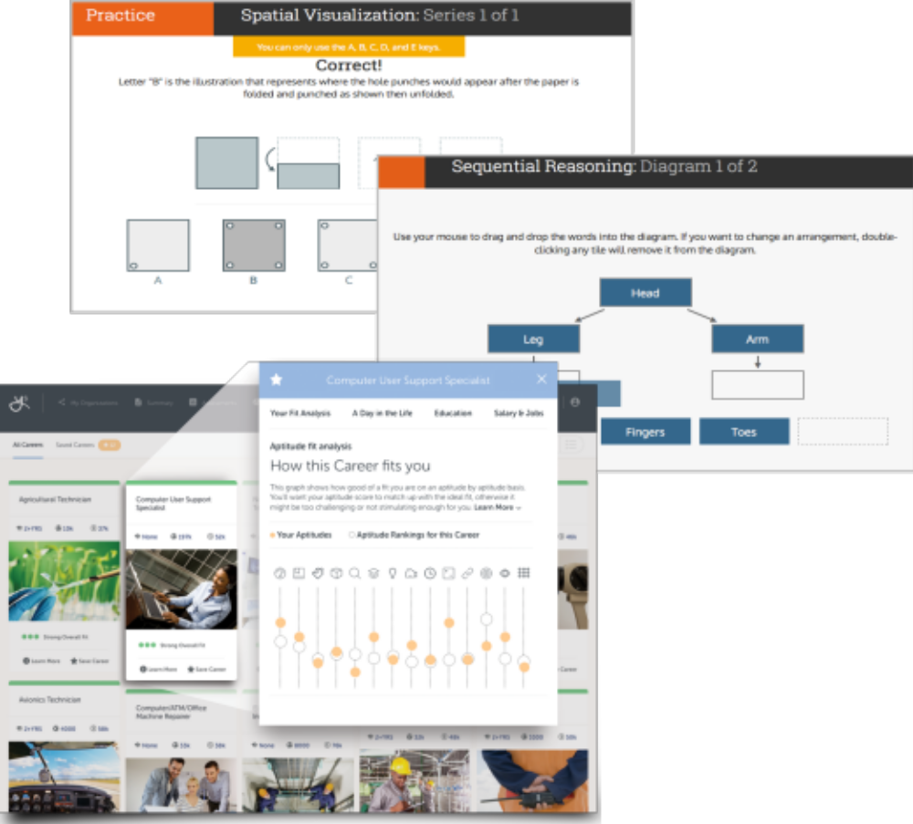


Validity | The Science Behind YouScience
First Online-Based Aptitude Exercises
  Backed by decades of psychometric validation
Normed & Verified
  O*Net career abilities

Slide 4
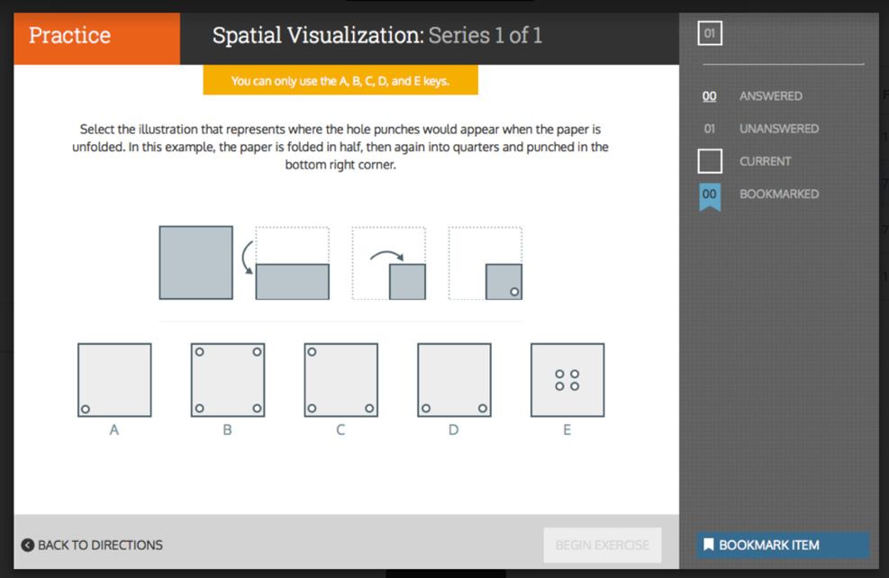
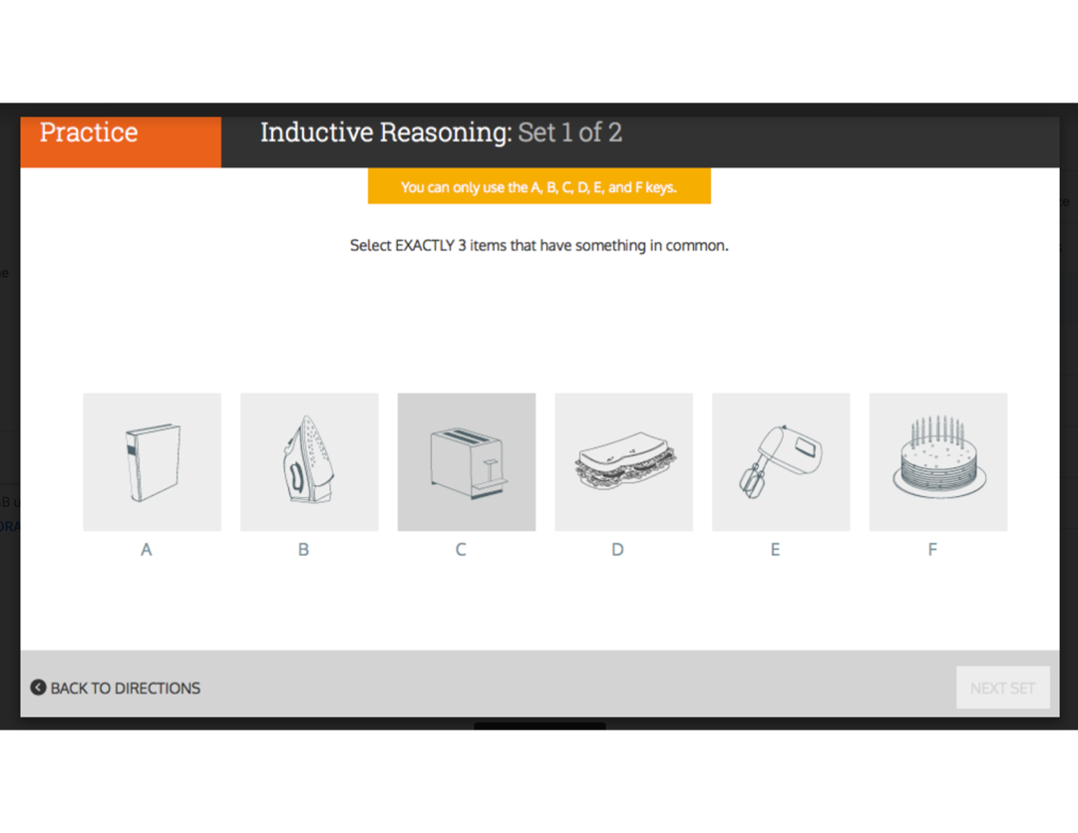
How It Works | Fun Engaging ’Brain Games’
Spatial Visualization
Inductive Reasoning
Sequential Reasoning
Idea Generation
and more…

Slide 5
Proof | Uncovers a Larger More Diverse Workforce
3.4x more females
identified a fit for key industries
%
%
%
%
Key In-Demand Industries: Technology, Manufacturing, Construction, Healthcare
2.1x on average more minorities
identified a fit for key industries
%
%
%
%
%
%
%
%

Slide 6

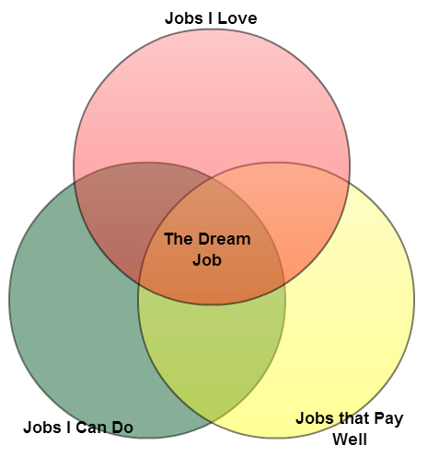
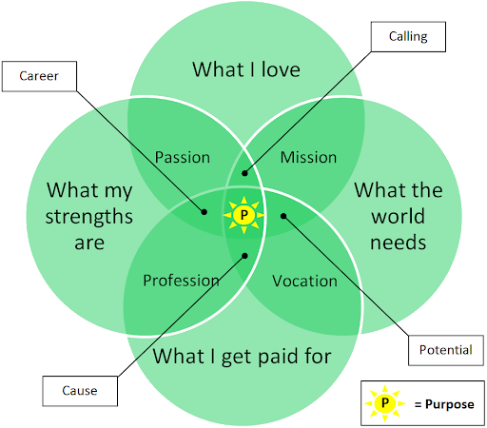

Slide 7

Talent Marketplace
Connect to your future workforce earlier and with more precision.

Slide 8
Economic
Development
Students &
Families
Who wins?
Volusia County
Schools
Business
Community
Community
At-Large
Higher
Education

Slide 9
A Partnership for the Future…
This partnership will be the first in the state of Florida to help students uncover their talents and align their educational programs of study to create a larger, more diverse talent pipeline for the community.

Slide 10
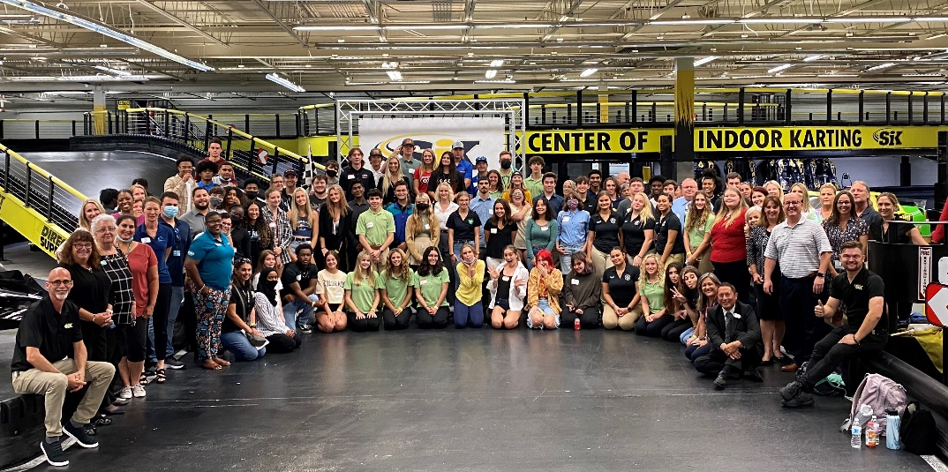
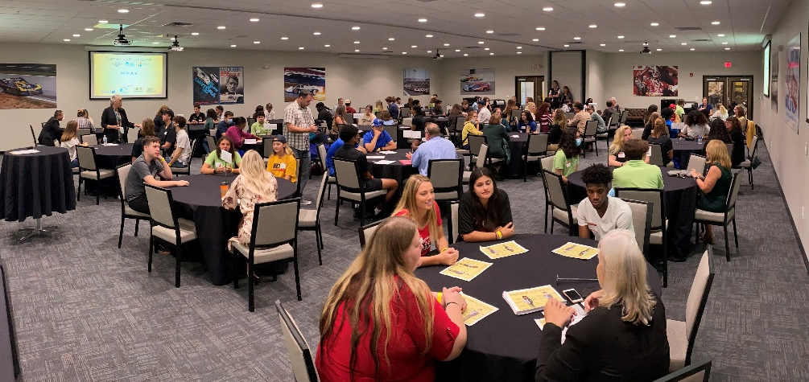
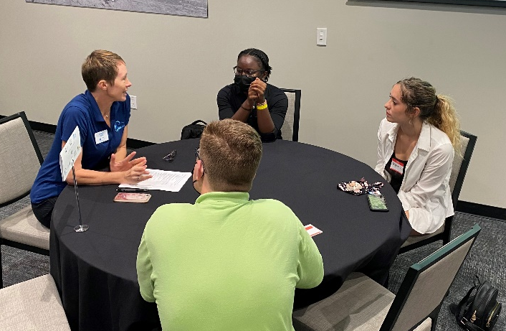
Soft Skills Youth Summit

Slide 11
A Partnership for the Future…
Questions?

Slide 12
A Partnership for the Future…
Thank you for sharing
some time today!

