Slide 1

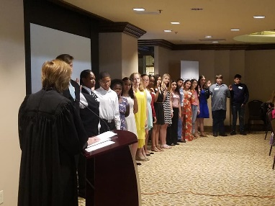
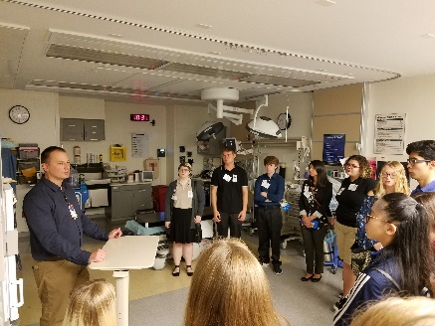


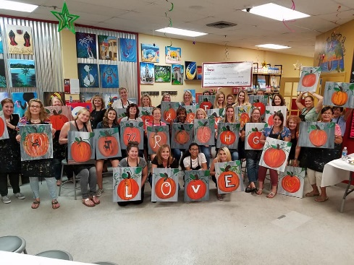
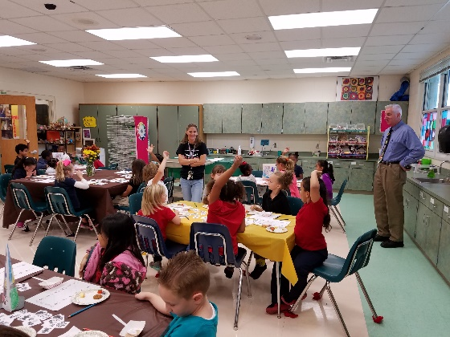
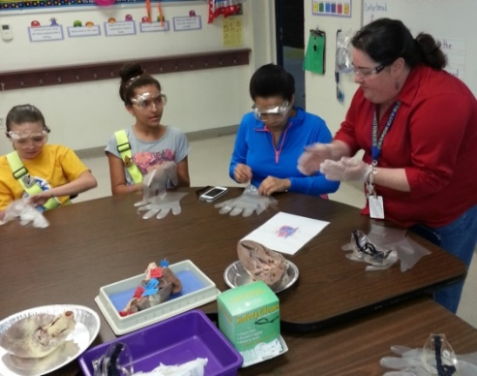

Slide 2
FUTURES is the education foundation for all of Volusia County Public Schools and was formed 33 years ago in 1985.
FUTURES provides programs and activities that are unable to be funded with tax dollars.
When we started in 1985, FUTURES’ annual budget was $27,900. Today our budget exceeds $800,000.

Slide 3
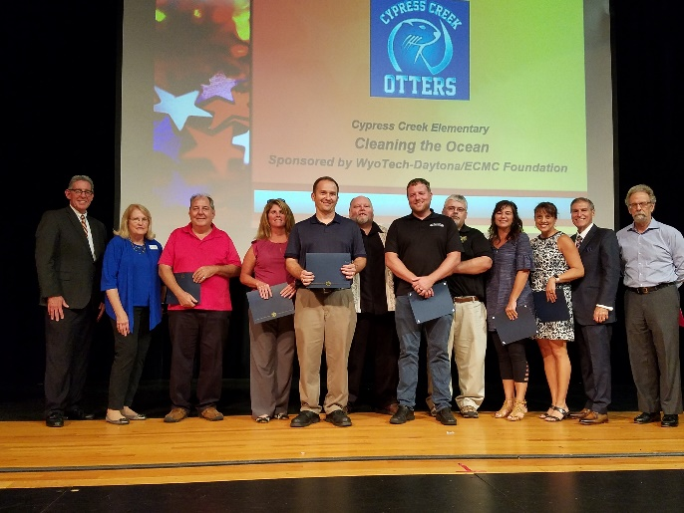
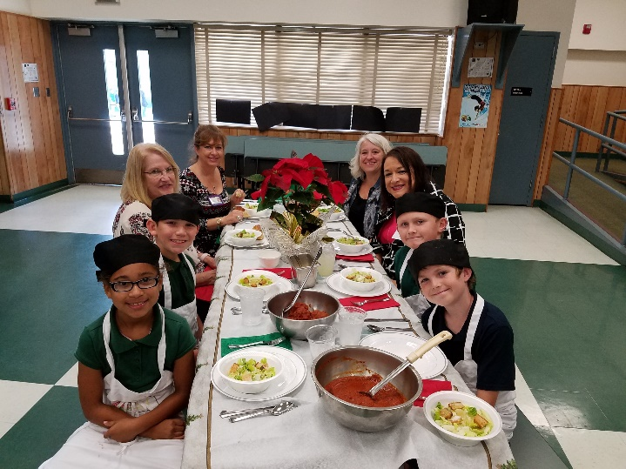
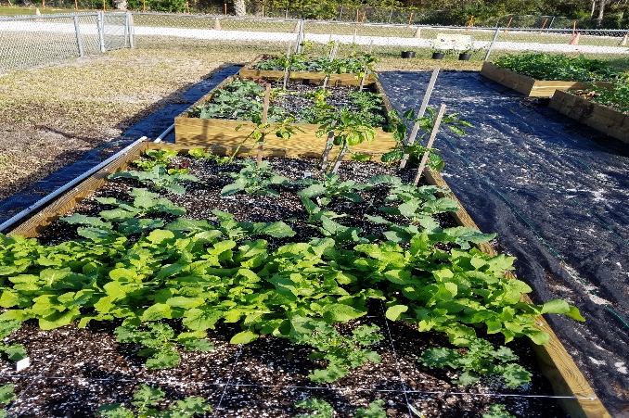
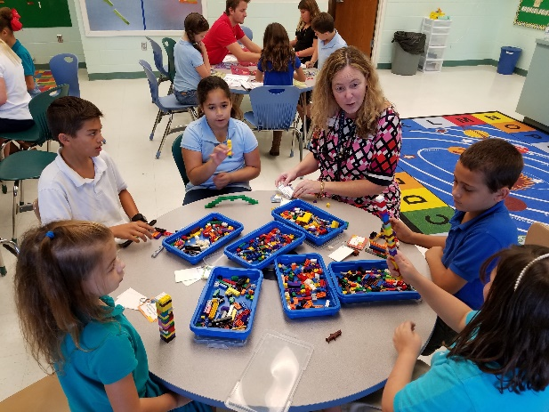
Teacher Mini-Grants
In the 2018-19 school year, FUTURES Foundation awarded over $111,000 to more than 170 teachers for classroom projects. Since the program's inception 33 years ago FUTURES has awarded over $1.7 million to 4,000 grants!

Slide 4
Mini-Grants on www.FindItFundItFlorida.com/Volusia
Paper-less application & evaluation process for our teachers
Allows our community to view & fund creative, innovative classroom projects
Offers social media functionality to help teachers promote their fabulous projects
Visit FIFI to read about this year’s grants
And fund all or a portion of a grant online through Jan. 31, 2019!

Slide 5
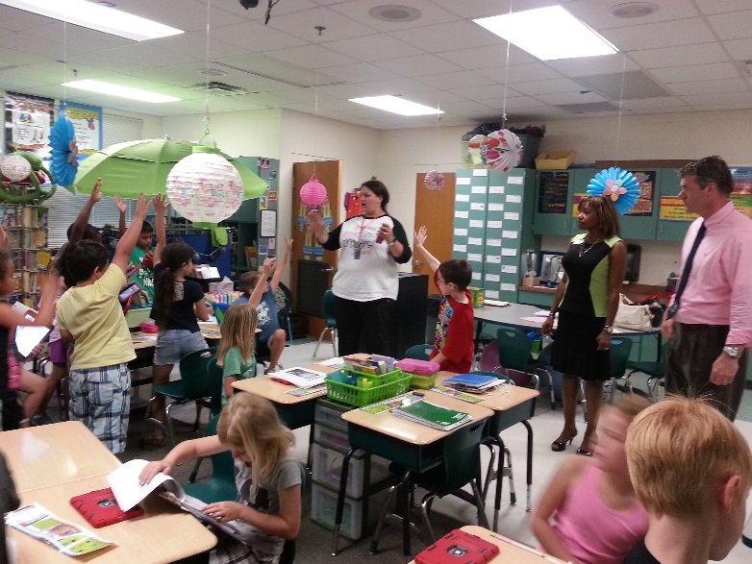
School District Education Foundation Matching Grants Program
FUTURES secures legislative funding to match private dollars raised by schools so they may fund a variety of programs which meet the SDEF requirements of assisting:
Literacy
Low performing students
Matching Grant allocations for VCS:
2008-2009 - $86,000
2009-2010 - $82,000
2010-2011 - $74,500
2011-2012 - $59,374
2012-2013 - $51,042
2013-2014 - $80,826
2014-2015 - $97,443
2015-2016 - $96,088
2016-2017 - $97,121
2017- 2018 - $82,593
2018-2019 - $82,605

Slide 6
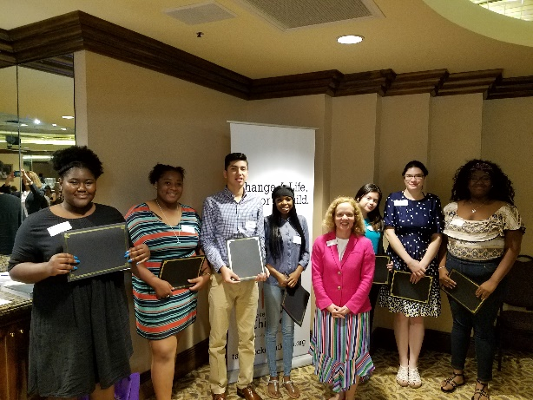
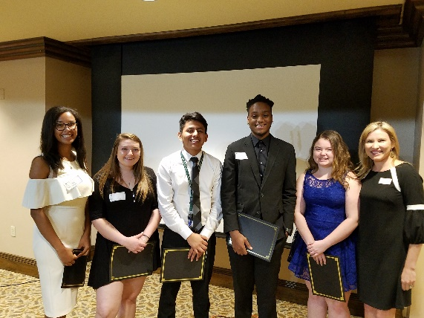
Take Stock in Children
TSIC is a state-wide comprehensive program which helps low income, financially eligible students succeed by providing:
early intervention during high school
assigned volunteer mentor(s)
college readiness workshops
assigned TSIC College Success Coach
college tuition scholarships
Volusia’s TSIC program, facilitated by FUTURES, has:
73 current high school scholars
73 adult volunteer mentors
119 TSIC graduates enrolled in college
135 TSIC scholars have graduated from college
More than $1.5 million in college scholarships provided

Slide 7
Take Stock in Children
TSIC Mentoring is rewarding and easy!
Easy application, screening process & mentor training by FUTURES/TSIC
Meet with your TSIC student for 30 minutes each week
Meet during lunch while school is in session (summers off)
Mentors are needed at the following west Volusia area high schools:
Pine Ridge High School: 1 female freshman, 1 female sophomore
DeLand High School: 1 male sophomore

Slide 8

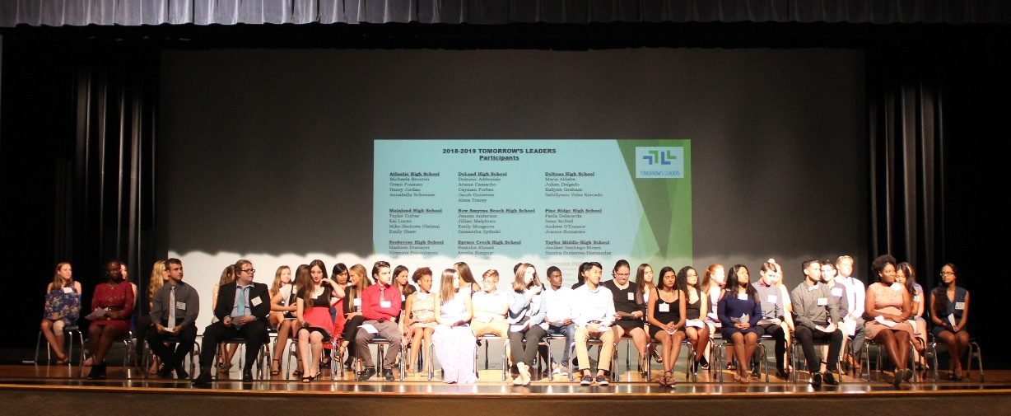
Tomorrow's Leaders
This year 40 students from all 10 high schools were selected to participate in FUTURES Foundation’s leadership training program – Tomorrow’s Leaders. This program is designed to familiarize them with different aspects and services of Volusia County while developing their leadership skills.
Seminars will include the following topics:
  Health Care & Social Services
  Manufacturing, Economic Development, and the Arts
  Criminal Justice
  Leadership and Diversity & Inclusion
  Government and Education

Slide 9
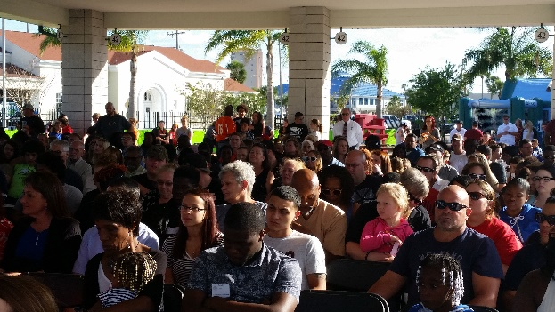
Turn Around Program
Turn Around recognizes middle and high school students each year who have demonstrated a marked improvement in school involvement and citizenship.
Students recognized at each grade level in the middle and high schools have shown a dramatic improvement in at least two of the following areas:
  Attendance
  Attitude (observation & determined by reduction in number of referrals)
  Grades (improvement in grades, not
  necessarily the highest grades)
  Citizenship (school involvement)

Slide 10
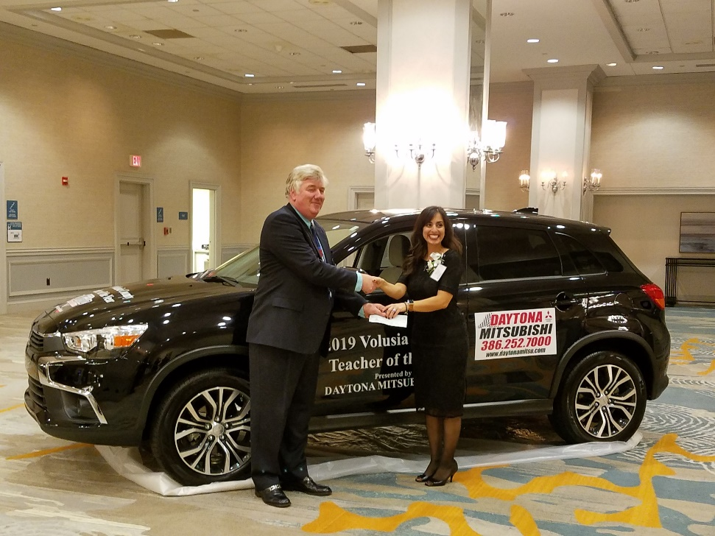
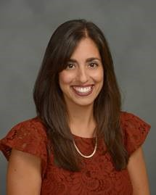
Teacher of the Year Program
2019 Teacher of the Year Nicole Grebosz
Citrus Grove Elementary School
This annual program honors TOTY nominees from each school.
It includes a fall recognition reception followed by a grand evening celebration attended by more than 920 friends which culminates in the naming of the Teacher of the Year!
This recipient represents Volusia County Schools in the Florida TOTY contest which takes place each July.

Slide 11
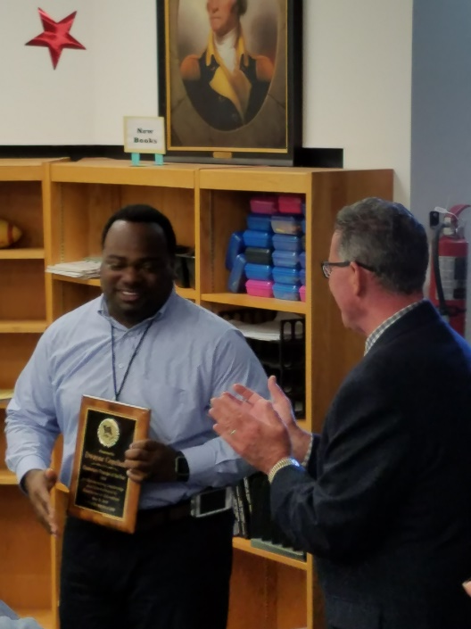
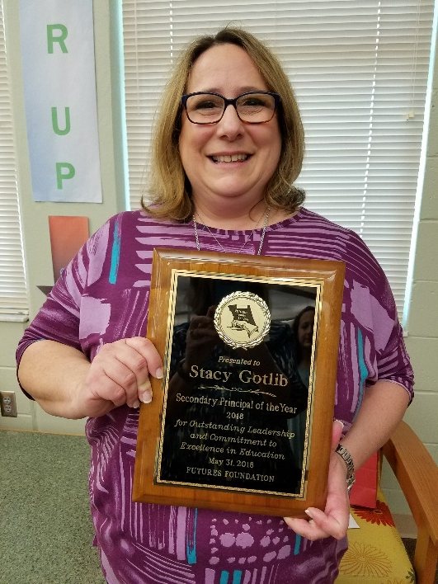
Elementary & Secondary Principals of the Year
Dwayne Copeland Stacy Gotlib
Edith I. Starke Elementary School River Springs Middle School
Principals are nominated or may self-nominate then their fellow principals select an elementary & secondary level winner. The winners are surprised by a visit from the Bus Brigade comprised of the Superintendent, FUTURES & community representatives, School Board Members, Area Superintendents and various District leaders!

Slide 12
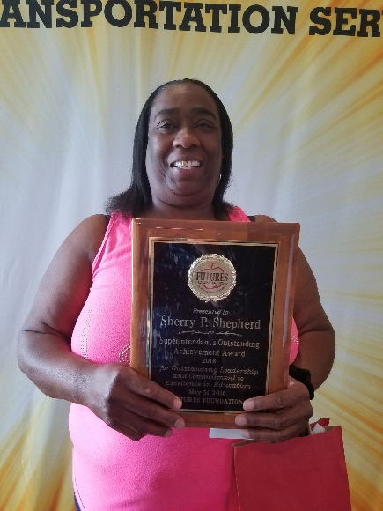
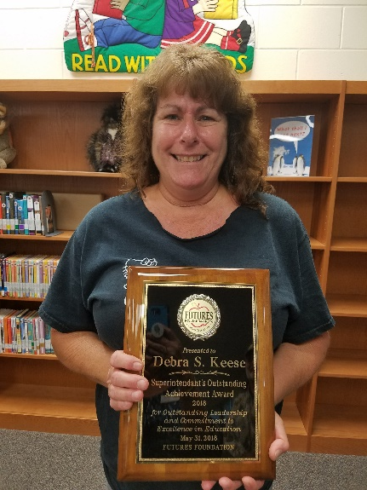
Superintendent's Outstanding Achievement Awards
2018 SOAA recipients Sherry P. Shepherd in Transportation and Debra “Debbie” Keese at Cypress Creek Elementary School
Each year a school and/or department nominates a non-instructional team member who has demonstrated outstanding commitment, teamwork, cooperation & innovation. A Selection Committee reviews all nominations and makes this selection which is confirmed by the Superintendent. This Recipient also receives a surprise visit from Bus Brigade.

Slide 13
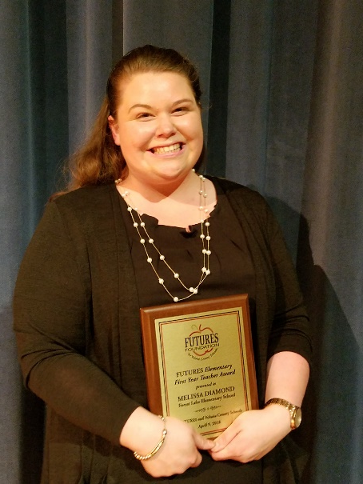
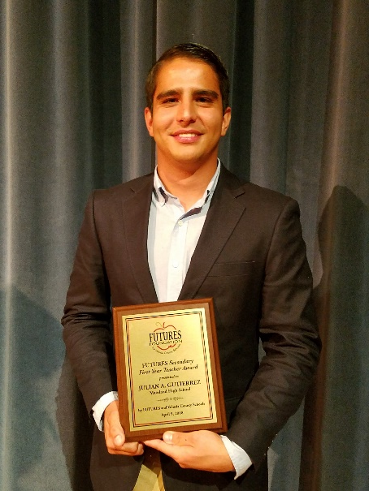
First Year Teacher Awards
Melissa Diamond
Forest Lake Elementary School
2018
Julian Gutierrez
Mainland High School
2018
FUTURES First Year Teacher Awards Program recognizes beginning teachers who exceed district expectations. Each Principal may nominate one new teacher and a Selection Committee announces the winners for elementary & secondary level. For the 2017-2018 school year, we recognized 47 new teachers who were nominated and announced the our two recipients at an April 9th celebration
at Mainland High School.

Slide 14

After 25 years and more than a million miles on Florida’s highways, it’s time to upgrade the look of our favorite plate. The new design focuses on Florida’s bright education system with a look that can only be found in the Sunshine State. And while the design may be new, the cause is the same – supporting education initiatives in your local communities.

Slide 15

What does the money from your tag purchase support?
When Florida residents purchase or renew their Support Education tag, $20 goes directly back to support public schools through the district’s local education foundation such as FUTURES.
The proceeds stay in our community, benefitting the children in our area through programs facilitated by FUTURES.
In Volusia County, FUTURES has used the funds to support Teacher Mini-Grants and purchase Take Stock in Children Scholarships supporting at-risk, low-income high school students.

Slide 16


How can you support FUTURES and its programs?
Become a Club Member or Sponsor
Attend a Fundraising Event
Purchase a License for Learning license
plate to show your support of education
Talk to your attorney and/or accountant about a planned gift through your estate
Become a mentor for the Take Stock in Children program
Sponsor a Take Stock scholarship
Invite FUTURES as a guest speaker
Fund a Mini-Grant on
www.FindItFundItFlorida.com/Volusia

Slide 17

Thank you for this opportunity and for your support of
Volusia County Schools!
We welcome any questions you may have about our programs or events!
Contact
Laura Reece, Take Stock College Success Coach
Stephanie Parks, Program Coordinator
Cynthia Ramirez, Executive Director
386.255.6475, ext. 50729, 50728 & 50730

