Slide 1
An Eye for an Eye
is our revenge discipline mindset leaving us blind and Restorative Practices?

Slide 2


Slide 3

Allow me to reintroduce myself…

Slide 4


Slide 5
How do you know if you have a revenge mindset with discipline?
Have you ever said:
I’m going to show them
We don’t ever do “enough” or “harsher” punishment
We don’t do anything here
I already know that I am going to…
“that’s what the deans for”
After the referral is done, have you taken it back to the administrator?
If _____ was not here I would be much better (switch him/her/them out)

Slide 6
The Restorative Philosophy
The aim of Restorative Practices in school communities is to develop community and to manage conflict and tensions by repairing harm and restoring relationships.

Slide 7
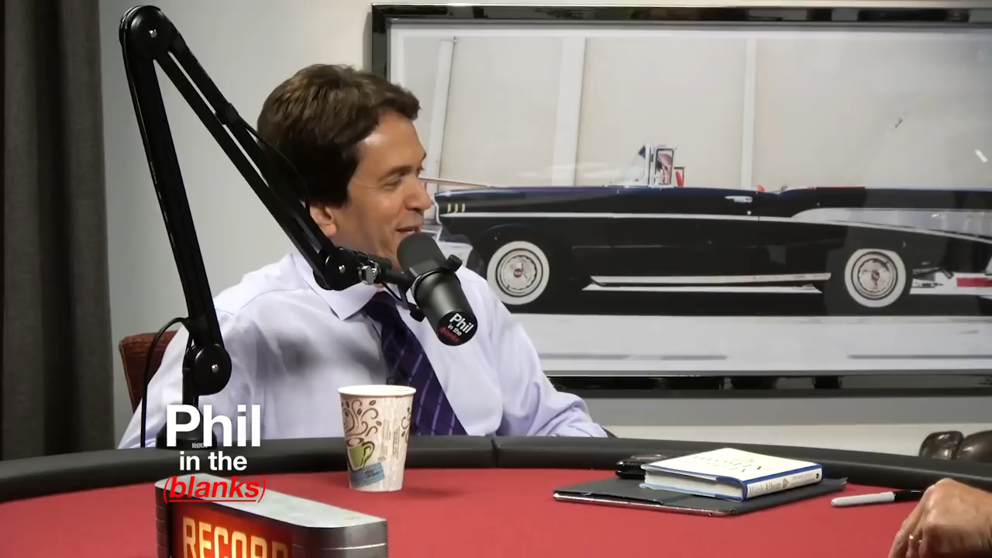

Slide 8
Restorative Practices Framework is a relationship-building, strength-based and solution-focused approach. To provide clarity about the roles, responsibilities, values, assumptions and outcomes to which we prescribe to as a community.

Slide 9


Slide 10
The fundamental Hypothesis
The fundamental hypothesis of restorative practices is that human beings are happier, more cooperative and productive, and more likely to make positive changes in their behavior when those in positions of authority do things with them, rather than to them or for them.

Slide 11


Slide 12
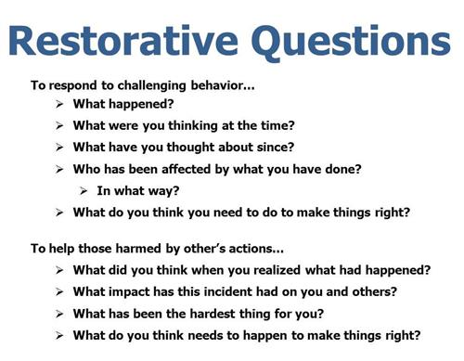

Slide 13
How can we build and connect or reconnect our community?
“The child who is not embraced by the village will burn it down to feel its warmth”-African Proverb
Use of Restorative Circles
  Relationship building
  Repair Harm

Slide 14
Implementations
PASS-Positive Alternatives to School Suspensions
  Why Try Curriculum
School wide and individual use
Volusia Learns Opportunities
Impact on DSPC

Slide 15
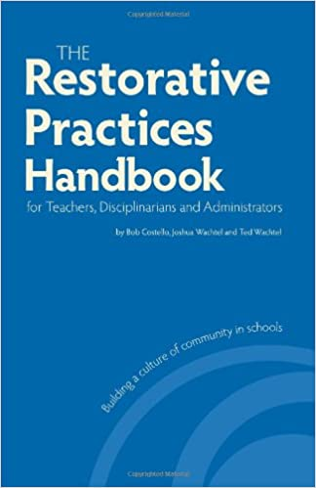
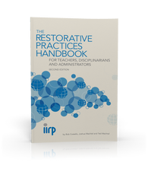

Slide 16
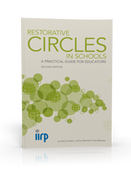
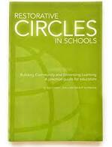

Slide 17

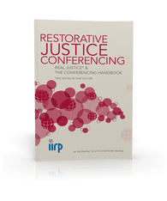

Slide 18
