Slide 1

Midlothian ISD
District Demographics Update
1Q 2022
Solutions Through Demographics

Slide 2

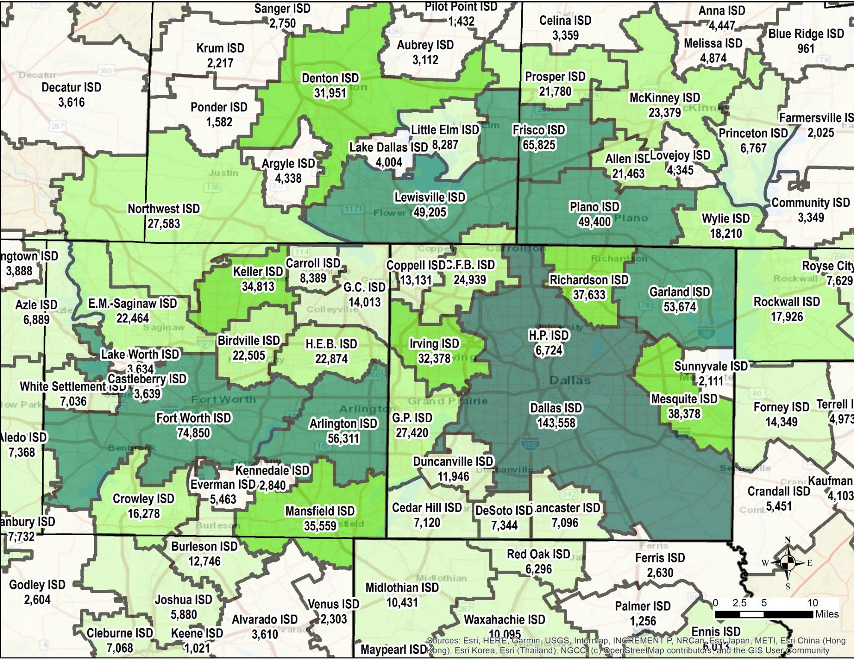
DFW PUBLIC SCHOOL DISTRICTS: 2021-22 TOTAL ENROLLMENT
RSI’S DFW survey area includes 90 public independent school districts.
As of the 2021/22 snapshot, Midlothian ISD had the 31st largest total enrollment among all DFW school districts
Source: Texas Education Agency PEIMS
*Total enrollment as of 10/29/21 Snapshot

Slide 3
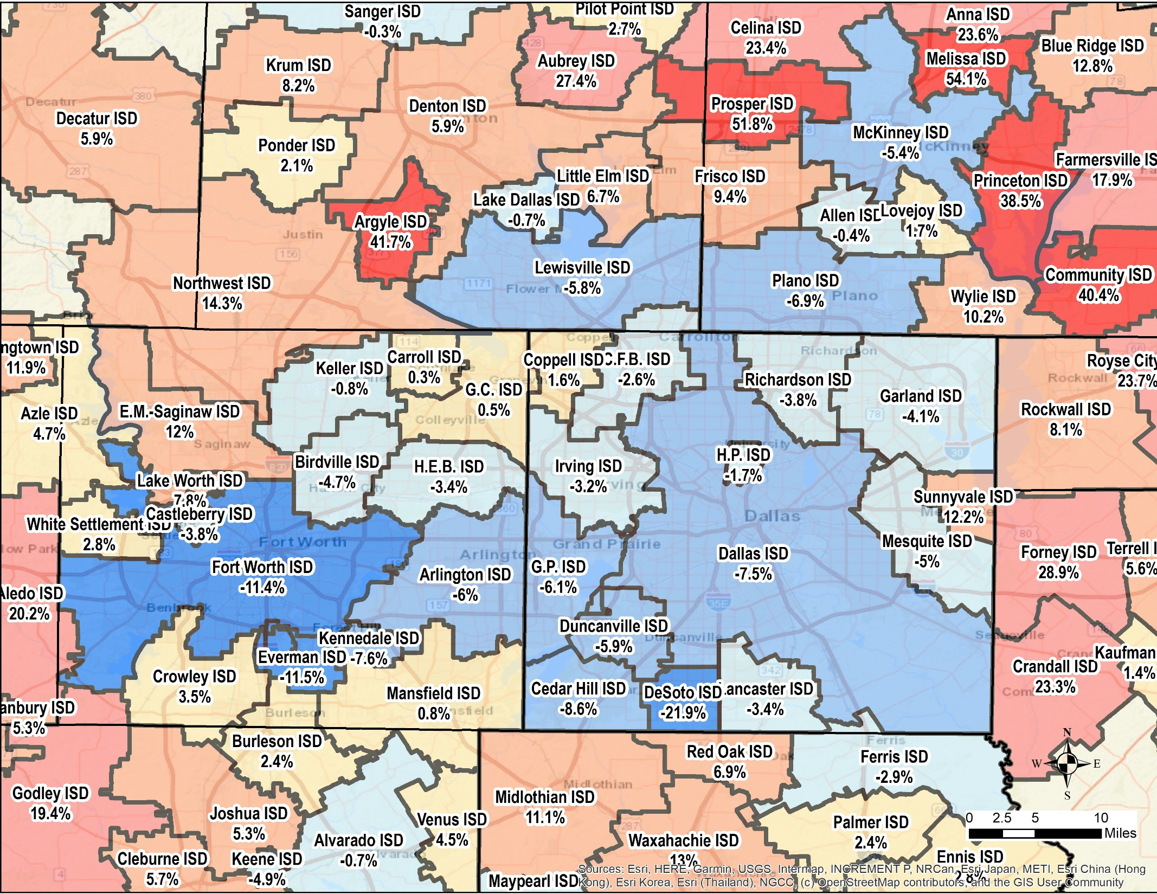
DFW PUBLIC SCHOOL DISTRICTS: 3-YEAR ENROLLMENT CHANGE 2018/19 – 2021/22
Midlothian ISD ranked 26th in highest percentage growth over the past 3 years
Source: Texas Education Agency PEIMS

Slide 4

DFW: NEW HOME STARTS, CLOSINGS & LOT DELIVERIES
Gap between start and closing pace provides clear illustration of labor and supply constraints present in market
Record new home construction in DFW continues from 2Q21-1Q22

Slide 5
GROWTH DRIVERS:
1Q22 DFW HOUSING MARKET: A MARKET IN TRANSITION
Two Headline Stories Affecting the Housing Market
30-Yr Mortgage Rate Climbs Over 200 basis points in first 4 months of 2022
  When combined with surging house prices, affordability challenges rapidly emerge
Builders & Developers deal with 30-40% increases in lot development costs
  Push to resupply market with lots leads to record # of lots U/D, but also massive inflation and protracted cycle times

Slide 6
30-YEAR MORTGAGE RATE
May 5, 2022
30YR : 5.27%
15YR : 4.52%
1YR ARM : 3.96%
Highest Mortgage Rates Since 2009
Source: Freddie Mac
Record Low on 1/7/21 at 2.65%

Slide 7
MONTHLY PAYMENT STICKER SHOCK
Doing the Math
An increase in the 30-year rate from 3.00% to 5.27% increases the monthly payment on the P+I portion of a loan by 31.3%
When higher housing costs are factored in, the P+I portion of a loan equivalent to the median new home price is up 37.6% since 2021YE –just 4 months
$406K at 5.27%
Market Pushback in 4Q18 as 30-YR rate climbed from 4.5 to 5%

Slide 8
CONSTRUCTION CAPACITY ISSUES PERSIST
Disconnect Between Starts & Completions
Annual starts near 59K while annual closings up only 3.8%--just over 46K
Some builders share that they pushed starts in 1Q22 in order to get closings in calendar year 2022—they expect to now dial back on starts
Shortage of workers, supply chain challenges continue to elongate construction cycle times
Many builders see 220+ days for standard production houses, up from normal 130-140 days
After climbing in January & March, lumber prices settling down
But with gasoline and diesel prices surging, many builders report fuel surcharges
Market braces for further delays with recent China COVID lockdown
Interim lenders closely watching ‘spec & release’ approach to market—will higher rates lead to cancellations and accumulation of F/V inventory this summer?

Slide 9
DFW HOUSING MARKET—THE GOOD NEWS
Housing Demand Remains Exceptionally Strong
Job formation vibrant
Relocations bringing plenty of buyers with large equities
Existing home inventory at record low levels, prices continue to climb
Millennials eye first time homes—many are able to cope with higher prices
Rental rates are no bargain for many households
Corporate Relocations
DBJ 3/26/22 article reports “There’s a ‘lull’ of corporate relocations to Texas this year, but pipeline ‘as big as it’s ever been’”
As companies figure out their post-pandemic office needs, expect an increasing number of announcements
Ingredients that make Texas a relocation destination remain intact

Slide 10
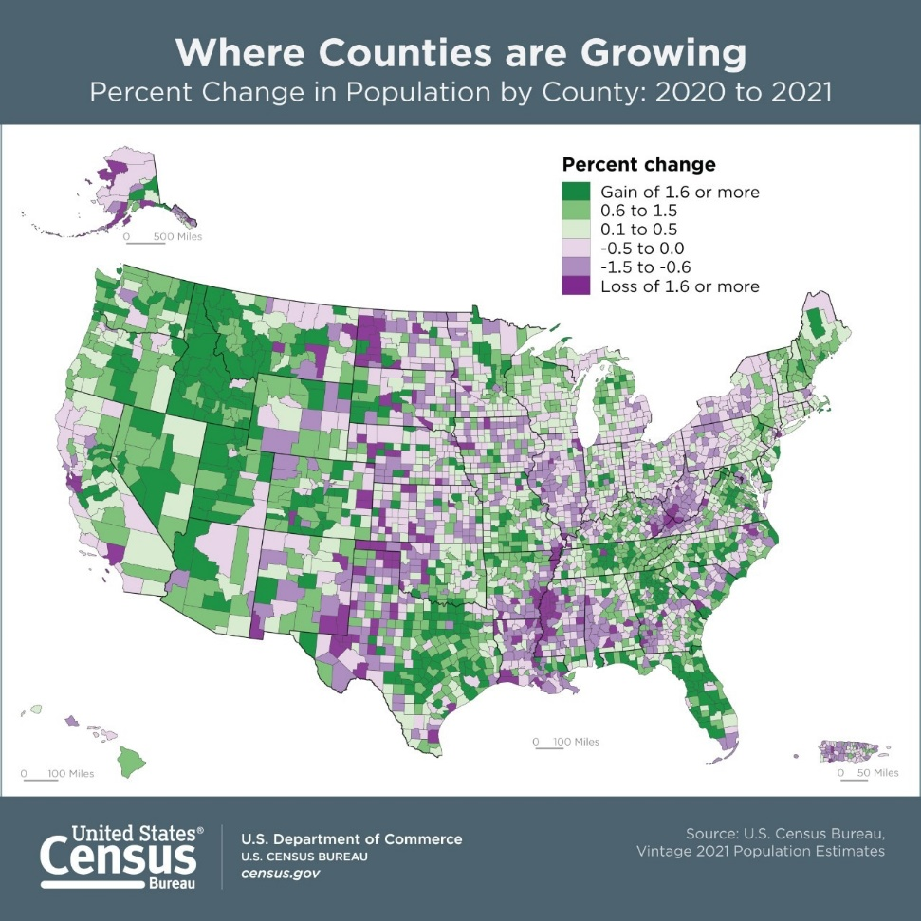
POPULATION & MIGRATION
Annual Population Growth
Dallas-Fort Worth-Arlington, Texas (97,290)
Phoenix-Mesa-Chandler, Ariz. (78,220)
Houston-The Woodlands-Sugar Land, Texas (69,094)
Austin-Round Rock-Georgetown, Texas (53,301)
Riverside-San Bernardino-Ontario, Calif. (47,601)
Atlanta-Sandy Springs-Alpharetta, Ga. (42,904)
Tampa-St. Petersburg-Clearwater, Fla. (36,129)
San Antonio-New Braunfels, Texas (35,105)
Charlotte-Concord-Gastonia, N.C./S.C. (31,381)
Raleigh-Cary, N.C. (28,186)
7-1-20 to 7-1-21
Annual Net Migration For DFW
Five of the top 10 largest-gaining counties in 2021 were in Texas

Slide 11
TEXAS ECONOMY
Employment Recovering
  Difference From Pre-Pandemic Level of 2/20 and 3/22
  United States
  -1,030,000 -0.68%
  Texas
  +255,700 +1.98%
  Major Texas Markets (Mar 2022) Gap From Pre-Pandemic High
  DFW +181,100 +4.71%
  Houston -28,000 -0.88%
  Austin +80,200 +7.02%
  San Antonio +11,600 +1.07%
Employment Climbs to New Highs
COVID decline of 1.4M jobs and recovery
Great Recession
Source: TWC – CES (Not Seasonally Adjusted)

Slide 12
DFW EMPLOYMENT GROWTH
Annual Change Mar.‘21 – Mar.‘22
TWC CES: +267,800 (+7.13%)
Total Employment: 4,019,800
407,100 jobs lost in April 2020
DFW Area now 181,100 jobs ahead of pre-pandemic employment high recorded in 2/20
March ‘21-Sept ‘21 = +126,600 returning jobs
Oct ‘21-March ‘22 = +141,200 new growth
COVID-19 related layoffs & recovery
Sources: TWC – CES, Dallas Federal Reserve (Not Seasonally Adjusted)

Slide 13
MONTHLY CHANGE IN DFW EMPLOYMENT
March 2022 | Annual Change | % Change
Mining, Log, Construction | 8,300 | 3.8%
Manufacturing | 9,500 | 3.3%
Trade, Transportation & Utilities | 58,300 | 7.1%
Information | 5,600 | 7.0%
Financial Activities | 26,100 | 7.8%
Professional & Business Services | 64,800 | 9.9%
Education & Health Services | 29,900 | 6.6%
Leisure & Hospitality | 51,300 | 15.0%
Other Services | 11,100 | 9.6%
Government | 2,900 | 0.6%
+44,300 jobs in Feb 2022
+51,700 jobs in October 2021
+62,100 jobs in November 2021
Source: TWC—CES Survey (NSA)

Slide 14
DFW UNEMPLOYMENT RATE
Unemployment Rates –March 2022
US : 3.8% Texas: 3.9%
DFW: 3.4%
4% considered ‘full employment’
Not Seasonally Adjusted Source: TWC - LAUS

Slide 15
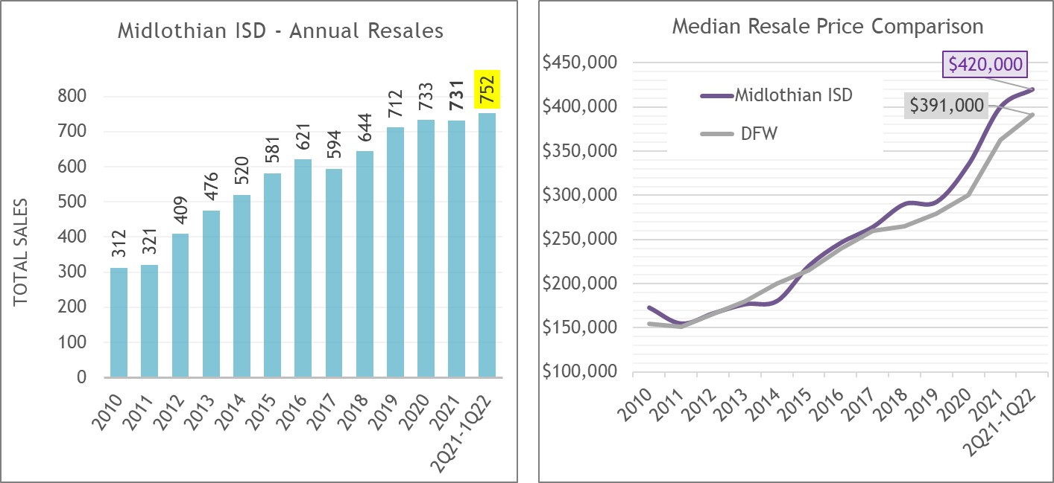

MIDLOTHIAN PREOWNED HOME SALES
Source: NTREIS – SF detached, non-builder sales only
752 pre-owned homes sold from 2Q21-1Q22 in the district
From 2019-2021, MISD has averaged 725 pre-owned home sales per year
MISD’s median resale sold price over the past 12 months was a record $420,000 (+22.5% vs. YoY)
DFW’s annual median resale price currently a record $391,000 (+21.8% YoY)

Slide 16
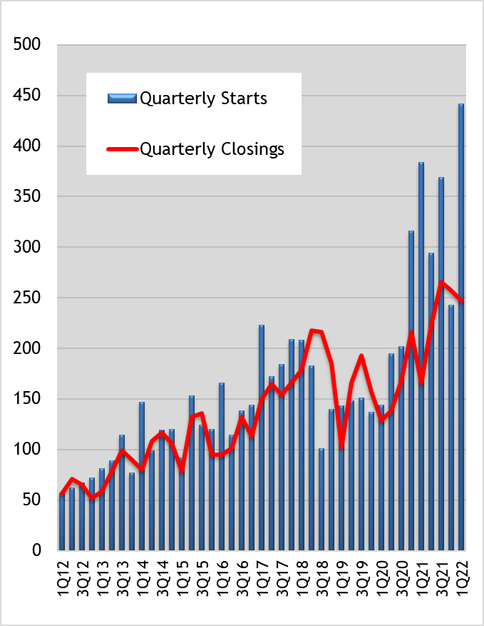
MIDLOTHIAN ISD
QUARTERLY NEW HOME CONSTRUCTION
New homebuilders set a record for quarterly starts in 1Q22
Start = Foundation started
Closing = Visibly occupied home
A record 442 new homes were started in the 1st quarter of 2022
Another 247 homes closed during 1Q22, which is the 3rd most in any quarter

Slide 17
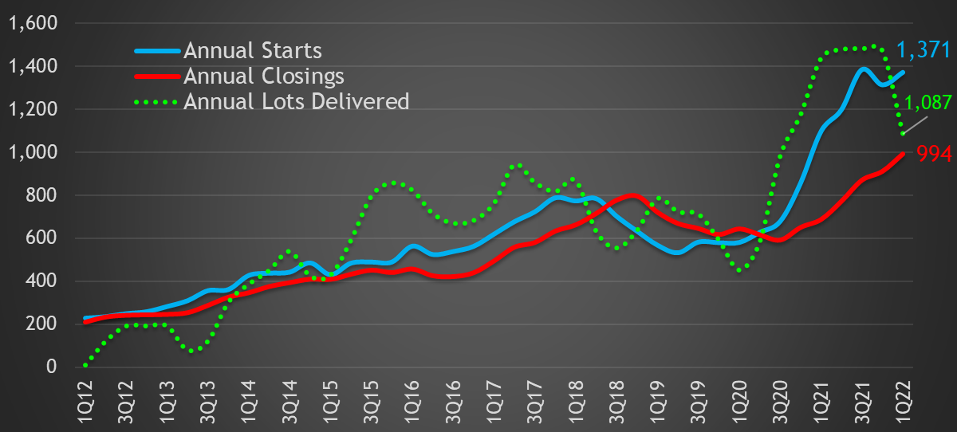
MIDLOTHIAN ISD ANNUAL NEW HOME CONSTRUCTION AND LOT DELIVERIES
Record activity 4Q20-3Q21 (1,384 starts)
2Q21-1Q22 Annual Totals/Change
1,371 Starts: +25% (+274 homes)
994 Closings: +44% (+305 homes)
Start = Foundation started
Closing = Visibly occupied home
New homebuilders started 1,371 homes in MISD over the past 12 months
  2nd highest annual total (record = 1,384)
Annual closings increased to a record high of 994 homes from 2Q21-1Q22 (+44% YoY)
Developers delivered 1,087 new single-family residential lots in MISD over the past year

Slide 18
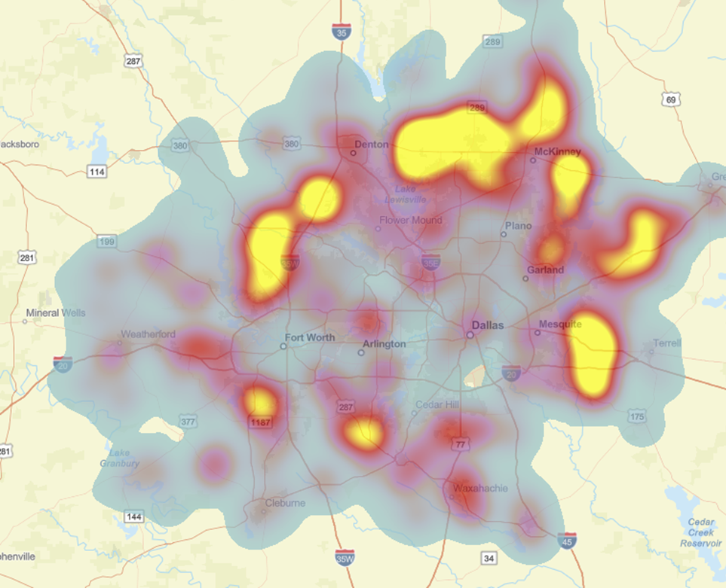
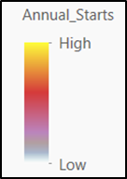
DFW SCHOOL DISTRICT ACTIVITY:
RANKINGS BY NEW HOME CLOSINGS 2Q21-1Q22
Midlothian ISD currently ranks 12th in total annual new home closings compared to the other 90 DFW school districts

Slide 19
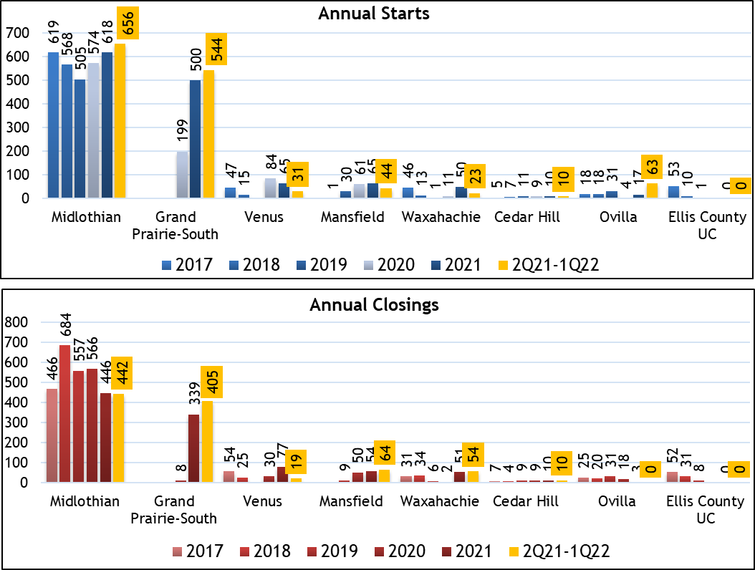
MISD NEW HOME ACTIVITY BY CITY SECTOR: 2Q21-1Q22
City of Midlothian continues to see the most activity within the district
Emerging Grand Prairie area produces 544 starts and 405 closings from 2Q21-1Q22
Annual starts in the Grand Prairie portion of the district are up 173% since 2020

Slide 20
MIDLOTHIAN ISD TOP PRODUCING NEW HOME SUBDIVISIONS 2Q21-1Q22 (ranked by annual closings)
Rank | Subdivision | Annual Starts | Annual Closings | Elementary Zone | Middle School Zone | High School Zone
1 | Greenway Trails | 379 | 222 | Vitovsky | Frank Seale | Midlothian
2 | Prairie Ridge | 142 | 170 | Vitovsky | Frank Seale | Midlothian
3 | The Grove | 125 | 118 | Baxter | Walnut Grove | Heritage
4 | Autumn Run | 27 | 69 | Coleman | Dieterich | Midlothian
5 | Mill Valley | 35 | 58 | Vitovsky | Frank Seale | Midlothian
6 | Horseshoe Meadows | 22 | 52 | Longbranch | Walnut Grove | Heritage
7 | Dove Creek | 85 | 46 | Coleman | Dieterich | Midlothian
8 | Massey Meadows | 41 | 31 | Longbranch | Walnut Grove | Heritage
9 | Legacy Estates | 0 | 25 | Longbranch | Walnut Grove | Heritage
10 | Coventry Crossing | 3 | 23 | Mt. Peak | Dieterich | Midlothian
11 | Villas of Somercrest | 45 | 22 | Miller | Dieterich | Midlothian
12 | Brandi Ridge | 92 | 21 | Mt. Peak/Coleman | Dieterich | Midlothian
13 | Heritage Hills Estates | 31 | 19 | Irvin | Dieterich | Midlothian
14 | Horizon Estates | 10 | 13 | Longbranch | Walnut Grove | Heritage
15 | Thomas Trail Estates | 0 | 10 | Mt. Peak | Dieterich | Midlothian
16 | Stone Hollow Estates | 25 | 7 | Miller | Dieterich | Midlothian
 | Hawkins Meadows | 57 | 4 | Coleman | Dieterich | Midlothian
*Boundaries reflect approved attendance zones for 2022-23

Slide 21
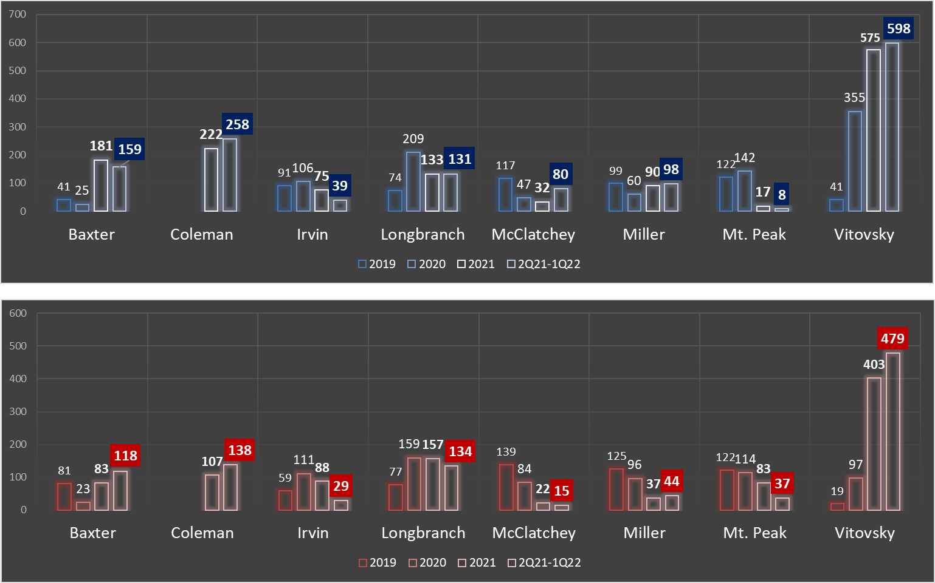
MIDLOTHIAN ISD NEW HOME CONSTRUCTION ACTIVITY
BY ELEMENTARY ATTENDANCE ZONE
A surge in activity in the Vitovsky zone leads the district’s growth

Slide 22
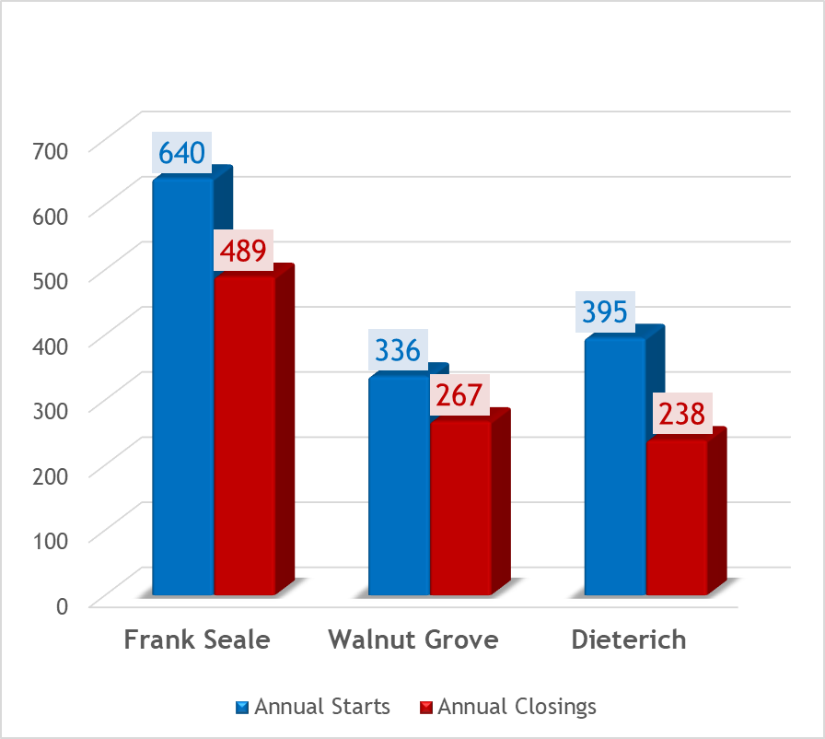
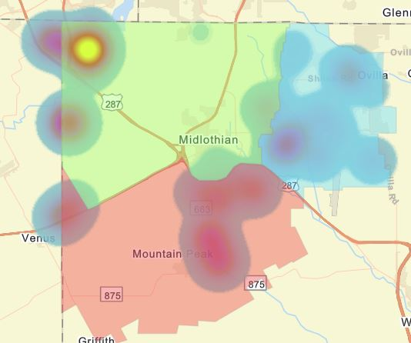
MIDLOTHIAN ISD NEW HOME CONSTRUCTION ACTIVITY BY MIDDLE SCHOOL ATTENDANCE ZONE: 2Q21-1Q22
Starts in the northwest portion of the district feed into Frank Seale MS
Frank Seale
Walnut
Grove
49%
27%
24%
Dieterich
Frank Seale zone continues to see the majority of the district’s new home activity
*Boundaries reflect approved attendance zones for 2022-23

Slide 23
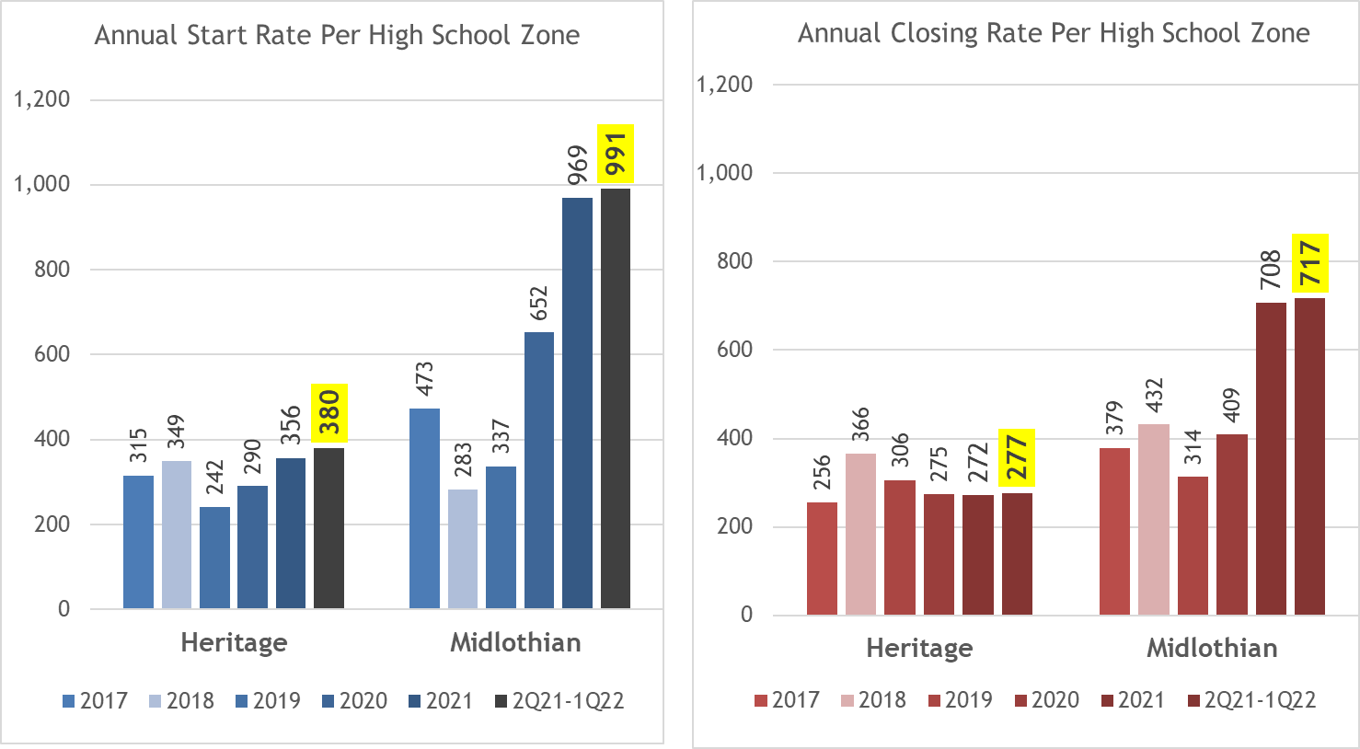
MIDLOTHIAN ISD NEW HOME CONSTRUCTION ACTIVITY BY HIGH SCHOOL ATTENDANCE ZONE
*Boundaries reflect approved attendance zones for 2022-23
72% of all Closings over the past 12 months occurred in the MHS zone

Slide 24
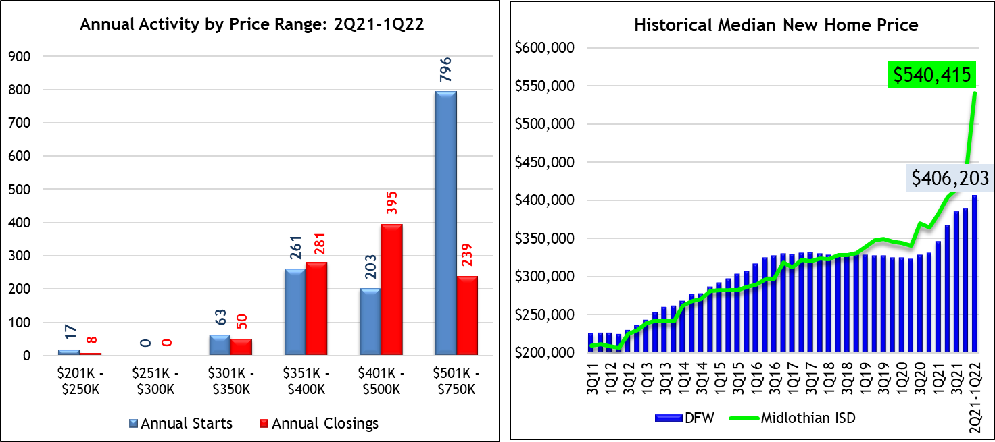
DISTRICT MEDIAN NEW HOME PRICE HISTORY
Start activity over $500K surges in early 2022
District’s median new home price now stands at a record $540,415 (+41% YoY)
DFW Median New Home Price as of March 2022 is a record $406,203 (+17.4% YoY)

Slide 25
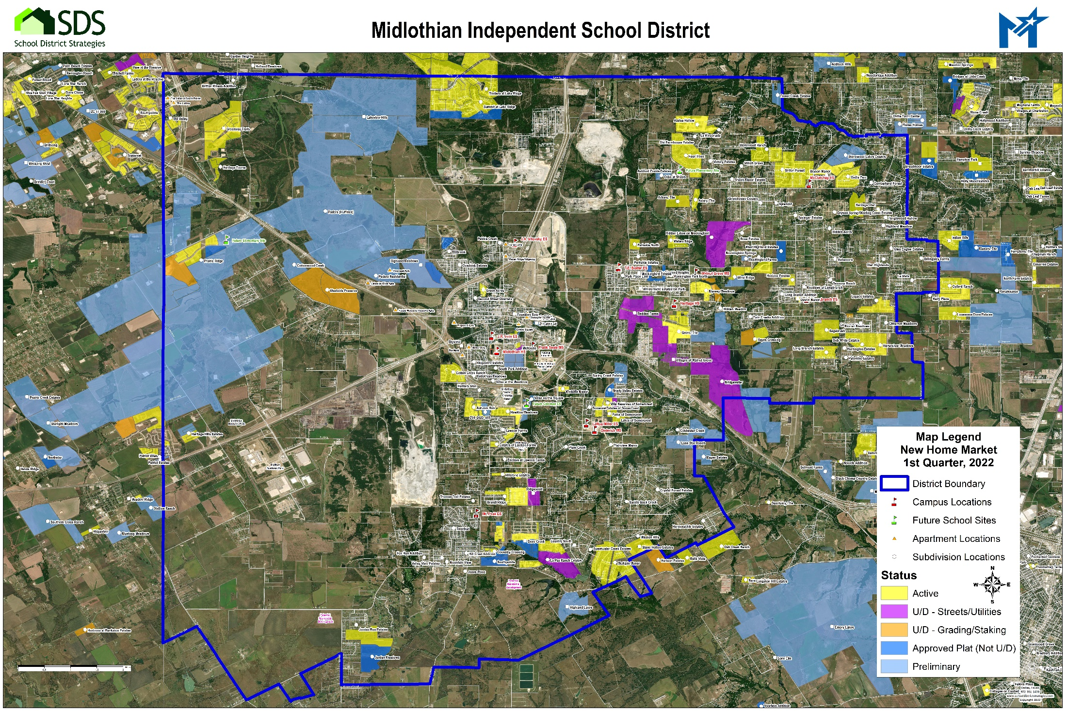
Windsor Hills sold to Huffines Development and renamed Padera: 2,968 total lots planned
Midtowne Ph. 8 – 9 lots
Sagebrush – 67 lots
First preliminary plat received for Highland Lakes: 602 lots in Phase 1
76 New lots delivered in the 1st Quarter of 2022

Slide 26
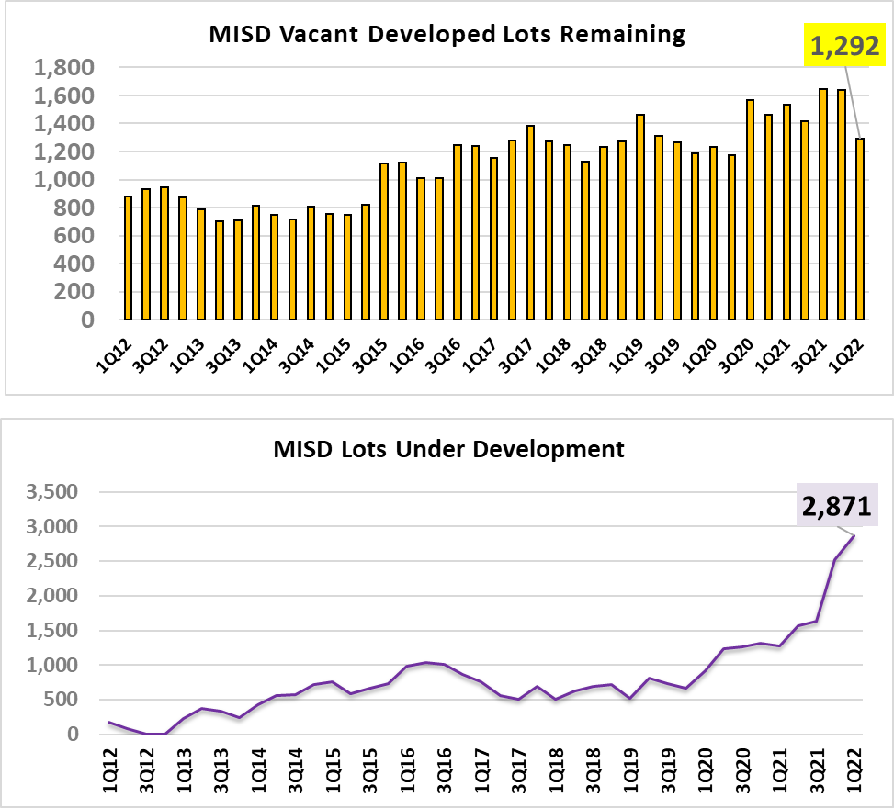
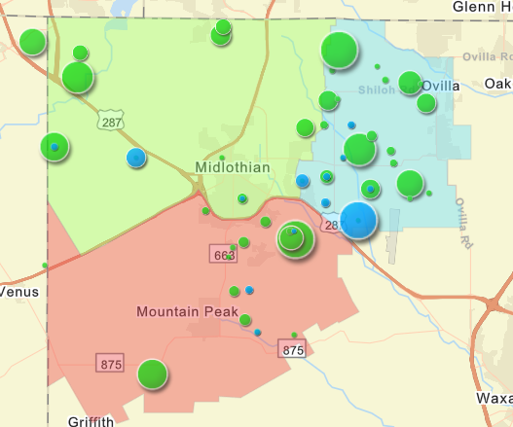
MIDLOTHIAN ISD RESIDENTIAL LOT INVENTORY
VDL
Lots U/D
Combined there are over 26,000 lots in-process/planned as of 1Q22 in MISD (total of homes U/C, VDL, lots U/D, and future lots)
1,160 total homes currently in production (started not occupied)
1,292 vacant developed lots remaining as of March 2022
2,871 lots under development at the end of 1Q22 (record high)
20,100+ additional single-family lots are planned in MISD

Slide 27
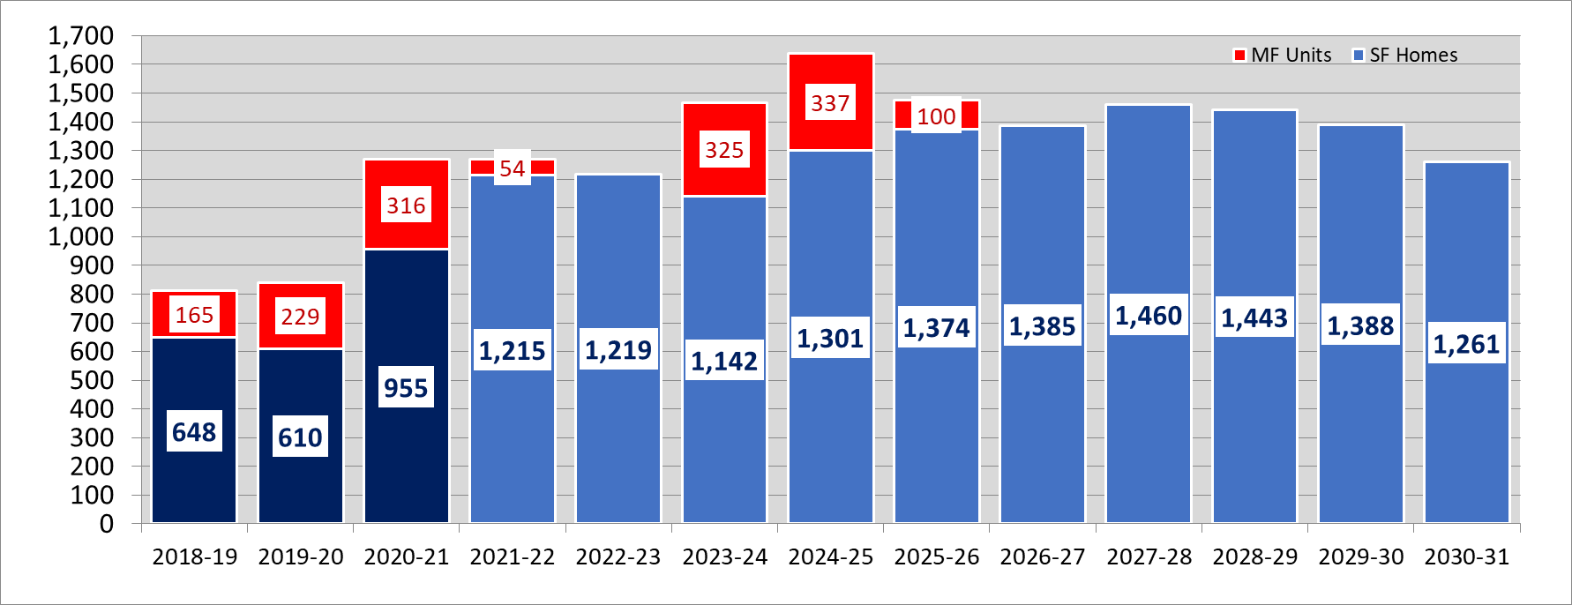
MIDLOTHIAN ISD NEW HOME CONSTRUCTION
MODERATE GROWTH CLOSINGS FORECAST FALL 2022-2031
More vacant land is likely to be developed during this timeframe; keeping the rate of home sales from declining
Annual periods represent 4Q-3Q
The district is poised to see an average of 1,250 closings over the next five years
Under the Moderate Scenario, MISD builders could produce approximately 6,250 total new occupied homes over the next five years
Over the next 10 years, MISD is poised to see over 13,000 new homes completed
Apartment developers working to add another 700+ units in MISD

Slide 28
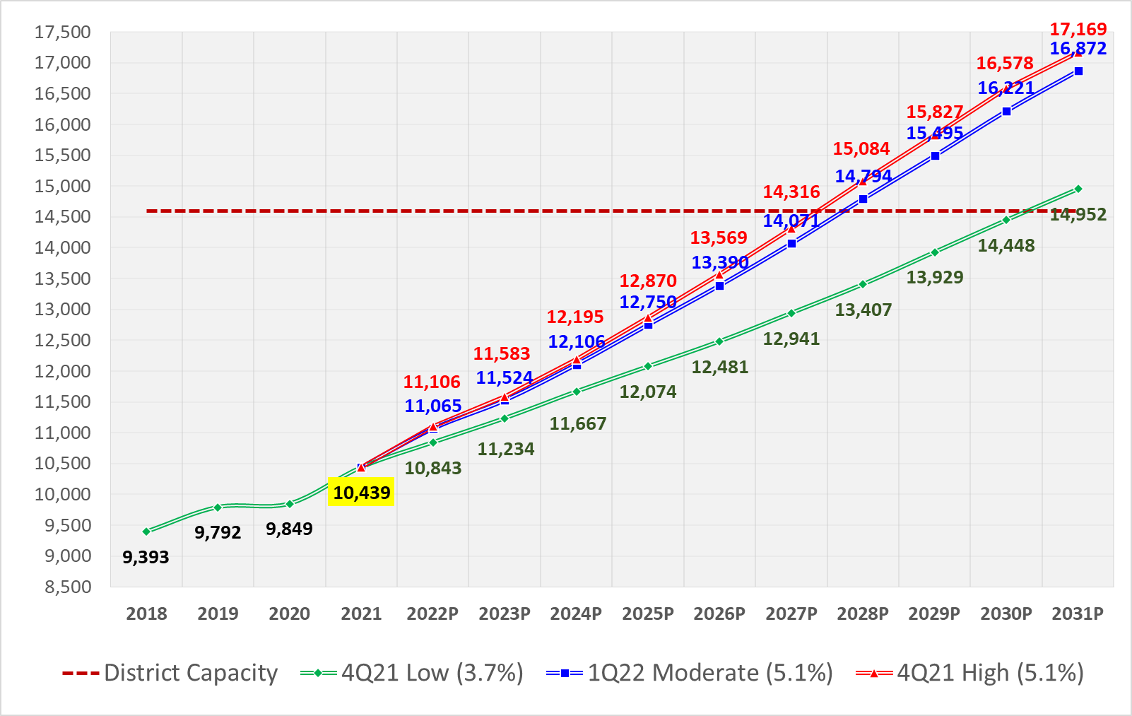
MIDLOTHIAN ISD
10-YEAR ENROLLMENT PROJECTIONS (1Q22 DRAFT)
Additional platted lots at Padera (Huffines) and Highland Lakes would likely push the moderate scenario up towards 5% annual growth
Residential growth expected to keep district enrollment growth near 5% per year
District Capacity: 14,600 w/ MS #3, Heritage Expansion, and ES #8
Projected
Historical
Projected Net Growth | Low Scenario | Moderate Scenario | High Scenario
5-Year | 2,042 | 2,951 | 3,130
10-Year | 4,513 | 6,433 | 6,730
5-Yr. Ann. Avg. | 3.6% | 5.1% | 5.4%
10- Yr. Ann. Avg. | 3.7% | 4.9% | 5.1%

Slide 29
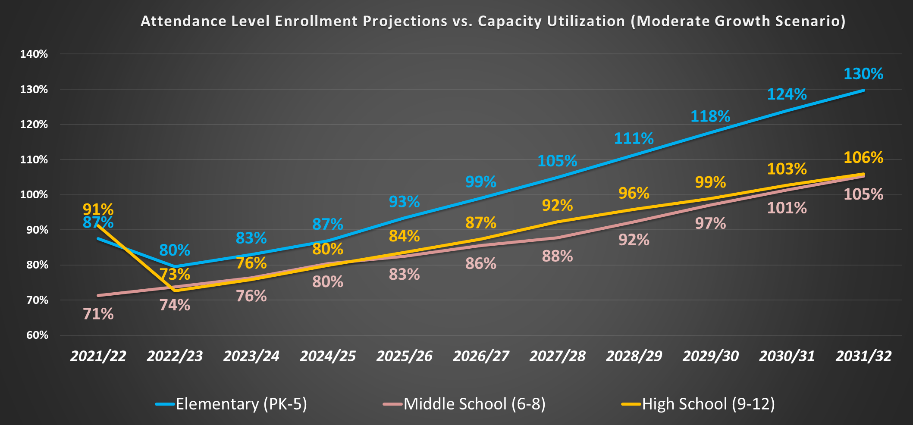
ATTENDANCE LEVEL CAPACITY UTILIZATION
(MODERATE GROWTH 1Q22 DRAFT)

Slide 30
ELEMENTARY CAMPUS CAPACITY UTILIZATION
Additional lots means that the district could need 3 new elementary schools by 2031/32

Slide 31
MIDDLE SCHOOL CAMPUS CAPACITY UTILIZATION
(MODERATE GROWTH 1Q22)

Slide 32
HIGH SCHOOL CAMPUS CAPACITY UTILIZATION
(MODERATE GROWTH 1Q22)

Slide 33
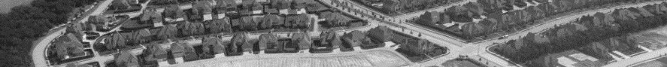
Midlothian ISD
1Q 2022 Demographics Summary
As of the 2021/22 SY, MISD had the 31st largest enrollment among the 90 DFW public school districts
The district ranks 26th in percentage enrollment growth over the past three years (among all DFW districts)
Rapid enrollment growth continues to be driven by record new home construction in MISD
Builders produced record activity in 1Q22 with 442 starts
From 2Q21-1Q22, homebuilders started 1,371 new homes and a record 994 homes were occupied
District’s median new home price now stands at a record $540,415 (+41% YoY) [DFW = $406K]
The recent housing surge is mainly the result of a 3rd growth area emerging in the northwest/Grand Prairie portion of the district (Vitovsky ES zone); starts in this area are up 173% since 2020
Developers delivered another 1,087 new single-family (SF) lots in MISD from 2Q21-1Q22
1,160 total homes currently in production (started but not complete/occupied)
1,292 vacant SF lots were remaining at month-end March 2022
A record 2,871 SF lots are currently under development in the district
Developers are planning over 20,000 additional future SF lots
MISD on pace for 6,200+ new homes occupied by Fall 2026 and 13,000 homes by Fall 2031
New home subdivisions in MISD are currently yielding 0.65 enrolled students per home
Apartments in MISD are currently yielding 0.25 enrolled students per unit
Residential growth is expected to keep annual enrollment growth near 5% per year
If enrollment growth averages 5.0% over the next five years (Moderate Scenario), MISD would surpass 13,000 students by 2026/27
Over the next 10 years, the district could add nearly 6,500 students if the annual growth rate averages 5% (Fall 2031 = 16,900)

Slide 34


16980 Dallas Parkway
Suite 101
Dallas, Texas 75248
www.schooldistrictstrategies.com
Although School District Strategies (SDS) has used commercially reasonable efforts to obtain information from sources it believes to be reliable and accurate, SDS does not guarantee the accuracy or completeness of such information. Information presented in this report represents SDS’s estimates as of the date of the report and is subject to change without notice. This report is not intended as a recommendation or endorsement of any action taken by you or any third party in regard to the subject matter of this report or any other real estate activity. SDS WILL HAVE NO LIABILITY FOR INDIRECT, INCIDENTAL, CONSEQUENTIAL, OR SPECIAL DAMAGES, INCLUDING (BUT NOT LIMITED TO) LOST PROFITS, OR DIMINUTION IN VALUE OF YOUR BUSINESS OR PROPERTY, ARISING FROM OR RELATING TO SDS’S SERVICES HEREUNDER, REGARDLESS OF ANY NOTICE OF THE POSSIBILITY OF SUCH DAMAGES AND WHETHER OR NOT SUCH DAMAGES ARE REASONABLE OR FORESEEABLE UNDER THE APPLICABLE CIRCUMSTANCES. SDS’S LIABILITY ON ANY CLAIM OF ANY KIND, INCLUDING NEGLIGENCE, FOR ANY LOSS OR DAMAGE ARISING OUT OF, CONNECTED WITH, OR RESULTING FROM THIS REPORT OR THE SERVICES PROVIDED BY SDS SHALL IN NO SINGLE CASE, OR IN THE AGGREGATE, EXCEED THE AMOUNTS ACTUALLY PAID TO SDS IN CONNECTION WITH THE REPORT.
The following contingencies and limiting conditions are noted as fundamental assumptions that may affect the accuracy or validity of the analysis and conclusions set forth in this report. Specifically, the parties assume: that the Dallas/Fort Worth metropolitan area, the State of Texas, and the nation as a whole will not suffer any major economic shock during the time period of the forecast contained in this report; that general population levels will continue to increase at or above the rate forecast; that the public and third party sources of statistical data and estimates used in this analysis are accurate and complete in all material respects, and that such information is a reasonable resource for project planning purposes; the proposed real estate development projects described herein, when completed, will be designed, promoted, and managed in a manner that will have an impact on the local market that is reasonably consistent with other similar projects in the past; and that the recommendations set forth in this report will be acted upon within a reasonable period of time to preclude major changes in the factual conditions evaluated.
Copyright 2022 School District Strategies.

