Slide 1

CATS WITH CATTITUDE!

Slide 2

Cats—what does it stand for?

Slide 3
What does it look like?
When a PCHS student is demonstrating Courage he/she is choosing to do the right thing at all times.
When a PCHS student is demonstrating a CATS Attitude he/she is overcoming all obstacles to do his/her best by having a positive outlook toward growth of self & others.

Slide 4
What does it look like?, cont’d.
When a PCHS student is demonstrating Teamwork, he/she is considerate and helpful to each other. PCHS students realize that all students must be successful, not just a few.
When a PCHS student is demonstrating Spirit he/she is showing his pride in the school and the community in which he/she lives.

Slide 5

Voice Levels
Voice Level 0 – Silent
Voice Level 1 – Quiet
Voice Level 2 – Conversational
Voice Level 3 - Loud

Slide 6

Cell Phones
Students can make calls/text, check email, etc., during the following times:
Before 1st Period begins at 8:05
In between classes
During their designated lunch time
All cell phones must be TURNED OFF during class time!
Must submit your BYOD Form to use during class

Slide 7
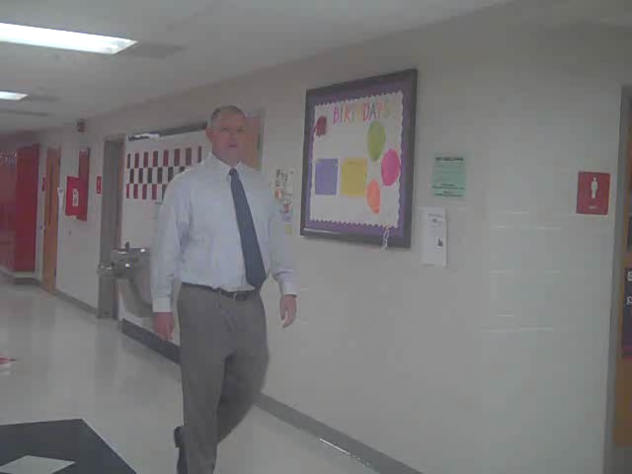
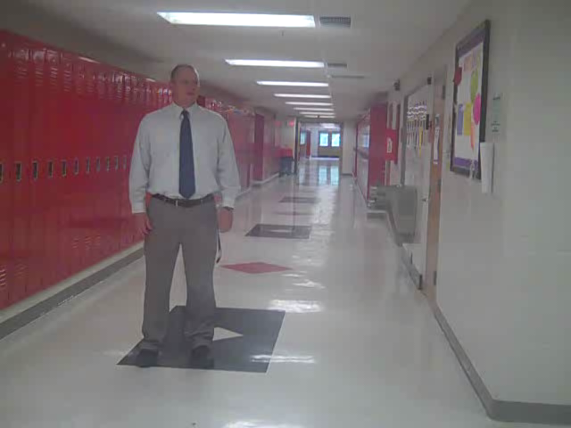
HALLWAY BEHAVIOR

Slide 8
What does CATS look like in the hallway?
Walk safely on the right side in the hallways.
Keep hands, feet and objects to yourselves, the lockers, and walls.
Use a level one voice during class change and a level zero voice during class time.
Stop, look at, listen to and respond if necessary when addressed by an adult.
Correct your behavior when asked.
Have the hall pass during class time and/or during lunch.

Slide 9
What does CATS look like in the hallway?, cont’d.
Go directly to designated areas upon arrival to and departure from school and upon leaving the classroom or dismissal from classroom.
Use appropriate language at all times.
Treat others with respect, dignity and courtesy.

Slide 10

Great job. That’s all for today.

Slide 11

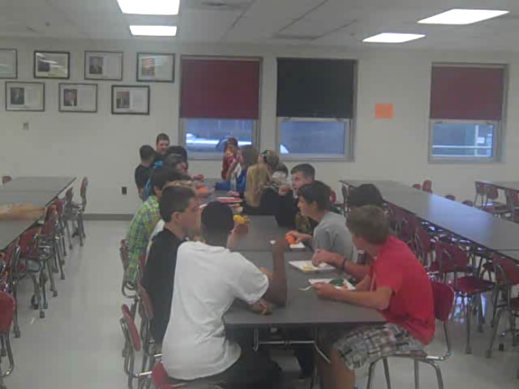
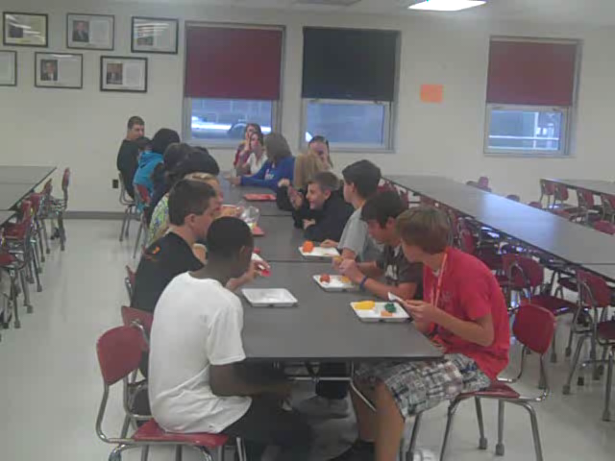
Cafeteria Behavior

Slide 12
What does CATS look like in the cafeteria?
Walk to and from the cafeteria using level one (quiet) voice.
When entering proceed to the left or right side and exit via the center aisle.
Wait patiently in a single-file line.
Have money and lunch code ready.
Use level two (conversational) voice in the cafeteria area.
Be courteous to staff and other students.
Respect each other’s space by keeping hands to yourself.

Slide 13
What does CATS look like in the cafeteria?, cont’d
Staff signed agenda must be presented to exit cafeteria for any other reason other than restroom.
Clean your area of food by placing trash in garbage cans.
Food and drink, except water, must remain in the cafeteria at all times.
Remain in cafeteria, seated in assigned area, until dismissed.
Push in chair when exiting.

Slide 14
Great job. That’s all for today.

Slide 15

Restroom Behavior

Slide 16
What does CATS look like in the restrooms?
Must have Agenda Book hall pass signed.
Use level two (conversational) voice.
Follow directions of adults.
One person per stall.
Be considerate of other’s privacy.
Be patient.
Respect facilities--Keep restroom clean.
Follow good hygiene procedures—always wash hands before exiting.
Return to class promptly.
Use of tobacco products is prohibited.

Slide 17
Great job. That’s all for today.

Slide 18
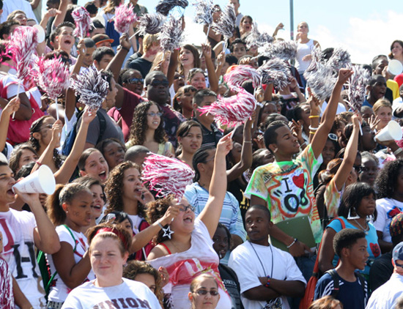
Gym & Assembly Behavior

Slide 19
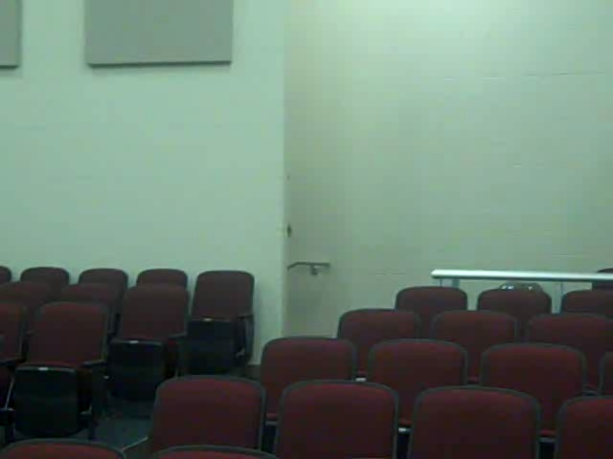
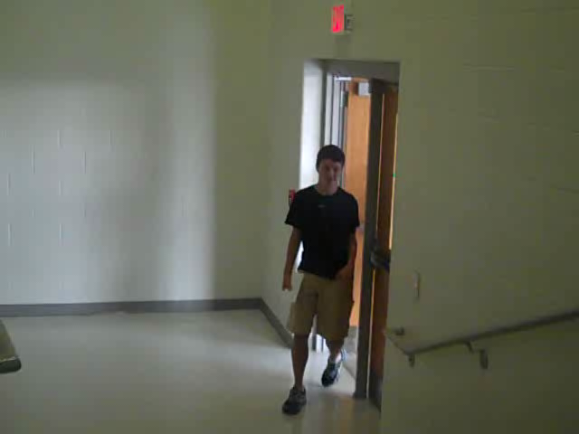
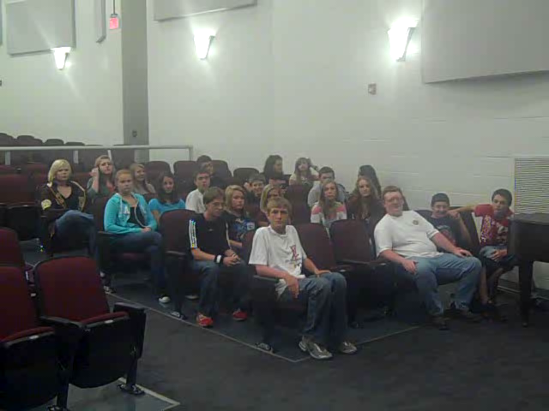
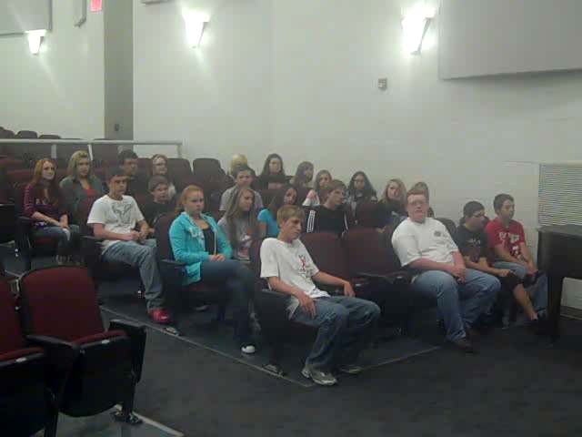
Auditorium Behavior

Slide 20
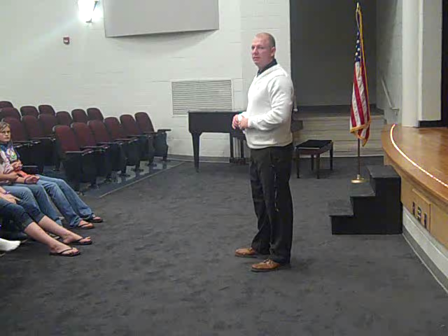
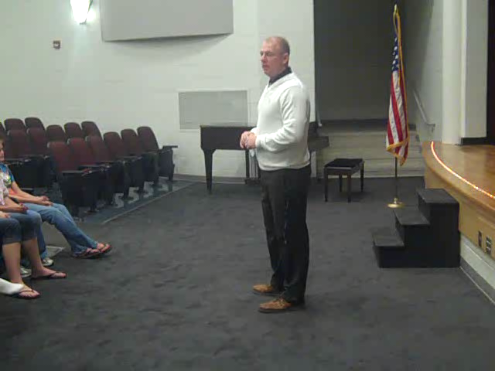
Auditorium behavior (listening/responding)

Slide 21
What does CATS look like during assemblies?
Listen and follow adult directions.
Enter & exit quietly, reporting to assigned areas.
Focus on presentation and give full attention to the speaker(s).
Clap/respond when appropriate.
Sit facing forward in an upright position, keeping hands and feet to yourself.
Keep feet on the floor.
Be supportive of our school in a positive manner.
Food and drink are prohibited during assemblies.

Slide 22

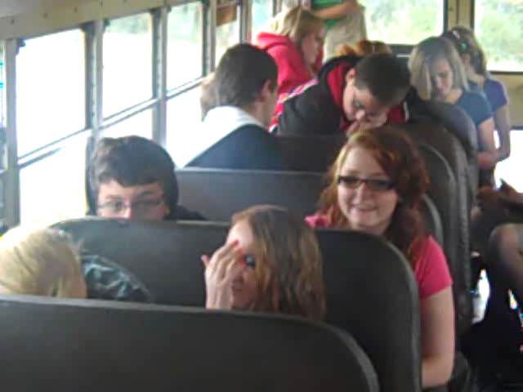
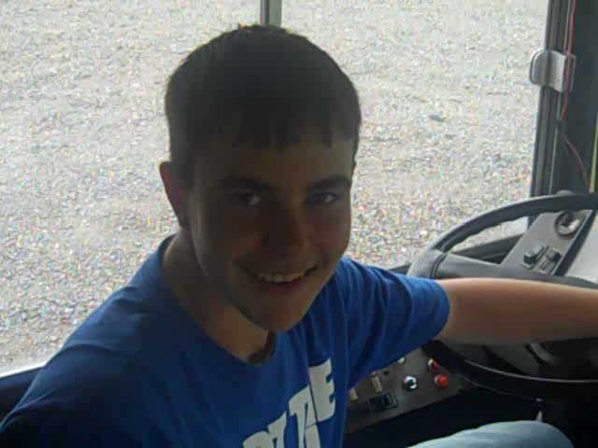
Bus Behavior

Slide 23
What does CATS look like on the bus?
Be on time to the bus stop.
Follow directions of bus driver & monitor(s).
Use appropriate language.
Load and unload quietly and in a single-file line.
Use level 2 (conversational) voice.
Keep aisles clear of all objects.
Remain seated with hands and head inside the bus at all times.

Slide 24
What does CATS look like on the bus, cont’d.
Respect the property of and be courteous to fellow riders, the driver and other travelers.
Report to assigned location upon arrival to school.
Keep busses clean and put all trash in garbage cans/bags.
Use of tobacco products is prohibited.

Slide 25
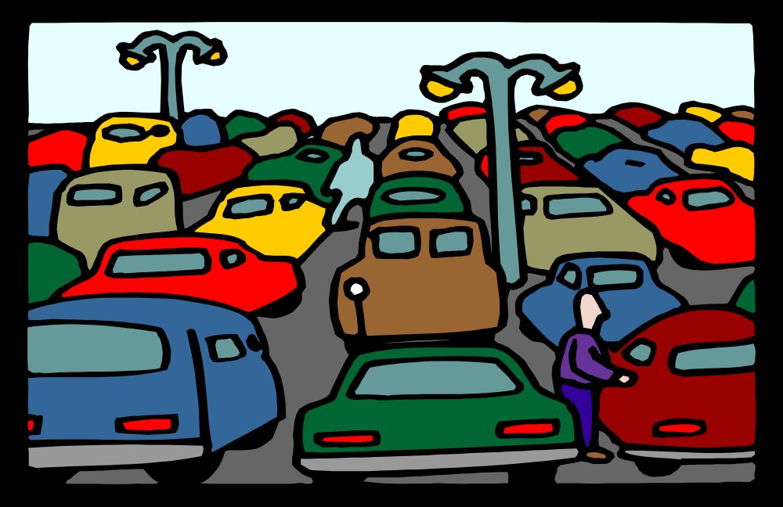
Parking Lot

Slide 26
What does CATS look like in the Parking Lot?
Enter & Exit building immediately upon arrival & departure
If a driver – you must have a Parking Permit displayed in vehicle
Park only in your assigned spot
Observe all traffic rules
Respect property – Keep lot clean
Tobacco products are prohibited on school property
Be courteous to other drivers & pedestrians
Obey all traffic laws
Reminder: Parking privileges can be revoked at any time

Slide 27
Great job. That’s all for today.

