Slide 1
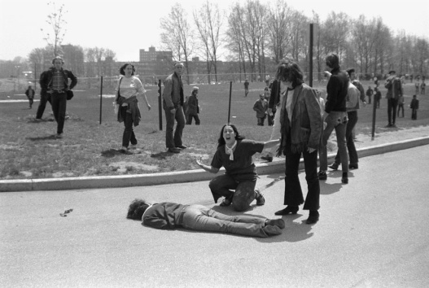
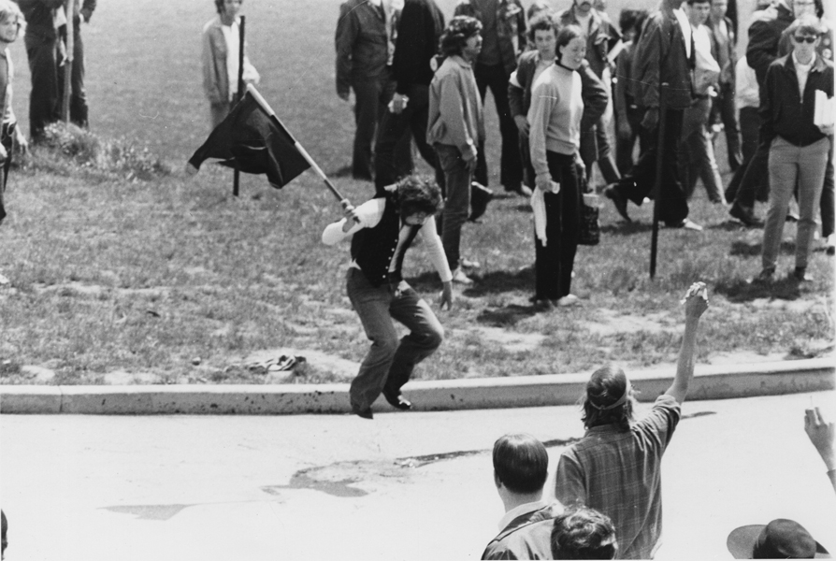
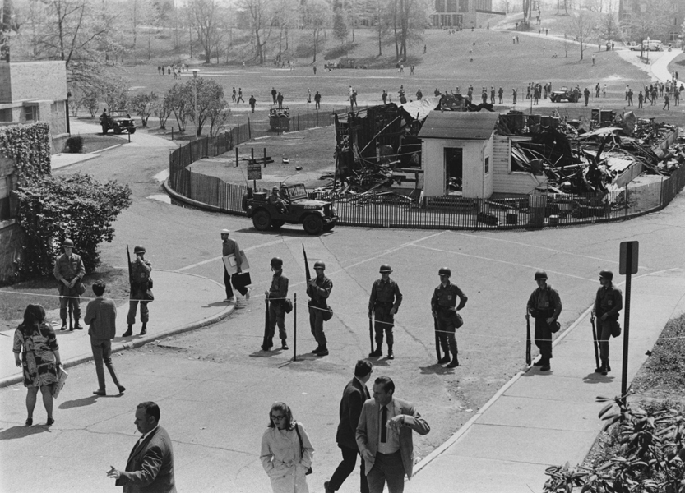
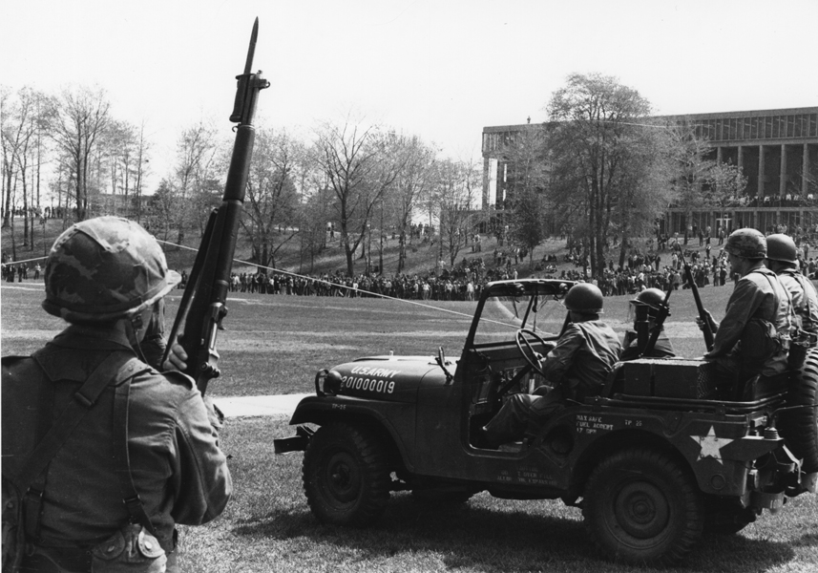
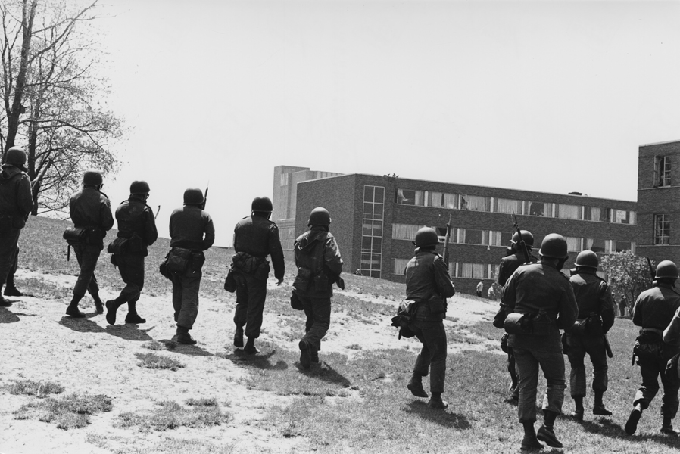
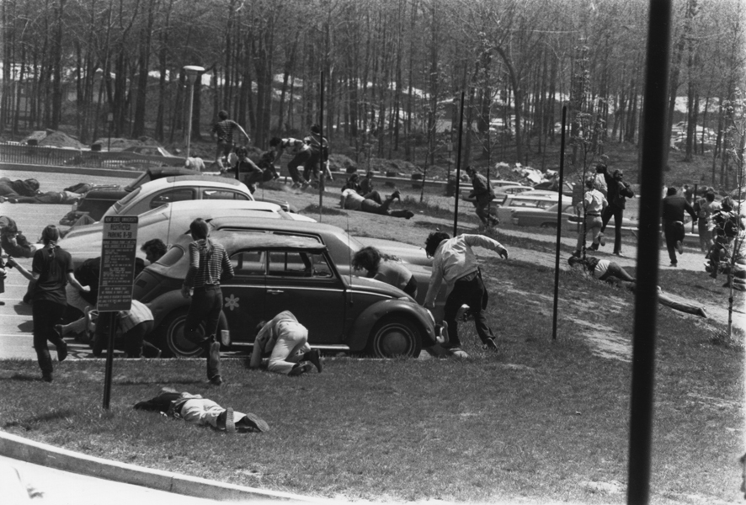
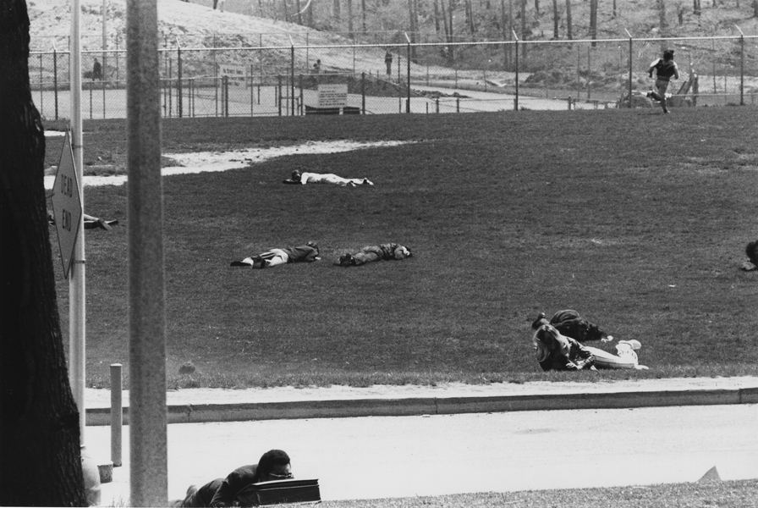
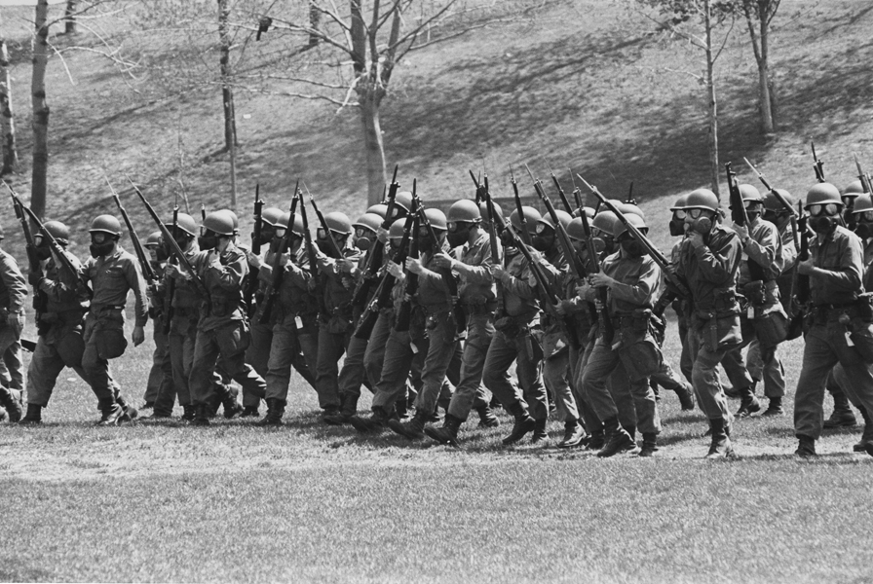
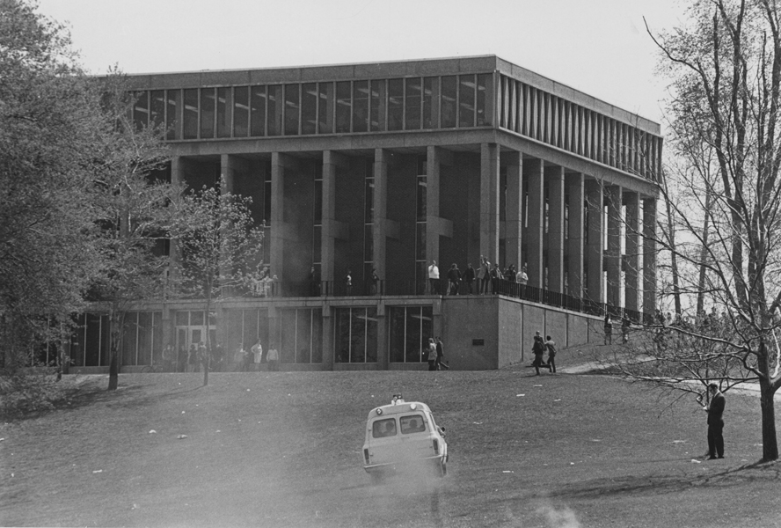
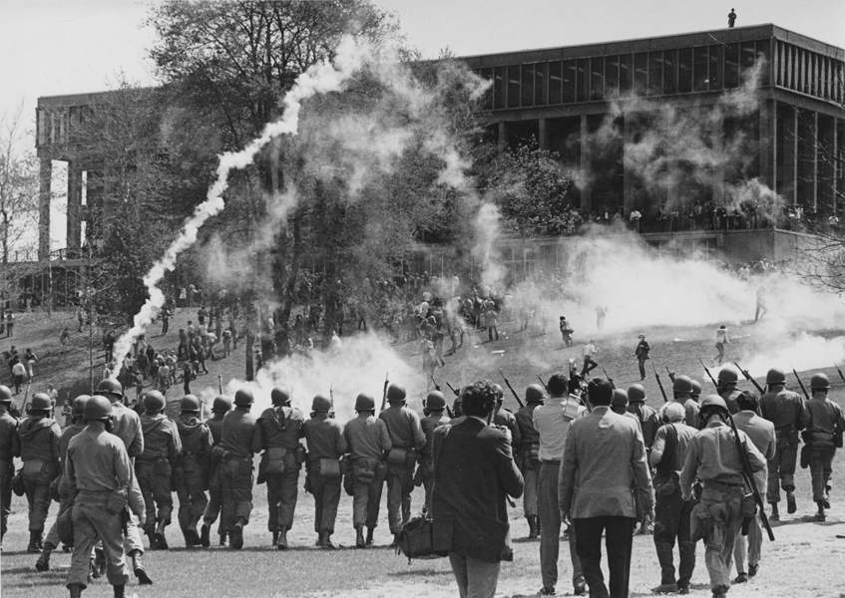
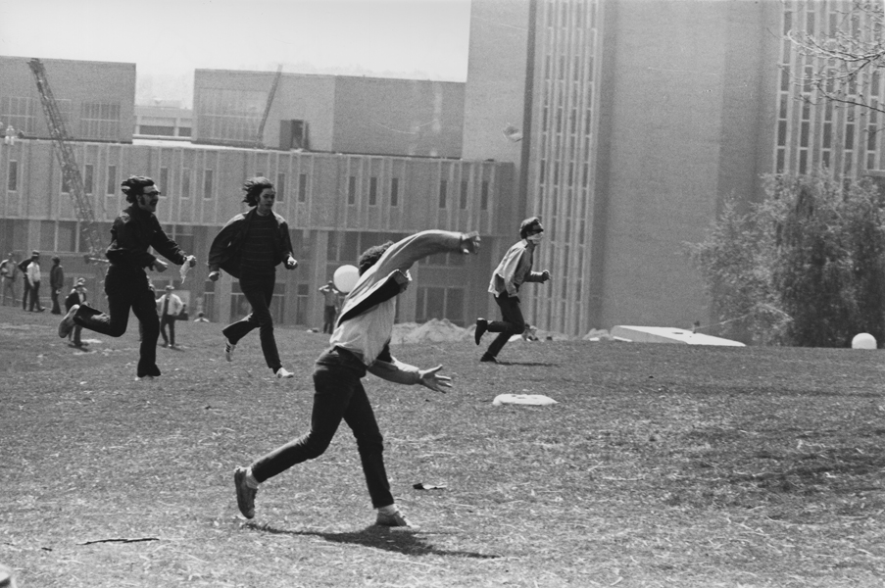
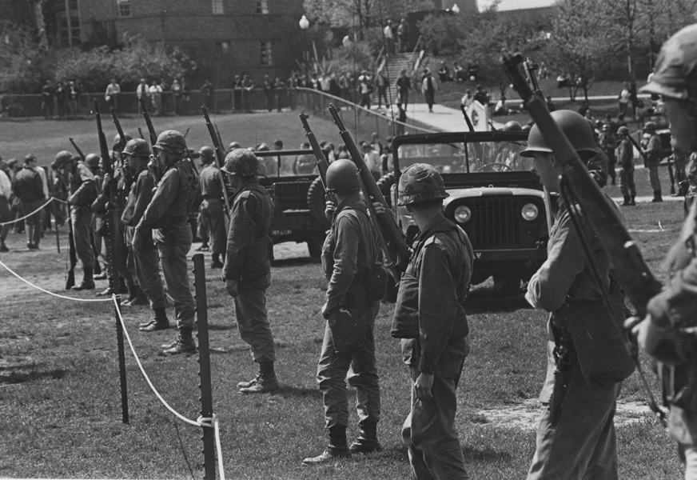
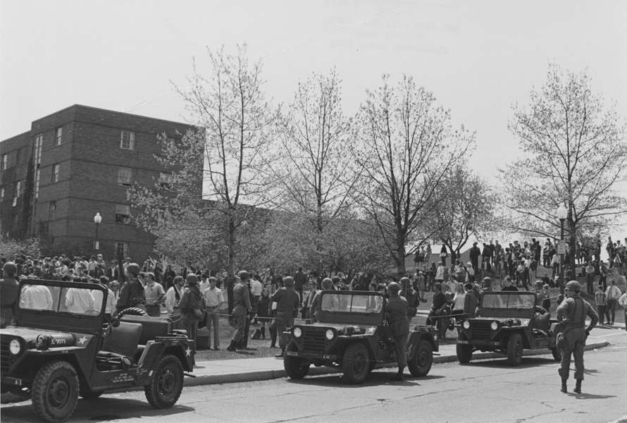
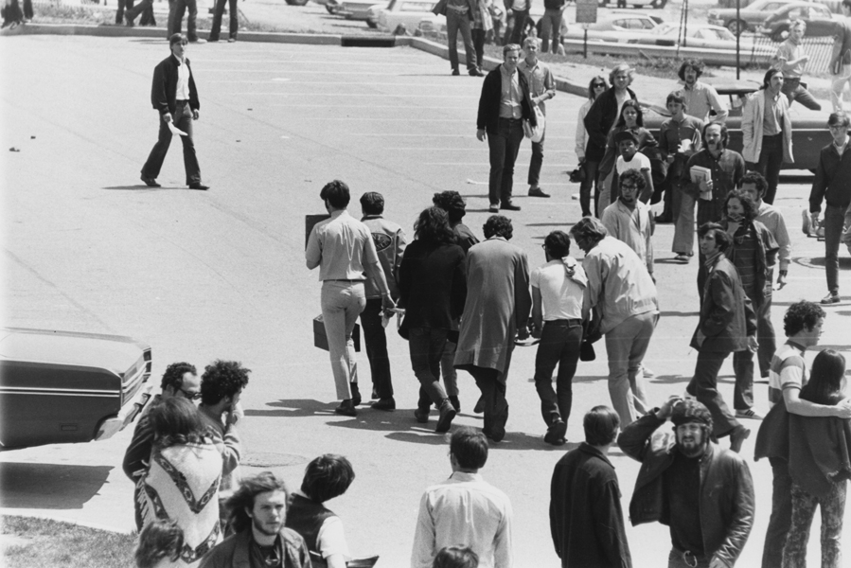
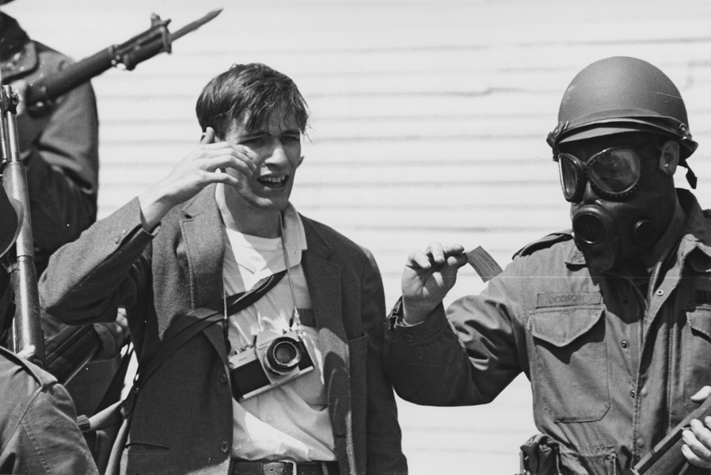
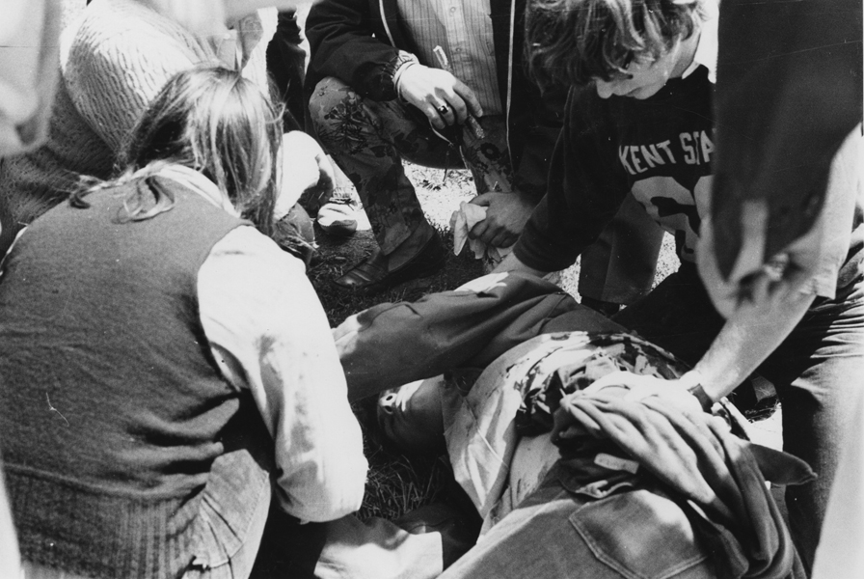
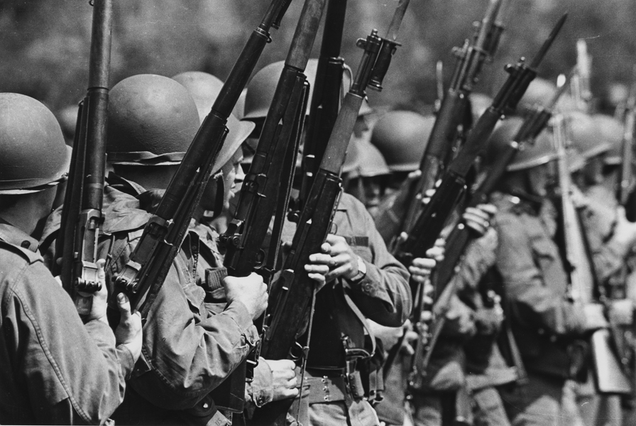
Kent State Shootings
“Ohio” – Neil Young

Slide 2
Kent State University, May 4, 1970
“tin soldiers” – untrained in “peace keeping”

Slide 3
“four dead in Ohio”

Slide 4
Kent State’s ROTC building was burned down
in response to Nixon’s Cambodian ‘incursion’

Slide 5
Guardsmen were handed live ammunition rather than non-lethal

Slide 6

Filo’s famous photo of student turmoil

Slide 7
The students were not entirely peaceful

Slide 9
Guardsmen clearing the campus

Slide 10
Gas masks & bayonets for student protest?

Slide 11
Clearing the hill

Slide 12
Diving for cover!

Slide 13
‘Soldiers are cutting us down’

Slide 14
Limiting the press

Slide 15
The calm before the storm

Slide 17
State of
disbelief

Slide 18
It should have never gone this far
‘four in Ohio’
How many more?

Slide 19
Citations
Filo, John. Kent State/John Paul Filo. 1970. Photograph. Library of Congress, Washington, D.C.. Web. 5 Mar 2014. http://www.loc.gov/pictures/collection/cph/item/2009632261/.
Kent State University. News Service, Multiple Images. 1970. Photograph. Kent State: Special Collections and Archives, Kent, OH. Web. 5 Mar 2014.
http://www.library.kent.edu/drc/may4/browse_titles.php.
Young, Neil. Ohio. Crosby, Stills, Nash, & Young. Rec. 21 May 1970. Atlantic, 1970. Vinyl recording.

