Slide 1
Partnering For Success:
Prioritizing non-cognitive skill development in our youth

Slide 2
District Target: Culture of Readiness
All Kids Deserve Rigor
Building Capacity
Resources and Support for Students and Parents
Success
Refer to Handout:
The Parent Connection: Madeline Levine

Slide 3
What determines success?
Intelligence
Talent
Cognitive Hypothesis
Character
Non-Cognitive Skills

Slide 4
What are non-cognitive skills?
Simple definition: Skills that are non-academic in nature; personality/character traits; “soft skills”
WWS Guiding Principles
Be Compassionate
Be Hard-working
Be Honest
Be Respectful
Be Responsible

Slide 5
What are non-cognitive skills?
More specifically…
  Empathy
  Self-Control
  Grit*
  Resilience*
  **Will be discussed more in-depth during the parent night in February**

Slide 6
Why are NCS important?
General Education Development (GED) program
Vs.
High school diploma recipients
(Heckman, 2001)
Cognitive abilities (achievement/IQ tests)
Differences in future outcomes
Research implications: Re-thinking skills
that lead to success
http://www.youtube.com/watch?v=hSmG87MOyV0

Slide 7
Today’s (and tomorrow’s?) World…
http://www.youtube.com/watch?v=YmwwrGV_aiE

Slide 8
So… What does it all mean?
Adapting to a rapidly-changing, fast-paced world…
How do we help ourselves? How do we help our kids?
Explosion of internet-connected devices…
24/7/365 access to information
Importance of emphasis on non-cognitive skills…
    “Stand the test of time”
    Learnable/malleable for a long, long time
    Influence on academic achievement

Slide 9


What tonight isn’t… and is.
“We only have one chance to prepare our children for a world none of us can possibly predict. What will we do with that one chance?”
-- Dr. Stephen Covey
Vs.
How, together, can we influence this conversation?

Slide 10
Empathy: Defined
Empathy is the ability to recognize what is happening with another person and to communicate this understanding.
Children with empathy understand what others are feeling and look at things from their perspective- and wish to relieve their pain and help to better the situation. Teaching kids about empathy is not just to feel sorry for someone; it’s moving beyond sadness or pity, and aspiring to change it.
Stand in their shoes!

Slide 11
Empathy vs. Sympathy
http://www.youtube.co
m/watch?v=1Evwgu369Jw

Slide 12
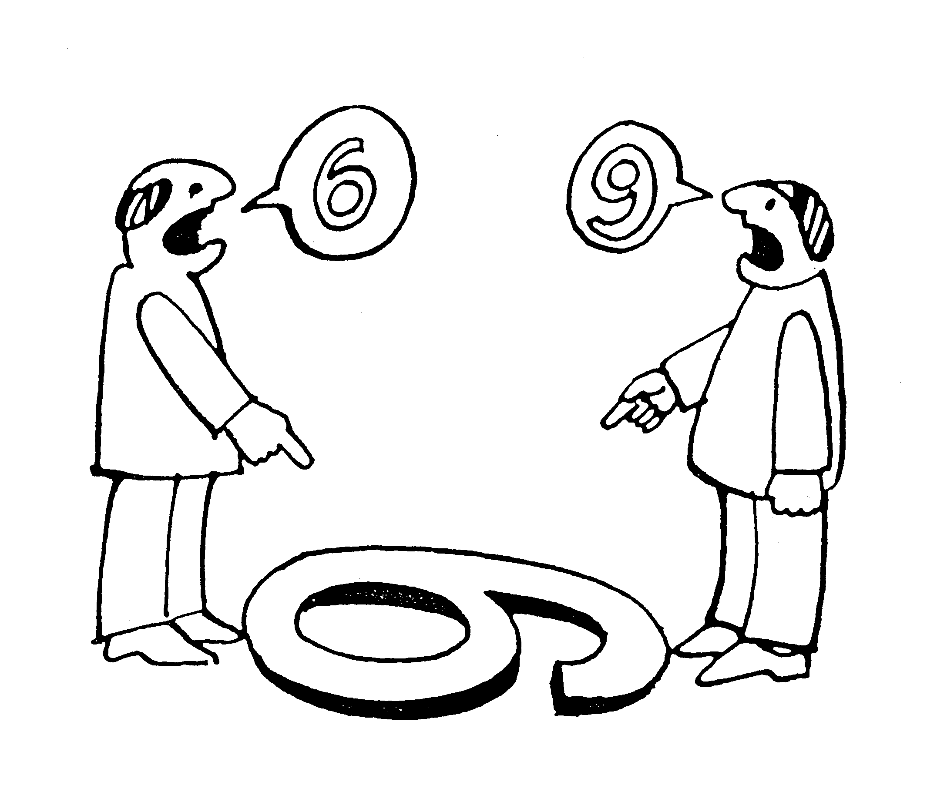
Perspective

Slide 13
Empathetic Responses
Problem | Empathetic Response
There is a new kid at school and he looks nervous. | “Hey there, I was a new kid last year. I was excited and nervous all at once!”
Someone is sitting alone at a lunch table. | Ask the lunch monitor if you can invite the child over to your table.
A group of kids won’t let a student join them at recess. | “Hey do you want to come play with us?”
A child is crying in the grocery store and you don’t see an adult with them. | Let your parent know what you see. Offer to walk the child to the Customer Service Desk.

Slide 14
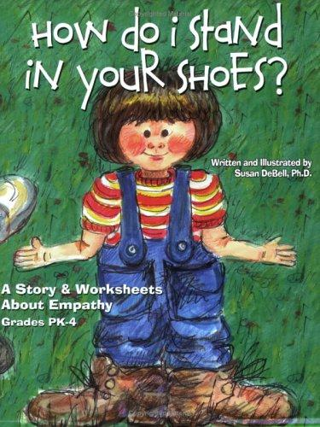
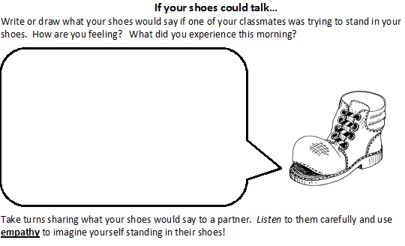
How to Develop Empathy
Role Playing
Put yourself in their shoes.
  What were your difficulties and frustrations?
  What will you do to help next time?

Slide 15
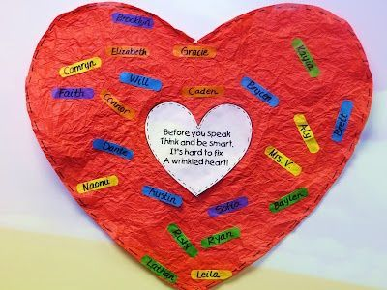
How to Develop Empathy
Fix a Wrinkled Heart

Slide 16
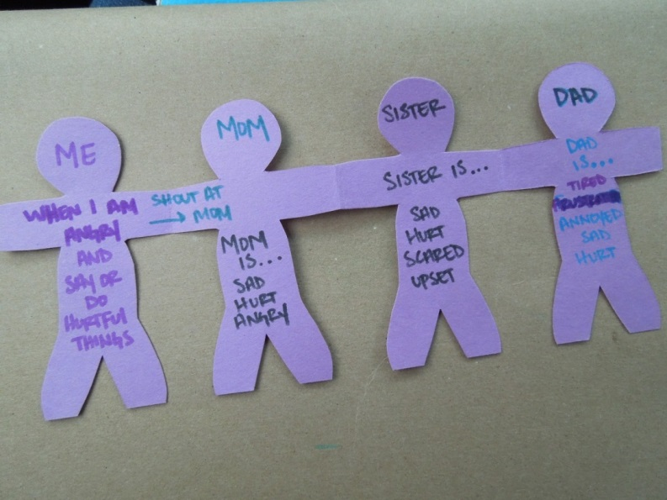
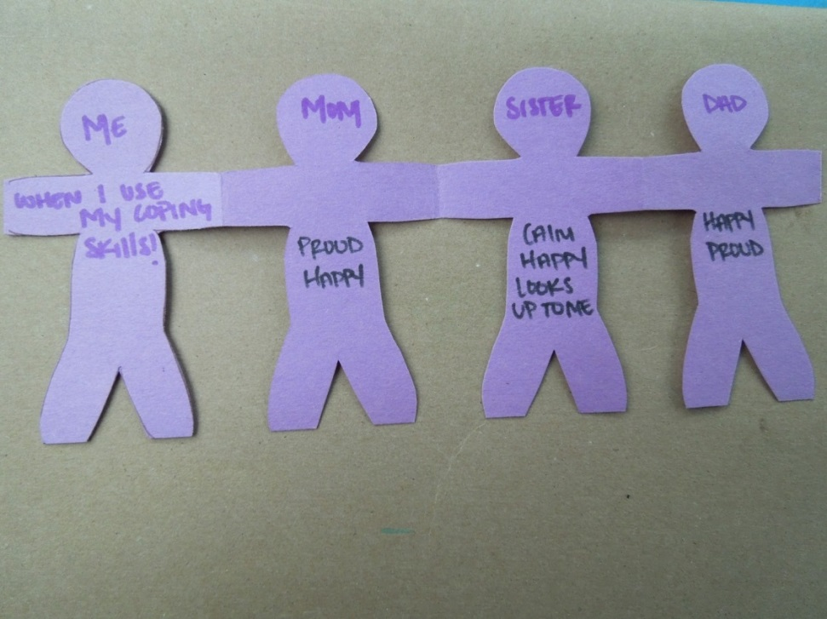
How to Develop Empathy
Chain Effect

Slide 17
What You Can Do: Everyday Empathy
Celebrate the times you see your child using empathy. Have them watch for it in others and when watching movies or television shows.
“How would you feel if someone did that to you?” A great thing to ask a child if they have behaved negatively toward others, however this can also be used as praise when your child does something empathetic.
Be a role model. You are your child’s first and forever teacher. Let them know how you are feeling and what caused you to feel that way. Share with your child times when others were empathetic to you.

Slide 18
What is self-control?
Self-control is when I am in charge of what I do and what I say. It is remembering to stop and think before acting.
Self-control is the ability to maintain composure in challenging situations. We may not always have control of our environment, but we can control our response to it.
Self-control is being aware of one’s own thoughts and feelings. It is the ability to moderate the expressions of our emotions.

Slide 19
Why do I need self-control?
    Self-control helps me listen and follow directions.
    Self-control helps me cope with life challenges.
    Self-control helps me stay safe and be successful.

Slide 20
What are some examples of self-control?
Home:
Using your words that you want your toy back when your sister takes it from you
Ignoring the other player calling you names on the field
School:
Waiting to give an answer when the teacher asks you a question
Reading test directions before proceeding; not rushing through work

Slide 21
What are strategies to gain physical self-control?
Regulate Breathing
Tense, scared, or angry feelings often cause a student’s breathing to become quick and shallow, which changes the way the brain handles the situation. Taking slow, deep breaths is calming and allows more oxygen to the brain. Think “hot chocolate”.
Take a Break
When a student experiences a frustrating situation, encourage the child to take a break or remove him or herself from the situation for a moment.

Slide 22
What are strategies to gain physical self-control?
Out-Tension the Tension
Have a student tense all the muscles in his or her body and then relax. The student can do all the muscles at once or various parts one at a time.
Stimulate the Brain through
Bi-lateral movements
Have the student take turns cross his or her arms and legs in front of his or her body.

Slide 23
How can I express my emotions in a healthy way?
  Identify feeling accurately
  Feeling chart, clip art exercise, book walk
  Use “I” statements
  Tim, I feel jealous when you don’t ask me to play kickball with everyone. Will you please ask me once a
  week to play?
  Recognize a safe time and place
  Safe Box
  Remote Control
  Pause, Fast Forward, Rewind

Slide 24
How can I help as a parent?
Role model by self-talking aloud
  Driving: I feel frustrated by all this traffic. I’m going to take some deep breaths to calm down.
Empower your child by giving them 2 choices
Bedtime: Would you like to read a book or put your PJ’s on first?
Give Wait-Time
Allow time for your child to process requests and questions. Remember, we are not trying to control the kids, but
instead help them navigate and remove barriers in their
lives.

Slide 25

For all of us to consider…
"Do not prepare the path for the child. Prepare the child for the path and he will find his way.“
--Native American saying
What does “success” mean to us?
What are we modeling?
What messages – verbal and non-verbal – are we sending?

Slide 26
Future Parent Partnership Sessions
Session 2: Embedding Rigor, Part 1
November 3 @ SSES (for MG, MT, SS)
November 4 @ WWES (for WW, OT, CR)
Session 3: Non-cognitive Skills, Part 2
February 9 @ WWES (for WW, OT, CR)
February 23 @ MGES (for MG, MT, SS)
Session 4: Embedding Rigor, Part 2
March 2 @ MGES (for MG, MT, SS)
March 3 @ WWES (for WW, OT, CR)
**All sessions begin at 6:30 pm**

