Slide 1

Year in the Life of a Powerful Secretary
By Raelyn Wallock
rwallock@mba-link.com

Slide 2
DISCLAIMER
This is the way WE use PowerSchool in my district.
It does not necessarily represent right or wrong.
PowerSchool is a flexible tool allowing each district to customize and use in ways that works in each district.
All names/data in screenshots are fictitious

Slide 3
Brought to you by….
Raelyn Wallock
Implementation Specialist
Marcia Brenner Associates
rwallock@mba-link.com

Slide 4
About Me
Implementation Specialist for Marcia Brenner Assoc.
Administrative Assistant for rural Nevada Schools for 10+ years
Taught at PSUG Las Vegas since it started 7 years ago and teach at many regional events
Attended three PSU’s so far ☺
Was a PowerSchool consultant for a Secondary Schools in Nevada
Onsite consulting /teaching
Worked in PowerSchool for over 15 years
Computers for 25+
LOVE TO TRAVEL
Love love grandbaby!!!

Slide 5
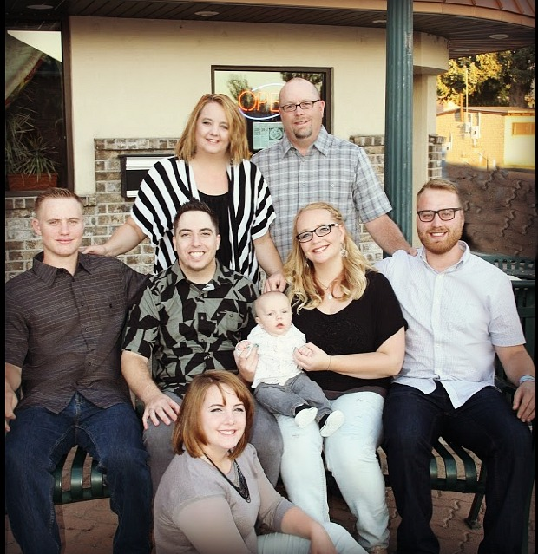

My Family
The Wallock’s

Slide 6
Agenda
Helpful advice for anyone
Enrollments
Historical Grades
Master Schedule
Alerts
Student Functions
Reports
Clearing and Changing Fields and Activities
Staff Screens
Tidbits

Slide 7
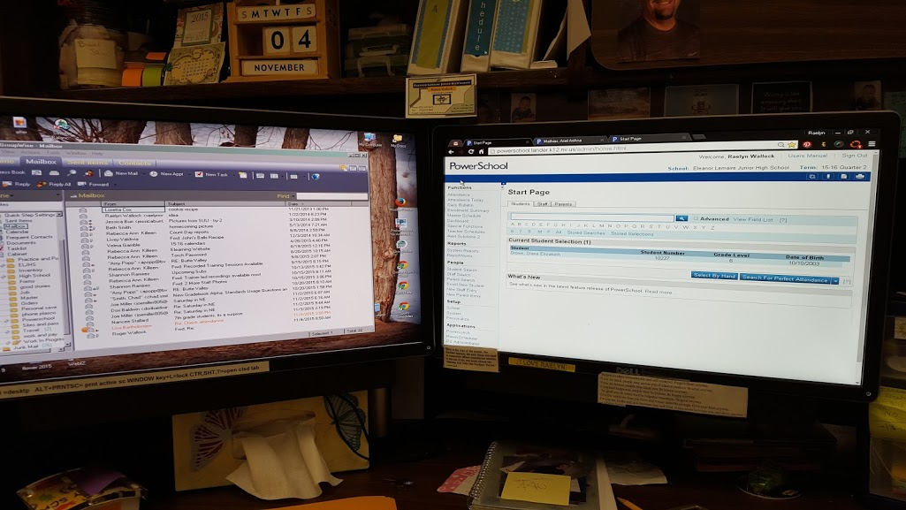
DUAL COMPUTERS!!

Slide 8
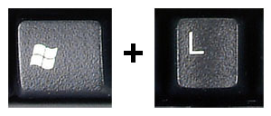
Lock Your Screen

Slide 9

Master Schedule

Slide 10
Master Schedule
Preferences – viewing your master schedule
How to add a section
  Dependent Sections
Import sections with Excel template

Slide 11
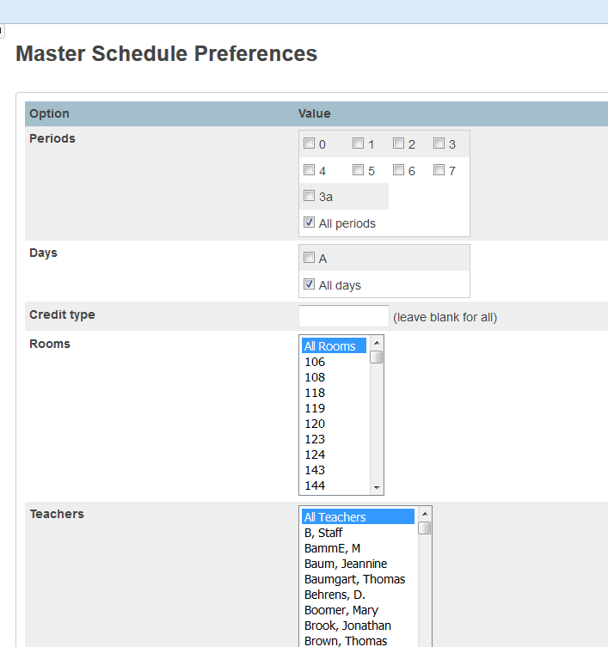
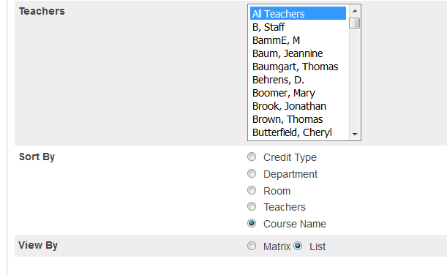
Master Schedule

Slide 12
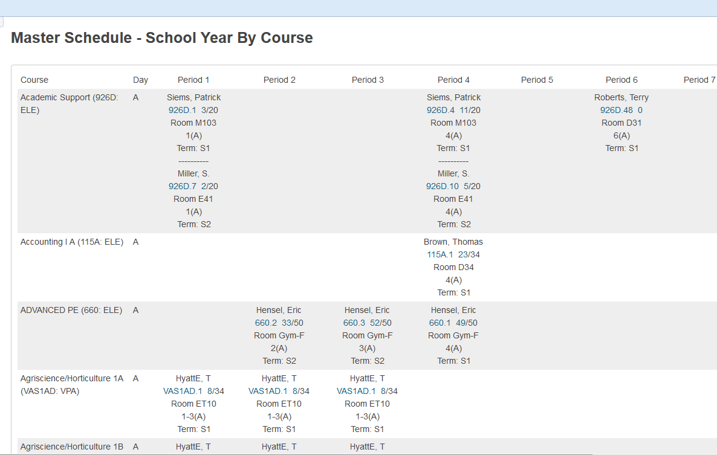
Master Schedule - Matrix

Slide 13

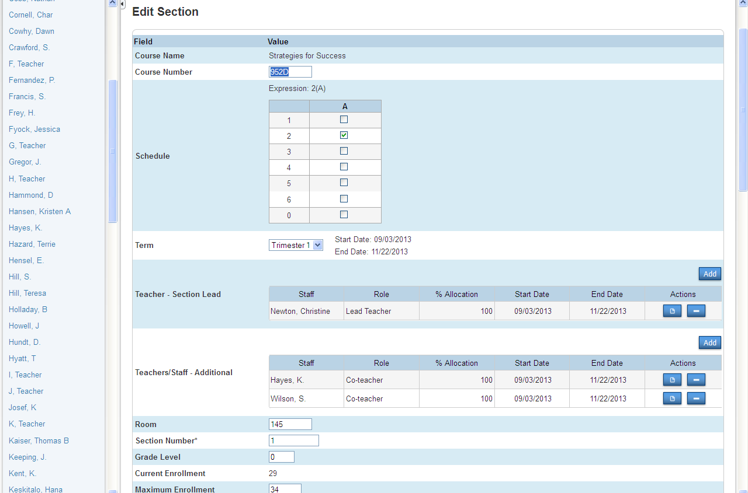
Co-Teacher

Slide 14
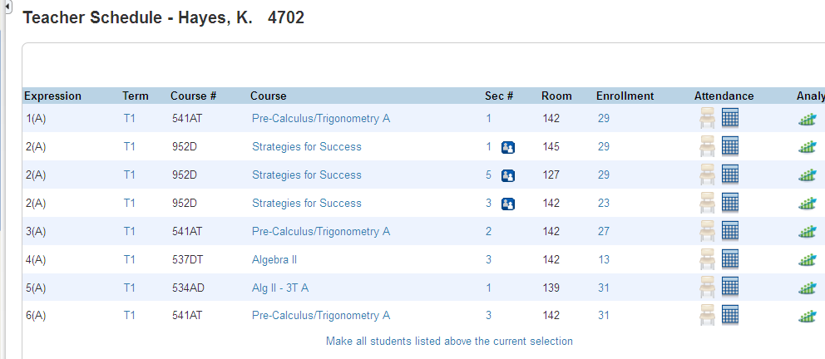
Teacher Schedules
Create co-teacher

Slide 15
Teacher Schedules
Create co-teacher

Slide 16
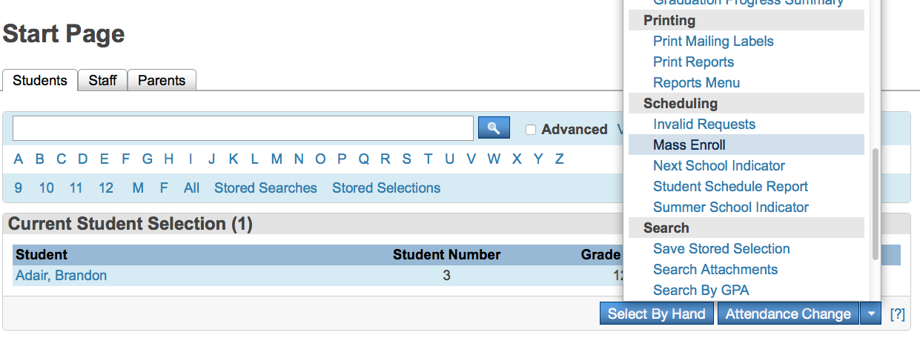
Scheduling – Group of Students

Slide 17
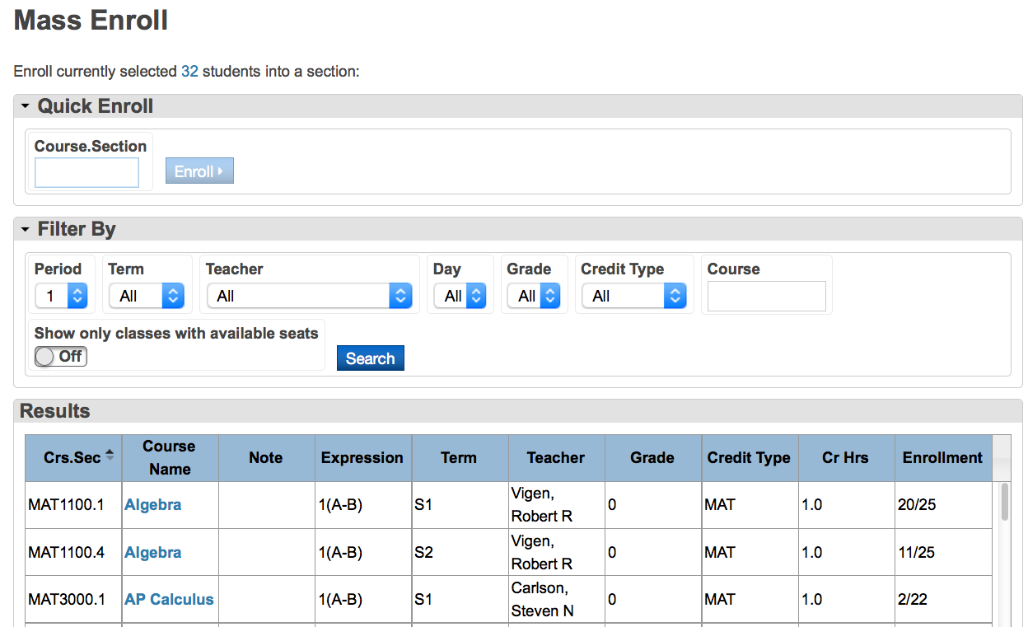
Scheduling – Group of Students

Slide 18

Alerts

Slide 19






Alert…Alert…Alert

Slide 20
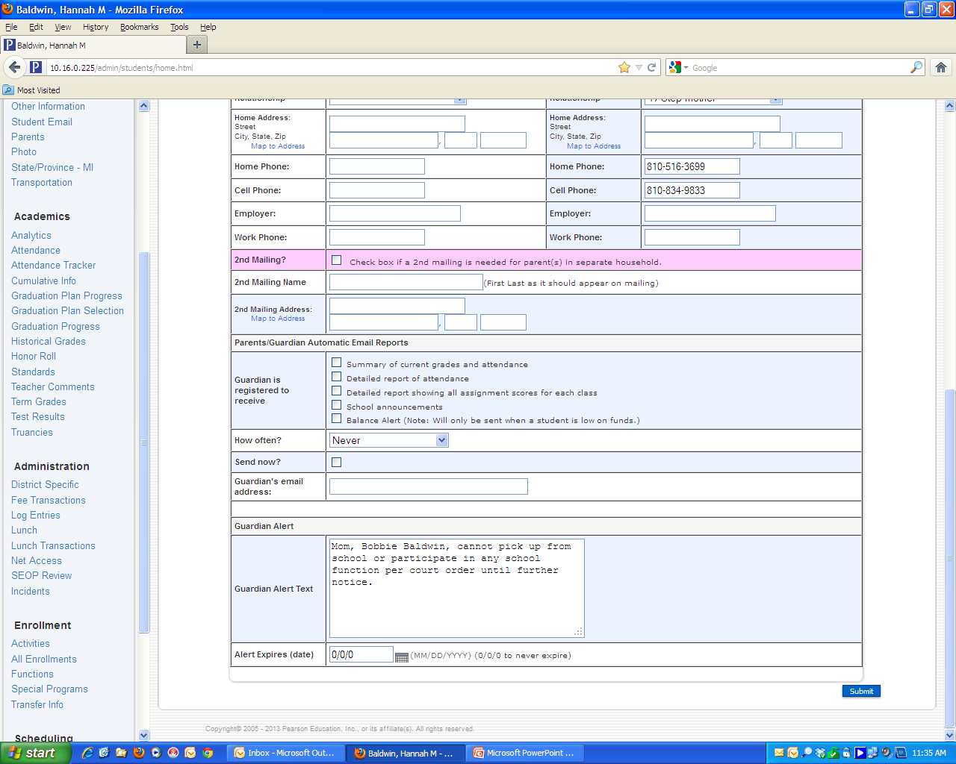
Guardian Alert
Information > Parents/Guardian
  Enter under Guardian Alert Text

Slide 21

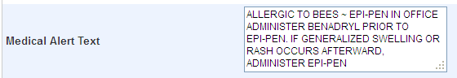
Medical Alert
Information > Emergency Medical
  Enter under Medical Alert Text

Slide 22

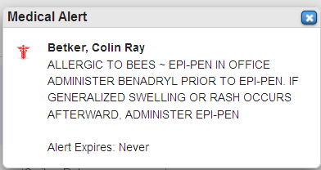
Medical Alert
Alert Symbol in upper left corner by student name when medical alert is entered

Slide 23
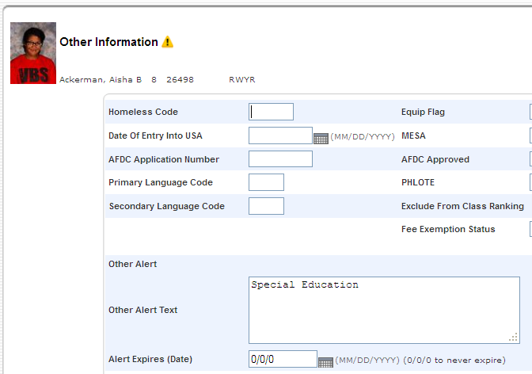
Other Alert

Slide 24
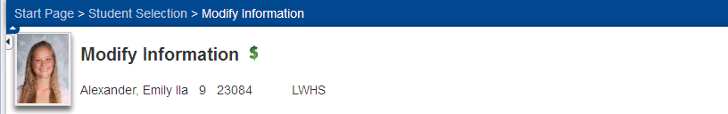
Balance Alert
Green Dollar Symbol alert is displayed depending on the value established through school setup

Slide 25
Alerts
Discipline
  Entered through Log Entries
Birthday
  System automatically adds and deletes this one

Slide 26
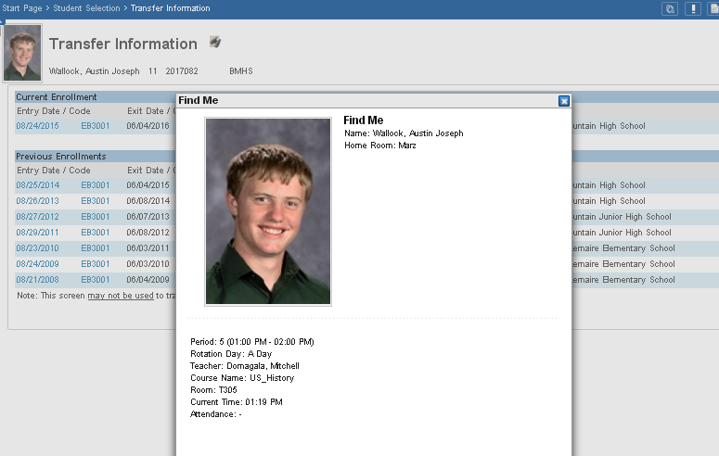
Find Me Now – CUSTOM by PDS

Slide 27
Reports

Slide 28

Reports
Enrollment Summary By Date
Discipline Reports
Form Letters
Net Access Reports
Perfect Attendance

Slide 29
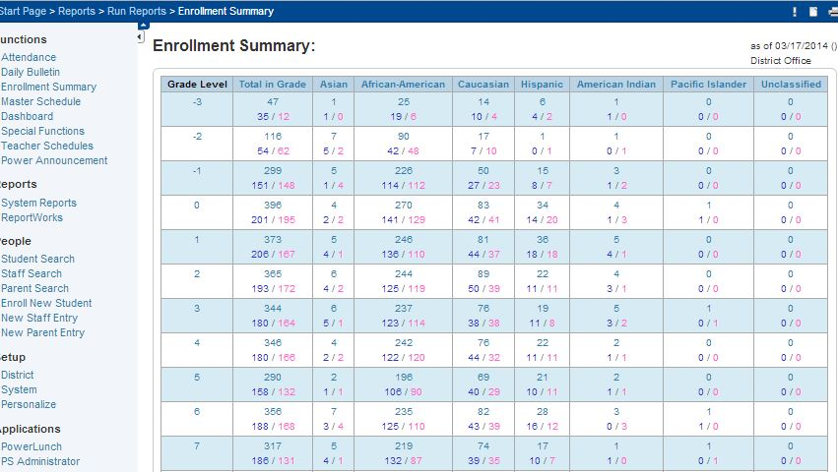
Enrollment Summary

Slide 30
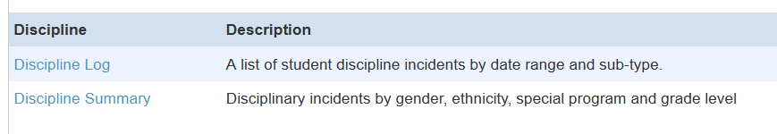
Discipline Reports

Slide 31
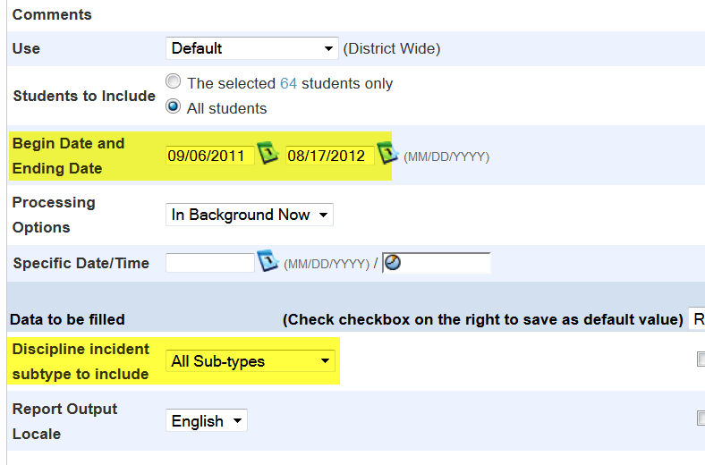
Discipline Log Report

Slide 32
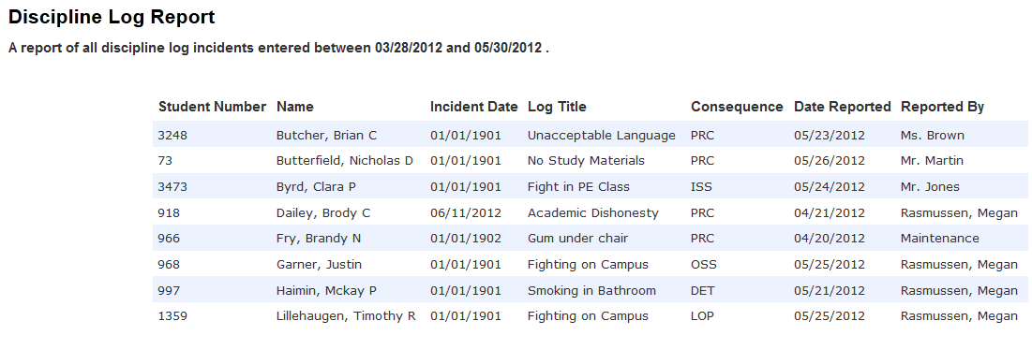
Discipline Log Report

Slide 33
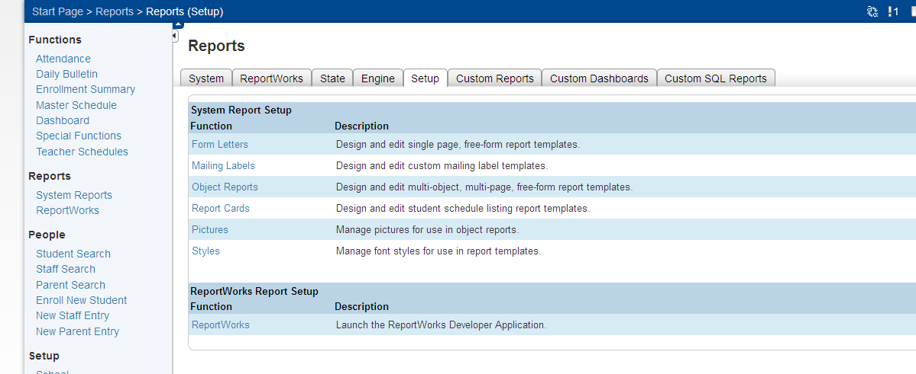
Form Letters

Slide 34
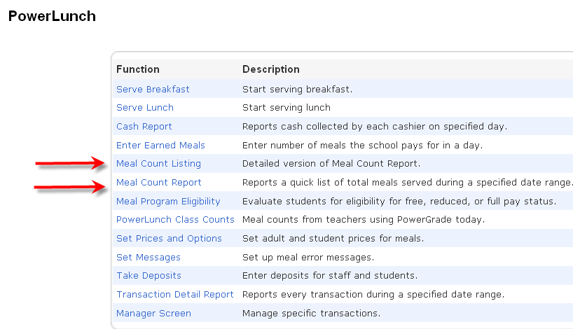
Lunch Reports
Lunch Totals – Nice even if not using PowerLunch

Slide 35
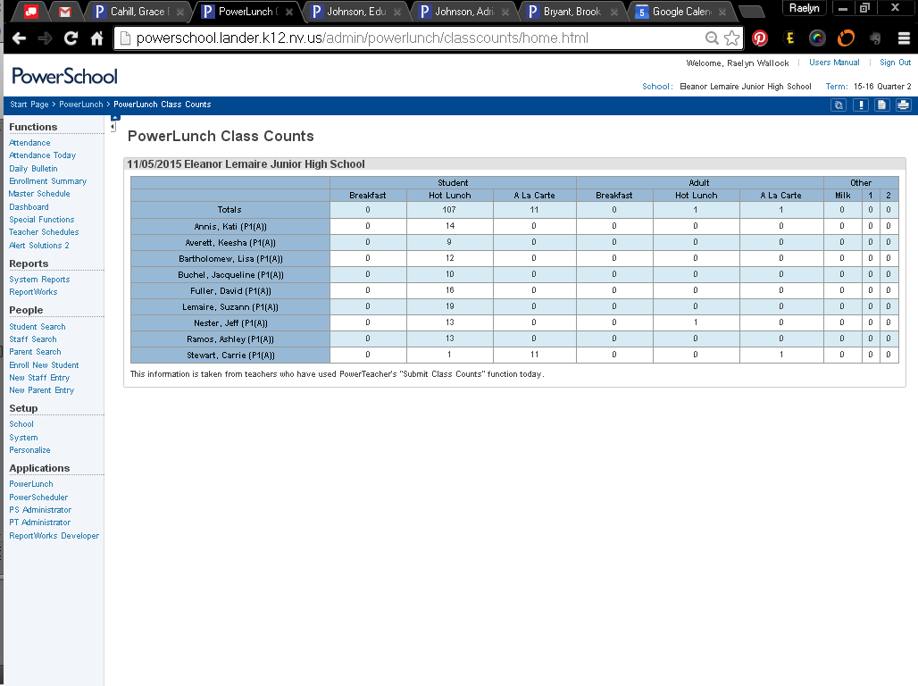
PowerLunch Class Counts

Slide 36
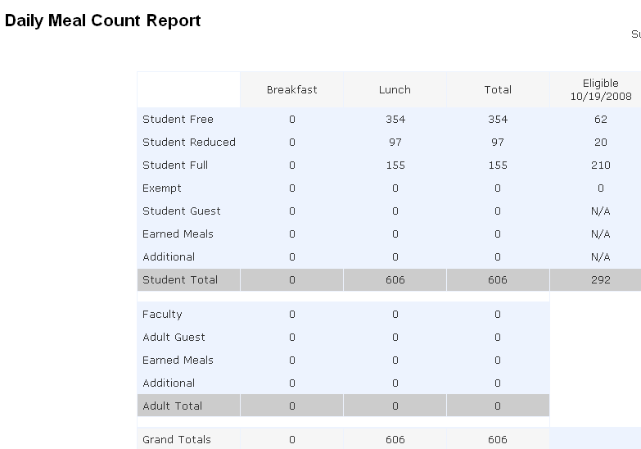
Lunch Reports
Lunch Totals

Slide 37
Form Letters

Slide 38
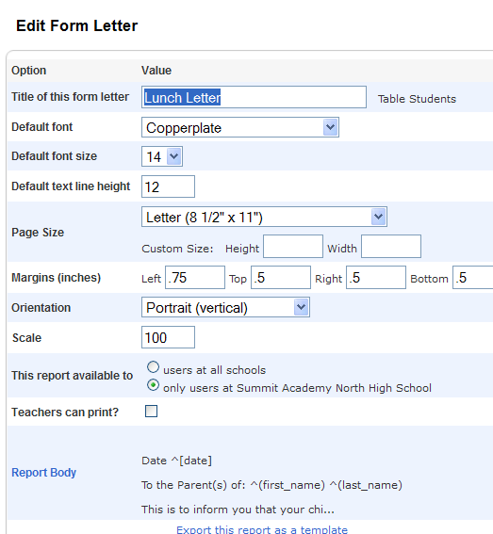
Form Letters

Slide 39
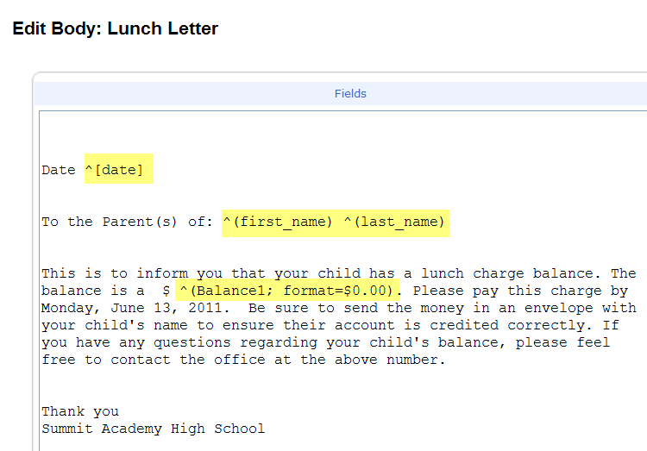
Form Letter Fields

Slide 40
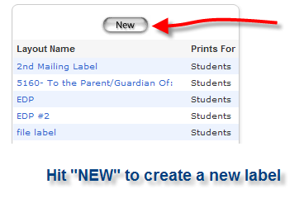
Mailing Labels
Reports
Run Reports
Report Set up
Mailing Labels

Slide 41
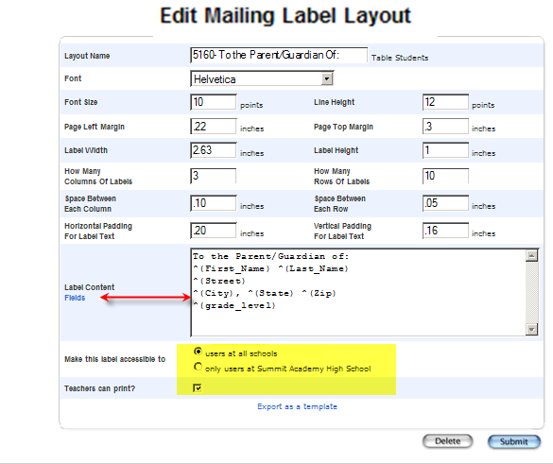

Slide 42
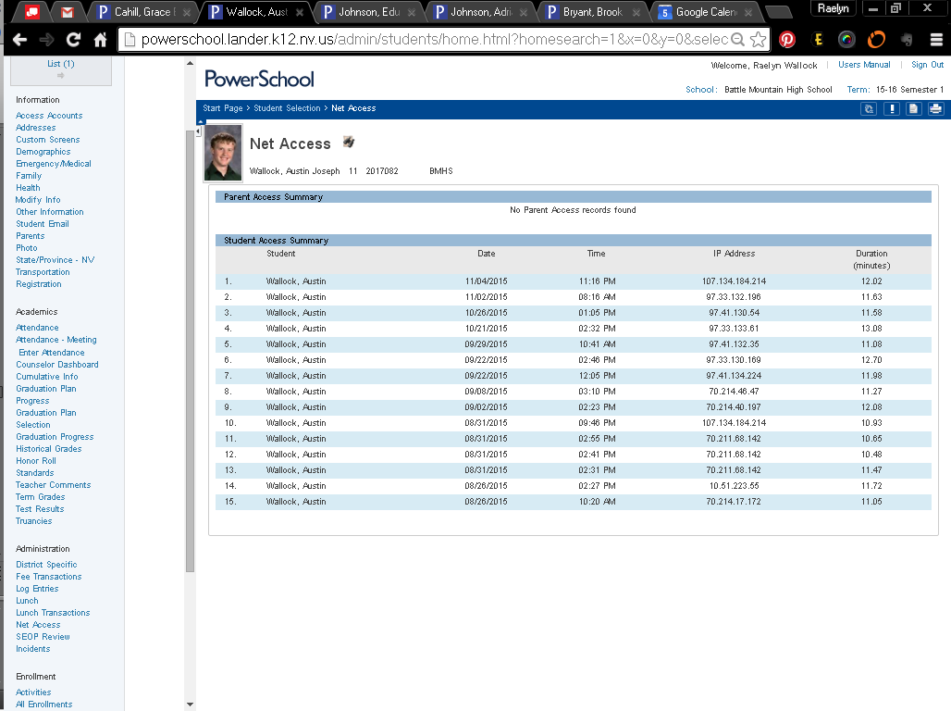
Net Access Report – student screen

Slide 43
Exporting

Slide 44
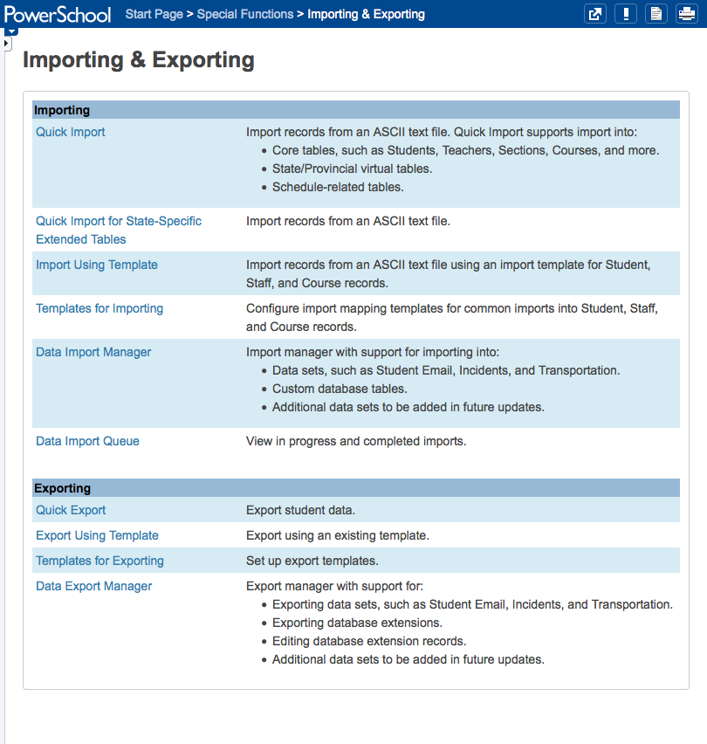
Exporting Information

Slide 45
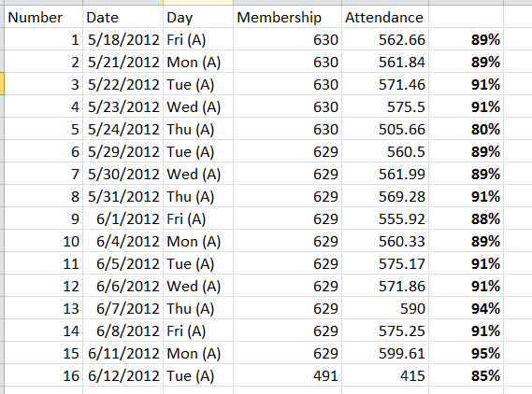
Pasting Data into Excel

Slide 46
Why Export Data ?
List of Title One students for Admin Report
Phone number of basketball students for coach
Password list to enter into new software
GPA list for Athletics ^(*gpa method="Q1")
Spreadsheet view of data
Fix data to re-import

Slide 47
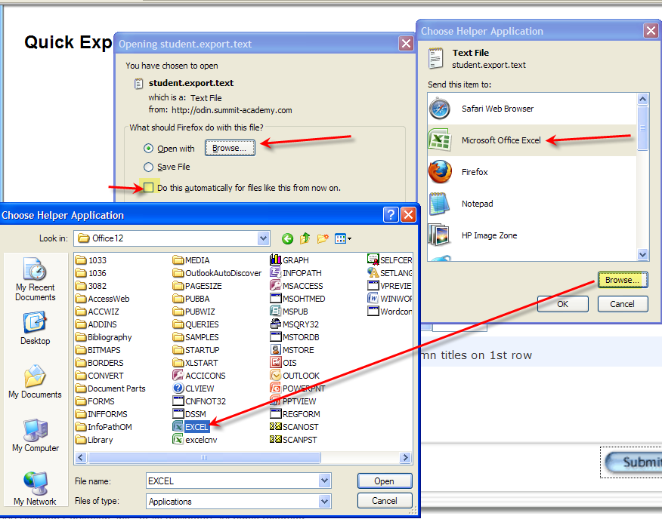
Opening Quick Exports

Slide 48
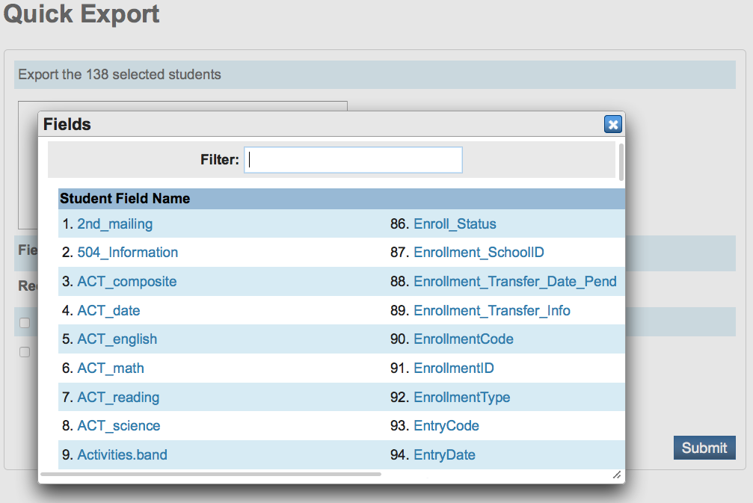
Quick Exports
TIP:
Use the filter to easily find
the field you want.

Slide 49
List Export
Easy Export: Start Page>select students> special functions>group functions>student list.
Report Title (shown at top of page):
Chose export

Slide 50
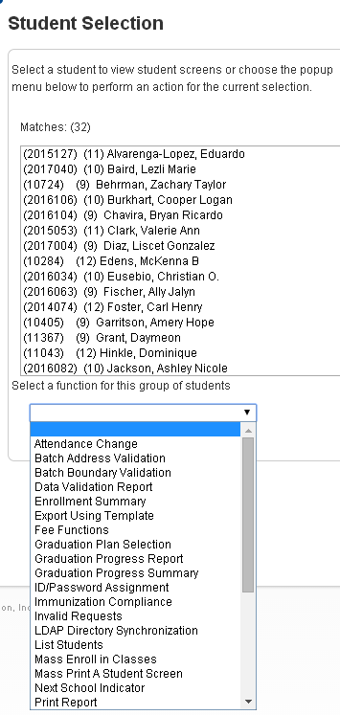
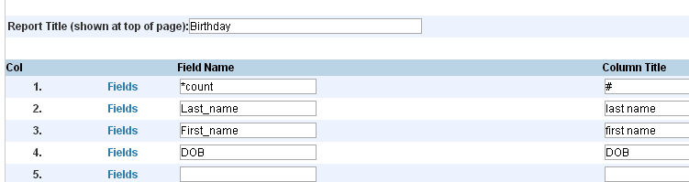
List Students
List Students with Numbers
A great way to get the list with a number in front of each item, go to List Students and use the first field as a counter by using the code of *Count in the first field name before any other fields or data.
1. *Count #
2. Last_name Last Name
3. First_Name First Name

Slide 51
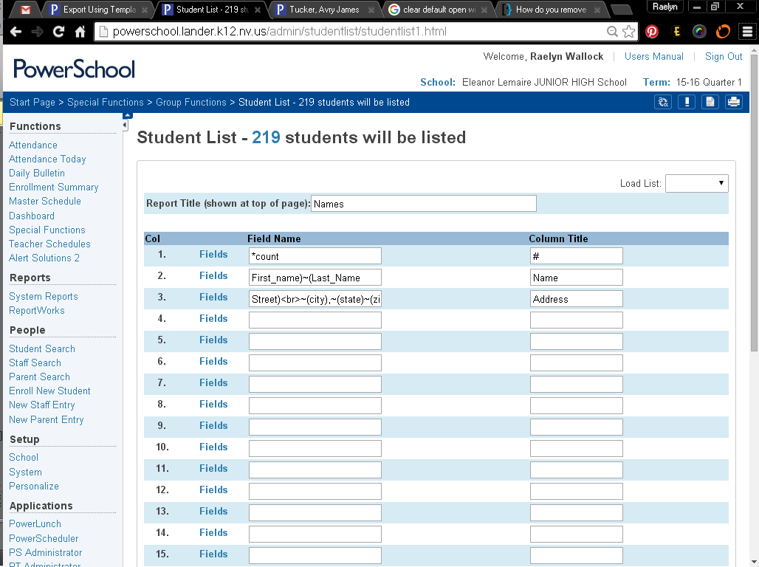
Need More Lines – or All In One Column
AWESOME TIP!!

Slide 52
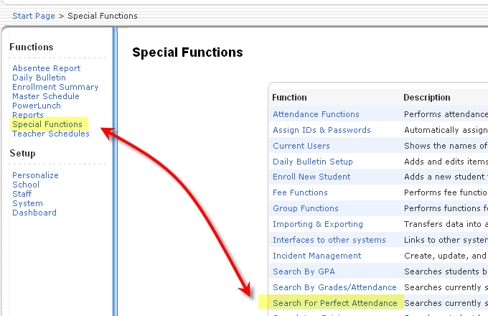
Perfect Attendance

Slide 53
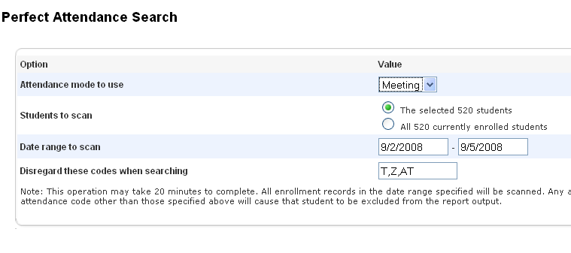
Perfect Attendance
Use all present codes

Slide 54
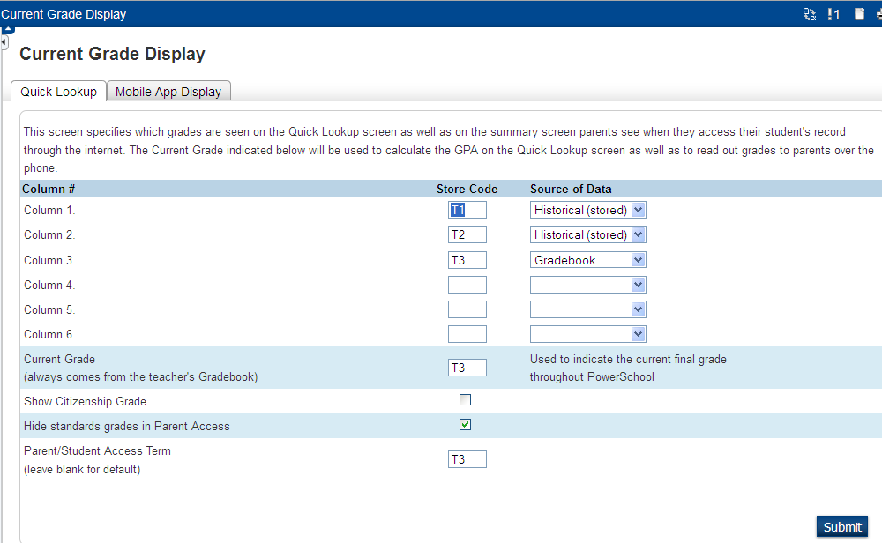
Current Grade Display
Mobile app too

Slide 55
Clear/Change Student Field Value

Slide 56
Clear Fields
Select group of students
  either through search
  select students by hand group function option
  Teacher Schedules
  Enrollment Summary

Slide 57
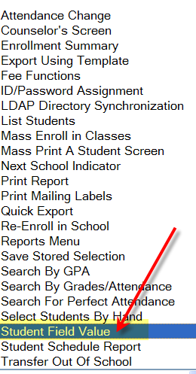
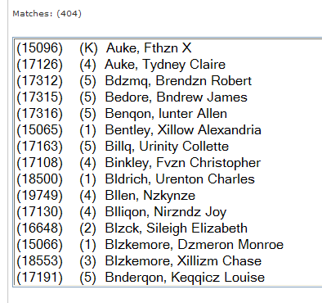

Clear Fields
Using Student Field Value

Slide 58
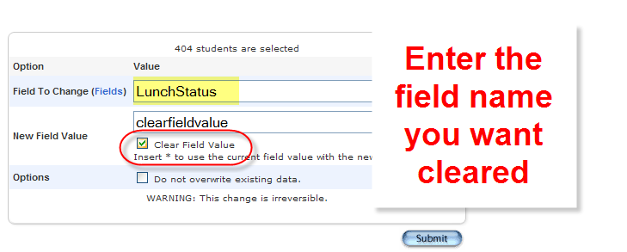
Changing Student Field Value
Or Changed!

Slide 59

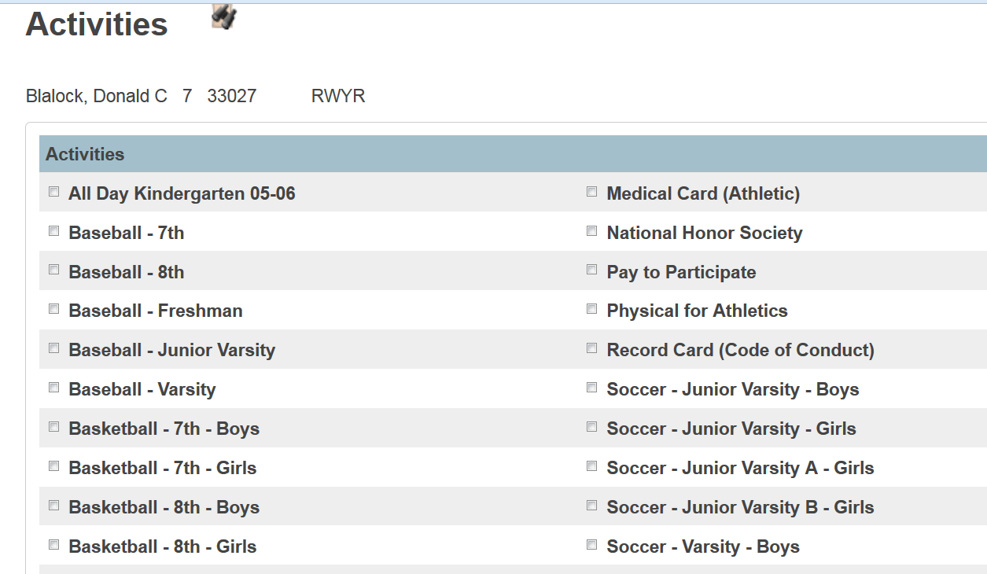
Activities

Slide 60
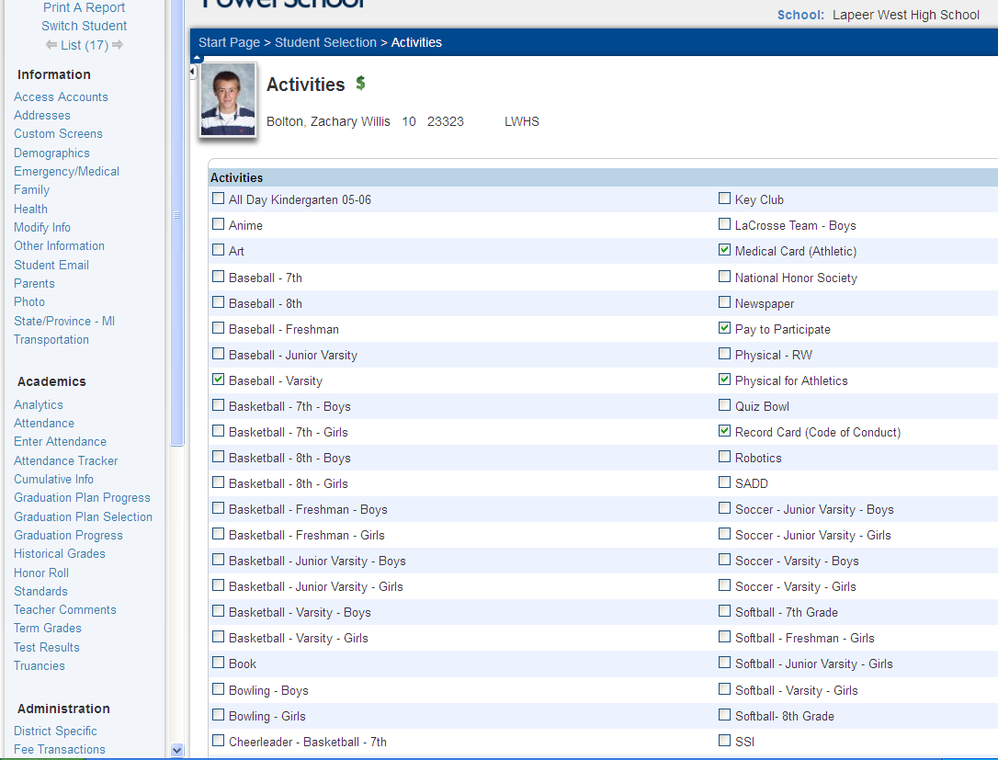
Activities – Adding for a Student

Slide 61
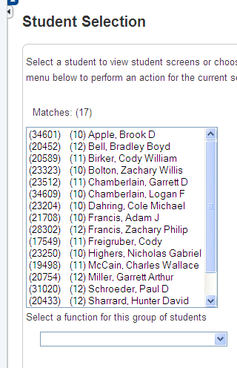
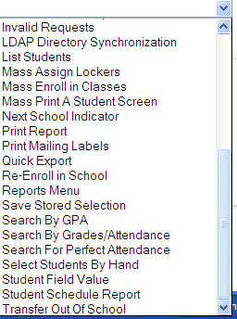
Activities – Adding for a group of students
Use Select Student by Hand Function

Slide 62
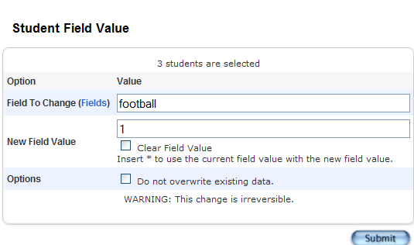
Activities for a Group
Click Functions
Select Student Field Value
Type in Activity Name or use the blue field link to select the field (Field to Change)
Use the value of 1 (New Field Value)

Slide 63
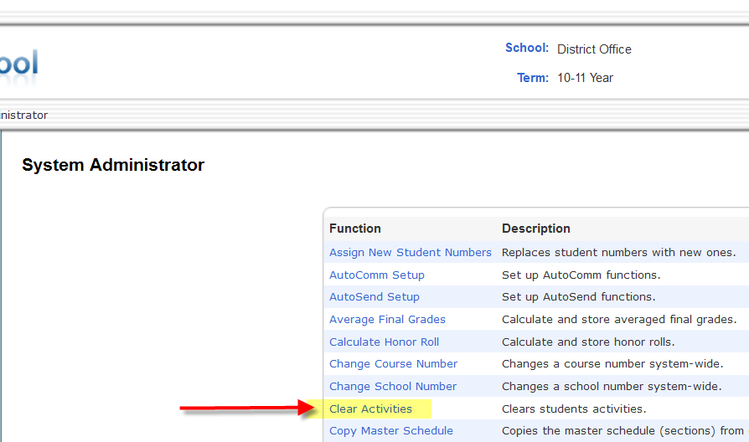
Clear Activities

Slide 64
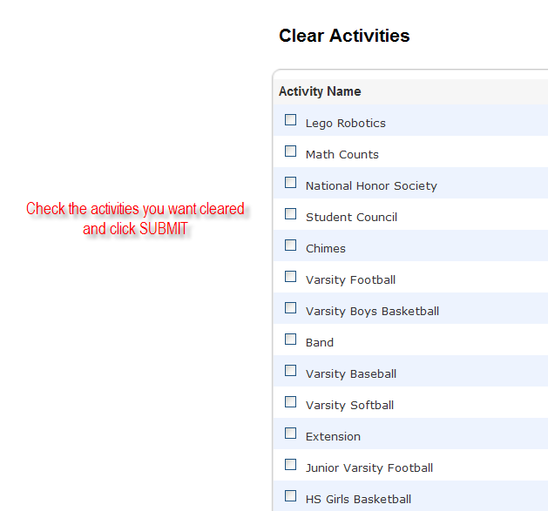
Clear Activities

Slide 65

Staff Screens

Slide 66
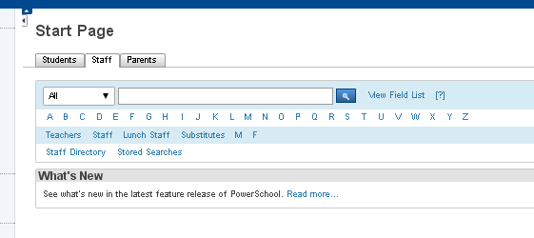
Staff Information

Slide 67




Slide 68

Staff Information

Slide 69

Teacher Schedules

Slide 70

Security

Slide 71
Tidbits

Slide 72

Administrative Reports
Save historical data

Slide 73

Stored Searches & Selections

Slide 74


Selecting Students
Notes:
For demonstration purposes I have selected all.

Slide 75
ReportWorks
Do you have problems with mailing labels not printing correctly?
  First try to check or uncheck fit to page
  Try building them in ReportWorks!

Slide 76


Stored Selection
Then Save Stored Selection
1st Select Students by Hand (Check box)

Slide 77

Stored Selection

Slide 78

Name your selection

Slide 79


Slide 80
ReportWorks
Do you have problems with mailing labels not printing correctly?
--First try to check or uncheck fit to page
  Try building them in ReportWorks!

Slide 81

Help
Help is available on every screen in PowerSchool
Normally this would say HELP (it is customized here to say User Manual)

Slide 82

PowerSource
https://powersource.pearsonschoolsystems.com

Slide 83

Psugevents.com

Slide 84

http://tech.groups.yahoo.com/group/PSUG

Slide 85
Other Favorite Resources
https://mba-link.com/webinars- Webinars, Plugins & customization
http://powerdatasolutions.org/forum- Q&A and customizations
http://nicktech.org/powerschool- Customizations
https://www.youtube.com/results?search_query=Powerschool- 25,100 results and growing

Slide 86

We learned a little bit about ……
Enrollments
Master Schedule
Alerts
Student Functions
Reports
Clearing and Changing Fields and Activities
Staff Screens
Tidbits

Slide 87

Summary and Questions

