Slide 1
PowerSchool Training
Instructor: Stephen Wilson
E-mail: stewilson@richlandone.org
Application Support
Information Technology Department

Slide 2
Overview
In this course you will learn how to:
  View Student Attendance Pages
  Find Teachers who have not taken Attendance
  Run the PowerTeacher Attendance Report
  View the PowerTeacher Attendance Report
  View the Teacher Attendance Submission Status Page.
  Find which Students are Absent
  Update Attendance
  Update Attendance for Multiple Days
  Change Attendance for a Group
  Verify Daily Attendance Records
  Search for Students with Chronic Attendance Problems.
  Running reports such as Attendance Count Report, Consecutive Absences Report, Student Attendance Audit Report, Average Daily Attendance Report and Average Daily Membership Report.
Notes:
This course will teach you how to use the master schedule and how to modify students’ schedules, including enrolling them into special programs and classes, after master scheduling has taken place at the beginning of the school year.

Slide 3
Login Procedure - If this is your first time
Username;password
  Example = stewilson;psadmin
Username = Novell Username
  Example = stewilson@richlandone.org, use the stewilson of your e-mail address.
REMEMBER DO NOT SAVE YOUR PASSWORD
Go To http://pstest.richlandone.org/admin

Slide 4
Managing Daily Attendance

Slide 5
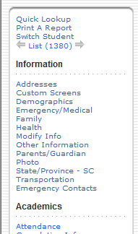
How to view Student Attendance Pages
To view the student’s attendance record in PowerSchool, first search for and select the student. Then, click one of these links on the student pages menu.
  Quick Lookup
  Attendance
1
2

Slide 6
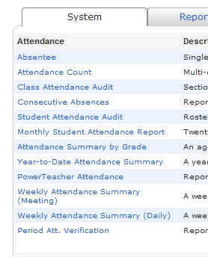
How to find Teachers Who Have Not taken Attendance
Use the PowerTeacher Attendance report or view the Teacher Attendance Submission Status page to find out which teachers have not yet taken attendance.
  Run the PowerTeacher Attendance Report
  View the PowerTeacher Attendance Report
1

Slide 7
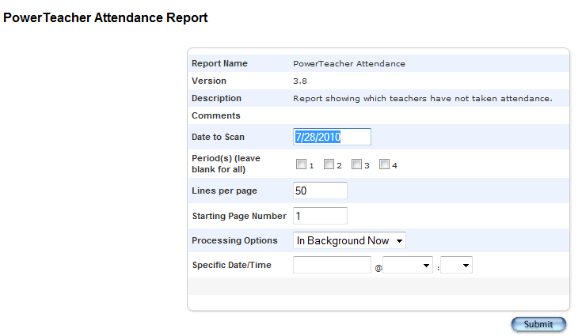
How to run the PowerTeacher Attendance Report
To run the PowerTeacher Attendance Report, use the following steps:
  From the Start Page click Reports.
  Select the System tab.
  Select PowerTeacher Attendance
  Select the appropriate period check box, usually period 1.
  Click Submit

Slide 8
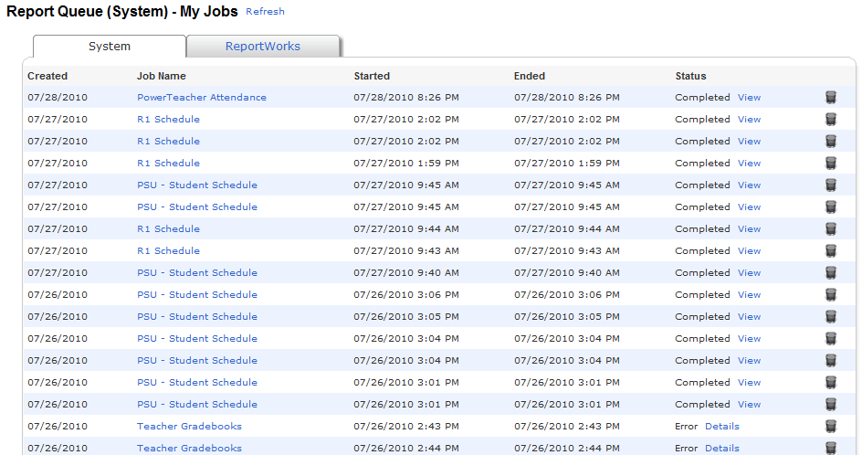
How to view the PowerTeacher Attendance Report
To view the PowerTeacher Attendance Report, use the following steps:
  On the Report Queue (System). Select My Jobs page.
  Click Refresh.
  When the Status is Completed, click View.

Slide 9
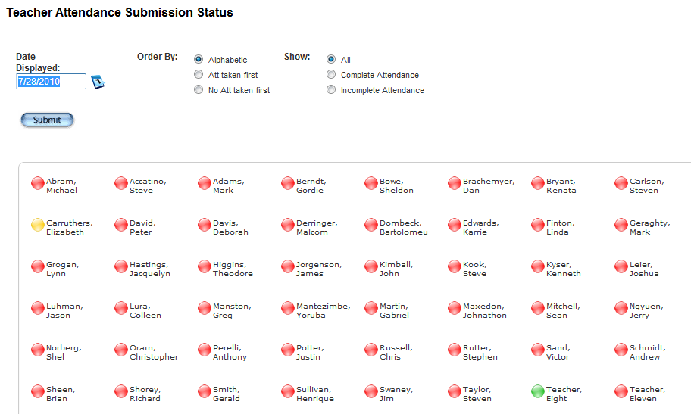
How to view Teacher Attendance Submission Status Page
To view the Teacher Attendance Submission Status page, use the following steps:
  From the Start Page, click Attendance.
  Next to each teacher’s name is a dot, which is the Attendance Indicator.
  Click the teacher’s name to see a list of the teacher’s classes and the attendance status for each one.
  A green dot means that the teacher has submitted attendance for all of his /her classes.
  A yellow dot indicates that the teachers has submitted attendance for only some of his / her classes.
  A red dot indicates that the teacher has not submitted attendance for any of his / her classes.
3
2
1

Slide 10
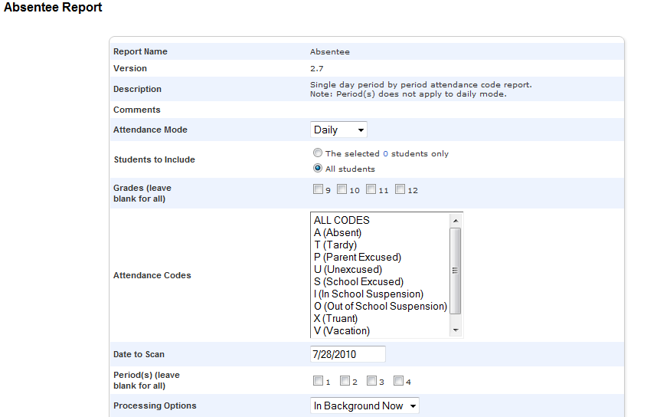
How to find which Students are Absent
Use the Absentee Report to find which students are marked absent:
  One the Start Page, click Attendance
  Click Absentee Report.
  Select the desired Attendance Code.
  Click Submit.
Notes:
Run the Absentee report when you need to find out which students have been marked absent. You can use this report to document contacts you’re made with parents about the student’s absence.
There is no need to select a period in Daily mode.
Optionally, include the student number, blank lines, and verification line.
This report is generated in the Report Queue.

Slide 11
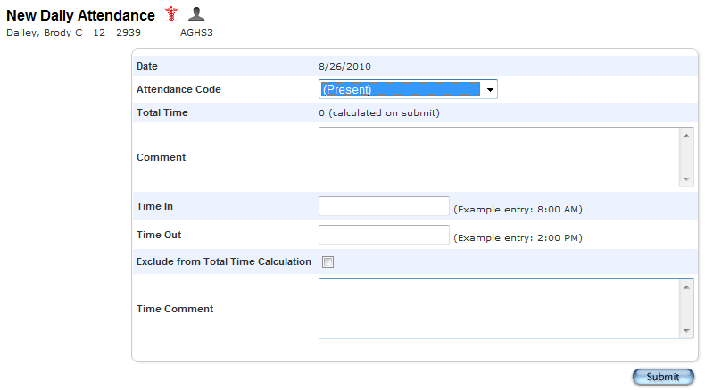
How to Update Attendance
To change past or future attendance for an individual student:
  One the Student Pages menu, click Attendance.
  Navigate to the appropriate week.
  Click on the day you want to change.
  On the New Daily Attendance page, choose the desired code from the Attendance code menu.
  Enter a comment stating the reason for the change.
  If the student is missing a part of the day, enter the Time In and Time Out, and click Exclude from Total Time Calculation.
  Add any additional comment regarding the time.
  Click Submit

Slide 12
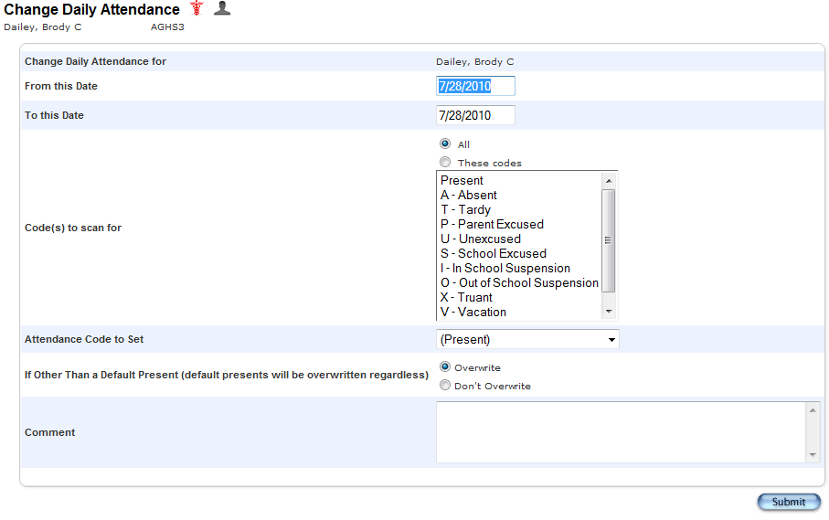
How to Update Attendance for Multiple Days
To update Attendance for Multiple Days, use the following steps:
  On the Student pages menu, click Attendance.
  Click Change Multiple Days.
  Populate the From and To date.
  Click All to scan for all attendance codes.
  Chose Absent or Parent Excused from the “Attendance Code to set” menu.
  Select Overwrite so that the code for the known event (vacation, medical leave, or in school suspension) cancels a potential even like a field trip.
  Add a comment to document why the student will be out of school and click Submit.
Notes:
Use the Attendance page when you need to change attendance for a student’s upcoming vacation or medical even. First, search for and select the student.
Enter the First date of the absence in the “From this date” field
Enter the last date of the absence in the “To this date” field

Slide 13
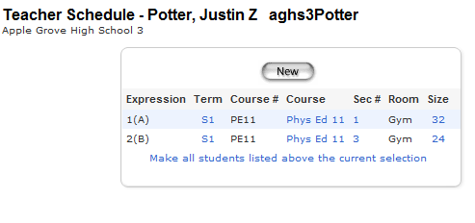
How to Change Attendance for a Group
Use this function to update your records when a group of students, like one teacher’s homeroom class, is going on a field trip.
  On the Start Page, click Teacher Schedules.
  Select a Teacher.
  Click the number in the Size column for the teacher’s homeroom section.
  On the Class Roster page, click Make this the current selection of students.
  One the Group Functions Page, click Attendance Change.

Slide 14
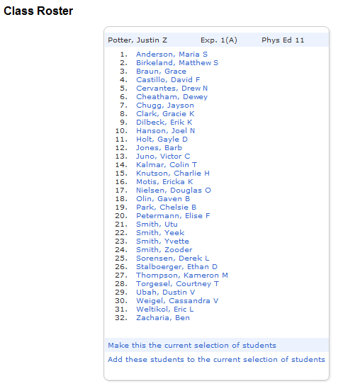
How to Change Attendance for a Group continued
Enter the Date range.
Click All to scan for all Attendance Codes.
Choose the code you want PowerSchool to record, such as School Excused.
Select Don’t Overwrite to preserve previously-entered future attendance codes for family vacation or medical leave.
Enter a comment and click Submit.

Slide 15
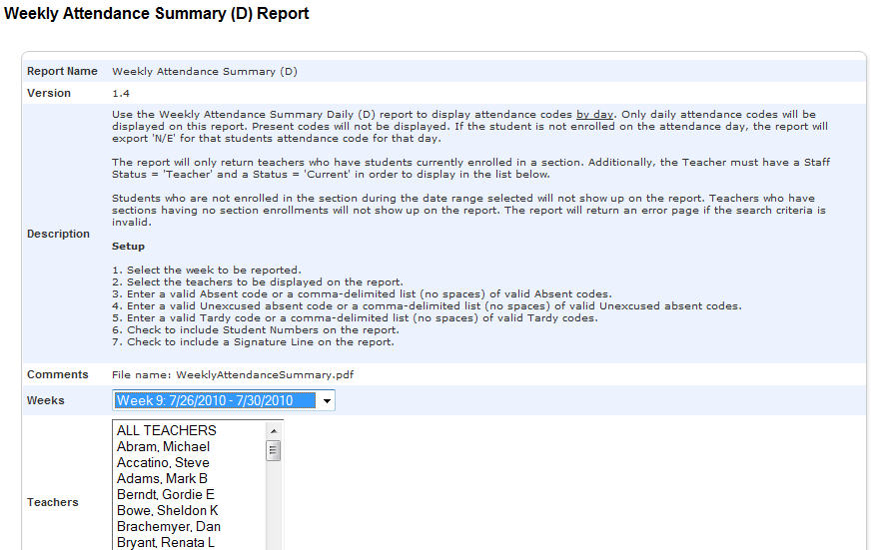
How to Verify Daily Attendance Records
One the Start Page menu, click Reports, under the Systems tab.
Click Weekly Attendance Summary (Daily).
Choose the week for which to run the Report.
Choose which teacher to run the report for, or select ALL TEACHERS.
In the Attendance Code section, populate the Absent Codes.
Check Include Verification Line.
Click Submit.
Notes:
Some schools like to have their staff sign off that attendance records are correct. PowerSchool provides a report for this purpose.
To verify daily attendance records, use the Weekly Attendance Summary Report.
Notice that the instructions to run this report are listed on the criteria page.
5. In the Attendance Code section at the bottom of the report setup page, fill in all of the codes in the Absent field that the school uses to indicate a student has an excused absence.
* If you plan to run this report routinely and want the values you set to be the default – so you don’t have to reset them everytime – click the boxes on the right side of the page for each value you want to save.

Slide 16
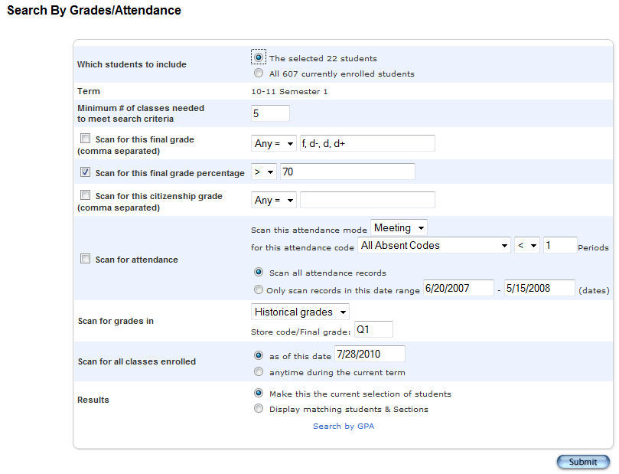
How to Search for Students with Chronic Attendance Problems
One the Start page, click Attendance or Special Functions.
Click Search by Grades / Attendance.
Select the students to include in the search.
Clear all check boxes pertaining to searching by grades.
Check Scan for Attendance.
Choose the appropriate attendance code, such as U (Unexcused) or All Absent Codes.
Choose a comparator.
Enter the number of days.
Either enter a date range or select Scan all attendance records.
Select Make this the current selection of students.
Click Submit
Notes:
PowerSchool provides three ways to help you identify students with Chronic Attendance Problems.
Use this report to identify students with a minimum number of an attendance code you specify within a time frame

Slide 17
Reports

Slide 18
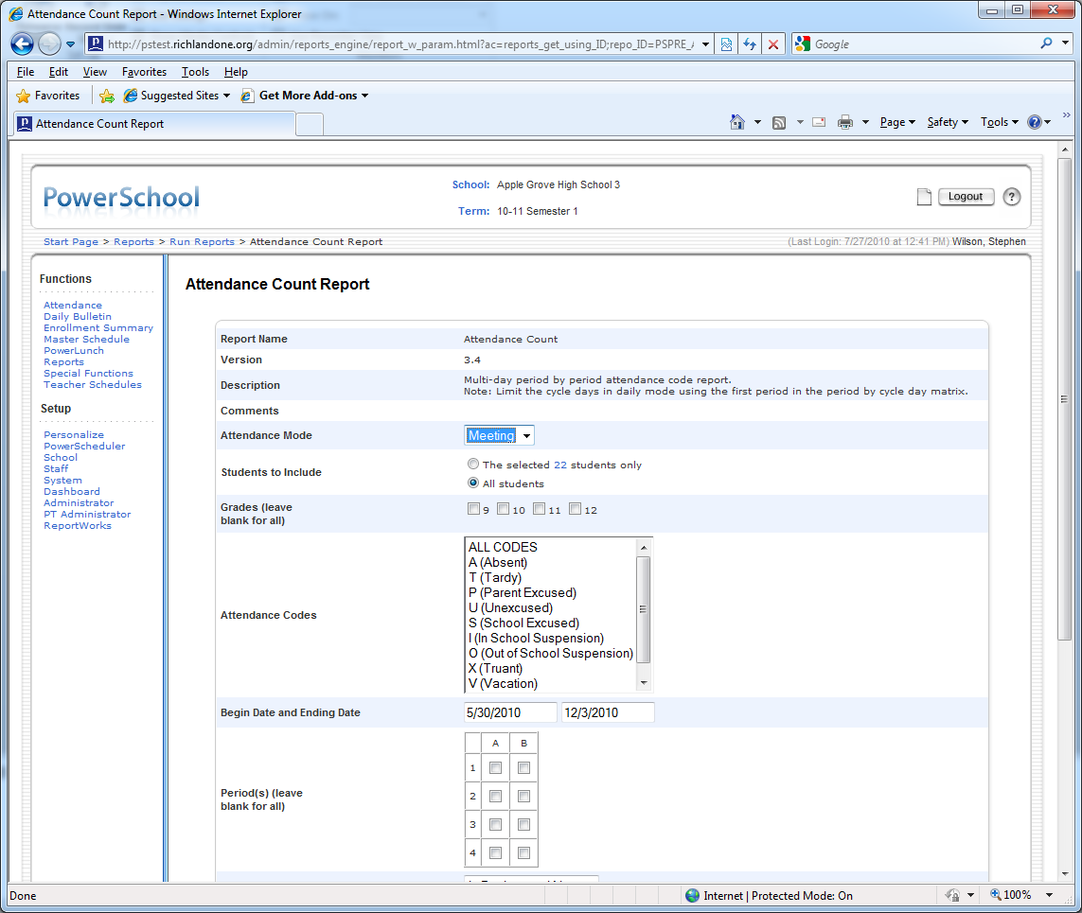
How to run the Attendance Count Report
One the Start Page, click Attendance > Attendance Count.
Select the students and grade level(s) to include in the search.
Select an attendance code to scan for, for example U (Unexcused) or A (Absent).
Enter beginning and ending dates.
In “Minimum Number of Total Occurrences” enter a number representing the threshold value your school has identified as indicating a chronic attendance problem – 5 or 10, for example.
Click Submit.
When the report has finished processing, click View on the Report Queue page.
Click Functions on the Attendance Count Report to access the Print Reports menu so you can print a Report Card template based Attendance Letter.
Notes:
Use this report to identify students with a minimum number of total occurrences of an attendance code you specify within a specific time frame.

Slide 19
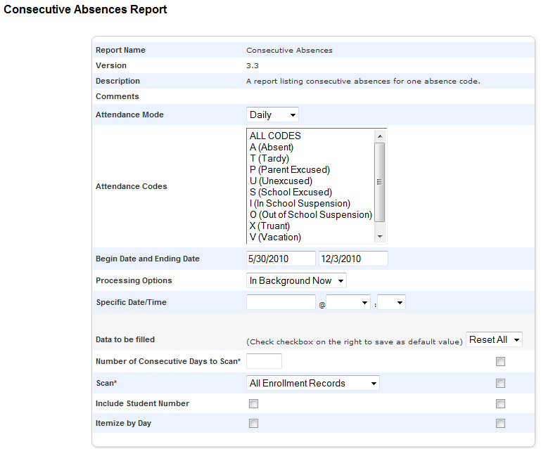
How to run the Consecutive Absences Report
One the Start Page, click Attendance > Consecutive Absences.
Select an attendance code to scan for, for example U (unexcused) for “No Show” students.
Enter beginning and ending dates, such as the first day of school to the present.
Enter a number (such as 3) in Number of Consecutive Days to Scan*
Click Submit.
Notes:
Use this report at the beginning of the year to identify students who have not ever attended.

Slide 20
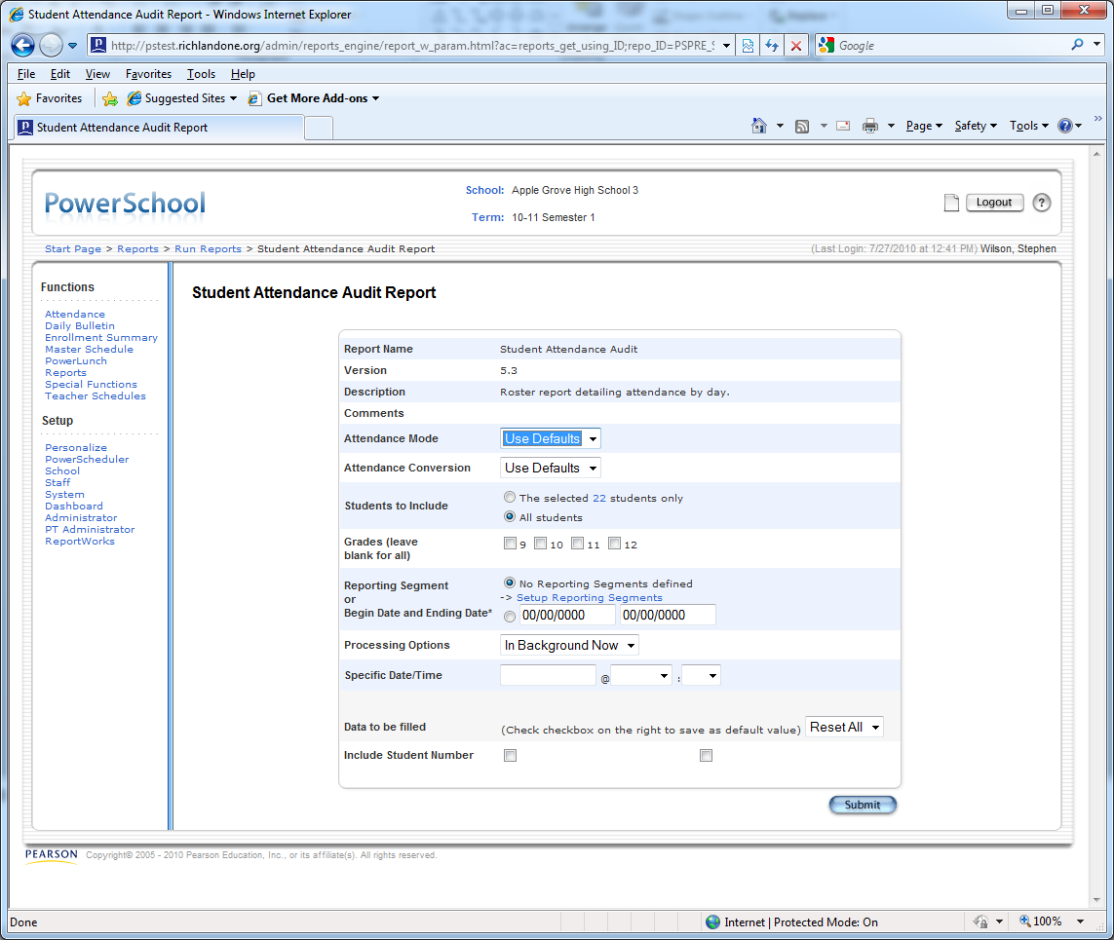
How to use the Attendance Audit Report
One the Start page, click Reports > Systems tab.
Click Student Attendance Audit Report.
Select the students and grade level(s) to run the report on.
Enter beginning and ending dates for the current month, or select a reporting segment.
Check “Include Student Number,” if desired.
Click Submit.
Notes:
Use this report to review data you will be sending to the state. This report displays converted attendance values.

Slide 21
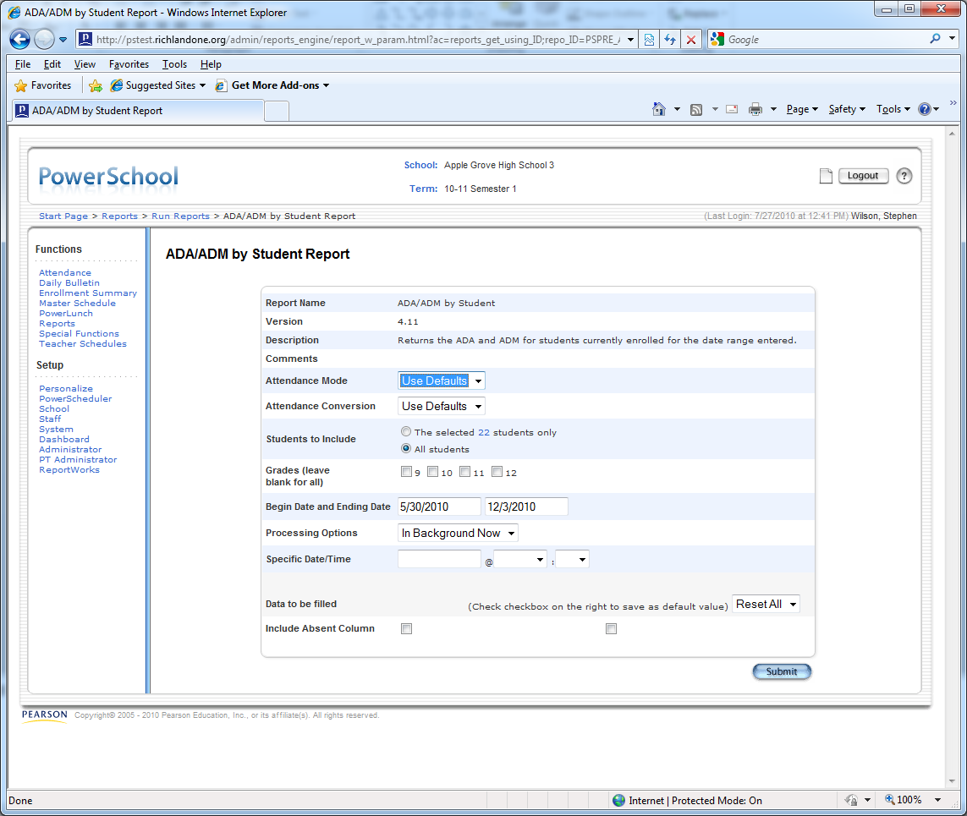
How to run the ADA/ADM by Student Report
One the Start Page, Click Reports > System tab.
Click ADA/ADM by Student Report.
Select which students and grade level to include.
Enter beginning and ending dates.
Check Include Absent Column if you want PowerSchool to show how many days each student was absent during the time you specify and click Submit.
Notes:
Use this report to review attendance records for students enrolled during the date range you specify. This report shows the number of days a student is absent or present, even if your school uses meeting attendance.

Slide 22
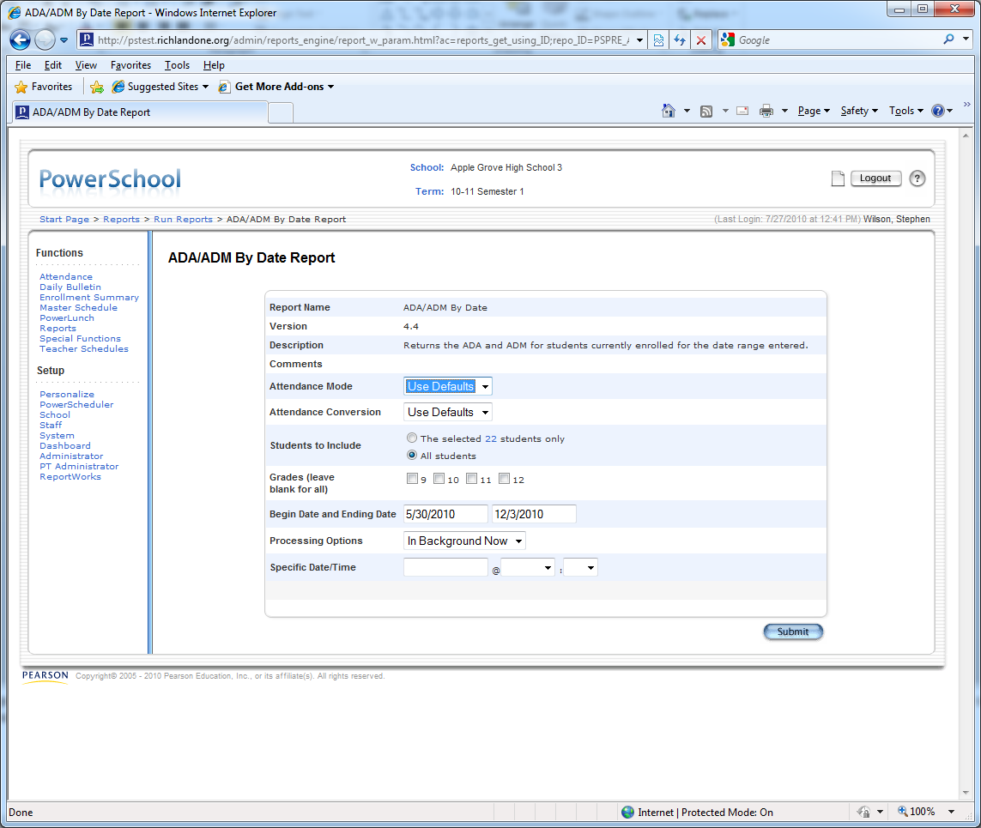
How to run the ADA/ADM by Date Report
One the Start Page, click Reports > System tab.
Click ADA/ADM by Date Report.
Select which students and grade level to include.
Enter beginning and ending dates
Click Submit.
Notes:
Use this report to compare the number of students enrolled (membership) to the number of students who actually attended school on a specific day. Use it to check if the school gained or lost students during a time period. The total number should match the values displayed in the ADA / ADM by Student Report.

Slide 23
Where Can I locate these Documents
Power Point Slides and Word Documents generated for PowerSchool classes will be available on:
http://data.richlandone.org/

Slide 24
Question?
Questions, Comments, and/or Concerns?

