Slide 1


CLASS OF 2027 and Class of 2028
WELCOME
NJSLA – M & Advanced Honors Math Program
INFORMATIONAL SESSION
Mrs. Mala Maharana
( District Supervisor of Mathematics, Business and Computer Science )
Mrs. April Magistro
( Elementary Supervisor and Gifted and Talented Supervisor )

Slide 2





Please!
Silence Cell Phones or Use Vibrate Mode
and
Questions will be answered after the presentation.

Slide 3
Agenda
Topics
Spring 2020 State Assessment Name, Length and Time
Blue print of the test
NJSLA Score Reports
Advanced Honors Program in Mathematics
Questions

Slide 4
Spring 2020 State Assessment Name, Length and Time
State Assessment Name Change
The State of New Jersey has ended its membership of the interstate consortium that produced the Partnership for Assessment of Readiness for College and Careers (PARCC) assessments. While the online platform will remain the same, the state’s mathematics and English Language Arts (ELA) assessments will no longer be called Partnership for Assessment of College and Career Readiness (PARCC).
The statewide assessments for ELA and mathematics will be called:
New Jersey Student Learning Assessments-ELA (NJSLA-ELA)
New Jersey Student Learning Assessment-Mathematics (NJSLA-M)

Slide 5
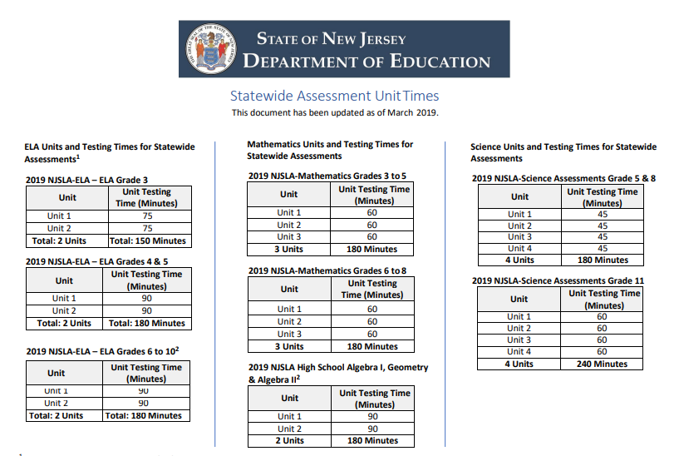

Slide 6
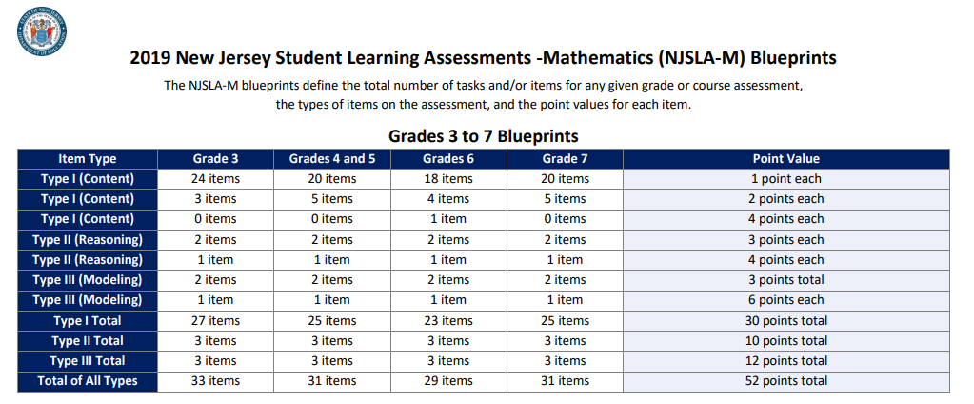

Slide 7
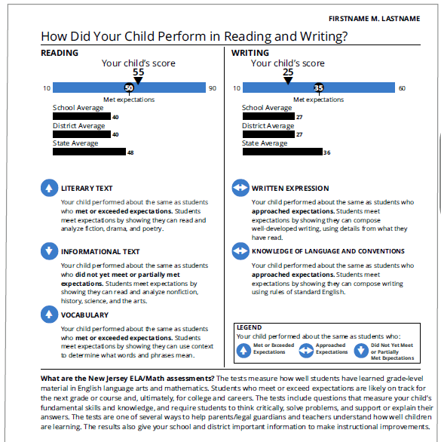
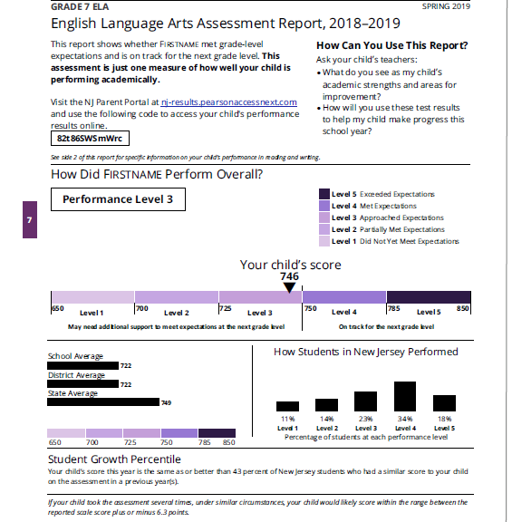
NJSLA ELA Score Reports

Slide 8
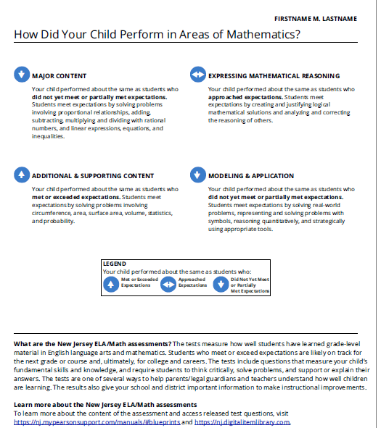
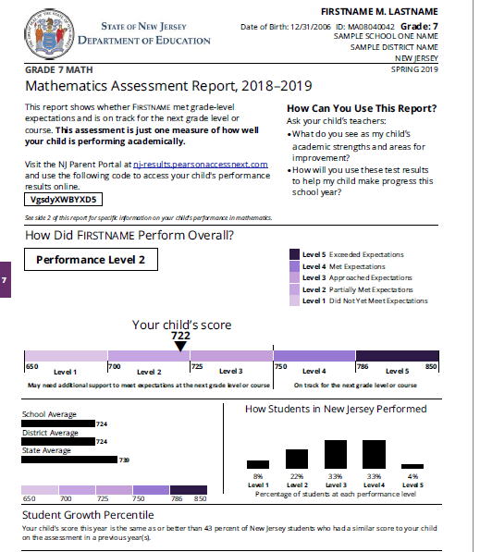
NJSLA Math Score Report

Slide 9
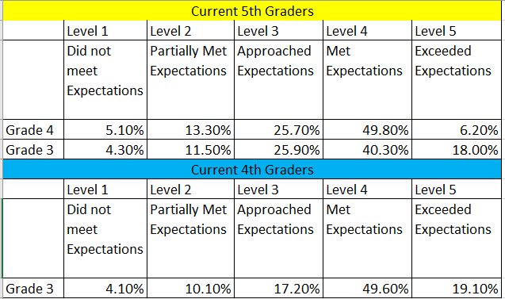
DATA BITS AND BITES

Slide 10
Advanced Honors Program in Mathematics
There are students in Samsel Upper Elementary School's Grade 5 program who excel in Mathematics. Sayreville would like to embrace those students and provide an accelerated program designed to build on their current advanced skills and "move them to the next level."
The Advanced Honors Program in Mathematics which begins in Grade 6, allows those students significantly above grade level the opportunity to challenge themselves in a higher level math course. These students will enter the middle school and begin their program of studies with a course that is rigorous and challenging. In order to be considered for the Advanced Honors Program in Grade 6, the mathematics department is requesting the parents / guardians to submit an online google form acknowledging the course requirements and responsibilities for the student. The Google form will be available on the website starting May 14 –May 21 ( until 11 p.m.).
We recommend submitting the application ahead of the deadline to avoid last minute problems with online submission. You will receive an acknowledgement email once the application is submitted.
Additionally, a District Advanced Honors Mathematics Admission Test will be administered on June 1, 2020 during the school day. Only students who averaged a minimum grade of on mathematics Form A and Form B are eligible to take the Mathematics Admission Test.

Slide 11
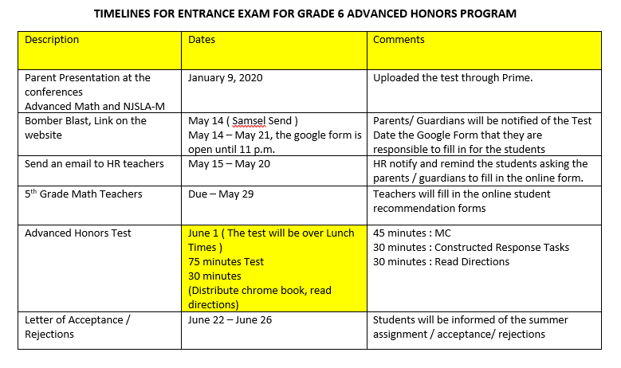
Advanced Honors Program in Mathematics

Slide 12
Rubric
Advanced Honors Program in Mathematics
Elements of the Rubric
Grade 4 NJSLA Score
Average of Form A and Form B Benchmark Scores
District Advanced Honors Mathematics Test
Teacher Recommendation Score

Slide 13
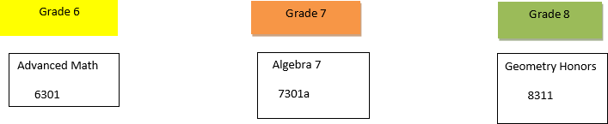
Curriculum
Advanced Honors Program in Mathematics

Slide 14







QUESTIONS !

