Slide 1
Science Research
Overview
Fall 2009

Slide 2
Welcome
14th year
Students receive up to $250,000 in college scholarships based on their research endeavors
14 national Intel semi-finalists, which led to $28,000 dollars in cash awards
22 students competed at the state level for the Junior Science and Humanities Symposium
2 students competed at the International Science and Engineering Fair
Over 160 students have completed the science research program

Slide 3
The Idea is Born
The first step of a research project: identifying the research concept
Process
  Involves introspection and investigation
  Is the idea realistic, testable, significant, novel?
Idea → Question → Hypothesis
  The idea has to be further defined
  Made much more specific

Slide 4
Where did the
Research Questions Originate?
From articles in newspapers, journals, or magazines
From previous extra-curricular activities
From parents’ line of work
From observations
From interests

Slide 5
Assessments
Assessments
No Examination; Biweekly assessments (4 per marking period)
Critical thinking
Students are forced to be honest with themselves; Must show proficiency in their subject
One-on-one mediation between student and Mr. Selg

Slide 6
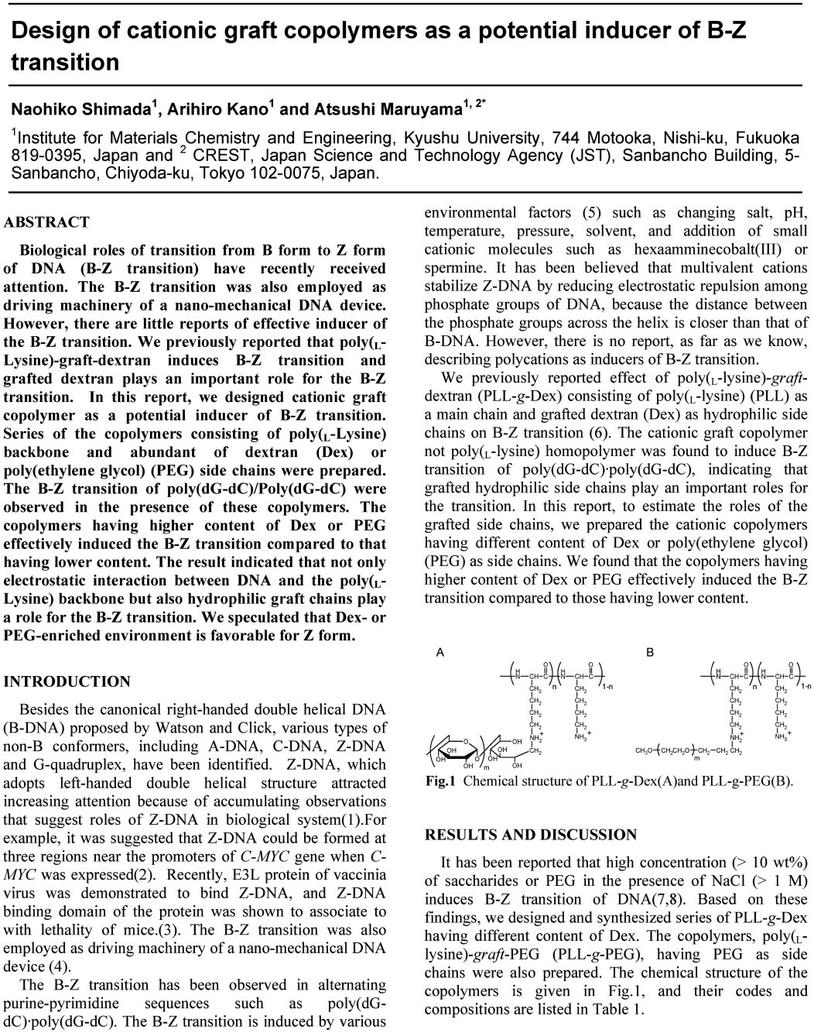
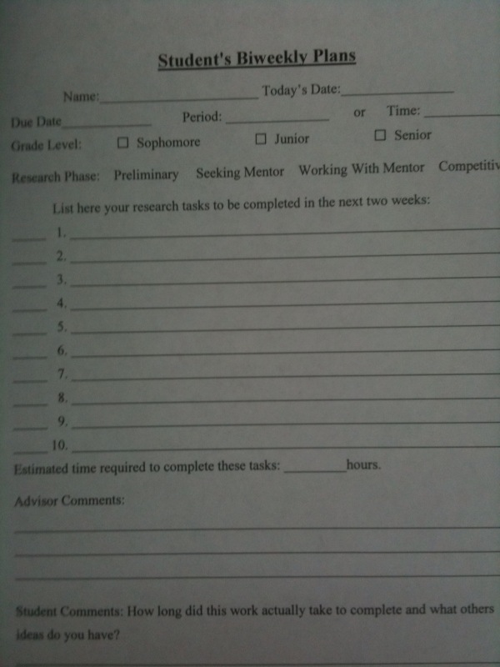
Assessments

Slide 7
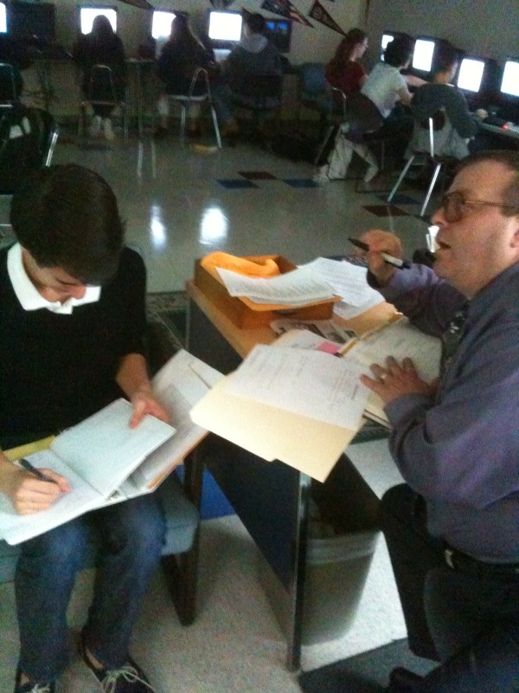
Assessments

Slide 8
Bibliographic Research
Research must be backed up by previous studies
Articles can be obtained on the internet, through a mentor, or requested through the school library
Pubmed can be used for medical research
www.ieee.org can be used for engineering research

Slide 9
Bibliographic Research
Search for repeated authors
Can be used to find possible mentors
30 citations needed for final scientific paper

Slide 10
Narrowing Down A Topic
After selecting a topic, students must search for supportive data
Establish a void within the topic
Some topics are not feasible due to time, laboratory facilities, and financial constraints

Slide 11
Narrowing Down A Topic –
One Student’s Sequence
1
Childhood Obesity Leading to Secondary Diseases
2
The Effects of Pre and Post Bariatric Surgery
3
The Physical and Emotional Effects in Rapid Weight Changes in Bariatric Surgery Patients

Slide 12
Finding a Mentor
Several ways to obtain a mentor:
  Traditional method:
    Conduct literature search
    Identify most frequently cited authors
    Determine their locations
    Make phone calls/ email
    Meet with possible mentors
Other methods:
    Join association/ organization
    Through family/ friends

Slide 13
Changing Direction
Original
Changed
“ The Racial Difference in the Treatment of Endometrial Cancer”
“Incidence of Cervical Cancer in Hispanic Women Based on Country of Origin”

Slide 14
Safety Reviews for Experiment
Mission: Minimize risk to test subjects
Objectives:
  Justify study
  Weigh benefits to society
  Describe the methods, test population, recruitment, test location, age, gender, race
  Review the literature (12 articles)
Institutional Review Board (human subjects) or Safety Review Committee

Slide 15
Research Approval
Review Board
IRB
Local High School
Institution, Research Facility, Lab Research, Hospital, Nursing Home
SRC
Local High School

Slide 16
Institutional Review Board (IRB)
  Researcher must include other forms required for experiment:
    Parent/Student consent forms
    Surveys
    Tests
  Example:
  Clinical Research Proposal Form
    Describe how you will identify and recruit potential subjects for participation in the study.
    How many subjects will be enrolled? If controls are being used, state how they will be identified and informed to allow for proper consent.

Slide 17
Obstacles Students May Face
Finding a Mentor
Communicating With Mentor
Scheduling
Cost of Supplies and Experiments
SRC and IRB
State and Federal Rules and Regulations
Changing Topic

Slide 18
Summer Internship
Students participate in the UHS program which requires working for a 90 hour internship
Completing the internship awards college credits to the student
Requirements
    A daily journal describing activities
    A letter from the supervisor verifying the completion of 90 hours
    A summer evaluation written by the student

Slide 19
Senior Year
Students in the Science Research Program are required to enter and compete in the following competitions:
  White Plains Invitational (10th grade)
  Intel STS
  Intel ISEF
  WESEF
  JSHS
Many students submit papers for publication

Slide 20
White Plains Invitational
First competition for students in the science research program
Based on topic, quality of board, and presentation skills
Research students from high schools all over Westchester County compete in this competition

Slide 21
Development of an Individual
Science Research requires greater maturity compared to other high school classes
Self-discipline and independence
Students learn to become professional
Develop confidence
Patience
Honor System

Slide 22
In Closing
By the end of senior year Science Research students will have achieved:
  Up to 12 SUNY College Credits
  Scholarships for college
  Cash awards and prizes
  Recognition in the scientific community
College credits offer Science Research students an advantage over other seniors across the country

Slide 23
