Slide 1
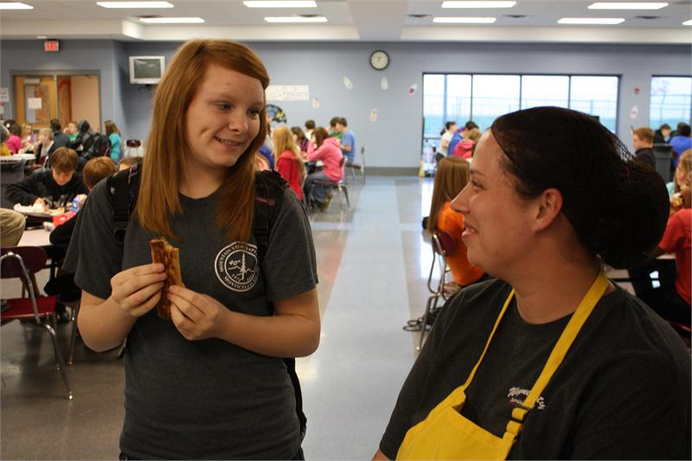
SBSW Grant Wayne County
Middle School
BREAKFAST IN THE BLUEGRASS
MARCH – OUR CHALLENGE MONTH
Join the Breakfast Club
Notes:
Meet Casey Holt, SNA Certified, WC Food Nutrition Manager

Slide 2
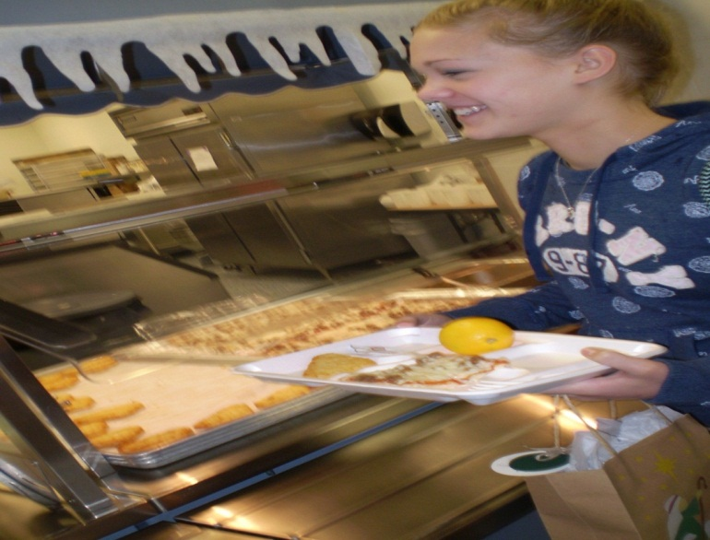
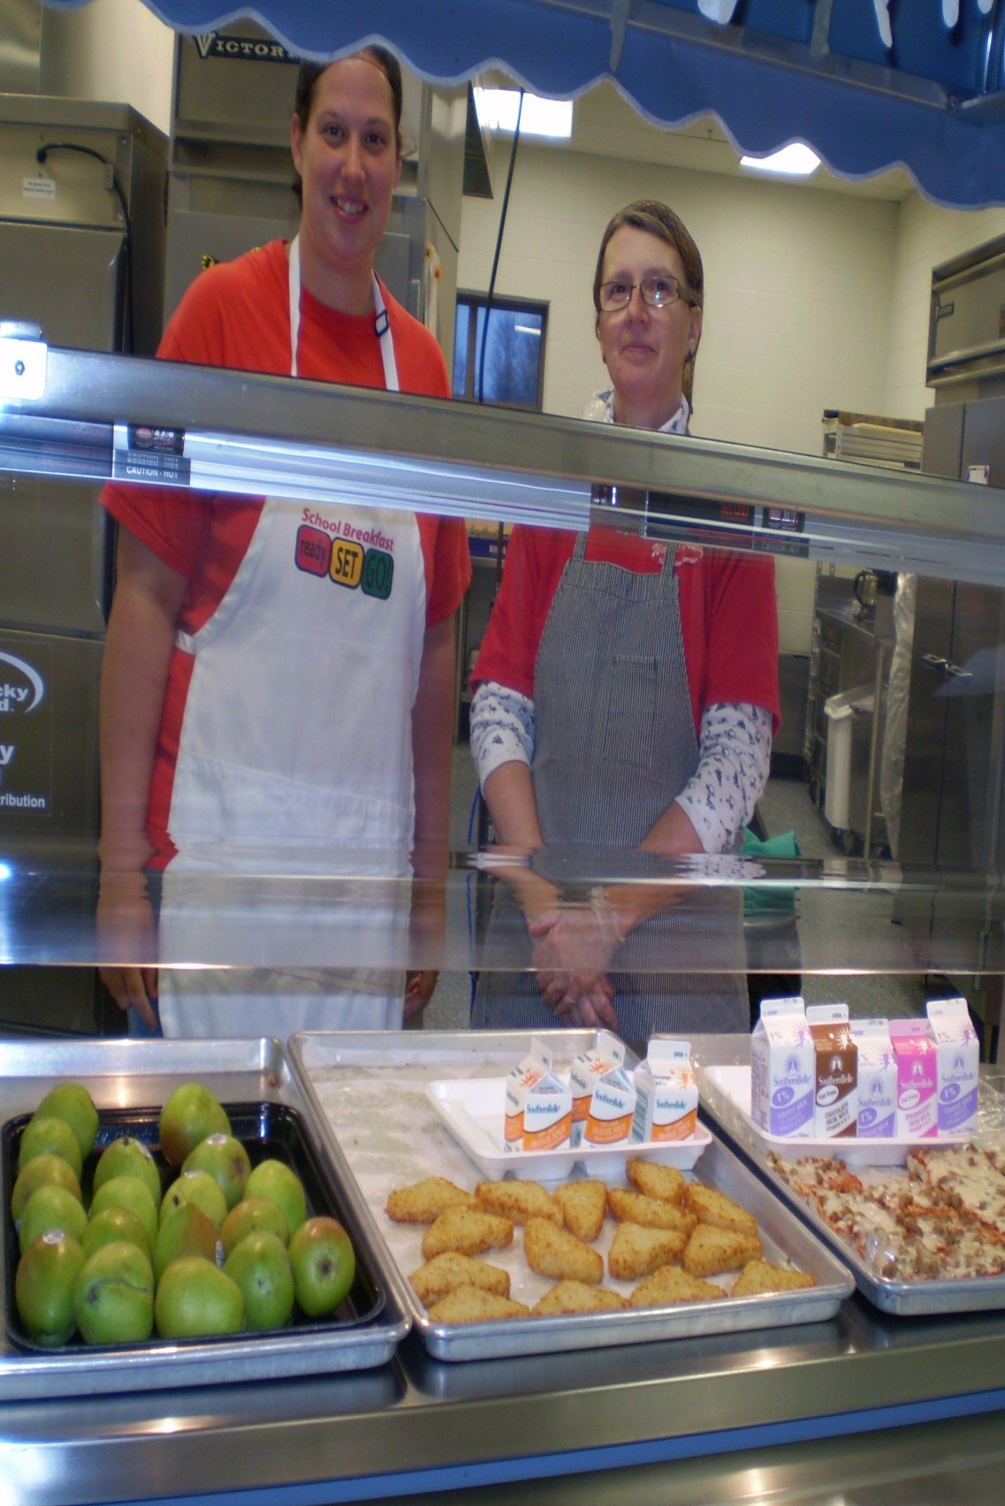
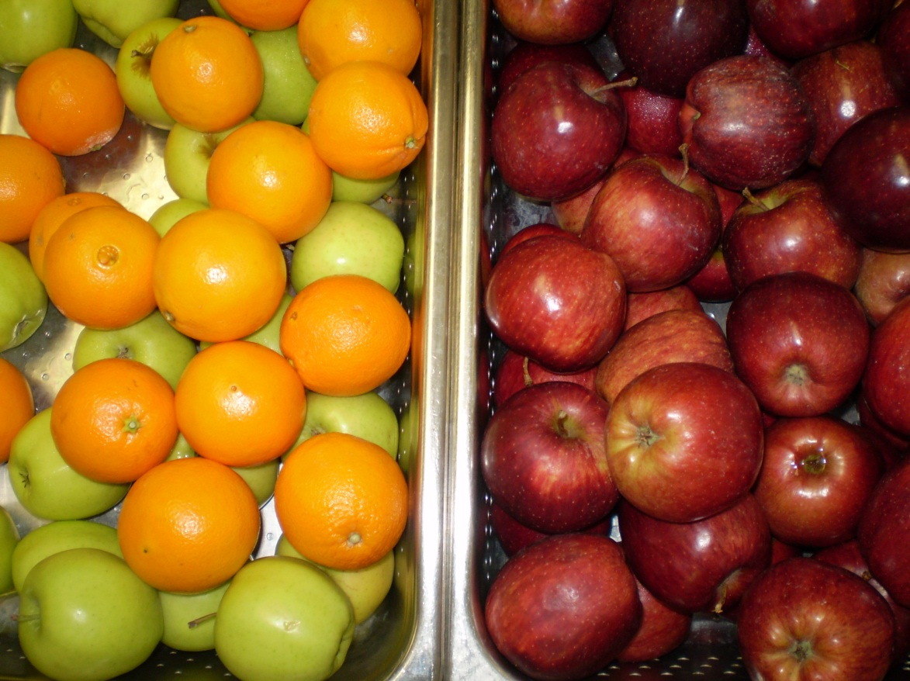
Notes:
Fresh Fruit or Fruit Cup and 100% Juice served daily with any breakfast entrée. Variety at breakfast but where are the students?

Slide 3
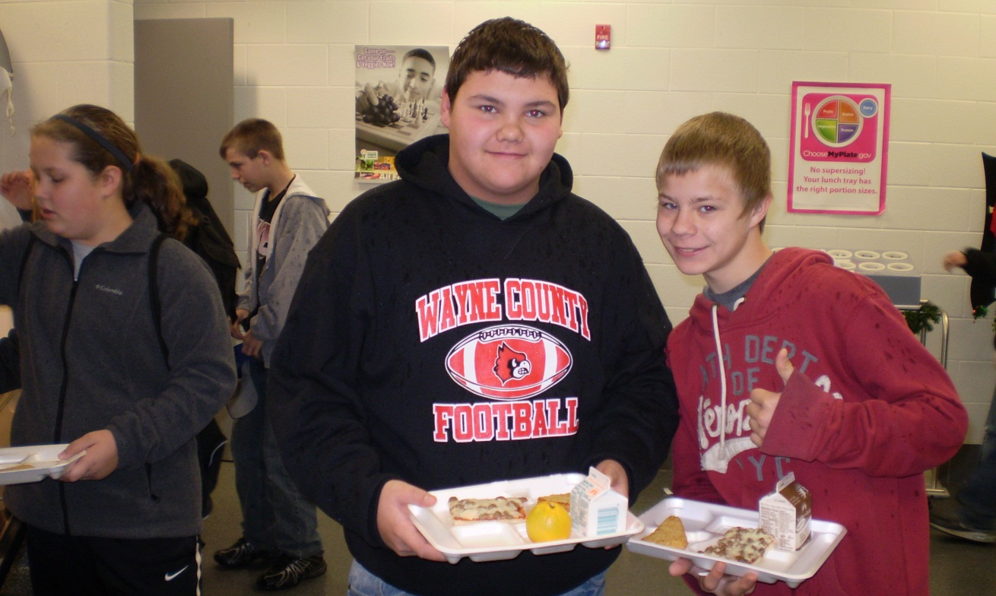
Universal Breakfast- get meal without charge
ONLY 40 % ADP OCTOBER 2011

Slide 4
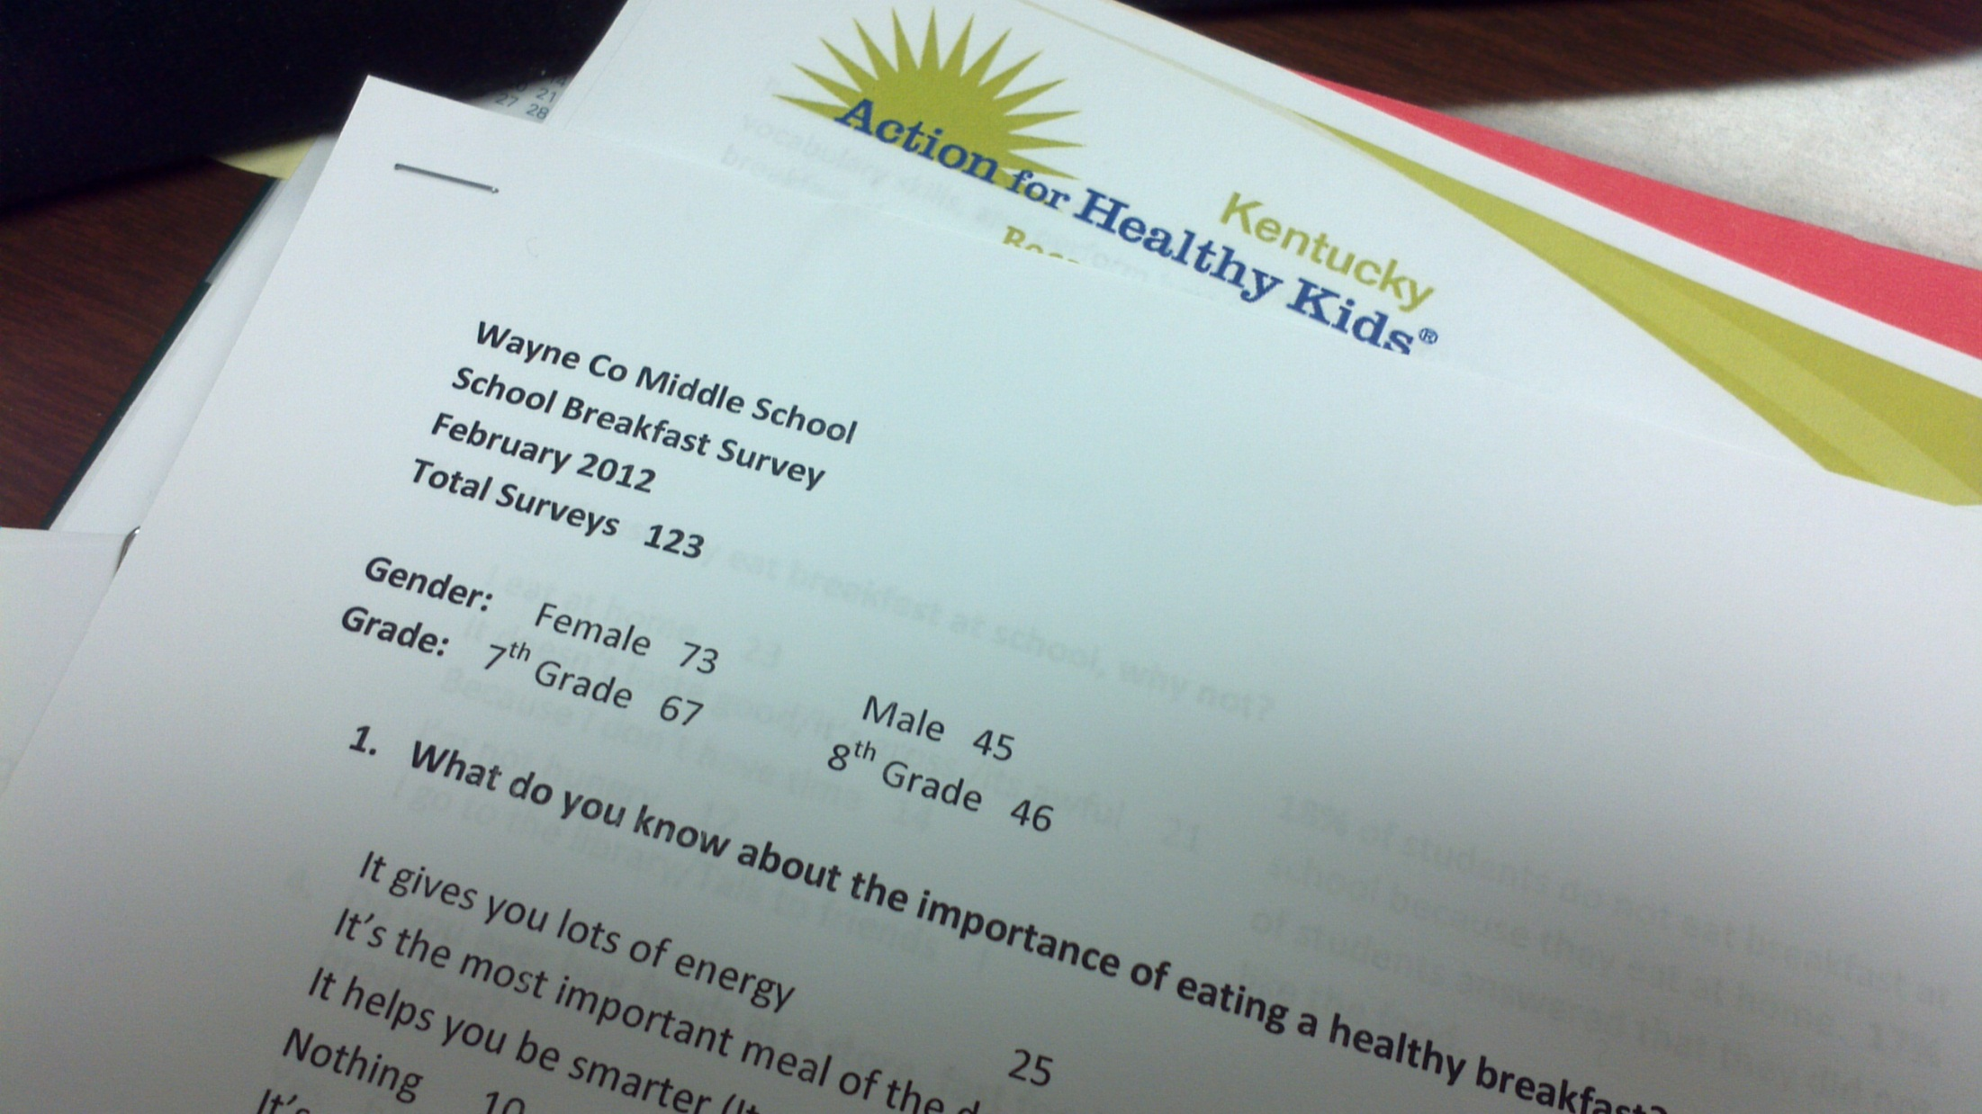
Notes:
Students participated in breakfast survey. 123 surveys returned; 50% said they didn’t like the food offered. Worked on taste testing new foods and menu changes and variety mix.

Slide 5
Notes:
Taste Testing of New Products during Breakfast

Slide 6
Challenges and Successes
Student ADP
March 52% - 198 students eating
September 40% - 156 students eating
Goal was to improve 15% student participation
Food Nutrition Manager met with key school stakeholders, principal, 21st Century instructor and selected students.
Student leadership team developed a breakfast plan to improve participation.
Fuel Up to Play 60 Wellness Program Inventory- Fall, 2011
Student Breakfast Survey – February, 2012
March was the school breakfast challenge month.
Quote: “To get our students eating a good nutritious breakfast. We know what statistics say about academic performance and good breakfasts!” Katherine Kidd, WCMS Teacher
Notes:
“We can’t loose sight of our student preferences as they drive school meal participation” Karen Gibson, RD, LD WC Food Nutrition Director

Slide 7
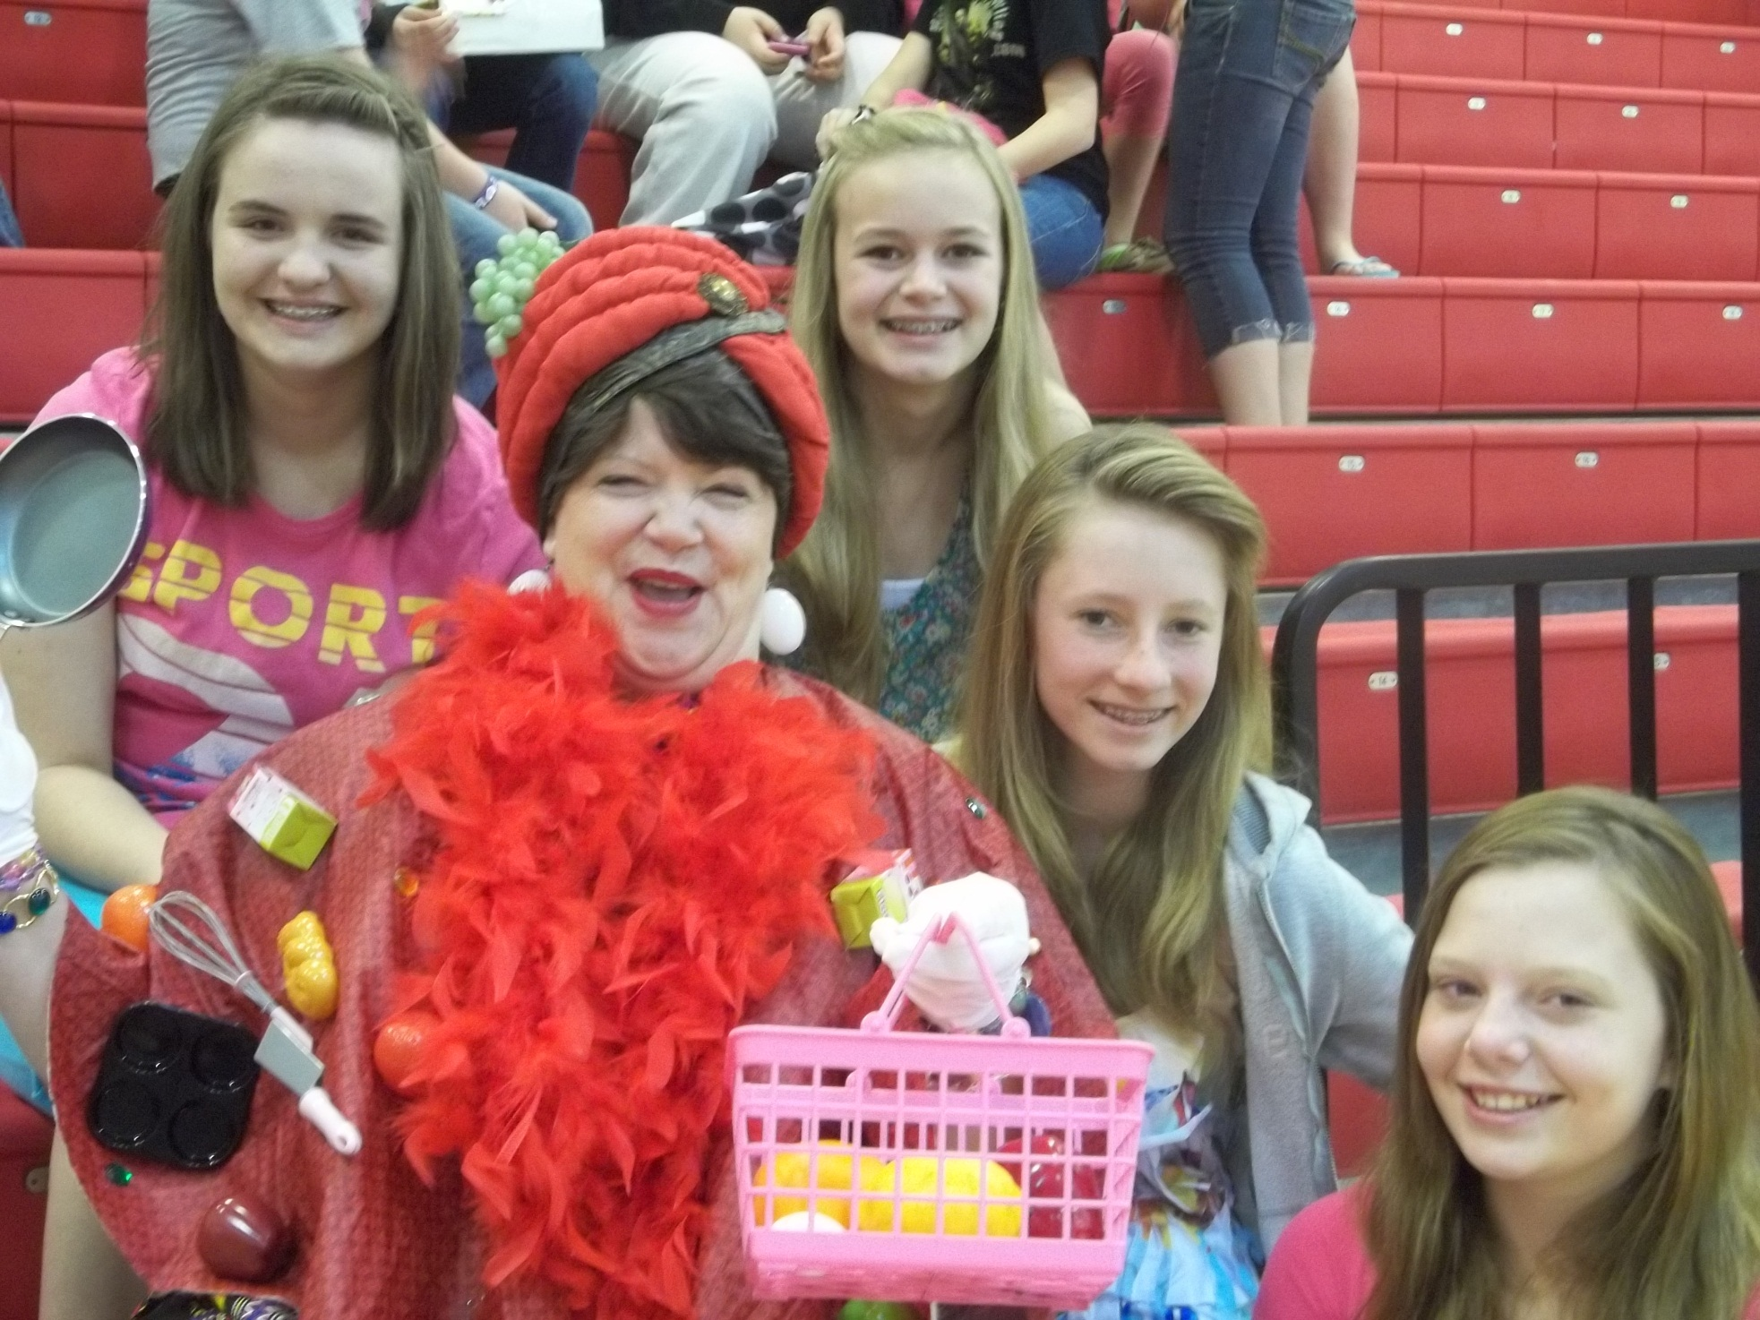
Notes:
Ms. Bluegrass Breakfast Becomes an Partner & Advocate for Healthier Eating. Katherine Kidd is our Gifted/Talented Resource & 21st Century Teacher

Slide 8
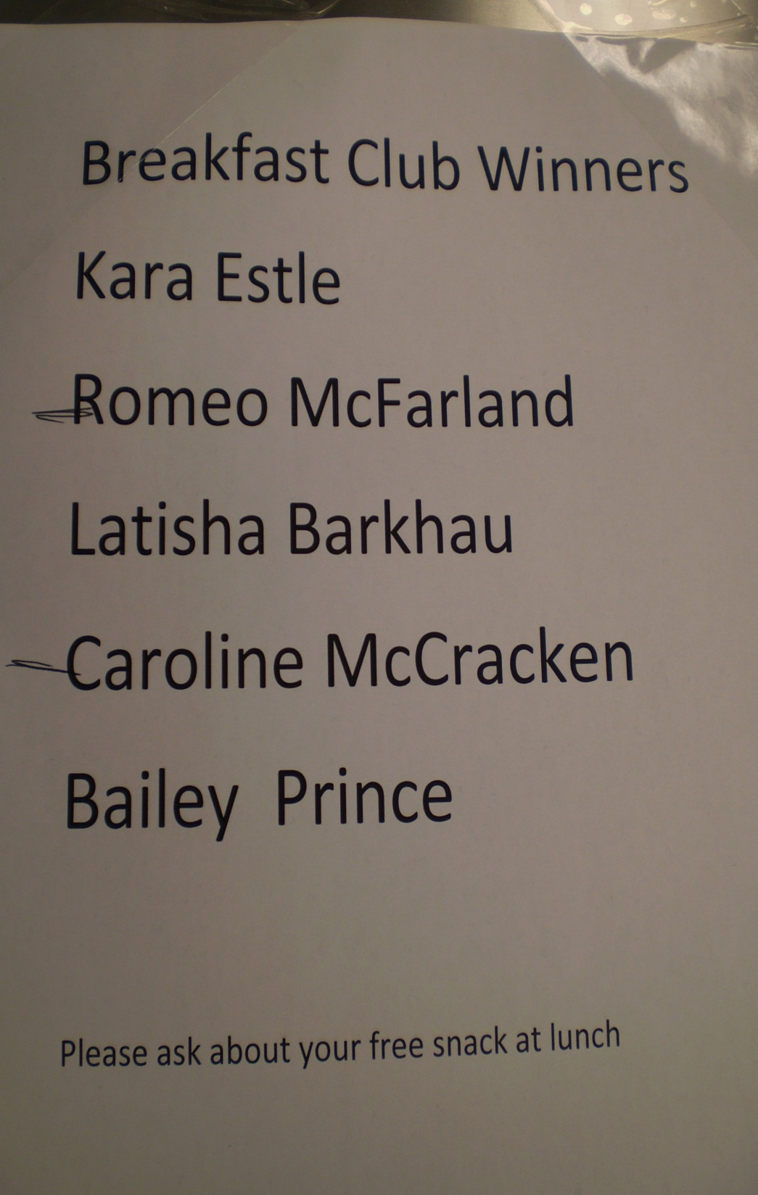
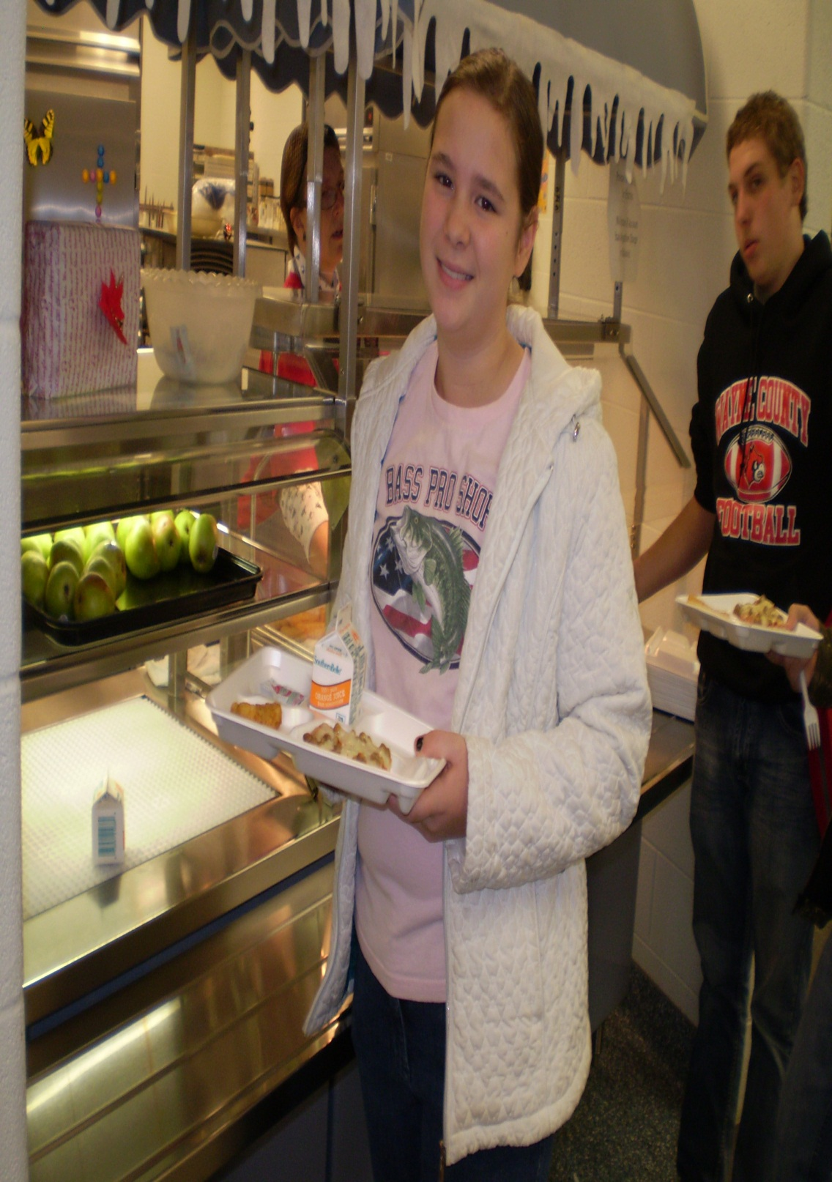
Notes:
BREAKFAST CLUB WINNERS

Slide 9
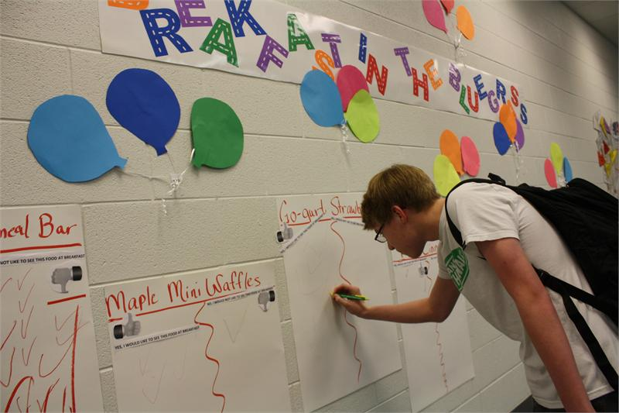
Notes:
Students Voices with Food Tasting Weekly Event

Slide 10
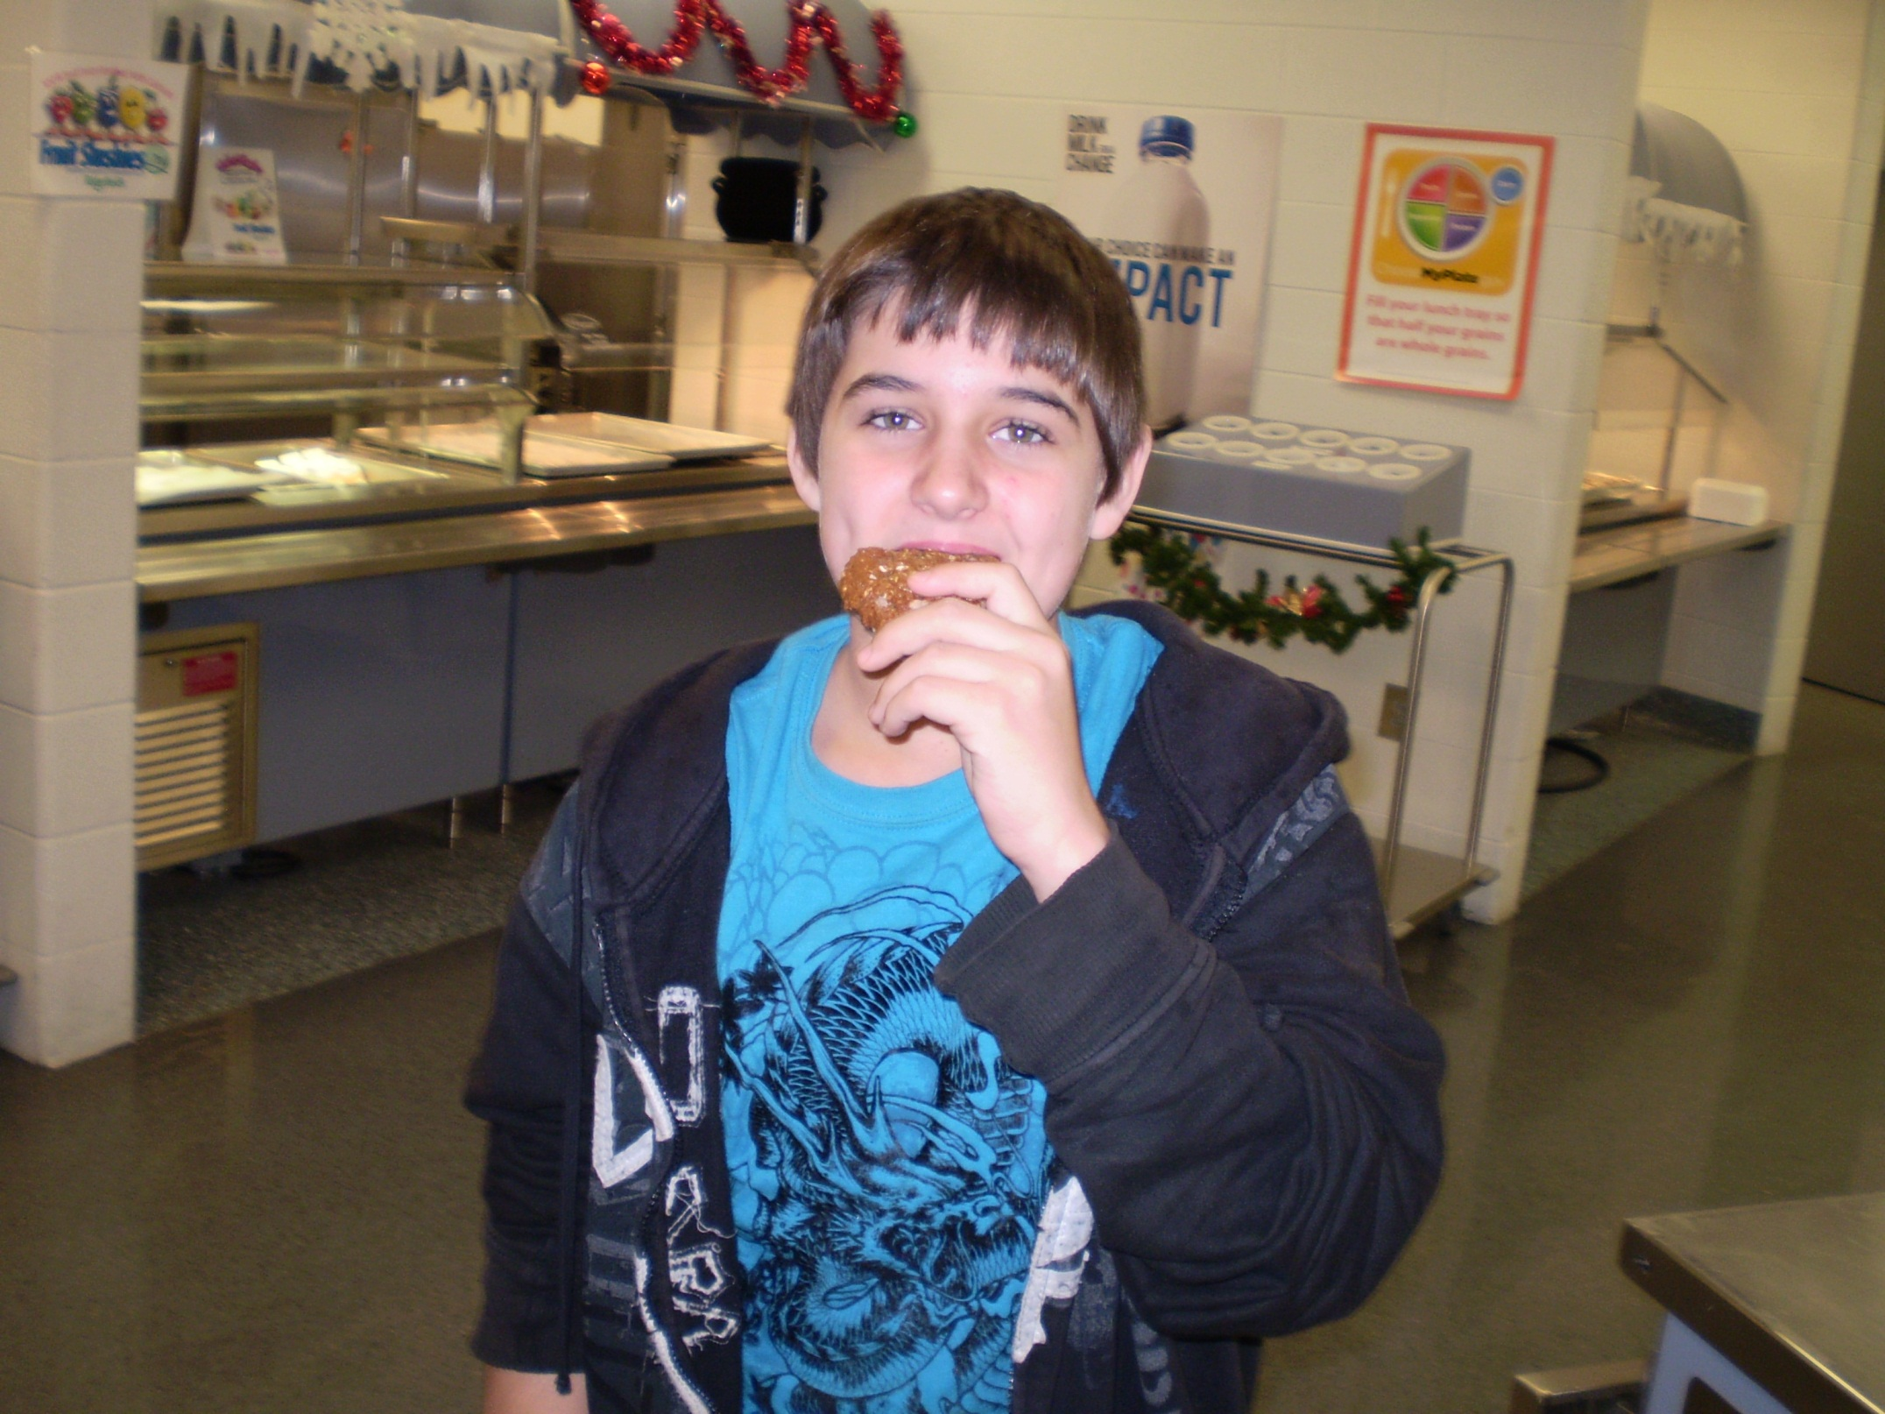
Notes:
Student states “That Breakfast Cookie Is Calling My Name- Can I Have Another One?” the new Ultimate Breakfast Rounds (UBR) whole grain too

Slide 11
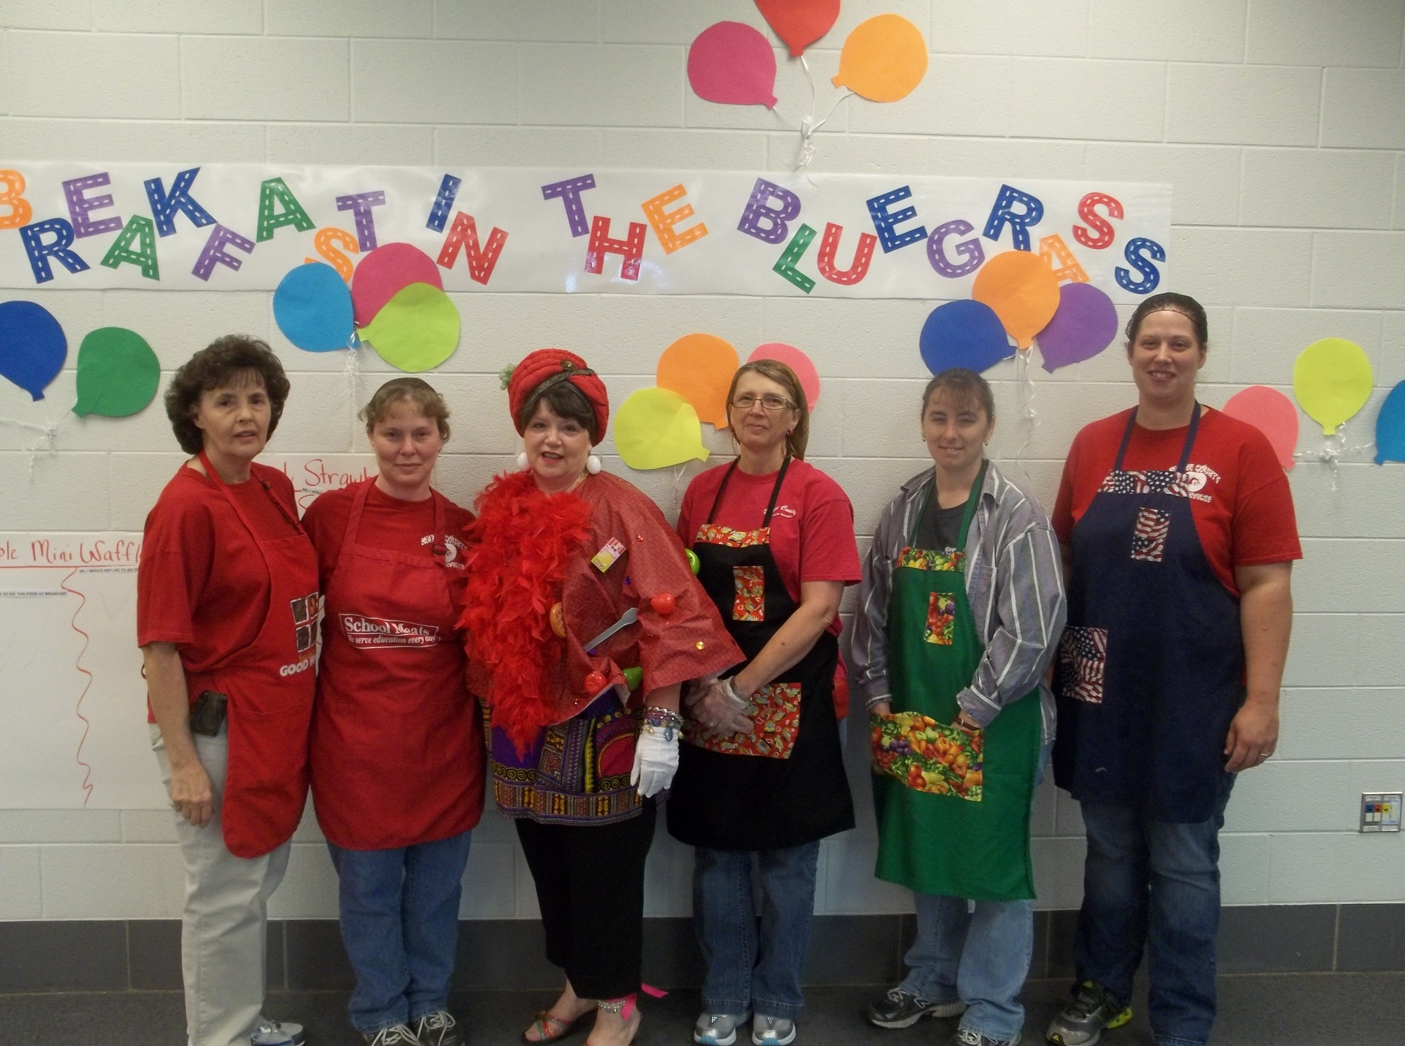
Notes:
OUR TEAM ( RIGHT TO LEFT) CASEY HOLT, MANAGER, MELISSA PENNICUFF, MELINDA BERTRAM, KATHERINE KIDD- G/T TEACHER & 21st CENTURY RESOURCE (Ms. Bluegrass Breakfast), SHEILA LOWE, PEGGY MCGINNIS

Slide 12
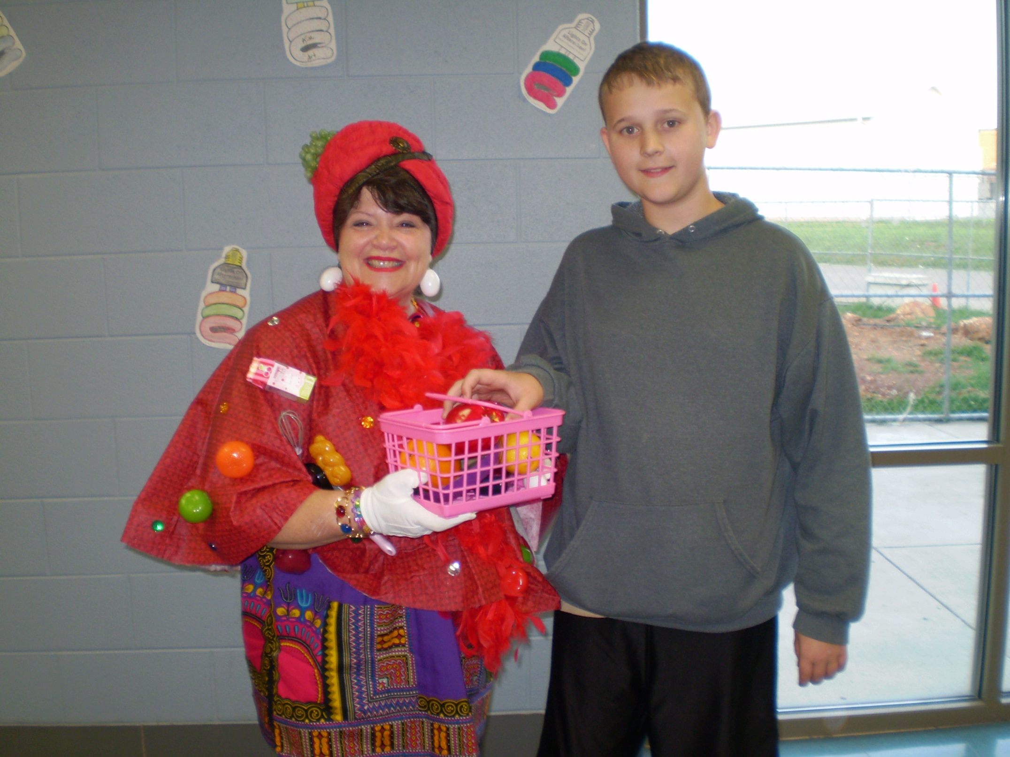
Notes:
Encouraging Fruit by Ms. Bluegrass Breakfast

Slide 13
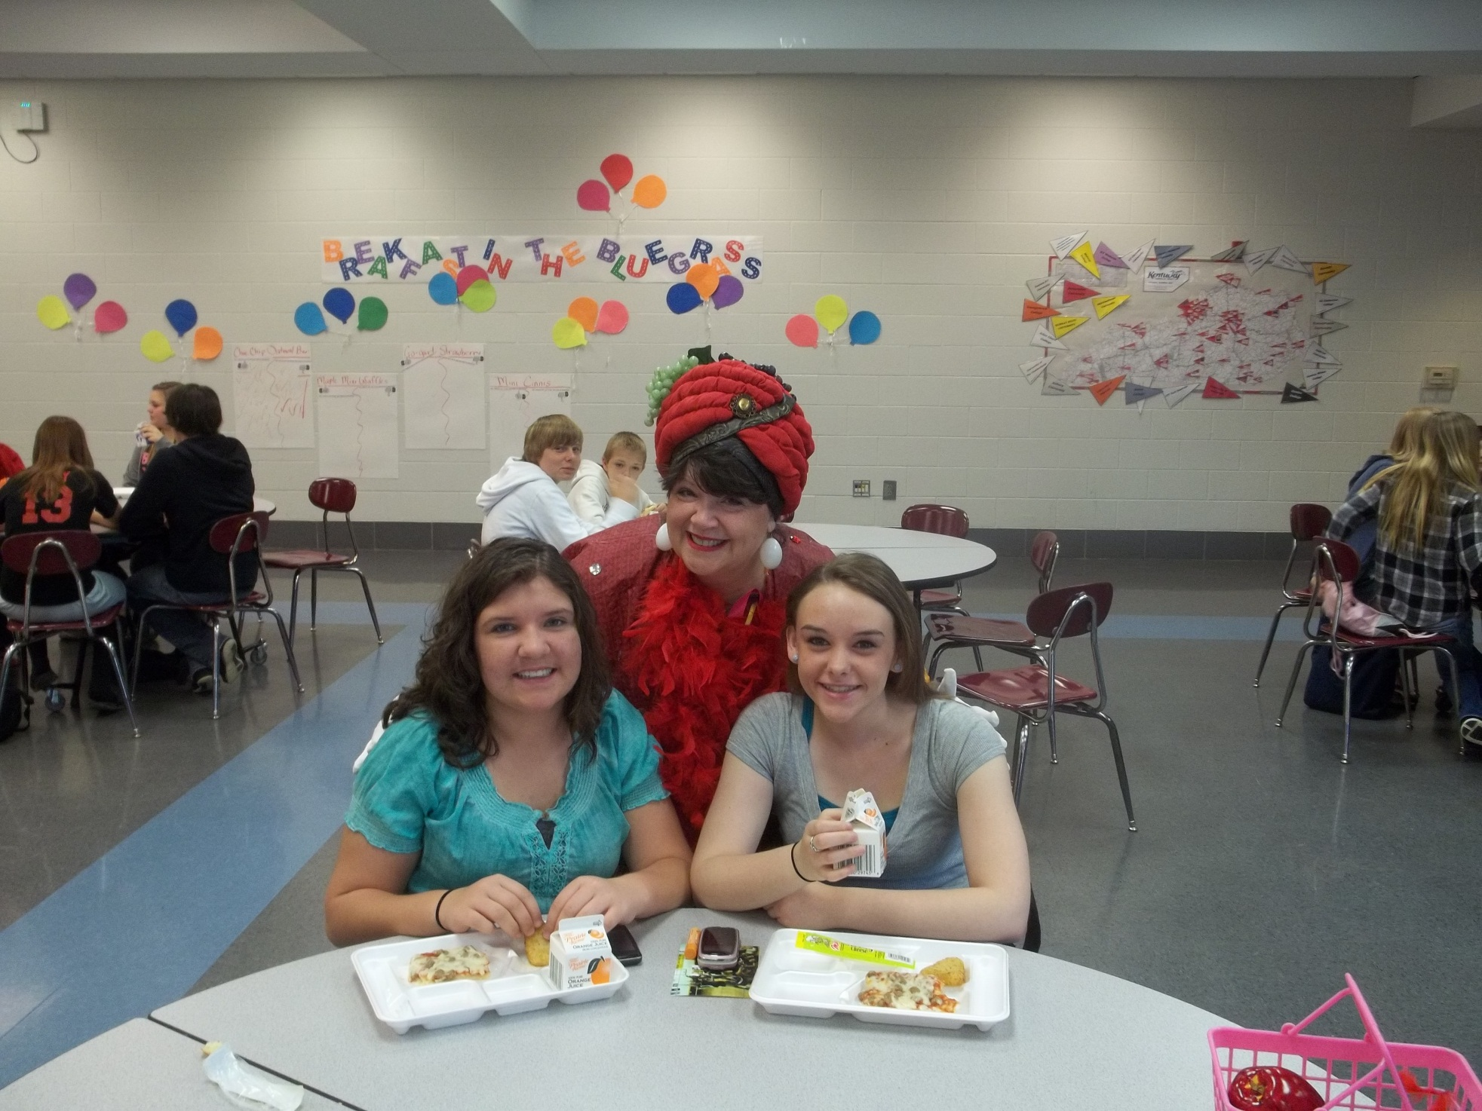
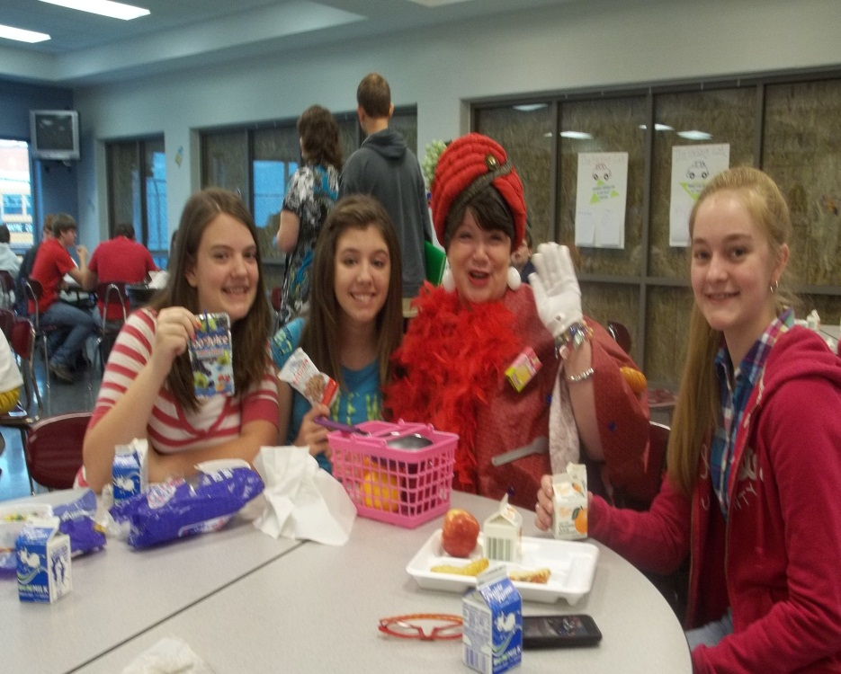
Notes:
Breakfast Challenge with Taste Tasting; Breakfast Cereal becomes a Hit with whole grain snack and new marketing

Slide 14
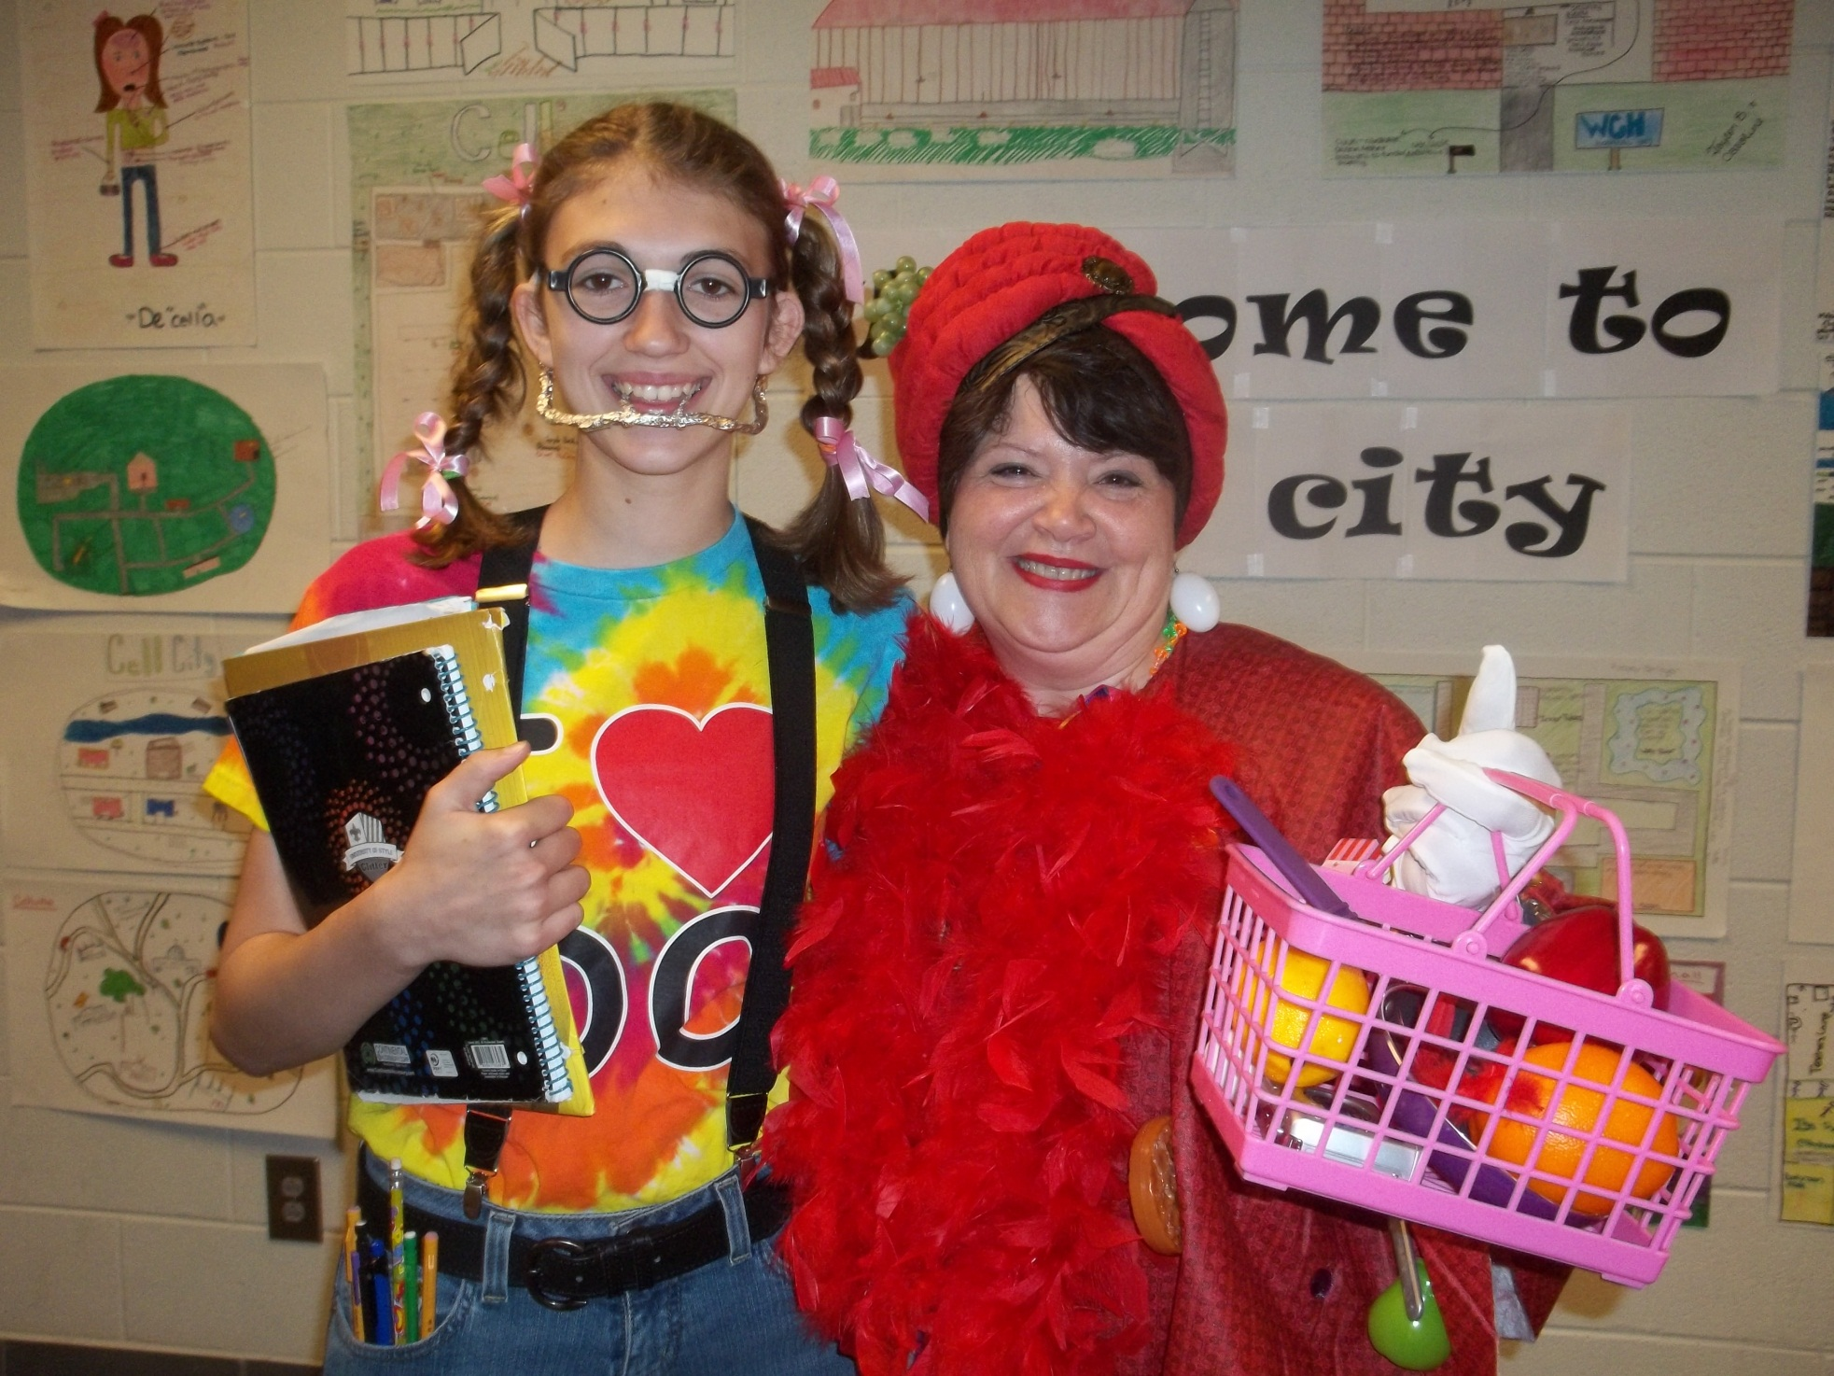
Notes:
Special Friday Ticket Activity Dress Up Nerd Day October 30. Eat 3 times in a week to get this special ticket for activity Friday. Special Friday Activity themes- 80’s Day, Mis-Match Day, Wear Your Favorite Hat Day, etc.

Slide 15
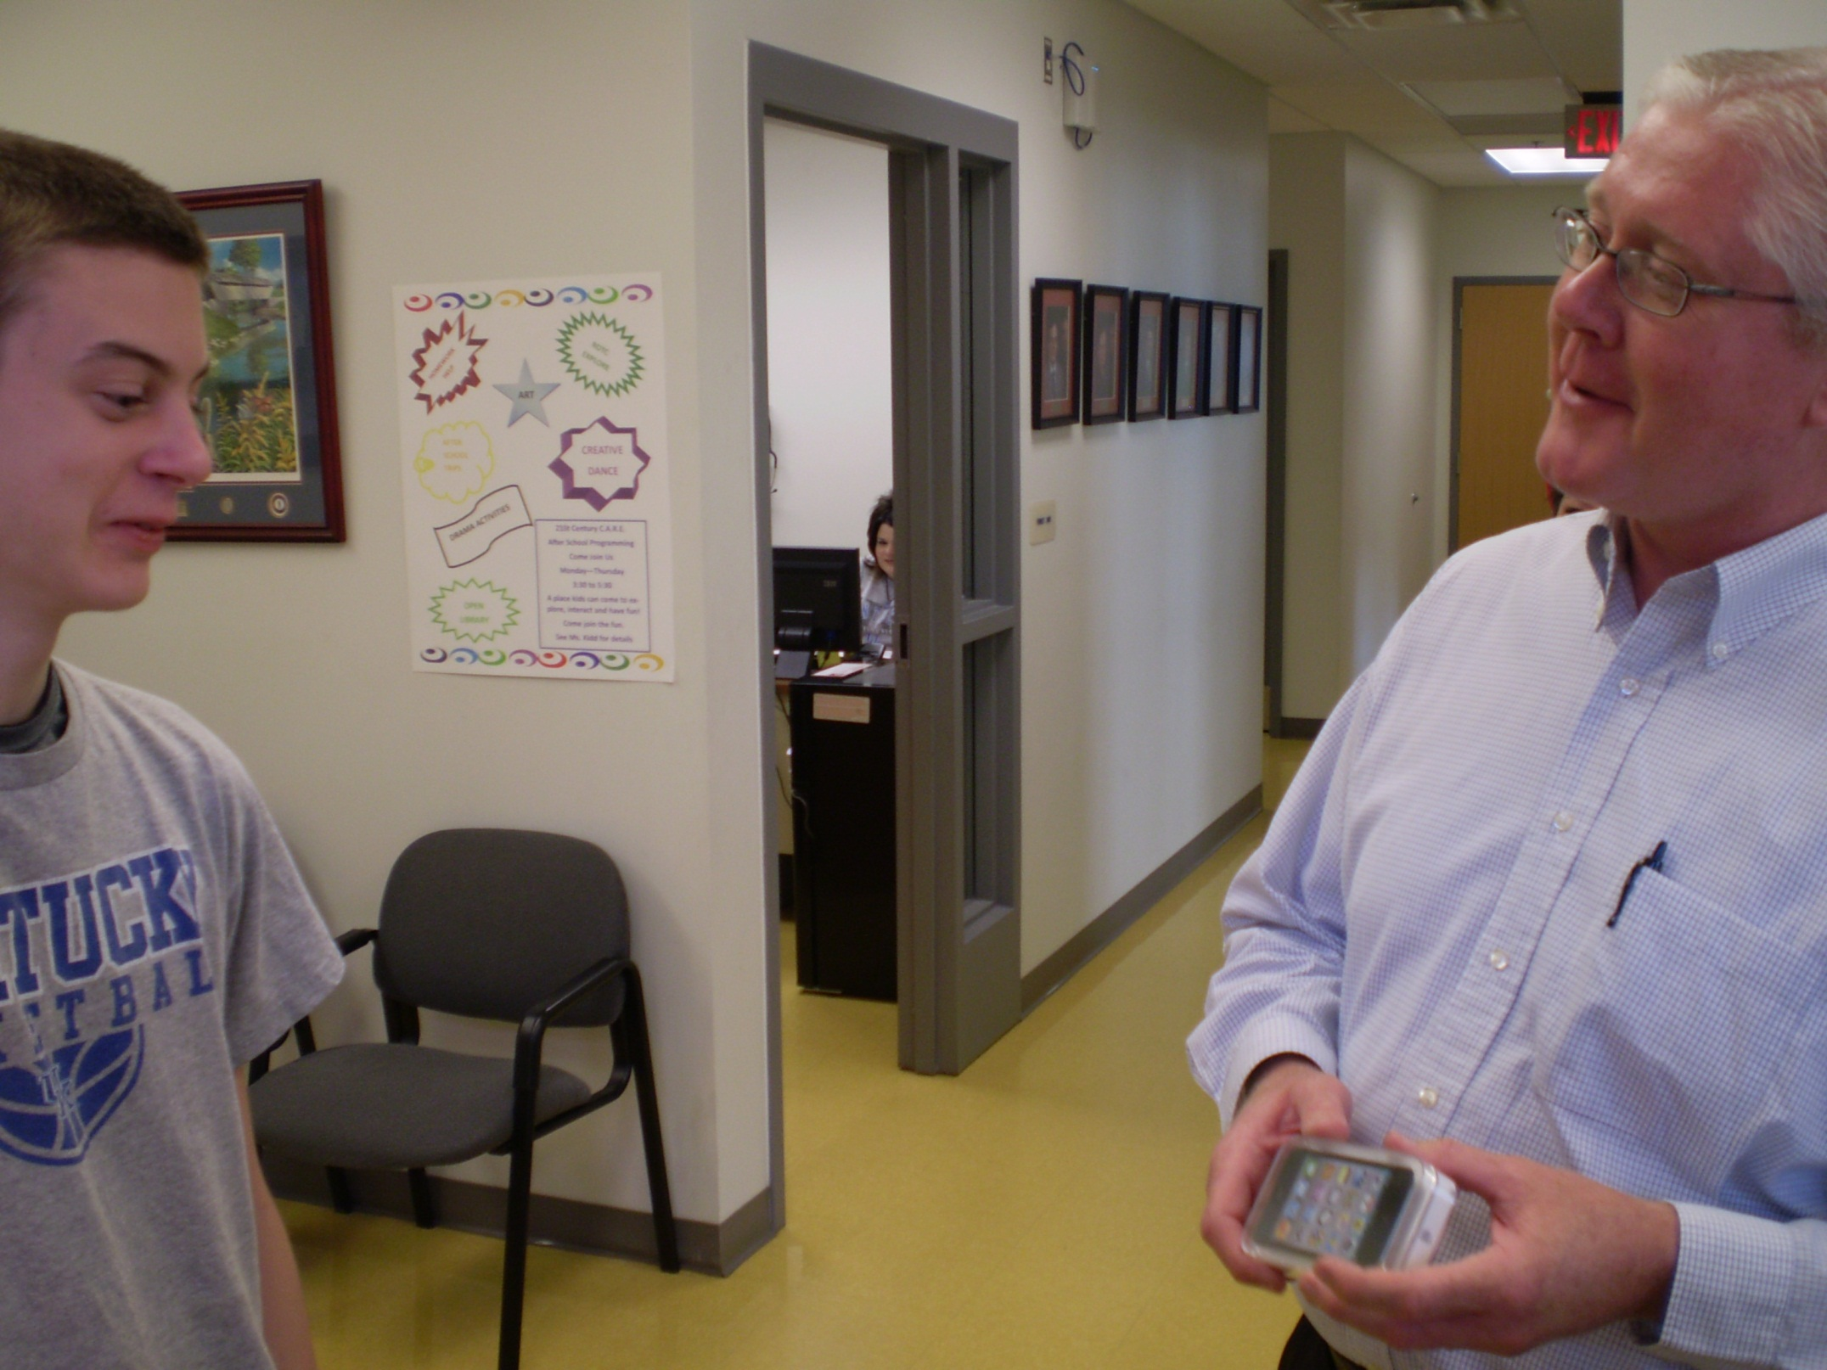
Notes:
Drew is our Bluegrass Breakfast Champion…an iPod presentation by our Superintendent

Slide 16
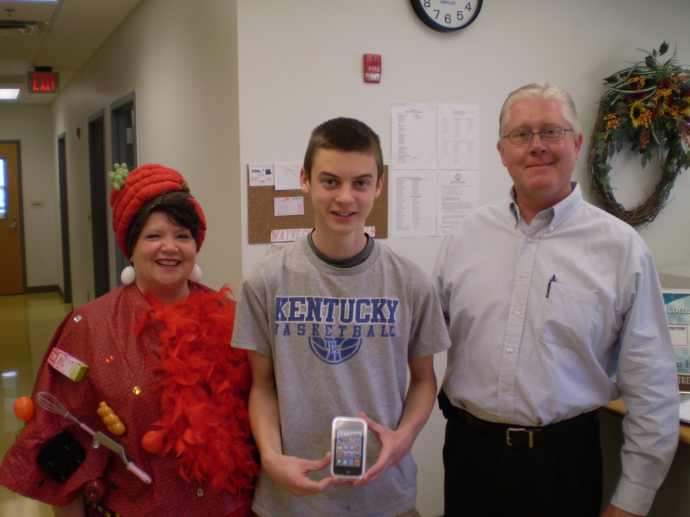
Notes:
Eating School Breakfast is rather Cool!

Slide 17
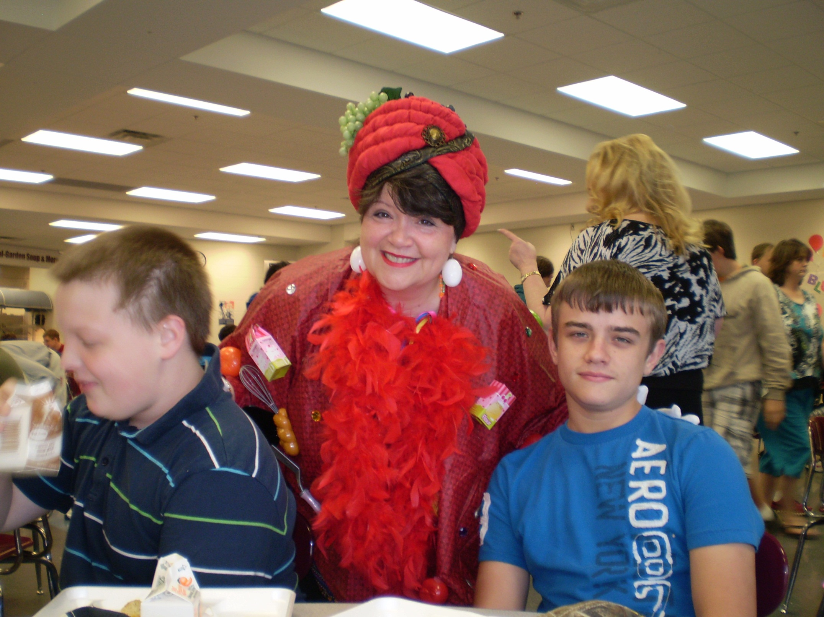
Notes:
Lots of ACTION now in the CARD ROCK CAFÉ… Needing more TABLES is a good problem to have!!!

Slide 18
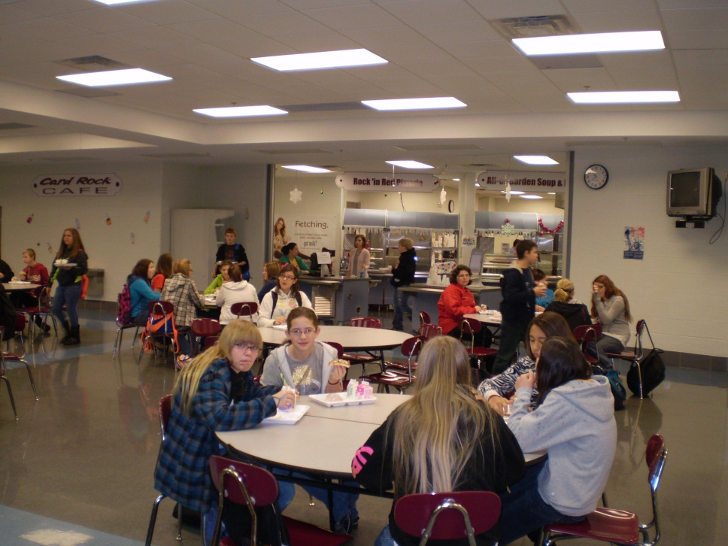
Dining Environment student Driven Voices of action
Our Dining Environment- students say “ a lot of gray and white”
Creating a Mural by with 21st Century students
Action Plan: Students created a mural afterschool during 21st Century time.
*Students taking ownership help drive participation with school meals
Notes:
Student driven voices of concern with action plan: students created a mural with afterschool 21st Century time

Slide 19
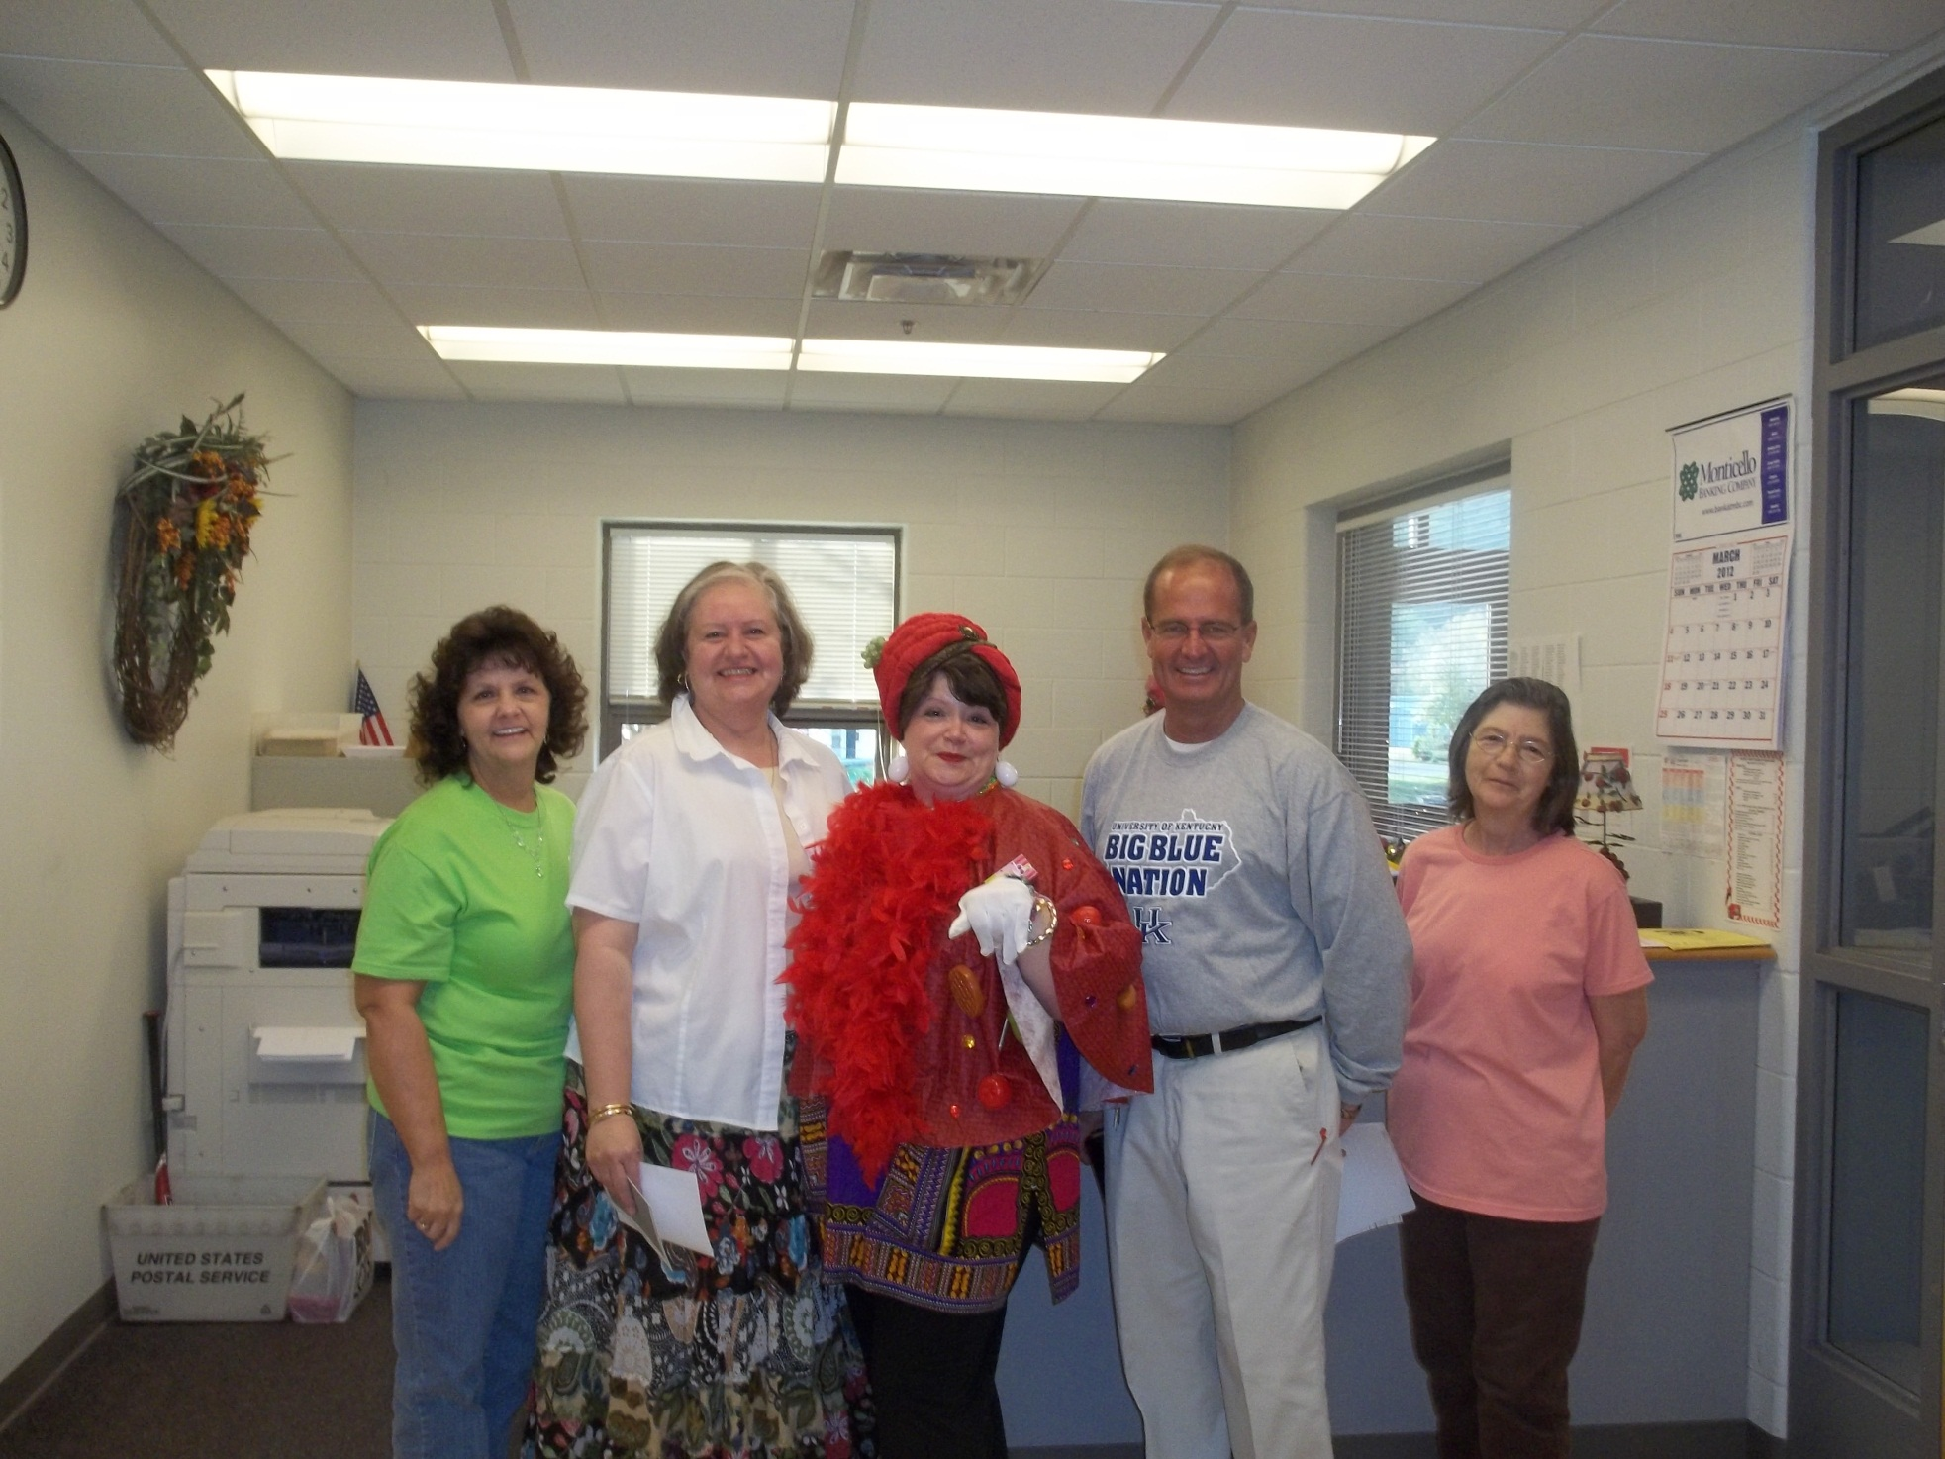
Notes:
Key stakeholders - school secretary, teachers, principal, office staff; MORE TALK ABOUT SCHOOL BREAKFAST NOW!!!!!!

Slide 20
SCHOOL YEAR 2012-2013
Planning for CEO School District
Using an Alternative Breakfast with Grab n Go Menu and eating in Classroom
Continuing Activity Friday twice per month with Breakfast Club
Continuing Taste testing of products and student involvement
Networking with Nutrition Council Students
LET OUR SUCCESS GROW AND CONTINUE…

