Slide 1
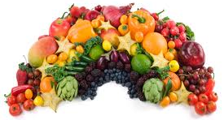
The NEW Nutrition Standards
Embrace Our Changing Meal Patterns
Serve A Rainbow A Week
Kimberly Gibson Rogers R.D.

Slide 2
 | Breakfast Meal Pattern |  |  | Lunch Meal Pattern
 | Grades K-5 | Grades 6-8 | Grades 9-12 | Grades K-5 | Grades 6-8 | Grades 9-12
Meal Pattern | Amount of Food Per Week (Minimum Per Day)
Fruits (cups) | 5 (1) | 5 (1) | 5 (1) | 2 ½ (1/2) | 2 ½ (1/2) | 5 (1)
Vegetables (cups) | 0 | 0 | 0 | 3 ¾ (3/4) | 3 ¾ (3/4) | 5 (1)
Dark Green | 0 | 0 | 0 | ½ | ½ | ½
Red/Orange | 0 | 0 | 0 | ¾ | ¾ | 1 ¼
Beans/Peas (Legumes) | 0 | 0 | 0 | ½ | ½ | ½
Starchy | 0 | 0 | 0 | ½ | ½ | ½
Other | 0 | 0 | 0 | ½ | ½ | ¾
Additional Veg to Reach Total | 0 | 0 | 0 | 1 | 1 | 1 ½
Grains | 7-10 (1) | 8-10 (1) | 9-10 (1) | 8-9 (1) | 8-10 (1) | 10-12 (2)
Meats/Meat Alternates | O | O | O | 8-10 (1) | 9-10 (1) | 10-12 (2)
Fluid Milk (cups) | 5 (1) | 5 (1) | 5 (1) | 5 (1) | 5 (1) | 5 (1)
Other Specifications: Daily Amount Based on the Average for a 5-Day Week
Min-Max Calories (kcal) | 350-500 | 400-550 | 450-600 | 550-650 | 600-700 | 750-850
Saturated Fat (% of total calories) | <10 | <10 | <10 | <10 | <10 | <10
Sodium (mg) | ≤430 | ≤470 | ≤500 | ≤640 | ≤710 | ≤740
Trans Fat | Nutrition Label or manufacturer specifications must indicate zero grams of trans fat per serving.

Slide 3
Reading the Meal Pattern Chart
First column - required food components & dietary specifications
Next three columns - weekly SBP requirements based on age-grade
Last three columns - amounts required for Lunch based on age-grade

Slide 4
Reading the Meal Pattern Chart
Weekly requirements in cells; daily requirements in parentheses
Fruits, Vegetables, Fluid Milk: daily/weekly minimums
Grains, Meat/Meat Alternates: daily/weekly minimums and weekly maximums
Calories: weekly minimums; weekly maximums
Saturated Fat, Sodium: daily average in a week
Trans Fat: daily/weekly maximum
Chart available for download
Nutrition Standard Chart

Slide 5
The Basics
Grade Groups - K-5, 6-8, 9-12
K-5 and 6-8 menus will be similar due to overlap in requirements
Changes to Breakfast will be implemented SY 2013-2014
Changes to Lunch will be effective SY 2012-2013

Slide 6
LUNCH Meal Pattern
Lunch Meal Components
  Fruit
  Vegetables
  Meats/Meat Alternates
  Grains
  Fluid Milk

Slide 7
Component
A “component” is a
term used to describe a “meal pattern food group”
Protein: Purple Choice
Grain: Orange Choice
Fruit: Red Choice
Vegetables: Green Choice
Milk: Blue Choice

Slide 8
Fruits
 | Breakfast Meal Pattern |  |  | Lunch Meal Pattern
 | Grades K-5 | Grades 6-8 | Grades 9-12 | Grades K-5 | Grades 6-8 | Grades 9-12
Meal Pattern | Amount of Food Per Week (Minimum Per Day)
Fruits (Cups) | 5 (1) | 5 (1) | 5 (1) | 2.5 (0.5) | 2.5 (0.5) | 5 (1)
Under Offer versus Serve
  A student has to select fruit or vegetable component
  Schools required to offer full required amount, but student may select at least ½ cup serving

Slide 9

Fruits
Fruits/Vegetables separated; 2 components
Daily serving at lunch (1/2 cup minimum)
May select fresh, frozen without added sugar, canned in juice/light syrup, or dried
  No more than half of fruit offerings may be juice and all juice MUST be 100% juice
  Juice can be NO larger than 4 ounces – ½ cup fruit
  ¼ cup of dried fruit = ½ cup of fruit

Slide 10
Vegetables
 | Breakfast Meal Pattern |  |  | Lunch Meal Pattern
 | Grades K-5 | Grades 6-8 | Grades 9-12 | Grades K-5 | Grades 6-8 | Grades 9-12
Meal Pattern | Amount of Food Per Week (Minimum Per Day)
Vegetables (cups) | 0 | 0 | 0 | 3 ¾ (3/4) | 3 ¾ (3/4) | 5 (1)
Dark Green | 0 | 0 | 0 | ½ | ½ | ½
Red/Orange | 0 | 0 | 0 | ¾ | ¾ | 1 ¼
Beans/Peas | 0 | 0 | 0 | ½ | ½ | ½
Starchy | 0 | 0 | 0 | ½ | ½ | ½
Other | 0 | 0 | 0 | ½ | ½ | ¾
Additional | 0 | 0 | 0 | 1 | 1 | 1 ½
Weekly minimums of all vegetable subgroups are required

Slide 11
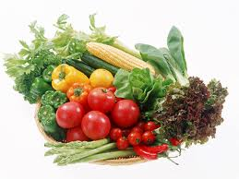
Vegetables
Daily lunch serving reflects variety over week
  Vegetable subgroups have weekly requirements for:
    Dark Green (broccoli, turnip greens, spinach)
    Red / Orange (baby carrots, tomatoes)
    Beans / Peas (baked beans, black beans)
    Starchy (potatoes, green peas, corn)
    Other (green beans, iceberg lettuce, cauliflower)
    Additional vegetables to help meet 3.75 to 5 cups weekly vegetable total (extra starchy vegetables can be included here)

Slide 12
VEGETABLES
Variety of preparation methods available
  Fresh, frozen, and canned products
  USDA Foods offers a variety of no salt added or lower sodium products
Changes in crediting of leafy greens
  Uncooked, leafy greens will credit as half of volume as served. Therefore, one cup of romaine lettuce is creditable as one half of a cup of vegetables.
Foods from the beans/peas subgroup may be credited as a vegetable OR a meat alternate NOT both in the same meal

Slide 13
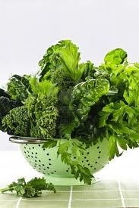
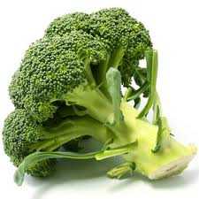
Dark Green Vegetables
Broccoli
Collard Greens
Dark Green Leafy Lettuce
Kale
Mustard Greens
Romaine Lettuce
Spinach
Turnip Greens

Slide 14
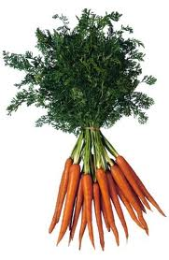
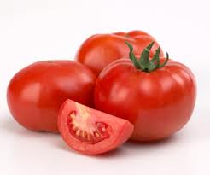
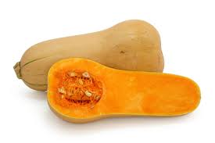
Red/Orange Vegetables
Squash
Carrots
Pumpkin
Red Peppers
Sweet Potatoes
Tomatoes
Tomato Juice

Slide 15
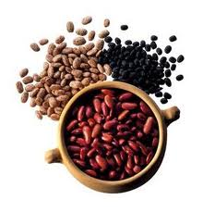
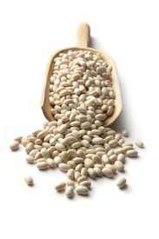
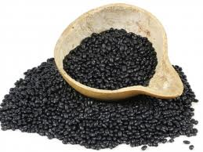
Beans/Peas (Legumes)
Black Beans
Black-Eyed Peas
Garbanzo Beans (Chickpeas)
Kidney Beans
Lentils
Navy Beans
Pinto Beans
Soy Beans
Split Peas
White Beans

Slide 16
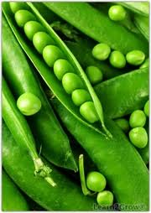
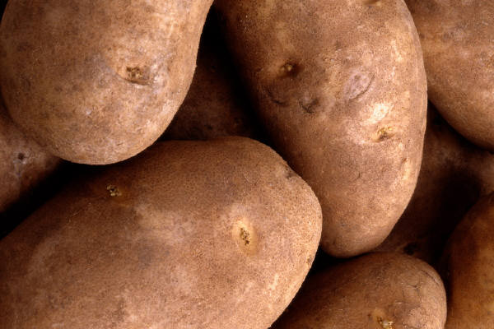
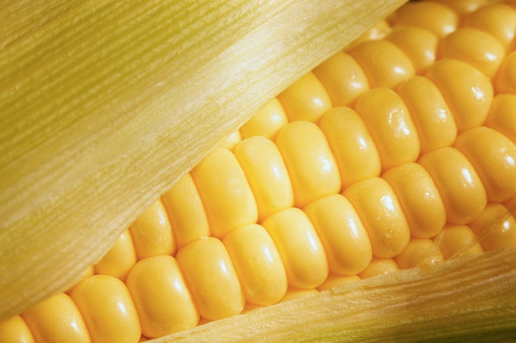
Starchy Vegetables
Cassava
Corn
Fresh Cowpeas, field peas, or black-eyed peas (not dry)
Green Peas
Green Lima Beans
Potatoes (white)
Water Chestnuts

Slide 17
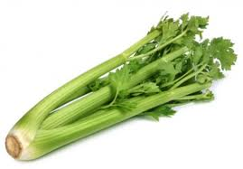

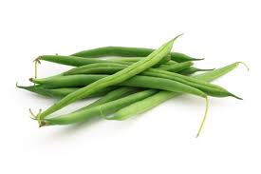
Other Vegetables
Asparagus
Avocado
Bean Sprouts
Beets
Brussels Sprouts
Cabbage
Cauliflower
Celery
Cucumbers
Eggplant
Green Beans
Green Peppers
Iceberg Lettuce
Mushrooms
Okra
Onions
Parsnips
Turnips
Wax Beans
Zucchini

Slide 18
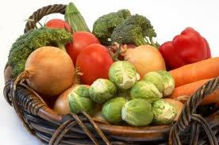
Name That SUBGROUP!!!
Green Beans
  Other
Broccoli
  Dark Green
Baked Beans
  Beans/Peas
Corn
  Starchy
Peas
  Starchy
Baby Carrots
  Red/Orange
Iceberg Lettuce
  Other
Tomatoes
  Red/Orange
Potatoes
  Starchy
TIP: Starchy vegetables can also be counted as additional vegetables

Slide 19
Grains
 | Breakfast Meal Pattern |  |  | Lunch Meal Pattern
 | Grades K-5 | Grades 6-8 | Grades 9-12 | Grades K-5 | Grades 6-8 | Grades 9-12
Meal Pattern | Amount of Food Per Week (Minimum Per Day)
Grains (oz. eq.) | 7-10 (1) | 8-10 (1) | 9-10 (1) | 8-9 (1) | 8-10 (1) | 10-12 (2)
Schools must offer daily and weekly serving ranges of grains
  Maximums and Minimums
Initially, at least half of the grains offered during the week must be whole grain-rich

Slide 20
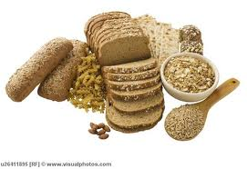
Criteria for Whole Grain-Rich Foods
Meet serving size requirements in Grains/Breads Instruction
Meet at least one of the following
  Whole grains per servings must be ≥ 8 grams
  Product includes FDA’s whole grain health claim on its packaging
  Product ingredient listing lists whole grain first

Slide 21
Meats/Meat Alternates
 | Breakfast Meal Pattern |  |  | Lunch Meal Pattern
 | Grades K-5 | Grades 6-8 | Grades 9-12 | Grades K-5 | Grades 6-8 | Grades 9-12
Meal Pattern | Amount of Food Per Week (Minimum Per Day)
Meats/Meat Alternates (oz. eq.) | 0 | 0 | 0 | 8-10 (1) | 9-10 (1) | 10-12 (2)
Daily and Weekly requirements for lunch
  2 oz. eq. daily for students in grades 9-12
  1 oz. eq. daily for students in grades K-8
Variety of Proteins are encouraged

Slide 22

Fluid Milk
Allowable milk options include
  Fat-free (unflavored or flavored)
  Low-fat 1% (unflavored only)
  Fat-free or low-fat (lactose-reduced or lactose-free)
Must offer at least two different choices
Does not alter nutrition standards for milk substitutes
Students may decline milk component under OVS

Slide 23
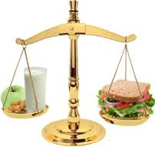
A Balanced Meal
Breakfast =
3 out of 4 available components
Lunch =
3 out of 5 available components
A balanced meal is any breakfast or lunch that contains the minimum amount of components needed to be considered a reimbursable meal.

Slide 24

Offer Versus Serve
For a Balanced (reimbursable) lunch:
  Student must select:
    At least 3 out of 5 components
  Student must select:
    Fruit component
    OR
    Vegetable component
Under OVS:
  All 5 components must be offered daily
Student may decline
  2 food components at lunch
  1 food component at breakfast

Slide 25
A Balanced Lunch

Slide 26
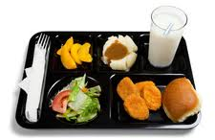
A Complete Meal
  Breakfast =
  4 Components
  Lunch =
  5 Components
A complete meal is any breakfast or lunch that contains the maximum amount of components for an established meal price.

Slide 27
A Complete Lunch

Slide 28
A Rhyme To Remember…
Place three colors on your tray,
to have a balanced day.
Start with red or green,
to keep your body lean.
Purple, orange or blue,
are left up to you.
Choose one of each,
to make your lunch complete.

Slide 29

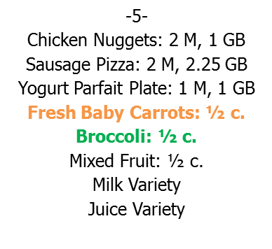



Is it Balanced, Complete, or Neither?
Student 1: Chicken Nuggets, Baby Carrots, Broccoli, Mixed Fruit, Milk, and a Juice.
COMPLETE
Student 2: Sausage Pizza and Milk.
NEITHER
Student 3: Parfait and a Juice.
BALANCED
-7- Hamburger: 2 M, 2 GB Uncrusted Grape PB&J: 1 M, 1.25 GB Turkey Super Salad Bowl: 2 M Yoplait Yogurt Parfait Plate: 1 M, 1 GB Fresh Baby Carrots: ½ c. Baked Beans: ½ c. Peaches: ½ c. / Crackers: 1 GB Milk Variety / Juice Variety
Student 1: Baby Carrots, Baked Beans, Peaches, Milk, and a Juice.
BALANCED
Student 2: Hamburger and Milk.
NEITHER
Student 3: Turkey Salad w/ Crackers.
BALANCED

Slide 30
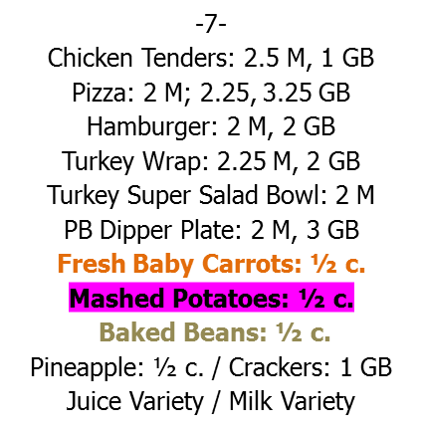
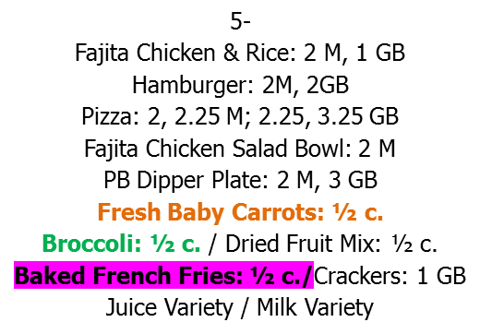
Is it Balanced, Complete, or Neither?
Student 1: Mashed Potatoes, Baked Beans, and Milk.
NEITHER
Student 2: Turkey Super Salad and Milk.
BALANCED
Student 3: Chicken Tenders, Baby Carrots, Mashed Potatoes, Pineapple, Milk and a Juice.
COMPLETE
Student 1: Fajita Chicken & Rice and a Milk.
NEITHER
Student 2: Pizza, Baby Carrots, Broccoli, Dried Fruit Mix, Milk, and a Juice.
COMPLETE
Student 3: Hamburger and Dried Fruit Mix.
BALANCED

Slide 31
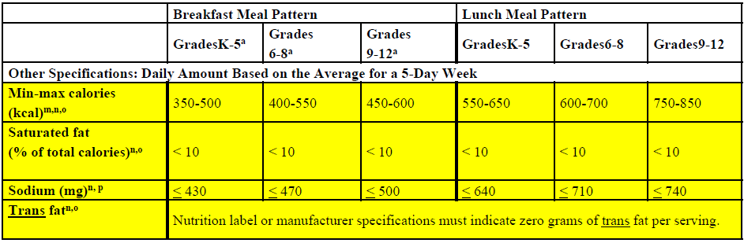
Dietary Specifications
Minimum and maximum calorie levels
Standards for sodium, calories (minimum and maximum), and saturated fat to be met on average over the course of the school week
Products and ingredients used to prepare daily meal must contain zero grams of trans fat per serving (less than 0.5 gram per serving)

Slide 32

Summary of Lunch Changes for SY 2012-13
Offer fruit daily
Offer vegetable subgroups weekly
Half of grains must be whole grain-rich
Offer weekly grain ranges
Offer weekly meat/meat alternate ranges
Offer only fat-free (flavored or unflavored) and low-fat (unflavored) milk
Calorie ranges

Slide 33

Summary of Lunch Changes for SY 2012-13
Saturated fat limit <10% calories
Zero grams of trans fat per portion
Single-Food Menu Planning approach
Establish age/grade: K-5, 6-8, and 9-12
Reimbursable meals must contain fruit or vegetable

Slide 34
Crediting Updates
No more than half of the fruit or vegetable offerings may be in the form of juice.
All juice must be 100% full-strength.
One quarter-cup of dried fruit counts as ½ cup of fruit
One cup of leafy greens counts as ½ cup of vegetable
  ½ cup of leafy greens counts as ¼ cup of vegetable

Slide 35
SAMPLE Menu for K-8
-5- Chicken Nuggets: 2 M, 1 GB Sausage Pizza: 2 M, 2.25 GB Yogurt Parfait Plate: 1 M, 1 GB Fresh Baby Carrots: ½ c. Broccoli: ½ c. Mixed Fruit: ½ c. Milk Variety Juice Variety
-6- Chicken Sandwich: 2 M, 3 GB Turkey Wrap: 2.25 M, 2 GB PB Dipper Plate: 2 M, 3 GB Garden Salad: ½ c.=¼ c. Baked French Fries: ½ c. Warm Apple Slices: ½ c. Milk Variety Juice Variety
-7- Hamburger: 2 M, 2 GB Uncrusted Grape PB&J: 1 M, 1.25 GB Turkey Super Salad Bowl: 2 M Yoplait Yogurt Parfait Plate: 1 M, 1 GB Fresh Baby Carrots: ½ c. Baked Beans: ½ c. Peaches: ½ c. / Crackers: 1 GB Milk Variety / Juice Variety
-8- Pasta w/Mozz & Meat Sauce: 2.4 M, 1 GB Mozzarella MaxStix: 2 M, 2 GB PB Dipper Plate: 2 M, 3 GB Garden Salad: ½ c.=¼ c. Green Beans: ½ c. Applesauce: ½ c. Milk Variety Juice Variety
-9- Chicken Tenders: 2.5 M, 1 GB Turkey Super Salad Bowl: 2 M Yoplait Yogurt Parfait Plate: 1 M, 1 GB Fresh Baby Carrots: ½ c. Corn: ½ c. Pears: ½ c. Crackers: 1 GB Milk Variety / Juice Variety

Slide 36

Does it Meet the Nutrition Standards?
Fruit (2 ½) : 5 cups
Vegetables (3 ¾) : 4 ½ c.
  Dark Green (½): ½ c.
  Red/Orange (¾): 1 ½ c. (+¾)
  Beans/Peas (½): ½ c.
  Starchy (½): 1 c. (+½)
  Other (½): 1 c. (+½)
  Additional (1): 1 ¾ c.
Grains (8-9,8-10): 8.3
M/MA (8-10, 9-10): 9.2
Milk (5): 5
Calories (550-650, 600-700): 643
Saturated Fat (<10%): 6.25%
Sodium (640, 710): 1245mg
Trans Fat (0): 0.0017g

Slide 37
SAMPLE Menu for 9-12
-5- Fajita Chicken & Rice: 2 M, 1 GB Hamburger: 2M, 2GB Pizza: 2, 2.25 M; 2.25, 3.25 GB Fajita Chicken Salad Bowl: 2 M PB Dipper Plate: 2 M, 3 GB Fresh Baby Carrots: ½ c. Broccoli: ½ c. / Dried Fruit Mix: ½ c. Baked French Fries: ½ c./Crackers: 1 GB Juice Variety / Milk Variety
-6- Pasta w/ Mozz & Meat Sauce: 2.4 M, 1 GB Chicken Sandwich: 2 M, 3 GB Pizza: 2, 2.25 M; 2.25, 3.25 GB Ham Super Salad Bowl: 2 M Yoplait Yogurt Parfait: 1 M, 1 GB Garden Salad: ½ c.=¼ c./Corn: ½ c. Baked French Fries: ½ c. Peaches: ½ c. / Crackers: 1 GB Juice Variety / Milk Variety
-7- Chicken Tenders: 2.5 M, 1 GB Pizza: 2 M; 2.25, 3.25 GB Hamburger: 2 M, 2 GB Turkey Wrap: 2.25 M, 2 GB Turkey Super Salad Bowl: 2 M PB Dipper Plate: 2 M, 3 GB Fresh Baby Carrots: ½ c. Mashed Potatoes: ½ c. Baked Beans: ½ c. Pineapple: ½ c. / Crackers: 1 GB Juice Variety / Milk Variety
-8- Cheesy Chicken & Rice Burrito: 2 M, 2.7 GB Chicken Sandwich: 2 M, 3 GB Pizza: 2, 2.25 M; 2.25, 3.25 GB Ham Super Salad Bowl: 2 M Yoplait Yogurt Parfait: 1 M, 1 GB Garden Salad: ½ c.=¼c. Green Beans: ½ c. Baked French Fries: ½ c. Mixed Fruit: ½ c. / Crackers: 1 GB Juice Variety / Milk Variety
-9- Chicken Alfredo: 2 M, 1 GB Hamburger: 2 M, 1 GB Pizza: 2, 2.25 M; 2.25, 3.25 GB Turkey Super Salad Bowl: 2 M PB Dipper Plate: 2 M, 3 GB Fresh Baby Carrots: ½ c. Baked French Fries: ½ c. Peaches: ½ c. / Crackers: 1 GB Juice Variety / Milk Variety

Slide 38

Does it Meet the Nutrition Standards?
Fruit (5) : 5 c.
Vegetables (5) : 6 ½ c.
  Dark Green (½): ½ c.
  Red/Orange (1 ¼): 1 ½ c. (+ ¼)
  Beans/Peas (½): ½ c.
  Starchy (½): 3 c. (+2 ½)
  Other (¾): 1 c. (+¼)
  Additional (1 ½): 3 c.
Grains (10-12): 10
M/MA (10-12): 10
Milk (5): 5
Calories (750-850): 765
Saturated Fat (<10%): 7.6%
Sodium (740): 1885 mg
Trans Fat (0): 0.0082 g

Slide 39

QUESTIONS

Slide 40


SCHOOL LUNCH IS GOING TO ROCK

