Slide 1


Slide 2
We, the people of the United States, in order to form a more perfect union, establish justice, ensure domestic tranquility, provide for the common defence, promote the general welfare, and secure the blessings of liberty to ourselves and our posterity, do ordain and establish this constitution for the United States of America.
U.S. Constitution http://memory.loc.gov/ammem/amlaw/ac001/lawpres.html

Slide 3
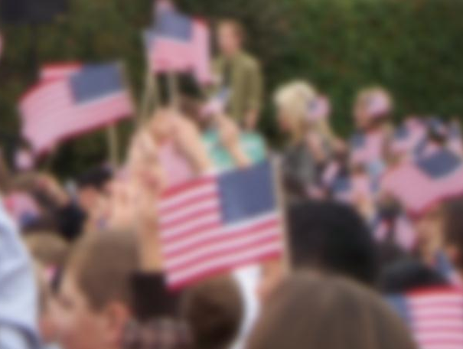
We
The people - union
Justice
Tranquility
Common defense
General welfare
Ourselves - Posterity
Establish THIS constitution
United
States
Of America

Slide 4

It’s Found Poetry

Slide 5
Found Poetry
Found poetry is a type of poetry created by taking words, phrases, and sometimes whole passages from other sources and reframing them as poetry by making changes in spacing and lines, or by adding or deleting text, thus imparting new meaning. (Wikipedia)

Slide 6
Found Poetry with Primary Sources
1. Choose a text from the Library of Congress site
Some quick ideas are –
      Historical documents
      Scientific definitions or quotes
      Biographies of famous or little known people
Select words of theme, essence, significance
Arrange into poetic form

Slide 7
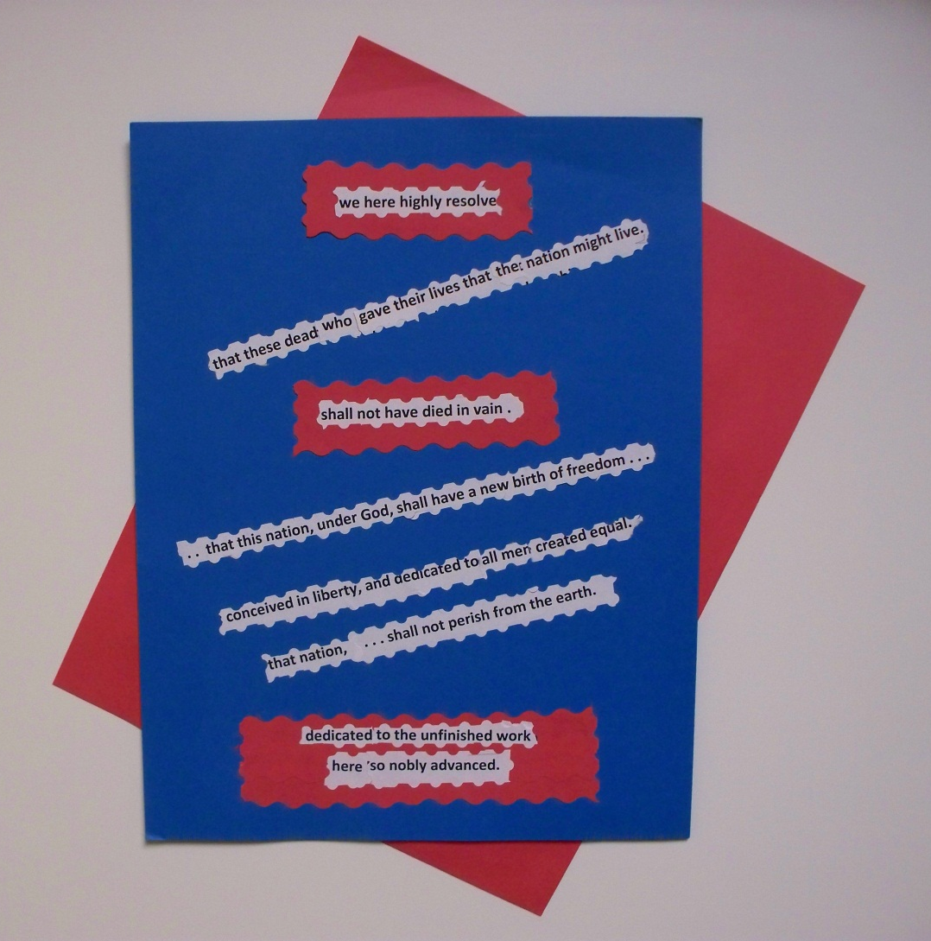
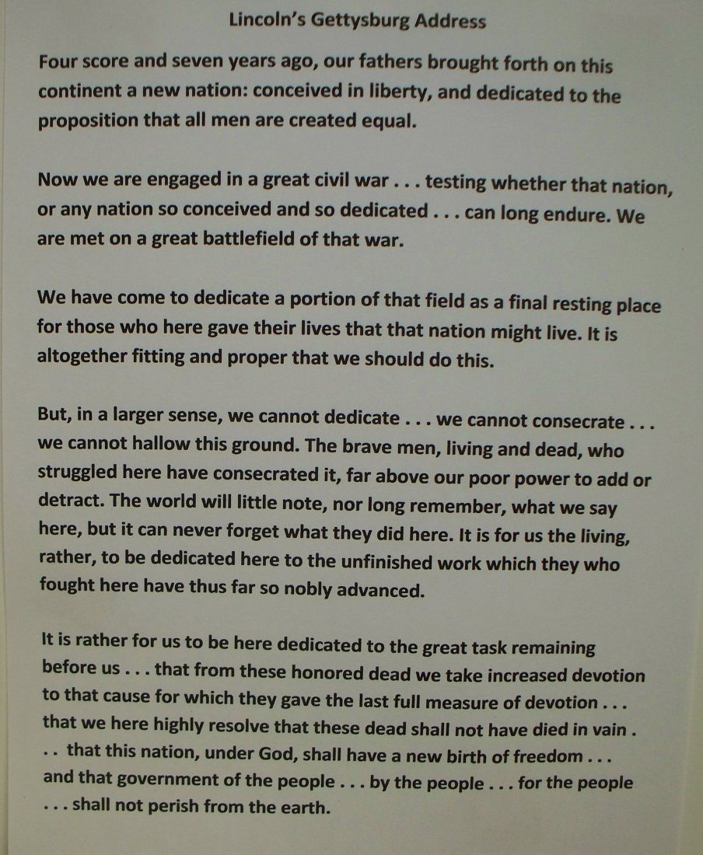
YOU MAKE THIS FROM THIS

Slide 8
Writing Found Poetry
Kent Pelton -- Writing Found Poetry
Beth Miller -- Found Poetry Lesson

Slide 9
Use Library of Congress Primary Sources to create FOUND POETRY!
LOC site: www.read.gov/kids/ >Educators & parents > Teaching Resources > Found Poetry-Primary Source Set > Found Poetry Teachers Guide (AND sources!)
http://prezi.com/ojds9861sn8e/writing-found-poetry/
Prezi > Explore> Education> Search “Found Poetry”> Choose: Writing Found Poetry by Kent Pelton
http://prezi.com/i_6y8a5grfsw/found-poetry-lesson/
Found Poetry Lesson by Beth Miller
Poetry 180 - A poem for each day of the school year

Slide 11
Support for your Primary Source Found Poetry
Read-Write-Think (by International Literacy Association, formerly Int. Reading Assoc.)
Lesson Plans
Theme Poems
Word Mover
NCTE National Council of Teachers of English
Lesson Plans
List and Riddle Poems
Found Poetry Review

Slide 12
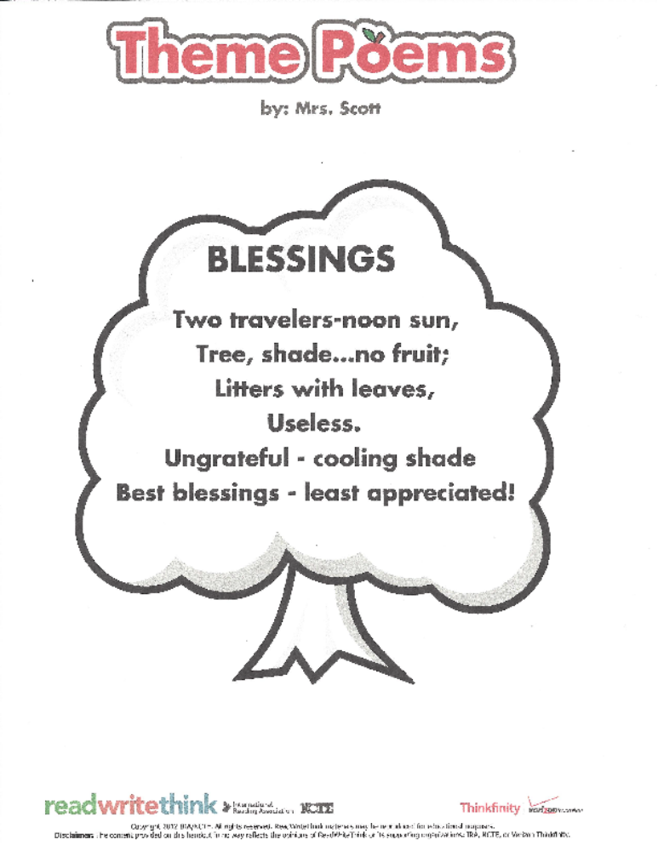
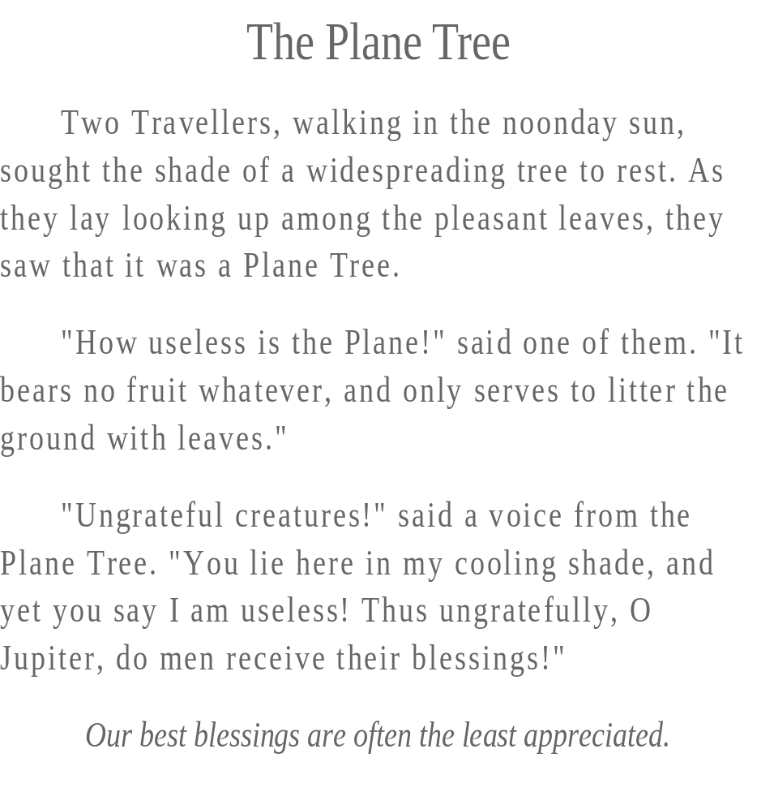
Theme Poem (Shape Poem)

Slide 13
From Hiding to Found Poetry
One of the strongest ways to teach students about how poets and poetry works is to encourage them to write their own poetry. As Dunning and Stafford explain, the advantage of found poems is that “you don’t start from scratch. All you have to do is find some good language and ‘improve’ it”.
“Poems hide in things you and others say and write. They lie buried in places where language isn’t so self-conscious as real poetry often is.” Foundpoetryreview.com

Slide 14
More Tips and Tools
Poets.Org https://www.google.com/#q=poets.org
Styles http://www.readwritethink.org/search/?resource_type=16&type=28
Instructions http://www.readwritethink.org/files/resources/lesson_images/lesson1034/found-poem-instructions.pdf
Rubric http://www.readwritethink.org/files/resources/lesson_images/lesson33/rubric.pdf
Assessment Form http://www.readwritethink.org/files/resources/lesson_images/lesson33/student-assessment.pdf

