Slide 1
Reporting Incidents Related to Culture and Identity
For Middle and High School Families
Issaquah School District
Equity and Family Partnership Department and School Counselors
April 2021
Updated April 2022

Slide 2
Welcome
English session (please see links to sessions in Chinese and Spanish in the Chat).
Some reminders – please put your microphones on mute
Enter questions in chat and staff will respond to group
Parents can ask questions at the end of the session
This presentation was recorded earlier. I will be posting the video and PowerPoint presentation on the Cultural and Family Partnership webpage by Friday (Delay so that we can get the YouTube video subtitled translated if possible)

Slide 3
Introduction of Presenters
Lorna Gilmour – Family Partnership Specialist
Julia Bamba – Principal of Gibson Ek
Miranda Williams – School Counselor at PCMS
Videos by:
Stacy Clawson – Secondary School Counselor Specialist
Stacey Zachau – HIB Compliance Coordinator, Assistant Director of Student Interventions

Slide 4
Objective: Parent workshop on how to respond to incidents related to culture and identity
What does the school do to support students in middle and high school in reporting incidents?
To whom and how to report incidents related to culture and identity.
Follow up from school when incident is reported.
What can parents do to support their child.
Definitions of terms – Racist remarks, bullying, harassment and intimidation

Slide 5
ISD Safe and Positive Environment
The Issaquah School District believes that a safe, civil environment is essential to high student and staff achievement, to the free exchange of ideas central to a quality educational process, and to the development of youth as thoughtful participants in our democracy. Conversely, uncivil conduct, like other forms of disruptive behavior, interferes with a student’s ability to learn and a school’s ability to educate its students.
The Issaquah School District strives to maintain a learning environment where all students, staff and members of our community can be free from intimidation and harassment. One way we foster such an environment is by informing students and employees--as well as parents--of their personal rights. We explain proper behavior in schools and what kinds of behavior are inappropriate. The District’s Regulations on harassment--sexual and otherwise--support our high expectations for proper behavior. Please take a moment to review the summary of Regulation 3205 and 3207, which protect students.
Notes:
Listed in the Student Handbook for parents
Listed in the School Planner (Middle and High School)

Slide 6
How do schools support students?
District – Equitable Conduct Policy and EL 16
School administration - Review the school policy at the start of the year (varies by schools – announcements, advisory or homeroom classes, other classes), at curriculum night with parents
Teachers - Review procedures with students, teachers will often also remind students about school rules and procedures throughout the year (usually after each break).
Parents - Review the school policy at the start of the year (September)
  Listed in the Student Handbook on school website and part of the Enrollment Verification Process in August (Under the "Our School tab – Student Handbook)
  Listed in the School Planner and Student Handbook (Middle and High School)
  If students enroll later in the year, parents should read the handbook and/or meet with a liaison about general school policies and procedures.
Advisory/Homeroom class Middle School- Social Emotional Learning Curriculum called Second Step Bullying Prevention Unit – Taught in ISD Middle (and Elementary) Schools from 6th to 8th grade
Notes:
Listed in the Student Handbook for parents
Listed in the School Planner (Middle and High School)

Slide 7
What do School Counselors do?
Conduct school wide trainings for staff, provide classroom lessons for students, and learning opportunities for parents.
Identify students who need help:
Provide individual and small group counseling
Help families support their student
Work with teachers to support classroom success
Connect students and families to community resources (food, scholarships, mental health resources)
Meet and discuss academic options and including postsecondary options (at high school).
504 Coordinator at the school (Section 504) plan to support students with disabilities that limit daily activities in a major way – not special education)
Notes:
Introduce the counselor

Slide 8
More about the Role of Counselors –
Social and Emotional Support at Middle and High Schools
Not a stigma to talk to counselor – support person in school
Support for students to overcome challenges and barriers to achievement in school
Works with individual and small groups of students in teaching social skills such as making friends and resolving conflicts
Works with students about managing feelings
Meet and talk with students and parents about social/emotional concerns.
Along with the PBSES coach, counselors teach the Social and Emotional Learning (SEL) curriculum
Video – Role of counselors and their role in bullying prevention and student support
Notes:
Introduce the counselor

Slide 9
How do middle and high schools support students?
Schools review the policies, including the prohibition of harassment, intimidation and bullying yearly for student body.
Define harassment, intimidation, and bullying.
Discuss the academic, social and physical impacts of HIB
Create a safe school community:
How to report and who to report
How to take action to stand up for each other

Slide 10
Who teaches these lessons and when is it taught?
Throughout the year
Dependent on school
Middle school – Advisory/Homeroom most often along with Social Emotional Curriculum
Second step curriculum – problem solving, conflict resolution, how to navigate relationships, how to participate in creating a safe school environment
Taught by PBSES coach, counselor, advisory/homeroom teacher, Dean, Assistant Principal, Principals
High School – varies by school

Slide 11
What is racist behavior around culture and ethnicity?
Behavior or language that makes a student feel unwelcome or marginalized due to race, heritage, culture, religion or other identity factors
Teased or targeted - made fun of for hair, skin color, name, accent, facial features
Students may be excluded from groups due to race, religion, or identity
Made fun of for their dress (Sikh turban, hijab, other clothing)
Made fun of for the food eating at school – rice, curry, tofu, noodles, pasta
Microaggression - a comment or action that subtly and often unconsciously or unintentionally expresses a prejudiced attitude toward a member of a marginalized group (such as racial minority). As defined by Merriam-Webster.

Slide 12
Examples of racist remarks:
Calling an African American student “Ni***r”
Calling an Asian student “Ch**k”
“Go back to Africa” or "Go back to China"
Calling an Asian student “Coronavirus." "Wuhan virus"
Chanting “Build a wall”
Telling a Hispanic student “you should be cleaning my house”

Slide 13
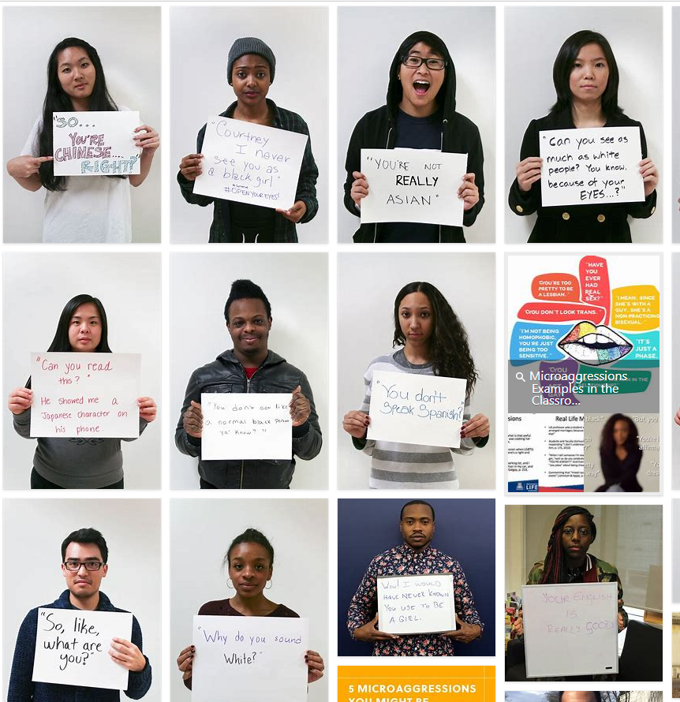


Examples of microaggressions (also considered racist remarks):

Slide 14
Who is doing this?
Any student could be the alleged aggressor
In cases involving racist remarks, misconception that only white student towards other students of color.
Racist incidents, bullying and unkindness is not ALWAYS one race towards another race.
Incidents of Asians being unkind or picking on new Asian immigrants (Fresh off the Boat) (Power difference)
Incidents of “full” blood Indian, Chinese or Black students picking on students that are bi-racial or multiracial or vice versa.
Incidents from Asian or European students towards Blacks or Hispanic students.
Class, socioeconomic level, religion, privilege and power all play roles in such incidents.
Sometimes – it IS unintentional, uneducated and uninformed behavior
Intention vs. impact is discussed with students when incidents happen.
At the ISD, schools will work with students to correct such behavior and teach about civility and kindness.

Slide 15
To whom to report the incident?
Students
Building principal, Assistant Principal, Dean of students
Classroom or Specialist Teacher
School Counselor
Bus driver, Paraprofessional (lunch helpers), Nurse,
Custodians
Any trusted adult staff member
Parents
Building principal, Assistant Principal, Dean of students
Classroom or Specialist Teacher
School Counselor
Any trusted adult staff member
Notes:
Sometimes parent report something after it has happened multiple times and by then they are very upset and frustrated.
Not a blame thing so make sure that the school, the teacher or counselor is aware of the incident – that you have reported it so that the situation can be resolved

Slide 16
Reporting incidents
The Washington State and ISD have clear definitions of HIB terms.
Many behaviors that do not rise to the level of harassment, intimidation, or bullying may still be prohibited by other district policies or building, classroom or program rules.
Regulations Manual ISD: Definition of Harassment, Intimidation and Bullying
Report the incident so that the school is aware of the concern and can address it.
Bullying Resources and Reporting
Form to report an incident: 3207FProhibitionAgainstHarassment, Intimidation and Bullying
Video by Stacey Zachau – HIB Compliance Officer
Notes:
Sometimes parent report something after it has happened multiple times and by then they are very upset and frustrated.
Not a blame thing so make sure that the school, the teacher or counselor is aware of the incident – that you have reported it so that the situation can be resolved

Slide 17
Behaviors/Expression
  It can be very hard to distinguish if an incident is a “one-off” example of mean/unkind behavior or a pattern that is bullying behavior without details and background information.
  Every situation may be unique and is treated as such by the school administration.
“Harassment,’ ‘intimidation,’ and ‘bullying’ are separate but related behaviors. Each must be addressed appropriately. Although this procedure differentiates the three behaviors, this differentiation should not be considered part of the legal definition of these behaviors,
Harassment refers to any malicious act, which causes harm to any person's physical well-being. It can be discriminatory harassment, malicious harassment, or sexual harassment.
Intimidation refers to implied or overt threats of physical violence.
Bullying refers to unwanted aggressive behavior(s) by another student or group of students that involves an observed or perceived power imbalance and is repeated multiple times or is highly likely to be repeated.
Bullying may inflict harm on the targeted youth including physical or creates an intimidating or threatening educational environment.
Bullying can also occur through technology and is called electronic bullying or cyberbullying
Notes:
Washington state law
Harassment, intimidation, or bullying means any intentional electronic, written, verbal, or physical act when the intentional electronic, written, verbal, or physical act:
Physically harms a student or damages the student's property; or
Has the effect of substantially interfering with a student's education; or
Is so severe, persistent, or pervasive that it creates an intimidating or threatening educational environment; or
Has the effect of substantially disrupting the orderly operation of the school.
Conduct that may rise to the level of harassment, intimidation, or bullying may take many forms, including, but not limited to: slurs, rumors, jokes, innuendoes, demeaning comments, drawings, cartoons, pranks, ostracism, physical attacks or threats, gestures, or acts relating to an individual or group whether electronic, written, oral, or physically transmitted messages or images. There is no requirement that the targeted student actually possess the characteristic that is the basis for the harassment, intimidation, or bullying.
Bullying refers to unwanted aggressive behavior(s) by another student or group of students that involves an observed or perceived power imbalance and is repeated multiple times or is highly likely to be repeated. Bullying may inflict harm on the targeted youth including physical or creates an intimidating or threatening educational environment. Bullying can also occur through technology and is called electronic bullying or cyberbullying

Slide 18
What can parents do to help their child?
Proactive Strategies (Before incidents happen)
Ask students about their day. What good things happened at school? What was something not positive or good that may have happened?
Specific questions: What was lunch, bus ride or class like? You may get one-word answers but be sure to show interest and not give up.
Discussions – What they would do if someone was being mean to them or ‘bullying” them at school?
Encourage your child to be an upstander (supportive bystander) and the difference between tattling and reporting
Model empathetic behavior- words you use to talk about people of other races.
Awareness: Be aware of own prejudice and bias.

Slide 19
What can parents do to help their child?
Proactive Strategies (Before incidents happen)
Talk to your kids about race and culture.
Talk to your kids about kindness and embracing differences – not to be colorblind but to recognize differences, being anti-racist
Show curiosity – learn about other cultures (Read and watch counternarratives)
Discuss unkind or bullying behaviors when reading books or watching TV shows.
Use these as learning opportunities: ask questions:
What would you do?
Do you know someone who has experienced this?
Who would you talk to if this happened to you?
If you saw this happen to someone, how would you help them?

Slide 20
When parents have concerns – warning signs
If your child is experiencing unkind behavior or potentially being bullied, he or she might remain quiet out of fear, shame or embarrassment. Warning signs may be vague, and some may mimic mental health issues. Be on the lookout for:
Lost or destroyed clothing, electronics or other personal belongings
Abrupt loss of friends or avoidance of social situations
Poor school performance or reluctance to go to school
Headaches, stomachaches or other physical complaints
Trouble sleeping or frequent nightmares
Changes in eating habits
Distress after spending time online or on the phone
Abrupt avoidance of electronic devices
Feelings of helplessness or low self-esteem
Self-destructive behavior, such as running away from home
Monitor your child’s behavior – check with child’s school counselor if you have concerns

Slide 21
What can parents do to help their child?
When child reports an incident
Listen to child
Validate child’s concerns and feelings
Get details - ask questions so that you can get the context of the incident or incidents, names of students or adults involved, where and when it happened
Consider if it is a problem the school needs to address? How can class teachers, school or counselor address the behavior? Does the behavior need to be monitored? (big problem or minor problem)
Ask your child to help you determine how to help them:
Can he/she address it on their own? – be a coach and mentor
Has it been going on for a while? - monitor after child has reported
Is it impacting student behavior, academics, etc? How?
Depending on age and incident – either have the student report or you may report incident to school administrator via an email or phone call.
Parents can also fill out an incident report (link in Resource page)
Don’t expect the child to solve the problem on their own, you may need to intervene and/or monitor
Cultural components
Parents may want to avoid a problem at school
Parents may not want to make a “big deal”
Some cultures and parents are fearful of reporting
If you are not sure since new to US school system, ask for help from the School Counselor, Family Partnership Liaison, or other staff
Notes:
If incident was reported to para or bus driver. Sometimes students may say something but it is not taken further or may appear like nothing happened.
Sometimes it may take a while to see follow up from the school between reporting and action.
Parents can be proactive and also report to the school and ask for follow up information.

Slide 22
Parent Reporting an incident
Call or email the School Principal, Assistant Principal or Dean of Students.
Include the teacher (if incident is happening in classroom) so they are aware of your concern
For major incidents, parents should contact school administrator by calling, emailing or filing an incident report.
Parents can encourage students to report to a trusted adult but are always welcome to follow up with a report or help the child report (model the behavior).
Issaquah School District Prohibition Against Harassment, Intimidation and Bullying Incident Reporting Form
Any parent or student can also report concerns on Equity or other race related issues here.
Notes:
Video on Bullying – Stacey Z.

Slide 23
Response by the school
School administrator will talk to (interview) the students involved including witnesses to the incident (important to give details of when, who and where if possible).
Review previous incidents by student or the person who engaged in the bullying or incident (alleged aggressor)
Implement corrective measures after investigation- response will depend on unique situation (including if claim was false)
Depending on severity of incident – corrective measures may include counseling, education, discipline, (referral to law enforcement as appropriate)
Response will depend on several factors including – incident, age of student, history of behaviors, etc
All responses of incident are confidential (from parents reporting, teachers and/or other staff unless they need to be involved).

Slide 24
Response of school for incidents reported
Parents are not connected with the other parents
No public apologies are required by the school
Consequences of incident are kept private and confidential
If your child was the complainant (reporting student)
  Supports are available for them – counselor or teacher check-ins, check-in with administrator, etc
  Retaliation is prohibited by the alleged aggressor or complainant.
  Students and parents are informed about retaliation in handbook and often in discussions about consequences for the behavior
Parent role after reporting an incident
  Check in with your child,
  Ask if the situation has improved or resolved
  Continue to monitor and check in with student, school administrator, teacher and counselor.

Slide 25
Resources
Executive Limitation 16 (Equity Work in ISD)
Family Resources for Bullying and Cyberbulling
Equitable Conduct Policy
HIB resources and reporting
Issaquah School District Prohibition Against Harassment, Intimidation and Bullying Incident Reporting Form
Student Handbook and School Website
Video by Stacey Zachau – HIB Compliance Officer (2021)
Video – Role of counselors and their role in bullying prevention and student support
Equity Resources for parents:
Talking to Kids about race
https://www.learningforjustice.org/magazine/spring-2020/lets-talk-about-it

Slide 26
Questions?
ISD School staff are here to help you:​
If you have any questions, please reach out to ISD staff.​
Classroom teacher​
School Counselor​
Building Principal, Assistant Principal or Dean of Students​
Family Partnership Liaison for help navigating the school​
ISD HIB (Harassment, Intimidation and Bullying) Coordinator (Compliance Officer)​
Jordan Frost
frostj@issaquah.wednet.edu
(425) 837-7109

