Slide 1

Overview of Basic School Budgeting
January 2019

Slide 2


Slide 3


FUNDS
GENERAL FUND
TRAFFIC ED
RENTAL
BUS
DEPR
TRANS
RETIRE
FOOD
SERVICE
TUITION
MISC
ADULT ED
TECHNOLOGY
BUILD
RESRV
DEBT
SERVICE

Slide 4

School Funding 101
General Fund
Base Budget
  80%
Maximum Budget
  100%
Enrollment determines budget
Taxable Value – impacts taxes

Slide 5
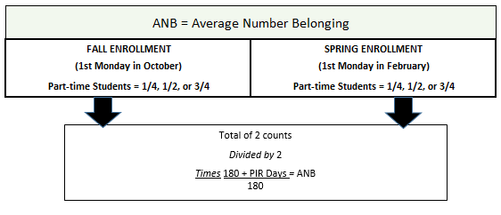

Enrollment
ANB

Slide 6
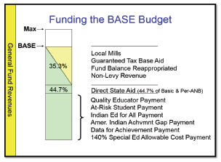
Basic Structure of the General Fund
The Over Base Budget includes previously approved local mill levies, newly voted levies & tuition payments.

Slide 7
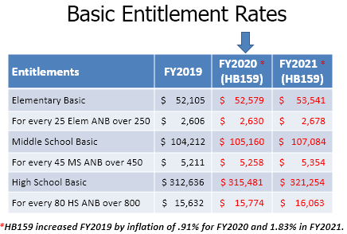


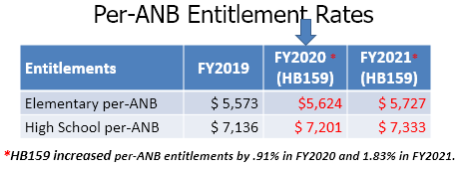

Slide 8
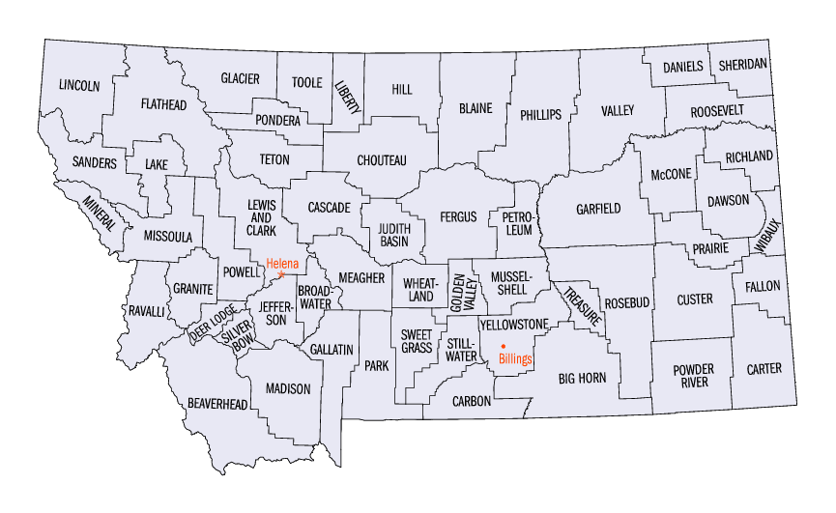
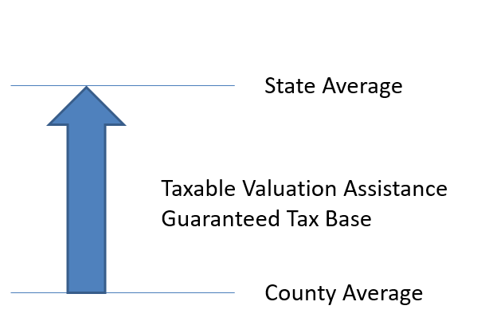
Guaranteed Tax Base
Taxable Valuation of each county
Average for the State
State Assistance for Counties below the average

Slide 9

State Payment Categories
Direct State Aid – Student Related
  Special Education
  Quality Educator
  Indian Education for All
  American Indian Achievement Gap
  Guaranteed Tax Base (if applicable)
  At Risk
  Non- levy Revenue
  Basic Entitlement – (School Building)

Slide 10
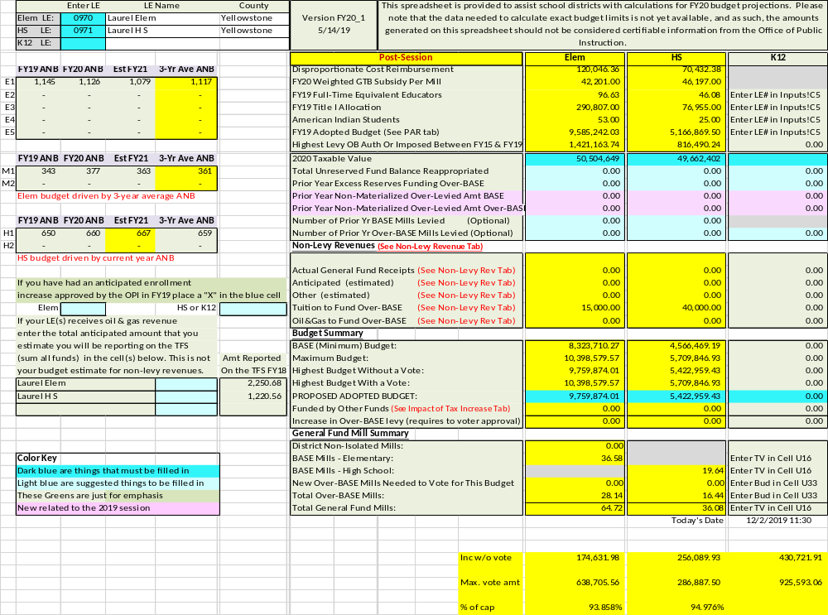

Slide 11
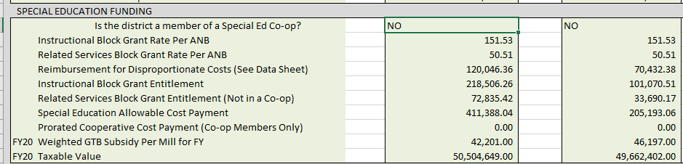
Special Education Funding

Slide 12
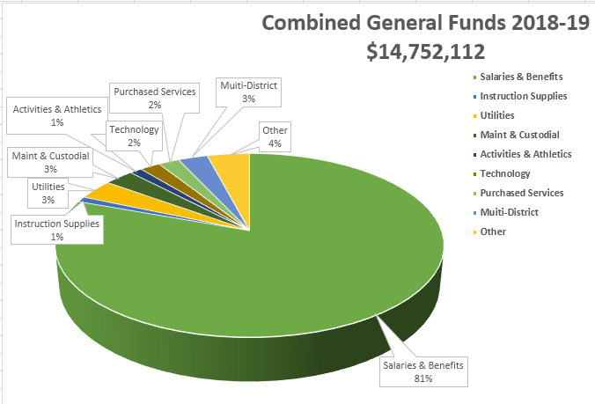

Slide 13

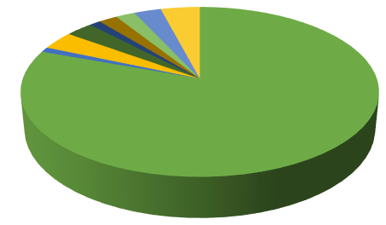
Other 4% $604,931
Administration~ elections, audit, postage, advertising,
Insurance~ liability
Sp Ed Co-op ~
Food Service ~
Reappropriation ~
Profession Development
4%

Slide 14

Moving Parts
Student Enrollment
Taxable Valuation/Mill Value
State Support
Guaranteed Tax Base
Annual Increases (Inflation + Increases)
Health Insurance Costs & Negotiated Agreements
Local Levies
Legislative Adjustments to the Funding Formula including non payment of revenues and triggers
Protested taxes

Slide 15

Budget Considerations
Salaries
  Negotiated Increase – 2% as per negotiated agreement
  Steps and lane changes – lanes for 2019-20, $21,278
Health Insurance
  Increases - $645 as per negotiated agreement
Utilities
Positions – increase or decrease number
Technology – minimal resources
  Zero-based Budgeting Process

Slide 16
Enrollment
 | 2011-12 | 2012-13 | 2013-14 | 2014-15 | 2015-16 | 2016-17 | 2017-18 | 2018-19 | 2019-20 | 2020-21 | 2021-22 | 2022-23
Projected | 1899 | 1943 | 1981 | 1991 | 1993 | 1998 | 1988 | 2003 | 1997 | 2011 | 2021 | 2048
Actual | 1899 | 1945 | 2030 | 2077 | 2119 | 2113 | 2072 | 2087 | 2029

Slide 17
Actual ANB Enrollment
Elementary
School Year ANB Used for Budgeting Purposes | K-8 ANB Enrollment
2018-19 | 1503
2017-18 | 1,519
2016/17 | 1,504
2015/16 | 1,474
2014/15 | 1,445
2013/14 | 1,385
2012/13 | 1,318
2011/12 | 1,319
2010/11 | 1,346
2009/10 | 1.332
2008/09 | 1,335
2007/08 | 1,291
High School
School Year ANB Used for Budgeting Purposes | 9-12 ANB Enrollment
2018-19 | 660
2017-18 | 673
2016/17 | 678
2015/16 | 674
2014/15 | 669
2013/14 | 629
2012/13 | 649
2011/12 | 628
2010/11 | 631
2009/10 | 653
2008/09 | 626
2007/08 | 596

Slide 18
Market and Taxable Valuations
LAUREL ELEMENTARY DISTRICT
 | Taxable Market | Taxable
Fiscal Year | Valuation | Valuation¹
2019-20 | $2,363,822,945 | $50,504,649
2018-19 | $2,050,266,085 | $43,122,201
2017-18 | $2,169,654,467 | $48,207,165
2016/17 | $2,088,632,510 | $46,449,667
2015/16 | $2,047,733,958 | $43,999,386
2014/15 | $1,542,979,017 | $41,672,703
2013/14 | $1,329,180,227 | $34,435,424
2012/13 | $1,269,228,645 | $33,002,786
2011/12 | $1,180,866,228 | $30,239,968
2010/11 | $1,197,269,237 | $28,688,467
2009/10 | $1,165,655,049 | $28,418,940
2008/09 | $1,003,219,785 | $29,057,705
2007/08 | $754,942,322 | $22,624,922
2006/07 | $671,330,955 | $20,479,213
LAUREL HIGH SCHOOL DISTRICT
 | Market | Taxable
Fiscal Year | Valuation | Valuation¹
2019-20 | $2,313,883,855 | $49,662,402
2018-19 | $2,003,463,855 | $42,340,330
2017-18 | $2,123,594,790 | $47,448,309
2016/17 | $2,042,572,833 | $45,690,811
2015/16 | $2,008,371,303 | $43,348,021
2014/15 | $1,502,524,345 | $40,989,133
2013/14 | $1,310,752,332 | $34,838,208
2012/13 | $1,250,800,740 | $32,447,255
2011/12 | $1,162,996,927 | $29,690,056
2010/11 | $1,180,540,349 | $28,686,008
2009/10 | $1,149,878,153 | $28,333,039
2008/09 | $987,740,022 | $28,551,360
2007/08 | $740,462,171 | $22,145,449
2006/07 | $658,247,098 | $20,030,429

Slide 19
Tax Levies
Taxing Entity | 2012-13 | 2013-14 | 2014-15 | 2015-16 | 2016-17 | 2017-18 | 2018-19 | 2019-20
Laurel Elementary District | 125.10 | 115.11 | 102.79 | 109.27 | 106.80 | 112.30 | 122.66 | 95.25
Laurel High School District | 89.11 | 74.39 | 65.08 | 66.52 | 64.93 | 68.23 | 73.84 | 54.47
Both Districts Total | 214.21 | 189.50 | 167.87 | 175.79 | 171.73 | 180.53 | 196.50 | 149.72
Difference |  | -24.71 | -21.63 | +7.92 | -4.06 | +8.8 | +15.97 | -46.78

Slide 20
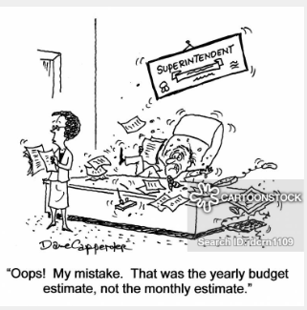

Slide 21

Understanding Montana School Finance
and School District Budgets
MONTANA OFFICE OF PUBLIC INSTRUCTION
SCHOOL FINANCE DIVISION
JUNE 2018
For more information, contact
Kara Sperle, Administrator
School Finance Division
Montana Office of Public Instruction
(406) 444-3249
OPI School Finance Webpage

Slide 22


