Slide 1
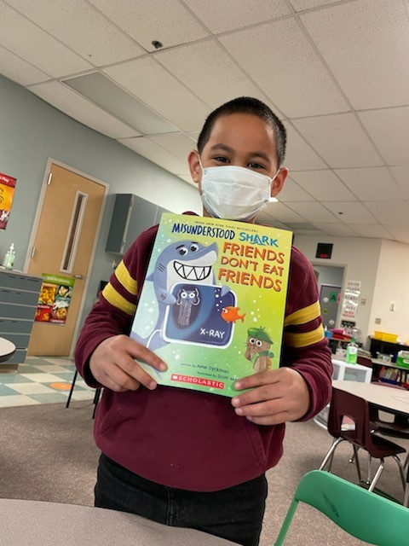

BOOK UP SUMMER
Giving kids in need the chance to read
Notes:
Facilitator (Teacher, Librarian or Principal)
After greeting guests and making them feel at home, kick things off with a welcome message and introduce yourself.
Facilitator: We are here tonight to talk about a really exciting program your child is part of: Book Up Summer brought to you by Page Ahead. Families have an important role in promoting reading to their children. We serve as models for reading and can help instill a life-long love of reading in our children.

Slide 2


HOW DO YOU FEEL ABOUT READING?
Notes:
Facilitator (Question for audience): How do you feel about reading? Do you like books or magazines? Non-fiction or fiction? Or do you prefer to listen to audio books?

Slide 3
HOW DO YOU FEEL ABOUT READING?
DOES YOUR CHILD LIKE TO READ?
Notes:
Facilitator (Question for audience): How about your child? Do they like to read? Do they like it when you read to them or do they want to read to you?

Slide 4
HOW DO YOU FEEL ABOUT READING?
DOES YOUR CHILD LIKE TO READ?
HOW WOULD YOU LIKE YOUR CHILD TO FEEL ABOUT READING?
Notes:
Facilitator (Question for audience):
There is a connection between how we as grownups feel about reading and how we demonstrate how we feel about reading, and how our kids feel about reading. Did you know that? You know what good copycats they are, right? So if we want our kids to be strong readers and enjoy reading, what can we do?
(Jot down what answers audience provides on flip chart or wipe board).

Slide 5


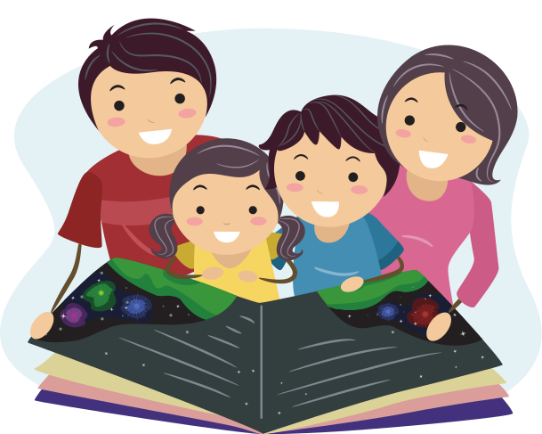

FAMILY NIGHT AGENDA
Discuss the Summer Slide
How Book Up Summer works
Learn about the Five Finger Test
Ways that families support literacy
Notes:
Facilitator: Tonight we are going to talk about how the Book Up Summer program can help you create those positive reading experiences you just mentioned. We are also going to talk about why creating those experiences is especially important in the summer time. I will describe the Five Finger Test for choosing books and discuss all the different ways that families can support their child's literacy.

Slide 6
SUMMER SLIDE IS REAL
On average, students can lose more than 3 months of reading achievement over the summer
Notes:
Facilitator: Have you heard the phrase "Summer Slide"? (Wait for a show of hands). What is that term "Summer Slide" describing? (Wait for responses).
Research tells us that the summer slide is real. Over the summer without the structure of school, the instruction of teachers, and the access to books, students can lose more than 3 months of reading achievement.

Slide 7
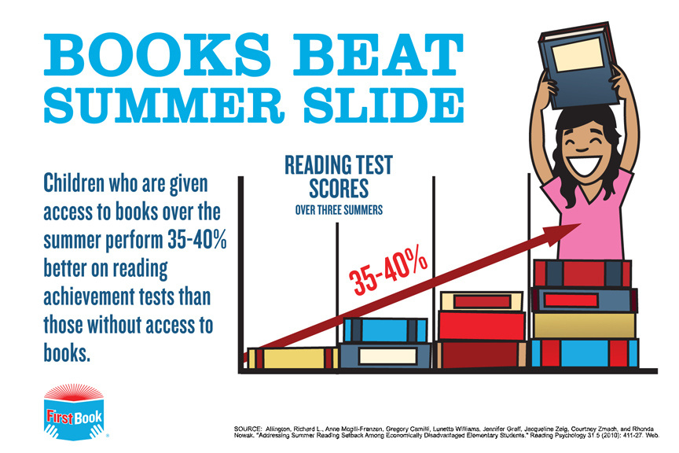
Notes:
Facilitator: But reading fun books over the summer can change all that.
This is where Book Up Summer comes in and it's where you come in, too! [Refer back to audience answers on your flip chart or wipe board]. Remember these? The books your child is choosing is to help you create these positive feelings and experiences around reading that you described.

Slide 8
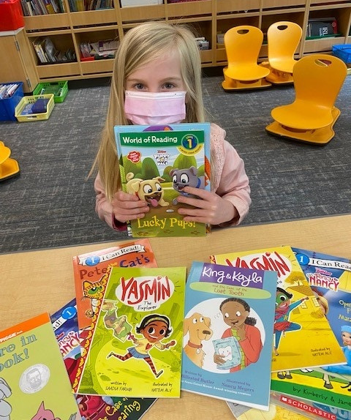
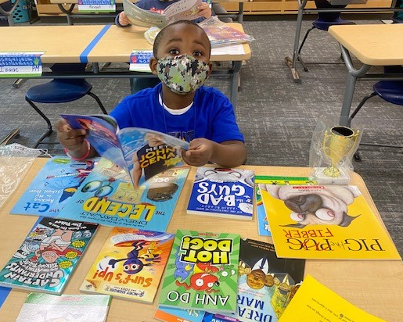
Your child gets to choose the books!
Notes:
Facilitator: Through Book Up Summer, your child will be choosing 12 NEW books THEY want to read. Getting to choose what they want is motivating! And they can participate in this program for up to three years. Any student that is in kindergarten now and remains at this school through the end of 2nd grade, can participate each year and end with a home library of 36 new books of their choosing! Choice is a really important part of Book Up Summer. Studies have shown that if they choose it, they will read it.
When the books come home, you’ll probably see they have a whole variety of books. That’s the point!

Slide 9




WHAT TYPE OF BOOK DO YOU THINK YOUR CHILD WILL CHOOSE?
Non-Fiction
Picture
Book
Graphic
Novel
Chapter
Book
Notes:
Facilitator (Question for audience): What is your child's favorite type of book? What do you think they will choose?
Which type would you like for them choose? Why?

Slide 10
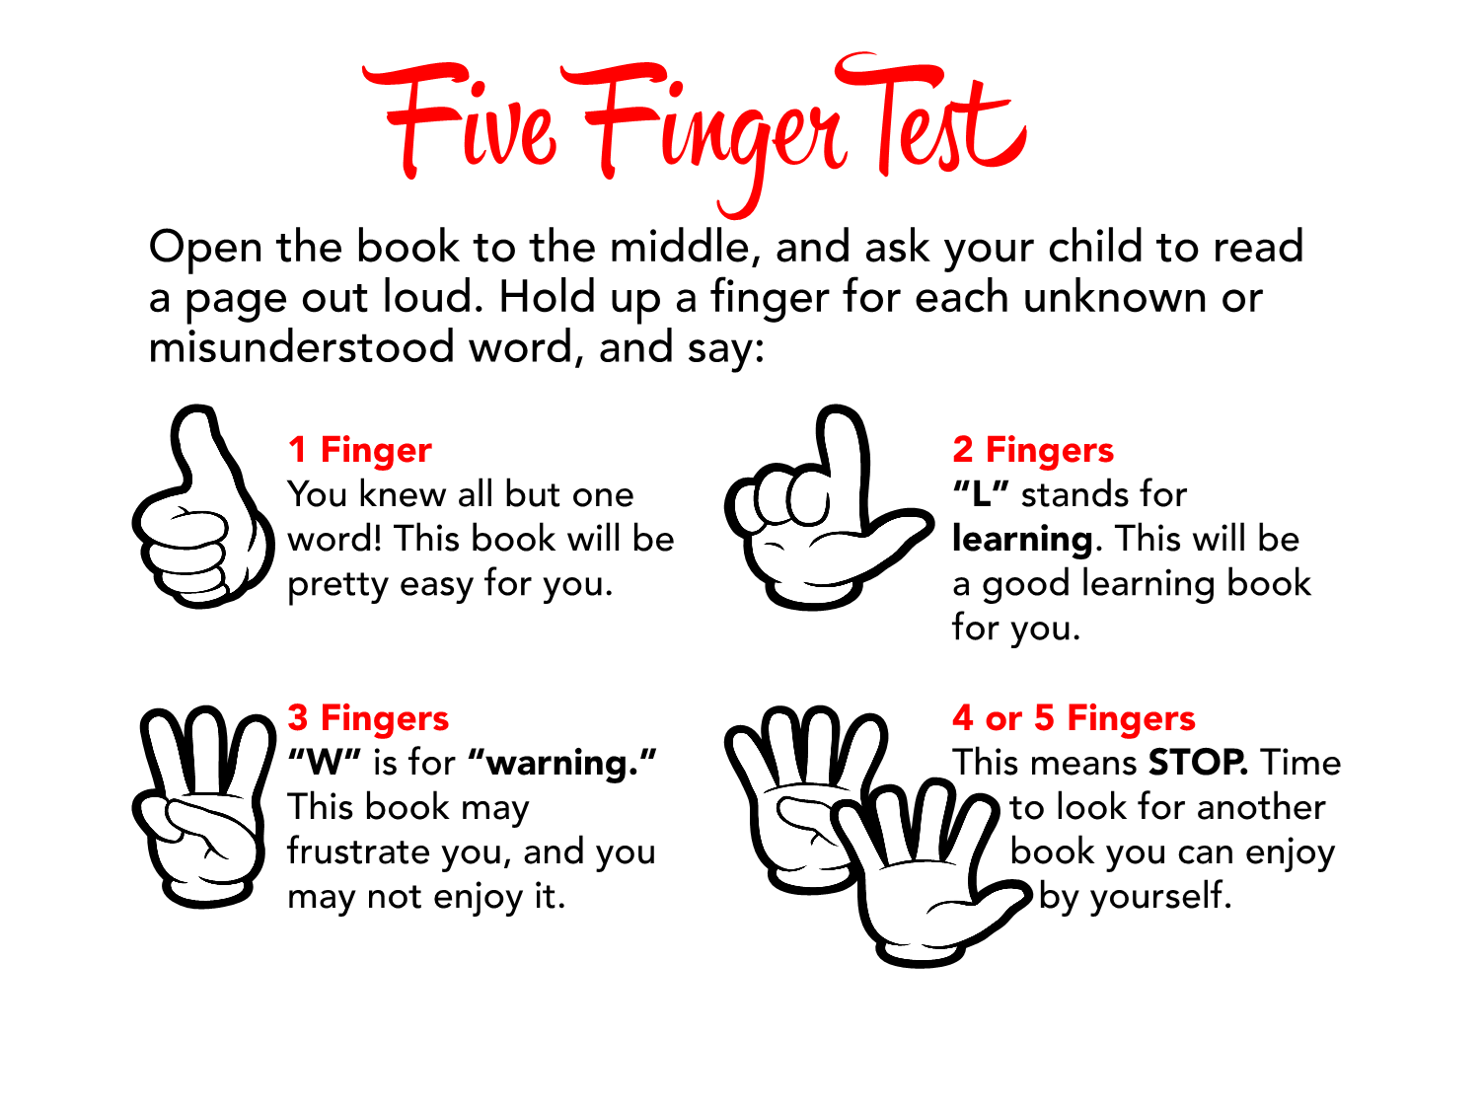
Notes:
Facilitator:
No matter what type of books your child will choose, we want to make sure that the books they select will get read.
The Five Finger Test is an
easy way to help your child choose books that are just right. Just-right books are the books your child should read on their own. This will help to improve their concentration and reading skills. You should always have them read a paragraph or page aloud so you can check on their ability to read the story using the 5 finger test (briefly go over the bullet points).

Slide 11
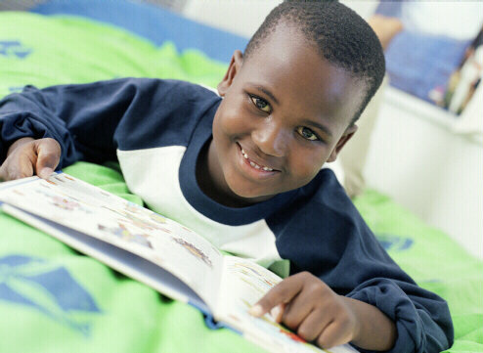
Books that are too easy will build confidence
Notes:
Facilitator: There is a role for books that are too easy. Too-easy books are fun for your child to read and give your child a sense of accomplishment. Children should read too-easy books to relax and practice previously learned words and skills. It is great for a child to read books again and again – this improves fluency.

Slide 12

Books that are too hard make great read alouds
Notes:
Facilitator: There is also a role for books that are too hard. They make great read-alouds and can be a book a child can aspire to read. Children continue to increase their listening, vocabulary, and comprehension skills when you read aloud with them. Your child’s listening ability should always be above her reading ability.
Facilitator Note: Add a personal story, e.g. “There is a student in my school in second grade who wanted to carry a Harry Potter book home . . . “

Slide 13
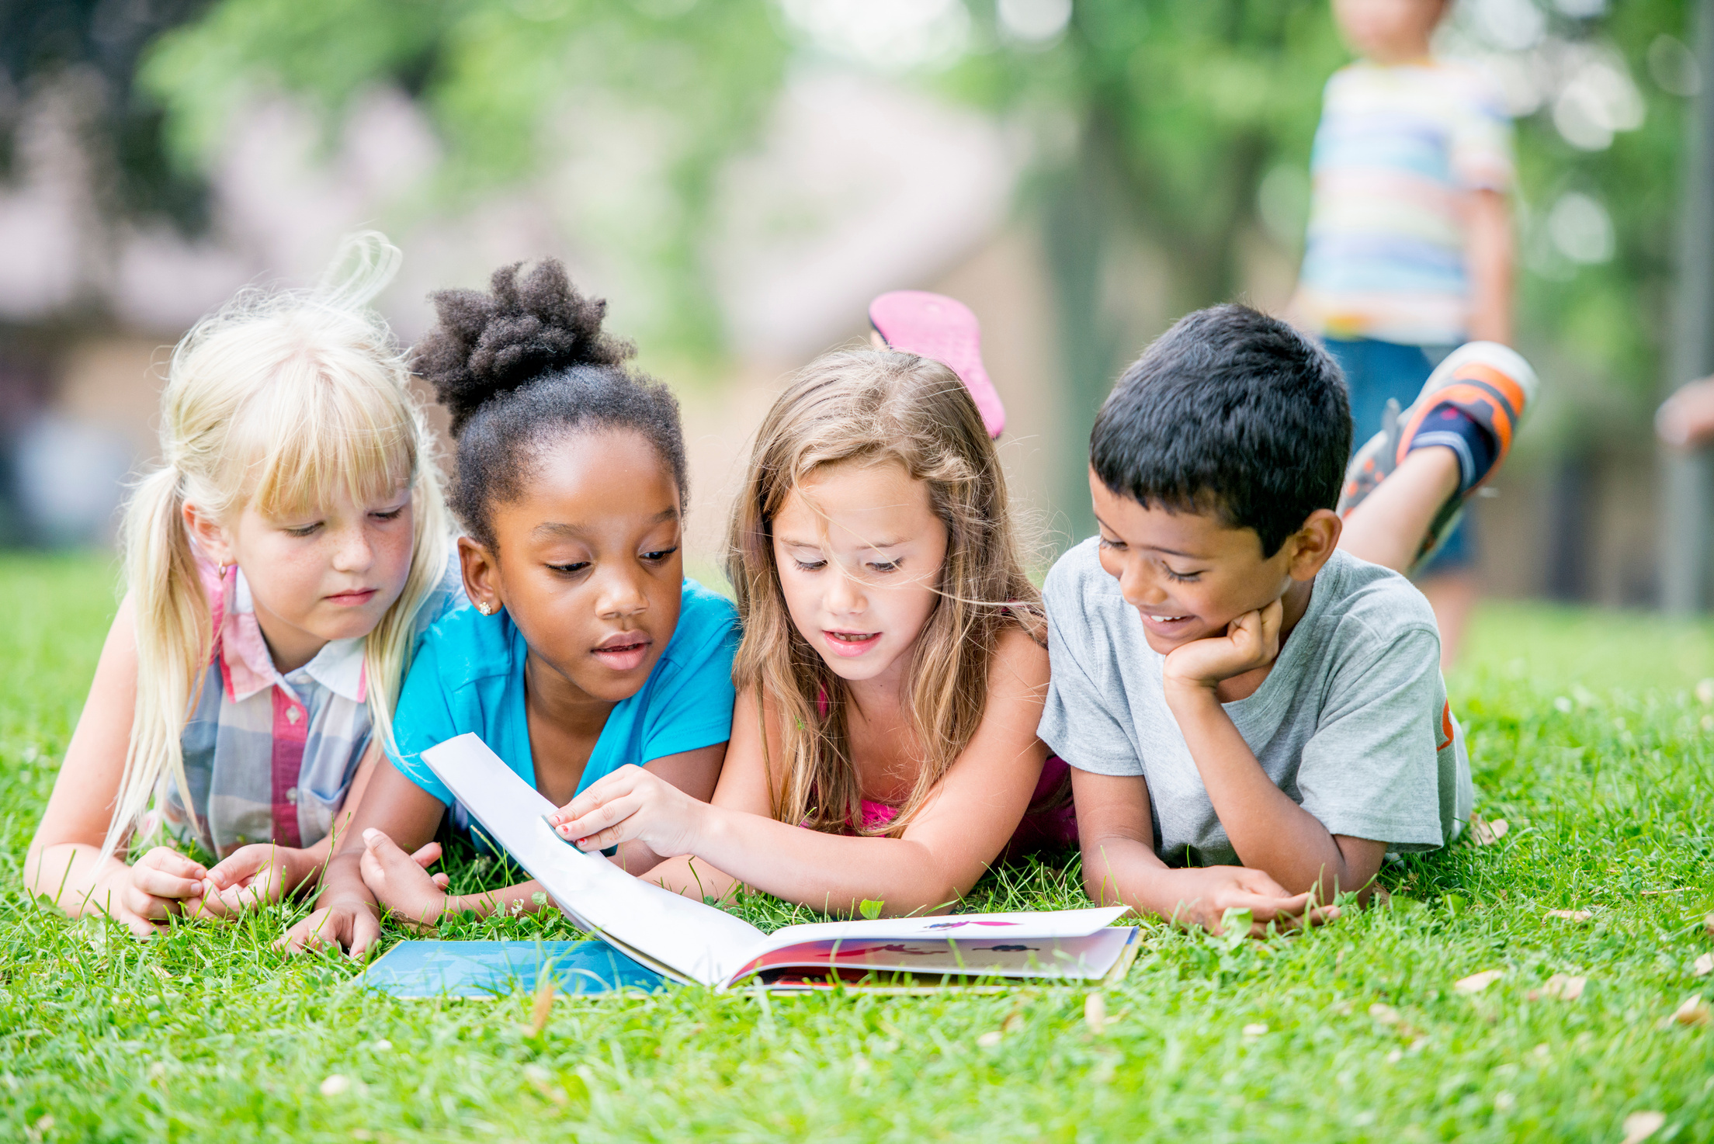
Children need to have books they want to read
Notes:
Facilitator: At this age, children are learning to read. They need to have books they want to read so encourage them to read what excites them and is enjoyable. Later, when they will read to learn, the purpose and content become different.

Slide 14
DOES YOUR CHILD ENJOY WHEN YOU READ ALOUD?
Notes:
Facilitator (Question for audience): How does your child like it when you read aloud? Do they sit still and listen quietly? Or are they wiggly and easily distracted?
Does anyone have any good tips to share about how they make reading aloud work with their child? Let's take some time to share with the group.
How many of you read books, newspapers, or magazines in front of your child?
This is actually quite helpful to your child. Show that reading is important to you. Model reading – newspaper, cookbooks, how to books, for pleasure.
Take books with you in your daily comings and goings – grab 5 min to read while waiting in line to get a prescription filled, on the bus, etc.

Slide 15
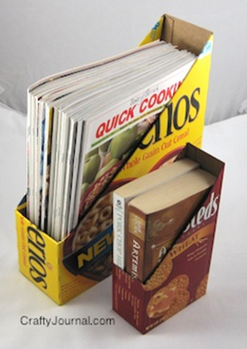
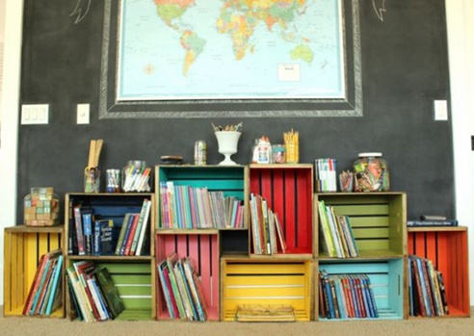
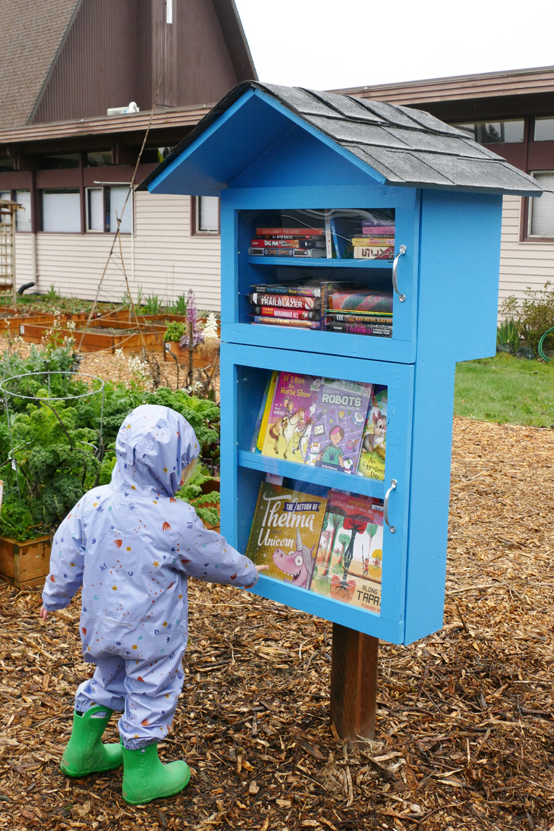
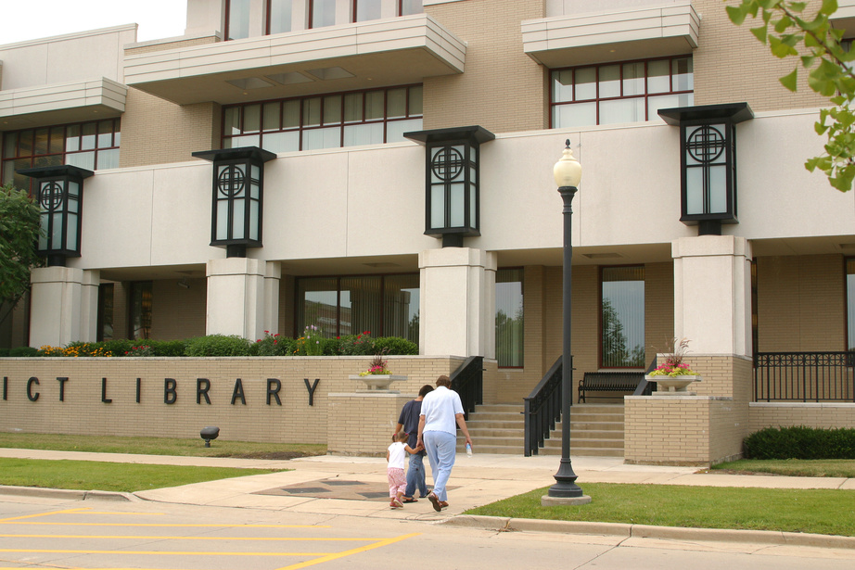
Make Reading Fun!
Build a home library
Find a little free library
Visit your local library
Notes:
Facilitator:
There are lots of ways to turn reading into a fun activity.
Do you like doing crafts with your child? You can create a home library with your child using a cardboard box or a wooden packing crate. Decorate them together with your child and you will have a good bookcase. Starting a home library will show your child just how special and important their books are.
Add to your library: Become a treasure hunter. Go to flea markets, used bookstores, or even garage sales to find great books to keep.
If your child likes to always read something new or different, visit your local library. It's never too soon to get your child a library card. A library card is a ticket to unlimited adventure and exploration in the universe of imagination. It opens up a world of possibilities, and better yet, a library card is free.
You can also look for Little Free Libraries in your neighborhood. These are an easy way to find some great books to borrow and to swap out some of your books that your child might have outgrown. (If your school is in Seattle) You might also find one of the 18 Book Oases that Page Ahead has installed all over the city. The Book Oases are specially built for younger readers and is frequently restocked with children's books.
Does anyone else have good ideas how to make reading fun or where to get good books?

Slide 16
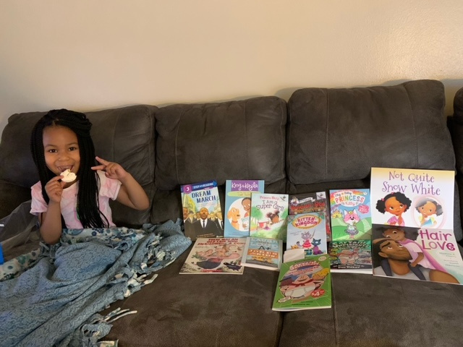
STOP THE SUMMER SLIDE!
Notes:
Facilitator: As we near the end of our presentation, I want to remind you about how we can work together to stop the summer slide! When your child comes home with their 12 new books from Book Up Summer, share their excitement about these books. Read these books with your child and encourage your child to read all of their new books over the summer. Remember that through reading, your child can improve their reading skills and they will be more prepared for school in the fall.

Slide 17

"You may have tangible wealth untold;
Caskets of jewels and coffers of gold.
Richer than I you can never be-
I had a Mother (Father, Sister, Aunt, Uncle, Brother)
who read to me."
By Strickland Gillian
Notes:
Facilitator: Strickland Gillian (1869-1954), the author of The Reading Mother, wrote this beautiful poem many years ago, and it is still inspiring today. When you model reading aloud for your child, it promotes developing a lifelong habit of reading. Make reading part of your daily ritual together. Start accumulating a library of books at home so that your child can reread the books you have shared together.
The greatest partnership you can develop between your home and your school is the one that supports what your child is learning in school. Make reading a priority in your home. I guarantee you will enjoy rereading many of the picture book classics you read when you were a child. I hope it brings back memories of your reading favorite stories that you can talk with your child about when you read together.
Note:
Thank the participants for coming.
Answer any questions.

Slide 18

THANK YOU FOR COMING!

