Slide 1

Notes:
cover requirements (GPA, SLH, attendance), cost, transportation, high school vs. college setting (including access to grades), the transcript/ weighting of grades

Slide 2

Welcome
Dual Enrollment
Advising Session
Summer and Fall 2022

Slide 3
Today’s Goals
  Impacts of Dual Enrollment
  New Student Information
  Success Tips for College
  Course Selection & Registration Instructions

Slide 4

General Housekeeping:
Post your first and last name in the chat for attendance.
Parent(s)/Guardian(s) are welcome, but students must be present for this meeting.
Questions will be answered at the end of the presentation.
You are not registered as a result of today’s group meeting. We will review information about next steps.

Slide 5
Getting Started
Create your Carroll Account (information in email)
  College Email
  Lynx Student Portal
  Canvas
  Microsoft Office (including Teams)
Notes:
Just in case people haven’t done this yet…
Make sure that all prospects set up and check Carroll email regularly, this is where all official communication from the college will appear once your Carroll community college account is activated, personal email will no loner be used.
Everything brand new students need to know can be found here https://www.carrollcc.edu/mycarroll/ (include link in chat)
We make sure to tell brand students to go here whenever they are looking for anything. Carrollcc.edu/mycarroll/ click on info for current students

Slide 6
What’s the difference?
Less seat time in college – Math will meet 3 days a week and English will meet 2.
College classes are more lecture based.
Students must communicate directly with professor; parent has no access to professor unless student grants permission.
The majority of the work in college is completed outside of class.
Student is responsible for learning and seeking help and assistance.

Slide 7

Considerations
Selective colleges/universities may not accept the transfer credit
Transfer
Note that if you’d like a course to be dual credit you must connect with your school counselor and receive approval prior to registration. This applies to courses taken outside of the school year.

Slide 8
Tuition Discount as a CCPS student
Add information

Slide 9
Grad Req & Your Transcript
English 101 will satisfy the fourth English credit requirement for the student – must pass with a D or above.
Math 115 will satisfy the senior math requirement – student is required to remain in the course the entire semester and must pass if it is their third math credit.
For college credit, you need to earn a final grade of C or higher.
These courses and their grades will show on your student’s high school transcript.

Slide 10

Grading
No quarter grades are given, CE (concurrent enrollment) will show for quarter grade on high school report card.
School counselors are only sent mid-term grades, have no access to professor.
Final grade will show on transcript and report card.
Parent has no access to college grades.

Slide 11
Logistics
If your student drives, they aren’t expected to be at their school on days their course isn’t meeting during that mod.
If your student doesn’t drive, we will have designated study space for your student to use during that mod when their class usually meets (on off days).
Office hours and college attendance policy will be listed on syllabus.
Student should reach out to Carroll Community College regarding issues with course, not high school counselor.

Slide 12
Attendance
Consistent attendance is critical for success in any class including Dual Enrollment.
Attendance in a Dual Enrollment class does not affect a student’s CCPS attendance record or eligibility status for extracurricular activities.
Mod 1 Dual Enrollment students must sign in at the front office upon arrival to school.
Mod 4 students must sign out at the front office, if they do not have class that day and are leaving after mod 3.

Slide 13
Expectations
Students are expected to follow school and CCPS rules during the In-House Dual Enrollment classes and while utilizing study areas on non-class days.
If a student engages in inappropriate conduct, such as Academic Dishonesty, that affects the integrity of the course; CCC will be notified.
Final Dual Enrollment course grade can affect eligibility for participation in extracurricular activities at your school.

Slide 14
Dual Enrollment
You are a COLLEGE student.
You are responsible for asking questions, attending class, and communicating with your teachers.
Family Education Rights and Privacy Act (FERPA)
Course Expectations
Academic Calendar (most classes 8/30 – 12/17)
Communicate with your school counselor
Withdraw (no WP/WF)
Midterm/Final Grades reported
College Credits & Jump Start Scholarship
Disability Support Services

Slide 15

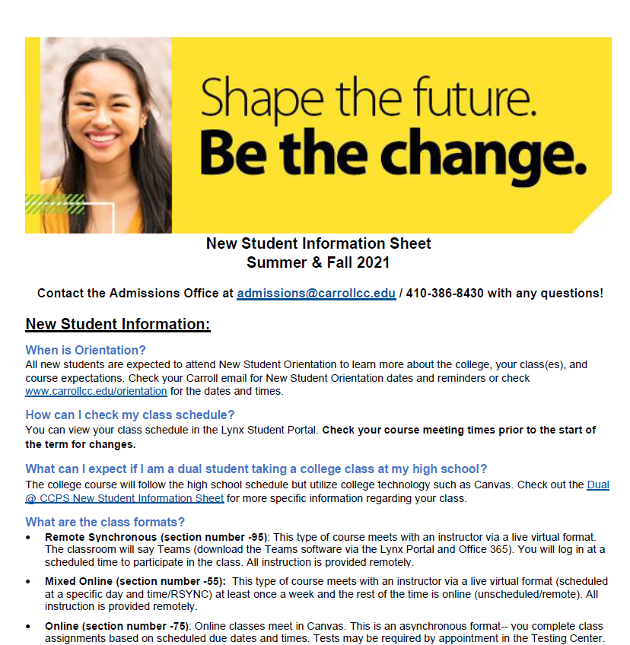

New Student Information
This document contains lots of great information!
You can always refer to this at www.carrollcc.edu/newstudentinfo
Dual @ CCPS?
Check out the Dual @ CCPS New Student Information Sheet!
Classes start 9/8
Notes:
This form will need to be updated as we get more information about fall.
This page is linked to www.carrollcc.edu/newstudentinfo. Just click on the PDF.
Dual @ CCPS is linked in the bubble (but also linked in the main document)
This will be emailed to them as PDF
Things to highlight: (most other stuff will be mentioned on another slide in this presentation)
The document in general as it houses a lot of great info!
Orientation—check their email for more information
Academic Calendar / Term Dates
Disability Support Services

Slide 16

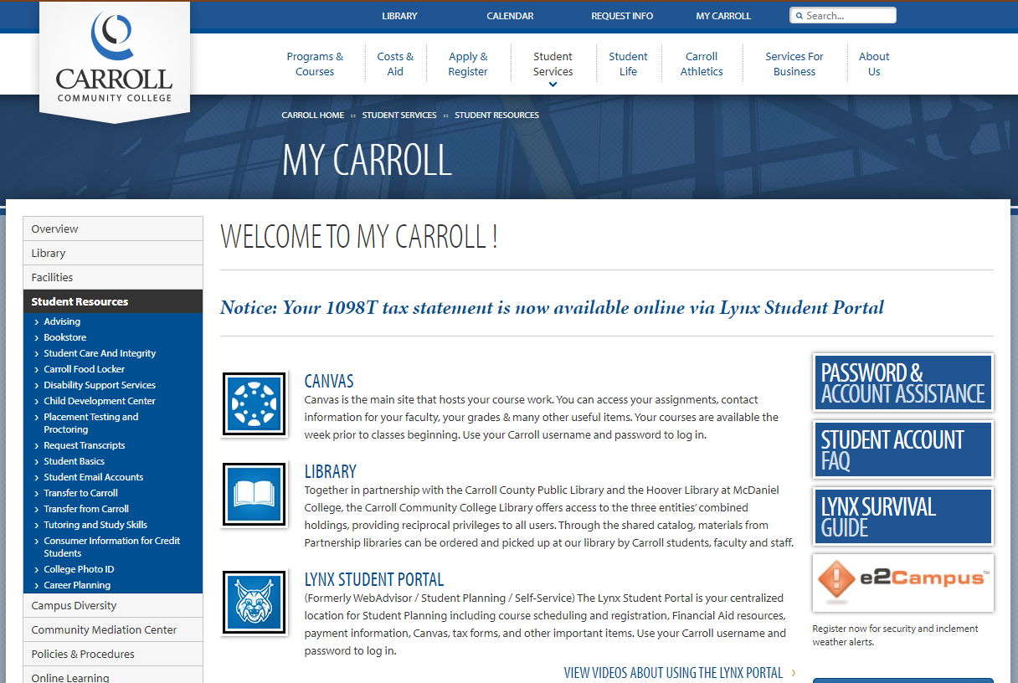
My Carroll Page:
Notes:
This is linked to www.carrollcc.edu/mycarroll to show them live.
Highlight how important the Carroll account is and to check their email.
Share examples of what can happen when email is not checked e.g., cancellation of class (a true concern if it’s a course that will meet a graduation requirement).

Slide 17

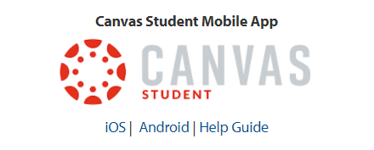
Canvas
College’s Learning Management System
Each course will have a designated Canvas site that houses:
  Grades
  Syllabus
  Course Materials
  Microsoft Teams link (RSYNC classes)
Canvas is also used by student clubs, organizations and academic services.
Notes:
Important to learn early
Technical questions—teacher or IT
Teams link for remote sync classes
All information for all classes, assignments, grades, changes will be listed in Canvas. They will have individual course sites for each course they are taking.
Everything a student needs to know is in their course site and that is where all communication/changes from the instructor will be

Slide 18

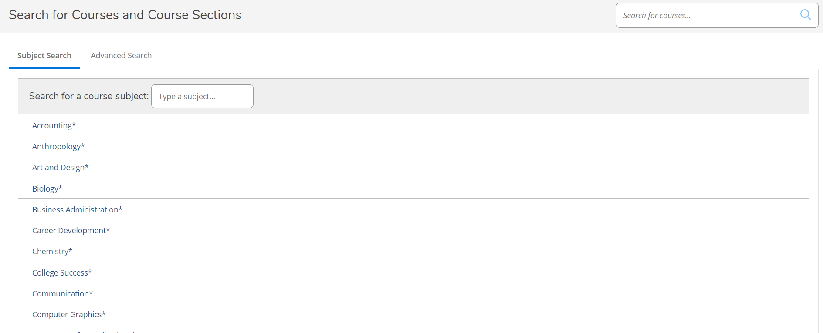
Course Information:
You do not need to log-in to search for classes:
https://dtsserv1.carrollcc.edu/Student/courses
Course Formats:
Synchronous vs Asynchronous
On Campus Lecture vs Remote
Other options: Labs and Hybrid
Be sure to check start dates when looking at classes!
Notes:
It will be easier to show live how to search for classes. This is linked to searching (without logging in to Student Planning)
Explain course formats and section information (live). The link is in the image.
Things to consider when looking at course times—travel time and mod time.
Need section information as well
AP Credits

Slide 19
Registration:
You are not registered as a result of this meeting—action is required.
We need your dual paperwork from your school to finalize your registration.
Steps for registering:
Check your Carroll email. There will be instructions on how to register.
APPOINTMENT: Schedule an individual follow-up appointment. The link will be posted in the email for you to self-select a time with an advisor.

Slide 20

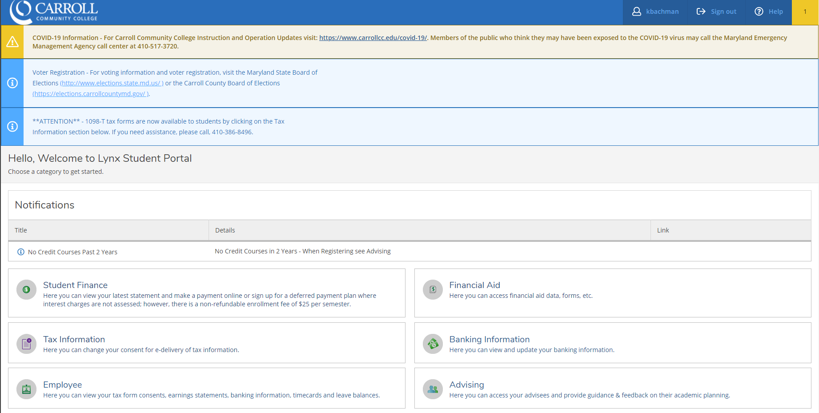
Payment
Once registered, you will have a bill.
Fall Payment is due August 2
After August 2, payment due at the time of registration
Pay online via the Lynx Student Portal
Payment Plan available
Notes:
No financial aid
No summer dual discount
The discounted is applied at registration (should immediately see discount)
Accessed via myCarroll
Even after the payment deadline students can still register if there is space available in a class but tuition will be due at within 24 hours of registration.
The payment is important, so the student doesn’t get dropped rom the class especially if its full. If a student is dropped from a class for non payment (because they forgot) often they cannot get back in because there is no longer space someone else has taken it.

Slide 21

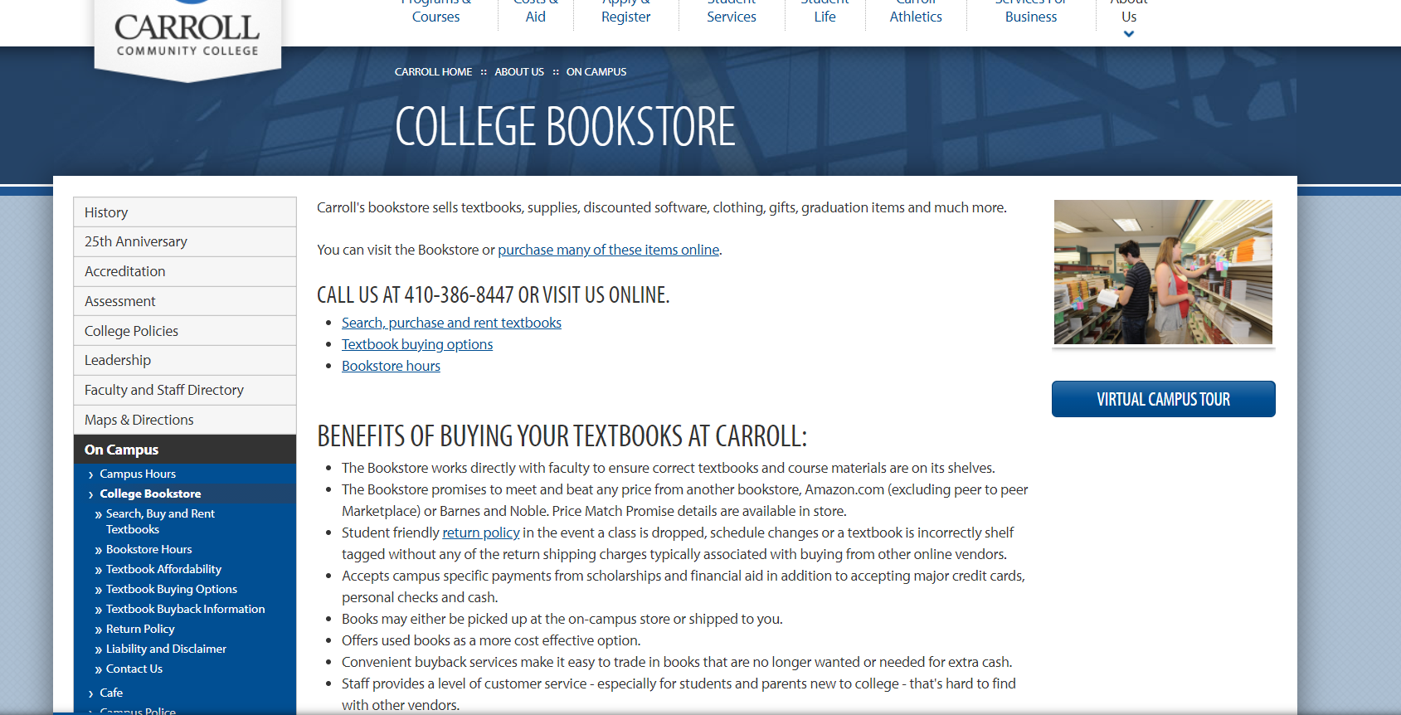
College Textbooks
Visit www.carrollcc.edu/bookstore for textbook needs. You do not need to wait until Preview Week to determine what textbook you need.
Notes:
The bookstore link is on the image. Please visit the page to show how to search for textbooks. (quick)
Textbooks should be purchase before your class begins. There are new, used and rental options. Don’t wait until classes begin

Slide 22
Success Tips
Preview Week
Go to New Student Orientation
Attend Class
Read and Respond to your Carroll Email (daily)
Student Office Hours
Academic Support and Tutoring
Deadlines Matter
Ask for Help
Notes:
Provide quick details on each one:
Preview week opens one week ahead of the actual class starting. That gives students an opportunity to log into the class, review the syllabus and content and ensure this class is what the student thought it would be. No work is required during this time its just to help the student feel comfortable and make schedule adjustments if not.
NSO is critical for DE students and all students even if you are only taking one class. it helps you to meet people and feel comfortable with how to access all requirements and technology needed for your classwork.
You have to go to class to be successful. The question is, did I miss anything? the answer is YES if you were not in class you missed information and its your responsibility to make it up.
College email is how we communicate with you, its essential to check email daily.
Student office hours are open times that your instructor is available for you or anyone in your class to drop in and get class support or feedback from your teacher. They always are the ones that can help you the most with how to be successful in your class. they know what your work looks like and can give you the best insight. USE This!!!!!
We have peer and professional tutors to help you with your homework, math really any topic. Sometimes you just need someone to explain it to you a little differently. You can also submit a course assignment along with your draft assignment and receive feedback from tutors to know if you are meeting the objectives of the assignment or not
Unless your teacher changes something and tells you deadlines are very strict in College. You need to look at the course syllabus to see the deduction or penalty for late assignments
Don’t be scared to ask for help that is what we are here for.

Slide 23
Registration:
You are not registered as a result of this meeting—action is required.
We need your dual paperwork from your school to finalize your registration.
Steps for registering:
Check your Carroll email. There will be instructions on how to register.
APPOINTMENT: Schedule an individual follow-up appointment. The link will be posted in the email for you to self-select a time with an advisor.
Notes:
Repeat to reinforce

Slide 24
Questions?

Slide 25


