Slide 1
AP Capstone™ Diploma Program
is an innovative program that allows students to engage in rigorous college-level study of the critical skills necessary for success in college. The program of study includes a two-course sequence

Slide 2
AP Capstone overview
“Research is essential for college. I would highly recommend a research class to anyone who plans on attending college.”
Natalie, Sophomore, University of Maryland at College Park

Slide 3
The truth about AP Capstone
AP Capstone is NOT a course
Notes:
Higher ed origins

Slide 4
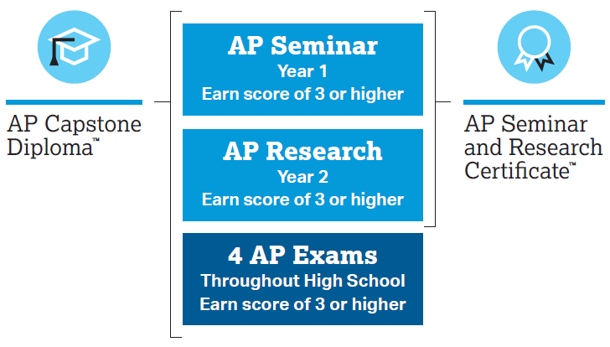
AP Capstone is a diploma program
Notes:
Higher ed origins

Slide 5
AP Capstone is based on two core courses
AP Capstone Diploma program was conceived by the AP Higher Education Advisory Committee
EVALUATE
academic conversations
AP Seminar
(Year 1)
AP Capstone Courses
CONTRIBUTE TO
academic conversations
AP Research
(Year 2)
Notes:
- Complements the in-depth subject matter study in discipline-specific AP courses
Empowers students to practice scholarly research skills while exploring topics that appeal to their interests
Myth buster: AP Capstone is NOT a course, but instead a diploma program with two required courses: AP Seminar and AP Research

Slide 6
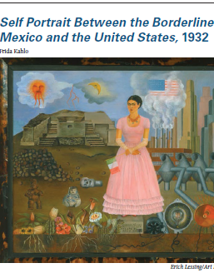
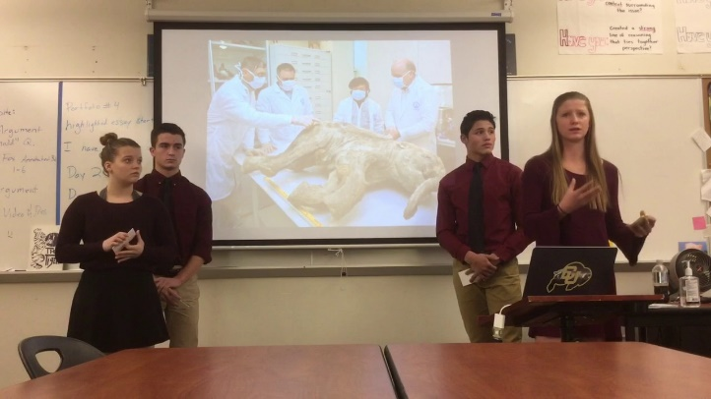

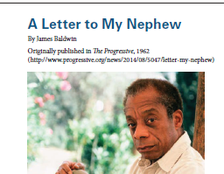

AP Seminar: evaluate academic conversations
Year 1 of 2-year sequence
Evaluate complex questions
Develop evidence-based arguments from sources
Communicate findings individually and with teams
Cultural
Scientific
Economic
Political

Slide 7
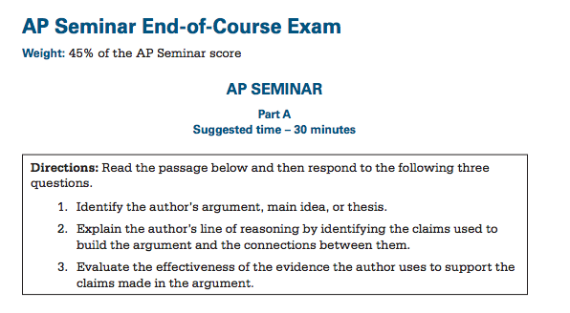


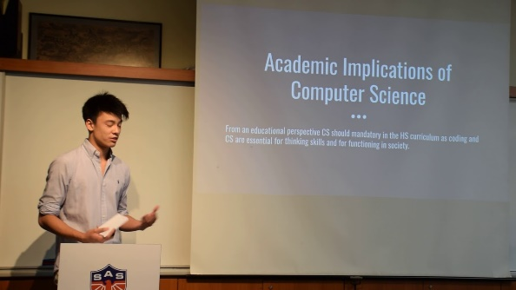
AP Seminar assessment
Students’ overall AP Seminar score comprise of two performance tasks and an End-of-Course exam
Performance Task 1 (20%)
(Dec – Feb)
Performance Task 2 (35%)
(Jan – Apr)
End-of-Course Exam (45%)
(May)
Cultural
Scientific
Economic
Political
No multiple choice!

Slide 8




AP Research: contribute to academic conversations
Year 2 of 2-year sequence
Review the existing body of work
Develop a research question to address gaps
Contribute to the body of knowledge
Focus
Your ideas!

Slide 9
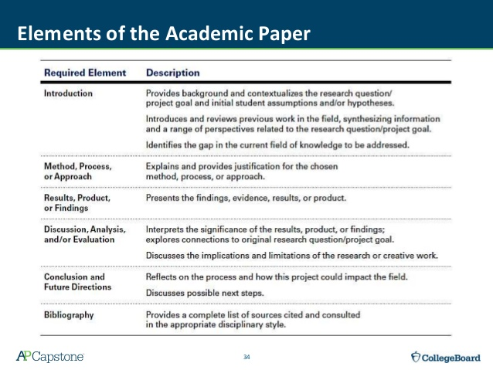

AP Research assessment
There is NO End-of-Course exam in AP Research!!!!
4,000-5,000 word Academic Paper (75%)
(Nov – Apr)
Presentation and Oral Defense (25%)
(Apr)

Slide 10
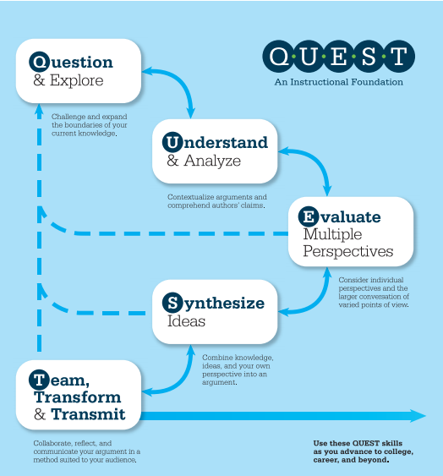

Slide 11
AP Research discussion: research topics
What would you research?

Slide 12
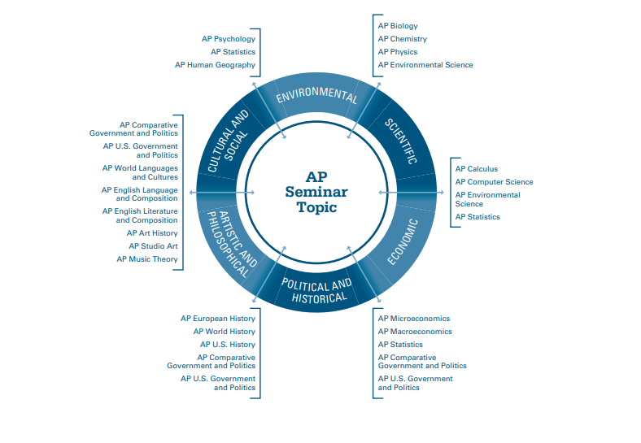

Slide 13
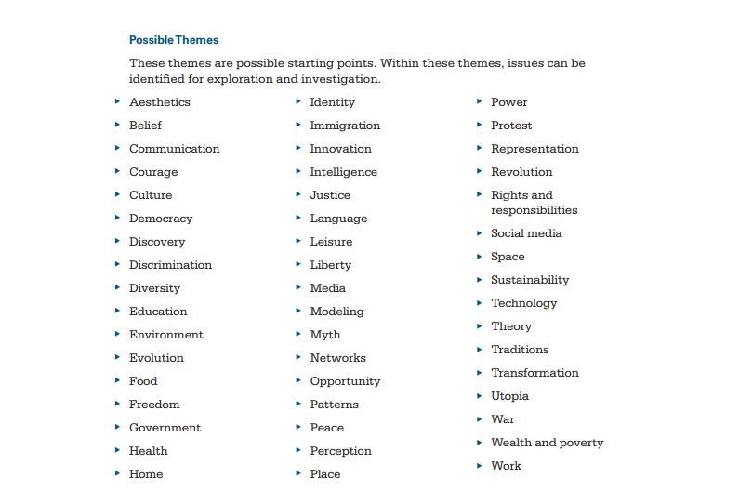

Slide 14
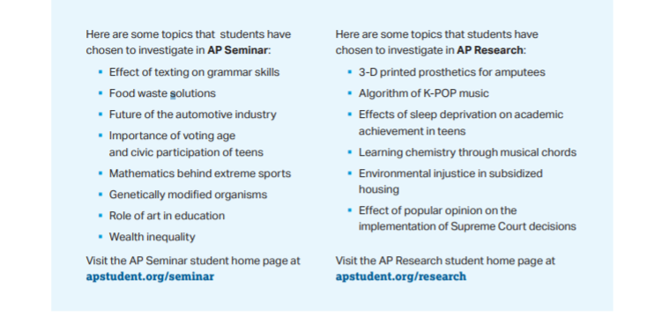

Slide 15
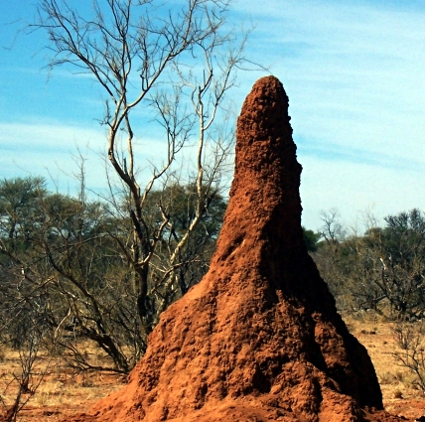
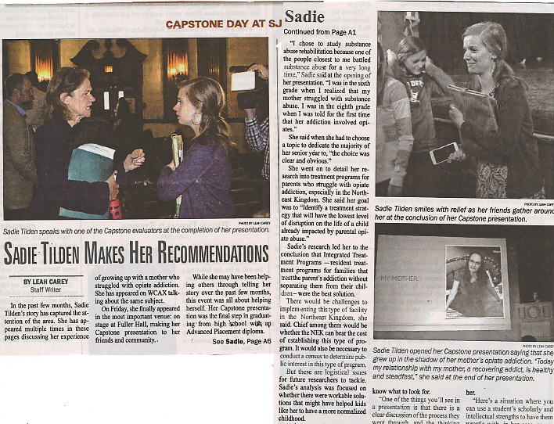

Students become experts in a topic of their choice
Sample AP Research topics
Engineering
Healthcare
Sports
Designing energy efficient buildings based on termite colonies
Evaluating alternative addiction therapies which include families
Goal scoring patterns in the
English Premier League

Slide 16
Is it for me?
Personal Passion
Stand Out
Problem Solving
College Bound
Collaboration
Research and Writing Skills
Communication

Slide 17
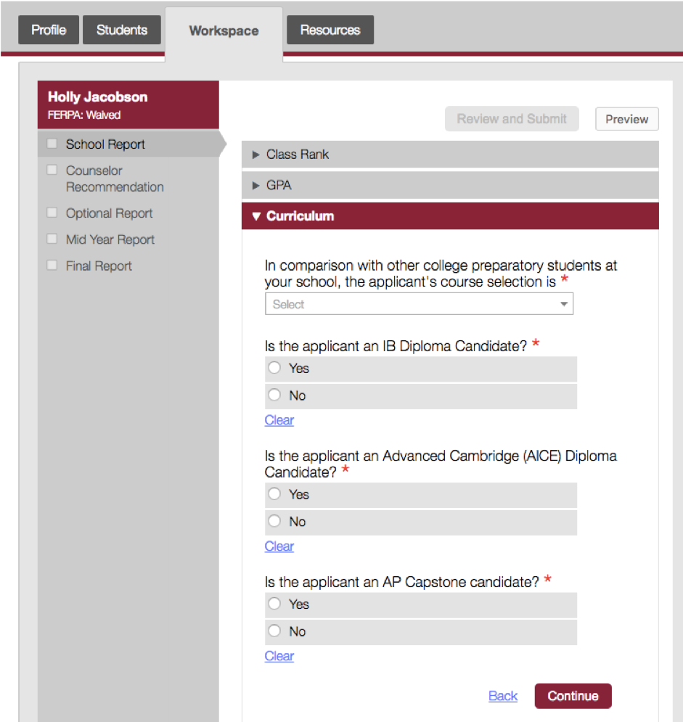


Students stand out in college admissions process

Slide 18
Students earn AP Capstone awards
Over 7,000 AP Capstone awards earned in 2018 (67% Diplomas)
AP Capstone awards
2,966
1,183
1,185
2016
2017
2018
Notes:
Higher ed origins

Slide 19
AP Capstone alumni report high scholarship rates
% respondents self-reporting scholarships
AP Capstone Alumni
(n = 1,210)
College Student Survey
(n=15,837)
Source: 2018 AP Capstone alumni survey

Slide 20










































AP Capstone alumni are enrolled all over the world

Slide 21
Student benefits
“Embrace the experience because it's different than anything else you've done in high school.”
William, Sophomore, University of Pennsylvania

Slide 22
Higher Ed engagement
“I was able to use my research as evidence of my passion towards gender equality in my college applications”
C., Junior, Harvard University

Slide 23
“Not a day goes by where I don't use a skill I learned in the course[s]. My best advice: just do it”
Reagan, Sophomore, University of Oklahoma

Slide 24
“AP Capstone ultimately made me a better writer, a more informed student, and a smarter thinker…these skills can be applied in every aspect of every day life”
Donnaya, Junior, Delaware State University

Slide 25
Add to your ECP now!
When should I take these courses?
Enroll as a JUNIOR to begin the AP Capstone program (Consider pairing with AP Lang)
OR
Enroll as a SENIOR for your English credit
  (Consider pairing with AP Lit)
AP Seminar
(Year 1)
SENIORS who have completed AP Seminar
AP Research
(Year 2)
Notes:
- Complements the in-depth subject matter study in discipline-specific AP courses
Empowers students to practice scholarly research skills while exploring topics that appeal to their interests
Myth buster: AP Capstone is NOT a course, but instead a diploma program with two required courses: AP Seminar and AP Research

Slide 26
CCPS Graduation Requirements
Four English credits: One credit per year
AP Research OR AP Seminar may only count toward the graduation requirement during the student’s senior year

Slide 27
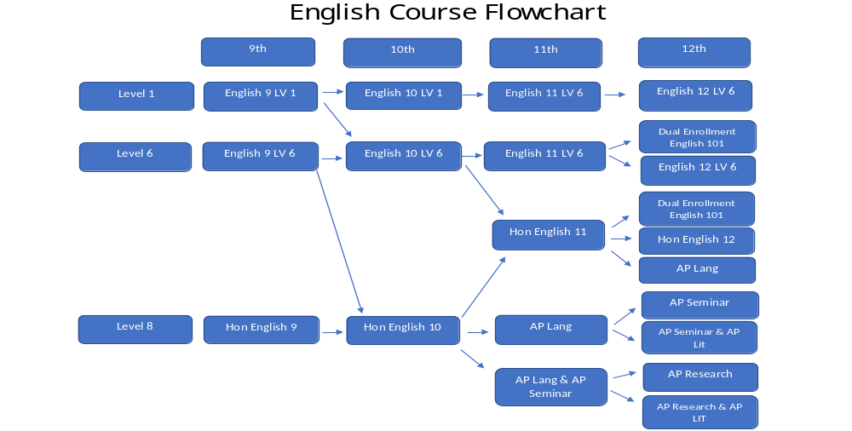
A student may move to Honors at any point and progress through that sequence.
The various course sequence options are designed to offer flexibility for students in meeting graduation requirements and to enable them to select English courses of sufficient rigor to match their post secondary plans.
The more selective the college(s) they are attempting to get into, the more important it is that their transcript is competitive and reflects challenging courses that predict college success.

Slide 28
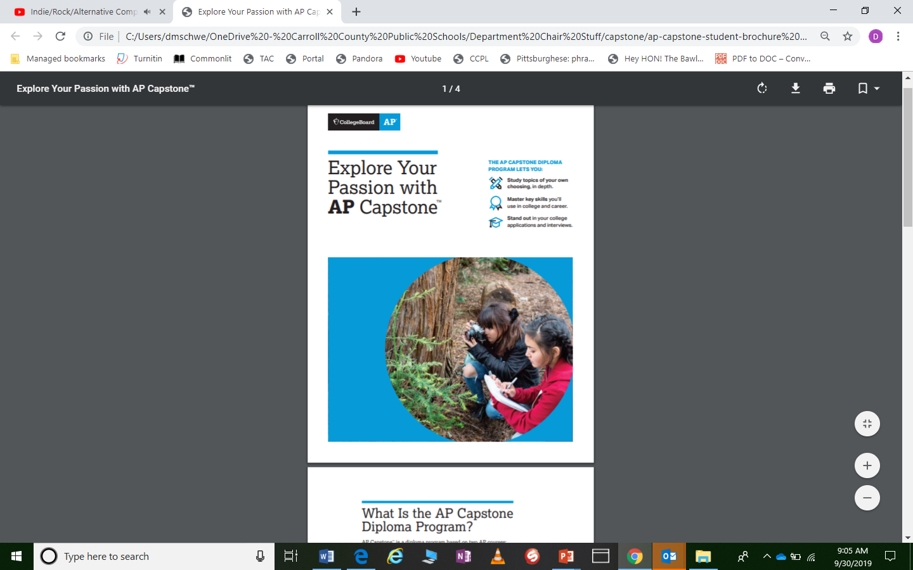
What next?
Questions?
For more info
Visit: apcentral.collegeboard.org
Email: tsdeen@carrollk12.org

