Slide 1
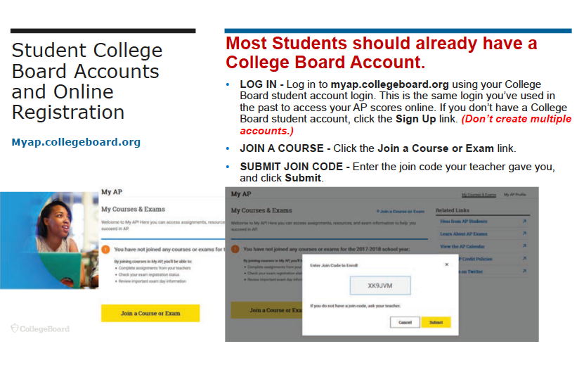
Notes:
Provide an overview using the next three slides, then pass out the paper copy Joining Your AP Class Section.

Slide 2
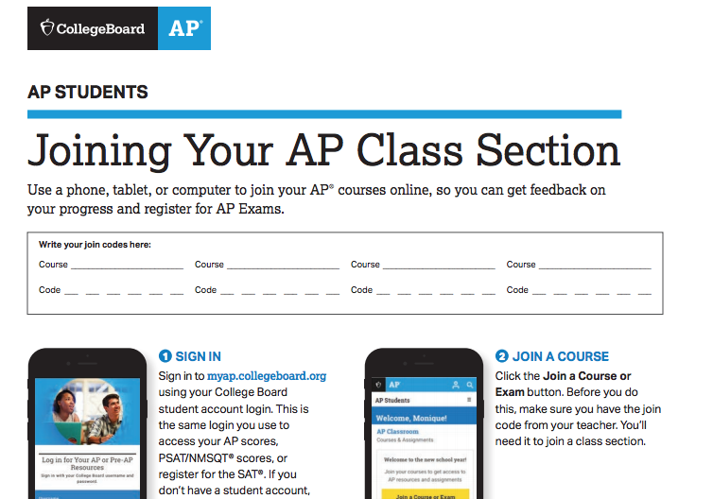
YOUR TEACHER WILL GIVE YOU THE JOIN CODE.
Notes:
Pass out hard copies of this guide sheet with exam schedule.

Slide 3
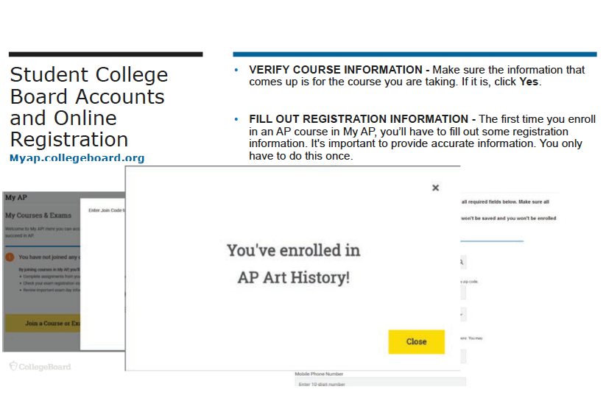

Slide 4
How to Create a College Board Account
This is ONLY if you have NEVER created a College Board account.
On the www.myap.collegeboard.org page, click on “Create an Account”
  You must complete all parts that have a *
    Be sure to read the information and follow the instructions
    For “Address Line 1” put your street address.
      Ex: 2800 Snowden Ave.
      Leave “Address Line 2” BLANK
    Graduation month: June
    Name of School: Robert A. Millikan High School
  Have a piece of paper and something to write with so that you can write down the Username, Password, and email connected to the account

Slide 5
FORGOT USERNAME OR PASSWORD?
On the www.myap.collegeboard.org , there are links you can choose: Forgot Username or Forgot Password
  They will be in blue just below the sign in boxes
Forgot Username
  Enter any email you may have used for your College Board account
    If the response is GREEN, that is the email you will need to check
      I have attached a handout on how to check your district email if this is the email on the account
        If you do not see the email, type in College Board in the search function
    If the response if RED, that is not the correct email for the account
Forgot Password
  Complete the same steps as above
  You will be asked to rest your password
    You will be asked a security question before you can reset your password
      if you do not remember the answer to the security question, there is a link above the security question so that you can RESET your password
      An email will be sent with a temporary password for you to reset your password

Slide 6
unable to login to your college board account or
have multiple accounts?
Call the College Board (866) 433-7728.
Each time you hear a recorded voice, press 2
  This will eventually get you to a College Board support person.
Tell them that you need help logging into your account
  When you are speak with them, have a computer in front of you.
  They will be asking you questions to confirm your account
  Have a piece of paper and something to write with so that you can write down the login information they give you
Stay on the line with the College Board until you have successfully logged in to your account

Slide 7
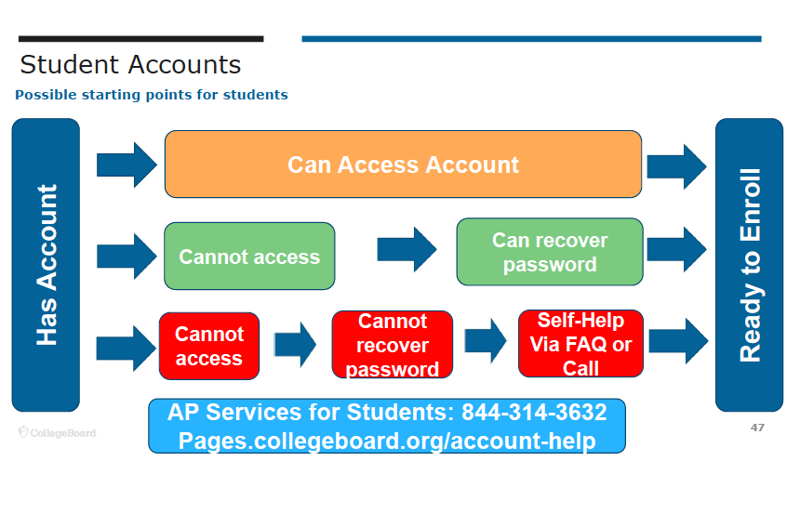
866-433-7728

