Slide 1

Sayreville Board of Education Business Meeting
Tuesday, November 20, 2018
See the video.
See the Agenda
See the Addednum

Slide 2
CALL TO ORDER

Slide 3
PLEDGE TO THE FLAG

Slide 4
PUBLIC NOTICE
Take notice this public meeting of the Sayreville Board of Education was e-mailed to The Home News Tribune and the Star Ledger in accordance with Chapter 231, Public Law 1975. Further in accordance with N.J.S.A. 10:4-6 to 10:4-21, a copy of this notice was posted outside the Board Secretary's Office and a copy was also filed with the Clerk of the Borough of Sayreville.

Slide 5
ROLL CALL

Slide 6
STUDENT COUNCIL REPORT
John Lewis

Slide 7
PRESENTATION
SWMHS Girls Tennis – GMC White Division Champions
  Coach Michael Provenza – GMC Coach of the Year
SWMHS Boys Cross Country – GMC White Division Champions

Slide 8
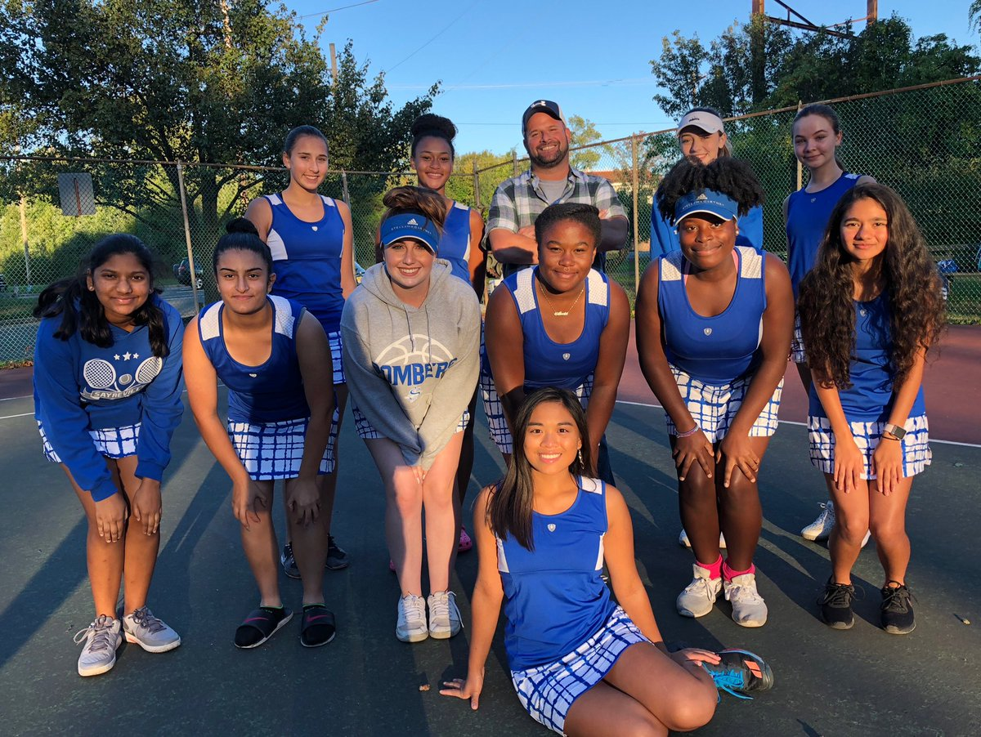
Congratulations to the SWMHS Girls Tennis Team – GMC White Division Champions & Coach Michael Provenza – GMC Coach of the Year!

Slide 9
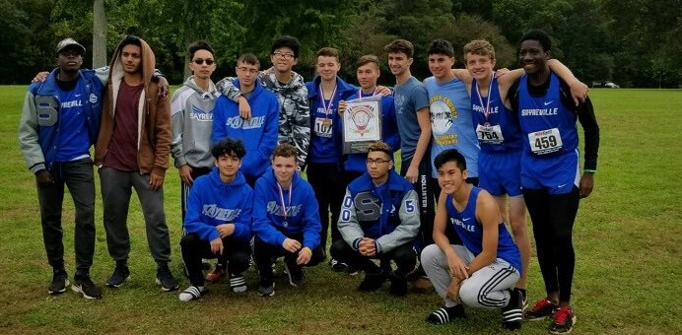
Congratulations to the SWMHS Boys Cross Country – GMC White Division Champions!

Slide 10
District Highlights – Mr. Esposito
The Samsel Upper Elementary School Student Ambassadors hosted a “Change for Charity Halloween Coin Drive” during all lunch periods on Halloween. Students got involved in a very special way. The SUES students always show interest in raising money for charities and causes that are near and dear to their hearts. Many students chose to write persuasive essays to Mrs. Coglianese and Mr. Tola describing why their charity should receive the donations collected on Halloween. Mrs. Coglianese and Mr. Tola then chose the top five essays and the entire school voted on which charity they want the money donated to. Teachers then dressed up and students were only able to vote for their favorite costume by making a donation to the winning charity. A $335.87 donation will be sent to the winning charity, Husky House! A $50.00 donation will be sent to each of the other top charities that were written about. We want to applaud the students and staff of the SUES for their caring, kindness and generosity!
The 2018 Sayreville War Memorial High School Marching Band, which is 85 members strong, had an amazing competition season. Starting with multiple practices over the summer as well as a week of Band Camp in August, the marching band has perfected their performance of Dante’s Journey. Their talent and hard work is reflected in what they accomplished this year in the highly competitive Tournament of Band’s Circuit with the score and rank placements below:
9/22 Matawan 81.160 2nd Place
9/29 Brick Memorial 82.235 2nd Place
10/6 Sayreville 84.610 2nd Place
10/13 Woodbridge HS 86.605 2nd Place
10/14 Gov. Livingston 87.305 1st Place
10/20 NJ State Championships 89.105 2nd Place
10/21 NY/NJ Metro Regional 92.295 2nd Place
The Sayreville War Memorial Marching Band, led by Dr. Caruso and his amazing staff, is an example of what hard work and dedication yields. Congratulations on a wonderful season!
We would like to congratulate the SWMHS Boys’ Cross-Country Team and Coach Logan for their terrific season accomplishments. Along with winning the GMC White Division Championship, Dylan Rodriguez was also selected to be on the GMC All-Conference Team, and Justin and Brett Moran were selected for the All White Division Team.
We would also like to congratulate the SWMHS Girls’ Tennis Team for their spectacular season and for winning the GMC White Division Championship, which is their 3rd championship title. Likewise, we commend and congratulate Coach Michael Provenza on his 10th career White Division Title for the Sayreville Tennis Program, and for being named the GMC White Division Coach of the Year once again. Special honors also went to the following players who were named to the All White Division Team: Samantha Gagnon; Shrusti Sheth; Katherine Sudol; Liana Masangkay; Grace Ekpe; Jasmine Yehudaioff and Stephanie VanNote.

Slide 11
CORRESPONDENCE
Monthly Technology Work-Order Report
Monthly Maintenance Work-Order Reports

Slide 12
APPROVAL OF MINUTES
Approval of the Regular & Executive Session of October 16, 2018.

Slide 13
SUPERINTENDENT’S REPORT HIGHLIGHTS
A – VISION 2030 FINANCE & INFRASTRUCTURE
  #14 Approval of the revised proposal of Professional Engineering Services, from CME Associates, for the Baseball Field Improvements for Sayreville War Memorial High School in the amount of $19,500, amending the initial proposal of $18,500 on page 3.
  #18-20 Approval of the submission of the “Security Vestibules” at SUES, SMS, and SWMHS to the NJDOE for review and approval of an “other capital project” with no state funding and amendments to the 2010 long-range facilities plan to be consistent with the projects on pages 4-5.
  #22 Approval for Dr. Eric Milou to provide professional development to the SMS and SUES Mathematics teachers. The topics will include tiered instruction and effective use of the block, on page 5.
  #24 Retroactive approval of the submission of a grant application to the New Jersey Department of Education for the Advanced Computer Science Competitive Grant on page 5.
  #25-26 Approval of the donation of a climbing wall valued at $11,290 and a playground valued at $27,018.57 from the Truman School PTO, and a 2004 Audi Cabriolet with a Trade-in Value of $1,845 from Mr. and Mrs. Barreiro for the auto shop program at SWMHS on pages 5-6.

Slide 14
B – VISION 2030 STUDENT ACHIEVEMENT
  #3 Approval the use of Fountas & Pinnell Classroom curriculum & instruction materials for literacy instruction in grades K – 3 classrooms and Fountas & Pinnell Leveled Literacy Interventions (LLI) for use in the Academic Support Instructional program, on page 13.
  #4-9 Approval of Co-Curricular clubs, activities, and trips on pages 13-14.

Slide 15
C – VISION 2030 Governance
  #2 Approval of the the initial 2018-19 NJQSAC District Performance Review on page 15.
  #3 Approval of the revised job description for Full-Time 10-Month Secretary on page 15.
  #4 Approval of the In-District Mileage Calculation and Voucher Form on the Addendum.
Origin School | Destination School
 | AES | EES | TES | WES | SUES | SMS | SWMHS | Selover
AES | - | 2.50 | 0.50 | 3.00 | 1.50 | 0.90 | 0.60 | 2.60
EES | 2.50 | - | 3.00 | 4.60 | 1.00 | 2.40 | 2.20 | 2.10
TES | 0.50 | 3.00 | - | 3.50 | 2.00 | 1.30 | 1.10 | 2.60
WES | 3.00 | 4.60 | 3.50 | - | 3.50 | 2.10 | 2.40 | 5.60
SUES | 1.50 | 1.00 | 2.00 | 3.50 | - | 1.40 | 1.20 | 3.10
SMS | 0.90 | 2.40 | 1.30 | 2.10 | 1.40 | - | 0.20 | 3.50
SWMHS | 0.60 | 2.20 | 1.10 | 2.40 | 1.20 | 0.20 | - | 3.30
Selover | 2.60 | 2.10 | 2.60 | 5.60 | 3.10 | 3.50 | 3.30 | -

Slide 16
D– VISION 2030 PERSONNEL
  #1 Acceptance of the retirements of James Brown, SWMHS Principal, effective January 1, 2019, and Joy Pollack, Wilson School Nurse, effective July 1, 2019, on page 16.
  #7-8 Approval to appoint new certificated and non certificated staff for the 2018-19 school year on pages 18-20.
  #9-10 Approval to transfer a certificated and non certificated staff member for the 2018-19 school year on page 20.
  #14-17 Approval of GED and SPED teachers and substitutes to work in the fall Literacy and Math Academies, the Title 3 Tutorial Program, and Tier 3 Intervention Services on pages 21-23.
  #18 Approval of curriculum writers on page 23.

Slide 17
PUBLIC PARTICIPATION (AGENDA ITEMS ONLY)*

Slide 18
SUPERINTENDENT’S REPORT APPROVAL
A – VISION 2030 FINANCE AND INFRASTRUCTURE
B – VISION 2030 STUDENT ACHIEVEMENT
C – VISION 2030 GOVERNANCE
D – VISION 2030 PERSONNEL

Slide 19
DELEGATE TO THE NEW JERSEY SCHOOL BOARDS ASSOCIATION
Mr. Ciak

Slide 20
COMMITTEE REPORTS

Slide 21
BOARD DISCUSSION

Slide 22
PUBLIC PARTICIPATION

Slide 23
Upcoming Meeting Dates
Tuesday, December 18, 2018
Wednesday, January 2, 2019 (Reorganization Meeting)

