Slide 1

Pulaski County FCCLA Scrapbook
2018-2019

Slide 2
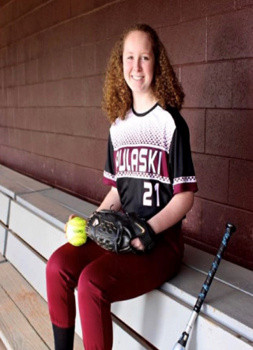
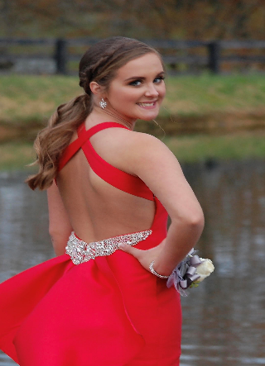
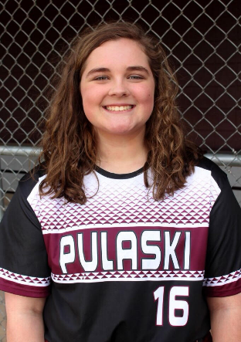
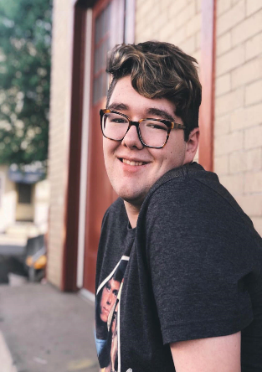
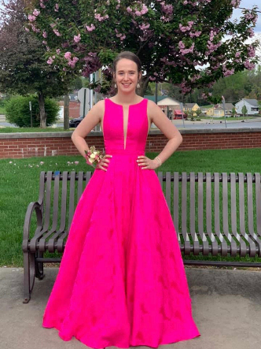

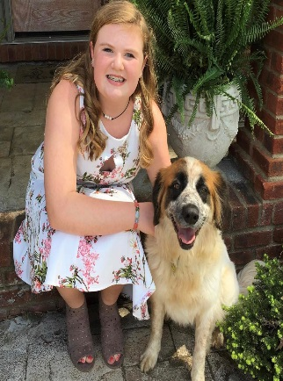
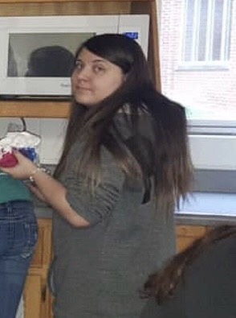

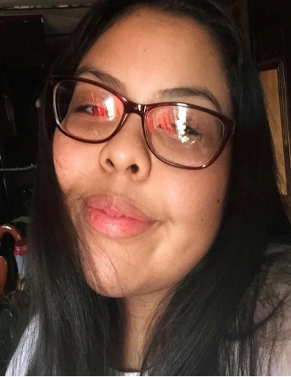
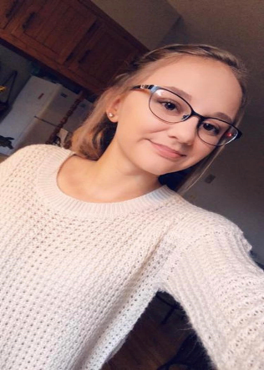
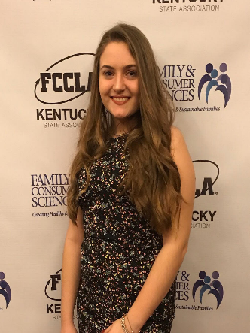
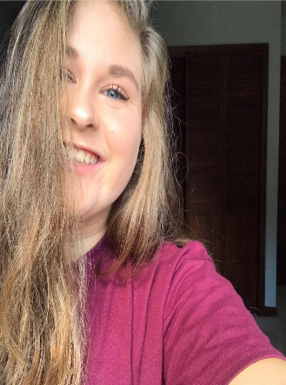
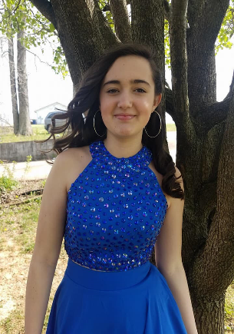
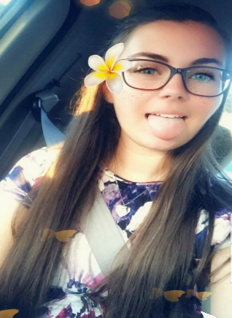
FCCLA Members
Natalie Abner (Ninth Grade)
Shelby Brown (Eleventh Grade)
Sadie Brown (Ninth Grade)
Blake Buis (Twelfth Grade)
Sarah Burton (Twelfth Grade)
Jesi Chumbley (Twelfth Grade)
Madison Criswell (Ninth Grade)
Shaylee Dishman (Tenth Grade)
Courtney Doyle (Eleventh Grade)
Odalys Garrica (Eleventh Grade)
Lydia Goodin (Twelfth Grade)
Destiny Gossett (Ninth Grade)
Taylor Kiser (Eleventh Grade)
Taylor Mayfeild (Ninth Grade)
Jessica Norton (Twelfth Grade)

Slide 3
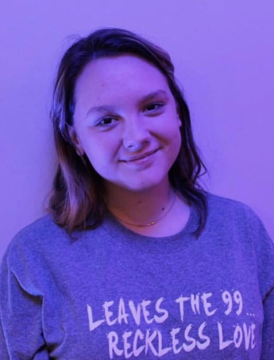
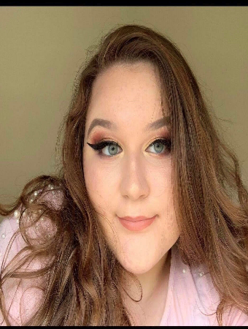
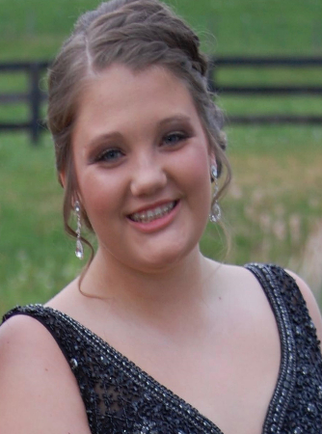
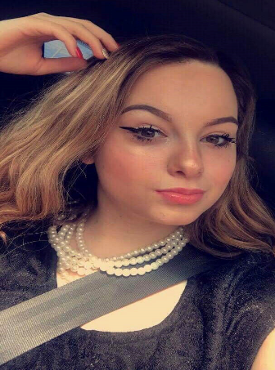
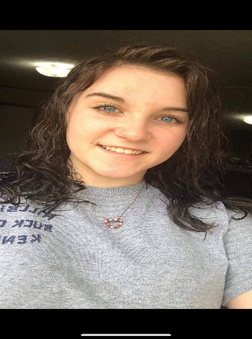
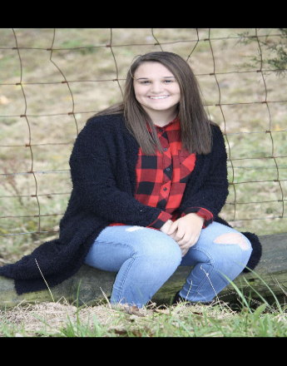
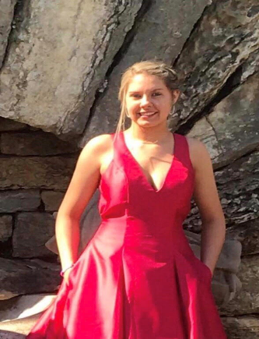
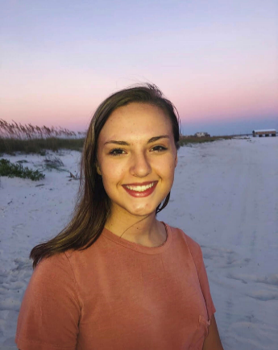
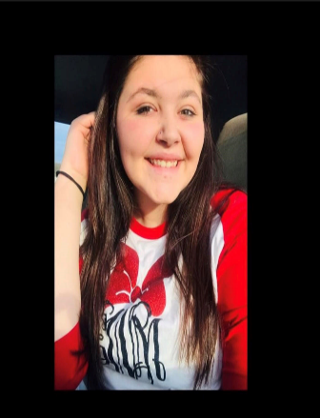
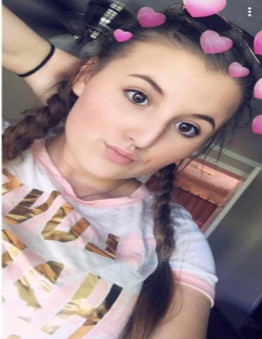
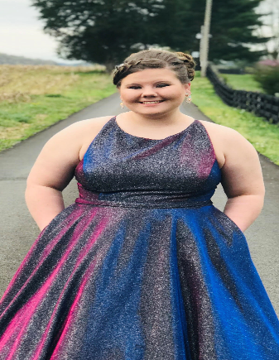
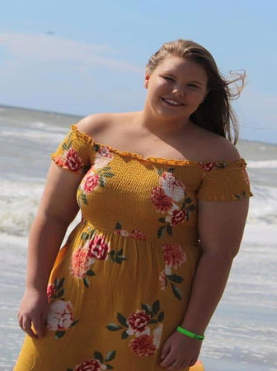
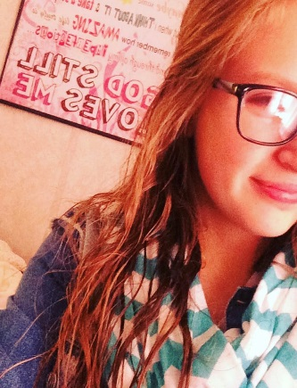
FCCLA Members Continued
Destiny Ramsey (Tenth Grade)
Madison Roberts (Eleventh Grade)
Alex Russel (Eleventh Grade)
Jessica Simpson (Twelfth Grade)
Angel Smith (Eleventh Grade)
Peyton Tucker (Twelfth Grade)
Trinity Turner (Eleventh Grade)
Olivia Turpin (Eleventh Grade)
Elizabeth Watkins (Twelfth Grade)
Karley Wells (Ninth Grade)
Mckenzie Whitis (Eleventh Grade)
Madison Whitis (Ninth Grade)
Alyssa Wilder (Ninth Grade)

Slide 4
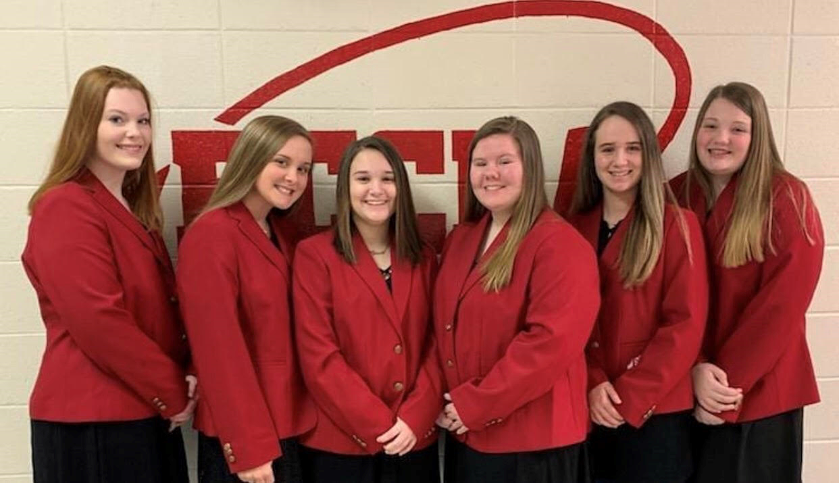
FCCLA Officers
Laura Lockard, Shelby Brown, Peyton Tucker, Mckenzie Whitis, Sarah Burton, and Alex Russel

Slide 5
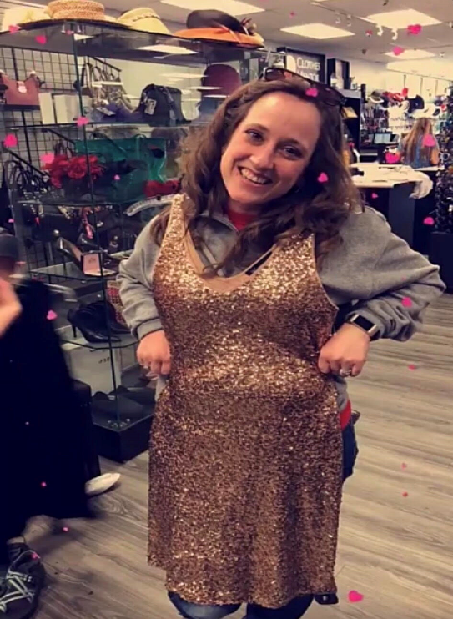
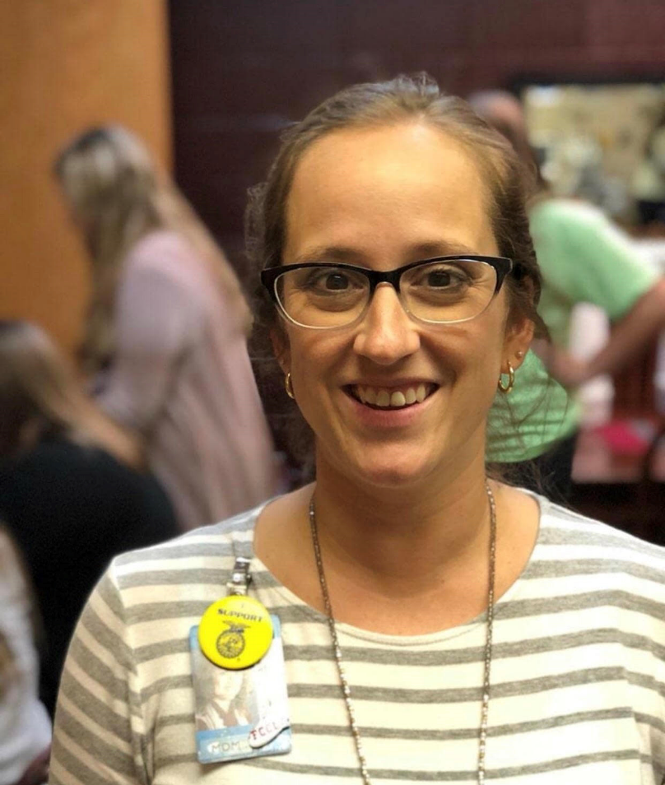

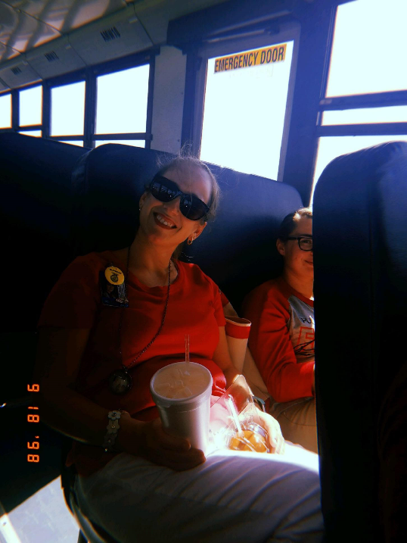


Our lovely FCS Advisor
Mrs. Jan Collins

Slide 6
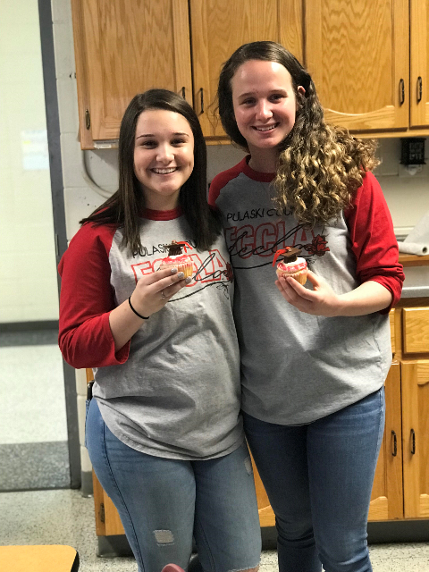
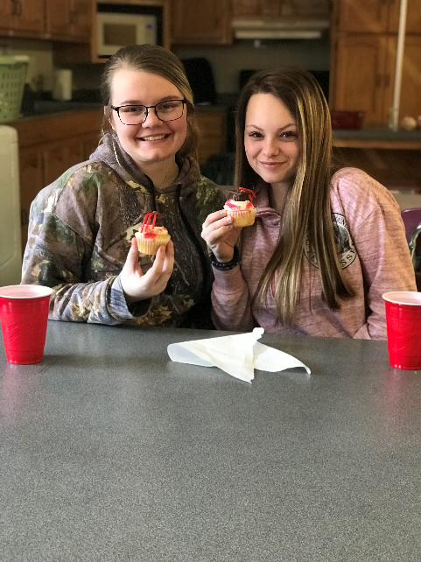
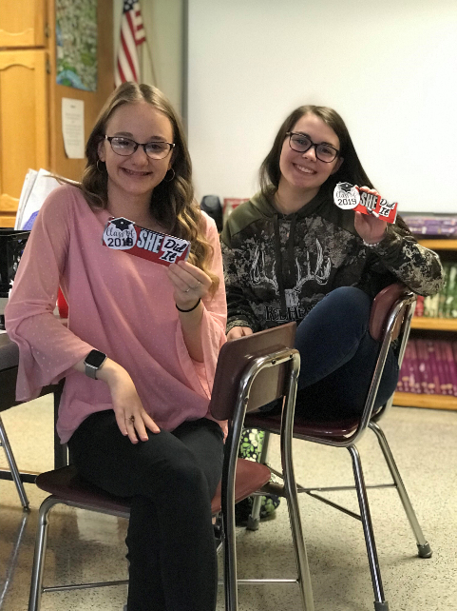
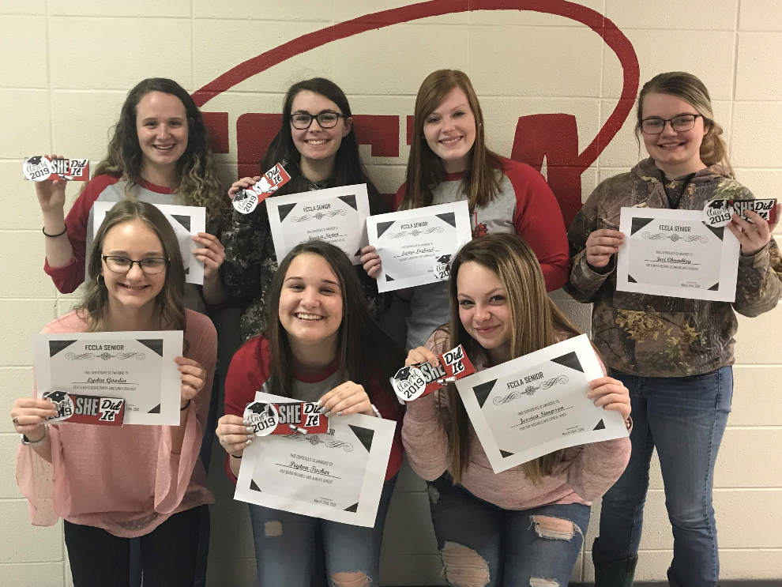
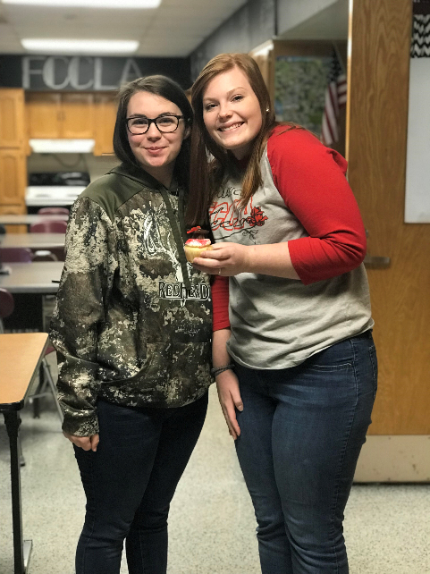

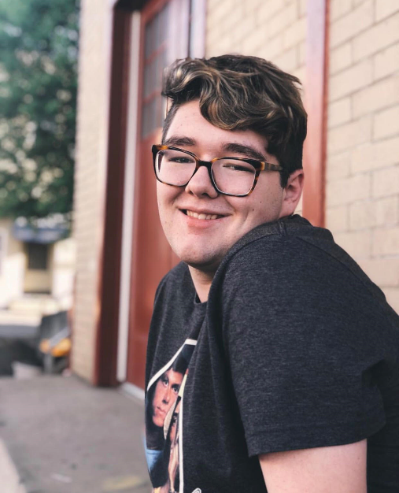


FCCLA Seniors, Class of 2019

Slide 7
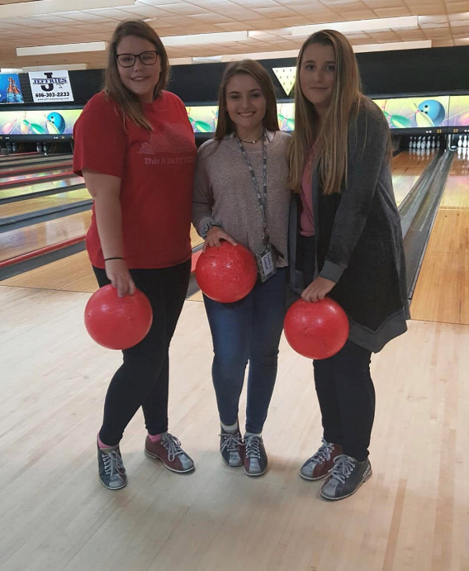
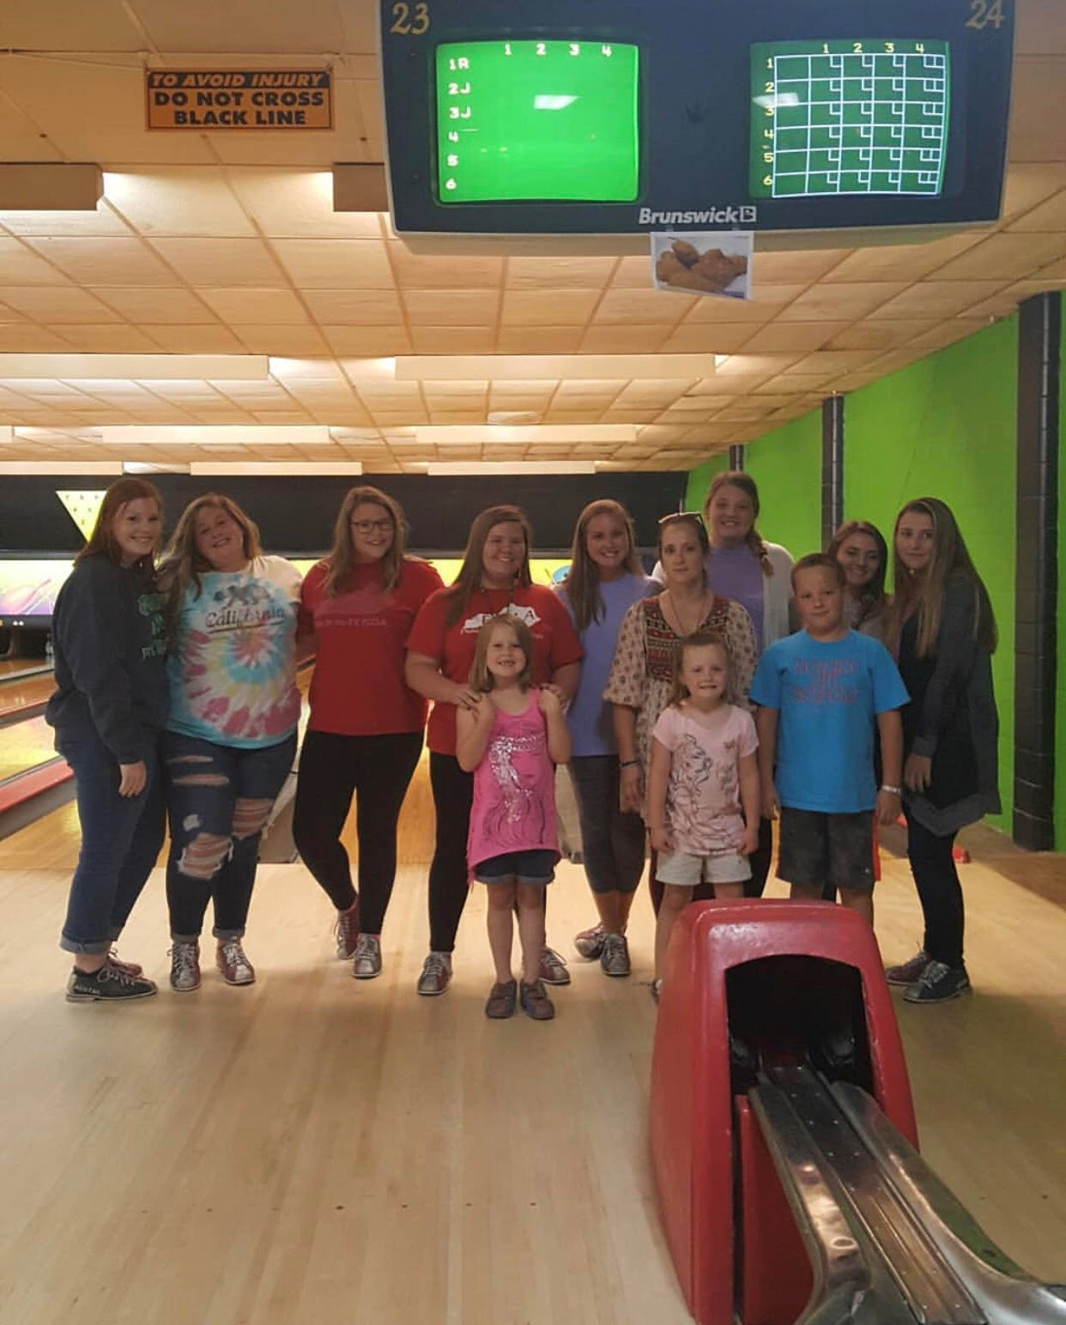
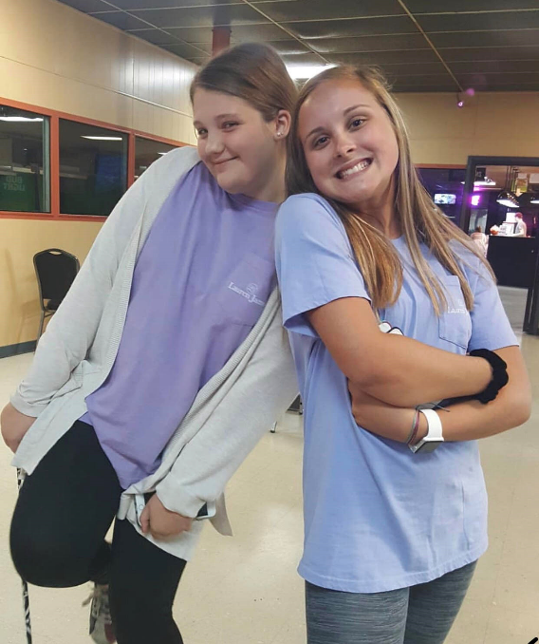

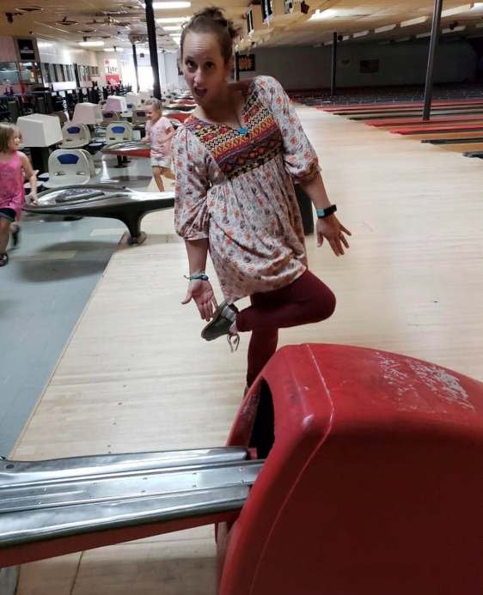
Bowling Fun

Slide 8

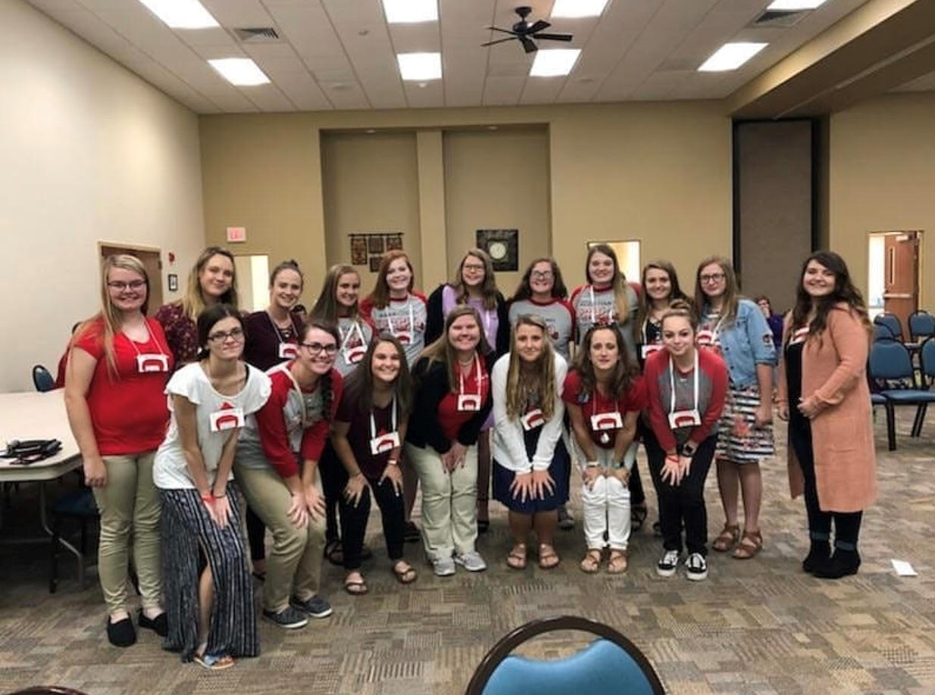
Fall Regional Meeting 2018

Slide 9
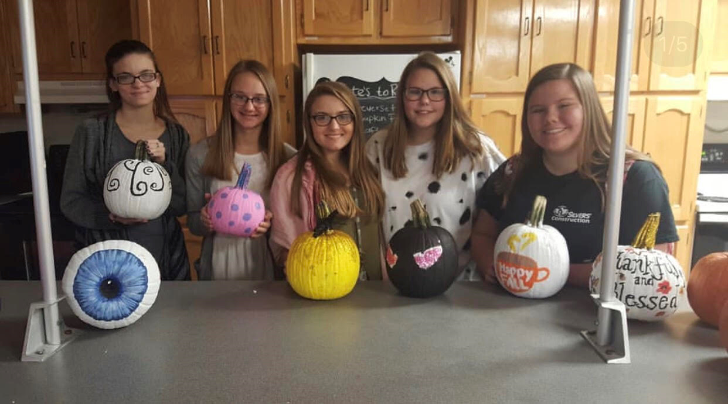
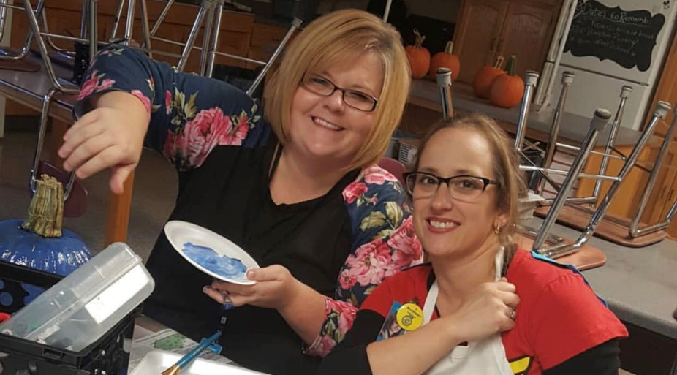

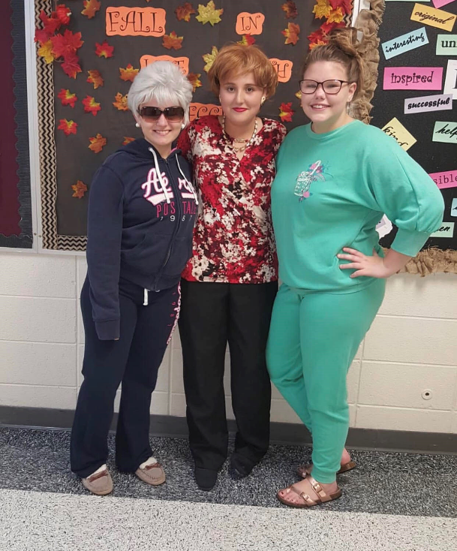
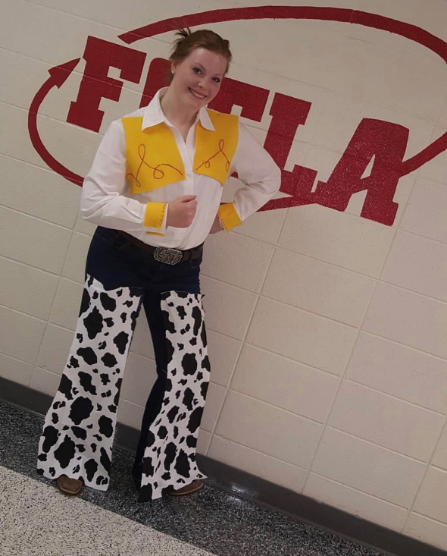
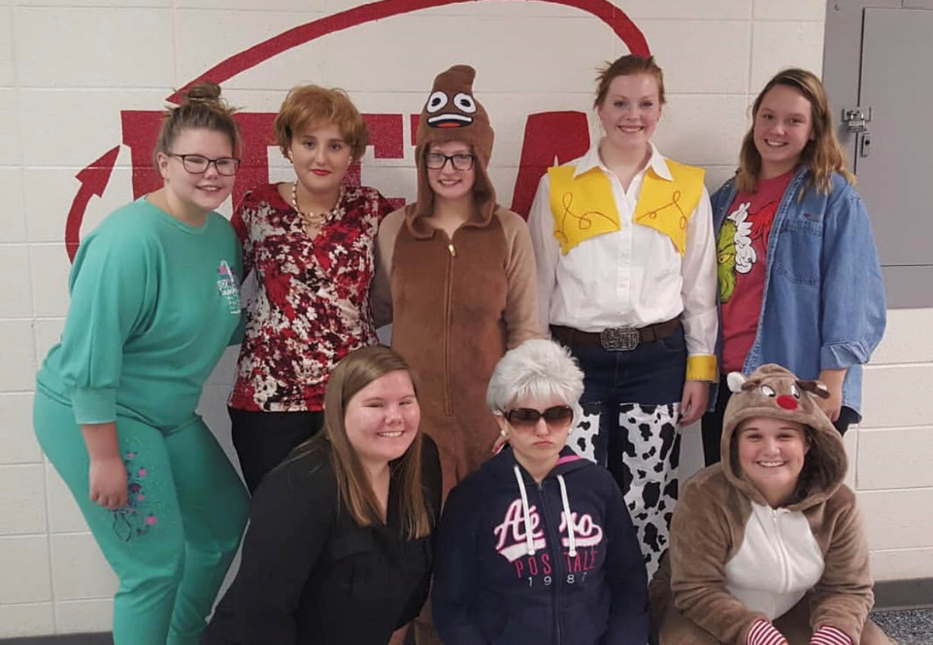

Fall Activities
Fall in
love with
FCCLA

Slide 10
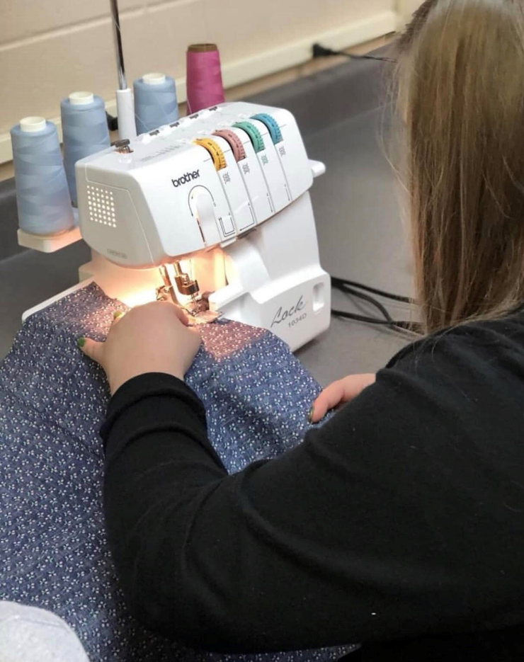
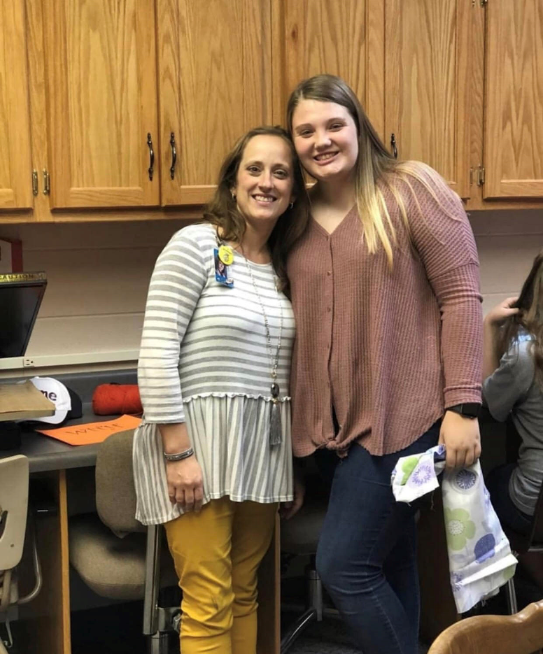
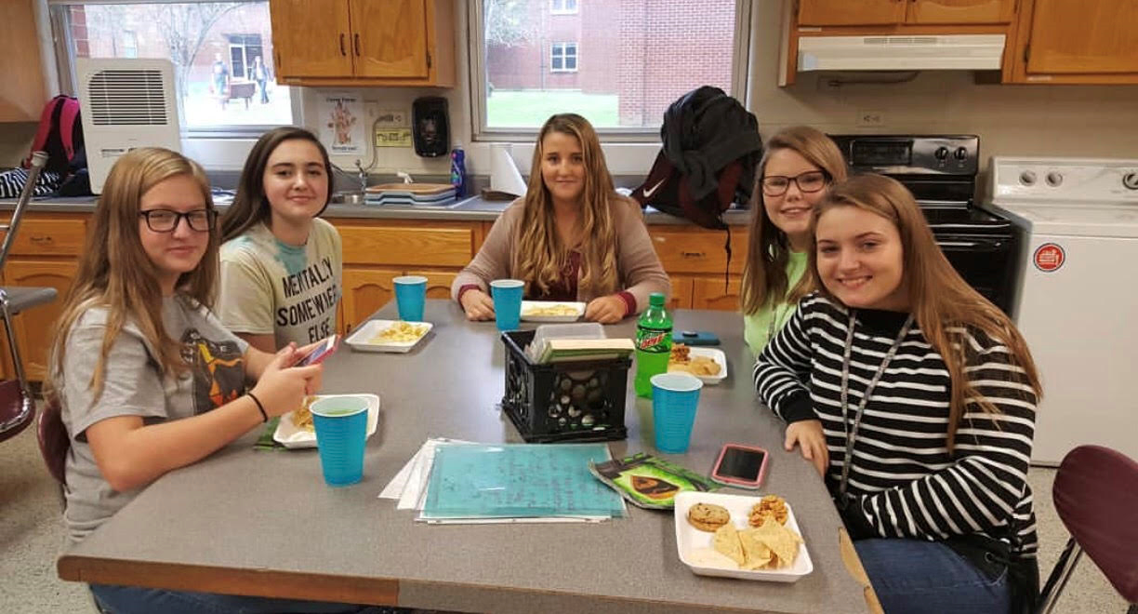
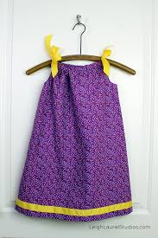

Sewing Pillowcase Dresses for Third World Countries

Slide 11





FCCLA Christmas Party
Packing food bags for Project 5810

Slide 12




FCCLA Week 2019
Monday: FCCLA apparel day and find an officer day!
Tuesday: Twin day and FCCLA family skate night!
Wednesday: Tie-Dye day, and custodial/lunch staff appreciation.
Thursday: Go RED Day, and membership appreciation.
Friday: Maroon Family Day and FCCLA scavenger hunt!

Slide 13





Spring Regional Meeting 2019

Slide 14





Touring The American Printing House for the Visually Impaired

Slide 15




State Meeting
Sporting our FCCLA blazers and receiving power of ones, silver honor award, and Community Service Participant Award.
F
C
C
L
A

Slide 16





State Meeting Banquet

Slide 17







Candid Pictures

Slide 18
Signatures…

