Slide 1


Slide 2
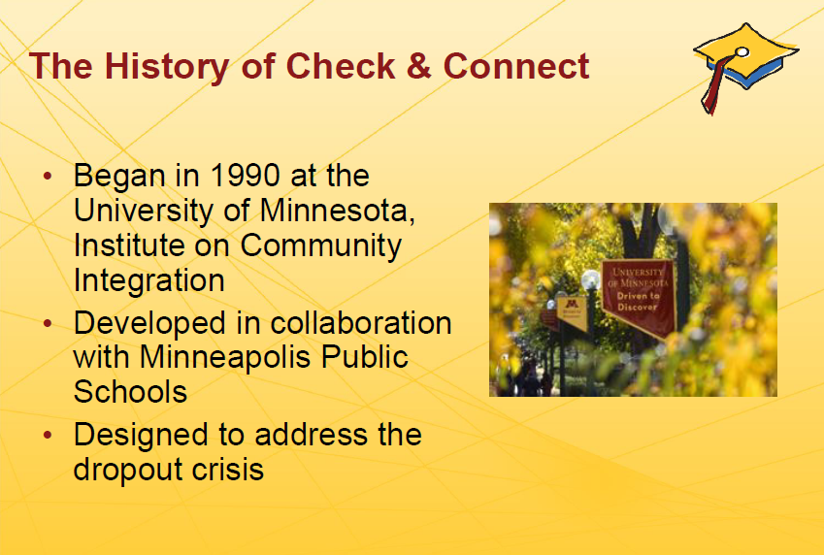

Slide 3

Check & Connect Intervention Model
Check & Connect is a structured mentoring intervention to promote student success and engagement at school and with learning through relationship building and systematic use of data.
This photograph and the remaining stock photos were used with permission from Microsoft.

Slide 4
Check & Connect Intervention Model
Structured
  Follows a fairly standard set of procedures –
    Mentor (meets weekly)
    Check
    Connect
    Family Engagement
But Not Scripted
  Delivery may differ for each child
    Mentor (meets weekly)
    Same areas “checked”
    Intervention “connections” may vary greatly
    Family engagement focus may also vary

Slide 5
Although interventions “connections” may vary greatly…
Keep the focus on EDUCATION!
Commit to and investment in learning
Identification and belonging at school

Slide 6
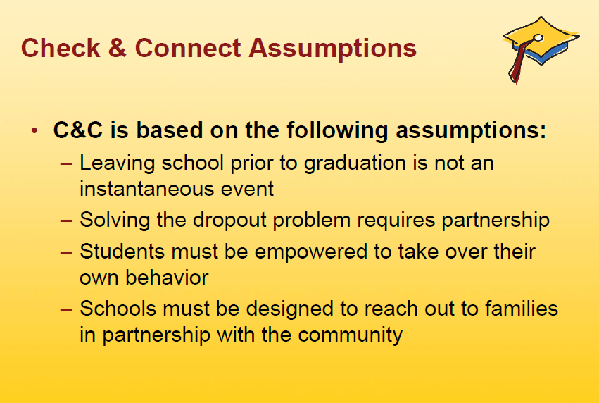

Slide 7
Educational Engagement vs Disengagement
Poor grades
Attendance problems
Behavioral challenges
May be signs of disengagement!

Slide 8
Disengagement is largely RELATIONAL!

Slide 9
Re-engagement is largely RELATIONAL!

Slide 10
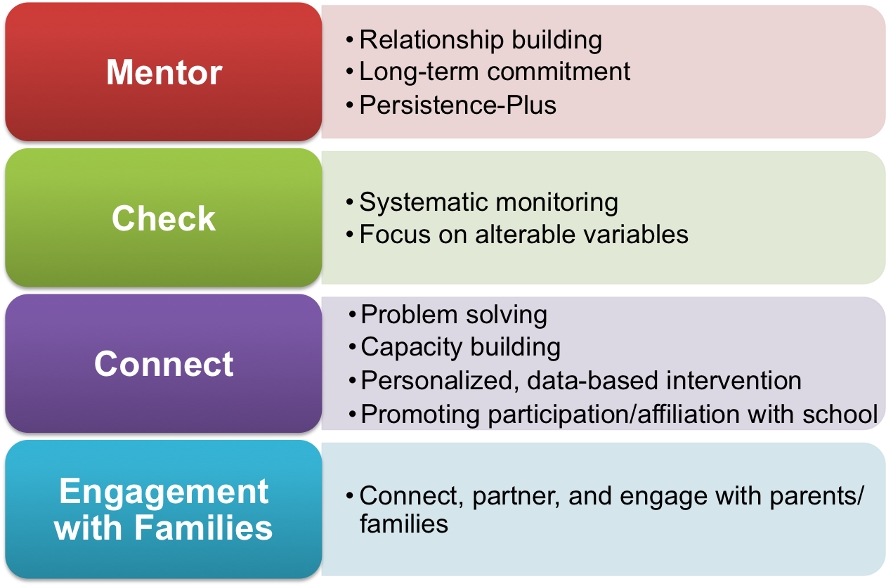
Four Core Components and Essential Elements
Notes:
FIDELITY SELF-ASSESSMENT IN MANUAL, (page 87)
Core components:
A mentor who works with students and families for a minimum of two years
Relationships are based in mutual trust and open communication, nurtured through a long-term commitment, and focused on promoting a student’s educational success
Long-Term Commitment. Mentors make at least a two-year commitment to a student.
2. Regular checks utilizing data schools already collect on students’ school adjustment, behavior, and educational progress (Check)
Focus on Alterable Variables. The systematic monitoring (“check”) of indicators of disengagement that are readily available to school personnel and can be altered through intervention.
3. Timely interventions, driven by data, to re-establish and maintain students’ connection to school and learning and to enhance students’ social and academic competencies (Connect)
Personalized, Data-Based Intervention. Supportive interventions (“connect”) that are personalized, not prescriptive; mentors use data as the basis for intervention design.
Participation in and Affiliation with School. Mentors facilitate student access to and active participation in school-related activities and events.
Problem Solving and Capacity Building. Mentors use a cognitive-behavioral approach to promote the acquisition of skills to: resolve conflict constructively, encourage the search for solutions rather than a source of blame, foster productive coping skills, and diminish dependency on the mentor.
4. Engagement with families – mentors engage with parents and strive to foster parents’ active participation in their child’s education

Slide 11
Focus on Alterable Variables
Alterable variables: indicators of disengagement that are readily available to school personnel and can be altered through intervention.
Status
  Age
  Metro status and region
  Disability
  Socioeconomic status
  Ethnicity
  Gender
  Family structure
Alterable
  Attendance
  Attitude toward school
  Extracurricular participation
  Behavior
  Homework
  Grades, credit accrual
Notes:
When we begin to think about students and engagement we need to keep our focus on the things we can change. Many students walk in the doors of the school with status variables which, for the most part, a those things that make us up that cannot be changed such as age, race, and gender. In Check & Connect we keep the focus on the alterable variable which are just what they sound like, the things we may be able to change or influence.
If you refer to Page 23, Table 7, in the Manual, you will see alterable risk and protective factors associated with dropping out of school in relation to the student, families and schools.

Slide 12
CHECK
Engages in a long-term relationship with mentee
Cares enough to meet weekly
Monitors important, alterable variables
  Attendance
  Grades
  Behavior

Slide 13
CONNECT (to Interventions)
Determined by “check” data and focus on
re-engagement
Examples of ‘interventions” include…
  Problem-solving with the student and/or family
  Goal setting with the student
  Teaching social skills
  Referrals…
    Mental health services
    Tutoring
    Medical services

Slide 14
FAMILY ENGAGEMENT
Families of disengaged students are often also disengaged
This is also a relational issue
Families of students need to know that you care about their child’s future (not just their graduation or class performance)
You may encounter resistance – don’t let this get you off course

Slide 15



Check & Connect Resources
Website and blog checkandconnect.umn.edu
hs.utah.gov/education
schools.utah.gov/yic/
Join the C&C community!
  Sign up to join the Discussion list
  Follow our blog & social media: Blog | Facebook | Twitter
  Coordinators -- join the Coordinators’ Community of Practice
Contact us: checkandconnect@umn.edu | 866-434-0010
Notes:
Show the website and point out important resources.

Slide 16
Check & Connect Resources
Check and Connect Manual – Check it out from your Check and Connect Coordinator.
District webpage – You can find the PowerPoint, handouts and other resources here.
Notes:
Show the website and point out important resources.

