Slide 1

Northern Middle School
"The Northern Way"
One Middle School's Journey with Schoolwide PBIS

Slide 2
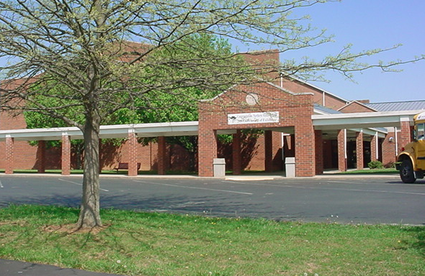
Northern Middle School
Somerset, Kentucky
68% free/reduced lunch
875 students
6th , 7th , & 8th grades

Slide 3
Beginning Data

Slide 4
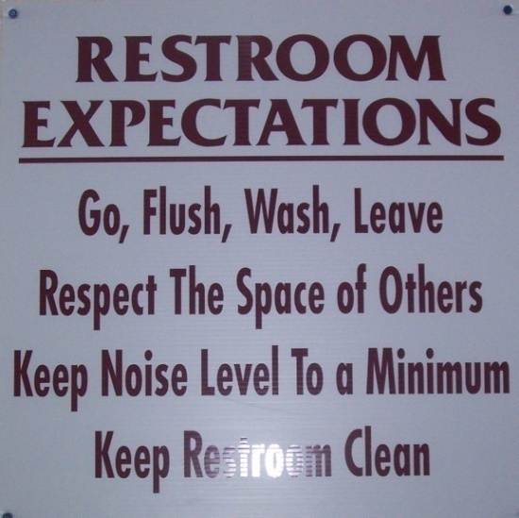
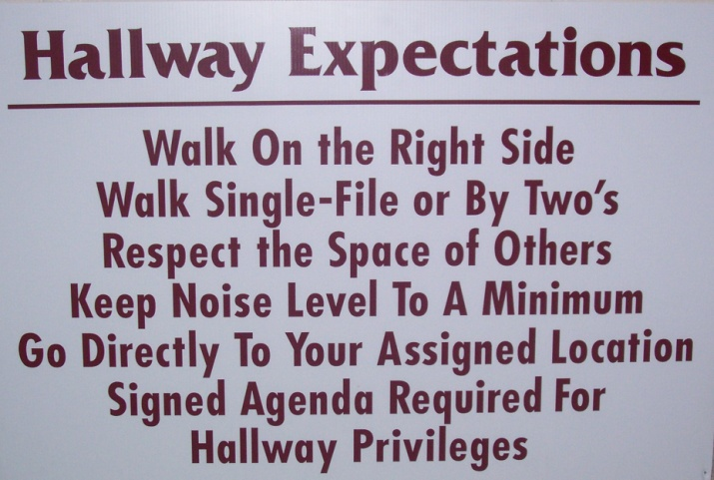
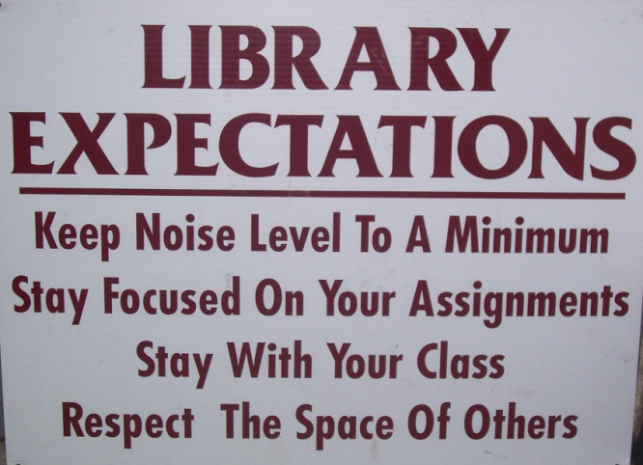
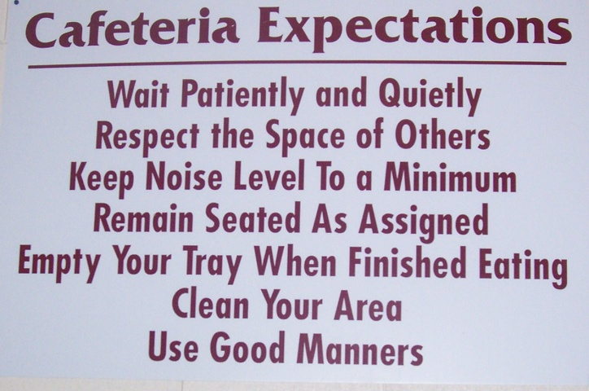
Year One: 2006-2007
Established a leadership team and attended 30+ hours of initial training
Established and posted school wide expectations for common areas
  Common Area Expectations
  LAB Expectations

Slide 5
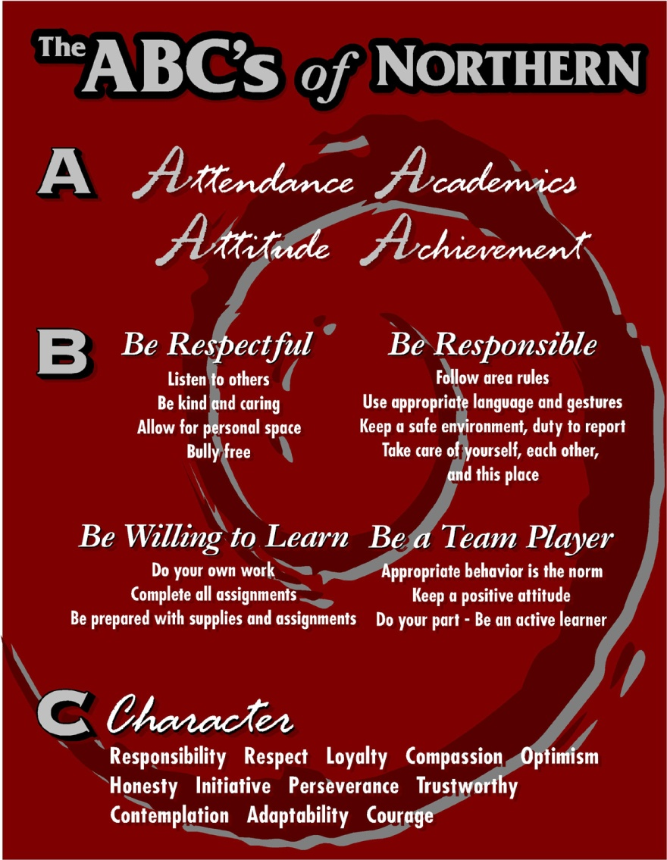
Year One: 2006-2007
Established the ABCs of Northern campaign to focus on our expectations
  ABC’s of Northern PowerPoint
    Reviewed each grading term within the classrooms
  ABC’s poster
  Pole Wrap

Slide 6
Year One: 2006-2007
Created Pyramids of Intervention
  Behavior
  Bullying
Documentation Tool
Developed Connection Plus mentoring program (early planning stages, targeted few students)
  Mentoring Pyramid

Slide 7
Year One: 2006-2007
SBDM Policies
  Discipline Policy
Referral Form modified to reflect school-wide expectations
  Referral Form
Team Discipline Logs changed to reflect these same school-wide expectations
  Sample Discipline Log

Slide 8
Year One: 2006-2007
Set a goal to improve student behavior as evidenced by decreased office referrals
  Reduced Referrals by 25%
Data Monitoring
KYCID team meets monthly
  Reviews Discipline Data
  Used the SWIS system along with STI to record student infractions and monitor data

Slide 9
Year One: 2006-2007
Results

Slide 10
Year One: 2006-2007
Results

Slide 11
Year Two: 2007-2008
12+ hours additional training for Leadership Team
6+ hours training for staff
Reinforcement activities at each faculty meeting
Continue to meet monthly to review discipline data and monitor initiatives
New staff introduction to initiatives and procedures

Slide 12
Year Two: 2007-2008
Set a goal for improved student behavior as measured by a reduction in office referrals and suspensions
  18% reduction in-school referrals
  25% reduction in suspensions
ICE (Isolated Curricular Environment) alternative to out-of-school suspension
Refine and maintain a focus on the ABC’s of Northern expectations
Revised the ABC’s of Northern Power Point teaching tool
Created a matrix of student expectations across all school settings
  Student Expectation Matrix

Slide 13
Year Two: 2007-2008
Developed specific lesson plans to target our expectations at each grade level
  Lesson Plans
Conducted School-Wide training for all staff on Systematic Supervision
  LookIRIS.com
Created a supervision handbook with expectations for staff at various duty stations
  Staff Duty Responsibilities
Developed specific procedures for class change on each team during the day, a supervision plan on each team, and end of day dismissal procedures/patterns
  Classroom Change Expectations

Slide 14
Year Two: 2007-2008
Refine and maintain our pyramids of intervention
Fully implemented the Connection Plus mentoring program (75+ students); all staff serve as mentors
  Mentoring Tips
  Connection Plus Description
  Connection Plus Presentation
  Connection Plus Results
Review “at-risk” students as we meet with teams each week and refer students to Response to Intervention (RTI) team or the Achieving in Middle School (AIMS) class
Obvious connection seen between behavior and academic issues
ICE (Isolated Curricular Environment)

Slide 15
Year Two: 2007-2008
Results

Slide 16
Three Year Comparison

Slide 17
Year Three 2008-2009
Set a Goal for the 2008-2009 School Year to improve behavior as evidenced by fewer referrals – Our goal was 15% and maintain suspensions
Develop Consistent Criteria for Team Time
Develop Guidelines/Policy for Electronics
Incorporate a training section on “Disrespect” into ABC’s - PowerPoint
Develop Expectations for Field Trips, Substitutes, Safety Drills, and Bus
Update Matrix to include: Expectations for field trips (Finley’s), Substitutes, Safety Drills, and Bus
Update ABC’s to include: Expectations for field trips (Finley’s), Substitutes, Safety Drills, and Bus, and Disrespect

Slide 18
Year 3 cont.
Update Lesson Plans: Expectations for field trips (Finley’s), Substitutes, Safety Drills, and Bus
All Staff to take the EBS on-line survey
Train Student Ambassadors in the “Northern Way” for new students
Do’s/Don’t, Examples/Non-Examples video made by staff of our school-wide expectations
Consider Other school-wide reward ideas – coffee house
Consider Quarterly Theme to recognize PBIS
Revise Pyramids of Intervention
Reinforce Supervision, show video to all staff
Booster session for new teachers
Connection Plus mentoring - ongoing

Slide 19
Year 3 cont.
Asked bus drivers to send home positive comment cards – great response
Meet bi-monthly with leadership team and review discipline data monthly with staff
Monitor student’s academic and behavior progress each week in team meetings – refer to RTI when needed
Offered research-based intervention classes in Reading and Math (SRA, Successmaker, Word Power, and AIMS)
More in class guidance and advisory activities on bullying

Slide 20
Year Three: 2008-2009
Results

Slide 21
Four Year Comparison

Slide 22
Additional Years 2009-2012
Refine and maintain!!!
Goal setting became more specific, focusing on specific locations and problem behaviors.
Held Bus Driver Summit
Teachers and administrators had option of riding a bus or doing home visits prior to school starting.
Created and taught behavior expectations for bus behavior.
Expanded reward system to include “Student of the Week” and mid-term rewards
Developed lessons for students to complete based on the infractions
Continued Examples/Nonexamples Expectations Video
Check-In/Check-Out
Continuing to focus on the area of Respect and behavior toward substitutes.
Safe Schools video

Slide 23
Seven Year Comparison

Slide 24
Next Steps for 2012-13
(Action Plan)
Maintain and refine existing practices – “The Northern Way”
Creating a new Expectations Video with an Artist in Residency
Refine out Check-In/Check-Out procedures to make it more systematic.
Redefining our mentoring program.
Working to more clearly define Tier 2 & 3 interventions
Show this presentation to staff members
Continue to merge discipline and academic pyramids, monitor data, meet with teams, discuss student progress and interventions, etc.

Slide 25
Additional Resources
  KY Center for Instructional Discipline
  Positive Behavior Intervention Supports
  School-Wide Information System
  IRIS Media – Systematic Supervision Video
    http://www.lookiris.com/store/K-12_Professional_Development/Systematic_Supervision_for_Middle_School
  Connection Plus Program
    shelly.hargis@pulaski.kyschools.us

Slide 26
Presenter Information
Shelly Hargis, Principal
  Northern Middle School Website – http://nms.pulaski.schoolfusion.us
  E-mail: shelly.hargis@pulaski.kyschools.us
Dusty Phelps, Pulaski County Psychologist and District KYCID/PBIS Coordinator
  E-mail: dusty.phelps@pulaski.kyschools.us

