Slide 1

DELAC
Feb. 9, 2022
Por favor ponga su nombre y correo electrónico en el chat.
Please add your name and email to the chat.
Notes:
Team

Slide 2

Nuestro Por Que/Our Why
“To give our best so that those we serve are inspired and empowered to become their best”
“Dar lo mejor todos los días para que aquellos quienes servimos estén inspirados y empoderados para convertirse en su mejor versión”
Notes:
David

Slide 3
Agenda
Good Things
Introduce Superintendent
LCAP
Scholarship Information
ELPAC - Polls
ELPAC Testing Information
FAFSA/Dream Act/Promise Grant
COVID Updates
Community Resources
Important Dates
Black History Month
Raffle
Cosas Buenas
Introducción del Nuevo Superintendente
LCAP
Información de Becas
Encuesta ELPAC
Información del Examen ELPAC
FAFSA/Dream Act/Promise Grant
Actualizaciones de COVID
Recursos de la Comunidad
Fechas Importantes
Mes de Historia
Rifa
Notes:
David

Slide 4

Cosas Buenas / Good Things
Nuevo TSA/New TSA - Pablo Andrade
170 estudiantes reclasificados/reclassified students
Nuevo personal/New members
Notes:
David

Slide 5

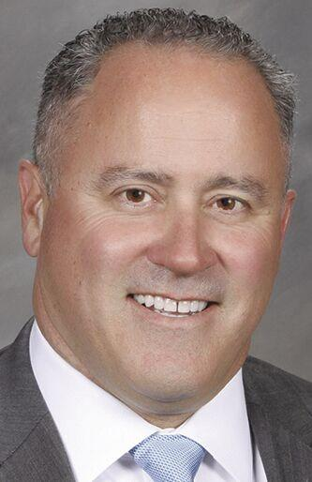
Superintendent / Superintendente
Greg Nehen
Notes:
David

Slide 6
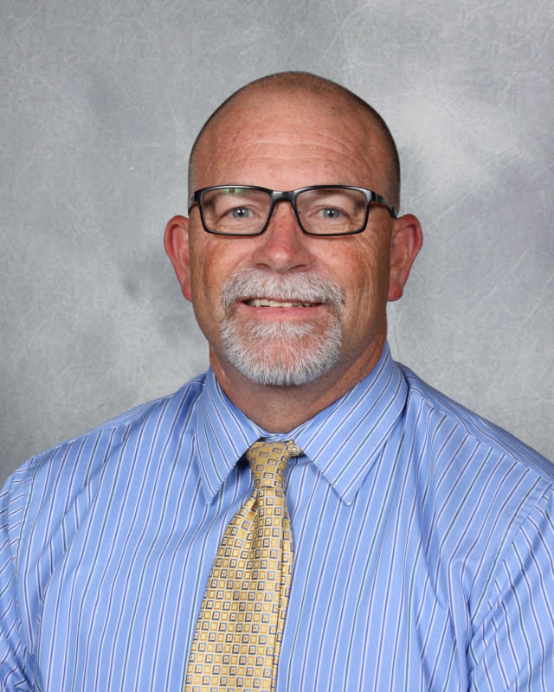
Director I of School Improvement / Director de Mejoramiento Escolar
Dr. Will Laird
Notes:
David

Slide 7
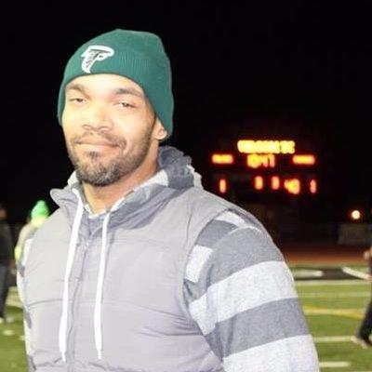
Director of Categorical and Special Programs
Director de Categóricos y Programas Especiales
Dr. Robert Harris
Notes:
David

Slide 8
Local Control Accountability Plan (LCAP) - Dr. Laird
Plan de Responsabilidad de Control Local (siglas LCAP) - Dr. Laird
Notes:
Will will be sending us the google slides to insert and for us to translate

Slide 9

LCAP Annual Update
Engagement of Educational Partners:
DELAC

Slide 10
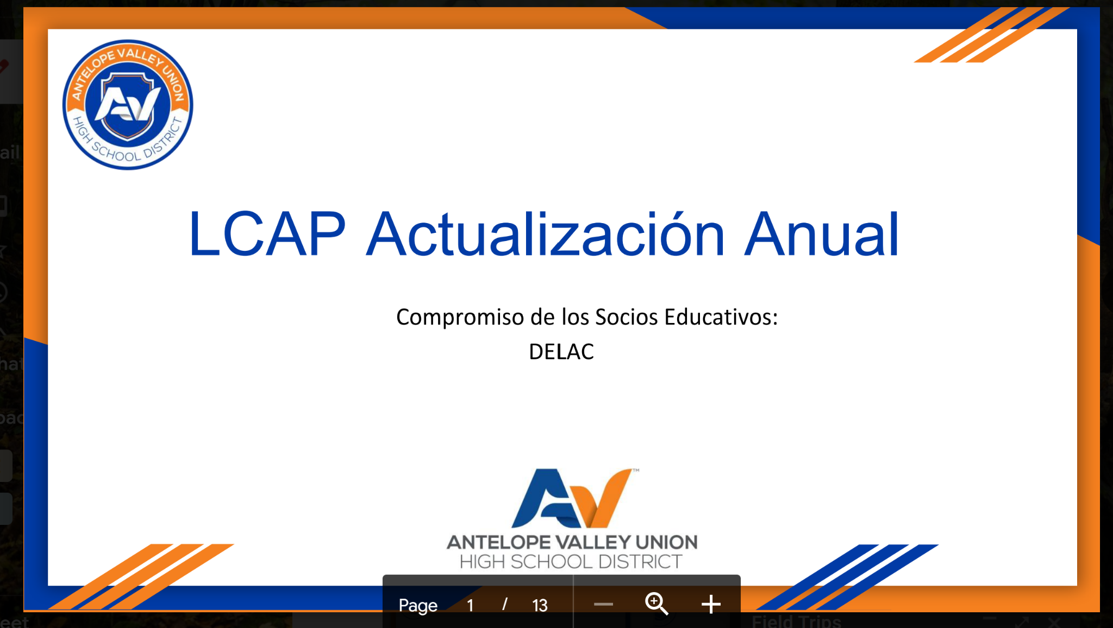

Slide 11

Educational Partner Engagement:
The Local Control and Accountability Plan (LCAP) is a three-year plan that describes the goals, actions, services, and expenditures to support positive student outcomes that address state and local priorities. The LCAP provides an opportunity for local educational agencies (LEAs) to share their stories of how, what, and why programs and services are selected to meet their local needs.
Since the approval of our current LCAP, primarily in response to COVID, AVUHSD has received (or will be receiving) funding through the California Budget Act of 2021 as well as the Federal CARES Act. The primary purpose of these additional funds is to aid LEAs (Schools) in addressing the need for:
The creation and maintenance of a continuous and safe in-person learning environment as well as doing whatever we can to mitigate the spread of COVID
Providing the necessary support to effectively meet our student’s academic, social-emotional and behavioral needs including the loss of instructional time and the retrieval of deficient credits.
Notes:
Introduction - What is the LCAP?

Slide 12
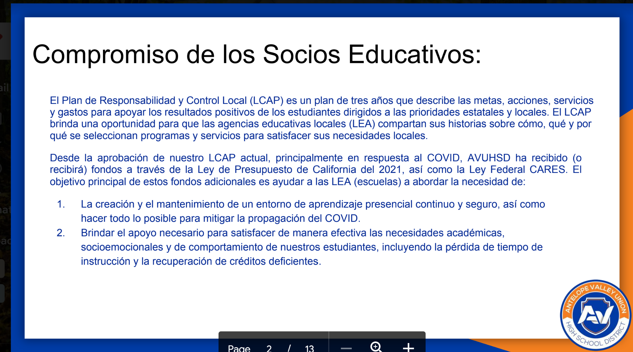

Slide 13
Antelope Valley Union
High School District
Metrics Update

Slide 14


Slide 15



Mid-year Update: LCAP Actions
LCAP Actions
Not Started
In Progress
Completed
Similarly, at this point in the school year, some LCAP actions have Not Started, some are In Progress, and some have been Completed. An update of LCAP actions will be shared with expenditures through the First Interim budget update.

Slide 16
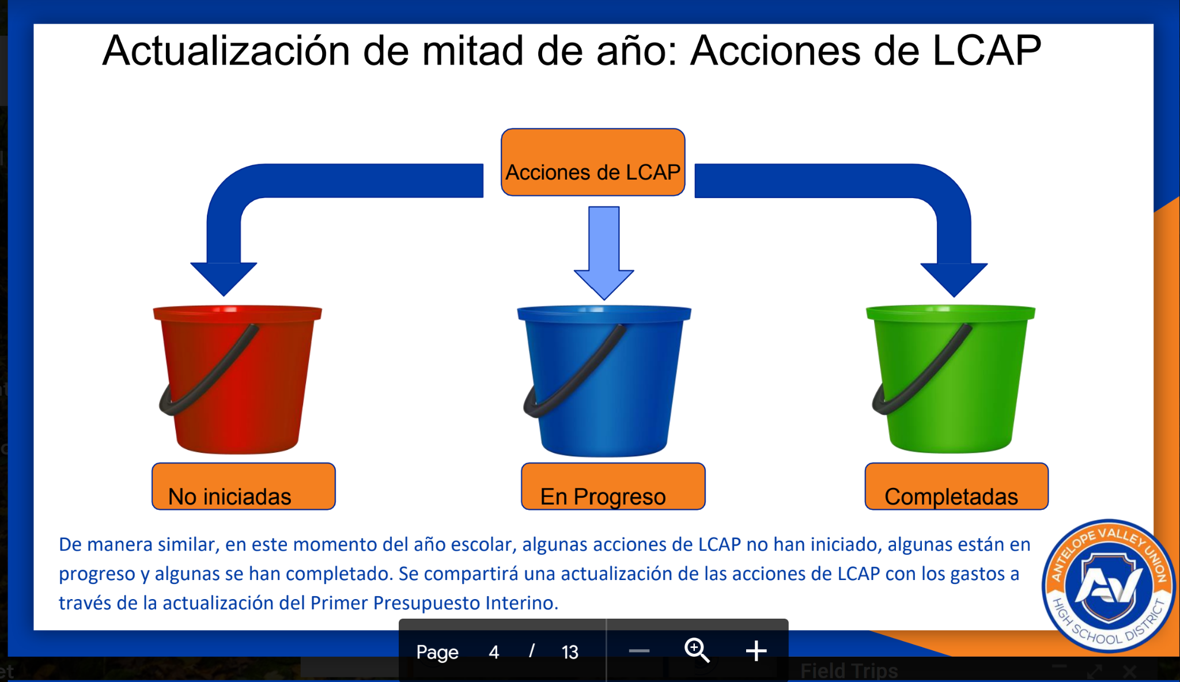

Slide 17
LCAP Goal 1
Ensure that all students are academically proficient and college and career ready.

Slide 18
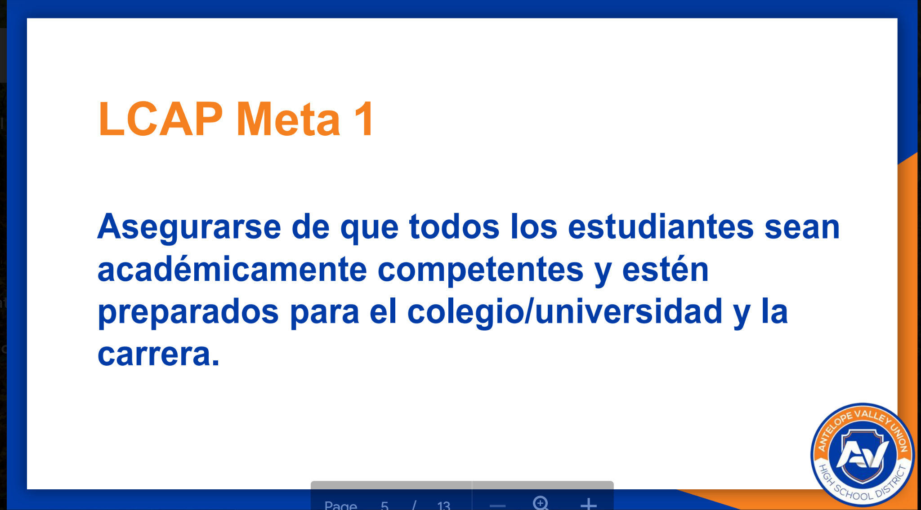

Slide 19
LCAP Goal 01 - Actions
Action/Service
1.01 Student Field Trips
1.02 College Readiness Exams
1.03 Advanced Placement Training
1.04 Expanded Learning Opportunities
1.05 Formative Assessment
1.06 ELA and Math Supports
1.07 EL Program Implementation
Action/Service
1.08 EL Reclassification Limited
1.09 Student-Free Professional Development Days
1.10 Variable Credit Recovery
1.11 Enhanced Data Systems
1.12 Ancillary Instructional Materials
1.13 Focus on Writing

Slide 20
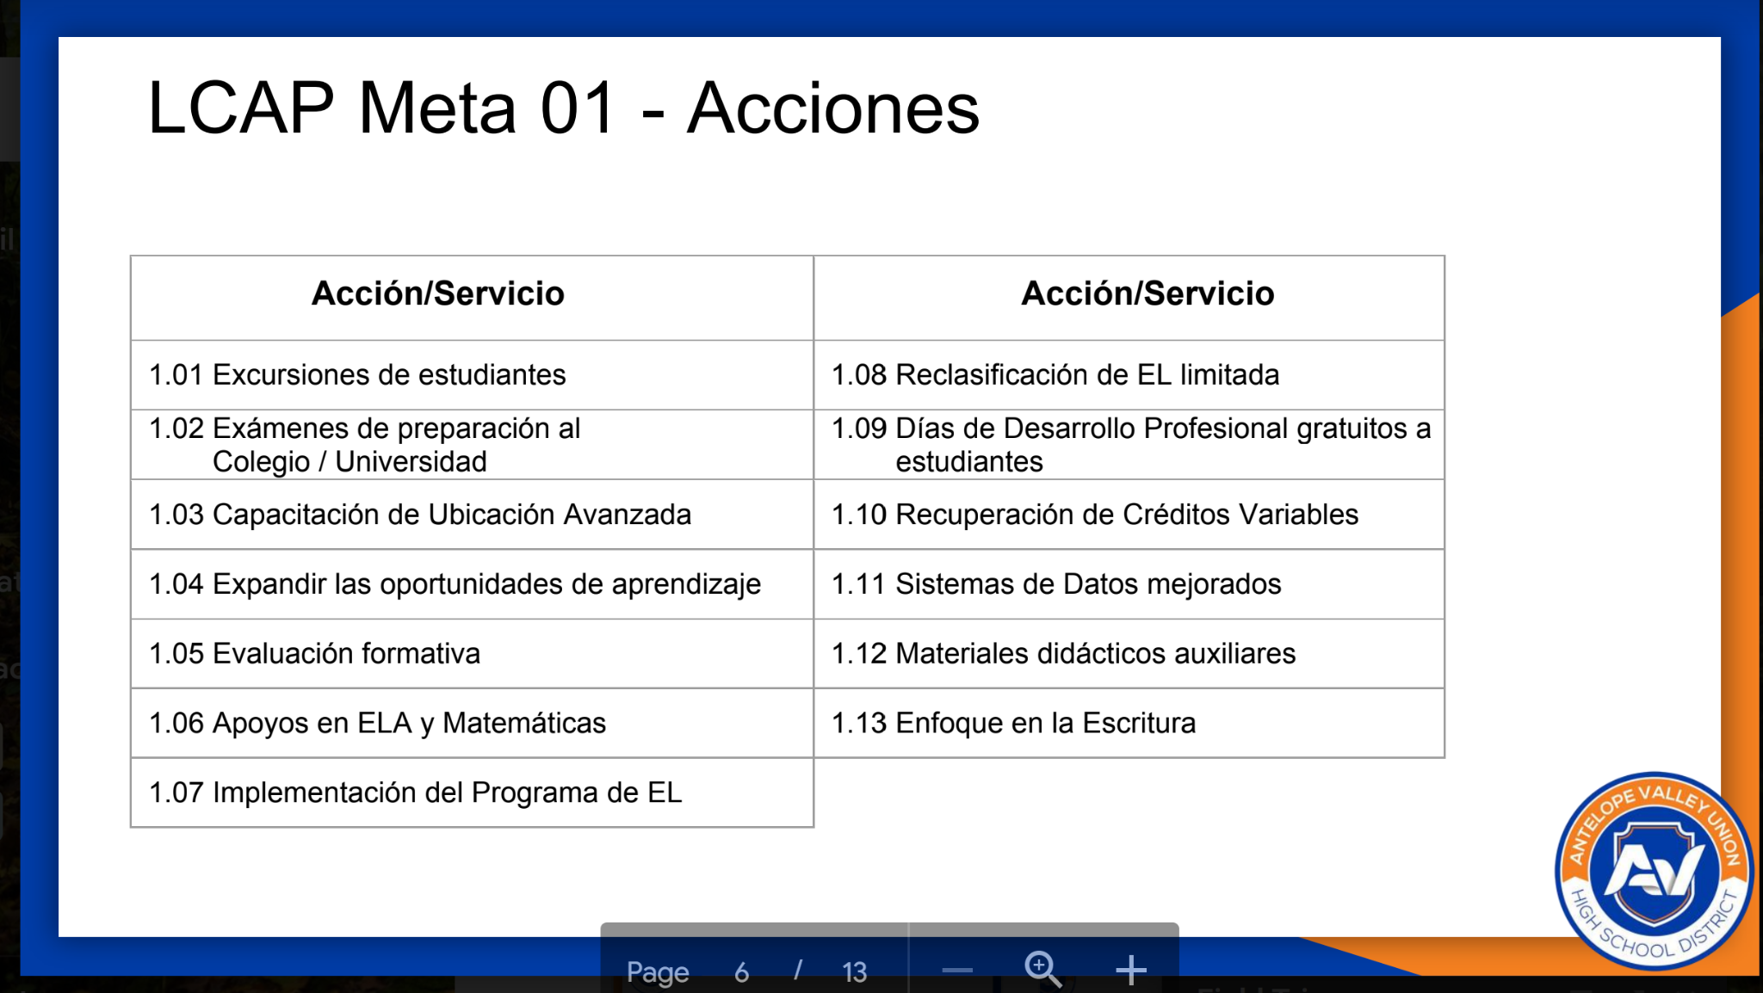

Slide 21
LCAP Goal 2
Provide a 21st Century learning environment and rigorous curriculum that allows students to have multiple experiences and opportunities for academic, collegiate, professional and personal growth.

Slide 22
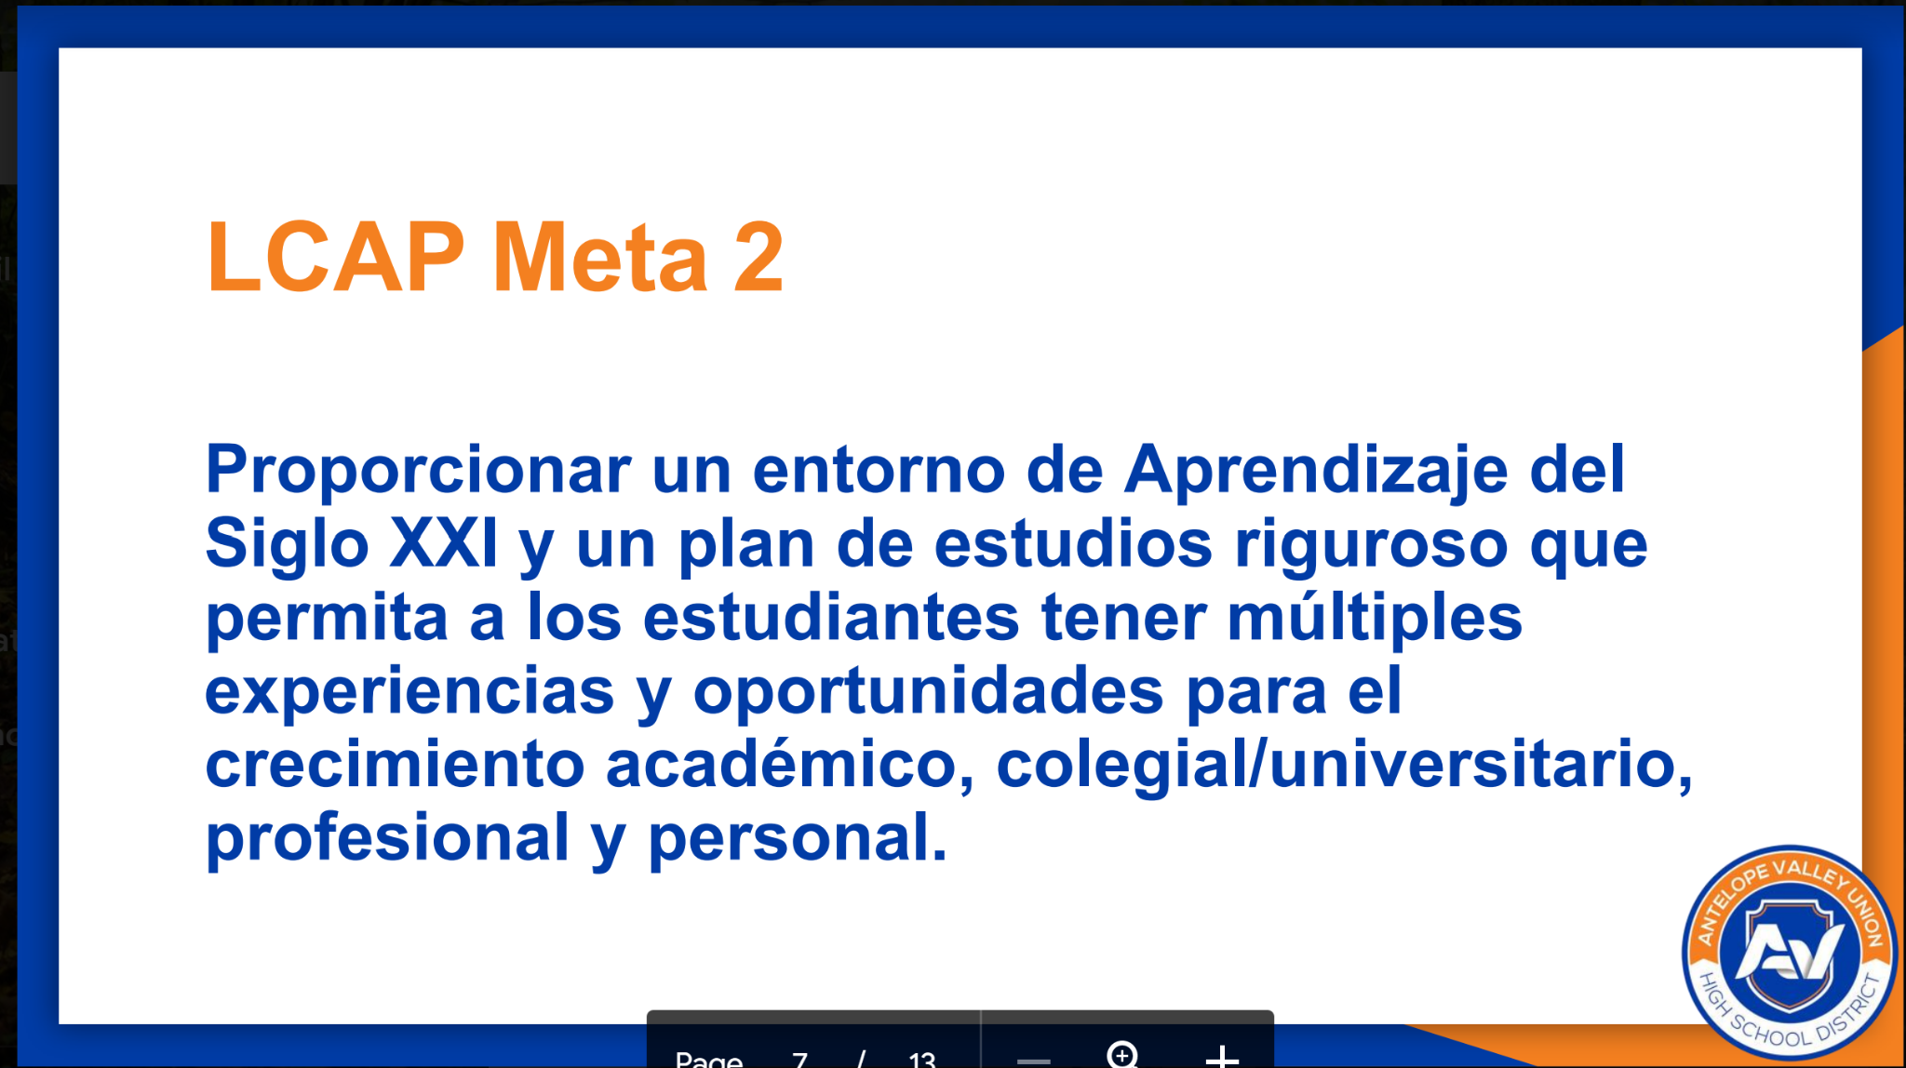

Slide 23
LCAP Goal 02 - Actions
Action/Service
2.01 School Counselors
2.02 Enhanced Counseling Services
2.03 Professional Development
2.04 Augment Credentialing Services1
2.05 Classroom Walkthroughs
Action/Service
2.10 Technology
2.11 STEM Support
2.12 Dual Enrollment/Internships
2.13 Enrichment Options
2.14 21st Century Learning Environments
2.15 NGSS Supports
2.06 AP Placement/Exams
2.07 Career Technical Education (CTE) Opportunities
2.08 AVID Elective
2.09 AVID Health Survey/Transition

Slide 24
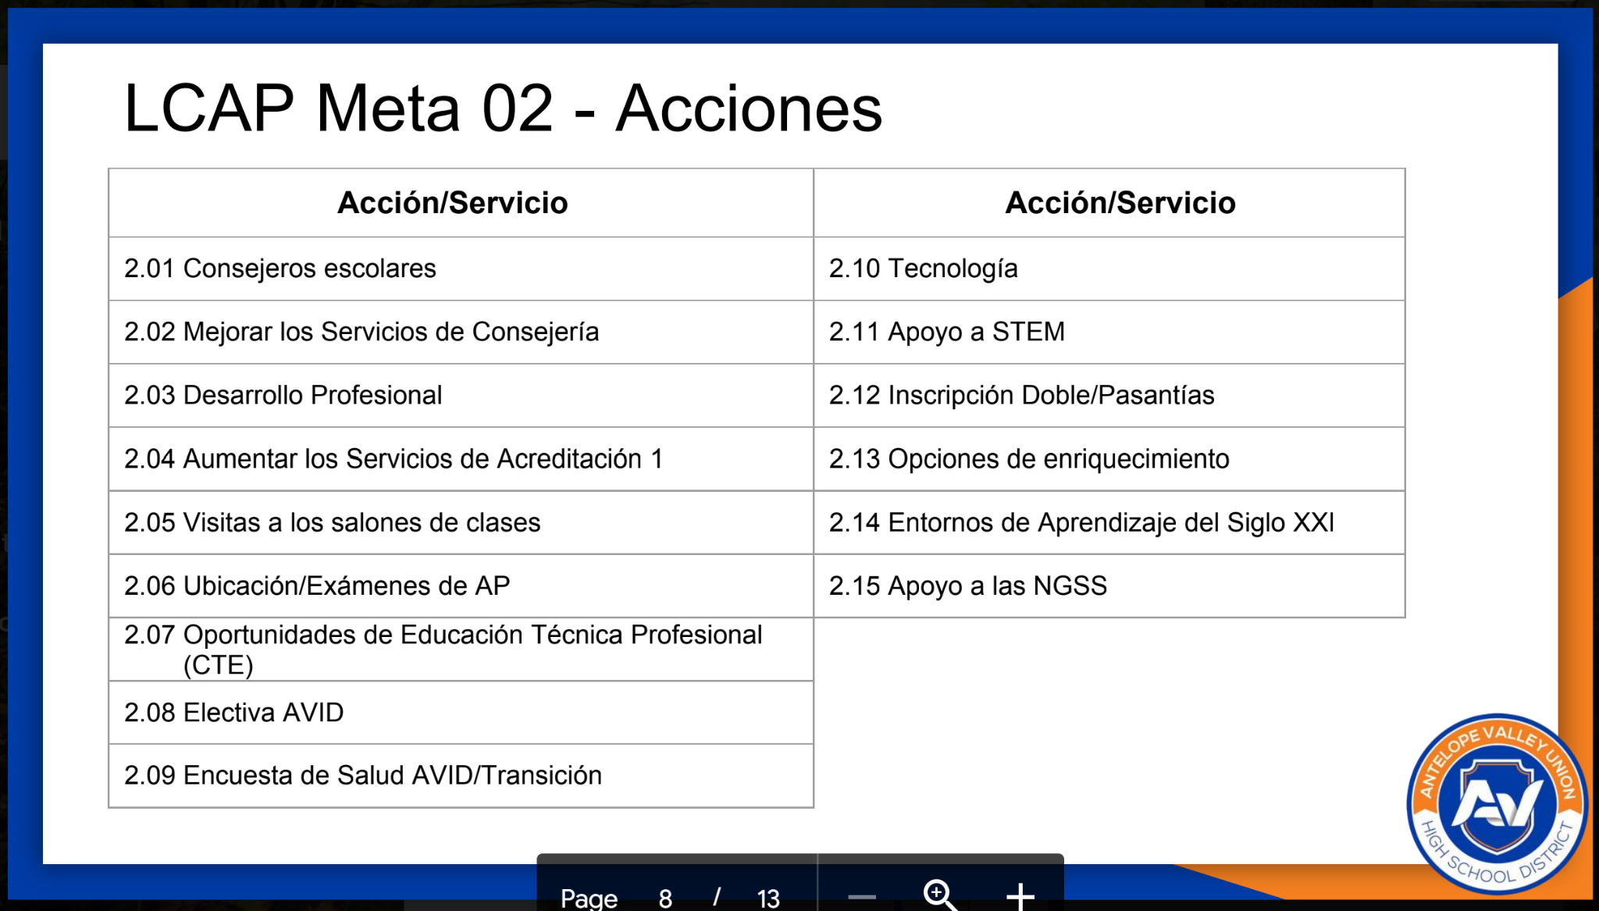

Slide 25
LCAP Goal 3
Cultivate a Safe and Secure, Positive School Culture that Supports all Students' Personal and Academic Growth.

Slide 26
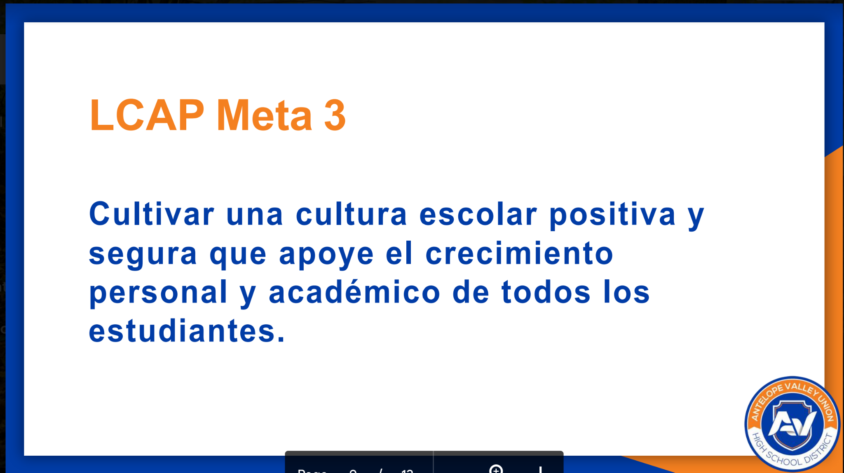

Slide 27
LCAP Goal 03 - Actions
Action/Service
3.01 Access to Standards - Aligned Instructional Materials
3.02 Facilities in “Good” Repair
3.03 Fully Credentialed and Appropriately Assigned Teachers
3.04 Special Education
3.05 CTE Programs
Action/Service
3.08 Student Support Centers
3.09 Implement PBIS
3.10 Classified Professional Development
3.11 Safe, Secure and Positive Learning Environments
3.12 Supplemental Interventions and Supports
3.13 Transportation
3.14 “Independent City”
3.15 Diversity Training
3.06 Recruit and Retain Teachers
3.07 Improve Attendance
3.08 Student Support Centers

Slide 28
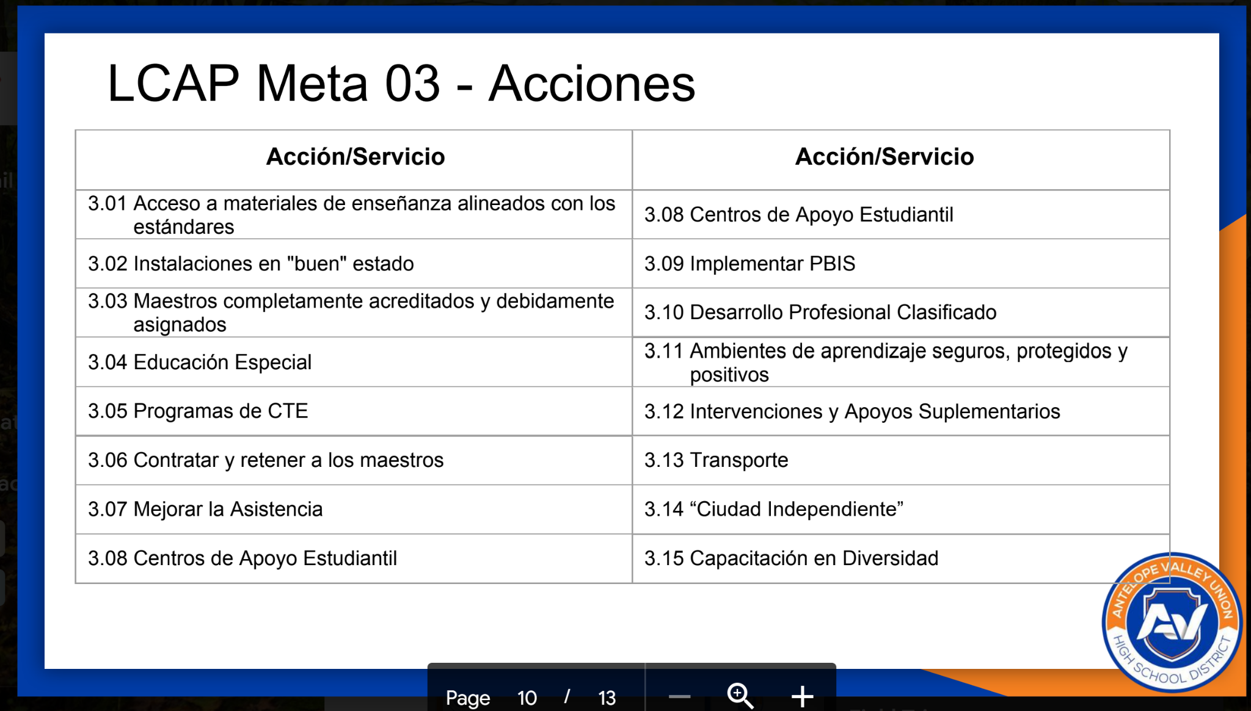

Slide 29
LCAP Goal 4
Communicate effectively with all stakeholders and continue to build relationships in the community that help provide our students with
innovative educational opportunities.

Slide 30
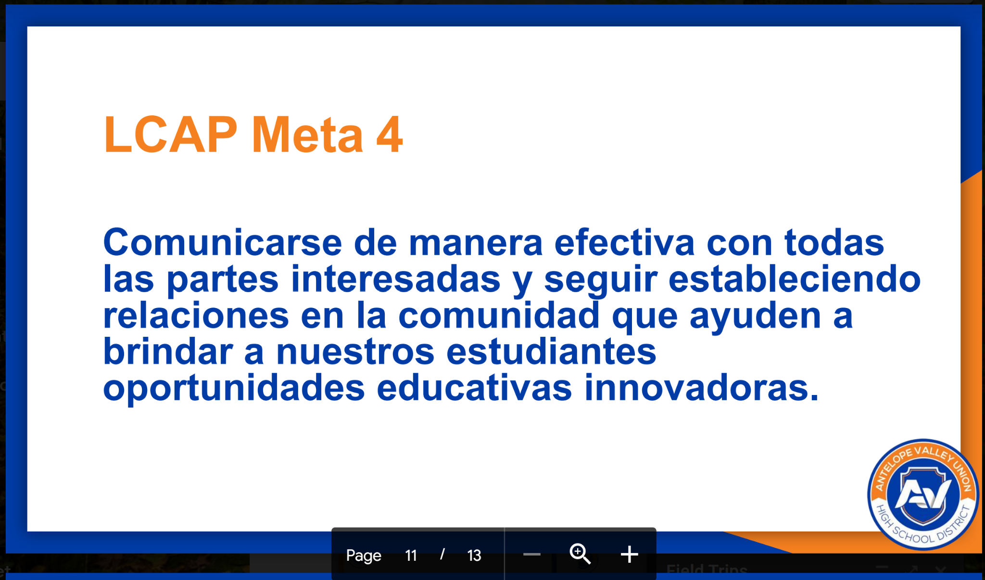

Slide 31
LCAP Goal 04 - Actions
Action/Service
4.01 PowerSchool
4.02 Qualtrics
4.03 Parent Link
4.04 EL Workshops
4.05 Cafe Con Leche
4.06 Parent/Family Collaboration
4.07 Increase Communication

Slide 32
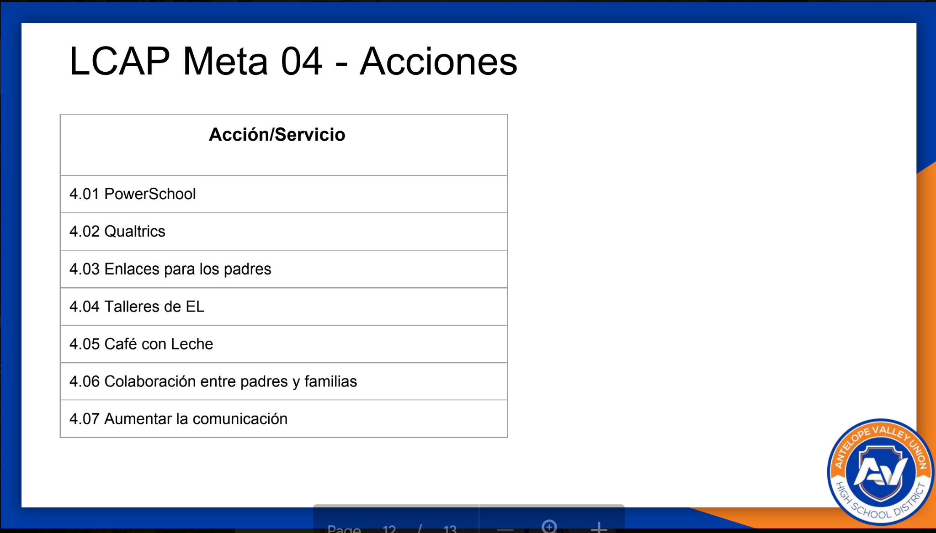

Slide 33
Questions?
?
?
?

Slide 34
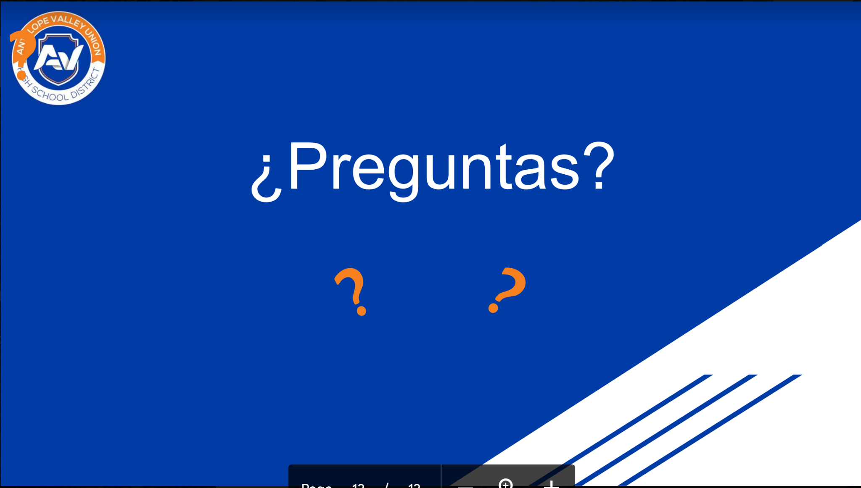

Slide 35
Aprobación de Minutas/Approval of Minutes
Please review the minutes from the last DELAC meeting in December
2 motions needed to approve
Por Favor revisen las minutas de la última junta de DELAC en Diciembre
Se necesitan 2 mociones para aprobar
Notes:
https://docs.google.com/document/d/126odXv2HgXN0sYRiuVftN7GGyCcVWB2t/edit?usp=sharing&ouid=109322047054228582600&rtpof=true&sd=true

Slide 36
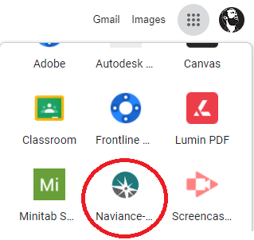

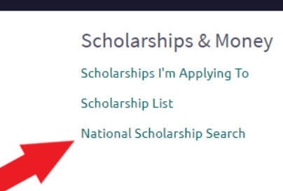
Scholarship Information / Informacion de Becas
Naviance Scholarship Search -Búsqueda de becas -Google
Search for scholarships nationwide for students in all grade levels
Complete the student profile to get results
Busque becas en todo el país para estudiantes en todos los grados
Complete el perfil del estudiante para obtener resultados
Top Scholarship Search Engines/Sitios web de búsqueda de becas
  www.goingmerry.com/
  www.cappex.com
  www.collegescholarships.com
  www.fastweb.com
  https://myscholly.com/
www.niche.com/colleges/scholarships/
https://pridefoundation.org/find-funding/scholarships/
www.scholarships.com
www.uncf.org
www.hsf.net
Notes:
Pablo

Slide 37

Scholarship Advice = consejos
PARA BECAS
Start searching EARLY - comience TEMPRANO
RESEARCH everywhere! - INVESTIGAR en todas partes!
Meet eligibility - Cumplir con Elegibilidad
Create a list with deadlines - Crear una lista con fechas limites
Make a list of accomplishments - Haz una lista de logros
Ask for Letters of Recommendations - solicite Cartas de Recomendaciones
Apply to as many as possible! - Aplicar a tantas como sea posible!
Do NOT give personal information (SSN, CA ID#) - NO DAR información personal
Notes:
Pablo

Slide 38

Ayuda Financiera para la Universidad
¿Qué es la ayuda financiera?
Dólares fiscales presupuestados:
  Para ayudar a los estudiantes a pagar la universidad
  Para quienes no pueden pagarlo solos o con asistencia familiar
Notes:
MARTHA

Slide 39

Fuentes de Ayuda Financiera
Gobierno federal
Gobierno estatal
Colegios, universidades, y escuelas vocacionales
Agencias privadas, empresas, fundaciones y empleadores.
Notes:
Martha

Slide 40

No necesitas devolver dinero
Tipos de Ayuda Financiera
Grants (Dinero Gratis)
  Dinero que te dan a ti para usar en la universidad
  Basado en la necesidad financiera
  Cal Grant: Promedio de calificaciones
    3.0 - hasta $5,000
    2.0 - hasta $2,000
Becas
  Dinero que te dan a ti para usar en la universidad
  Basado en la necesidad, talento, habilidad o mérito académico
Notes:
Martha

Slide 41

Tipos de Ayuda Financiera
Gana un sueldo
Ahorra
Paga por tus libros
Paga por imprevistos
Work-study (Estudio y trabajo)
  trabajo en el campus
    trabajo programado para antes o después de clases
Préstamos estudiantiles
  dinero prestado para la universidad,
  intereses son pagados por el gobierno
    comienzan a hacer pagos 6 meses después de la graduación o que deja la escuela
Debe devolverse
Notes:
Martha

Slide 42

Calculando Necesidad Financiera
Costo de asistencia (CDA)
  Matriculación y tarifas
  Libros y materias
  Alojamiento, comida, transportación y gastos personales.
Notes:
Martha

Slide 43
Ayuda Financiera para la Universidad
¿Qué es la ayuda financiera?
Dólares fiscales presupuestados:
  Para ayudar a los estudiantes a pagar la universidad
  Para quienes no pueden pagarlo solos o con asistencia familiar
Notes:
MARTHA

Slide 44
Fuentes de Ayuda Financiera
Gobierno federal
Gobierno estatal
Colegios, universidades, y escuelas vocacionales
Agencias privadas, empresas, fundaciones y empleadores.
Notes:
Martha

Slide 45
No necesitas devolver dinero
Tipos de Ayuda Financiera
Grants (Dinero Gratis)
  Dinero que te dan a ti para usar en la universidad
  Basado en la necesidad financiera
  Cal Grant: Promedio de calificaciones
    3.0 - hasta $5,000
    2.0 - hasta $2,000
Becas
  Dinero que te dan a ti para usar en la universidad
  Basado en la necesidad, talento, habilidad o mérito académico
Notes:
Martha

Slide 46
Tipos de Ayuda Financiera
Gana un sueldo
Ahorra
Paga por tus libros
Paga por imprevistos
Work-study (Estudio y trabajo)
  trabajo en el campus
    trabajo programado para antes o después de clases
Préstamos estudiantiles
  dinero prestado para la universidad,
  intereses son pagados por el gobierno
    comienzan a hacer pagos 6 meses después de la graduación o que deja la escuela
Debe devolverse
Notes:
Martha

Slide 47
Calculando Necesidad Financiera
Costo de asistencia (CDA)
  Matriculación y tarifas
  Libros y materias
  Alojamiento, comida, transportación y gastos personales.
Notes:
Martha

Slide 48

Calculando necesidad financiera
Contribución Familiar Esperada (CFE)
    Cantidad de dinero que el gobierno cree que tu y tu familia pueden contribuir razonablemente a tu educación
  FAFSA/CADAA
  Necesidad Financiera es:
CDA - CFE = Necesidad Financiera
Notes:
Martha

Slide 49

Ejemplo de Cálculo de Necesidad Financiera
¿Cómo determina el gobierno CFE?
FAFSA o CADAA
CSUN
Costo De Asistencia: $28,500
Contribución Familiar Esperada: 5,000
Necesidad Financiera: $23,500
Notes:
Martha

Slide 50


FAFSA or CADAA?
FAFSA
Ciudadano estadounidense
  La tarjeta del Seguro Social se ve así
  No ciudadano elegible (Visa)
CADAA: California Dream Act
Estudiantes de Dream Act
  Seguro social se ve asi
  Estudiantes indocumentados
Notes:
Martha

Slide 51


FAFSA & CADAA
Recomendado/a:
  Completa lo antes posible
    Los fondos son limitados
    Posibilidad de recibir más ayudas
¡Cada año, las solicitudes abren el 1 de octubre y cierran el 2 de marzo!
Fecha límite de prioridad para Solicitud de Ayudas 2022-2023 este año: 2 de marzo de 2022
Notes:
Martha

Slide 52

AVC New Student Success Workshops
Workshops for early registration - Talleres para inscripción anticipada
Dates - Fechas
Wednesday, February 9, (1pm-3pm)
Thursday, February 17, (10am-12pm)
Tuesday, March 22, (3pm-5pm)
Wednesday, March 30, (9am-11am)
Website Link

Slide 53

ELPAC Poll - Encuesta de ELPAC
What do you know about ELPAC?
Qué sabes sobre ELPAC?
4 Questions
4 Preguntas
Notes:
Crotty
How often do students take the ELPAC?
1x only
Annually until they reclassify
Twice a year
Which of the following is not a domain for ELPAC?
Listening
Speaking
Critical thinking
Reading
True or False, all Spanish speaking students have to take the ELPAC?
True or False, there are resources to prepare for the ELPAC

Slide 54


ELPAC Information / Información de ELPAC
ELPAC exams
  Initial
  Summative
  Alternate
All EL students take the Summative test Annually
There are 4 Domains
  Listening
  Reading
  Writing
  Speaking
Exámenes ELPAC
  Inicial
  Sumativo
  Alterna
Todos los estudiantes Aprendices de inglés toman el examen sumativo anualmente
Ay 4 Dominios
  Auditiva/Escuchar
  Lectura
  Escritura
  Expresion Oral
*** ELPAC will be in person - ELPAC sera en persona
Notes:
Mirna

Slide 55
ELPAC Resources / Recursos ELPAC
ELPAC Website/
Video Introduction / Video de introducción
Parent Resources / Recursos para padres
ELPAC Resources / Recursos de ELPAC
  Practice tests / examenes de practica
  Domain information / Información de los dominios
ELPAC Smarter website / Sitio web de ELPAC Smarter
Video on using the practice test / Video de como usar el examen de práctica
Notes:
Mirna

Slide 56
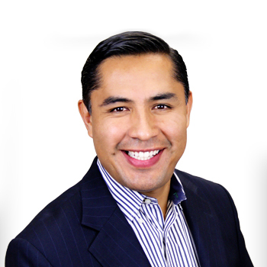

Positive Discipline Workshops / Talleres de Disciplina Positiva
FASE 4 : Cómo Motivar y Ayudar a tu Adolescente Ante su Elección de su carrera profesional y Descubrir su Propósito de Vida
Phase 4 : How to Motivate and Help Your Teenager in His Career
Choice and Discover His Life Purpose
DATES / FECHAS:
Tuesday/Martes, Feb. 1, 8, 15, 22, Mar. 1, 8 - 5:00-630 PM
Wednesday/Miercoles, Feb. 2, 9, 16, 23, Mar. 2, 9 - 11:00-12:30 PM
Friday/Viernes, Feb. 4, 18, 25, Mar. 4, 11, 18 - 9:00 - 10:30 AM
Friday/Viernes, Feb. 4, 18, 25, Mar. 4, 11, 18, - 3:00 - 4:30 PM
Notes:
Crotty
Hope this is okay with everyone on how I wrote it up We can add the flyers links
https://drive.google.com/file/d/1dUWOAaiomkxBF8AUyJfcfWa_7czQHLE3/view
https://drive.google.com/file/d/1g4qs1o1T_06E0VeDKihaK_D36zfXm7jP/view
https://drive.google.com/file/d/1q5OUNay1OwTnkvKKUVJsWWlVi1E-EE2Z/view

Slide 57

Talleres de Salud Mental
Mental Health Workshops
You Are Invited!! Los Invitamos!! 😊
02/15/22 Hora: 12:30pm Tema: Prevención de Violencia Familiar
02/22/22 Hora: 12:30pm Tema: Uso y prevención de drogas y alcohol durante COVID-19
02/15/22 Hora: 12:30pm Tema: Family Violence Prevention During COVID-19
02/22/22 Hora: 12:30pm Drug and Alcohol Use and Prevention During COVID-19
Notes:
Crotty
Microsoft Teams meeting
Join on your computer or mobile app
Click here to join the meeting
Or call in (audio only)
+1 323-776-6996,,282902952# United States, Los Angeles
Phone Conference ID: 282 902 952#

Slide 58
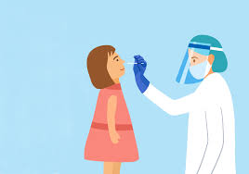
COVID Tests - Pruebas de COVID
Order your at home COVID test
Ordene su pruebas de Casa
www.usps.com/covidtest
Notes:
Crotty

Slide 59

Community Resources - Recursos Comunitarios
Find Help - Ayar Ayuda
PDF with resource - Hoja de recursos
CPR - LACARE
Notes:
Crotty
Find Help - you can find resources in your community with just a zip code
PDF - numbers of all the resources in our community
CPR - this is something you requested at the last meeting

Slide 60

Alternative Placement - Colocacion Alternativa
On Site Continuation
Escuela de Continuación
Continuation School
Escuela de Continuación
Independent Study
Estudio Independiente
Notes:
Attendance
If you would like a more detailed explanation we can present a the next DELAC

Slide 61
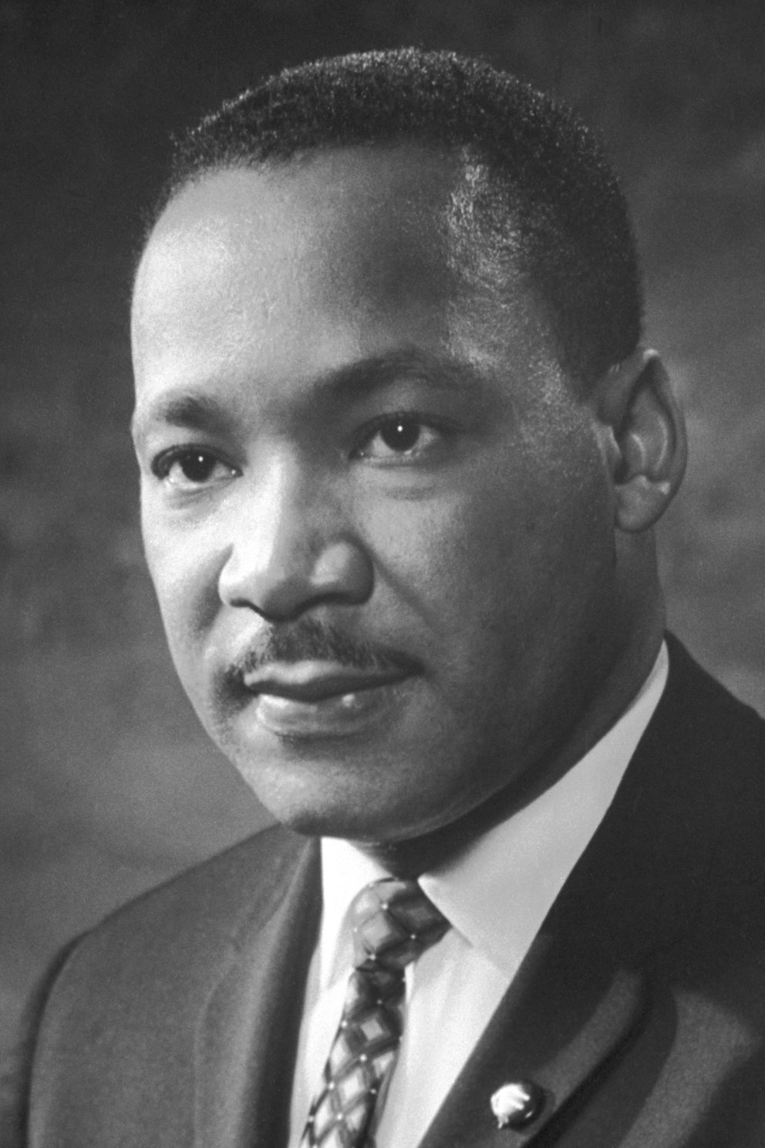
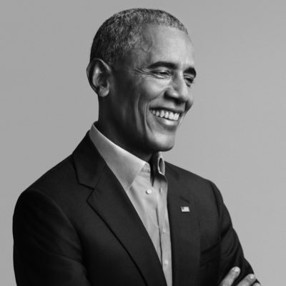



Black History Month
Started in 1915 - Comenzo en 1915
Celebrate all of February - Celebramos todo Febrero
Honor African American Men & Women - Honra a los hombres y mujeres afro americanos
Mez de la Historia Afro Americano y Afro Latino
Notes:
Crotty
Started as only a week, was selected to be celebrated the second week of february as this is Lincoln's birthday and Frederick Douglas. Carter Woodson is the Father of Black History month, he lobbied to encourage the study of African American history. The Civil Rights helped elevate black history and then the week evolved to a month. Black history month is meant to honor African American men and women and to recognize their central role in US history
Add Latin X African Americans

Slide 62

Important Dates / Fechas Importantes
Feb. 11th - Lincoln’s Birthday
Feb. 21st - President’s Day
Open Enrollment - March 11, 2022
  Application / Applicacion
  Applications can be emailed to: studentservices@avhsd.org
  Aplicaciones pueden ser mandalas a: studentservices@avhsd.org
  https://www.avdistrict.org/parents/open-enrollment
DELAC- March 9th - virtual/in-person
Notes:
Ana

Slide 63
Temas Para la Siguiente DELAC - 9 de Marzo de 2022
Topics for next DELAC - March 9, 2022

Slide 64

Gracias!
Thank You!

