Slide 1

FY18 Budget
Joint Finance Committee Meeting
November 17, 2016
Prepared by:
Stacey Metternick, School Committee Chair
Dr. Michael Harvey, Superintendent of Schools
Jeffrey D. Sands, Assistant Superintendent for Finance & Administration

Slide 2

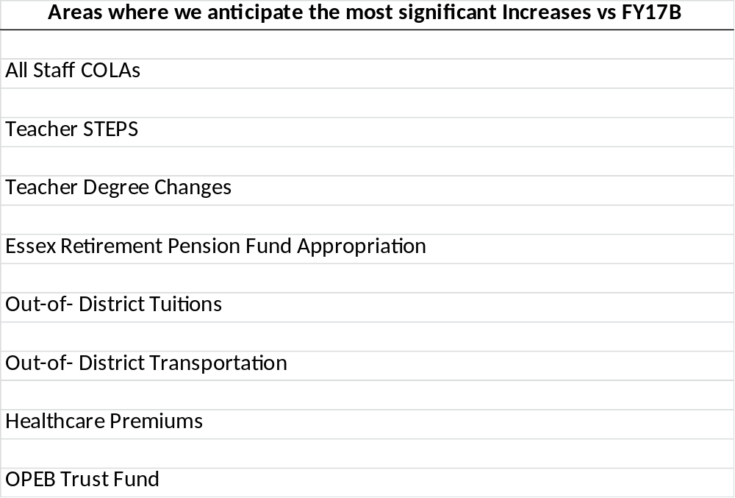
FY18 Budget – Primary Drivers
Budget Recommendation to School Committee on 12/15/16

Slide 3
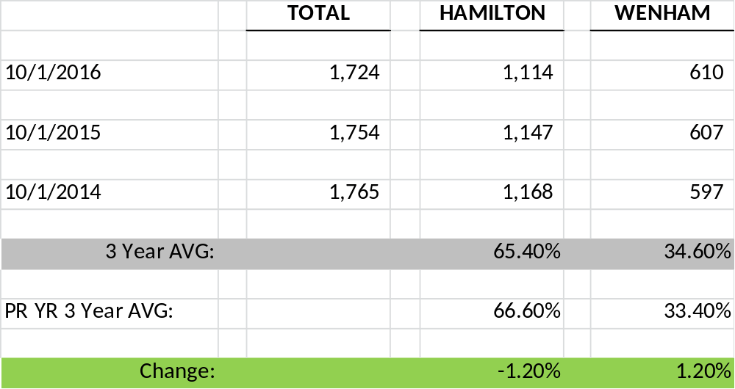
FY18 Budget – Enrollment Shift
Enrollment Data sent to Towns on 10/24/16
Note: A 1.2% shift is roughly the equivalent of $315,000.

Slide 4
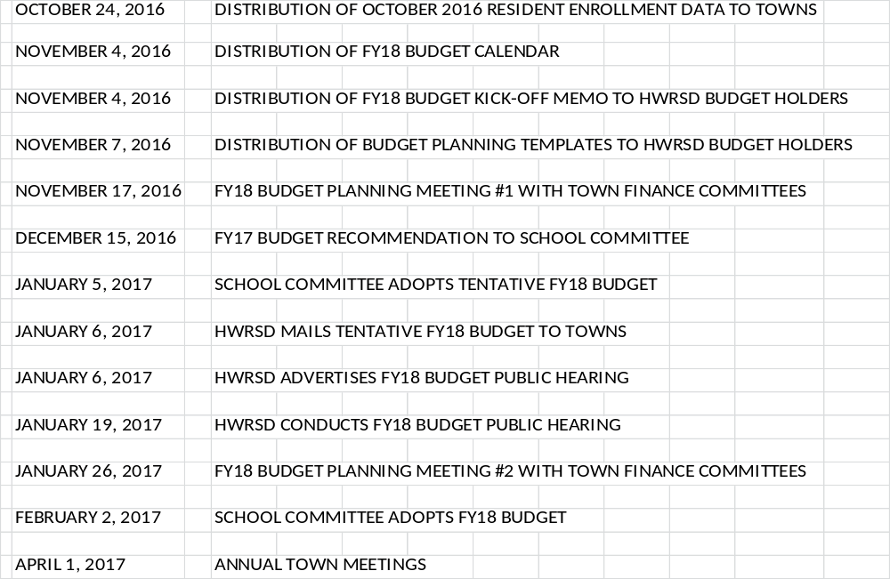
FY18 Budget: Calendar

