Slide 1

Interact Club
Susquehanna Township High School

Slide 2
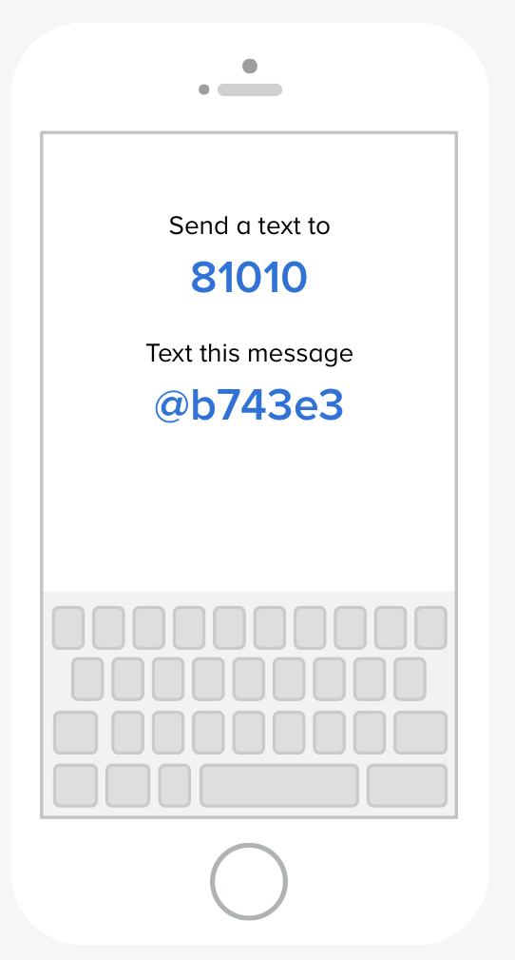

OFFICERS
FACULTY ADVISOR:
Ms. Tracy
Email: Jtracy@hannasd.org
President: Ben Teplitz
Email: 2310004@ststudents.org
Vice-President: Ava Waters
Email: 2310058@ststudents.org
Treasurer: Abby Feather
Email: 2310940@ststudents.org
Secretary: Kelsey McFarlane
Email: 2312860@ststudents.org
Interact Remind:
CLASS CODE:
@b743e3

Slide 3
WHY INTERACT?
Fun service projects
Can help fulfill service hour requirements
Looks great on college applications

Slide 4
HOW TO JOIN
Email Ben Teplitz for the Interact Club Membership Form
1
Fill out the Interact Club Membership Form
2
Come to our next meeting!
3

Slide 5
MEETING DATES AND TIMES
Jan. 28, 2022 @ 7:00 AM
In STHS Library
Feb. 11, 2022 @ 7:00 AM
In STHS Library
Feb. 25, 2022 @ 7:00 AM
In STHS Library

Slide 6
THE FOUR-WAY TEST
The four-way test is a moral code that is used by Interactors and Rotarians in almost all aspects of life
The four-way test is:
  Is it the truth?
  Is it fair to all concerned?
  Will it build goodwill and bear friendship?
  Will it be beneficial to all concerned?

Slide 7
PAST PROJECTS
Ski 4 Life- Leukemia and Lymphoma Society
Supported school building project in Sudan
Helped kids at the Womelsdorf Children's Home
Third Grade Dictionary Project at Thomas Holtzman Elementary School
Solar Computer Project in South America
Supported families through the YWCA
Helped keep the Hanna Hope Garden clean
American Heart Association Walk for Life
Pizza ½ Day sales for purchasing cots for "Our Daily Bread"
Helped in the kitchen of the Bethesda Mission
And many more!

Slide 8
CURRENT PROJECTS
Adopt-an-Inlet project: March 26, 2022 from 1:00 pm – 3:00 pm
Virtual Dictionary Project: more information to come

Slide 9
Virtual Rotary Speech Contest
Grade eligibility: 10th-12th grade
Speech length: five-to-eight minutes (will get points off if it is shorter than five minutes or longer than eight minutes)
Speech must deal with this year's prompt (TBA) and the four-way test
The four-way test is:
  Is it the truth?
  Is it fair to all concerned?
  Will it build goodwill and bear friendship?
  Will it be beneficial to all concerned?
Registration link: https://tinyurl.com/yxdlr2m3
How to register: email Ben Teplitz or Mrs. Tracy
Date and time: TBA
Past speeches: https://www.rotary7390.org/page/four-way-test-speech-contest
Prize money at the final District presentation is $750 for 1st place, $500 for 2nd place and $250 for 3rd place.

Slide 10
Rotary Speech Contest Club-Level Results
Winner: Mubarra Ali
Runners-Up: Chrystelle Angerville and Ashika Adhikari
We wish Mubarra Ali the best of luck at the mid-level round!

Slide 11
Virtual Dictionary Project
Students will read a script, teaching elementary students how to use a dictionary
More information coming soon!

