Slide 1

Are you “App”-solutely, “App”-prensive about your integration “App”-proach?
DON’T WORRY . . . GET APP-Y!

Slide 2
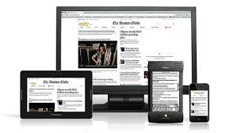
iPad or other Device?
App or Web Tool?
BYOD?
“Device Neutral”

Slide 3
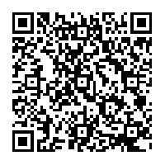
Session Resources
http://www.pike.kyschools.us/Default.asp?PN=DocumentUploads&L=3&DivisionID=4652&DepartmentID=4462&SubDepartmentID=1979&LMID=182692&ToggleSideNav=ShowAll
OR
http://www.pike.kyschools.us and drill down through Departments>Technology>Technology Integration Specialists > Document Uploads
and open the iPad folder to find the resources presented.

Slide 4
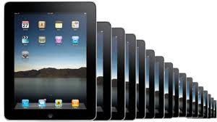
iPad Deployment in Pike County Schools
Only 1 iPad, Shared iPad Cart, and 1:1 iPad Classroom
Notes:
Pike County Schools Dir. Fed Progs. Robbie Osborne with Director of Tech Clayton Potter
District this large could not buy a set of ipads for every classroom, so
Summer 201? Request for Proposal went out to school over the summer.
Schools/Teachers had to write a grant narrative explaining what they would do if they had a set of classroom ipads.
Every K-8 school got at least one cart of 30 Larger schools with higher enrollments and strong proposals got two carts. Since that time some schools have used other funding sources to get an extra cart and Gear Up funds were used so that every math teacher received an iPad. We now have about 600 ipads in our schools.
We did some initial training on Setting up an iPad and how to operate an ipad for all the iPad teachers.

Slide 5

URGENT:
Classroom Management, Safety, & Security Tip
AUP and Parental Permission Forms
13 and older, only?
iPad Check Out Procedures
iPad Student Pledges
Organize Apps into Folders
Closing Apps

Slide 6


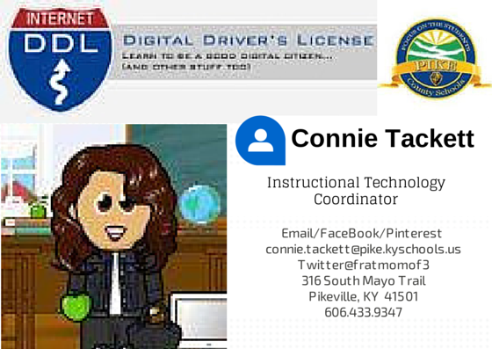
App
https://otis.coe.uky.edu/DDL/launch.php

Slide 7



District Initiatives
& iPad Integration
Edmodo Lync
CIITS
Notes:
We also covered some district initiatives and how these programs worked on the ipad device during that first training, before we grouped our iPad Teachers. The ITC began to investigate apps and starting making a resource list of apps.

Slide 8
The One iPad Classroom
“Help, I have one iPad and 30 students! What can I do?”
Notes:
Provided PD for the 1 or Just a Few iPads and 1:1 Ipad Classrooms.
For the Only 1 iPad Teachers (plus Just a Few iPads), we revisited the some of the trainings we had offered in the past such as COW and How to Do Learning Centers. With the 1:1 iPad classroom, we asked teachers to begin this first year of implementation by just trying out some free apps that provided content area practice.

Slide 9

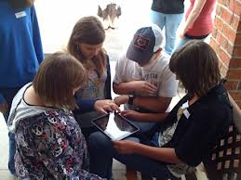
The 1:1 iPad Classroom
“Show What You Know”
Notes:
Before the next year, iPad teachers were ready to bump it up a notch to “Show What You Know!”

Slide 10
I Can . . .
. . . show how my students will demonstrate learning using the iPad.
Before, our focus was to find apps that allowed students to practice a concept.
Now, we want to move forward. Students need to “Show what they know.”
Today, we will focus on how students can use multiple apps and document sharing to demonstrate proficiency and accountability for learning.

Slide 11
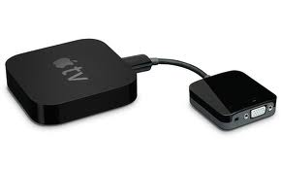
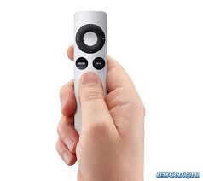

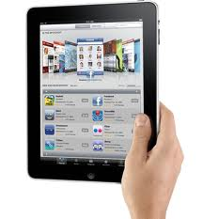
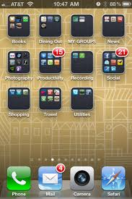
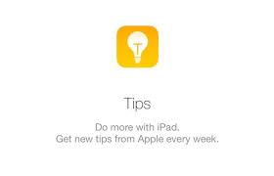

Instructional Technology Coordinators
Apple TV Set Up and Issues
Volume Purchasing Program (VPP)
Operating Tips

Slide 12

TIPS
Use a timer like the one on your SMART Board when giving students an iPad tasks to keep them on-task.
- Find a way for students to submit their work, electronically. Have them make and keep screenshots.
Give students a task that involves a voice recorder so they must speak and perform the task in an app such as Educreations interactive board app.
- App Locking locks students into an app
Say “Flip” as class management word cue for students to instantly turn the iPad screen toward the teacher

Slide 13
ADVICE
1. Make sure students can use Student Email.
2. Learn how to use more than one cloud storage service.
3. Make sure students logout of apps, not just close the app.

Slide 14


Going Paperless
Ann Harkins, Music Teacher
Dorton Elementary
Interactive Board App with a
Voice Recorder https://www.educreations.com/
Makes it easy to assign, collect and review student work http://www.showbie.com/

Slide 15


Classroom Management
And Differentiation
Leigh Ann Francis, Primary Teacher
Bevins Elementary
Build, track, and reward positive student behavior!
https://www.classdojo.com/
FrontRow(ed) Differentiated Common Core Aligned Math Practice for K-8
https://www.frontrowed.com/

Slide 16

Video Conferencing
and Virtual Field Trips
Timothy Brandon Mayhorn
Intermediate Teacher, Phelps Elementary
Lync is a platform for unified communications including online meetings, instant messaging, audio and video calls, availability info, and sharing capabilities.
https://products.office.com/en-us/lync/lync-2013-video-conferencing-meeting-software

Slide 17




Formative Assessment
and Accountability
Suzanne Henson
Intermediate Teacher, Bevins Elementary
www.imore.com/how-to-take-screenshot-ipad
www.gradecam.com
www.google.com/forms/about/
https://www.dropbox.com

Slide 18

Flipped Classroom
Virginia Bowen
Math Teacher, Belfry High School
See iPad Resource Folder for “Video Publishing and YouTube”

Slide 19



Blended Learning and Technology Integration
Amy Newsome
Math Teacher, Southside Elementary
Student Response System App
http://www.socrative.com/how-it-works
See iPad Resources
And
https://www.edmodo.com/
Free - Teachers create and customize interactive content presentations and assessments
http://www.nearpod.com/how-it-works/

Slide 20
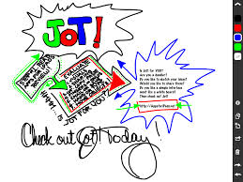
App Smashing!
Amy Carter
Language Arts Teacher, Southside Elementary
Check out the iPad Resources on Jot! and Dropbox
Screenshots, Photos, Genius Scan with Jot!

Slide 21



Check it out @
Genius Scan – scan to a PDF http://www.thegrizzlylabs.com/genius-scan/ http://doceri.com/
Slate-type app to mirror desktop
Remind – Free text message with fake phone number
(formally Remind 101) https://www.remind.com/
Notes:
ClassDojo to make behavior management easy, fun, and engaging for you and your class!
Go to the site and sign up for a free account.
Create your class or classes.
You can add cute monster avatars to students.
Download the app if to your iPads.
Use it on Smart Board or the app.
Tracks and reports class behaviors (positive and negative), attendance, and you can add behaviors like Returned Library Book. You can print these reports.

Slide 22




Prezi – Presentation App
http://prezi.com/create-better-presentations-5/?gclid=CJD8g6yi3boCFUhk7AodXywAlA
Quizlet – Flash Card App, also tests and study games make learning fun and engaging for students of all ages. http://quizlet.com/
“Device-less” Clicker App
https://www.plickers.com/

Slide 23


Slide 24

FAQs and Tips -
IT Jungle
http://www.itjungles.com/ipad-tips/
Apps Gone Free App - download app to see what is free for one day. You can get many apps during their trial period for FREE before that developer starts charging for the app http://appsaga.com/category/apps-gone-free/
edTechTeacher - Great site with learning objectives: http://edtechteacher.org/index.php/teaching-technology/mobile-technology-apps/ipad-as
Edudemic –
http://www.edudemic.com/2013/08/teachers-ipad-guide/
iPad4Schools
http://ipad4schools.org/

Slide 25

Wordle is a toy for generating “word clouds” from text that you provide. The clouds give greater prominence to words that appear more frequently in the source text.
http://www.wordle.net/

