Slide 1
Data To Instruction Framework
Notes:
Use during hands-on time of the training.

Slide 2
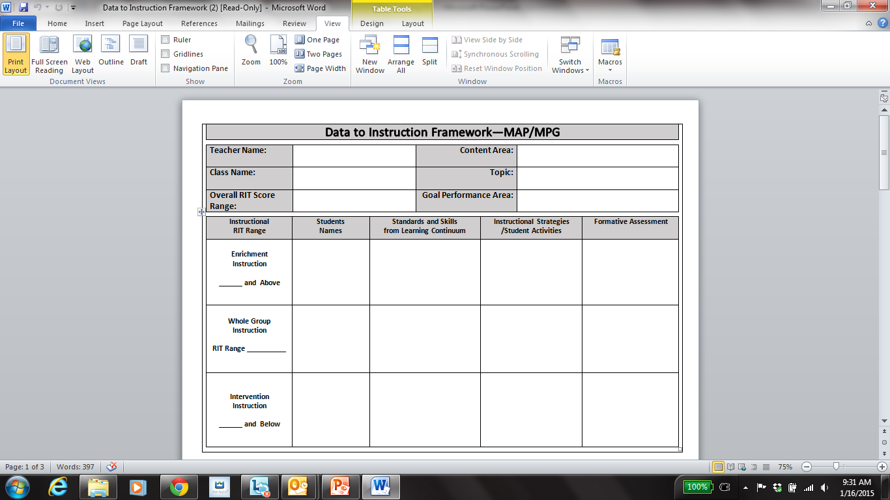
Data To Instruction Framework
Notes:
Use during hands-on time of the training.

Slide 3
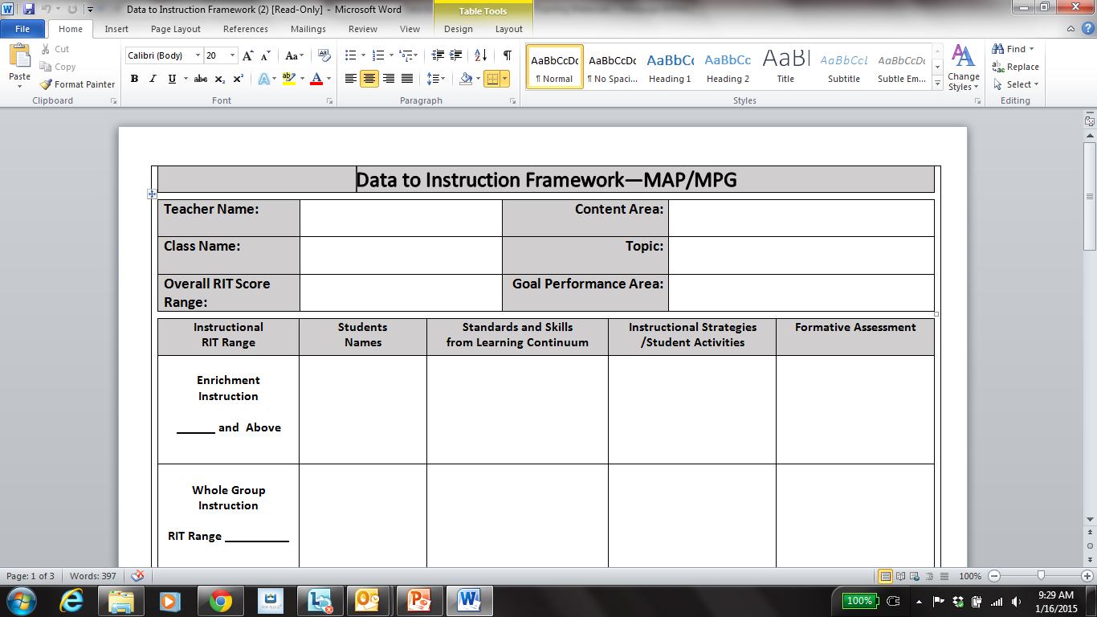
Content Area: Either Reading, Lang. Arts, or Math
Reading
Main Idea
Literature
Goal Performance Area: Example: If you choose Reading as your content area then either Literature, Informational Text, or Vocabulary Acquisition would be your Goal Performance Area.
Topic: The skill(s) on which your instruction will focus.

Slide 4
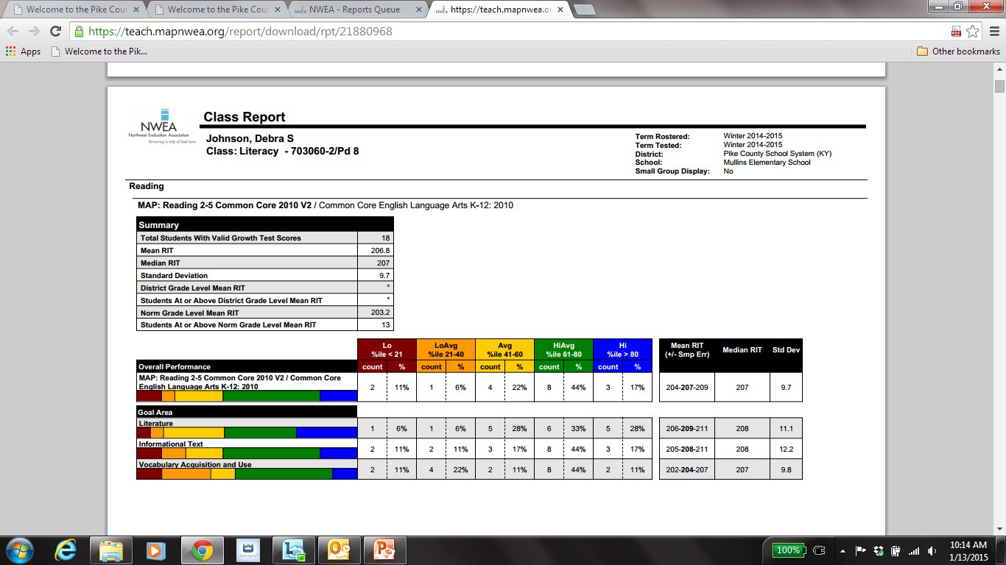
Overall RIT Score Range for a Goal Area in Reading
Class Report Page 2
Notes:
Page 2 of the Class Report is where the Overall RIT score for a subject area is located.

Slide 5
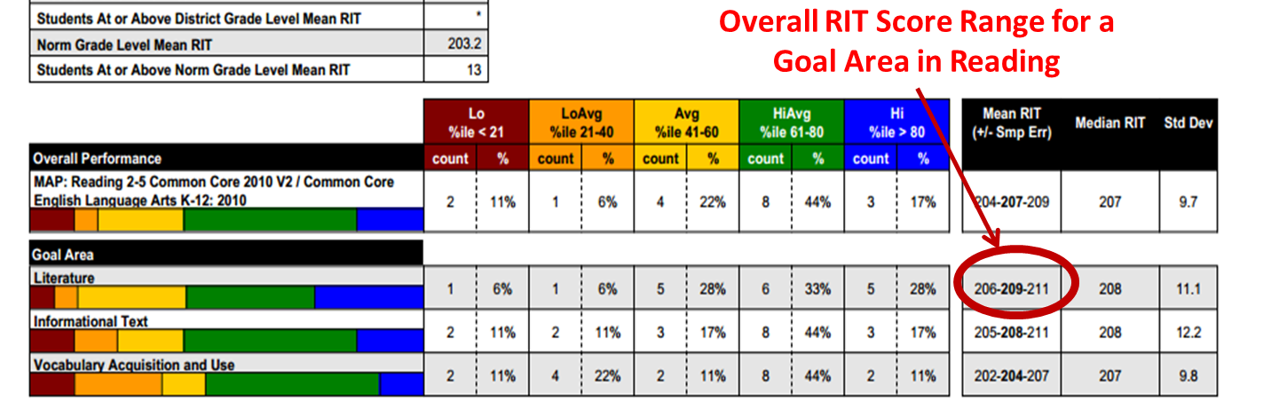
206-211
Transfer the Overall RIT Score from Page 2 of the Class Report to the Data to Instruction Framework
206-211

Slide 6
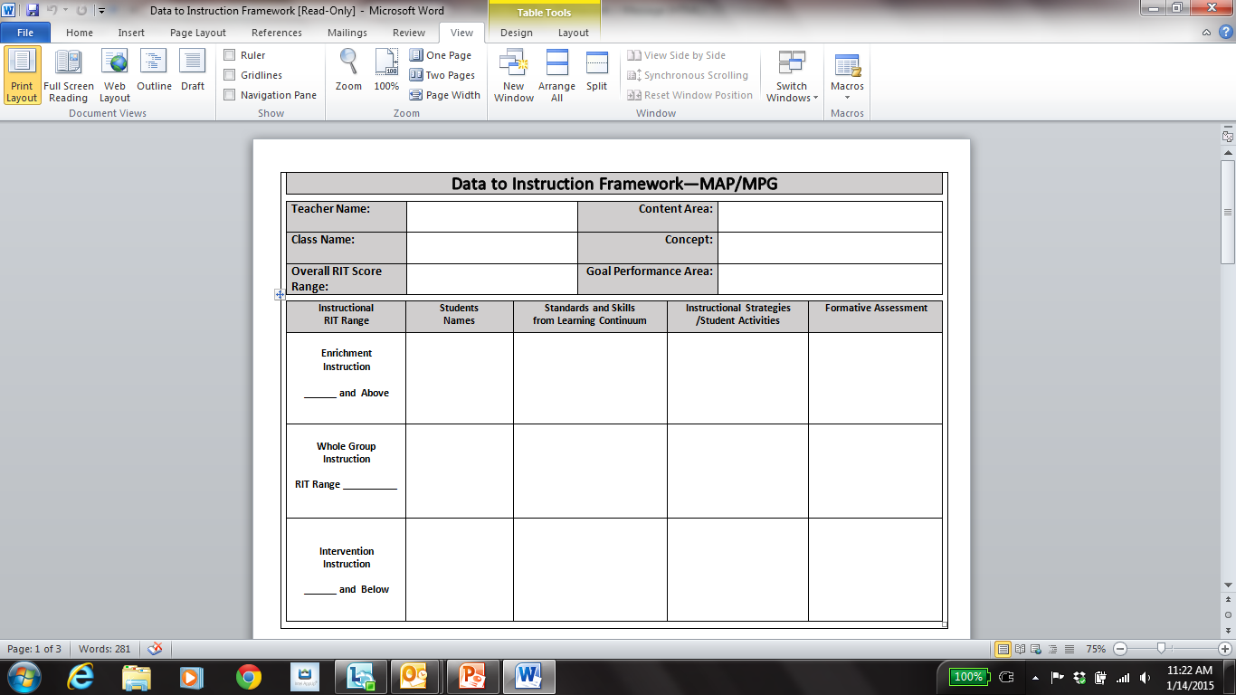
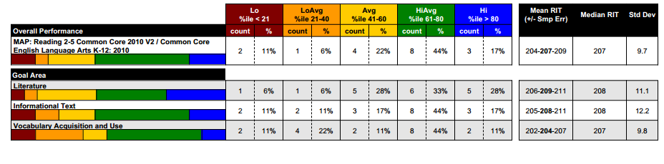
The Whole Group Instruction Range is the same as the overall RIT Score
206-211
Notes:
Change the box titles on here.

Slide 7
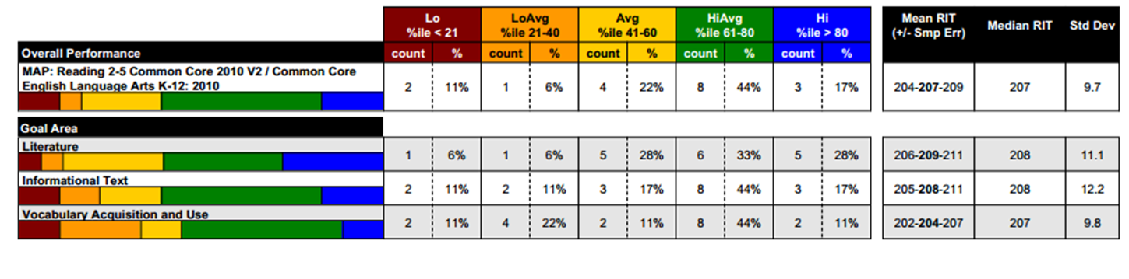

206-211
Intervention Instruction begins 1 point below the lowest number in the Overall RIT Score Range
Enrichment Instruction begins 1 point above the highest number in the Overall RIT Score Range
212
206-211
205

Slide 8
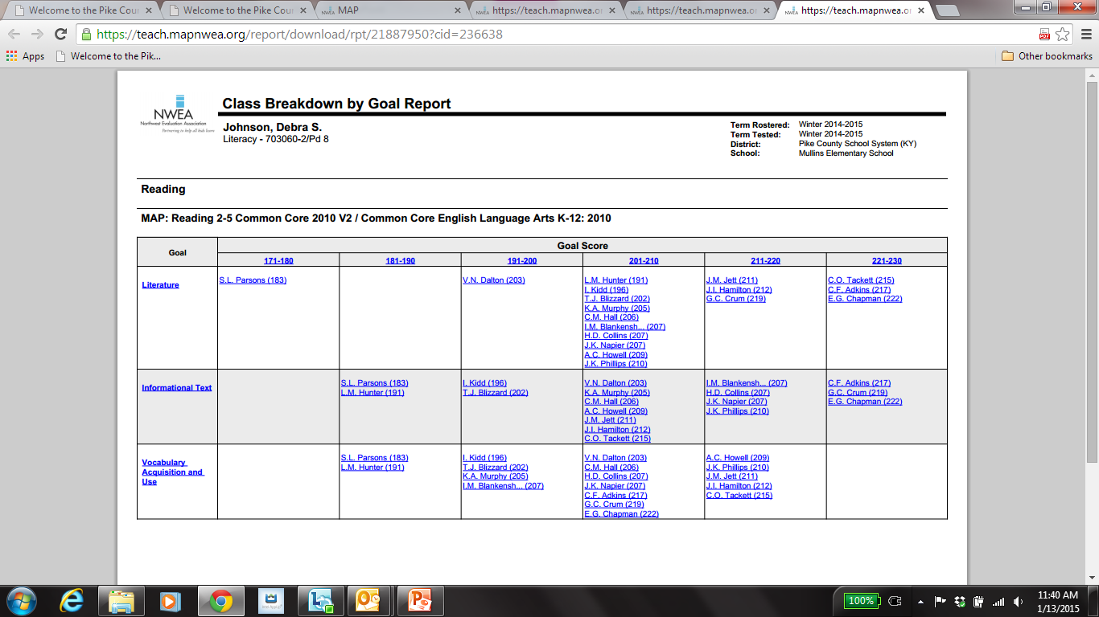
The Class Breakdown Report is used for the next sections of the Data Framework sheet.
J. Cox
M. Lee
T.Ray
C.Dye
G.May
S.Day
E.Lin
M. Fox
L. Ball
K. Hill
P. Art
R. Orr
L. Fin
Drill down in the report until you see the Goal Performance Areas

Slide 9
Even though the Overall RIT Range may not exactly match the RIT band on the Class Breakdown, you use the column that most closely matches the Overall as your group for whole group instruction.
Transfer the student’s names to the corresponding column
M. Fox R. Orr
L. Ball L. Fin
K. Hill
P. Art
212
T.Ray
C.Dye
G.May
S.Day
E.Lin
206-211
J. Cox
M. Lee
205
J. Cox
M. Lee
T.Ray
C.Dye
G.May
S.Day
E.Lin
M. Fox
L. Ball
K. Hill
P. Art R. Orr
L. Fin

Slide 10
Next you go back to the Class Breakdown Report and click on the Goal Area you chose.
J. Cox
M. Lee
T.Ray
C.Dye
G.May
S.Day
E.Lin
M. Fox
L. Ball
K. Hill
P. Art
R. Orr
L. Fin

Slide 11
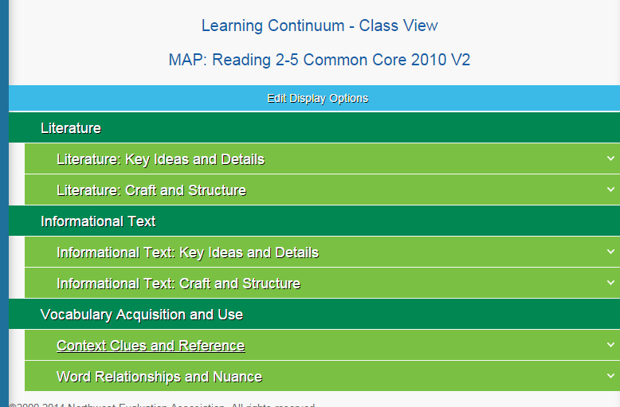
Click on the area under Literature where you would find your chosen topic.

Slide 12
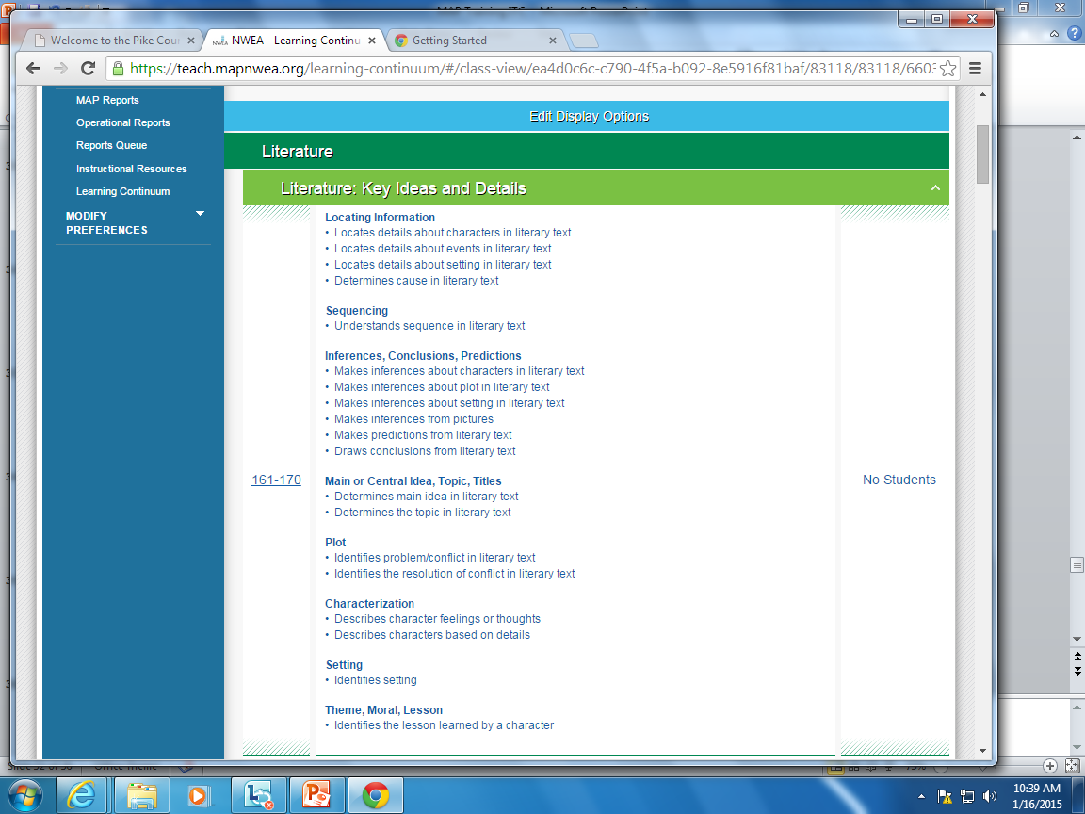
This screen shows the skills that are under Key Ideas and Details. You need to scroll down on the report until you find the RIT band for your whole group instruction

Slide 13
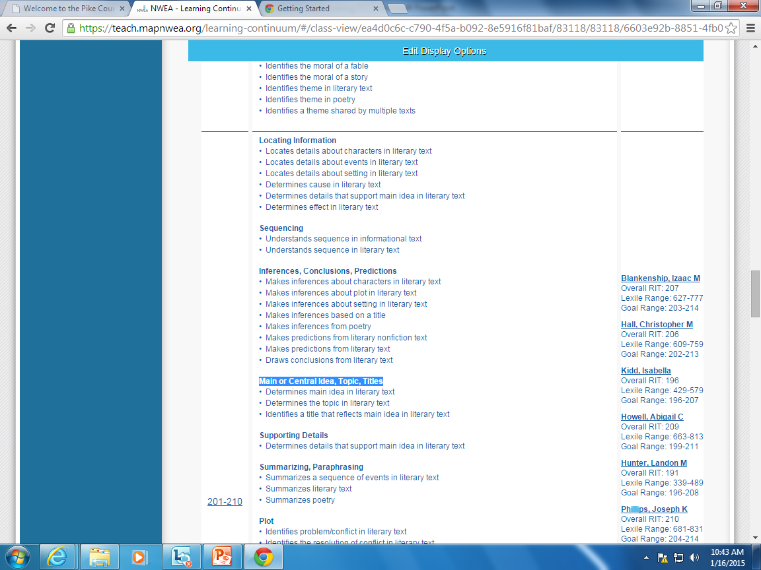
Lines separate each RIT band.
Your students that fall in this RIT band are listed here.
This is the RIT band for your whole group instruction.
Locate your topic and choose 2-3 skills.

Slide 14
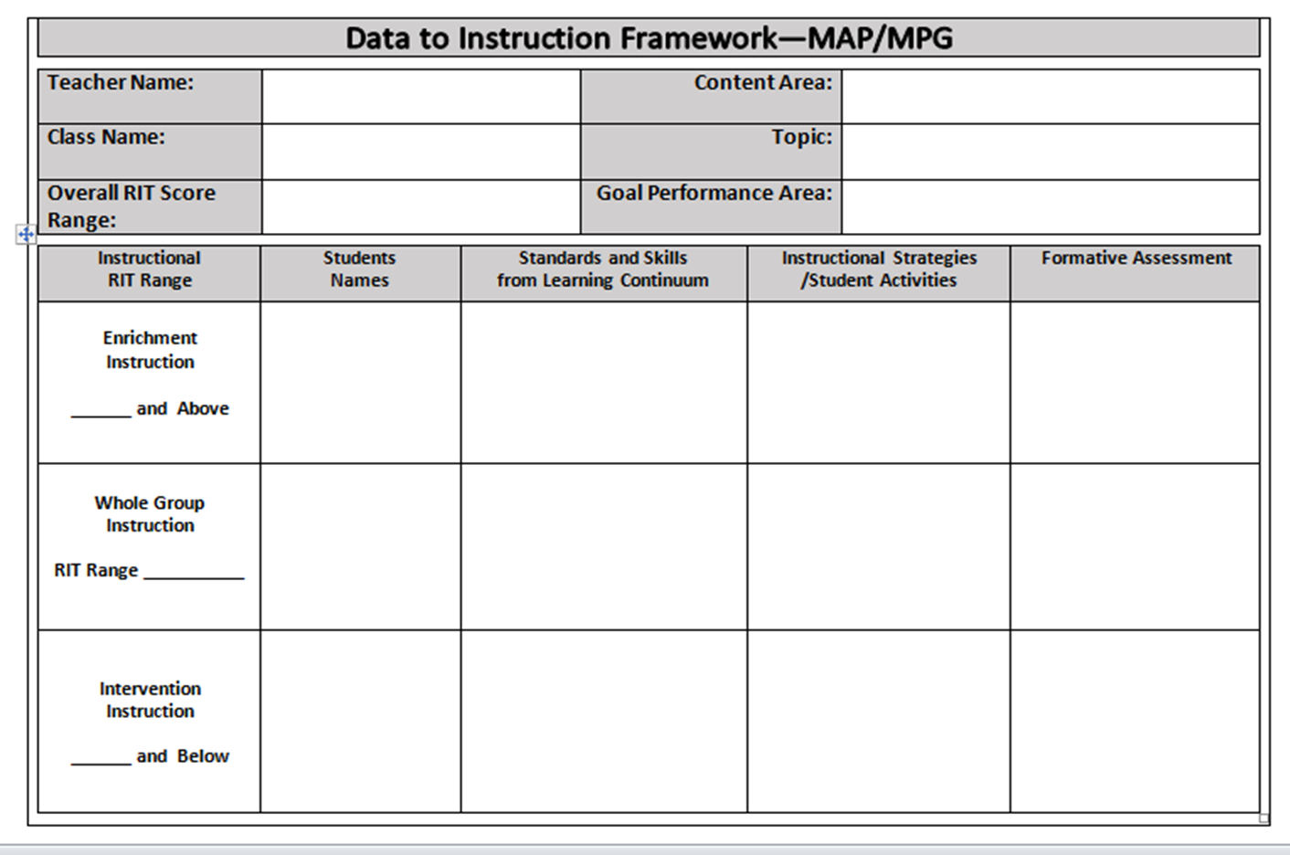
Write the skills you chose on your Data to Instruction Framework in the correct column.
T.Ray E. Lin
C.Dye
G.May
S.Day
-Determine the main idea in a literary text.
-Determine the topic in a literary text.

Slide 15
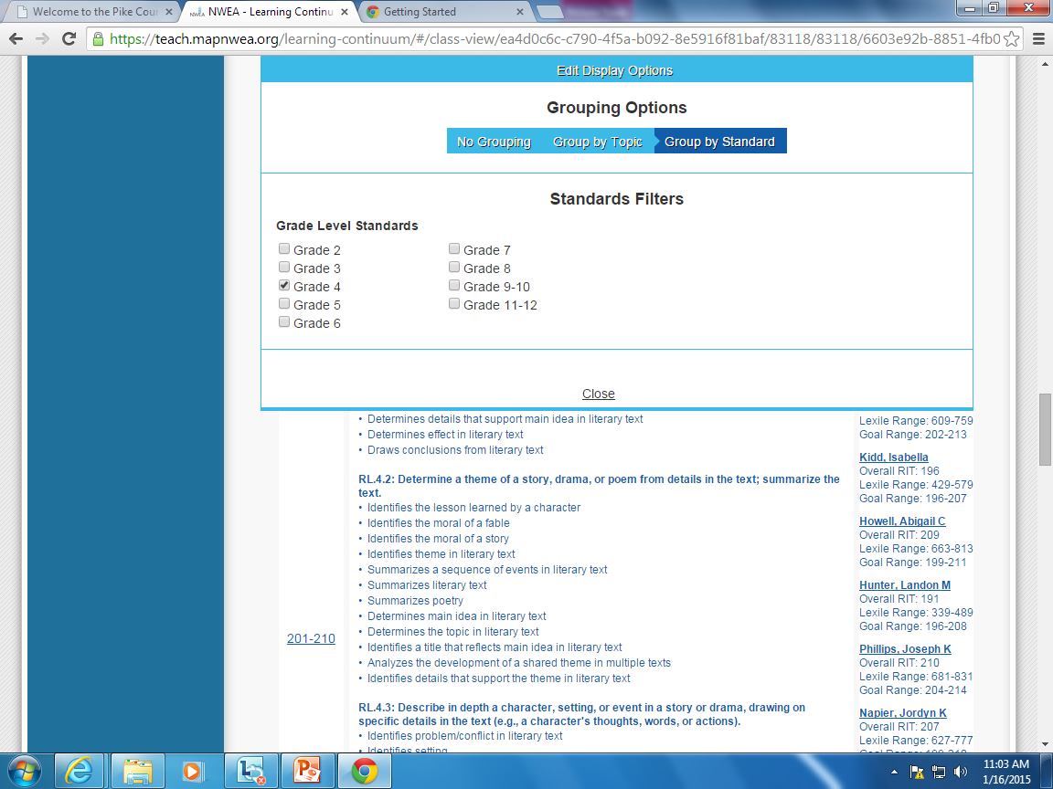
Click Edit Display Options Click Group by Standard Click your grade level.

Slide 16
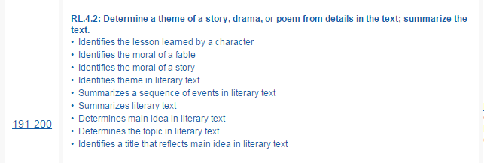
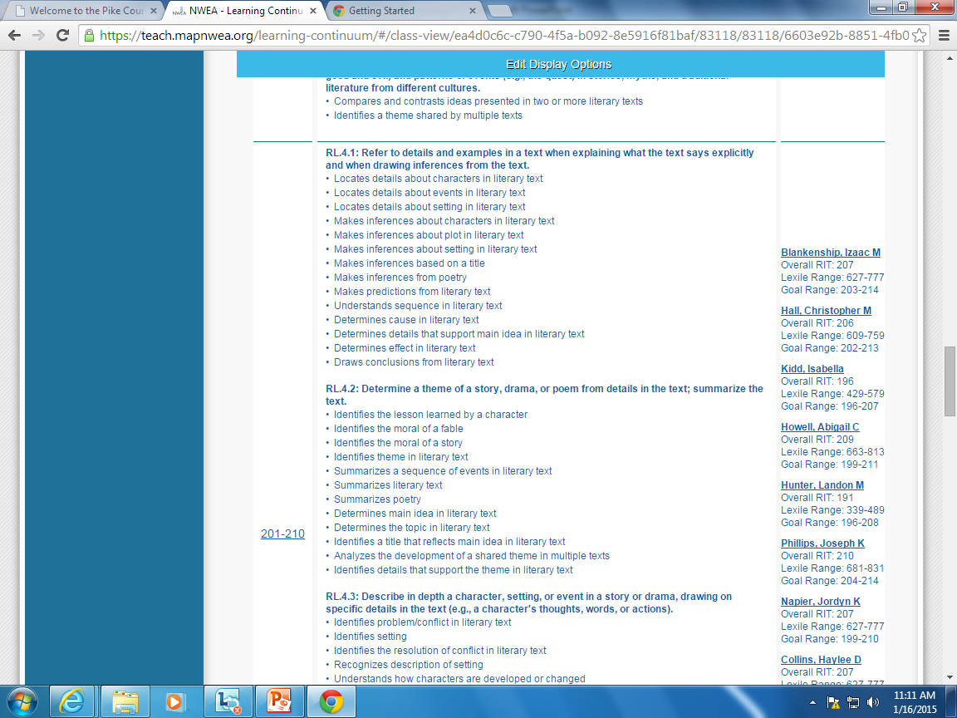
These RL 4.2 skills are for the RIT band just below your whole group instruction RIT band.
These RL 4.2 skills are for the whole group instruction RIT band.
Notice that even though the standard is the same for both RIT bands, there are more skills in the 201-210 band.
Notes:
Refer back to the fact that in the first view on the learning continuum there were only 3 skills listed under our topic of Main Idea, but now that we have switched to Standards View that there are more skills

Slide 17
Look at the Learning Continuum and transfer the Standard Number to your Data to Instruction Framework
T.Ray E. Lin
C.Dye
G.May
S.Day
RL.4.2…
-Determine the main idea in a literary text.
-Determine the topic in a literary text.
206-211

Slide 18
Determine the type of formative assessment you will use (see Types of Formative Assessment handout).
Reading
Main Idea
206-211
Literature
M. Fox R. Orr
L. Ball L. Fin
K. Hill
P. Art
212
RL.4.2…
-Determine the main idea in a literary text.
-Determine the topic in a literary text.
T.Ray E. Lin
C.Dye
G.May
S.Day
Short Test or Quiz
Observation
206-211
J. Cox
M. Lee
205
Notes:
You can use any Formative Assessment you want. Ours came from the Types of Formative Assessment handout.

Slide 19
Now you are ready to focus on the Instructional Strategies. Start with the RIT to Resource website (see resources slide).
Reading
Main Idea
206-211
Literature
M. Fox R. Orr
L. Ball L. Fin
K. Hill
P. Art
212
RL.4.2…
-Determine the main idea in a literary text.
-Determine the topic in a literary text.
T.Ray E. Lin
C.Dye
G.May
S.Day
Short Test or Quiz
Observation
206-211
J. Cox
M. Lee
205
Notes:
On the website search by the lowest number in the whole group instruction RIT band. You can use any instructional resources you have access to. You are NOT limited to what we have listed in this powerpoint.

Slide 20
List your Inst. Strategies/Student Act. that you decide you want to use.
Reading
Main Idea
206-211
Literature
M. Fox R. Orr
L. Ball L. Fin
K. Hill
P. Art
212
T.Ray E. Lin
C.Dye
G.May
S.Day
RL.4.2…
-Determine the main idea in a literary text.
-Determine the topic in a literary text.
Reading the Art (RTR)
Reading IV-Main Idea & Details (A+)
Short Test (ex. use assessment shown with the Reading The Art Activity)
206-211
J. Cox
M. Lee
205
Notes:
After you list the instructional strategies you can fine tune your Formative Assessment. Example: Short Test or Quiz…for the lesson in A+ there is already a built in quiz. On the Reading the Art activity there is are several choices of assessments.

