Slide 1
KY Science Summative Assessment Update
Sean.Elkins@education.ky.gov
Notes:
What’s NEW or DIFFERENT about (the Eng 2 EOC, the Alg 2 EOC, the Bio EOC, and the TCT process)?
What is an EXAMPLE of what to expect?
What are the INSTRUCTIONAL IMPLICATIONS?
What RESOURCES are available/suggested?

Slide 2
Science Assessment System
Classroom Embedded Assessment
Through Course Tasks
State Summative Assessment
evidence
evidence
evidence
KAS for Science
supports
Curriculum & Instruction
Notes:
Each component of the KAS science assessment system is intended to provide different types of evidence about the effectiveness of science instruction so that instruction and assessment can improve systematically, over time. The evidence from each component will influence and calibrate the other components. The KAS science standards demand evidence of the 3 dimensions working together; this assessment system will support developing the capacity of educators and the assessments themselves.

Slide 3
Classroom Embedded Assessment
Through Course Tasks
State Summative Assessment
evidence
evidence
evidence
KAS for Science
Focus is using the 3 Dimensions to make sense of phenomena
supports
Curriculum & Instruction
Notes:
The 3 components of this system work together, providing different evidence to improve instruction and assessment systematically, but the components need to have commonality for this system to “work,” or for the evidence to have some common alignment in order to calibrate. We say that each component has a common focus of “using the 3 dimensions to make sense of phenomena.*” It takes experience and time to develop useful understanding of what this phrase means. We will attempt to unpack this in the next few slides.
*from an engineering perspective we would phrase this as “using the 3 dimensions to solve problems.”

Slide 4
What does it mean to “use the 3 dimensions?”
What do we mean by “phenomena?”

Slide 5
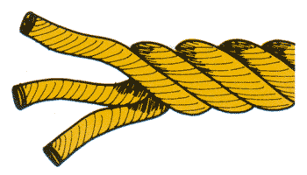

KAS for Science
crosscutting concepts
core ideas
practices
3 dimensions
Notes:
This graphic identifies the 3 dimensions of our science standards. The rope is a metaphor to show that these dimensions are intertwined, resulting in strong sense-making of scientific phenomena/problem solving.

Slide 6
KAS for Science
3-PS2-2
Make observations and/or measurements of an object’s motion to provide evidence that a pattern can be used to describe future motion.
Notes:
An example of a 3rd grade Performance Expectation, or science standard. The color coding identifies the 3 dimensions of the standard. The code in the beginning indicates 3rd grade, physical science, in particular – force & motion (3-PS2-2).

Slide 7
Science and Engineering Practices
Asking Questions/Solving Problems
Developing and Using Models
Analyzing and Interpreting Data
Planning and Carrying Out Investigations
Using Mathematical and Computational Thinking
Constructing Explanations / Designing Solutions
Engaging in Argument from Evidence
Obtaining, Evaluating, and Communicating Information
“Tools for accessing,
processing,
and explaining”
Notes:
The science and engineering practices (SEP) are TOOLS that students use (they are the same tools that scientists and engineers use).
2 main points:
These tools are used to meaningfully access, process, synthesize, and explain information. While some tools may seem very specific to the discipline of science, all disciplines (e/la, Math, SS, etc) use tools similar to these and we should be intentional in our instruction so that students understand this.
Consider which of these SEP (or tools) are “hands-on.” Many think of science as “hands on” learning, which can have the unintended effect of stakeholders assuming that when kids are engaged in a hands on experience that they are learning science in a meaningful way. Only “carrying out investigations” is required to be “hands on.” “Modeling” might be “hands on” but doesn’t have to be because models are more than physical reproductions. Effective use of these tools results in “minds on” experiences. Helping students build proficiency with these tools is one key to effective science instruction.

Slide 8
Crosscutting Concepts
Patterns
Cause and Effect
Structure and Function
Scale Proportion and Quantity
Energy and Matter
System and System Models
Stability and Change
“Sense-making
Lenses”
Notes:
The crosscutting concepts (CCC) are ways that people think in order to make sense of things – lenses for sense-making. While there are 7 CCC defined in our standards, these 7 CCC can be grouped into 3 more general categories in order to more simply understand them: patterns, causality and systems thinking. These 3 ways of thinking are distinctly very different, and result in different approaches to problem solving. It can be a good professional learning experience for teachers to reason through placing each of the 7 into the 3 categories because it deepens understanding of the CCC. Clearly, students will use all 7 CCC in their K-12 science experiences and beyond, and the 7 CCC provide more clarity about the 3 general categories.
Developing proficiency with the CCC, understanding how they are used to explain phenomena or solve problems, is very challenging but also very critical for developing lasting proficiency in sense-making/problem solving.
Finally, while the CCC are called “crosscutting” because they cross all disciplines of science, the also cross all general disciplines (Math, e/la, SS, etc). We should be intentional in our instruction so that students understand this connection to other content areas, and use these ways of thinking in all disciplines. This connection should also serve as a vehicle for interdisciplinary conversations among teachers.

Slide 9
Message:
  It’s the intentional and systematic use of the practices and crosscutting concepts, developed over time, that give students the capacity to “own” this lasting understanding.
Notes:
Must begin in kindergarten and continue each and every year!

Slide 10
How do you know what to expect for students to be able to do with respect to the SEP and CCC at any age / grade level?
NGSS Appendices
Notes:
Too many educators do not know of this valuable resource. Also useful for differentiating instruction because a learning progression is defined for each of the 8 SEP and 7 CCC.

Slide 11
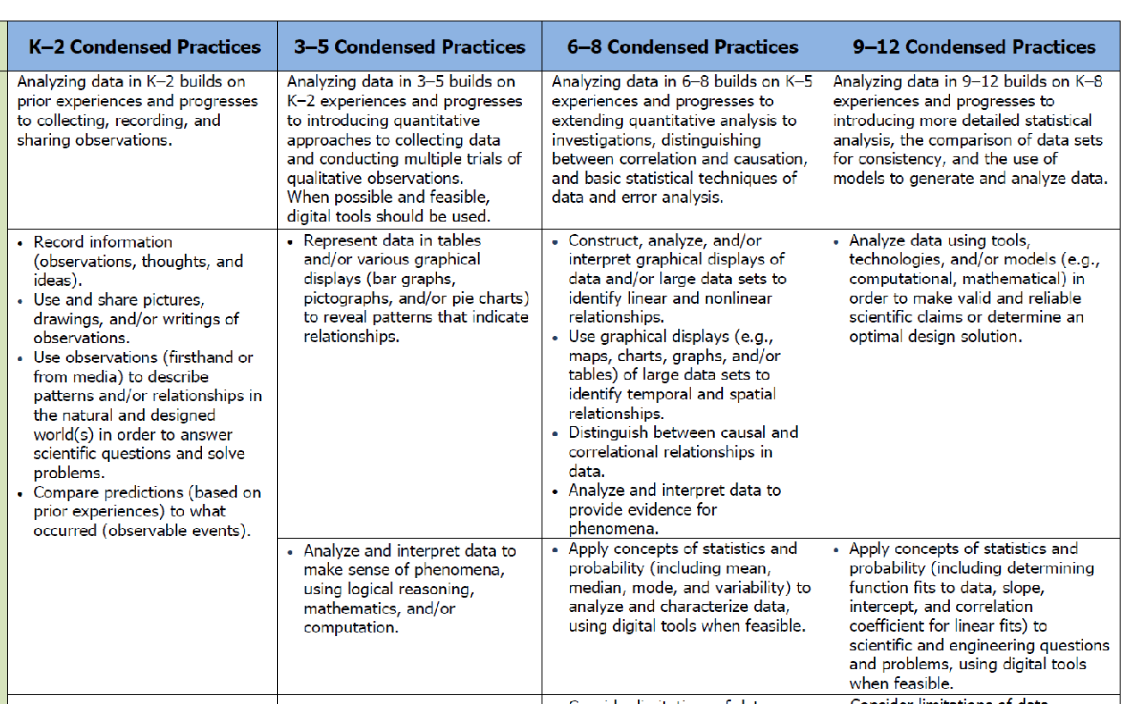
Analyzing & Interpreting Data
Appendix F
Notes:
This is an sample of one of two pages of this SEP: analyzing and interpreting data. There are 8 SEP. There is a lot of information for educators to use in both instruction and assessment of the 8 SEP along the K-12 continuum.
Appendix F can be found here:
http://www.nextgenscience.org/sites/default/files/Appendix%20F%20%20Science%20and%20Engineering%20Practices%20in%20the%20NGSS%20-%20FINAL%20060513.pdf

Slide 12
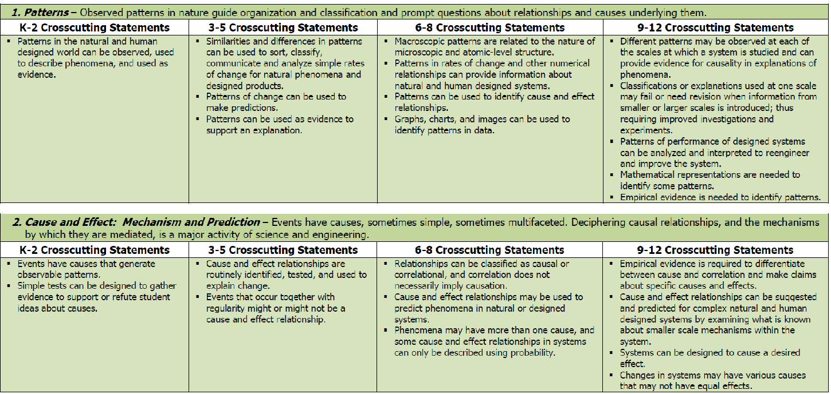
Analyzing & Interpreting Data
Appendix G
Notes:
The grade band continuum for the 7 CCC is defined in Appendix G.
Appendix G can be found here:
http://www.nextgenscience.org/sites/default/files/Appendix%20G%20-%20Crosscutting%20Concepts%20FINAL%20edited%204.10.13.pdf

Slide 13
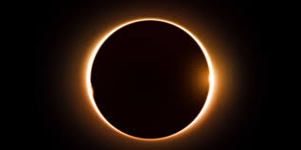
What do we mean by “phenomena?”
Notes:
A scientific phenomenon is anything you can observe and explain using scientific principles. An engaging phenomenon tends to make you wonder… But whether or not something is engaging can depend on how it is presented. One way of saying this is that “a phenomenon does not have to be phenomenal.”

Slide 14
Classroom Embedded Assessment
Through Course Tasks
State Summative Assessment
evidence
evidence
evidence
KAS for Science
supports
Curriculum & Instruction

Slide 15
Classroom Embedded Assessment
Through Course Tasks
State Summative Assessment
Provide a sampling of a school’s science program level of achievement (based on KAS Science) and identify percentage of students meeting expected levels of attainment particularly as they explain phenomena, use models, and solve problems using practices, core ideas, and crosscutting concepts
Notes:
This is the purpose statement for the SSA from the Science Assessment System document found here: http://education.ky.gov/curriculum/conpro/science/Documents/Next_Generation_Science_Assessment_System.pdf

Slide 16
PEs are “Bundled” – gather evidence of sense-making of phenomena or problem solving
A Storyline guides student sense-making
Science State Summative Assessment
Design Approach
Notes:
This “design approach” of bundling PEs and using a storyline to explore the phenomenon was used in the 7th grade pilot given in the spring of 2016. This same approach will be used in the 2017 field test at grades 4, 7, 11.

Slide 17
2017 Field Test for Science Assessment
Teacher developed phenomenon-based clusters of assessment items
Grades 4, 7 and 11
6 selected response, 2 constructed response per cluster (in general)
Students answered two clusters-not a full test
Awaiting student response data
Notes:
20 clusters were created at each grade level (4, 7, 11). Each student at grades 4, 7 and 11 will get a test booklet with 2 clusters. The 2 clusters for each booklet will vary, so it is unlikely (although possible) that 2 students in the same classroom will have the same 2 clusters. Each cluster is expected to take about 20-25 minutes, but a cap of 70 minutes has been set for the field test.
Selected response may have more than four answer choices, and students may be asked to select 1, 2, or 3 answer choices for a selected response question. Students will be told how many to select – they will NOT be told to “select all that apply.”
Constructed response means any question that must be hand scored. It could be a written explanation, a model, a flowchart, etc.
What’s different about the State Summative Assessment (SSA) for science?
Phenomenon-based item clusters
The field test of the SSA will utilize a phenomenon-based approach. Rather than being a collection of individual and unrelated items, questions will be grouped in clusters in which every question will be related to the others by asking students to use their understanding of science and/or engineering design to consider a phenomenon or solve an engineering design problem. A phenomenon is anything that can be observed and that students can attempt to understand or explain.
Each cluster of items will attempt to gather information about two or more standards that have been bundled together by the item writer. The phenomenon chosen by the item writers is one that allows the bundled standards to be assessed in a logical way.
The assessment clusters use narrative text to lead students through the progression of questions. This narrative text is referred to as the storyline and its purpose is to set up the context of the phenomenon and to link the items together in a way that makes sense to the student.
For example, the phenomenon of stream erosion could be used to create a cluster of items. The two standards bundled together to measure by this cluster could be an ESS (earth science) standard and one from ETS (engineering design) to create a cluster that asks students to both explain the reason a stream becomes muddy and to evaluate possible solutions to prevent this from happening. The storyline for this cluster might involve two friends noticing the creek near their house becoming muddy after a rain storm and attempting to explain why, then brainstorming ways to reduce the amount of sediment that washes into the stream.
One immediate difference students will notice when opening the field test booklets is this storyline. Rather than starting with Question 1 on the first page, each cluster begins with varying amounts of text that establish the phenomenon and/or provide needed information for students to answer the questions that follow. For the hypothetical example above the storyline might begin:
Two friends, Marcus and Tammy are walking down their street when they notice the stream that flows beside it is much higher than normal, and the water is dark brown and muddy.
“Wow, look at the stream,” said Marcus. “I’ve never seen it that muddy before.”
“Yeah,” said Tammy. “It was really clear last week. I wonder what changed to make it so muddy.”
“Let’s see if we can find some information to help us figure it out.”
This text might then be followed with a table of rainfall data, and then the first question requiring students to use the data to provide an answer.
Multi-dimensional items
The other difference as compared to previous science assessments students are familiar with is the multi-dimensional approach to item development. Item writers were asked to develop two or three dimensional items, even for multiple choice items. This means the items are designed to measure students ability to use the Science and Engineering Practices (SEP) and Crosscutting Concepts (CCC) as well as the Disciplinary Core Ideas (DCI) of the standards. Most science assessments in the past were heavily weighted toward what is traditionally thought of as science “content” and few items attempted to measure the practice of science. On the field test students will be asked to identify patterns, construct arguments, link cause and effect, etc. using the DCI as the context for applying those SEP and CCC.
For example:
Which of these most likely caused the stream to become muddy?
a) Rain washes soil into the stream
as compared to
Tammy claimed that the rainfall data explains why the stream becomes muddy. What pattern in the rainfall data supports her claim?
a) The creek was always muddy 2-3 days after it rained upstream
In the second instance there is a focus on the student being able to identify a pattern in the data. Patterns are one of the Crosscutting
Concepts, so the second question is an example of how a question can assess both a CCC as well as the DCI.
Specifics of test construction
In general, each cluster will consist of six (6) multiple choice questions and two (2) open response. This is not an absolute, as there are some clusters with more or less of both question type as determined by the standards that were bundled to create the clusters.
Some multiple choice questions require students to select more than one correct answer. Unless the item specifies otherwise, there is a single correct answer. The number of correct response will be identified in every question as follows:
For single answer questions the quantifier one will be included in the question:
(7) Which one location would be the best place to build a dam?
For multiple answer questions the number of correct responses will be specified in a separate line immediately preceding the answer choices:
(7) Which locations for a dam meet the design criteria?
Select the TWO best answers.
Multiple choice questions are not limited to a fixed number of answer choices. Although the large majority contain four (4) there are some that contain more, especially in the cases where students are asked to select more than one answer.
Constructed response questions on the field test ask for a greater variety of response types than in previous assessments. Students may be asked to draw and annotate a model, create a flow chart, create and explain a graph or some other type of response beyond a traditional written answer. In some cases, constructed response questions may incorporate multiple elements such as several related short answer questions combined within the same answer space. For example:
Part A. Where would the water collect if Gate A were placed in the following positions: (your answer choices could include upper pool, lower pool, river, reservoir, or unchanged)
1. Position X ________________________________________
2. Position Y ________________________________________
3. Position Z ________________________________________
Part B. Where would the water collect if Gate B were placed in the following positions: (your answer choices could include upper pool, lower pool, river, reservoir, or unchanged)
4. Position M________________________________________
5. Position Q ________________________________________
6. Position R ________________________________________
Part C. Based on these results, what predictions can you make about the effect of Gate C on the system?
Item vocabulary
At all grade levels, the terminology of the questions reflects the language of the standards. This includes the wording of the SEP and CCC as well as any content-specific language contained in the Kentucky Academic Standards (KAS) for Science.
For instance, the first grade standard 1-LS1-1 contains the word “mimicking” and therefore it might be possible for this word to appear in a question. Fourth grade standard 4-PS4-1 contains “amplitude” and “wavelength,” so students might be expected to understand how both terms relate to the properties of a wave.
Common terminology used in the SEP and CCC might also be expected to appear in questions, such as asking students to “construct an explanation” or to “generate a solution.” Since the Engineering Design (ETS) standards will be included in the field test, terms such as “criteria for success” and “constraints” may be included in questions. For instance, a student might be asked:
Which one of these criteria for success would most likely be met by Joe’s proposed solution?

Slide 18
Resources for today
kysas.weebly.com

Slide 19
Our Process:
Choose Phenomenon
Bundle PEs
Check for congruency, coherence and multi-dimensionality
Develop storyline to explain the phenomenon/guide item development
(see separate chart)
Write a stimulus that “sets the stage” for the questions that follow
Develop item cluster that provides evidence of understanding of the PEs (multiple dimensions)

Slide 20
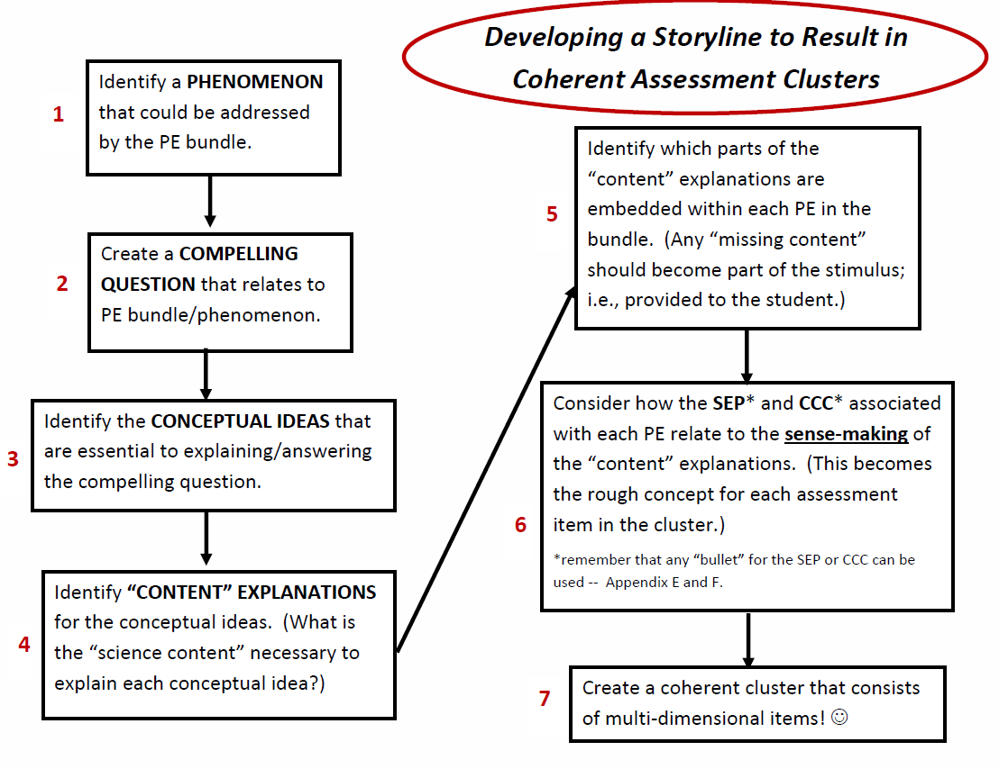
UNDERSTANDING THE INTENT OF THE PEs IN THE BUNDLE IS CRITICAL TO SUCCESS!!
(NOT ALWAYS AS EASY AS IT MAY SEEM)

Slide 22
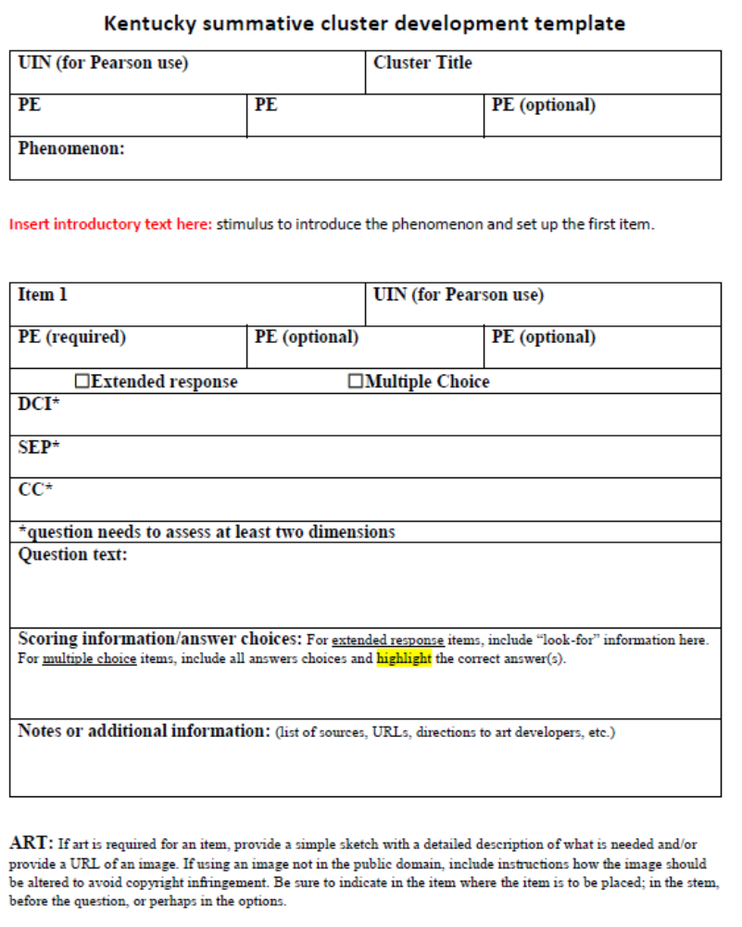

Slide 23
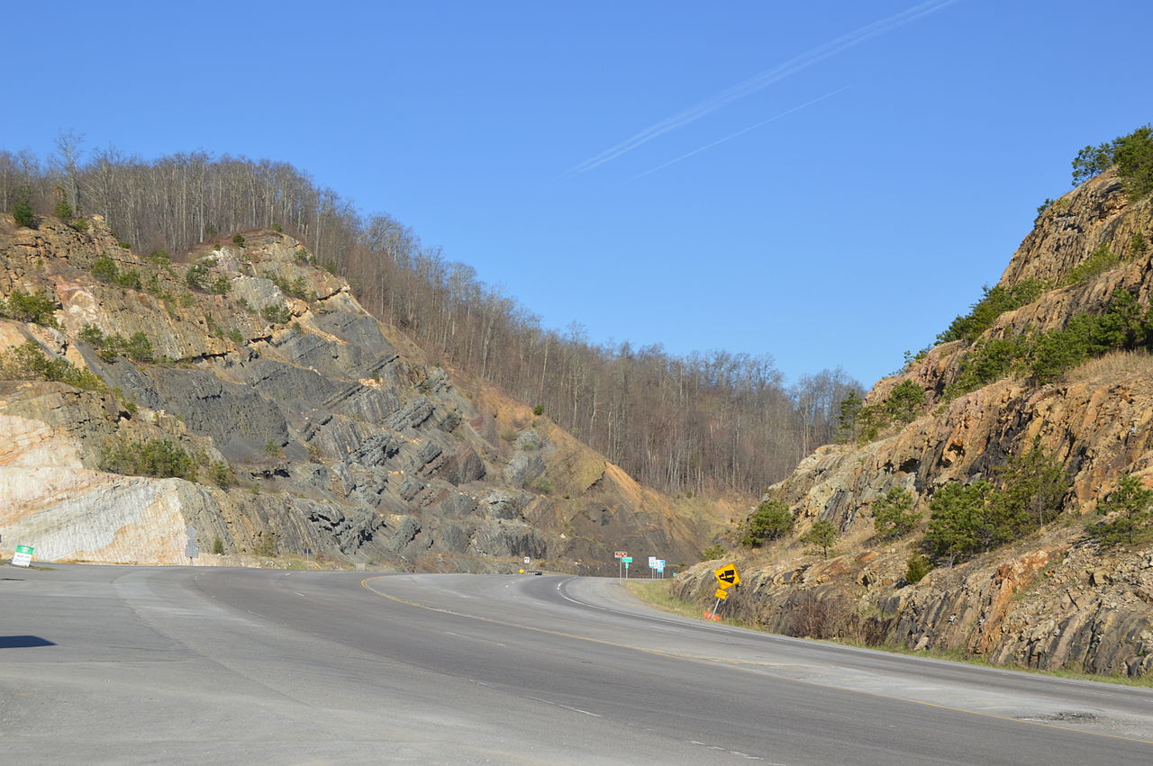
HS Example- Pine Mountain
Thrust Fault

Slide 24
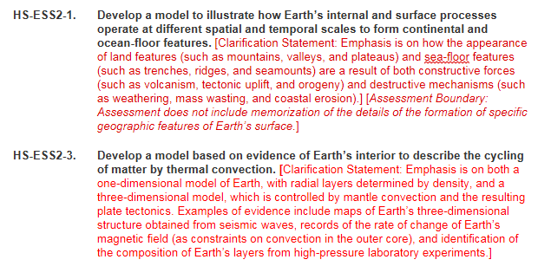
Pine Mountain PE Bundle

Slide 25
What we have learned (so far:)
Students liked the phenomenon-approach
Student surveys and OAA/OTL observations indicate time allotted was sufficient
Students felt the test was “fair”
(very preliminary) indications that very few problems with item design contributed to low performance

Slide 26
2018 Science Assessment
Expected operational assessment at grades 4 & 7. Configuration TBD.
Field Test of Biology EOC. 7 selected response, 1 constructed response per cluster (in general.)
Students will likely not complete a full assessment.
Biology EOC Field Test likely administered online.
PEs eligible for Biology EOC: all HS LS, 8th grade LS, HS ETS
Writers not limited to “bundled” SEP and CCC
Notes:
20 clusters were created at each grade level (4, 7, 11). Each student at grades 4, 7 and 11 will get a test booklet with 2 clusters. The 2 clusters for each booklet will vary, so it is unlikely (although possible) that 2 students in the same classroom will have the same 2 clusters. Each cluster is expected to take about 20-25 minutes, but a cap of 70 minutes has been set for the field test.
Selected response may have more than four answer choices, and students may be asked to select 1, 2, or 3 answer choices for a selected response question. Students will be told how many to select – they will NOT be told to “select all that apply.”
Constructed response means any question that must be hand scored. It could be a written explanation, a model, a flowchart, etc.
What’s different about the State Summative Assessment (SSA) for science?
Phenomenon-based item clusters
The field test of the SSA will utilize a phenomenon-based approach. Rather than being a collection of individual and unrelated items, questions will be grouped in clusters in which every question will be related to the others by asking students to use their understanding of science and/or engineering design to consider a phenomenon or solve an engineering design problem. A phenomenon is anything that can be observed and that students can attempt to understand or explain.
Each cluster of items will attempt to gather information about two or more standards that have been bundled together by the item writer. The phenomenon chosen by the item writers is one that allows the bundled standards to be assessed in a logical way.
The assessment clusters use narrative text to lead students through the progression of questions. This narrative text is referred to as the storyline and its purpose is to set up the context of the phenomenon and to link the items together in a way that makes sense to the student.
For example, the phenomenon of stream erosion could be used to create a cluster of items. The two standards bundled together to measure by this cluster could be an ESS (earth science) standard and one from ETS (engineering design) to create a cluster that asks students to both explain the reason a stream becomes muddy and to evaluate possible solutions to prevent this from happening. The storyline for this cluster might involve two friends noticing the creek near their house becoming muddy after a rain storm and attempting to explain why, then brainstorming ways to reduce the amount of sediment that washes into the stream.
One immediate difference students will notice when opening the field test booklets is this storyline. Rather than starting with Question 1 on the first page, each cluster begins with varying amounts of text that establish the phenomenon and/or provide needed information for students to answer the questions that follow. For the hypothetical example above the storyline might begin:
Two friends, Marcus and Tammy are walking down their street when they notice the stream that flows beside it is much higher than normal, and the water is dark brown and muddy.
“Wow, look at the stream,” said Marcus. “I’ve never seen it that muddy before.”
“Yeah,” said Tammy. “It was really clear last week. I wonder what changed to make it so muddy.”
“Let’s see if we can find some information to help us figure it out.”
This text might then be followed with a table of rainfall data, and then the first question requiring students to use the data to provide an answer.
Multi-dimensional items
The other difference as compared to previous science assessments students are familiar with is the multi-dimensional approach to item development. Item writers were asked to develop two or three dimensional items, even for multiple choice items. This means the items are designed to measure students ability to use the Science and Engineering Practices (SEP) and Crosscutting Concepts (CCC) as well as the Disciplinary Core Ideas (DCI) of the standards. Most science assessments in the past were heavily weighted toward what is traditionally thought of as science “content” and few items attempted to measure the practice of science. On the field test students will be asked to identify patterns, construct arguments, link cause and effect, etc. using the DCI as the context for applying those SEP and CCC.
For example:
Which of these most likely caused the stream to become muddy?
a) Rain washes soil into the stream
as compared to
Tammy claimed that the rainfall data explains why the stream becomes muddy. What pattern in the rainfall data supports her claim?
a) The creek was always muddy 2-3 days after it rained upstream
In the second instance there is a focus on the student being able to identify a pattern in the data. Patterns are one of the Crosscutting
Concepts, so the second question is an example of how a question can assess both a CCC as well as the DCI.
Specifics of test construction
In general, each cluster will consist of six (6) multiple choice questions and two (2) open response. This is not an absolute, as there are some clusters with more or less of both question type as determined by the standards that were bundled to create the clusters.
Some multiple choice questions require students to select more than one correct answer. Unless the item specifies otherwise, there is a single correct answer. The number of correct response will be identified in every question as follows:
For single answer questions the quantifier one will be included in the question:
(7) Which one location would be the best place to build a dam?
For multiple answer questions the number of correct responses will be specified in a separate line immediately preceding the answer choices:
(7) Which locations for a dam meet the design criteria?
Select the TWO best answers.
Multiple choice questions are not limited to a fixed number of answer choices. Although the large majority contain four (4) there are some that contain more, especially in the cases where students are asked to select more than one answer.
Constructed response questions on the field test ask for a greater variety of response types than in previous assessments. Students may be asked to draw and annotate a model, create a flow chart, create and explain a graph or some other type of response beyond a traditional written answer. In some cases, constructed response questions may incorporate multiple elements such as several related short answer questions combined within the same answer space. For example:
Part A. Where would the water collect if Gate A were placed in the following positions: (your answer choices could include upper pool, lower pool, river, reservoir, or unchanged)
1. Position X ________________________________________
2. Position Y ________________________________________
3. Position Z ________________________________________
Part B. Where would the water collect if Gate B were placed in the following positions: (your answer choices could include upper pool, lower pool, river, reservoir, or unchanged)
4. Position M________________________________________
5. Position Q ________________________________________
6. Position R ________________________________________
Part C. Based on these results, what predictions can you make about the effect of Gate C on the system?
Item vocabulary
At all grade levels, the terminology of the questions reflects the language of the standards. This includes the wording of the SEP and CCC as well as any content-specific language contained in the Kentucky Academic Standards (KAS) for Science.
For instance, the first grade standard 1-LS1-1 contains the word “mimicking” and therefore it might be possible for this word to appear in a question. Fourth grade standard 4-PS4-1 contains “amplitude” and “wavelength,” so students might be expected to understand how both terms relate to the properties of a wave.
Common terminology used in the SEP and CCC might also be expected to appear in questions, such as asking students to “construct an explanation” or to “generate a solution.” Since the Engineering Design (ETS) standards will be included in the field test, terms such as “criteria for success” and “constraints” may be included in questions. For instance, a student might be asked:
Which one of these criteria for success would most likely be met by Joe’s proposed solution?

Slide 27
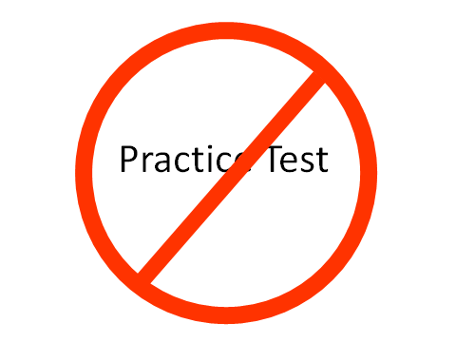
Cluster development: average 30 hours to create a draft

Slide 28
Things to think about: 4 & 7
Are you focusing on the SEP and CCC? Or is instruction only DCI? The summative measures all three parts of the standards.
Is instruction being planned to investigate phenomena?
Don’t forget the ETS standards for your grade band. Do students know what criteria and constraints are?

Slide 29
Things to think about: 4 & 7
The test will not reward memorizing definitions. Teach the word AFTER the concept is familiar.
Develop assessment when developing instruction.
Practice test banks built around phenomena aren’t practical in our experience. Do you have 30 hours to spare?

Slide 30
Things to think about: BIO EOC
All the advice for 4 & 7 applies equally well to the BIO EOC Field Test.
All HS life science (LS), 8th grade LS, HS ETS are eligible for assessment.
Field Test will not generate student scores. Biology teachers will need to develop their own final.
SBDM may wish to revise policies regarding impact on grades in EOC classes.

Slide 31
Where do I go for answers:
Start with your BAC or DAC.
The DAC emails are archived on the KDE website.
Science assessment info on the KDE Science Assessment webpage.
dacinfo@education.ky.gov

