Slide 1

Informing Systems
Developing a coherent LCAP is based on alignment, data collection for goal creation, and targeted action creation.
01
State Priorities, Metrics, and LCAP Alignment
03
Action Creation
02
Data Inquiry

Slide 2
Under the LCFF, all local educational agencies (LEAs) including school districts, county offices of education, and charter schools are required to prepare an LCAP, which describes how they intend to meet annual goals for all pupils, with specific activities to address state and local priorities identified pursuant to EC sections 52060(d), 52066(d), and 47605 (Link: http://bit.ly/LCAP_law ). These State Priorities can be organized into three groups: Conditions of Learning, Engagement, and Pupil Achievement.
Conditions of Learning | Engagement | Student Outcomes
Basic Services | Parent Involvement | Student Outcomes
State Standards | Student Engagement | Student Achievement
Course Access | School Climate

Slide 3
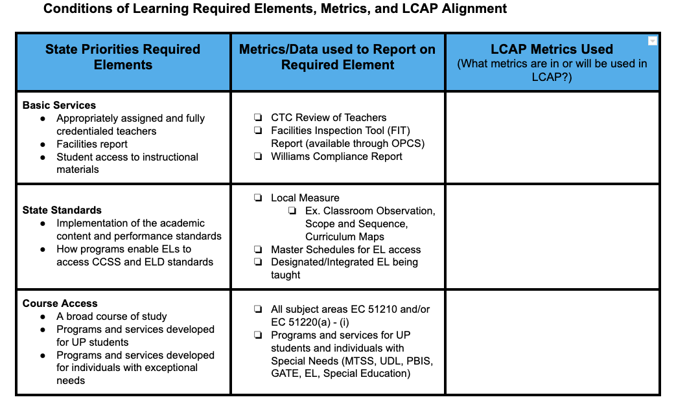
State Priorities and metrics to what is or what will be outlined in the LCAP. Using a three-column graphic organizer where the first column outlines the “Required Elements,” the second column designates “Metrics/Data Used to Report on Required Elements, and the third column, “Metrics,” lists what metrics are or will be used in the LCAP organizes this work to prepare for data collection.

Slide 4
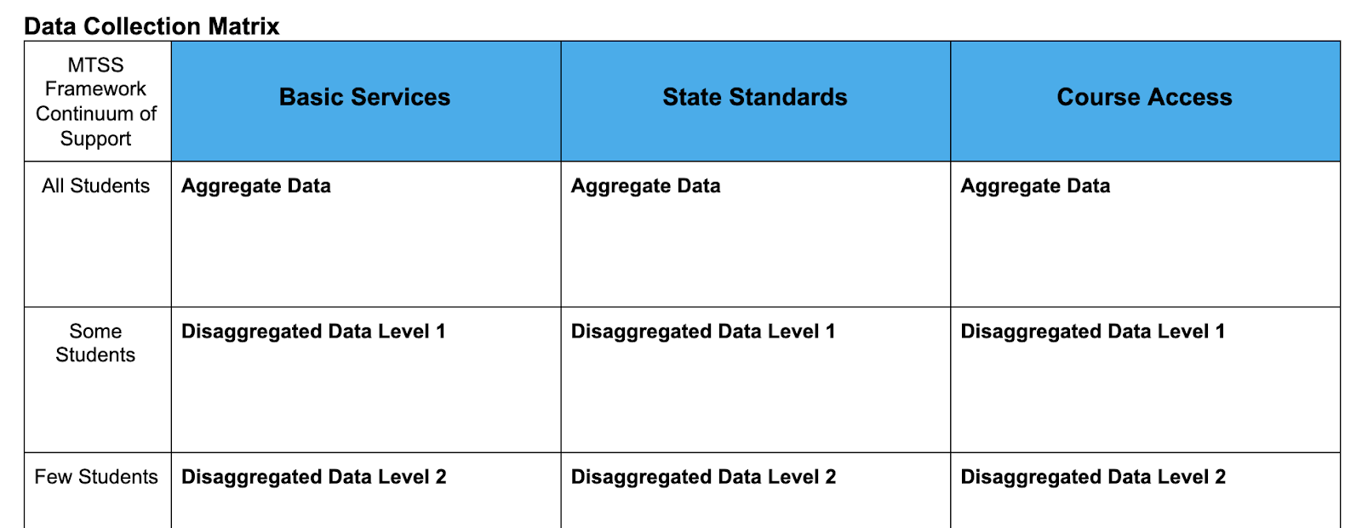
Data matters. Data inquiry is a fundamental component of operationalizing equity and LCAP development. Gathering and analyzing data prior to developing LCAP goals sets a strong foundation for focusing resources, systems, and programs. Additionally, it organizes and frames LEA work in preparation for creating aligned actions/services to improve student outcomes. It is imperative to view data collection in terms of the MTSS framework of continuum of support, “All,” “Some,” and “Few” students.

