Slide 1
Trends in National Student Clearinghouse Data for San Diego County
Shannon Coulter, Director of Research and Evaluation
Choosing the Right College Report

Slide 2
Starting the College Process on the Right Foot
  Chances of earning a college degree are higher than ever.
  College outcomes are important to consider before students enroll in college.
  Matching is the best way to ensure college completion.
  The pandemic forced more students to delay or defer college enrollment in 2020.

Slide 3
College and Career Readiness
College and career readiness remains steady across high schools.
About five in 10 San Diego County high school graduates are ready for college according to the CCI. The share of prepared students declined slightly from 58% in 2019 to 54% in 2020.

Slide 4
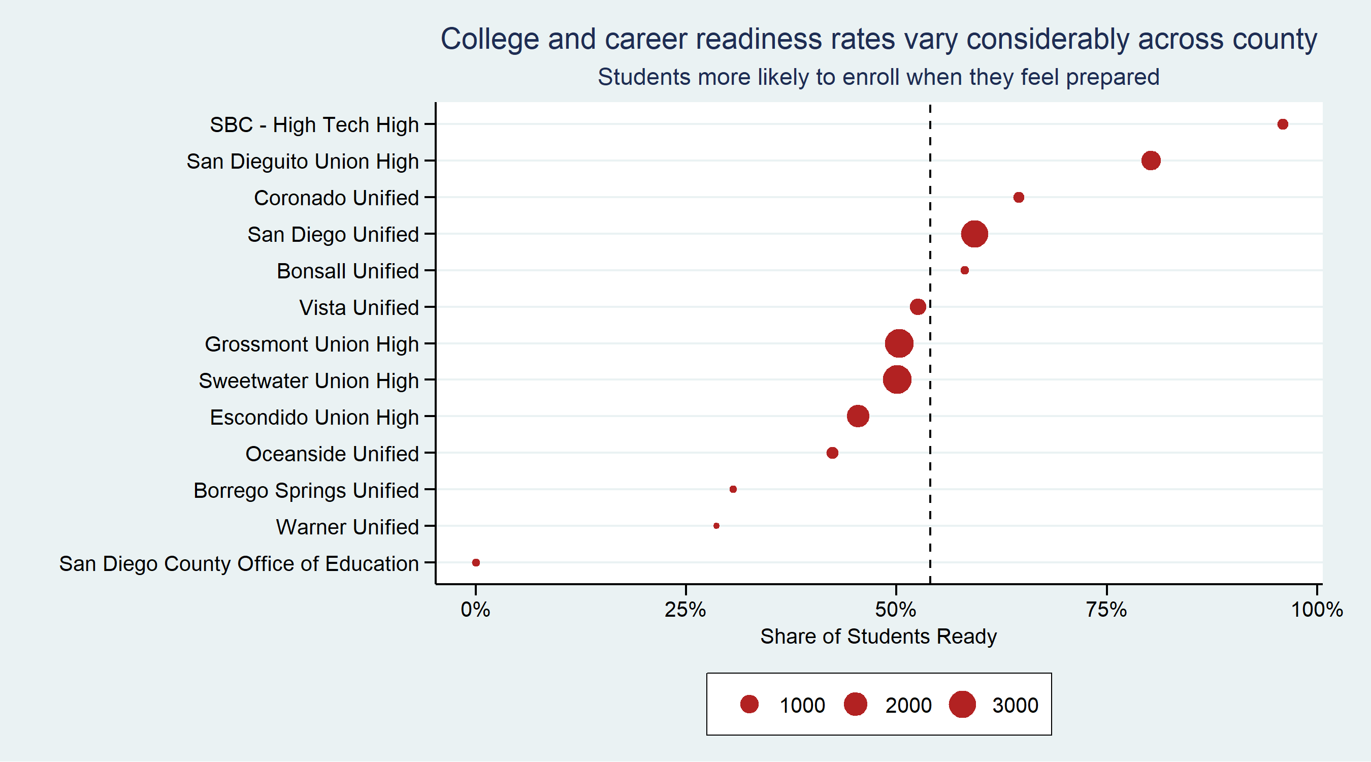

Slide 5
Seamless Enrollment
College enrollment declined significantly in 2020.
Only six in 10 San Diego County high school graduates (60%) immediately enrolled in college in 2020 compared to 7 in 10 in 2019. White student enrollment declined 15 percentage points from 80% in 2019 to 65% in 2020, while Latinx student enrollment declined 14 percentage points from 66% to 51%. Asian student and Black student enrollment declined 9 and 10 percentage points respectively.

Slide 6
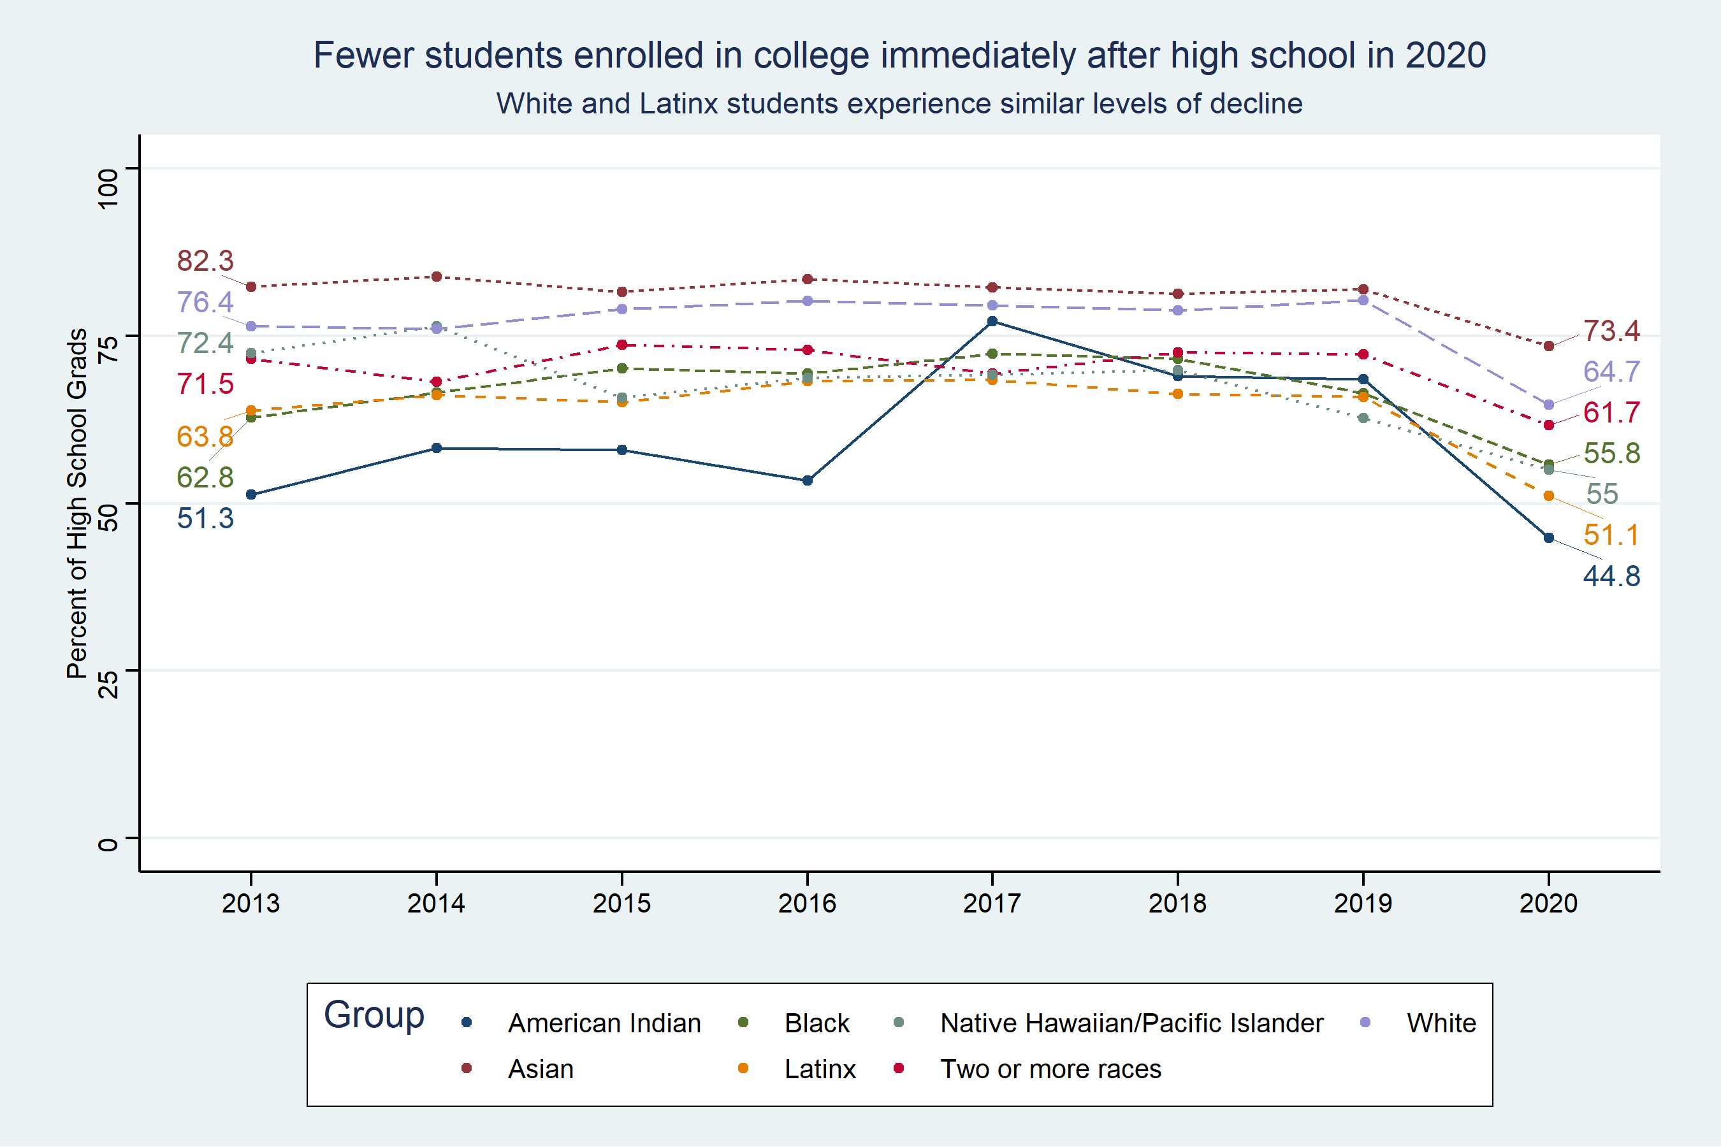

Slide 7
Completion
College completion rates reached an all-time high across the county.
The college completion rates for 2014 high school grads from two- and four-year institutions was 39% in 2020 up from 37% in 2018. A thirty-nine percent completion rate represents the highest percentage of graduates in the 29 year history of tracking these data.

Slide 8
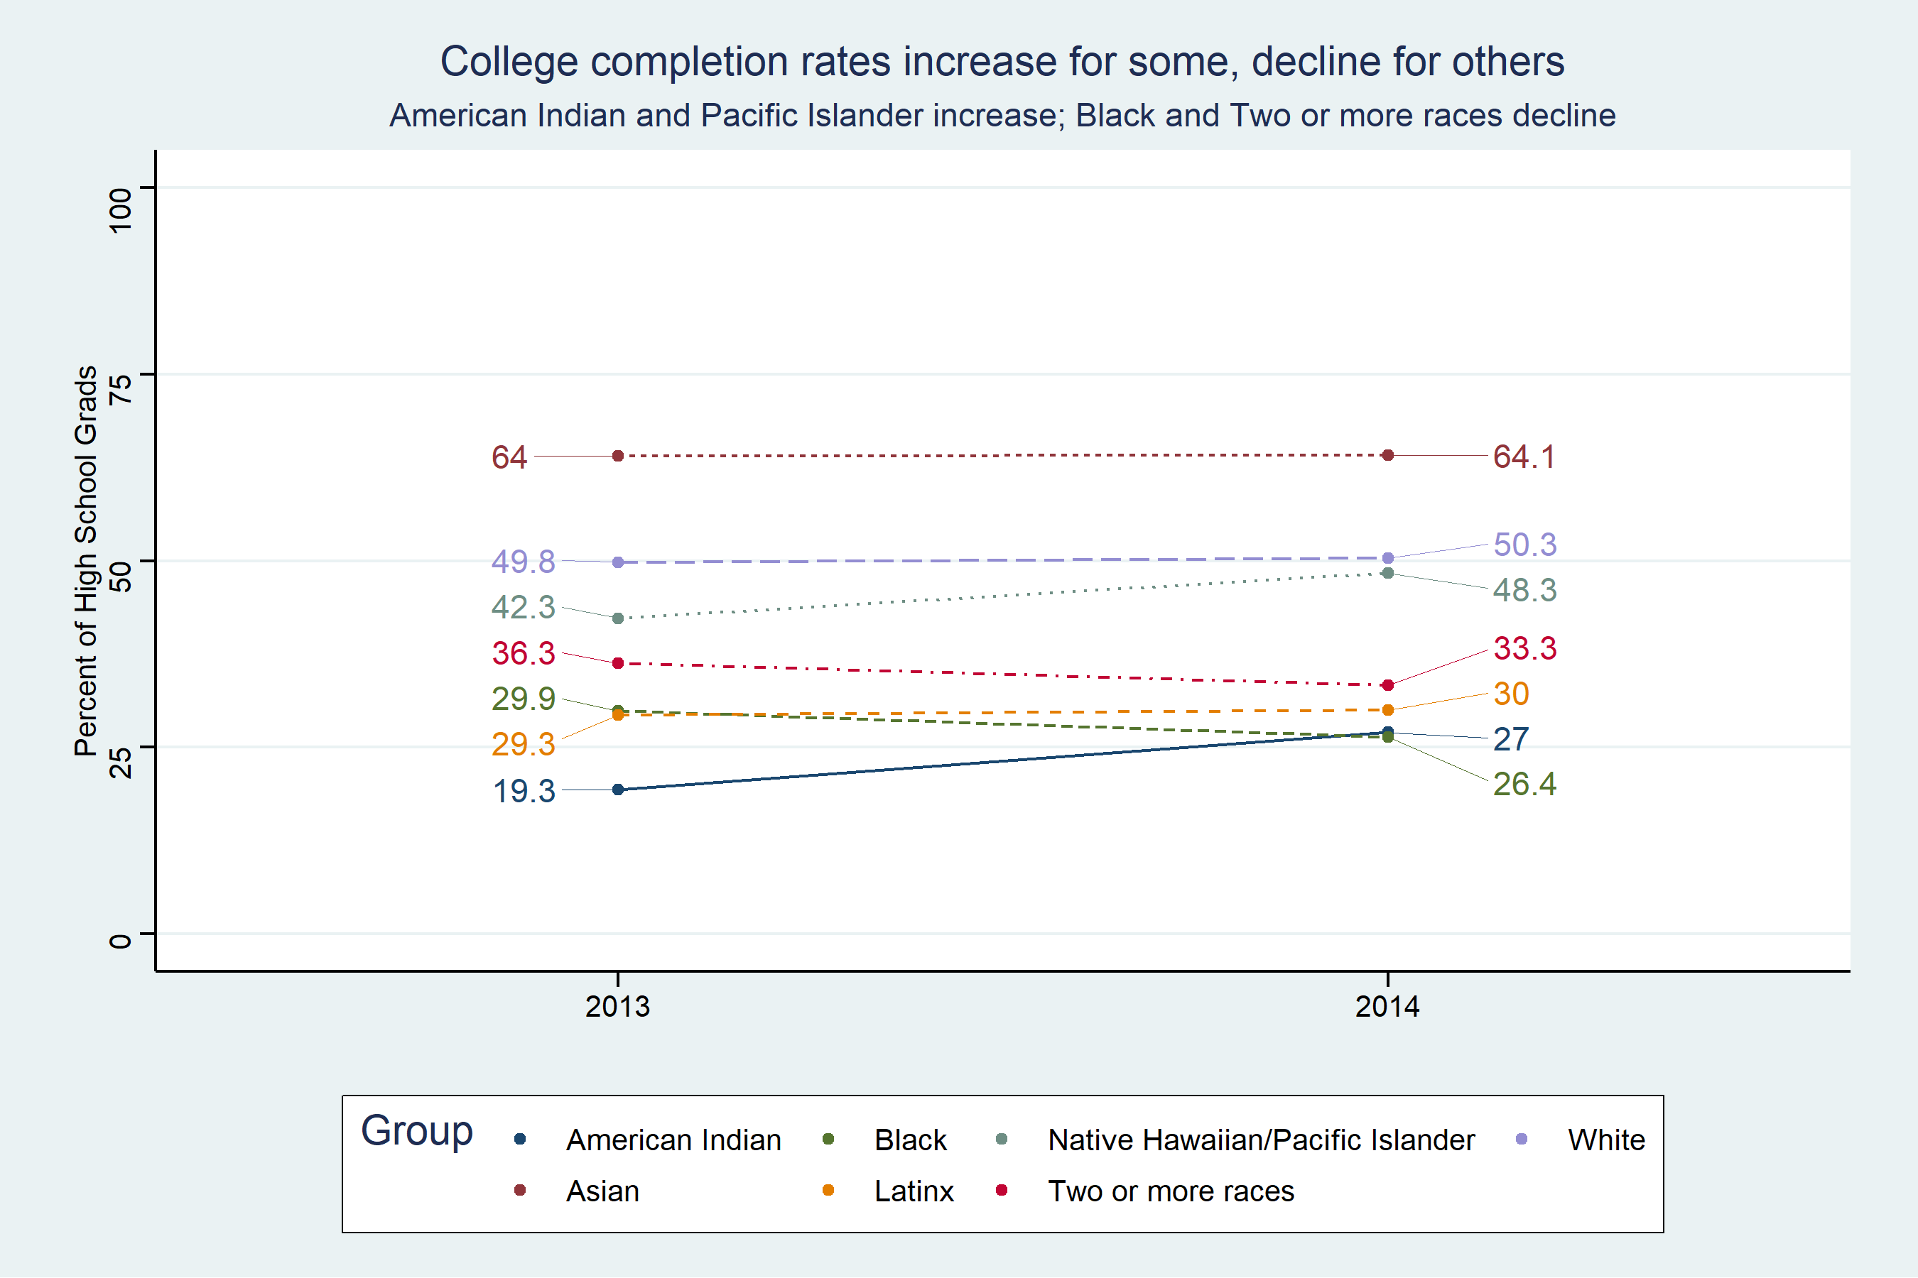

Slide 9
Institutional Enrollment
More students San Diego State University (1,694) and Southwestern College (2,491) than other institutions in 2020. Approximately 8,044 (50%) students enrolled in four-year colleges, while 7,920 (50%) enrolled in two-year. Nearly all students enrolled in public colleges and universities (91%) within-state (88%).

Slide 10
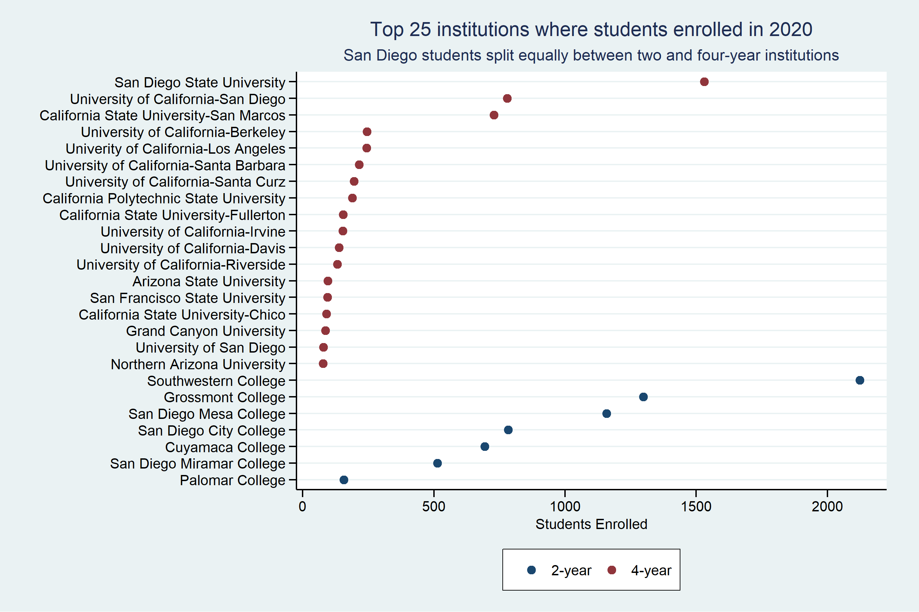

Slide 11
70% Graduation Rate Institutions
Many students from our most affluent areas are attending colleges with the highest degree completion rates. Research suggest that students who are low-income benefit from counseling and other interventions that get students to apply and enroll in colleges and universities with better completion rates.

Slide 12
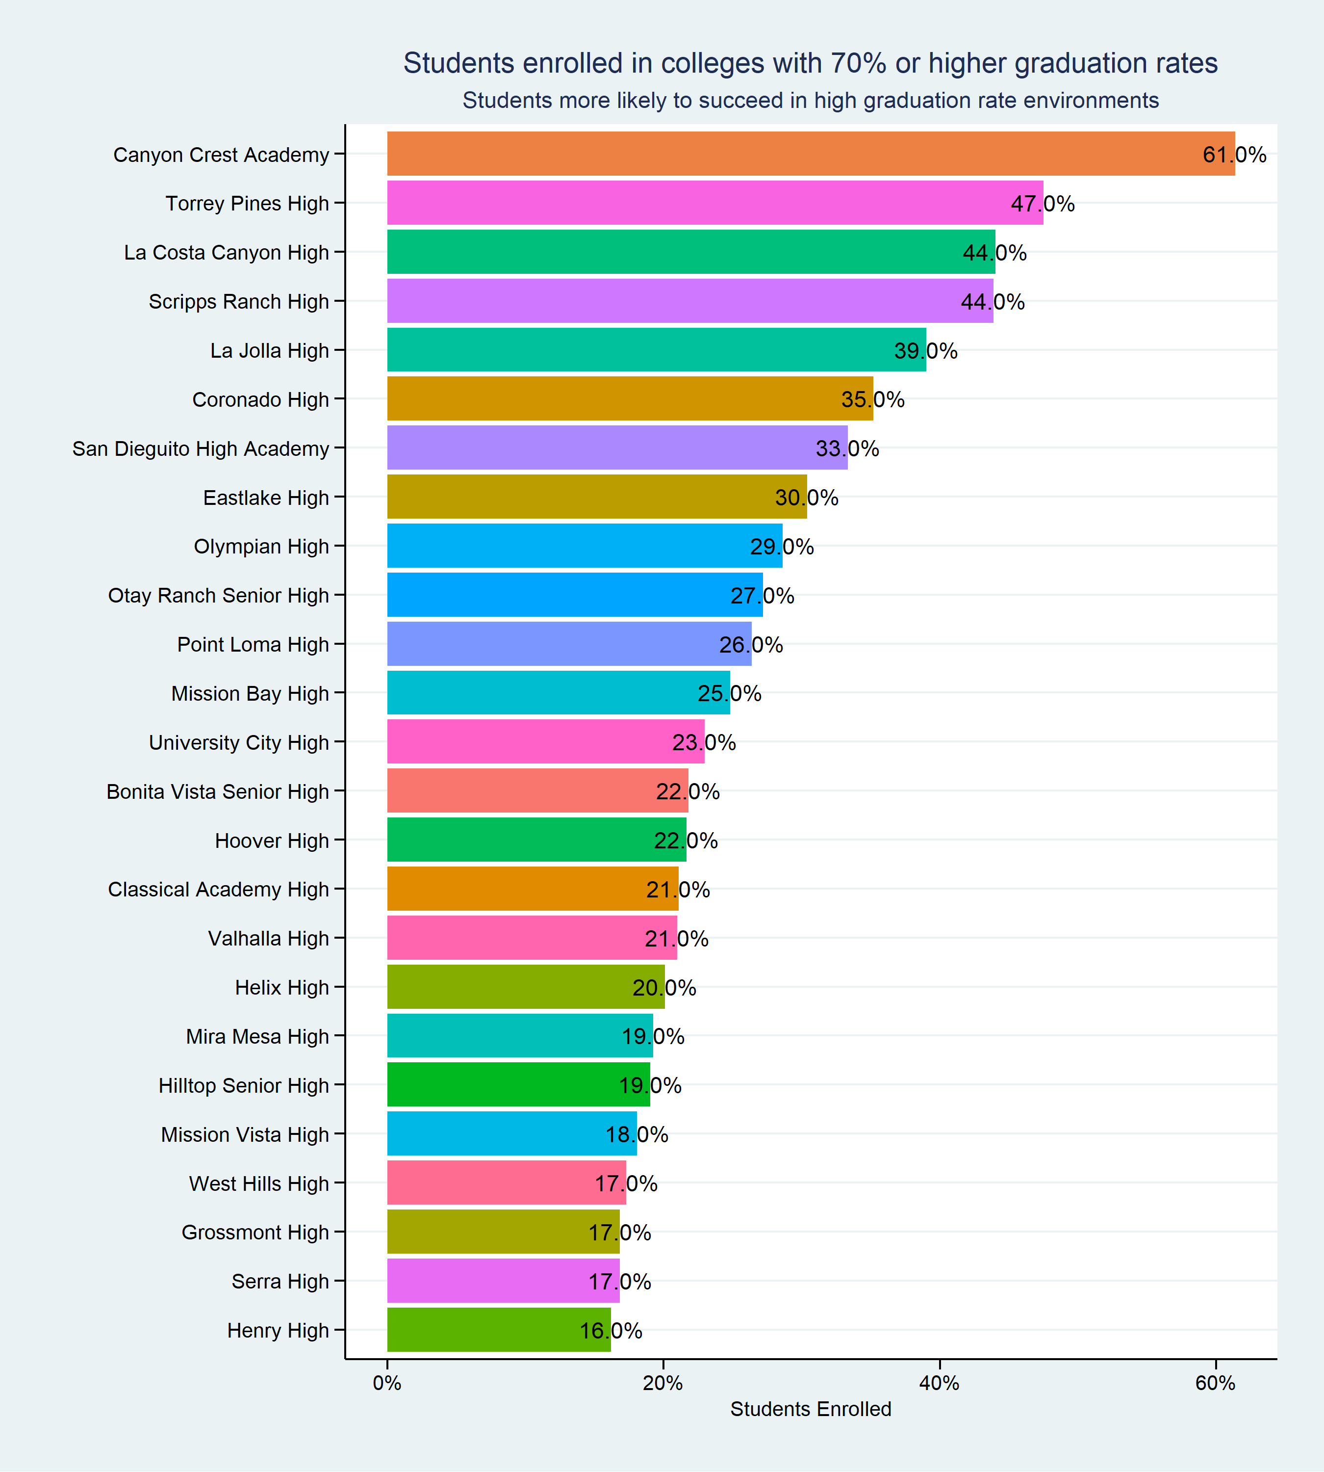
Enrollment Rates (70%)
Students attending colleges with 70% or higher graduation rates by high school

Slide 13
Retention Rates 4-Year Institutions
The University of California system has the highest retention rates compared to most colleges; however, the California State University system and other private universities rival these flagship universities in terms of retention rate. These institutions tend to provide more consistently high-quality student experiences, create a sense of school belonging, and have faculty who are engaged in the retention process (Caison, 2005).

Slide 14
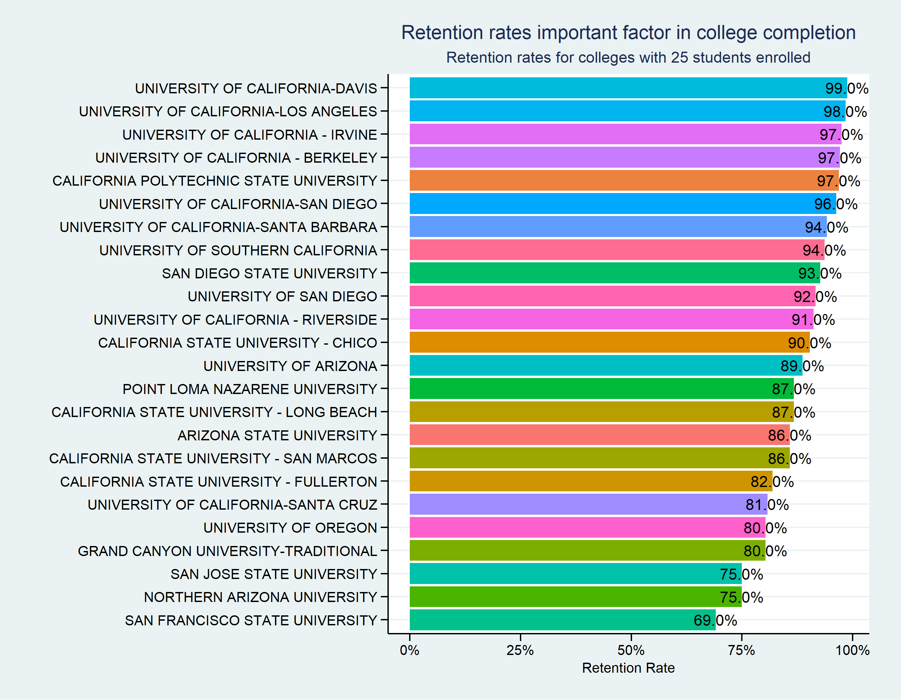
Retention Rates
Many of San Diego’s top universities have a retention rate of 70% or higher.

Slide 15
Retention Rates 2-Year Institutions
The average retention rates for two-year colleges is approximately 68%, considerably lower than a four-year college. Retention rates are often higher for any student enrolled full time, students who have a broad array of financial aid opportunities, and for students who enroll in student support services (Wessell, Bell, McPherson, Costello, & Jones, 2006).

Slide 16
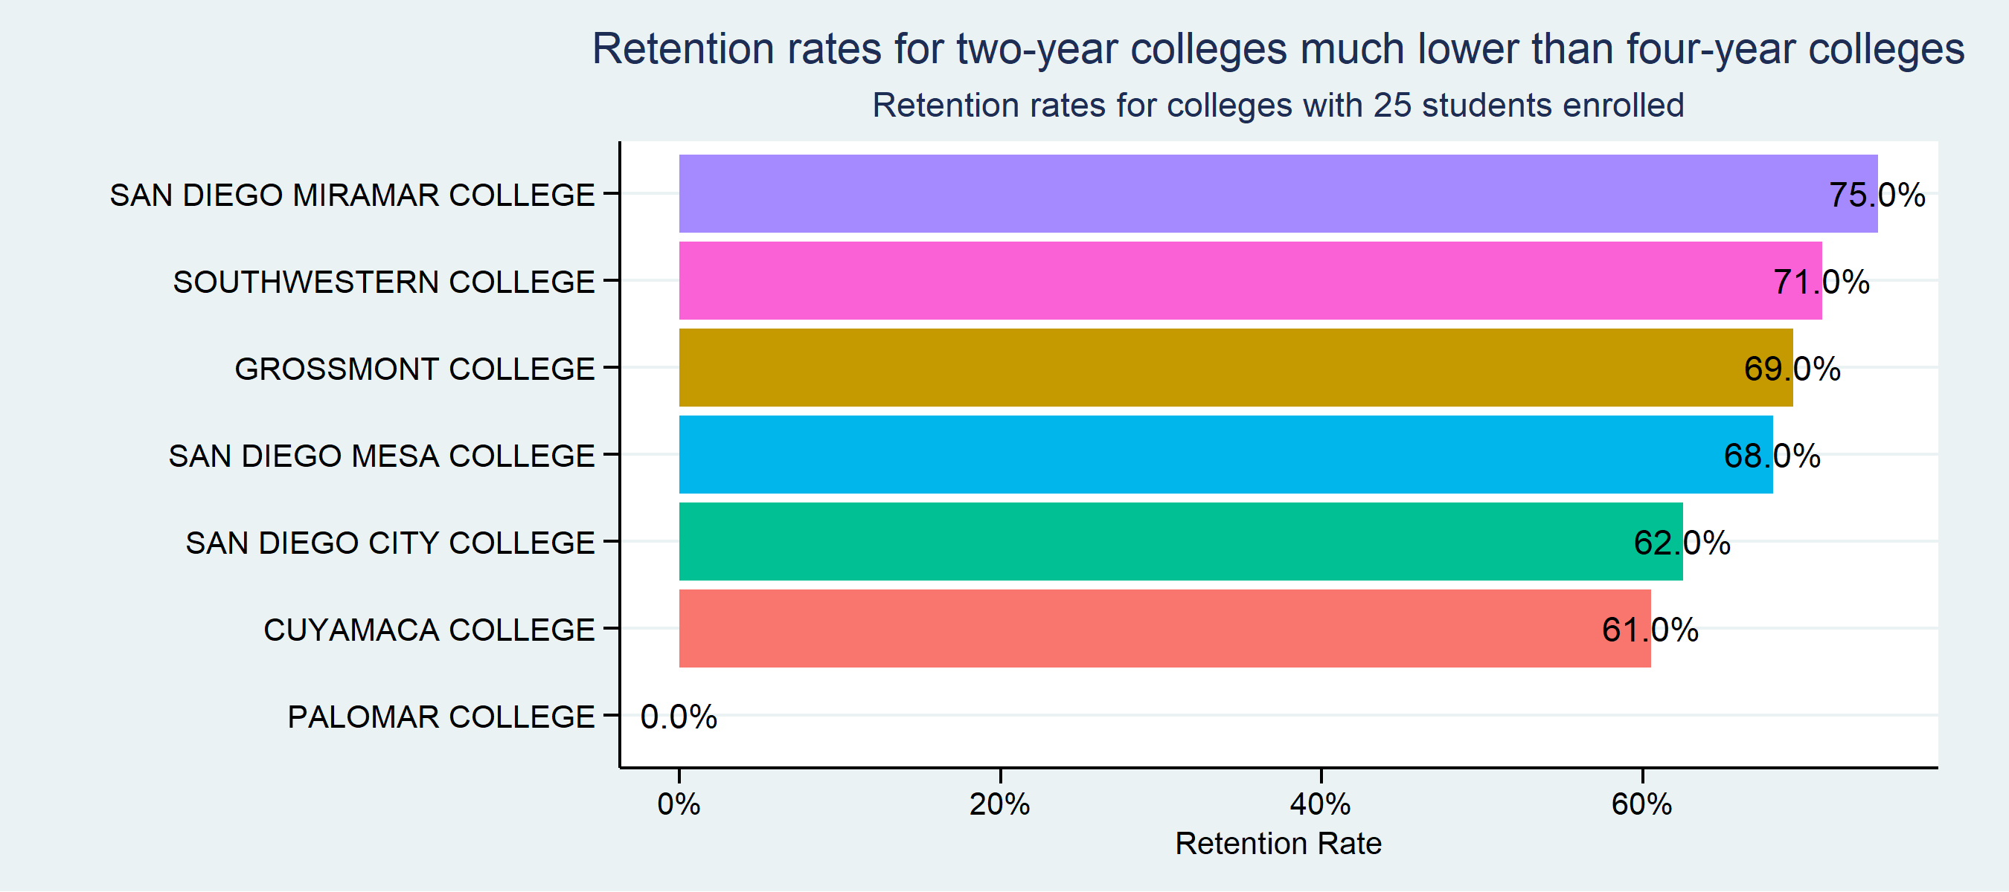

Slide 17
Completion Rates 4-Year Institutions
The next figure depicts six-year completion rates at the most frequently attended higher education institutions by San Diego County high school graduates. Students have the highest chance of completing a degree when they enroll in colleges with the highest graduation rates. Of course, many of the colleges with the highest graduation rates are the most selective institutions, which makes them challenging to gain admittance. However, this list comprises a variety of college and universities that have relatively high graduation rates and are more favorable in terms of acceptance rates.

Slide 18
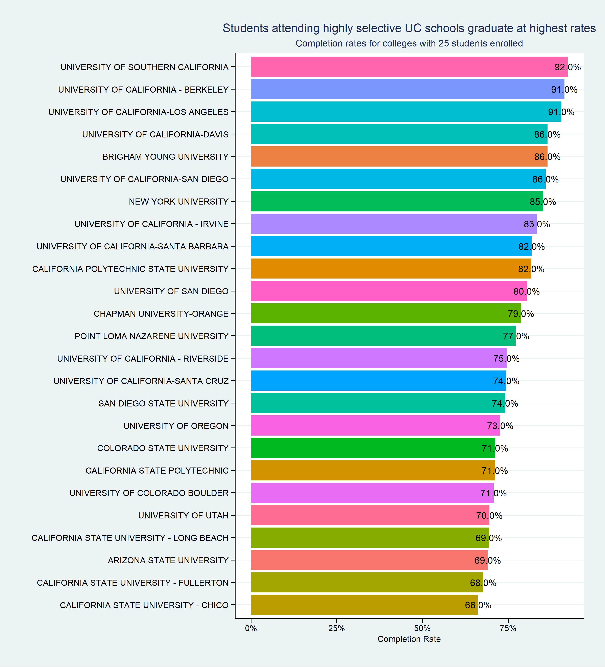
Completion Rates
San Diego’s top 25 universities have completion rates of 68% or higher.

Slide 19
Completion Rates 2-Year Institutions
students complete degrees or transfer to four-year institutions (i.e., our definition of success at a two-year institution) at much lower rates than students enrolled in more selective, four-year institutions. Not every student has the ambition to attend a four-year institution; however, counselors and advisors must ensure that students enroll in colleges that match their aspirations and preferences.

Slide 20
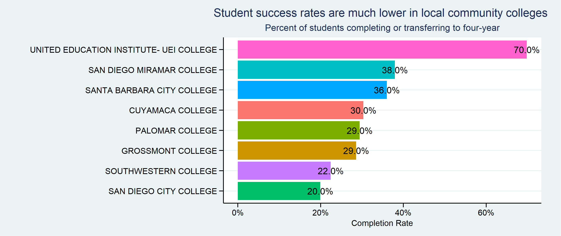

Slide 21
Key Takeaways
College and career readiness rates vary considerably across the county. While more students graduate college- and career-ready, many students continue to lack access to a rigorous curriculum, which is highly predictive of succeeding in college. Increasing college and career readiness by 10% will likely result in a similar increase in college enrollment.

Slide 22
Key Takeaways
The pandemic hindered college enrollment in 2020. College enrollment in San Diego County declined more than 10% from 2019. It’s important to monitor college access to determine how many students who deferred enrollment in 2020 enroll in 2021. We must also pay close attention to how the pandemic influenced enrollment rates for American Indian students, and students who are low-income, English learners, and others.

Slide 23
Key Takeaways
Less than 20% of students on average attend colleges with a 70% graduation rate or higher and about an equal share of students attend two-year and four-year colleges where success rates vary. It’s a critical priority that students are supported to attend colleges that ensure most students attain a degree. Every student needs access to the most relevant information when making a decision about where to attend college, especially an institution’s graduation rate.

Slide 24
Key Takeaways
A poor college match results in lower persistence rates for students and retention rates at colleges and universities. Notably, students enrolled less than full time are retained at a rate seven times lower than students enrolled full time. All students should be guaranteed the resources to navigate the college enrollment process including tools and information that support college matching, including net cost and graduation rates. Every high school student needs access to the resources necessary to get to and through college.

Slide 25
Contact
Shannon Coulter
Director of Research and Evaluation
San Diego County Office of Education
scoulter@sdcoe.net
Choosing the Right College Report

