Slide 1

Levy and District Finance Overview
      Levy Committee Meeting 6-5-2019

Slide 2
Overview of the Presentation
  District Financial Overview
    Operating Budget
    Other Levies/Measures
  I thought Schools were fully funded?
      What's an enrichment Levy?
      Why did the District just have a 2 year levy measure?
      What does our current/expiring Levy pay for?
  2019 and 2020 Educational and Operations Levy
      Promises made and Promises Kept
  What’s the District Levy authority?
    What are you $2500 per student or $2.50/1000 of Assessed Value
    Projected Amount of Springboard Proposal
  Projected Tax Impact of Springboard Proposal:
  Next Step and Questions

Slide 3
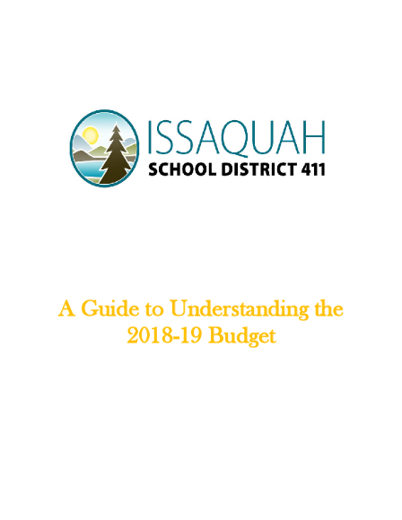
Guide to Understanding the Budget:
Where does the money Come From?
Where does it go?
Example of recent investments…

Slide 4
Other Levies and Bonds
The District is allowed under statute to run several types of supplemental taxing measures:
  Educational Programs and Operations Levy (M&O)
    Enrichment only
  Transportation Levy (Single Year Measure)
    Purchase of Buses only, not the operation of them
  Capital Levy (Technology, Critical Repairs) 2019-22
  Bond Measure (Super Majority 60% +1) passed in 2016
    Major construction, renovation or modernization

Slide 5
What’s ISD’s levy authority?
  Are you $2500 or $2.50?
    Current Statue limits the District’s Levy authority to $2.50/1000 or $2500 per student (adjusted by CPI beginning in 2020)
      Whichever is less….
  Issaquah will be a $2500 per student District as $2.50/1000 would generate significantly more that the per student amount.
  For Example using 2019 assessed value $2.50/1000 would generate $84,000,000
  Using the $2500 per student using prior year student FTE:
    20,550 *2500 = $51,375,000

Slide 6
Why do we need a local levy? I thought the State funded everything?
  In fiscal year 2018-19
    14.2% of the District’s operating revenue is local levy $44.35 million
    Enrichments, enhancements, short-falls, local values
    Education beyond “basic”
The District was a “McCleary” beneficiary. As we historically have been one of the lowest funded Districts in the entire state. The McCleary court ruling and the following action by the legislature increased educational spending at the state level and decreased local levy authority.
      This change increased State Property taxes and lowered local school taxes for Issaquah School District Tax Payers
  The Issaquah Board of Directors chose to only run a 2 year measure given the increase in state revenue. This measure was ran below full taxing authority($1.50/1000.
  In 2019 the actual rate is $1.08 with 2020 estimated rate to be at $1.26

Slide 7
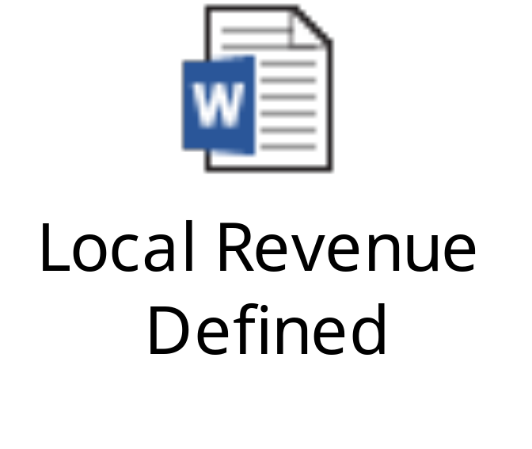
» What’s an “Enrichment,“ defined as under State Law

Slide 8
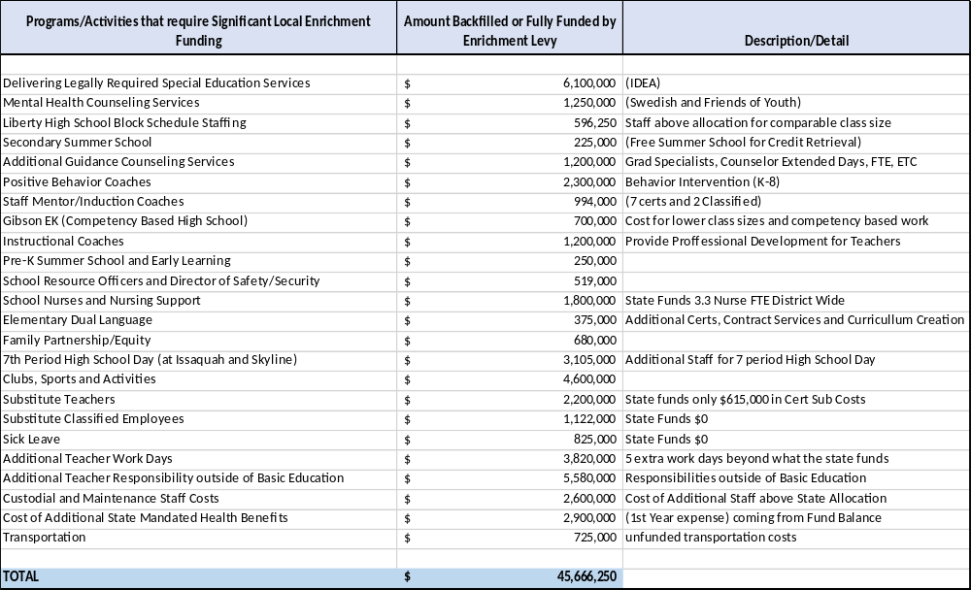
» Issaquah’s Current “Enrichments”

Slide 9
Springboard Levy Request for a two year renewal of an EP & O Levy for Calendar years
2021 & 2022
2021:
  $2,500 *1.03 (CPI Estimate) = $2,575
  $2,575 * 20,670 = $53,225,250
  Final Amount for 2021 is proposed @ $54,000,000
This allows for a small amount of “capacity” given uncertainty around inflation and the pattern of overall student enrollment growth.
2022:
  $2,575 *1.03 (CPI Estimate) = $2,652
  $2,652 * 20,823 = $55,227,802
  Final Amount for 2022 is proposed @ $56,500,000
    This allows for a small amount of “capacity” given uncertainty around inflation and the pattern of overall student enrollment growth.

Slide 10
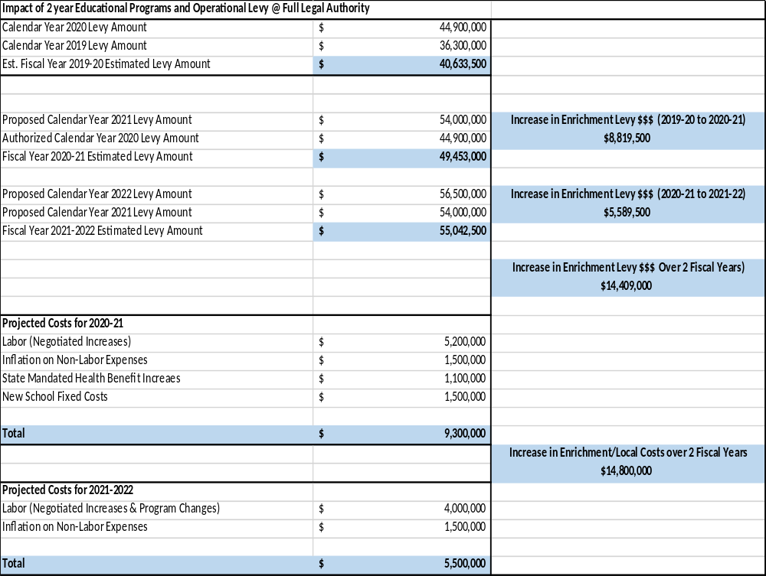

Slide 11
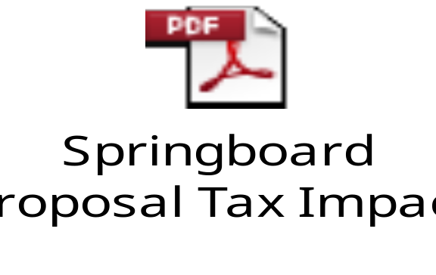

Slide 12
QUESTIONS, THOUGHTS?

